Slide 1
Cancer Diagnostic Features Representation in OMOP CDM
November 28, 2017

Slide 2
Considerations
Primary cancer diagnosis
In our current approach, we define cancer diagnosis as a combination of histology (morphology) + topography (anatomy)
Additional diagnostic features
In cancer, features like stage (pathological and clinical), grade, laterality, focality, and some others, are critical to diagnosis differentiation, prognosis, and choice of treatment. These features must accompany primary cancer diagnosis
Association of additional diagnostic features with primary diagnosis
These features are measured when a patient is first diagnosed and also (possibly) for each cancer recurrence
There a possibility of repeated measurements for the same recurrence
There is a possibility of measurements performed/reported on different dates

Slide 3
Modeling and ETL challenges
One pre-coordinated diagnosis concept or multiple diagnosis modifiers?
Pre-coordinated concepts may not work
Source representation is by axes
Certain axes may contain multiple values or variables
Too many axes and permutations to maintain
Missing axes will prompt using diagnoses of different levels of granularity (if exist) and complicate queries
Temporal association of diagnosis modifiers with primary diagnosis
There should be one set of “verified” cancer modifiers associated with the initial diagnosis (first cancer occurrence) and, possibly, with each recurrence
Repeated measurements of the same modifier (lymph node invasion) may be recorded
Different modifiers may be recorded on different dates
Identification of cancer recurrences (condition era)
First cancer occurrence and further recurrences may be derived algorithmically or extracted from the source data directly. If this information is available in the source, it should be persisted and override the derived one. This mixed approach is new to OMOP
Algorithmic derivation of recurrences would not be the same as current condition era derivation

Slide 4
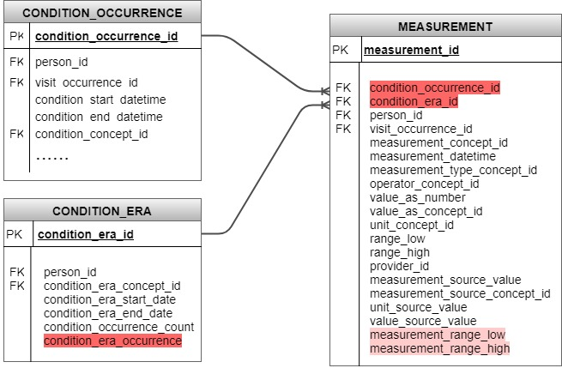
Proposed CDM extension

Slide 5
Proposed CDM conventions
Diagnosis modifiers are stored in the Measurement table
Association of diagnosis modifiers with primary diagnosis
One or multiple condition occurrence records containing primary cancer diagnosis may have associated diagnosis modifiers
Repeated modifier records (lymph node invasion) may be associated with one or multiple condition occurrence records
Modifiers may be recorded on different dates
Representation of cancer recurrences
Cancer recurrences are recorded as condition eras
Each recurrence is assigned a number
Recurrences are either derived algorithmically or extracted from the source data directly. Recurrence data extracted from the source is persisted and overrides the derived one
Algorithmic derivation of recurrences is TBD but will not be the same as current condition era derivation
Association of diagnosis modifiers with cancer recurrences
One set of “verified” cancer modifiers is recorded in measurement and associated with the first cancer occurrence and, if possible, with recurrence

Slide 6
Additional vocabulary to support CDM representation
Add domain “Condition Modifier”
To annotate condition modifier concepts
Add class “Cancer Modifier”
To annotate cancer modifier concepts
Add concept types: “Cancer Registry”, “Pathology Report”

Slide 7
Proposed Vocabulary Approach
Reference Cancer Protocol Templates
Issued by CAP (College of American Pathologists)
Provide guidelines for collecting the essential data elements for complete reporting of malignant tumors for 88 cancer types
Include pathological findings and genomic biomarkers
Use standardized terminology from Nebraska Lexicon Project
Works under the umbrella of LOINC-SNOMED CT compatible observables harmonization of content between LOINC® and SNOMED CT®
Intends to implement CAP Protocol Templates by providing terminology binding between LOINC and SNOMED CT
The majority of the associated terminology development is modeled within SNOMED 363787002|Observable entity| hierarchy. Coded LOINC observables are linked to SNOMED value sets.
Developed for breast and colorectal cancers.
Implementation in the OMOP Vocabulary
Adopt Nebraska terminology relationships for implemented cancer types
Create OMOP relationships for other cancer types based on CAP Protocol Templates
Collaborate with UNMS
Replace OMOP relationships with Nebraska ones as they become available

Slide 8
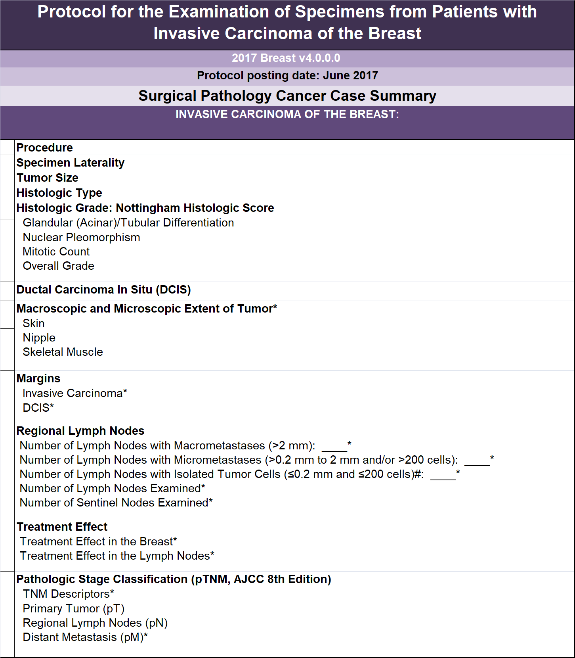
CAP Protocol for Invasive Breast Cancer

Slide 9
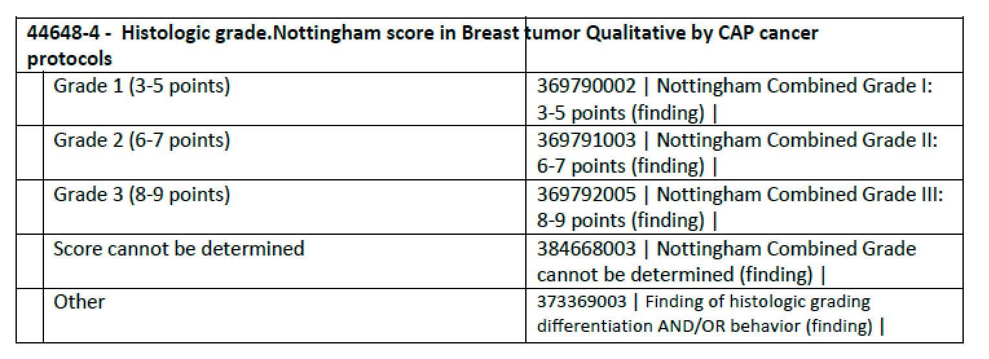
Examples of terminology binding between LOINC and SNOMED CT

Slide 10
References
CAP Protocol Templates
http://www.cap.org/web/oracle/webcenter/portalapp/pagehierarchy/cancer_protocol_templates.jspx
Nebraska Lexicon
https://www.unmc.edu/pathology/informatics/tdc.html
FORDS
https://www.facs.org/~/media/files/quality%20programs/cancer/ncdb/fords%202016.ashx

Slide 11
Appendix
Astrocytoma turned into GBM – new cancer or recurrence?

Slide 12
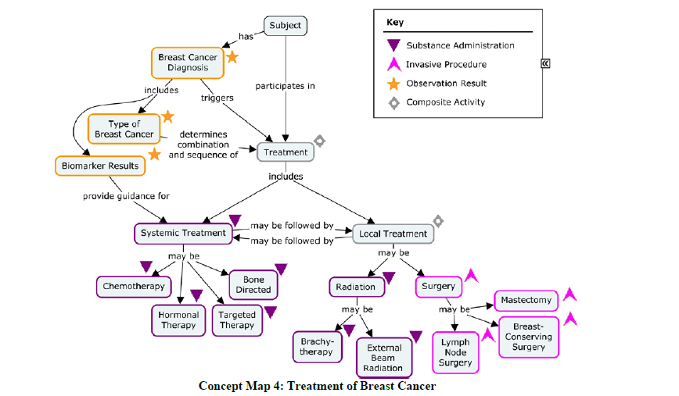
CDISC Breast Cancer Treatment Map
https://www.cdisc.org/standards/therapeutic-areas/breast-cancer

Slide 13
Data Sources
EMR, Structured
Cancer Registry, Structured
Clinical Trials , Structured
Pathology Reports, Unstructured

