Slide 1
Population level estimation workgroup
Martijn Schuemie
Marc Suchard

Slide 2
What is population-level estimation?
Does exposure to A increase the risk of outcome X?
Does exposure to A increase the risk of outcome X compared to exposure to B?

Slide 3
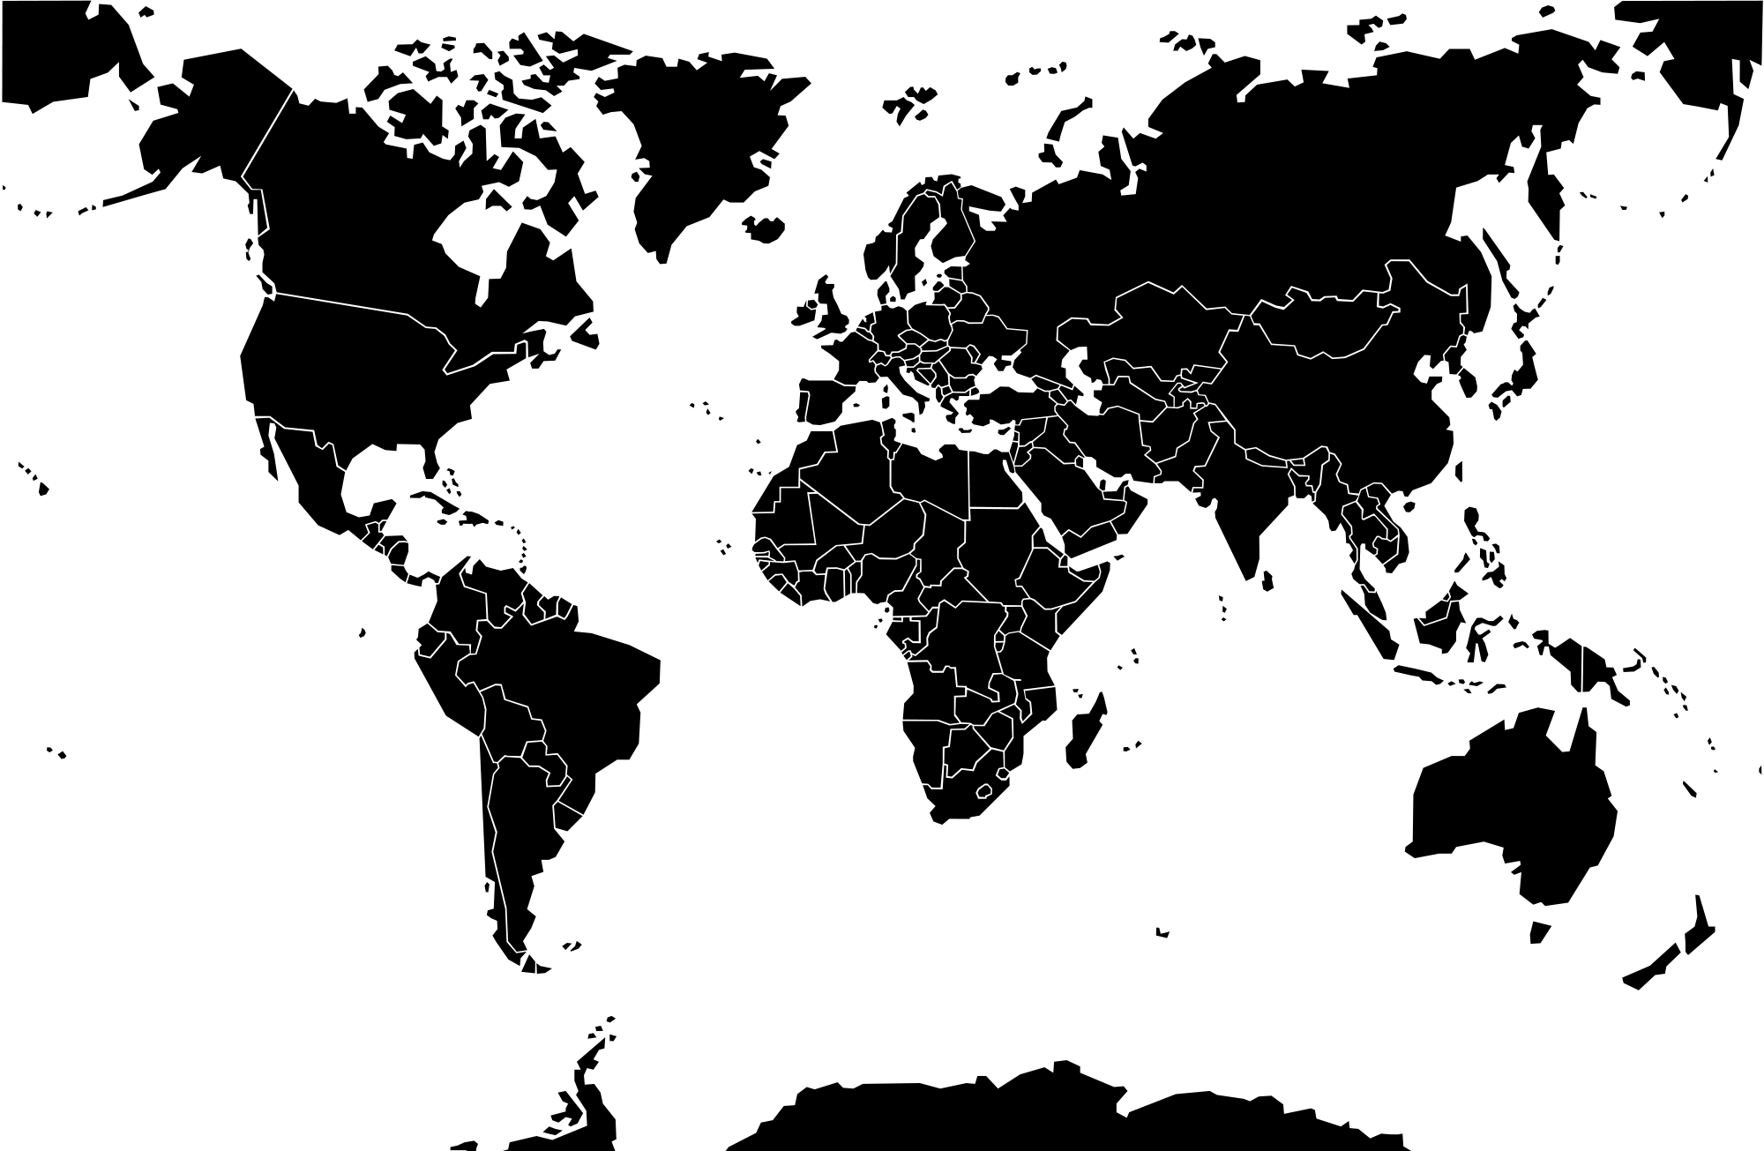
Workgroup meetings
Western hemisphere
Eastern hemisphere

Slide 4
Workgroup wiki

Slide 5
Objective
Develop scientific methods for observational research leading to population level estimates that are accurate, reliable, and reproducible, and facilitate the use of these methods by the community.
Specific goals:
Specify OHDSI Best Practices for Estimating Population-Level Effects
Develop the Methods library

Slide 6
Best practices
>= 10 guidelines on how to do population-level estimation:
AHRQ: Developing a Protocol for Observational Comparative Effectiveness Research
Comparative Effectiveness Research Collaborative: Observational Study Assessment Questionnaire
ENCePP Checklist for Study Protocols
ENCePP Guide on Methodological Standards in Pharmacoepidemiology
FDA: Guidance for Industry Good Pharmacovigilance Practices and Pharmacoepidemiologic Assessment
Good ReseArch for Comparative Effectiveness (GRACE) Checklist
GRACE Principles
ISPOR Good Research Practices for Retrospective Database Analysis Task Force Report
PCORI Methodology Standards
ISPE Guidelines for good pharmacoepidemiology practices (GPP)
All other guidelines are vague and non-prescriptive, especially about which methods to use.
OHDSI guidelines will be prescriptive, and we think researchers should justify why they deviate from best practices when they do.
11. OHDSI Best Practices for Population-Level Estimation

Slide 7
Best practices are on the Wiki
Workgroup verdict:
We need empirical evidence to support some of the proposed best practices
E.g. Large scale regularized regression for propensity scores requires evidence it is better than other approaches

Slide 8
Development
Methods library:
Methods:
CohortMethod
SelfControlledCaseSeries
CaseControl
SelfControlledCohort
ICTemporalPatternDiscovery
EmpiricalCalibration
MethodEvaluation
Available as open source R packages
Run against the CDM

Slide 9
Development
Novel methods:
Advanced approaches to propensity scores
Comparative SCCS

Slide 10
Method Evaluation Task Force
Develop the methodology for evaluating methods
Use the developed methodology to systematically evaluate a large set of study designs and design choices.
To inform best practices

Slide 11
OMOP Experiment

Slide 12
Lessons learned from OMOP
Issues with the OMOP experiment(s):
Problem with know positive controls (especially contra-indication) that artificially favors self-controlled designs
Limitations in methods library
Forgot to censor in SCC
MSCCS applied shrinkage to exposure of interest
CohortMethod did not correct for differences in length of follow up
Uncertainty around positive and negative status
Don’t know true RR if RR != 1

Slide 13
Must specify 3 components
Gold standard
(Exposure-Outcome pairs)
Methods
Data

Slide 14
Gold standard
Real negative controls
Synthetic positive controls
Recent RCTs: use only data from before

