Slide 1
OHDSI Method Evaluation
Martijn Schuemie

Slide 2
Quick recap of previous meeting
We discussed the SelfControlledCaseSeries package
Adjust for age and season using splines
Add pre-exposure windows
Add other drugs to model (all drugs)
Correct for event-dependent censoring
Using negative controls, we’re still biased even when applying extensive adjustments.
Sensitive to confounding by indication
Would like to hear about “Identifying the important questions that can be answered using observational research”

Slide 3
Method evaluation
How well does a method perform on known problems?
Is the effect estimate close to the real estimate?
Mean Squared Error (MSE)
Do positive controls have higher estimates than negative controls?
Area Under the receiver-operator Curve (AUC)
Does the 95% confidence interval contain the truth in 95% of the times?
Coverage

Slide 4
Lessons learned from previous experiments
Issues with the OMOP experiment(s):
Problem with contra-indication (relevant for known positive controls). Also applies to OSIM2
Limitations in methods library
Forgot to censor in SCC
MSCCS applied shrinkage to exposure of interest
CohortMethod did not correct for differences in length of follow up
Uncertainty around positive and negative status
Don’t know true RR if RR != 1

Slide 5
Objectives
Understand performance of methods
Investigate differences between databases
Are some DBs better at population level estimation? (for specific exposures or outcomes)
Develop a process that will inform the choice of methods used to answer a particular question
First step: pilot experiment

Slide 6
Experiment as a package
https://github.com/OHDSI/StudyProtocolSandbox/tree/master/PopEstMethodEvaluation

Slide 7
Experiment overview
Exposure-Outcome pairs
Methods
Data

Slide 8
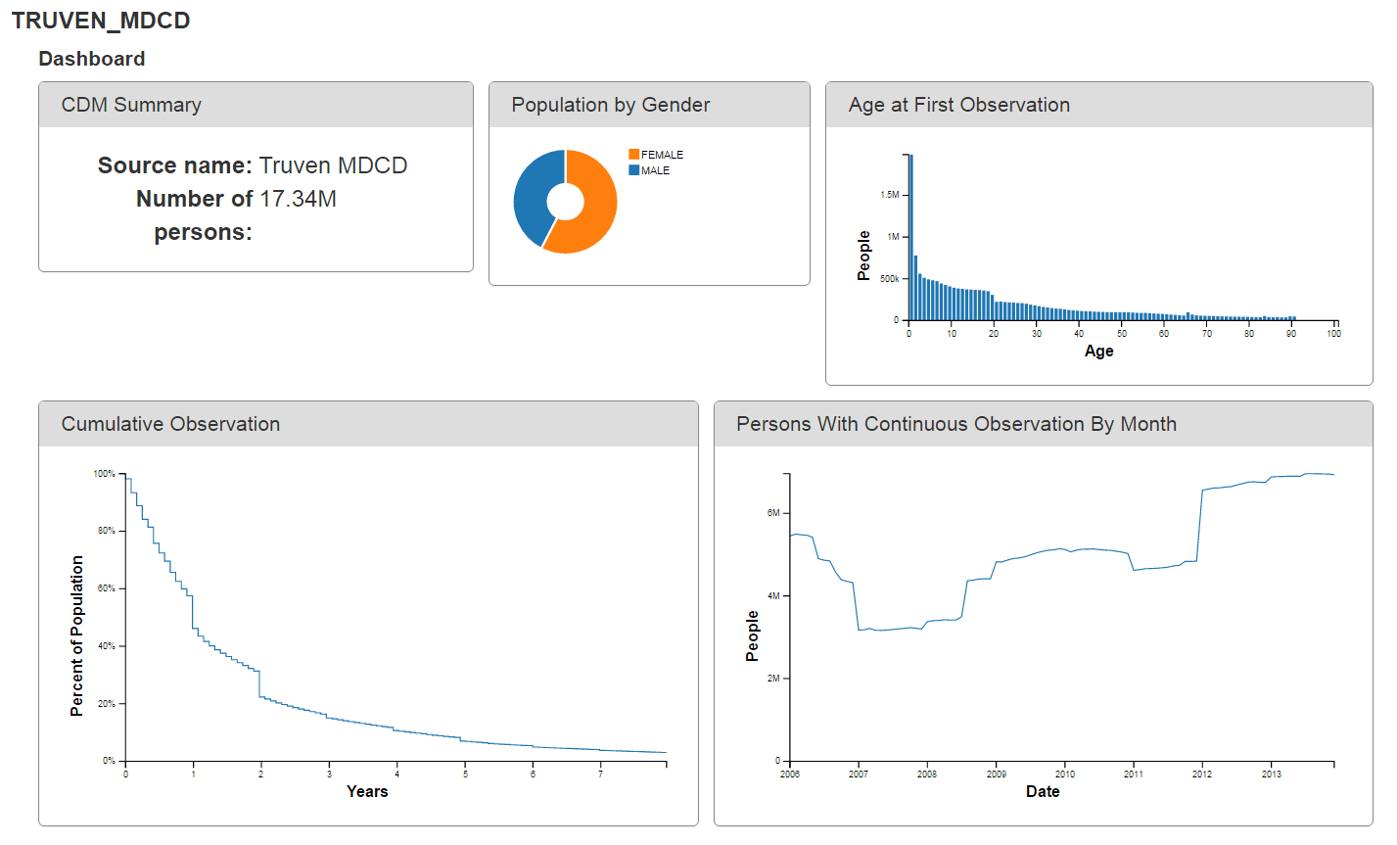
Data

Slide 9
Exposure-outcome pairs
RR = 1
Exposure: Diclofenac
Outcomes:
35 negative controls (in inpatient setting)
>= 100 events during diclofenac exposure
19 negative controls left

Slide 10
Signal injection
Injected outcomes are random! (No confounding)
Solution: Build an outcome model, and inject outcomes based on ‘baseline’ probability of outcome
Assume relative risk = 1 (negative control)
Count outcomes during exposure
For relative risk = 2: randomly insert just as many outcomes during exposure
Neg. control outcome X
Patient A
Example:
Outcome is myocardial infarction (MI)
Diabetes is a risk factor for MI
People with diabetes are more likely to have extra outcome injected
Diclofenac
Neg. control outcome X
Patient B
Diclofenac
Diclofenac
Neg. control outcome X
Patient C
Diclofenac

Slide 11
Exposure-outcome pairs
RR = (1.25, 1.5, 2, 4)
Fit Poisson model for outcome during any exposure to diclofenac (when prior obs > 365 days)
Inject additional outcomes to exposures

Slide 12
Signal injection limitations
No very small event counts
No time-varying confounding, including no contra-indication

Slide 13
Methods
Self-Controlled Case Series
Self-Controlled Cohort
Cohort Method
using celecoxib as comparator
(IC Temporal Pattern Discovery)
(Case-Control)

Slide 14
Self-Controlled Case Series
Is the outcome more likely during exposed time compared to non-exposed time?
Angioedema
Patient A
Diclofenac
Angioedema
Patient B
Ke Diclofenac ppra
Diclofenac
Angioedema
Patient C
Diclofenac

Slide 15
Self-Controlled Case Series
Given that the subject had an outcome, is the outcome more likely during exposed time compared to non-exposed time?
Outcome
Patient A
Diclofenac
Outcome
Patient B
Ke Diclofenac ppra
Diclofenac
Outcome
Patient C
Diclofenac

Slide 16
Self-Controlled Case Series
By design, adjusted for
Patient characteristics constant over time
Additionally adjust for
Age
Season
Contra-indication
(All) other exposures (MSCCS)
Outcome-dependent censoring

Slide 17
Self-Controlled Cohort
Is the outcome more likely during exposed time compared to time immediately prior to exposure?
Outcome
Patient A
Control
Diclofenac
Truncated control period
Outcome
Patient B
Diclofenac
Control
Diclofenac
Outcome
Patient C
Control
Diclofenac

Slide 18
New-user cohort design
Total population
Initiation of treatment
Diclofenac
Celecoxib

Slide 19
Randomized controlled trial
Total population
Initiation of treatment
Treatment arm
Randomization
Control arm

Slide 20
New-user cohort design
Total population
Initiation of treatment
Treatment assignment is not random!
Doctors have reasons why they prescribe diclofenac to some patients and celecoxib to others
Diclofenac
Celecoxib

Slide 21
Propensity model
Statistical model (logistic regression) of why patients get one treatment or the other
Using (all) information prior to initiation of treatment
Used to adjust for differences through
Trimming
Matching
Stratification

Slide 22
Outcome model
After trimming / matching / stratification on the propensity score
Estimate effect of treatment on outcome using
Cox
Poisson
Logistic
Include same information prior to initiation of treatment

Slide 23
Pilot experiment overview
Exposure-Outcome pairs
Methods (analyses)
19 negative controls
4*19 positive controls
SCCS (5)
SCC (8)
CohortMethod (5)
Data
Truven MDCD

Slide 24
Results SCCS
Analysis | True RR | AUC | Coverage | MSE
1 | 1 | NA | 0.42 | 0.09
2 | 1 | NA | 0.37 | 0.11
3 | 1 | NA | 0.42 | 0.09
4 | 1 | NA | 0.42 | 0.09
5 | 1 | NA | 0.68 | 0.07
1 | 1.25 | 0.62 | 0.37 | 0.08
2 | 1.25 | 0.61 | 0.32 | 0.10
3 | 1.25 | 0.64 | 0.37 | 0.08
4 | 1.25 | 0.60 | 0.37 | 0.08
5 | 1.25 | 0.67 | 0.68 | 0.06
1 | 1.5 | 0.79 | 0.37 | 0.08
2 | 1.5 | 0.77 | 0.37 | 0.10
3 | 1.5 | 0.79 | 0.37 | 0.08
4 | 1.5 | 0.77 | 0.37 | 0.09
5 | 1.5 | 0.80 | 0.68 | 0.06
1 | 2 | 0.87 | 0.32 | 0.08
2 | 2 | 0.85 | 0.32 | 0.10
3 | 2 | 0.87 | 0.37 | 0.08
4 | 2 | 0.88 | 0.42 | 0.07
5 | 2 | 0.87 | 0.68 | 0.06
1 | 4 | 1.00 | 0.37 | 0.09
2 | 4 | 1.00 | 0.32 | 0.11
3 | 4 | 1.00 | 0.37 | 0.09
4 | 4 | 1.00 | 0.37 | 0.09
5 | 4 | 1.00 | 0.42 | 0.08
Simple SCCS
Using pre-exposure window
Using age and season
Using event-dependent observation
MSCCS

Slide 25
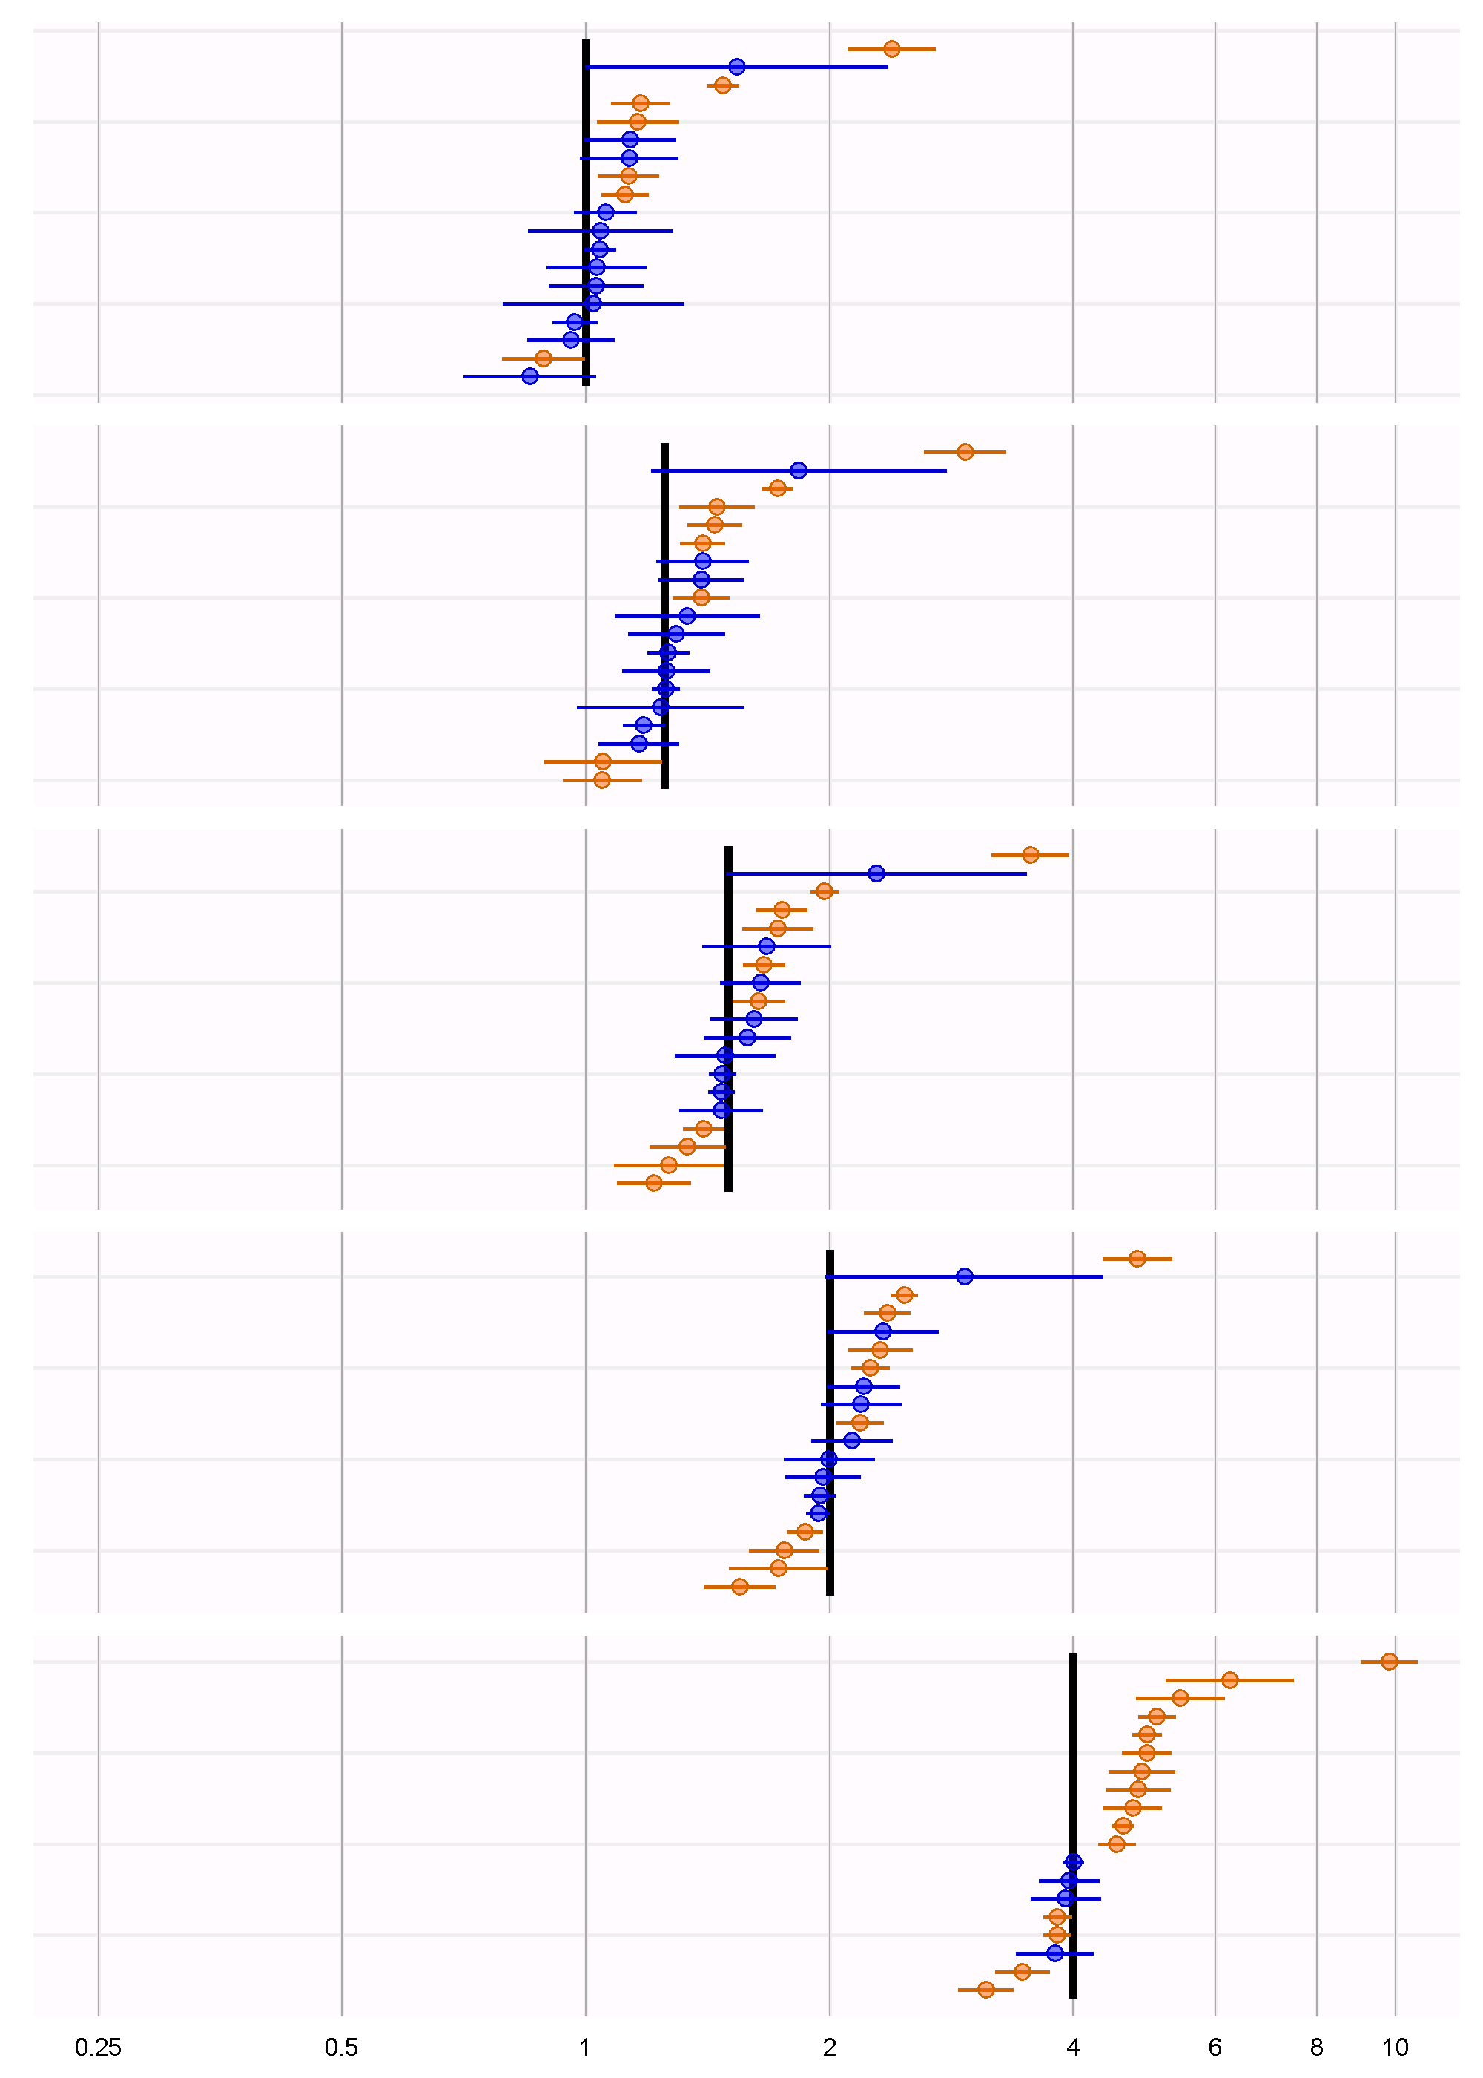
Forest plot
Carpal Tunnel Syndrome
Analysis 5:
MSCCS

Slide 26
Results SCC
Analysis | True RR | AUC | Coverage | MSE
1 | 1 | NA | 0.74 | 0.02
2 | 1 | NA | 0.84 | 0.05
3 | 1 | NA | 0.74 | 0.03
4 | 1 | NA | 0.84 | 0.05
5 | 1 | NA | 0.79 | 0.03
6 | 1 | NA | 0.84 | 0.07
7 | 1 | NA | 0.79 | 0.03
8 | 1 | NA | 0.84 | 0.07
1 | 1.25 | 0.64 | 0.89 | 0.02
2 | 1.25 | 0.71 | 0.74 | 0.05
3 | 1.25 | 0.63 | 0.84 | 0.02
4 | 1.25 | 0.71 | 0.74 | 0.06
5 | 1.25 | 0.62 | 0.89 | 0.03
6 | 1.25 | 0.62 | 0.74 | 0.07
7 | 1.25 | 0.61 | 0.84 | 0.03
8 | 1.25 | 0.62 | 0.74 | 0.07
1 | 1.5 | 0.84 | 1.00 | 0.02
2 | 1.5 | 0.87 | 0.68 | 0.06
3 | 1.5 | 0.85 | 0.84 | 0.02
4 | 1.5 | 0.86 | 0.68 | 0.07
5 | 1.5 | 0.82 | 1.00 | 0.03
6 | 1.5 | 0.82 | 0.68 | 0.07
7 | 1.5 | 0.83 | 0.84 | 0.03
8 | 1.5 | 0.82 | 0.68 | 0.08
1 | 2 | 1.00 | 1.00 | 0.03
2 | 2 | 0.98 | 0.63 | 0.08
3 | 2 | 1.00 | 0.95 | 0.03
4 | 2 | 0.97 | 0.63 | 0.08
5 | 2 | 1.00 | 1.00 | 0.04
6 | 2 | 0.98 | 0.63 | 0.09
7 | 2 | 1.00 | 0.95 | 0.03
8 | 2 | 0.97 | 0.63 | 0.09
1 | 4 | 1.00 | 1.00 | 0.11
2 | 4 | 1.00 | 0.53 | 0.11
3 | 4 | 1.00 | 1.00 | 0.08
4 | 4 | 1.00 | 0.53 | 0.12
5 | 4 | 1.00 | 1.00 | 0.11
6 | 4 | 1.00 | 0.53 | 0.12
7 | 4 | 1.00 | 1.00 | 0.08
8 | 4 | 1.00 | 0.47 | 0.13
Length of exposure, index date in exposure window
30 days of each exposure, index date in exposure window
Length of exposure, index date in exposure window, require full obs
30 days of each exposure, index date in exposure window, require full obs
Length of exposure, index date ignored
30 days of each exposure, index date ignored
Length of exposure, index date ignored, require full obs
30 days of each exposure, index date ignored, require full obs

Slide 27
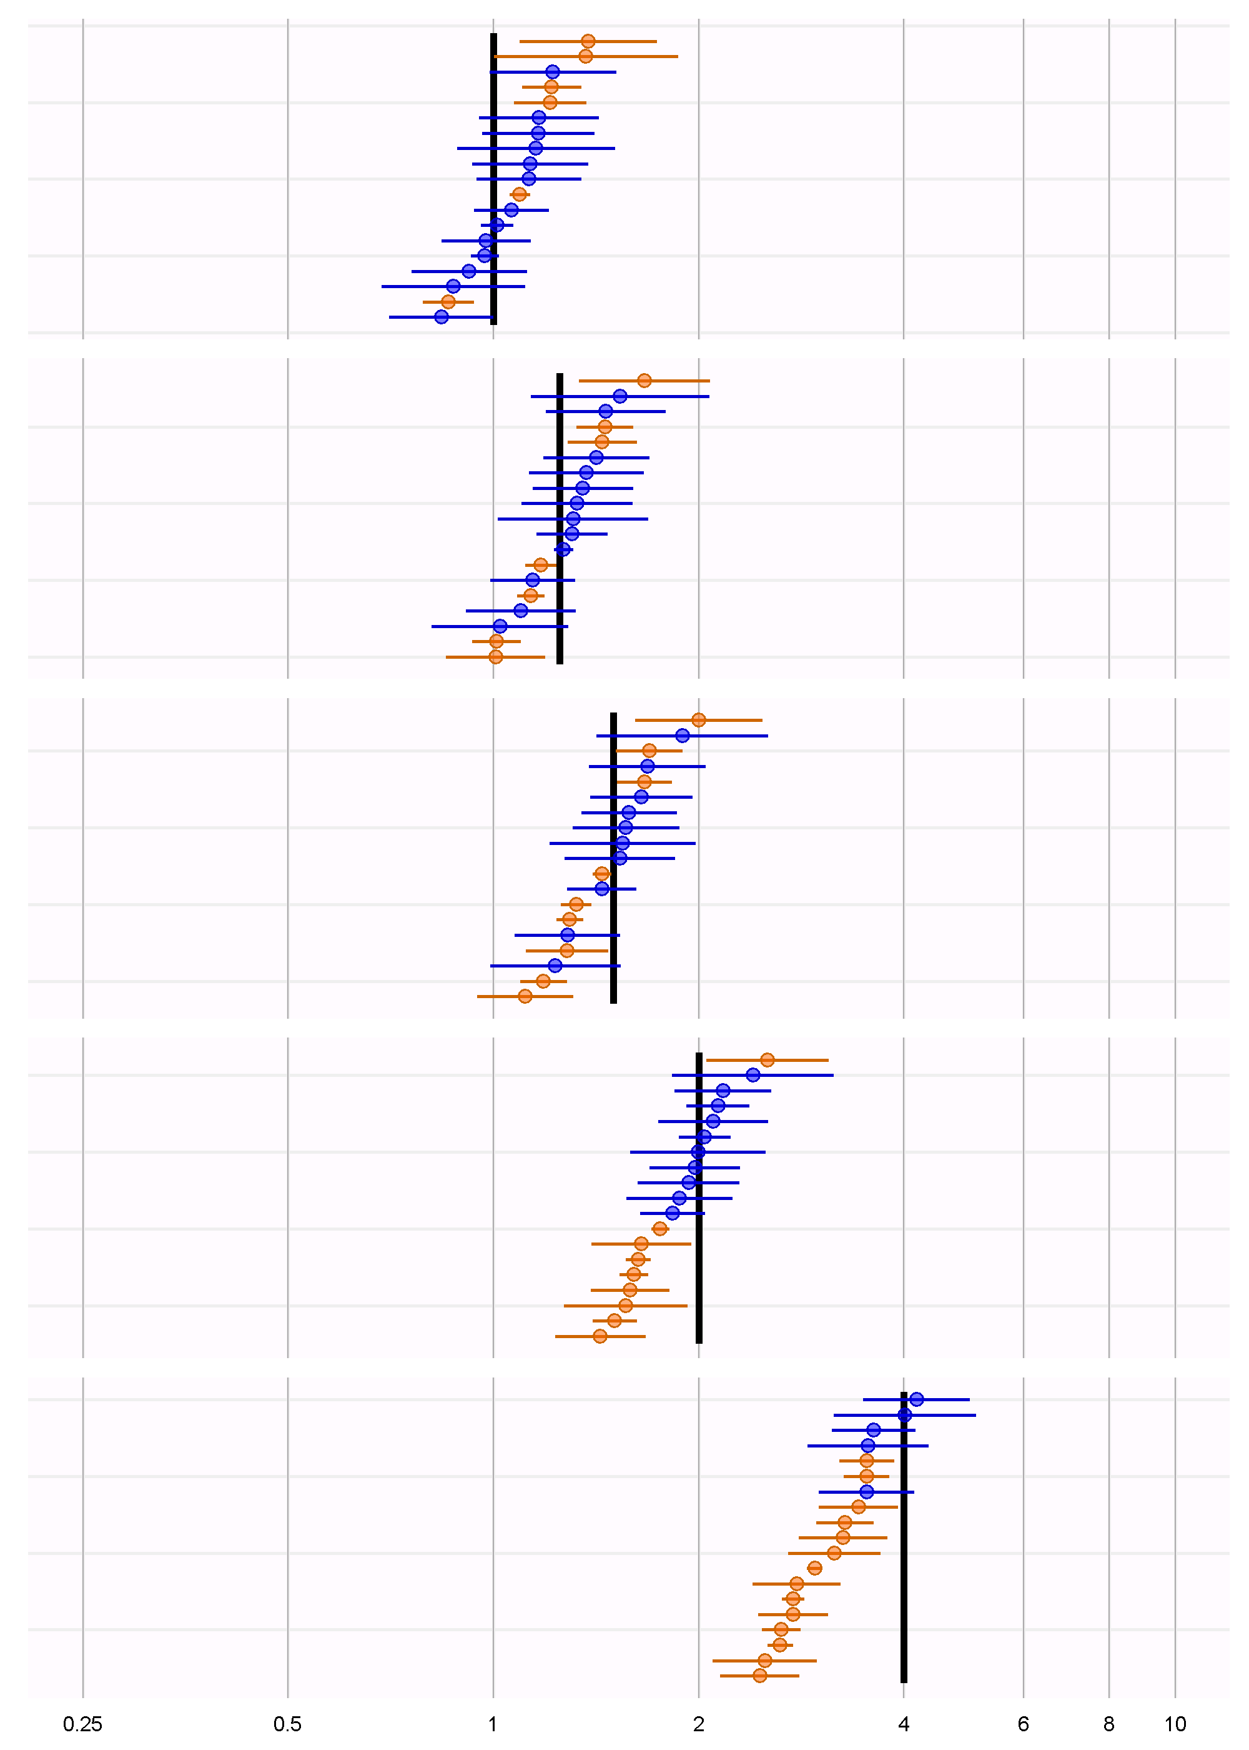
Forest plot
Analysis 3:
Length of exposure, index date in exposure window, require full obs

Slide 28
Results CohortMethod
Analysis | True RR | AUC | Coverage | MSE
1 | 1 | NA | 0.63 | 0.19
2 | 1 | NA | 1.00 | 0.05
3 | 1 | NA | 1.00 | 0.03
4 | 1 | NA | 1.00 | 0.13
5 | 1 | NA | 1.00 | 0.31
1 | 1.25 | 0.44 | 0.74 | 0.16
2 | 1.25 | 0.56 | 1.00 | 0.06
3 | 1.25 | 0.62 | 0.95 | 0.04
4 | 1.25 | 0.54 | 0.84 | 0.14
5 | 1.25 | 0.61 | 0.88 | 0.31
1 | 1.5 | 0.55 | 0.74 | 0.15
2 | 1.5 | 0.72 | 0.89 | 0.08
3 | 1.5 | 0.77 | 0.95 | 0.05
4 | 1.5 | 0.66 | 0.84 | 0.17
5 | 1.5 | 0.81 | 0.72 | 0.42
1 | 2 | 0.69 | 0.84 | 0.15
2 | 2 | 0.91 | 0.89 | 0.08
3 | 2 | 0.92 | 0.95 | 0.08
4 | 2 | 0.88 | 0.79 | 0.18
5 | 2 | 0.91 | 0.67 | 0.47
1 | 4 | 0.93 | 0.95 | 0.18
2 | 4 | 1.00 | 0.95 | 0.14
3 | 4 | 1.00 | 0.95 | 0.14
4 | 4 | 1.00 | 0.89 | 0.14
5 | 4 | 1.00 | 0.68 | 0.36
No matching, simple outcome model
Matching plus simple outcome model
Stratification plus stratified outcome model
Matching plus stratified outcome model
Matching plus full outcome model

Slide 29
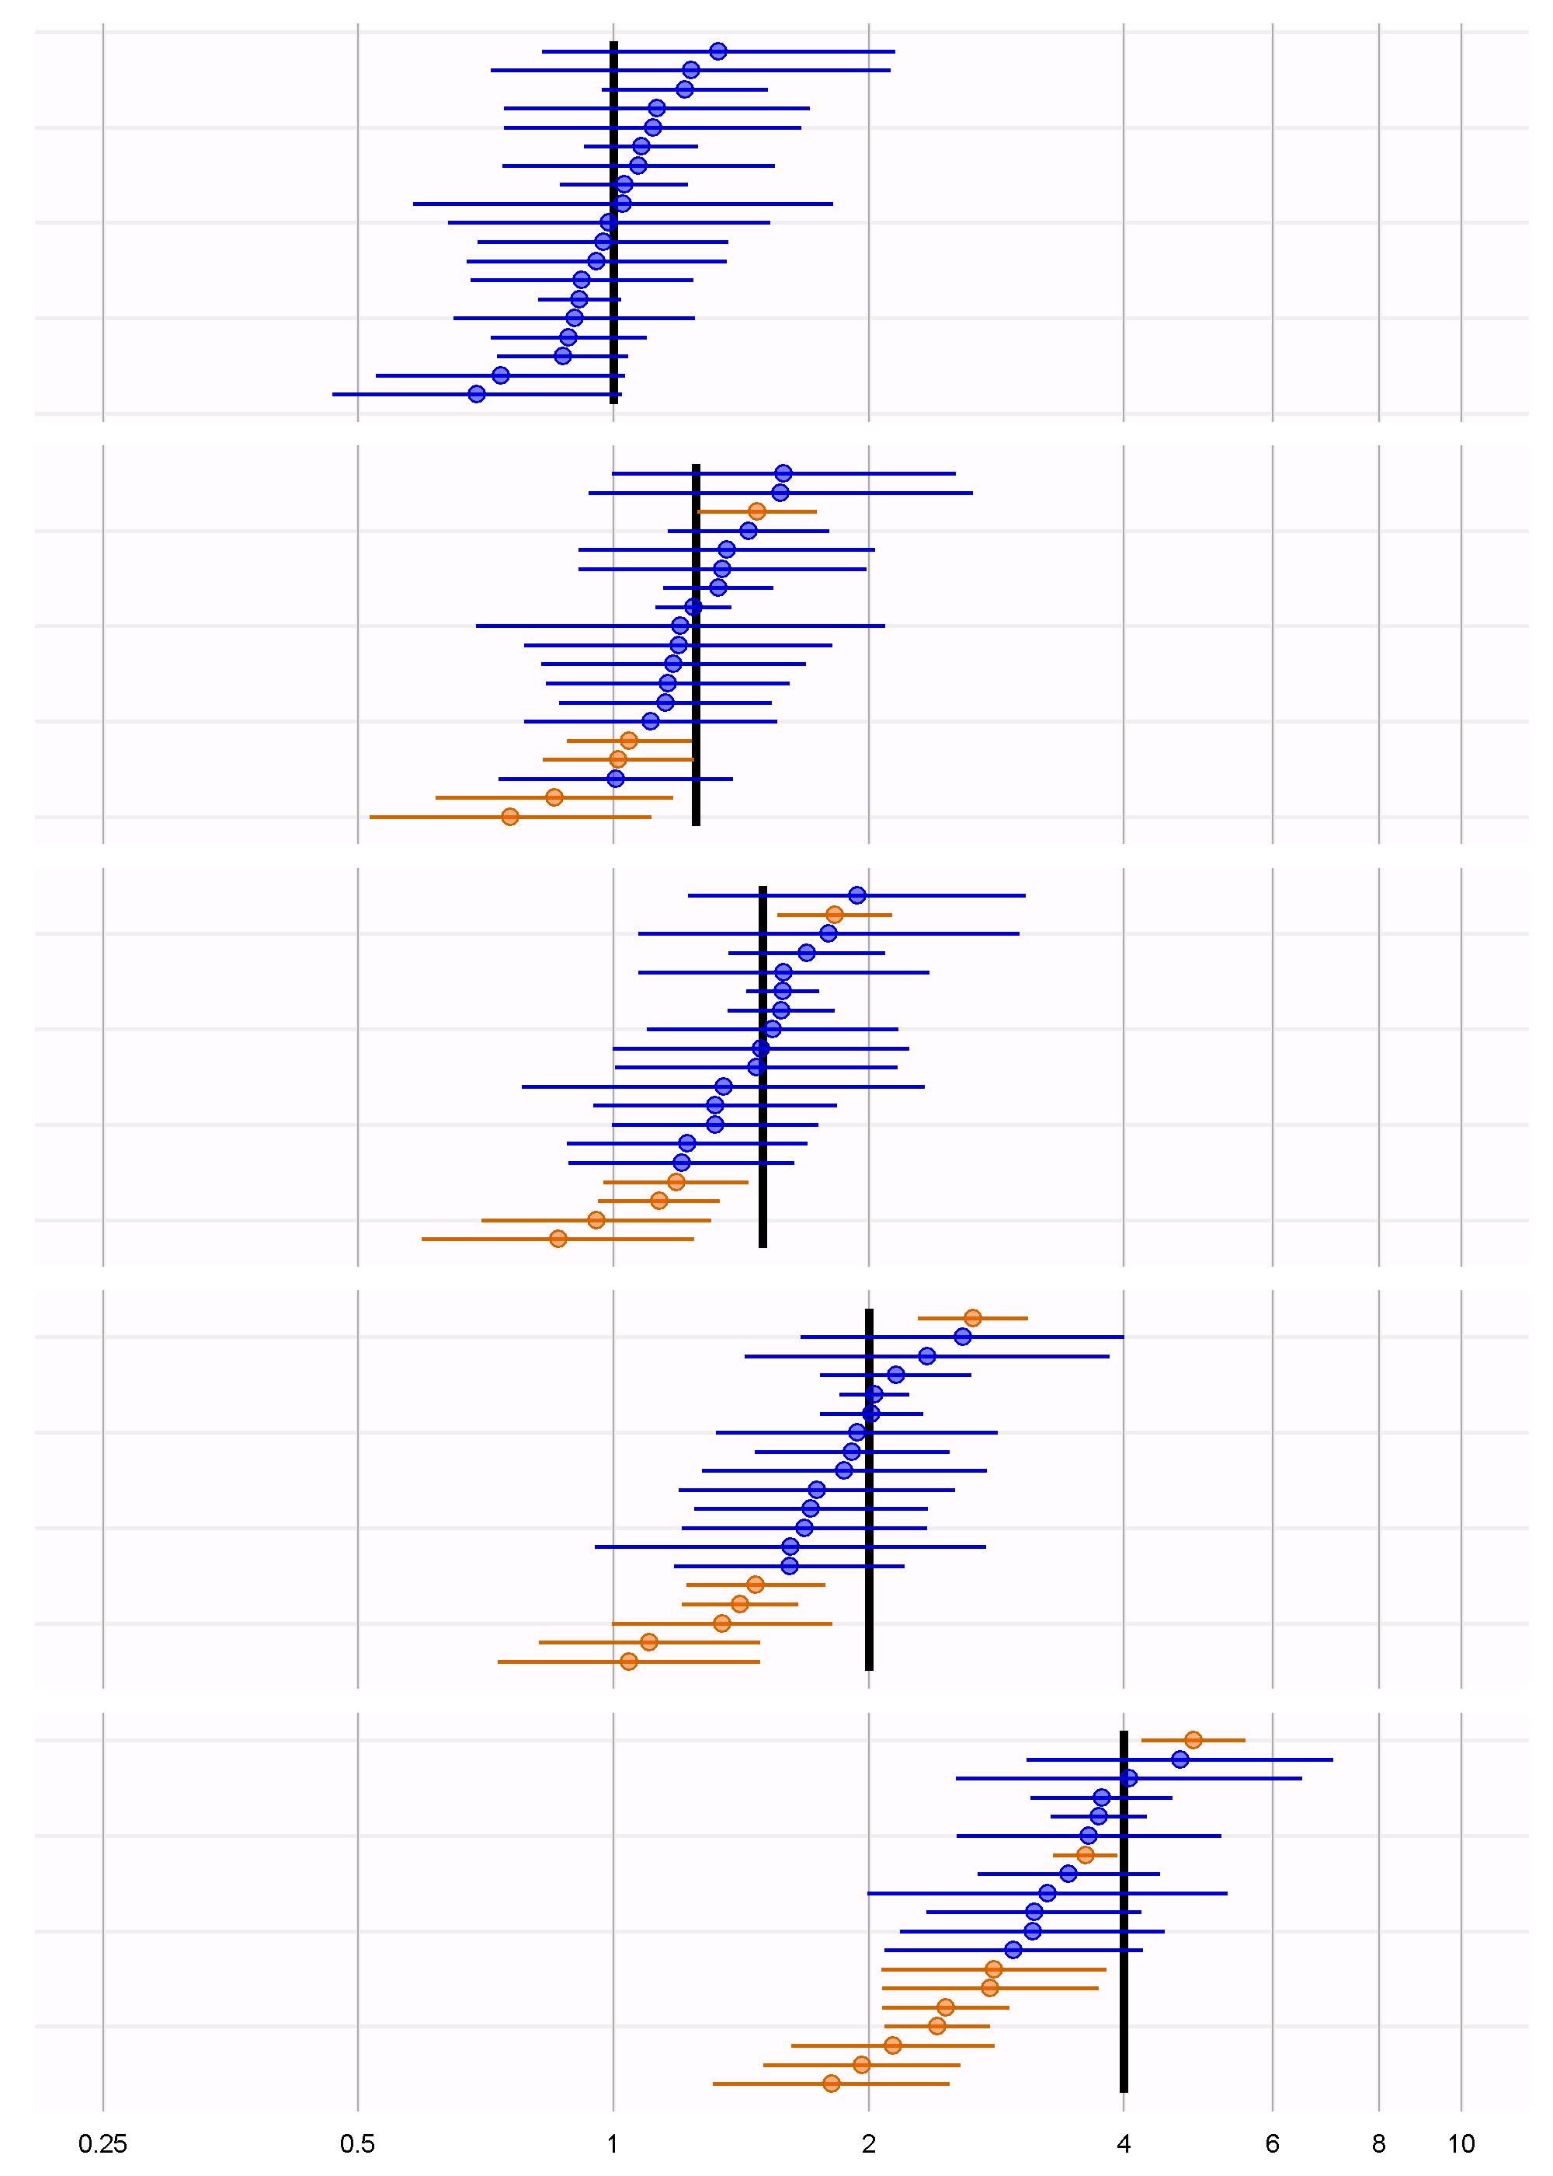
Forest plot
Analysis 3:
Stratification plus stratified outcome model

Slide 30
Discussion
MSCCS best SCCS performer, but still vulnerable to confounding by indication
Self-Controlled Cohort performs really well, but vulnerable to contra-indication (not injected)
CohortMethod least powerful but high coverage

Slide 31
Discussion
Not sure if results translate to other types of exposures and outcomes
Use such an experiment to inform analysis choices for a particular hypthesis of interest
…

Slide 32
Next topic
Identifying the important questions that can be answered using observational research

Slide 33
Next workgroup meeting
June 15st
3pm Hong Kong / Taiwan
4pm South Korea
4:30pm Adelaide
9am Central European time
http://www.ohdsi.org/web/wiki/doku.php?id=projects:workgroups:est-methods

