Slide 1
Jigsaw Study Builder: Architecture
Mark D. Danese, MHS, PhD
Ryan Duryea
Outcomes Insights, Inc.
2801 Townsgate Road, Suite 330
Westlake Village, CA 91361

Slide 2
What Is Jigsaw?
Design Goal:
To query observational datasets and extract data for a specific study design
Design Considerations
Flexibility
Provide a declarative language to unambiguously define queries independent of any relational database system (ConceptQL)
Generate SQL-based queries for various databases, including Impala
Support different data models including OMOP and our own Generalized Data Model
Consistency
To provide a consistent approach to designing and implementing studies
Speed
Allow users to conduct research faster

Slide 3
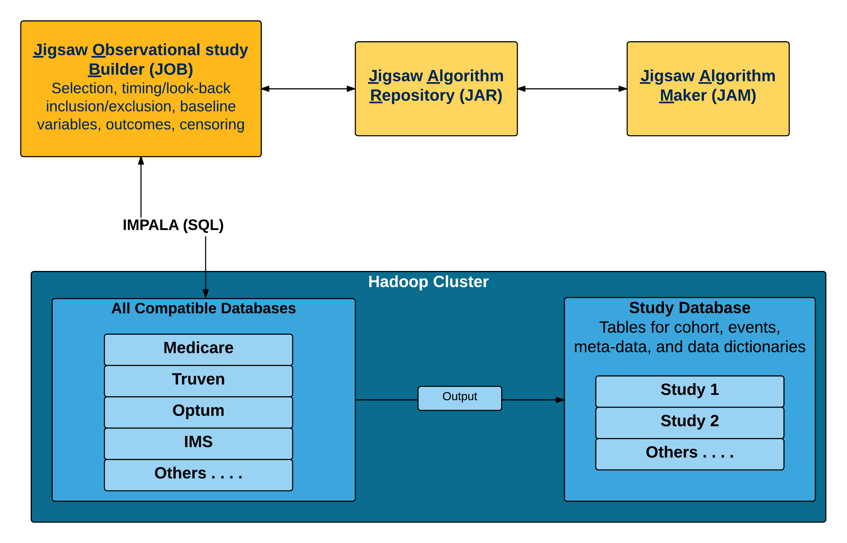
Jigsaw Overview

Slide 4
Process of Conducting A Study

Slide 5
Anatomy of a Study

Slide 6
Building Queries for a Study
ConceptQL
Unambiguous representation of a query
Stored as JSON object (not SQL)
Allows for substantial complexity
Open Source
Uses Ruby Sequel library
Uses JSON object to generate ANSI standard SQL for a specific database (e.g., Impala, Oracle, PostgreSQL, etc.)
SQL only – does not use database specific languages
Syntactically correct
Not optimized for speed
Too many factors to account for
This is the job of the query planner and the database system

Slide 7
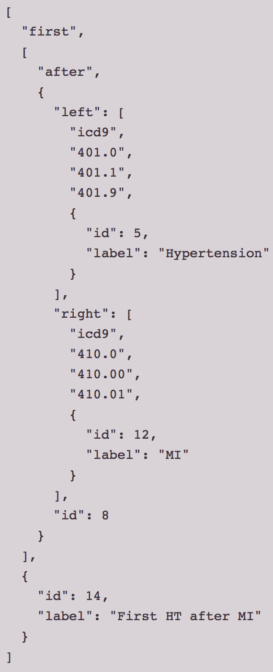
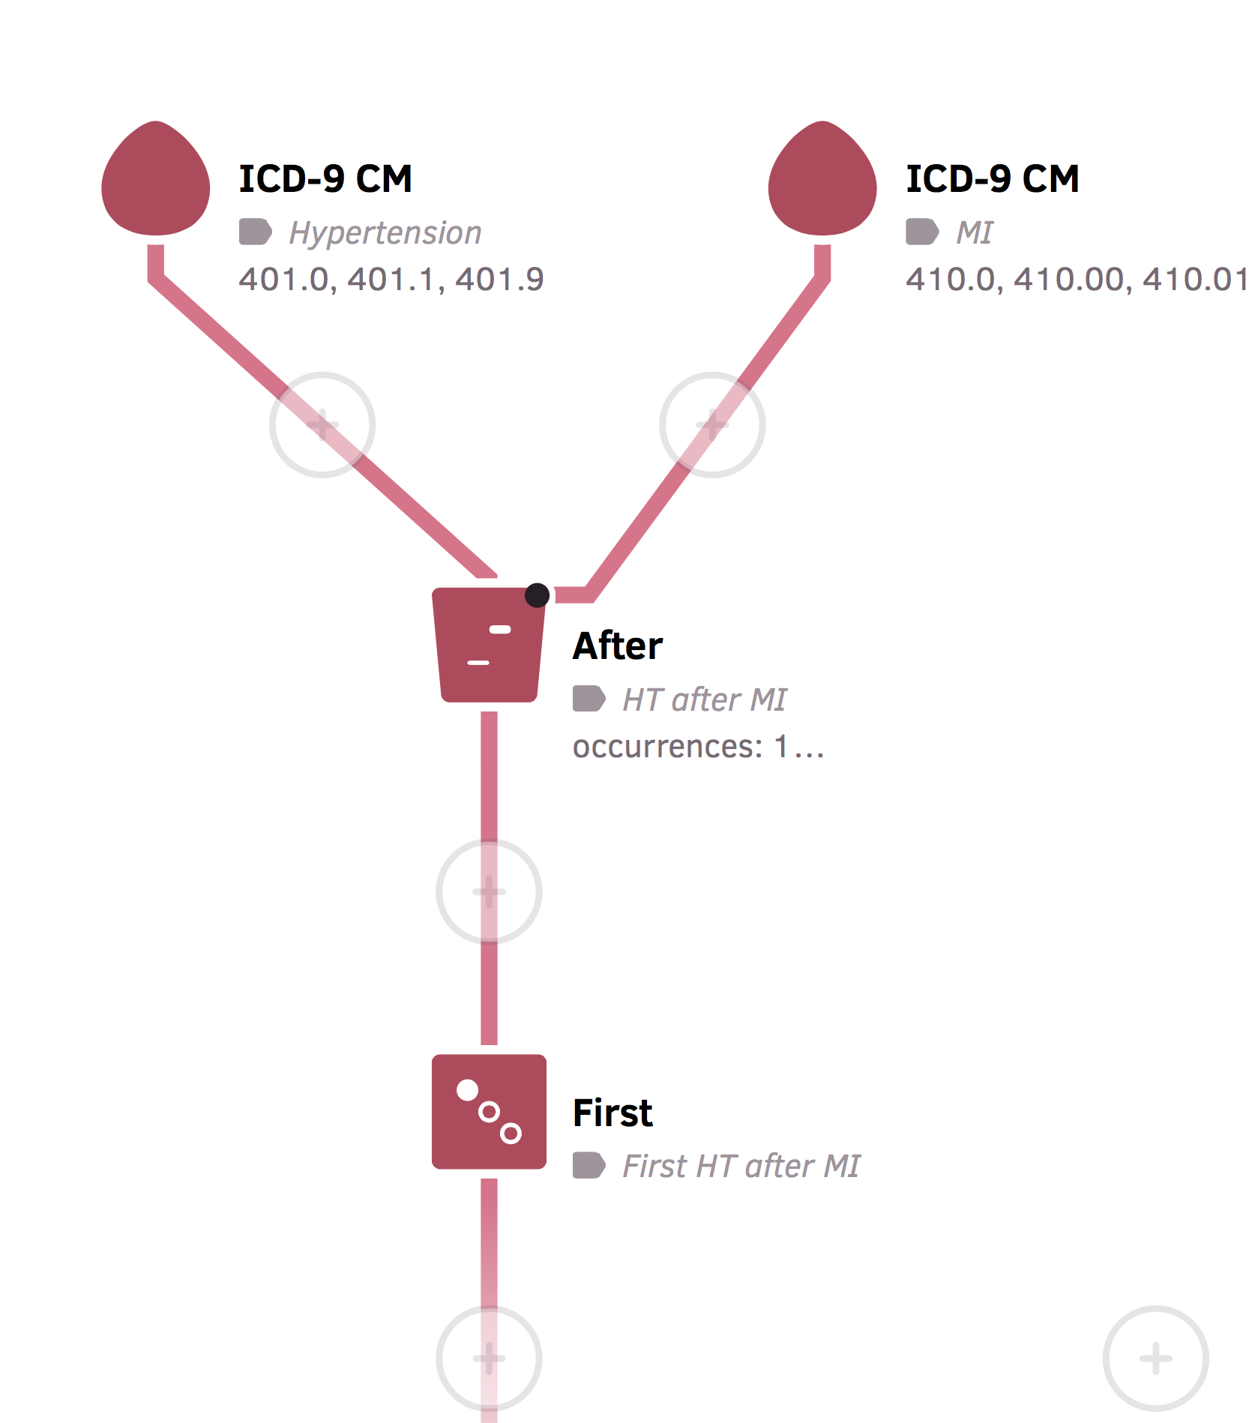
Algorithm Representation
Visualization:
Storage:
JSON format
Interpretation:
By person
Select all hypertension diagnoses that come after a myocardial infarction diagnosis
Take the first (earliest) hypertension diagnosis

Slide 8
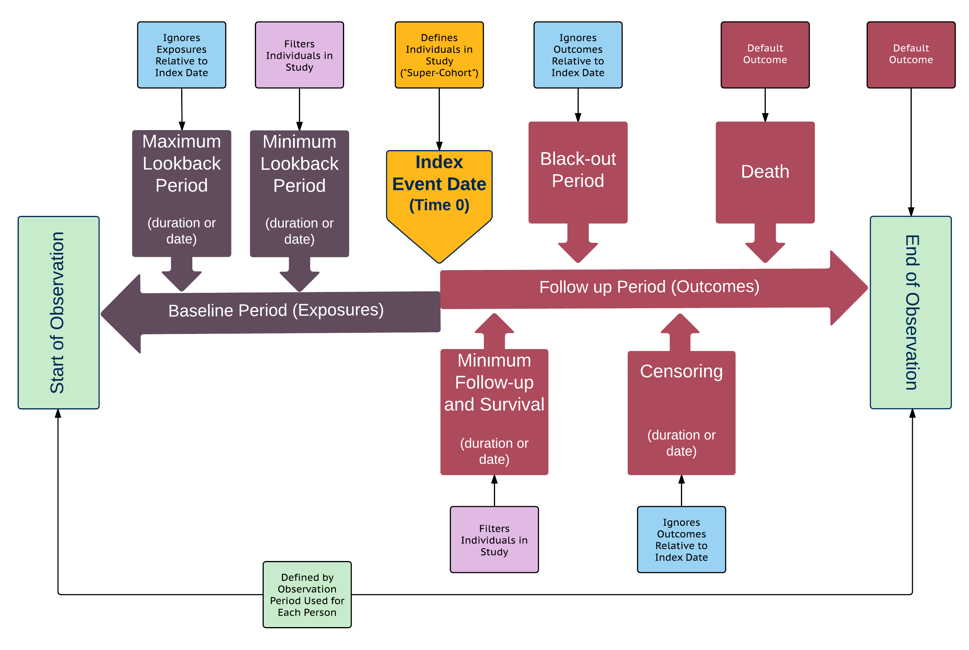
Components of an Observational Study

Slide 9
Cloudera Implementation
Needed to create adapter for Ruby’s Sequel library
Specific Impala syntax
Driver Issues
Using Impala-Ruby which is not supported by Cloudera, but may move to Cloudera-supported JDBC
Kerberos
Authentication
Impersonation
SQL syntax
Datetime
Handled by Ruby Sequel
No temp tables
Using common table expressions (CTE)
Limits on IN (for large code sets)
Using CTE
No INTERSECT, EXCEPT operations
Others . . . .
Initially, many queries failed to run
Change UNION => UNION ALL
Avoid GROUP BY where possible
Memory limits (MEM_LIMIT)
Impala 2.3 refused to run most queries because query planner was estimating 2+TB of memory for even simple queries
Impala 2.6 seems to be a lot more willing to attempt the queries
Updating
Substantial improvements from Impala 2.3 to 2.6
Up to 15x faster performance
Up to 75% reduction in memory use
RUNTIME_FILTER_MODE = OFF under CDH 5.7+
Avoids some non-deterministic behavior in our queries

Slide 10
Algorithm Test Framework
Needed a way to verify all algorithms in a database could successfully run against a particular dataset
Created a Rails app that will
Read all algorithms from an "algorithms" database
Run the query generated from each algorithm against the database and record:
success/failure of algorithm
the time it took the query to run
the query profile
any error messages if an error occurs
a hash of the results if query succeeds

Slide 11
Contact Information
Mark Danese, MHS, PhD
Outcomes Insights, Inc.
mark@outins.com
Phone
1-805-498-0034 (office)
1-805-368-2013 (mobile)
Address
2801 Townsgate Road, Suite 330
Westlake Village, CA 91361

