Slide 1
Gold Standard Phenotype Library Clinical Narrative Review System
Seng Chan You
Ajou University
January 19, 2019

Slide 2
What Makes a Phenotype a “Gold Standard”?
A phenotype that has been:
Designed with best practices
Evaluated with best practices
Documented with best practices

Slide 3
Heuristic and Computational
Phenotypes
Design
Evaluation
Rule-Based (Heuristic)
Computable (Probabilistic)
Chart Review (Annotations)
Automated (Algorithmic)
Library Architecture and Implementation

Slide 4
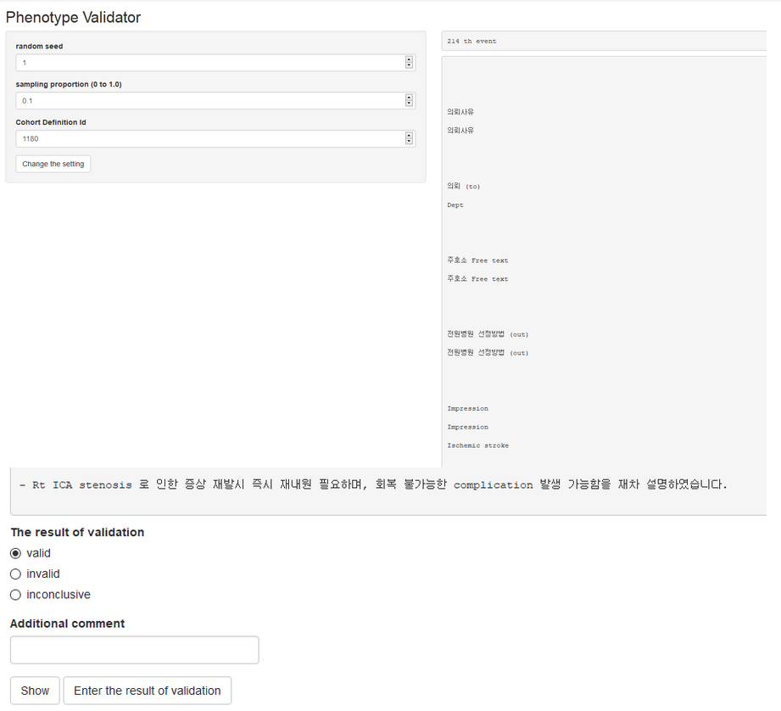
Chart Review / Evaluation
Shiny App – Seng Chan You
Visualize Discharge Notes
Check Validity

Slide 5
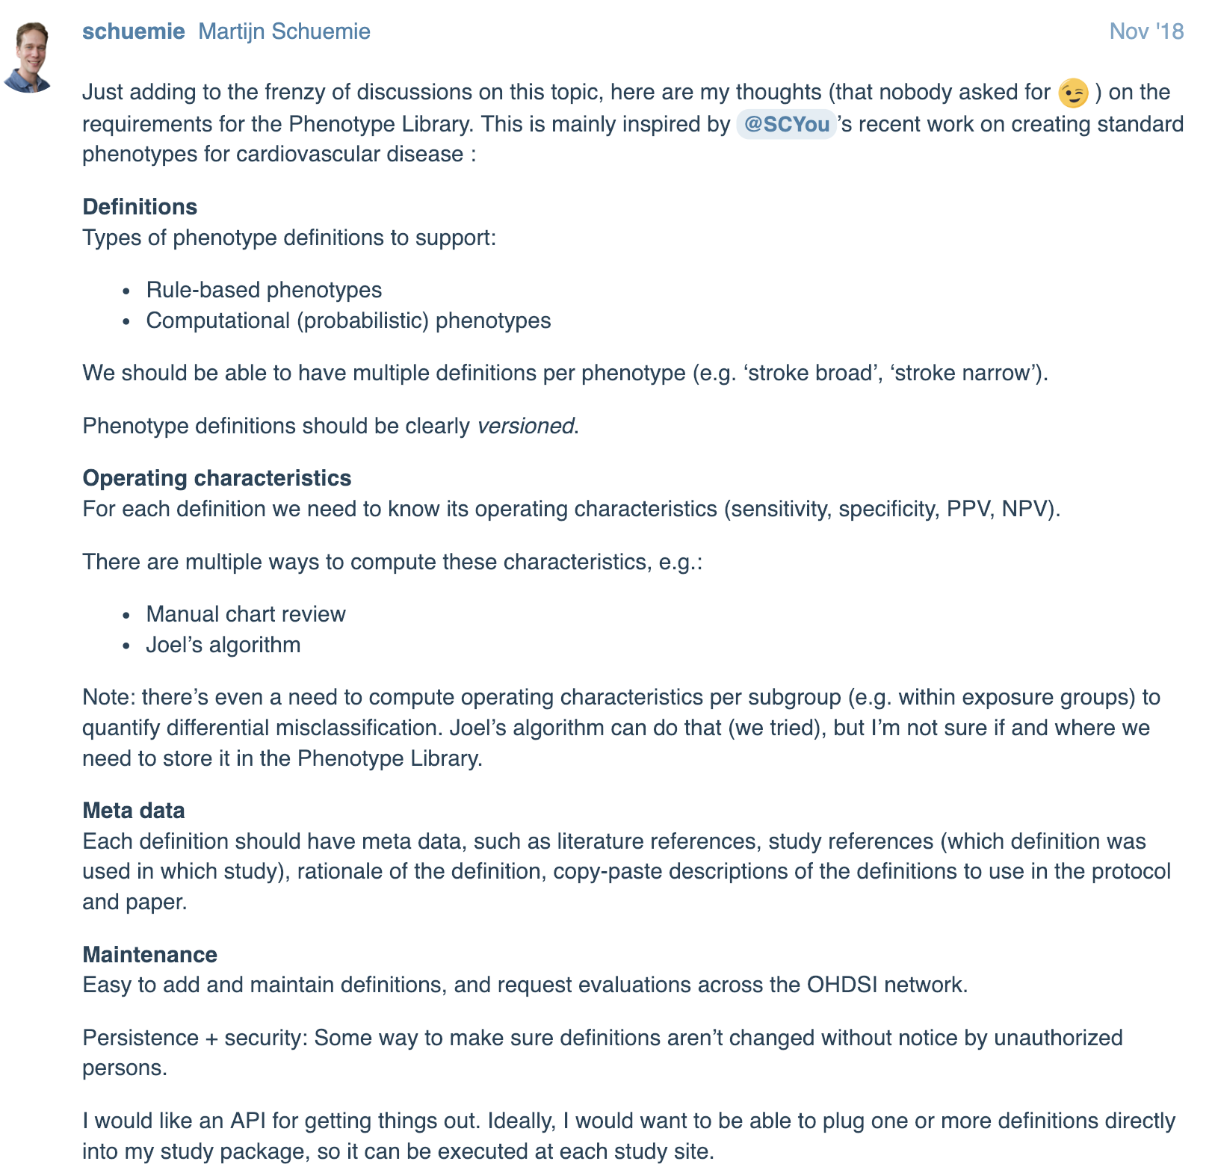
What should we standardize for phenotype library?

Slide 10
What should we standardize for phenotype library?
Definition
What should be defined for rule-based phenotypes? And How?
Validating operation
Validating operation should be standardized through standardized methodology
Meta data
The result from the validating work should be standardized.

Slide 11
Definition of the phenotype
Structured definition (or attributes) for rule-based cohort definition
Cohort ID
Atlas ID
Cohort Name
Condition Concept Identifier
Included Condition Concept
Included ICD9-CM code / ICD10 source code
Condition status concept id (eg, primary or secondary condition)
Event constraint (all event? Earliest event?)
Additional constraint (eg, for hemorrhagic stroke, I excluded those with same-day ischemic stroke)
Reference

Slide 12
Definition of the phenotype
https://github.com/OHDSI/PhenotypeLibrary/blob/master/ischemic%20stroke/inst/settings/settings.csv

Slide 13
Definition of the phenotype
https://github.com/OHDSI/PhenotypeLibrary/blob/master/ischemic%20stroke/inst/settings/settings.csv

Slide 14
Standardized way from ATLAS
Through webAPI, json/sql files for the phenotypes defined in ATLAS can be stored, and the actual cohort can be generated in pre-specified table

Slide 15
Standardized Clinical Narrative Review System
Define sampling number
Visualize Discharge Notes
Check Validity

Slide 16
Standardized MetaData
Cohort ID / Name
Total population of cohort
Validated population
Number of valid / invalid event
Number of inconclusive event
Positive Predictive Value
Database and method for validation
Validator
Validation date

Slide 17
Standardized MetaData
https://github.com/OHDSI/PhenotypeLibrary/blob/master/ischemic%20stroke/extra/metadata.csv

Slide 18
What I need
To standardize whole process from cohort definition to the meta data
Cohort Definition -> Cohort Generation and Storing json/sql -> Clinical narrative review Shiny ->metadata
To integrate clinical narrative validator with annotation tool developed by Trey Schneider
Unique ID for each event of the cohort

Slide 19
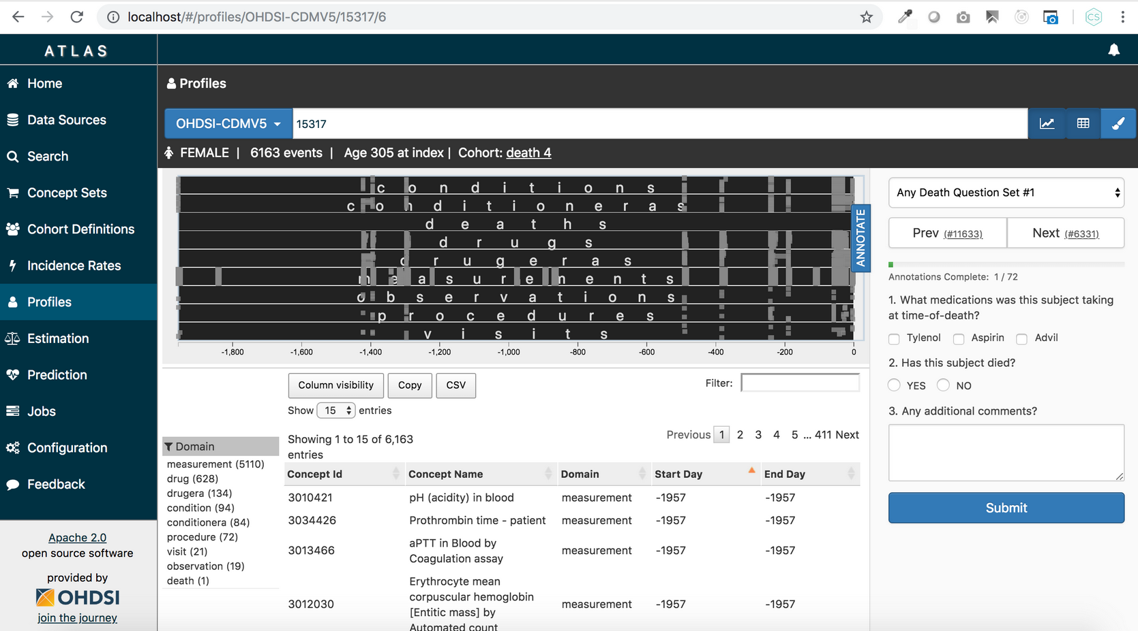
Chart Review / Evaluation
Annotation Tool – Trey Schneider

Slide 20
Thank you!

