Slide 1
Metadata and Annotations Working Group
Kickoff Meeting
April 27, 2018

Slide 2
Introductions
What organization are you part of?
What’s your OHDSI role there?
What brought you to this WG? What use cases have you already encountered?

Slide 3
Why Metadata?
Inform researchers about context not readily available
Pass on lessons learned
Collaborate on a decision

Slide 4
Proposed Goal
Our goal is to define a set of standard processes for storing and consuming all human- and machine-authored metadata and annotations to ensure researchers are provided with a comprehensive representation of the observational data set.

Slide 5
Proposed Deliverables
Create OHDSI’s definition of metadata and annotations
Design data structures to support metadata and annotations
Construct algorithms for identifying observable metadata opportunities
Create requirements for new Atlas and WebAPI enhancements that can allow for consumption and maintenance of metadata and annotations
Create best practices for OHDSI researchers that emphasize metadata review as part of any study work

Slide 6
General Definitions of Metadata and Annotations
Metadata
Annotation
“the information we create, store, and share to describe things”
“an intentional and topical value-adding note” that is tagged to a data element that helps explain “structure, function, location, and provenance”

Slide 7
How should we define them?
Metadata is information that can be directly observed, indirectly inferred, or externally obtained about an observational dataset that provides us with a more complete understanding of the patient experience being represented.
Annotations are notes about metadata authored by those with relevant experience or expertise that are intended to improve study design for other researchers.

Slide 8
Two Types of Metadata
Observable; can be obtained from the data itself
Unobservable; provided by data custodians, researchers, clinicians, vendors

Slide 9
Achilles: the original (and still very good) observable metadata
Achilles already provides us with observable metadata via aggregated statistics and data quality measures
The examples of death records dropping off or vocabulary usage shifting are observable in Achilles

Slide 10
What unobservable metadata can we create?
Data Source
The vendor, data collector (CDM_SOURCE)
Database
The CDM ETL process
Schema/Table
CDM specification version, compliance
Domain
ETL decisions for the domain, rationale for shifts in data availability
Vocabulary
Design changes from previous versions
Concept
Reason behind shifts in source code mappings in the data set

Slide 11
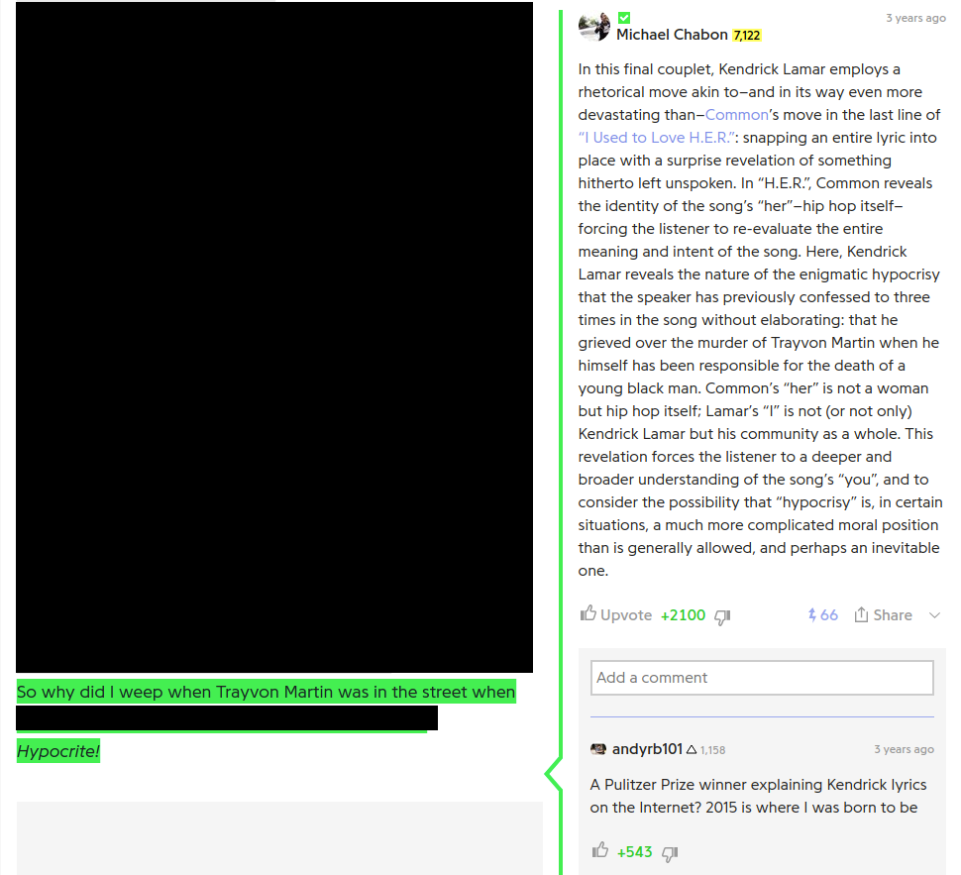
How should we think about annotations?
Genius.com, a site where song lyrics are annotated by the community….and sometimes the artists themselves or…..Pulitzer Prize winners?

Slide 12
What annotations could we write?
As ETLers:
Decisions about Achilles Heel warnings/errors
How to handle events that shift data stability
How to handle vocab shifts
As health care system experts:
How to interpret the patient experience associated with a concept but not captured in the ETL
As clinicians:
Chart review; does a patient truly qualify for a cohort?
As researchers:
Cohort definition or phenotype design

Slide 13
“Evidence dies in silos”
All of this is useless unless we foster a standard practice of identifying, writing, and consuming metadata
The standard OHDSI tools are a vehicle to ensuring standard practices
We need easy metadata management and intuitive metadata/annotation consumption

Slide 14
After we create definitions, we need four capabilities
Identify metadata candidates efficiently
Provide a method for review and annotation
Disseminate metadata and annotations to researchers
Establish table conventions

Slide 15
Roadmap for 2018
End of May: finalize definitions of metadata and annotations
June/July: design a new structure for metadata
August: formalize this structure for CDM ratification
September: complete WebAPI/Atlas branch that enables this work
October: present at OHDSI Symposium

Slide 16
WG Logistics
Post proposals in the forum using the metadata tag
Discuss in the forum threads and during WG calls
Move any table structure ideas to GitHub repo for formal review
Start a new repo or use CDM repo
Approved metadata and annotations tables would become part of CDM release

