Slide 1
Metadata and Annotations Working Group
May 16, 2018

Slide 2
Introductions for New Attendees
What organization are you part of?
What’s your OHDSI role there?
What brought you to this WG?

Slide 3
Previously, on the WG Call
Goals and Deliverables
Definitions of Metadata and Annotation
Roadmap
Logistics
Meeting slides posted on Wiki

Slide 4
Roadmap for 2018
End of May: finalize definitions of metadata and annotations, identify use cases
June/July: design a new structure for metadata
August: formalize this structure for CDM ratification
August/September: complete WebAPI/Atlas branch that enables this work
October: present at OHDSI Symposium

Slide 5
Continuing our definitions discussion
Metadata is information that can be directly observed, indirectly inferred, or externally obtained about an observational dataset that provides us with a more complete understanding of the patient experience being represented.
Annotations are notes about metadata authored by those with relevant experience or expertise that are intended to improve study design for other researchers.

Slide 6
From the Forum
Jon Duke: more concise, less explicit about patient experience
Metadata is information about an observational data set that provides a more complete understanding of the data contained.
Annotations are expert assertions intended to provide a more complete understanding of the data contained within a dataset.
Maxim Moinat: why limit it to a single source?
Instead of considering it as a purely source-specific construct, should we consider metadata at a site level?
Metadata is information about one or more observational data sets that provides a more complete understanding of the data contained.
Annotations are expert assertions intended to provide a more complete understanding of the data contained within one or more datasets.

Slide 7
Differentiating NLP from Metadata
Note NLP table is used to store clinical notes about a patient
Is this similar to metadata?
Written by clinicians with more direct access to the patient
Metadata is authored by researchers with secondary access to the patient data

Slide 8
Two Types of Metadata
Observable; can be obtained from the data itself (e.g. from a query, like in Achilles)
Unobservable; provided by data custodians, researchers, clinicians, vendors

Slide 9
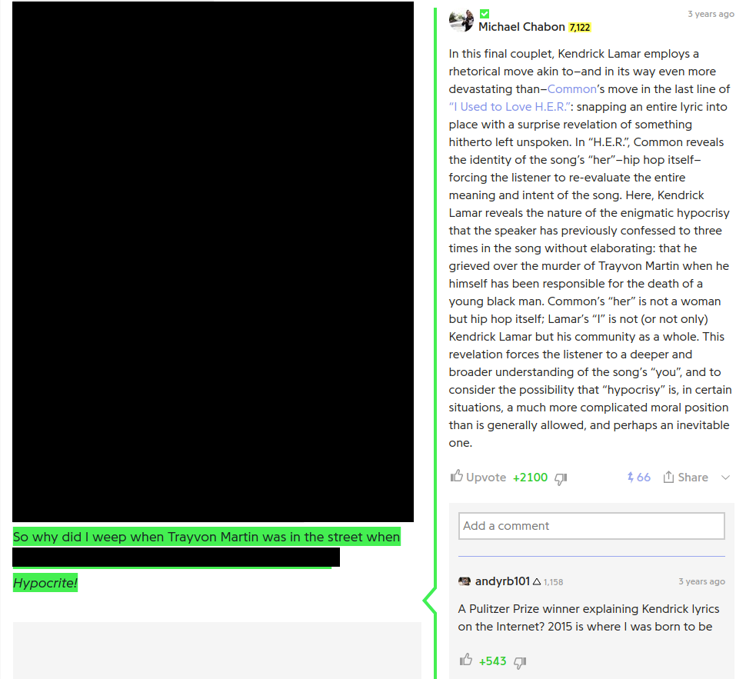
How should we think about annotations?
Genius.com, a site where song lyrics are annotated by the community….and sometimes the artists themselves or…..Pulitzer Prize winners?

Slide 10
How do we delineate between metadata and annotation
Metadata Repository
Metadata
Annotations
A human authors a clarifying point about a piece of metadata based on this expert opinion
Observable Metadata
A query can be run to obtain this
Unobservable Metadata
An external source is needed to obtain this

Slide 11
Optum Death Example
Observable Metadata
Death data drop in 2011
Unobservable Metadata
Social Security Administration changed policy
Annotation
Ajit says: “Use a study window that starts and ends either directly before or directly after the policy change”

Slide 12
Use Cases
What use cases do you currently have for Metadata/Annotation?
CDM Source table / Domain Meta table
Chart Review
ETL decisions / Heel decisions
Data trend anomalies
Will post thread seeking feedback

Slide 13
FAIR Principles (Thanks Maxim!)
https://www.dtls.nl/fair-data/fair-principles-explained/
Findable
Metadata are indexed with identifiers
Accessible
Retrievable by identifier
Can be obtained even after data is gone
Interoperable
Can be combined or joined with other data programmatically
Reusable
Can be used by both human and machine
Detailed provenance

