Slide 1
Meta-analysis across a database network using non-normal approximations: why and how
Martijn Schuemie, Yong Chen,
David Madigan, March Suchard

Slide 2
Distributed Research Network
Multiple sites with data
Hospital EHRs
Administrative Claims
Patient-level data cannot be shared
Site A
Site B
CDM
CDM
Site C
Site D
CDM
CDM

Slide 3
Distributed Research Network
Any site can lead a study
Study lead
Site A
Site B
CDM
CDM
Site C
Site D
CDM
CDM

Slide 4
Distributed Research Network
Any site can lead a study
Analysis code is developed locally
Study lead
Site A
Site B
CDM
CDM
Site C
Site D
CDM
CDM

Slide 5
Distributed Research Network
Any site can lead a study
Analysis code is developed locally
Code is distributed to study participants
Study lead
Site A
Site B
CDM
CDM
Site C
Site D
CDM
CDM

Slide 6
Distributed Research Network
Any site can lead a study
Analysis code is developed locally
Code is distributed to study participants
Results are generated (aggregated statistics)
Study lead
Site A
Site B
CDM
CDM
Site C
Site D
CDM
CDM

Slide 7
Distributed Research Network
Any site can lead a study
Analysis code is developed locally
Code is distributed to study participants
Results are generated (aggregated statistics)
Results are send back to site
Study lead
Site A
Site B
CDM
CDM
Site C
Site D
CDM
CDM

Slide 8
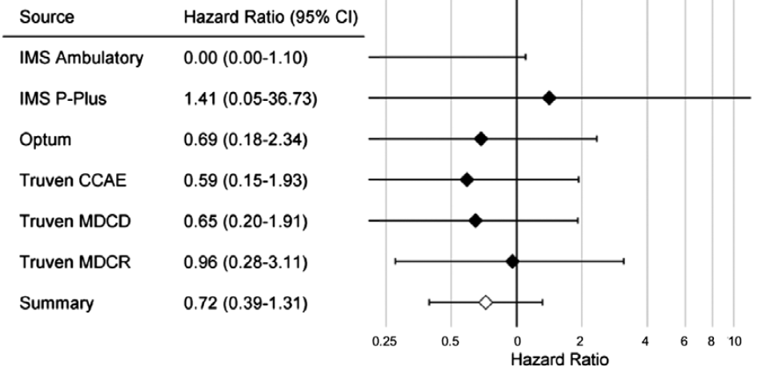
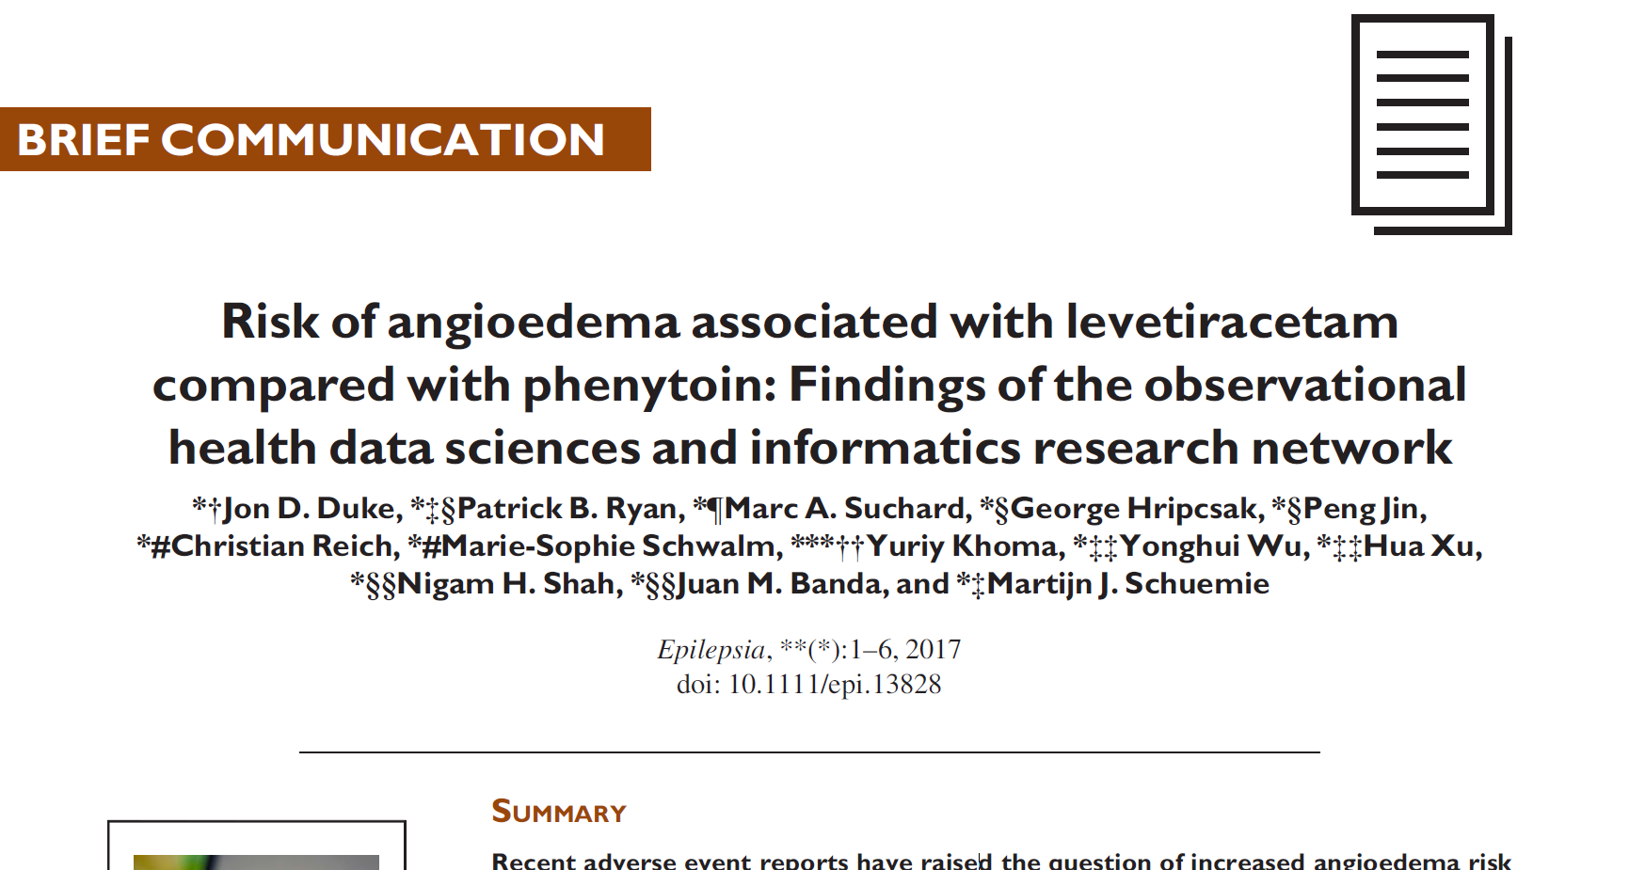
Distributed Research Network
Any site can lead a study
Analysis code is developed locally
Code is distributed to study participants
Results are generated (aggregated statistics)
Results are send back to site
Study lead
Site A
Site B
CDM
CDM
Site C
Site D
CDM
CDM

Slide 9
Hazard ratios from small counts
Hazard Ratio = 1.02 (0.27 – 3.78)
Assuming normal distribution
 | Subjects | Outcomes
Target | 22,002 | 3
Comparator | 130,200 | 25
Optimum:
1.02
Likelihood may not be normally distributed when counts are low
0.27
95% of probability
3.78
* Real data, no simulation

Slide 10
Hazard ratios from small counts
Hazard Ratio = 1.02 (0.27 – 3.78)
Hazard Ratio = 1.02 (0.22 – 3.31)
Assuming normal distribution
No shape assumption
* Real data, no simulation

Slide 11
Cox meta-analysis with small counts
Assuming
normal distribution
Normality assumption here leads to statistically significant summary estimate
No shape assumption
(Pooling data)
* Real data, no simulation

Slide 12
Hazard ratios from zero counts
 | Subjects | Outcomes
Target | 2,834 | 0
Comparator | 15,168 | 10
Traditionally, we would ignore this data source because no estimate is produced
No optimum, no confidence interval
* Real data, no simulation

Slide 13
Solution
Data sites share actual shape of likelihood, instead of just the hazard ratio + confidence interval

Slide 14
Solution
Data sites share actual shape of likelihood, instead of just the hazard ratio + confidence interval
Study lead
Site A
Site B
CDM
CDM
Site C
Site D
CDM
CDM

Slide 15
Non-normal approximations
Skew-Normal
Grid
Custom
Skew-normal and Custom are defined by 3 number (position, scale, and skew)
Grid requires communication of >= 100 gridpoints

Slide 16
Three real examples: Fixed-effects
Fixed-effects meta-analysis assumes the effect size is the same in each database
Pooled: gold standard
Traditional: current practice
Examples using four databases
* Real data, no simulation

Slide 17
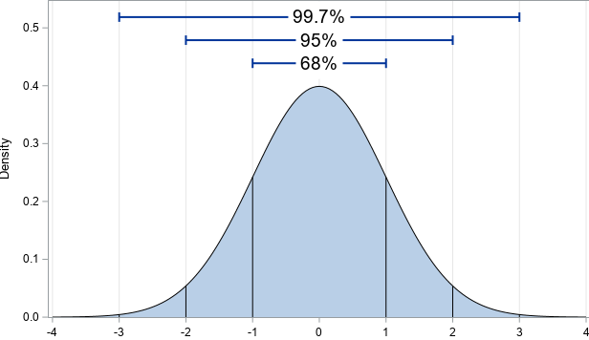
Random-effects
Random effects assumes each site draws effect size from a normal distribution with mean µ and standard deviation $τ$
$τ$ is ill-defined when we have a few small databases
What assumption do we want to make?
If we don’t know, $τ$ must be 0 (no heterogeneity)
If we don’t know, $τ$ might be 0, or might be >= 0
We can model this using a Bayesian approach
Default: half-normal prior with scale = 0.5
(Use fancy MCMC engine to compute: BEAST)
µ
$$τ$$

Slide 18
Three real examples: Random-effects
With too little information, traditional approach assumes no heterogeneity
Pooled: gold standard (Bayesian)
Traditional: current practice (Non-Bayesian)
Examples using four databases
* Real data, no simulation

Slide 19
Three real examples: Random-effects
Skew-normal is suboptimal
Pooled: gold standard (Bayesian)
Traditional: current practice (Non-Bayesian)
Examples using four databases
* Real data, no simulation

Slide 20
Simulations
https://data.ohdsi.org/SmallCountMetaAnalysisEvaluation/

Slide 21
Final thoughts
Normality assumption adds unnecessary bias to distributed research
Problem is larger with more databases, with coverage sometimes < 10%
Communicating full shape of likelihood function avoid this bias, without sharing patient-level data. Best candidates are
Custom function
Grid
Will be available in the EvidenceSynthesis package

