Slide 1
Population-level estimation working group Eastern hemisphere meeting
2018.11.14.
Seng Chan You

Slide 2
Content
Standard Phenotype Library for Cardiovascular Disease
Risk of acute kidney injury between conventional NSAIDs and COX-2 inhibitors in patients

Slide 3
Standard Phenotype Library for Cardiovascular Disease
Population-level estimation working group
Eastern hemisphere meeting
Seng Chan You

Slide 4
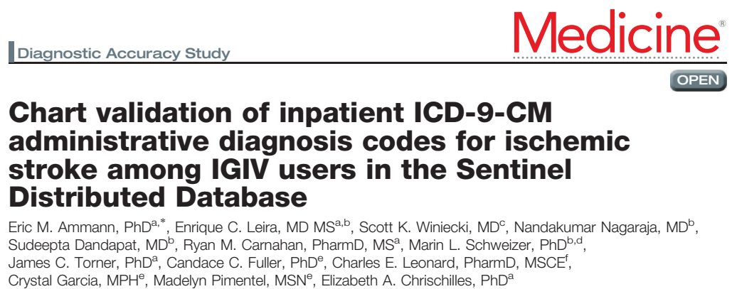
Why do we need standard phenotype library?
We all know why OHDSI needs standard phenotype library
OHDSI needs to learn from Sentinel’s efforts for this

Slide 5
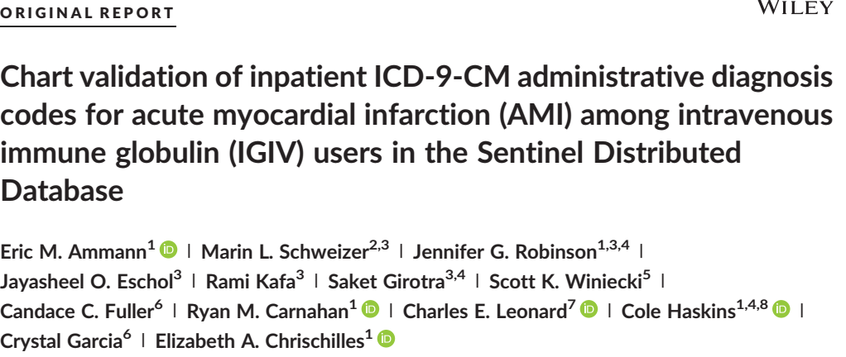
Why do we need standard phenotype library?
We all know why OHDSI needs standard phenotype library
OHDSI needs to learn from Sentinel’s efforts for this

Slide 6
Methods for phenotyping
Rule-based phenotype
Human curated SNOMED-CT code (by Patrick, Christian, ….)
Leverage legacy of ICD-code system
Computational phenotype
APHRODITE
Joel’s method
Others

Slide 7
Methods for phenotyping
Rule-based phenotype
Human curated SNOMED-CT code (by Patrick, Christian, ….)
Leverage legacy of ICD-code system
Computational phenotype
APHRODITE
Joel’s method
Others

Slide 8
Standard Phenotype Library for Cardiovascular Disease
http://forums.ohdsi.org/t/requirements-development-for-the-ohdsi-gold-standard-phenotype-library/4876

Slide 9
Standard Phenotype Library for Cardiovascular Disease
Why CVD? : Many OHDSI studies have been focused on CVD outcome
LEGEND – Martijn, Marc, and Patrick
Canagliflozin study – Martijn, Patrick and Janssen
External validation of atrial fibrillation – Jenna
Hypertension combination – Chan
My future studies
Targets
Acute myocardial infarction
Cerebrovascular accident (stroke)
Ischemic stroke
Hemorrhagic stroke
Heart failure
Sudden cardiac death
Major bleeding (hemorrhagic stroke + GI bleeding )

Slide 10
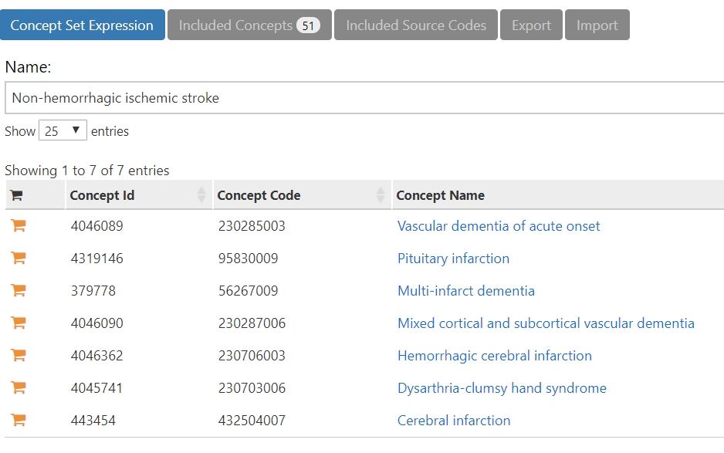
Why stroke?
It is not easy to define stroke in SNOMED-CT system
http://www.ohdsi.org/web/atlas/#/cohortdefinition/1768950

Slide 11
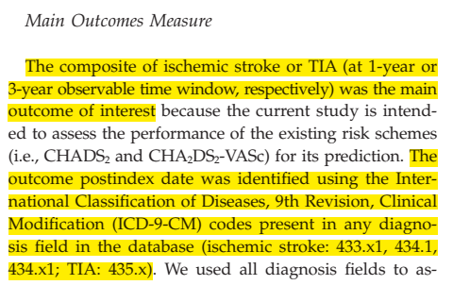
Why stroke?

Slide 12
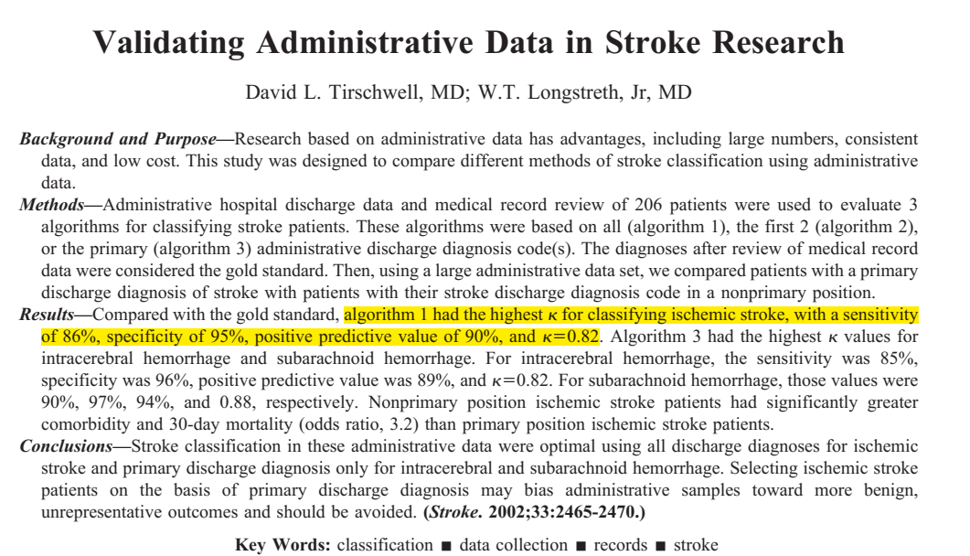
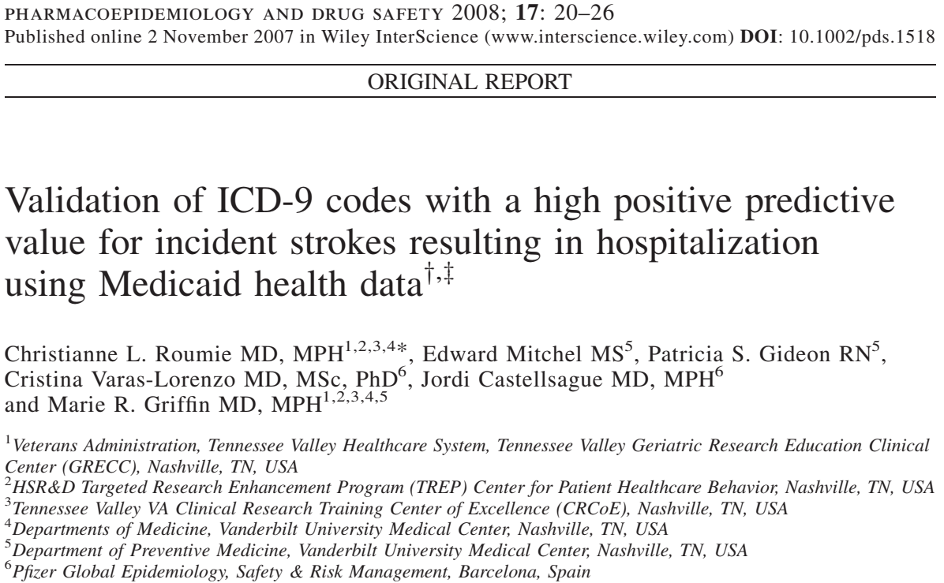
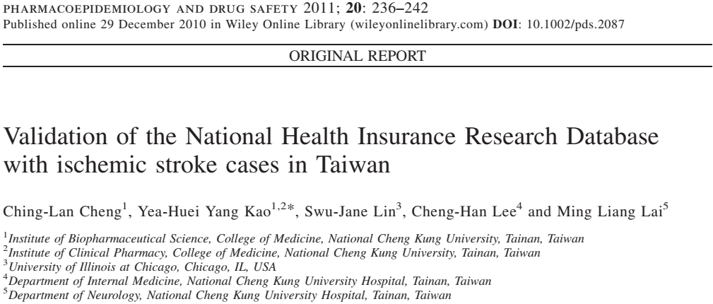
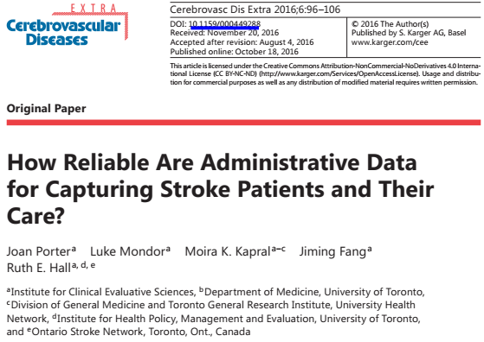
Previous papers validating stroke in ICD code system

Slide 13
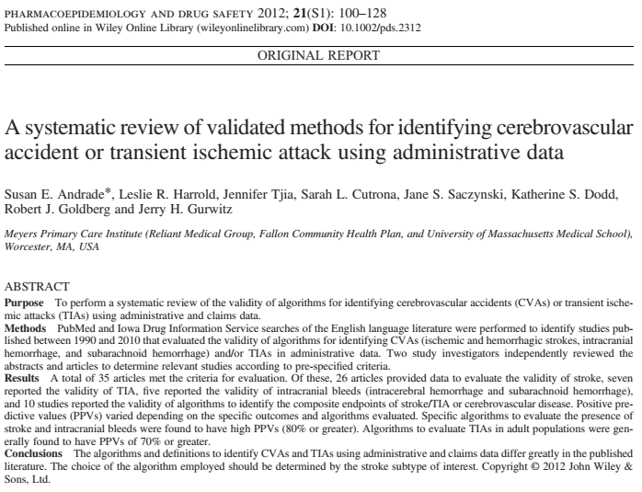
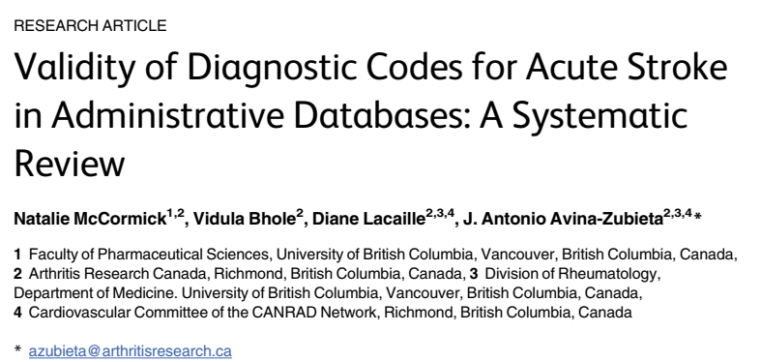
Systematic review for validation of stroke in ICD code system
Andrade et al., Pharmacoepidemiology and Drug Safety (2012)
McCormick et al., PLoS ONE (2015)
Notes:
McCormick, Natalie, Vidula Bhole, Diane Lacaille, and J. Antonio Avina-Zubieta. “Validity of Diagnostic Codes for Acute Stroke in Administrative Databases: A Systematic Review.” PLoS ONE 10, no. 8 (August 20, 2015). https://doi.org/10.1371/journal.pone.0135834.
Andrade, Susan E., Leslie R. Harrold, Jennifer Tjia, Sarah L. Cutrona, Jane S. Saczynski, Katherine S. Dodd, Robert J. Goldberg, and Jerry H. Gurwitz. “A Systematic Review of Validated Methods for Identifying Cerebrovascular Accident or Transient Ischemic Attack Using Administrative Data.” Pharmacoepidemiology and Drug Safety 21, no. S1 (2012): 100–128. https://doi.org/10.1002/pds.2312.

Slide 14
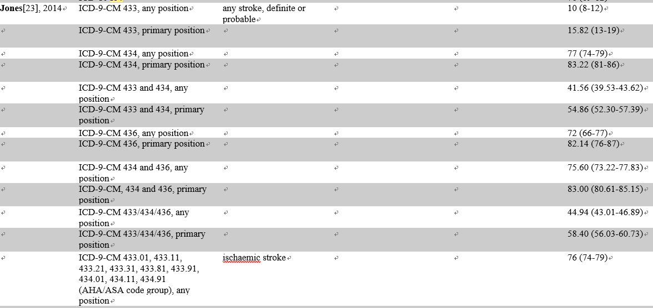
Diverse accuracy across the ICD codes
McCormick et al., PLoS ONE (2015)

Slide 15
Diverse accuracy across the ICD codes
Andrade et al., Pharmacoepidemiology and Drug Safety (2012)

Slide 16
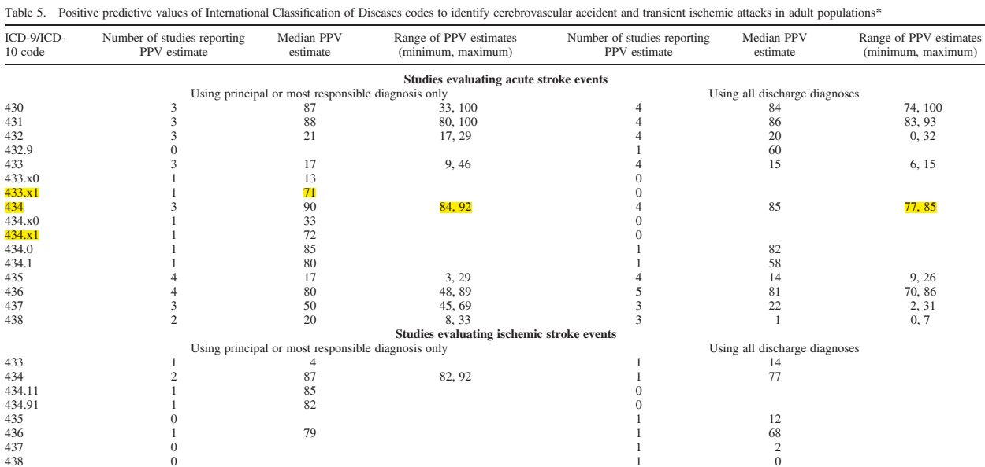
Diverse accuracy across the ICD codes
Andrade et al., Pharmacoepidemiology and Drug Safety (2012)

Slide 17
My conclusion
Diagnosis code
ICD-9-CM: 433.x1, 434.x1
ICD10: I63x
Should be considered
Specifiers
Inpatient or ED visit only?
Primary or secondary diagnosis only?
Brain CT or MRI?

Slide 18
Diverse accuracy across the ICD codes
Andrade et al., Pharmacoepidemiology and Drug Safety (2012)

Slide 19
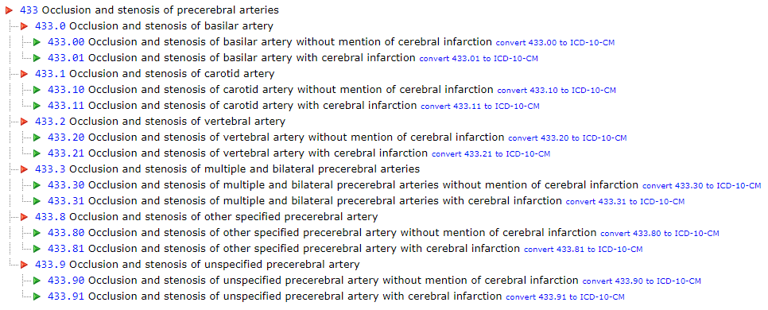
ICD-9-CM (433 & 434)

Slide 20
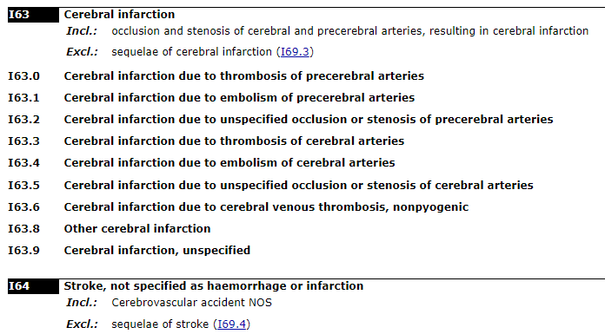
ICD-10 (I63, I64)

Slide 21
SNOMED-CT code
I found these two ancestor concept_ids can be used to include ‘maps to’ SNOMED-CT OMOP concept_id for ICD-codes(433.x1, 434.x1, I63x)

Slide 22
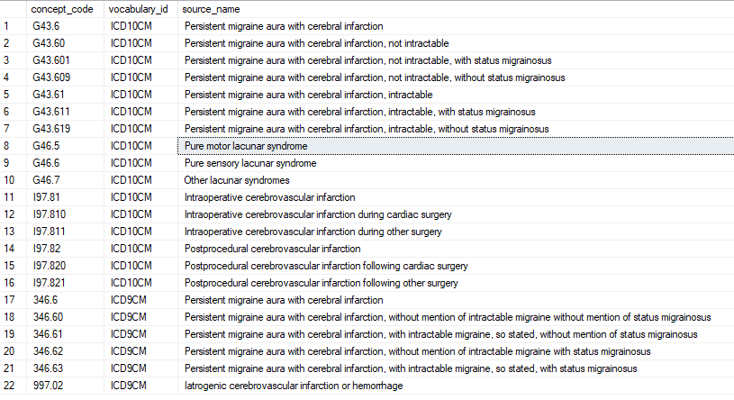
Unwanted ‘maps from’ ICD codes

Slide 23
Unwanted ‘maps from’ ICD codes
SELECT COUNT(DISTINCT PERSON_ID) FROM CONDITION_OCCURRENCE WHERE condition_source_value LIKE 'G436%’
➔ 0 (No one has this diagnosis code in Korea, NHIS-NSC)

Slide 24
Three options
We can validate concept id of 443454, 4043731 in OHDSI – The best option
We can make a stroke cohort definition with excluding terms for same-day migraine
We can count how many people actually have these diagnoses in multiple databases. If no database has this condition, then I would be relieved

Slide 25
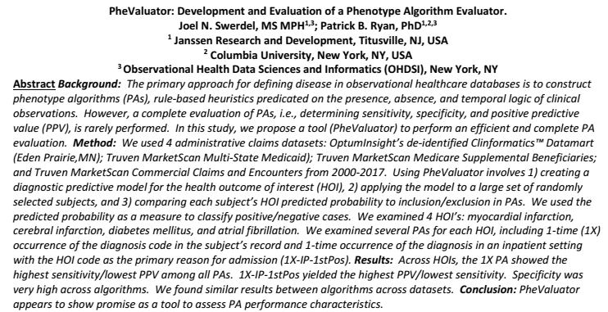
PheValuator: Phenotype algorithm evaluator

Slide 26
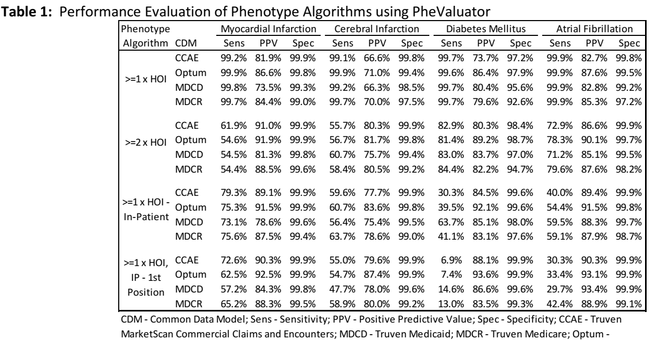
PheValuator: Phenotype algorithm evaluator

Slide 27
Plan
Evaluate phenotype libraries
Constructing most reliable (highly specific) stroke phenotype first
Cerebral infarction + Inpatient + Primary diagnosis + brain CT/MRI study + excluding those with migraine at the same day
Constructing various stroke cohorts with various specifiers
+/- Inpatient, +/- primary diagnosis, +/- brain imaging, +/- migraine
Evaluate phenotypes with various specifiers
PheValuator
Chart Review – Ajou university(ICD10), Columbia university(?, ICD-9-CM)
Consensus among OHDSI researchers
Sensitivity vs Specificity?
Add stroke definition to OHDSI Golden Standard Phenotype Library

Slide 28
Risk of acute kidney injury between conventional NSAIDs and COX-2 inhibitors in patients
Ji In Park, MD, Kangwon National University Hospital, Korea Seng Chan You, MD, Ajou University, Korea

Slide 29
Background
NSAIDs are commonly a/w renal toxicity
Reduced renal blood flow → compensatory mechanism by prostaglandins → dilation of afferent arteriole
Nonspecific inhibition of COX-mediated renal prostaglandins synthesis would remove this compensatory mechanism.

Slide 30
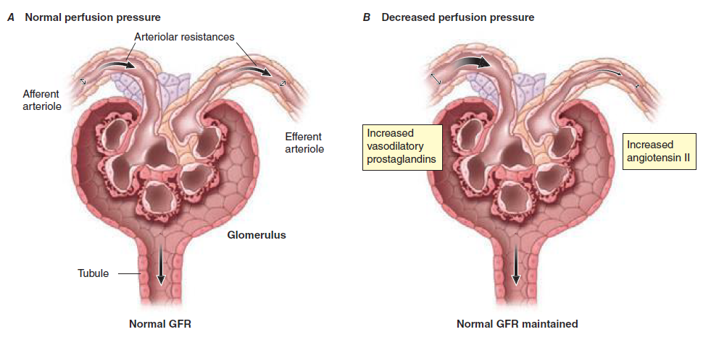

Slide 31
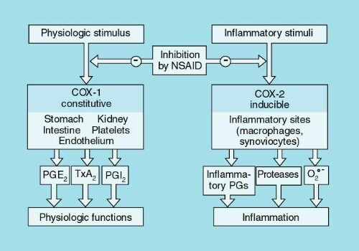

Slide 32
Background
Theoretically, COX-2 inhibitors are expected to be safer to conventional NSAIDs regarding renal toxicity. However, the previous reports are controversial.
Some favor COX-2 inhibitor, but others do not.
Arch Intern Med. 2000 May 22;160(10):1465-70
Am J Epidemiol. 2006 Nov 1;164(9):881-9.
Am J Med. 2008 Dec;121(12):1092-8.
Pharmacoepidemiol Drug Saf. 2009 Oct;18(10):923-31.
Am J Ther. 2000 May;7(3):159-75.
Ann Intern Med. 2000 Jul 4;133(1):1-9.
Eur J Intern Med. 2015 May;26(4):285-91.
BMC Nephrol. 2017 Aug 1;18(1):256.

Slide 33
Aim of the study
To compare the risk of acute kidney injury between conventional NSAIDs and COX-2 inhibitors in patients with osteoarthritis
Target cohort : COX-2 inhibitor users
Comparator cohort : Conventional NSAIDs users
Outcome : Acute kidney injury

Slide 34
Study design
First-user of COX-2 inhibitor or NSAIDs
Age >= 18
Without previous chronic kidney disease
Osteoarthritis within preceding one year
Endpoint
Acute Kidney Injury
Time at risk
Primary: On-treatment
Sensitivity analysis: Outcome during 30-day after drug initiation. Outcome within 30 days after stop of the drug
https://github.com/OHDSI/StudyProtocolSandbox/tree/master/COX2vsNSAIDsAKI

Slide 35
Study design
Statistics
Primary: 1:4 PS matching
Additional: PS stratification, Without matching
➔Conditional Cox regression
Covariates
Gender, age group, race, ethnicity, index year, index month, Condition group (1yr, 30day), Drug group (1yr, 30day), Procedure (1yr, 30day), Measurement (1yr), Device (1yr)
102 Negative controls
https://github.com/OHDSI/StudyProtocolSandbox/tree/master/COX2vsNSAIDsAKI

Slide 36
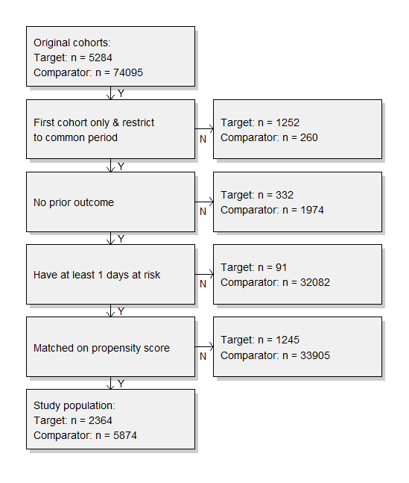
Result

Slide 38
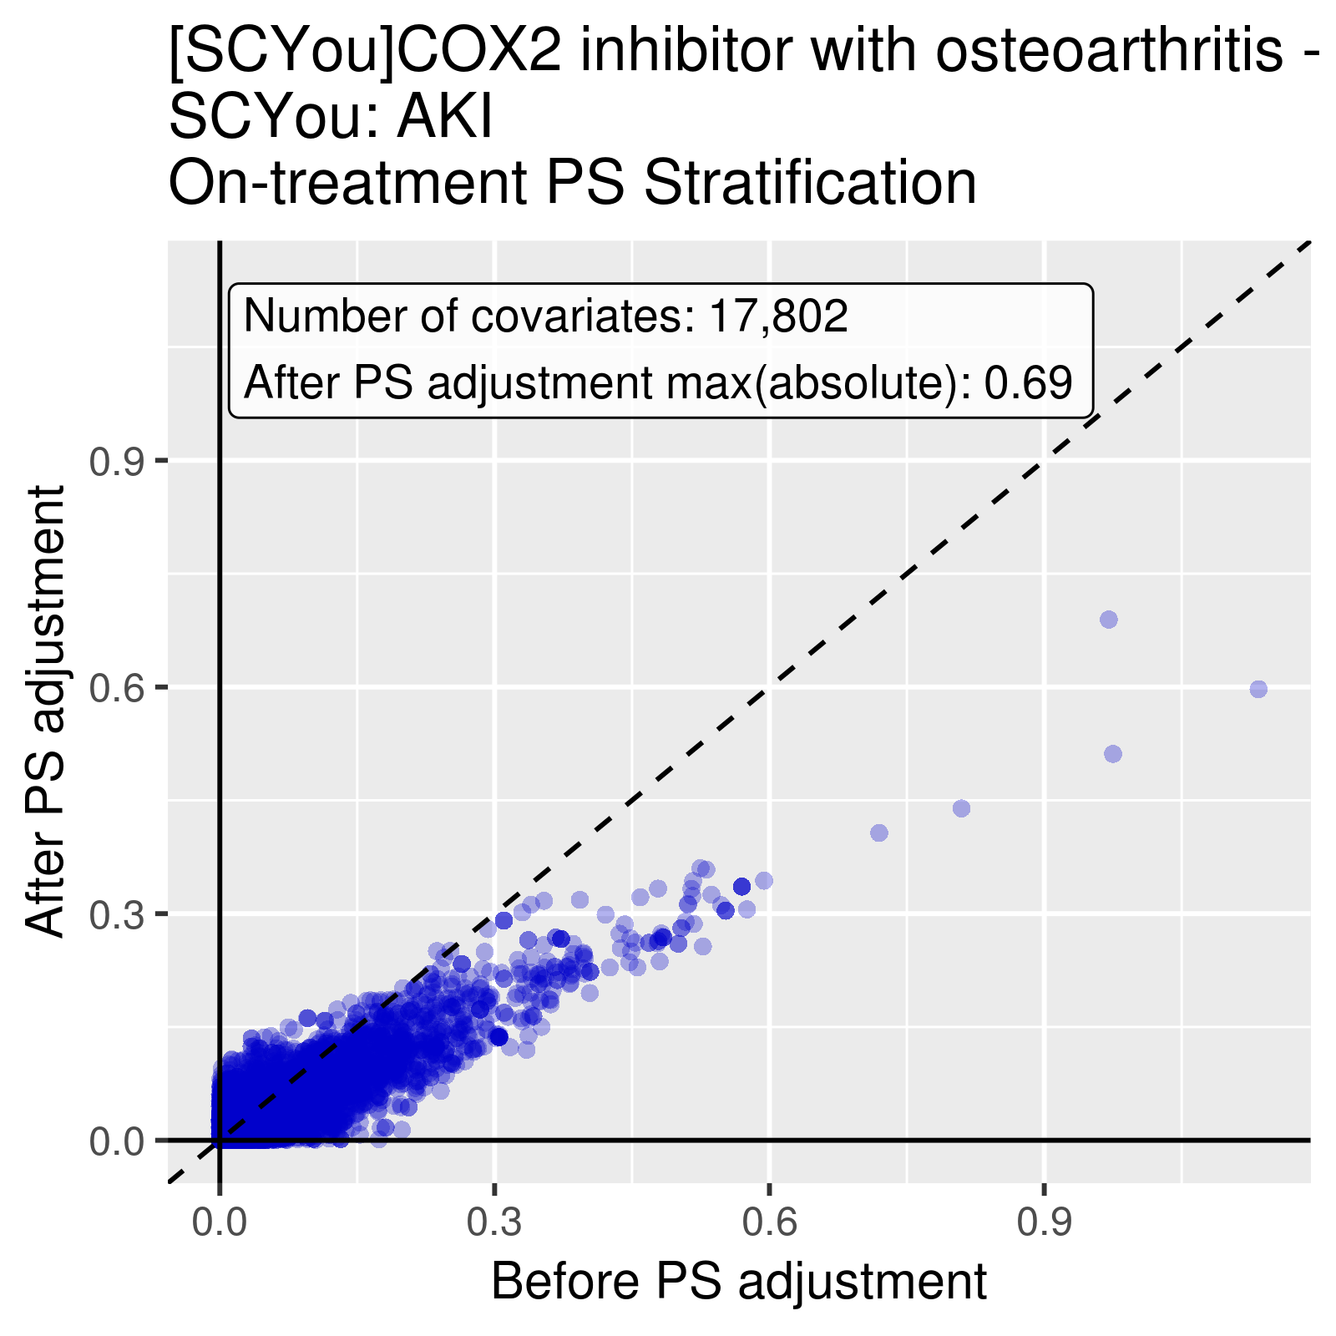

Slide 40
Negative controls

Slide 41
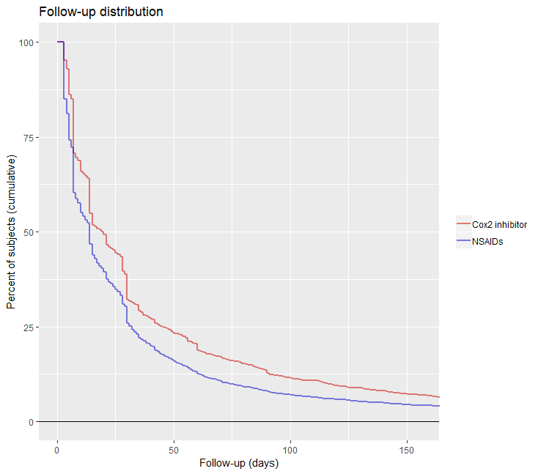

Slide 42
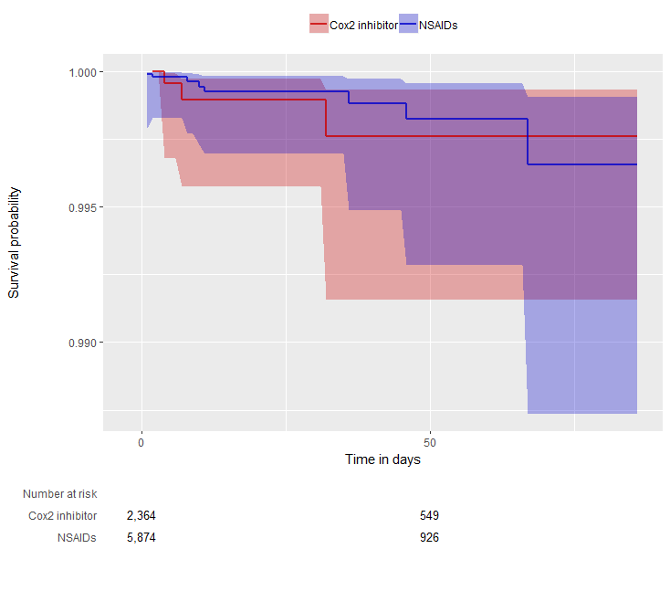
Result
Analysis Description | HR | p
On-treatment PS Matching | 1.16 | 0.874473
30day-After-treatment PS Matching | 0.57 | 0.338992
30-day PS matching | 0.87 | 0.82485
HR 1.16
p= 0.87

Slide 43
Conclusion
Inconclusive result identifying difference in risk of AKI between selective Cox-2 inhibitor and NSAIDs
This study should be replicated in larger database
Adding interaction term for elderlies and gender might be good

