Slide 1
Oncology WG Face-to-Face
May 5, 2018

Slide 2
Agenda
Detailed planning for the vocabulary tasks/subgroups
NAACR vocabulary integration and mapping, Nebraska Lexicon
Reconciling EMR and Cancer Registry diagnoses
QA of the ICD-O to SNOMED mappings

Slide 3
Vocabulary Tasks
Diagnoses
Finish of the ICD-O to SNOMED mappings
QA of the ICD-O to SNOMED mappings
Diagnostic features
Map between NAACCR and Nebraska Lexicon
Collaboratively develop Nebraska Lexicon
Add to the OMOP vocab
Treatment, chemotherapy
Compare and choose between SEER/NCI and RxNorm cancer drug classifications, implement additional classification if decided
Add NCCN cancer drug regimens to the OMOP vocab
Treatment, radiotherapy
Add NCI radiotherapy classification into OMOP vocab
Treatment, surgery
Choose vocabulary to provide classifiers: ICD-10 vs. SNOMED based on IMO CPT-SNOMED mappings
Add to the OMOP vocab

Slide 4
Nebraska Lexicon
Based on CAP Cancer Protocol Templates
Issued by CAP (College of American Pathologists)
Provide guidelines for collecting the essential data elements for complete reporting of malignant tumors for 88 cancer types
Include pathological findings and genomic biomarkers
Use standardized terminologies
Works under the umbrella of LOINC-SNOMED CT compatible observables harmonization of content between LOINC® and SNOMED CT®
Intends to implement CAP Protocol Templates by providing terminology binding between LOINC and SNOMED CT
The majority of the associated terminology development is modeled within SNOMED 363787002|Observable entity| hierarchy. Coded LOINC observables are linked to SNOMED value sets.
Status: Developed for breast and colorectal cancers

Slide 5
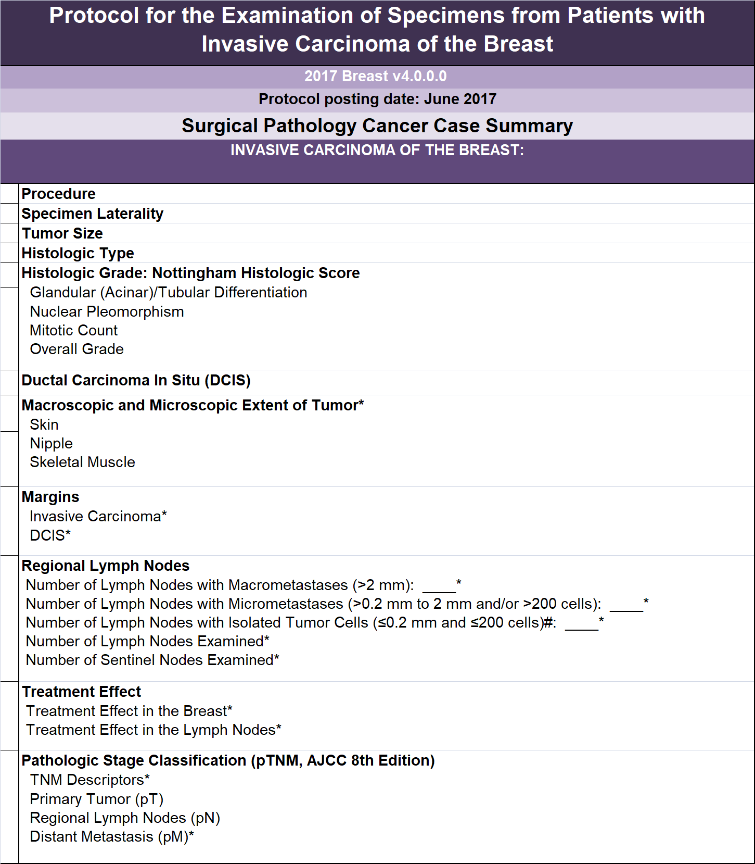
CAP Protocol for Invasive Breast Cancer

Slide 6
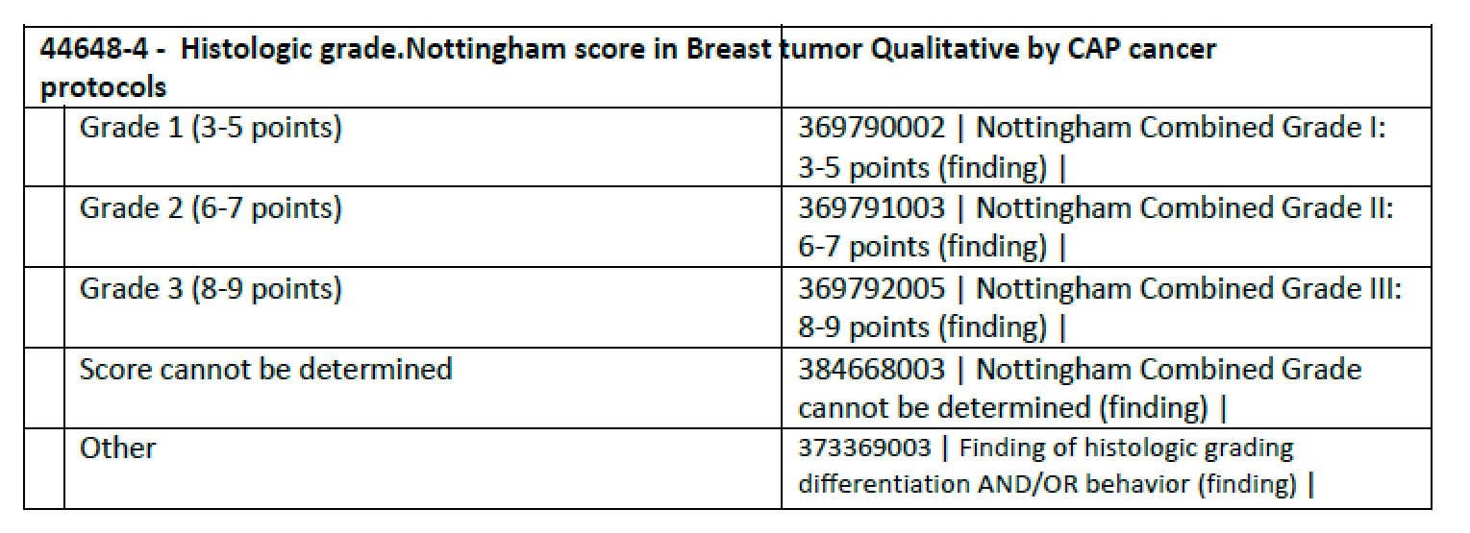
Examples of terminology binding between LOINC and SNOMED CT

Slide 7
Source Data, Feb 2017
Cancer Registry

Slide 8
In OMOP CDM, Cancer_Modifier table
Field | Record 1 | Record 2 | Record 3 | Record 4 | Record 5 | Record 6 | Record 7 | Record 8 | Comments
cancer_modifier_id | 123456 | 123456 | 123457 | 123458 | 123456 | 123457 | 123458 | 123458
event_occurrence_id | 123467 | 123467 | 123467 | 123467 | 123467 | 123467 | 123467 | 123467 | A foreign key to Condition_Occurrence table.
event_concept_id | 44819012 | 44819012 | 44819012 | 44819012 | 44819012 | 44819012 | 44819012 | 44819012 | Concept ID for ‘CONDITION_OCCURRENCE’. Needs to be verified.
person_id | 99999999 | 99999999 | 99999999 | 99999999 | 99999999 | 99999999 | 99999999 | 99999999
cancer_modifier_concept_id | 4152526 | (85298-8) | 3013500 | (85343-2) | 3047285 | 40769840 | 40769841 | 40769842
cancer_modifier_concept_name | Occurrence | Body structure included in specimen | Regional lymph nodes examined [#] Cancer | Lymph nodes with macrometastases | Histologic grade.Nottingham score in Breast tumor Qualitative by CAP cancer protocols | TNM pathologic staging - primary tumor - T [PhenX] | TNM pathologic staging - nodal involvement - N [PhenX] | TNM pathologic staging - distant metastases - M [PhenX]
cancer_modifier_date | 11/12/2016 | 11/12/2016 | 11/12/2016 | 11/12/2016 | 11/12/2016 | 11/12/2016 | 11/12/2016 | 11/12/2016
cancer_modifier_datetime
cancer_modifier_type_concept_id | Cancer Registry | Cancer Registry | Cancer Registry | Cancer Registry | Cancer Registry | Cancer Registry | Cancer Registry | Cancer Registry | New concept ID to be created
value_as_number | 1 |  | 2 | 0
value_as_concept_id |  | 4197399 |  |  | 4241172 | 4300144 | 436121000124104 | 4134634
value_as_concept_name |  | Left breast structure |  |  | Nottingham Combined Grade III: 8-9 points | pT category finding | No regional lymph node metastasis histologically | No metastases
provider_id | 555555 | 555555 | 555555 | 555555 | 555555 | 555555 | 555555 | 555555
cancer_modifier_source_value | Occurrence number | TM_LATERALITY_CD | TM_REGNODE_EXM_NO | TM_REGNODE_POS_NO | TM_HIST_CD_GRADE | TM_PATH_TNM_T | TM_PATH_TNM_N | TM_PATH_TNM_M
cancer_modifier_source_concept_id
value_source_value | 1 | 2 | 2 | 0 | 9 | Tp1MI | Np0I- | Mc0

Slide 9
Implementation in the OMOP Vocabulary
Add NAACCR Vocabulary and Concepts
Non-standard
For implemented cancer types
Create mappings between NAACCR concepts and Nebraska recommended concepts
Add Nebraska terminology relationships for implemented cancer types
For new cancer types
Collaborate with UNMS
Create OMOP relationships for other cancer types based on CAP Protocol Templates
Choose SNOMED/LOINC pairs based on CAP Protocol Templates
Create NAACR mappings
Create OMOP relationships
Replace OMOP relationships with Nebraska as they get vetted

Slide 10
References
CAP Protocol Templates
http://www.cap.org/web/oracle/webcenter/portalapp/pagehierarchy/cancer_protocol_templates.jspx
Nebraska Lexicon
https://www.unmc.edu/pathology/informatics/tdc.html
FORDS
https://www.facs.org/~/media/files/quality%20programs/cancer/ncdb/fords%202016.ashx

Slide 11
Additional vocabulary to support CDM representation
Add domain “Condition Modifier”
To annotate condition modifier concepts
Add class “Cancer Modifier”
To annotate cancer modifier concepts
Add concept types: “Cancer Registry”, “Pathology Report”
To represent provenance of cancer data

