Slide 1
Population-level estimation WG Building the Large Evidence Generator
Martijn Schuemie

Slide 2
Problem with current science
Effect size

Slide 3
Problem with current science
Effect size
Lack of evidence on small / null effects

Slide 4
Problem with current science
Suspicious cutoff at p=0.05
Publication bias (leads to false positives)
P-hacking (leads to false positives)
Study bias (leads to false positives)
Effect size

Slide 5
Problem with current science

Slide 6
Problem with current science
Very little evidence for a specific topic
(e.g. depression treatments)

Slide 7
Proposed solution
Define a large set of related research questions
Indication depression
Treatments n = 17
Treatments pairs n = 272
Outcomes n = 22
Research questions n = 5,984
Select negative controls
& synthesize positive controls
Negative controls n = 52 per treatment pair
Positive controls n = 156 per treatment pair
Control questions n = 56,266
Systematic observational research process
Select study population
e.g. excluding subjects with prior outcome
Create propensity scores
Stratify by propensity scores
Fit outcome (survival) model
Effect size estimates n = 5,984
Control estimates n = 56,266
Calibration models n = 272
Calibrated estimates n = 5,984
Evaluate & calibrate

Slide 8
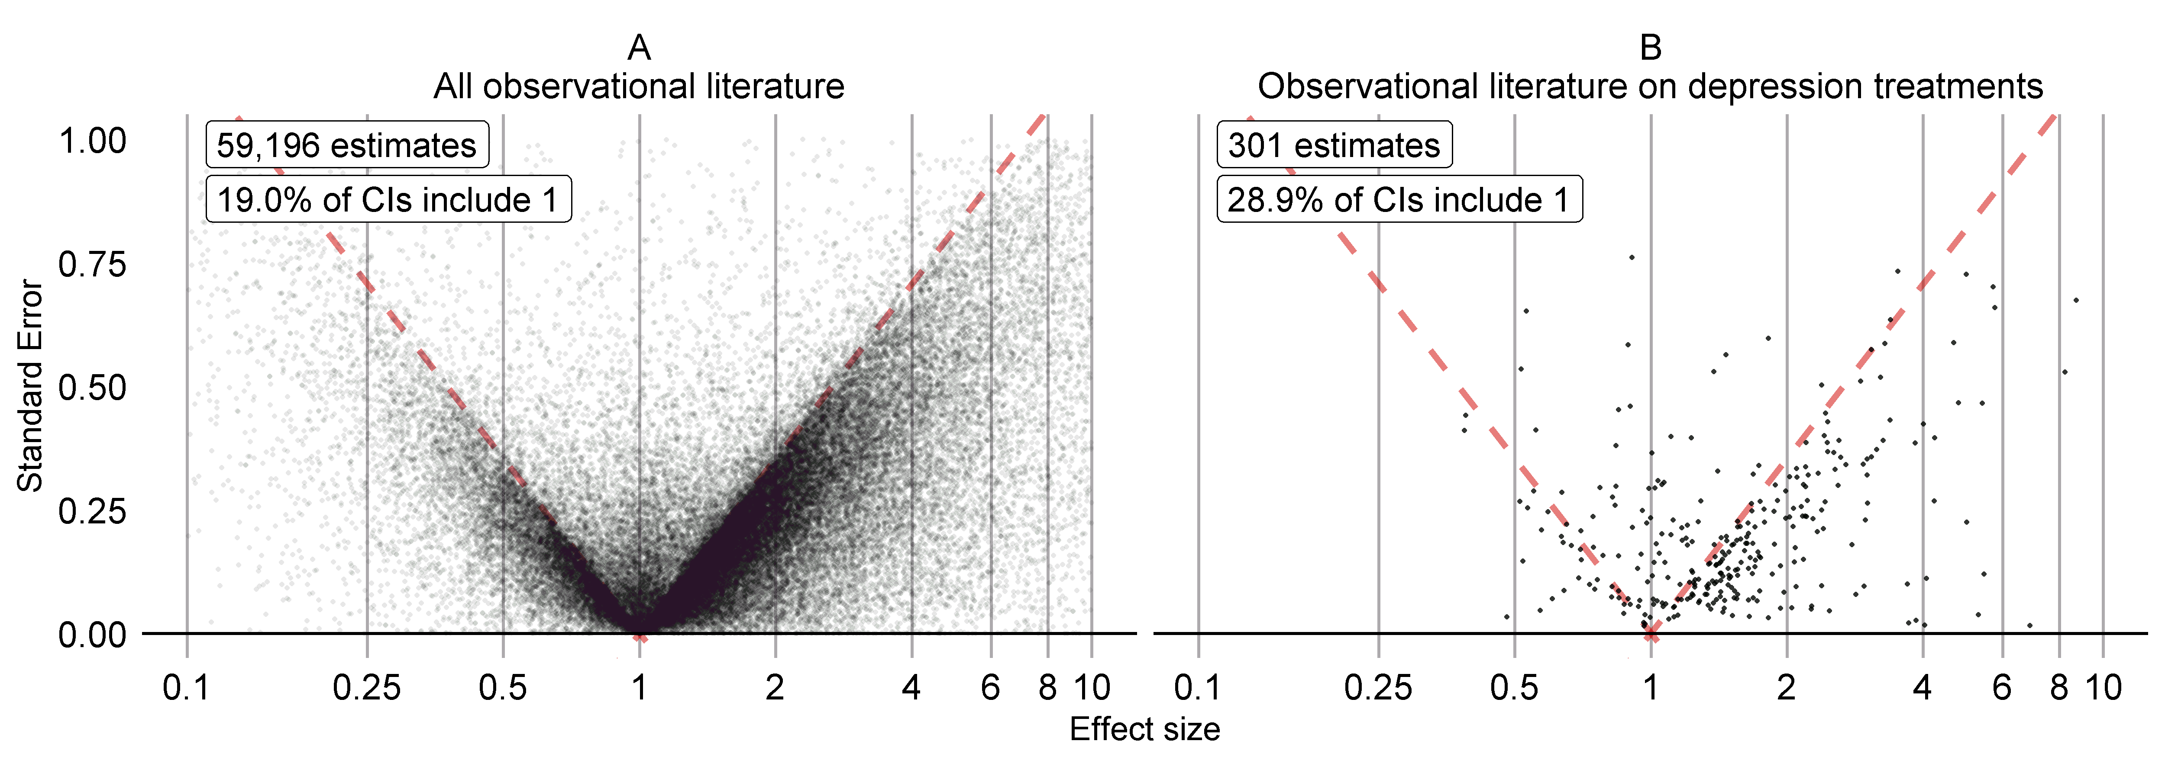
Results of proposed solution
Includes information on small effect sizes
Study bias assessed using negative and positive controls
No p-hacking, no publication bias

Slide 9
Science at its best!
Or is it?
Paper formally or informally submitted to:
Science: rejected after review
Nature: rejected by editor
BMJ: rejected after review
NEJM: rejected by editor
Science TM: rejected by editor
PLOS Medicine: rejected by editor
Annals of Internal Medicine: soft reject by editor
Philosophical Transactions: under review

Slide 10
Building OHDSIs LHC

Slide 11
Large Evidence Generator
Large Evidence Generator
Research questions
Evidence
base
Methods
Databases
HOMER
‘Weather Channel’
Papers

Slide 12
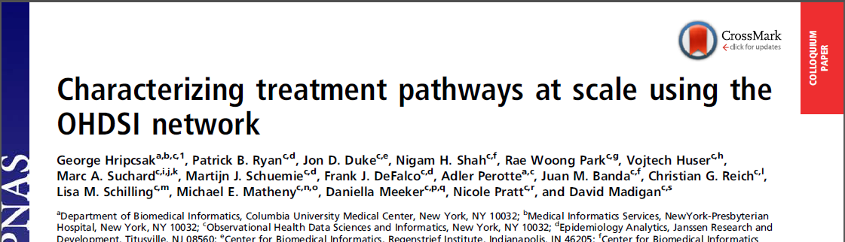
Research questions
Large Evidence Generator
Currently: Depression treatments
Next:
Hypertension treatments
Type 2 Diabetes treatments
?
Research questions
Methods
Databases

Slide 13
Methods
Large Evidence Generator
Currently: New-user cohort + large scale PS + empirical calibration
Next:
Larger variety of time-at-risk windows
CSCCS?
Probabilistic phenotypes?
Meta-analysis?
?
Driven by defined best practices
Those are driven by empirical evaluation
Research questions
Methods
Databases

Slide 14
Databases
Large Evidence Generator
Currently: 4 US insurance databases
Next:
OHDSI network?
Sites must have computational resources
Minimum data quality requirements?
Research questions
Methods
Databases

Slide 15
Evidence generation runs
Large Evidence Generator
At each new run:
Run all or some of the questions
Using latest methods
On all or some of the databases
Research questions
Methods
Databases

Slide 16
Organization
We need
A decision making process to decide on
Questions
Methods
Databases
Researchers to work on the questions and methods
Infrastructure at each database site
Funding for partners
Grants

Slide 17
Acronym
LEGEND
Large-scale
Evidence
Generation and
Evaluation in a
Network of
Databases

Slide 18
Topic of next meeting(s)?
Chan:
PS matching and balance of hidden variables
‘MySpace’ for Korean researchers
?

Slide 19
Next workgroup meeting
Eastern hemisphere: April 4
3pm Hong Kong / Taiwan
4pm South Korea
5:30pm Adelaide
8am Central European time
7am UK time
Western hemisphere: March 15
6pm Central European time
12pm New York
9am Los Angeles / Stanford
http://www.ohdsi.org/web/wiki/doku.php?id=projects:workgroups:est-methods

