Slide 1
FAQs from researchers and the answers of mine for OHDSI study pipeline
Seng Chan You

Slide 2
FAQ
1. Why don’t we just pool the data?
Pooled data vs. Meta-analysis approach
Synonyms: 1 stage vs. 2 stage meta-analysis
2. Why should we use large scale propensity score matching?

Slide 3
FAQ
1. Why don’t we just pool the data?
Pooled data analysis vs. Meta-analysis approach
Synonyms: 1 stage vs. 2 stage meta-analysis
2. Why should we use large scale propensity score matching?

Slide 4
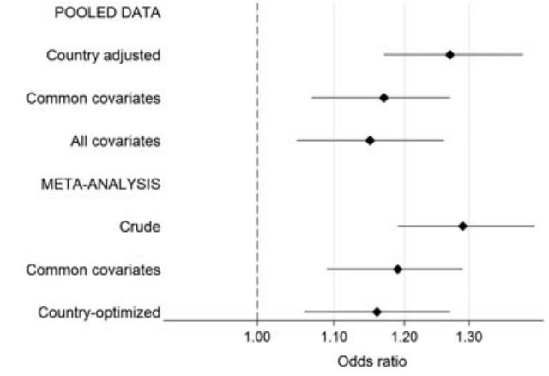
1st A: Pros for two-stage meta-analysis

Slide 5
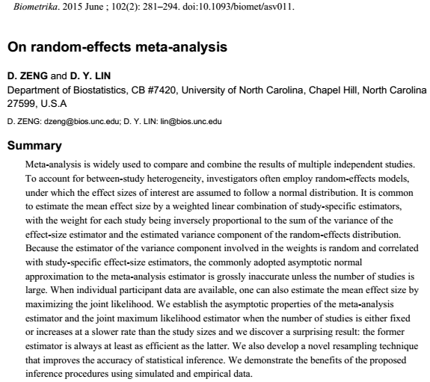
1st A: Pros for two-stage meta-analysis
Zeng and Lin. Biometrika (2015)
Notes:
Zeng and Lin. Biometrika (2015)

Slide 6
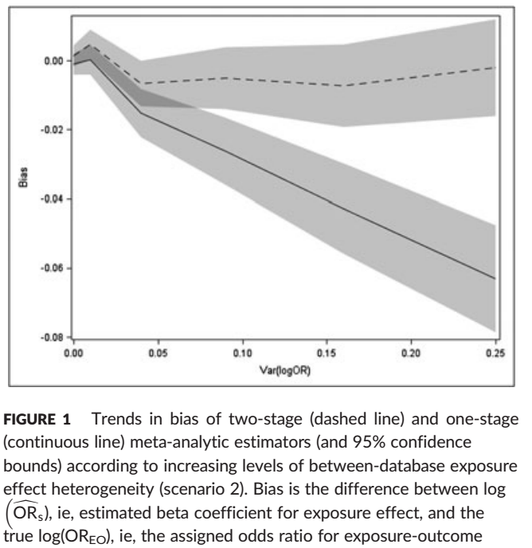
1st A: Pros for two-stage meta-analysis
When the effect of interest is heterogeneous, a one‐stage meta‐analysis ignoring clustering gives biased estimates.
Two‐stage meta‐analysis generates estimates at least as accurate and precise as one‐stage meta‐analysis.
La Gamba et al., Pharmacoepidemiology and Drug Safety (2017)
Notes:
La Gamba et al., Pharmacoepidemiology and Drug Safety (2017)
When the effect of interest is heterogeneous, a one‐stage meta‐analysis ignoring clustering gives biased estimates. Two‐stage meta‐analysis generates estimates at least as accurate and precise as one‐stage meta‐analysis. However, in a study using small databases and rare exposures and/or outcomes, a correct one‐stage meta‐analysis becomes essential

Slide 7
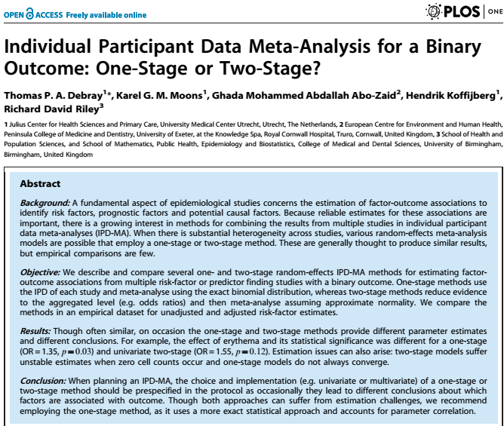
1st A: Cons for two-stage meta-analysis
Debray et al., Plos ONE (2013)
Notes:
La Gamba et al., Pharmacoepidemiology and Drug Safety (2017)
When the effect of interest is heterogeneous, a one‐stage meta‐analysis ignoring clustering gives biased estimates. Two‐stage meta‐analysis generates estimates at least as accurate and precise as one‐stage meta‐analysis. However, in a study using small databases and rare exposures and/or outcomes, a correct one‐stage meta‐analysis becomes essential

Slide 8
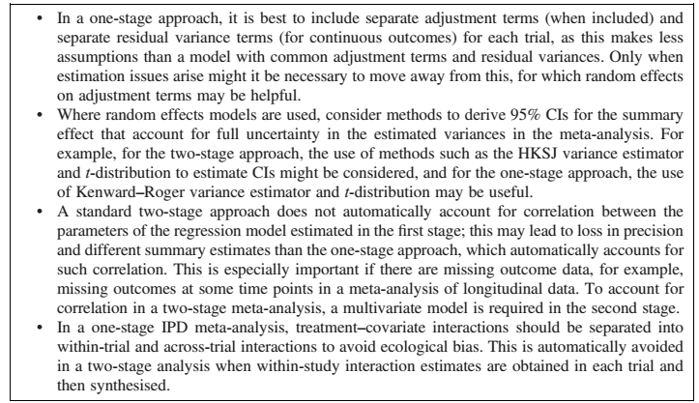
1st A: Recommendation
Burke et al., Statistics in Medicine (2016)
Notes:
La Gamba et al., Pharmacoepidemiology and Drug Safety (2017)
When the effect of interest is heterogeneous, a one‐stage meta‐analysis ignoring clustering gives biased estimates. Two‐stage meta‐analysis generates estimates at least as accurate and precise as one‐stage meta‐analysis. However, in a study using small databases and rare exposures and/or outcomes, a correct one‐stage meta‐analysis becomes essential

Slide 9
1st Q: Pros and Cons
Burke et al., Statistics in Medicine (2016)
Notes:
La Gamba et al., Pharmacoepidemiology and Drug Safety (2017)
When the effect of interest is heterogeneous, a one‐stage meta‐analysis ignoring clustering gives biased estimates. Two‐stage meta‐analysis generates estimates at least as accurate and precise as one‐stage meta‐analysis. However, in a study using small databases and rare exposures and/or outcomes, a correct one‐stage meta‐analysis becomes essential

Slide 10
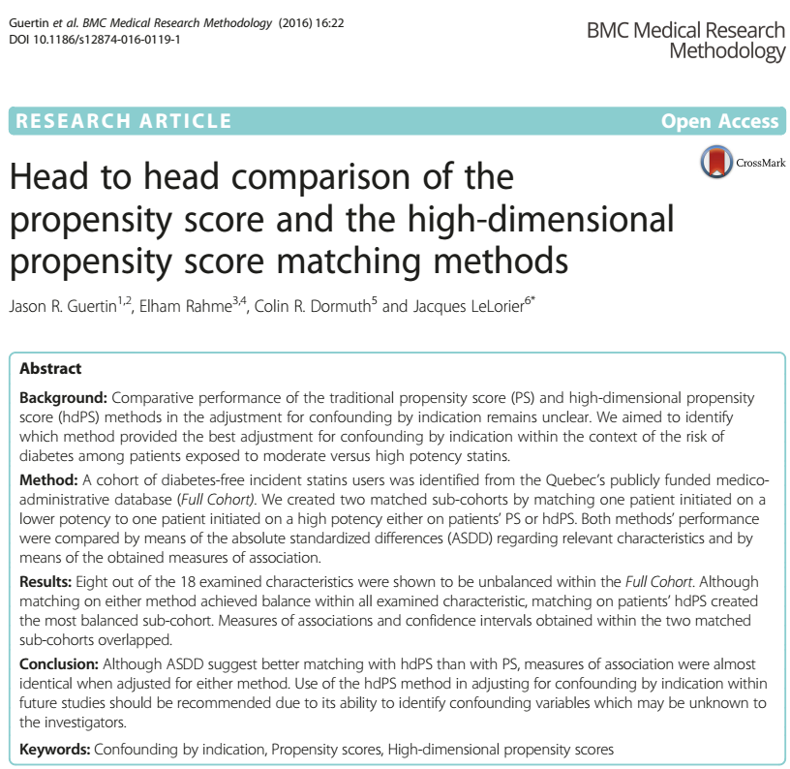
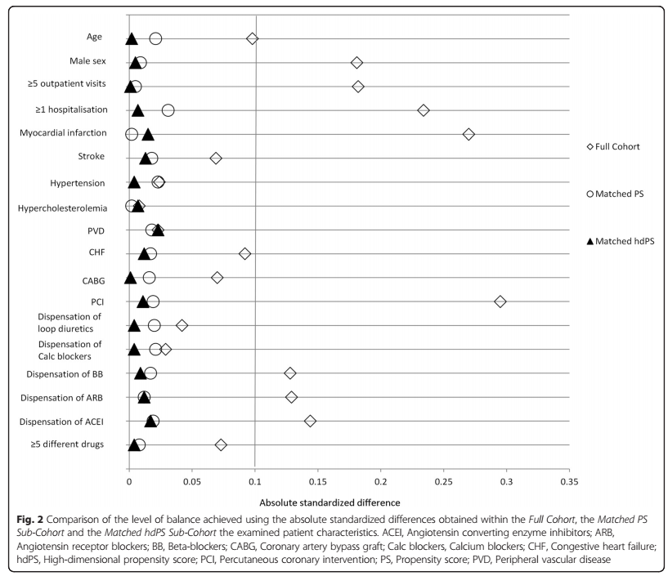
2nd A: Evidence for high-dimensional propensity score matching
Guertin et al., BMC Medical Research Methodology, 2016
Notes:
Guertin, Jason R., Elham Rahme, Colin R. Dormuth, and Jacques LeLorier. “Head to Head Comparison of the Propensity Score and the High-Dimensional Propensity Score Matching Methods.” BMC Medical Research Methodology 16 (February 19, 2016). doi:10.1186/s12874-016-0119-1.

Slide 11
FAQ
1. Why don’t we just pool the data?
Pooled data vs. Meta-analysis approach
Synonyms: 1 stage vs. 2 stage meta-analysis
2. Why should we use large scale propensity score matching?

Slide 12
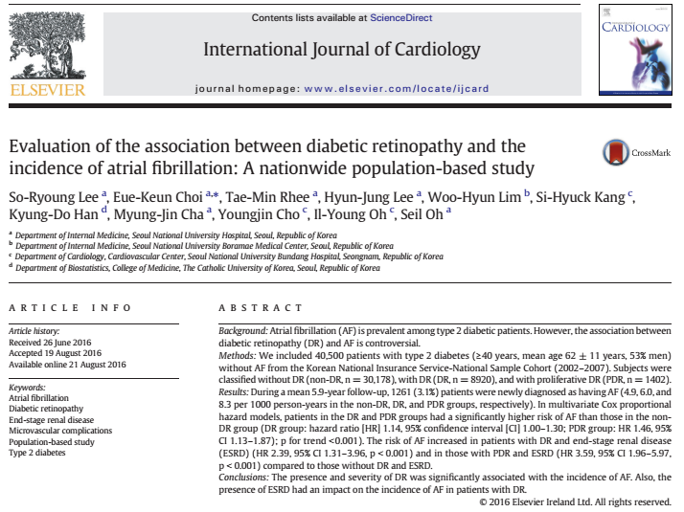
2nd A: Experience from replica study
Lee et al., International Journal of Cardilogy, 2016
Notes:
Guertin, Jason R., Elham Rahme, Colin R. Dormuth, and Jacques LeLorier. “Head to Head Comparison of the Propensity Score and the High-Dimensional Propensity Score Matching Methods.” BMC Medical Research Methodology 16 (February 19, 2016). doi:10.1186/s12874-016-0119-1.

Slide 13
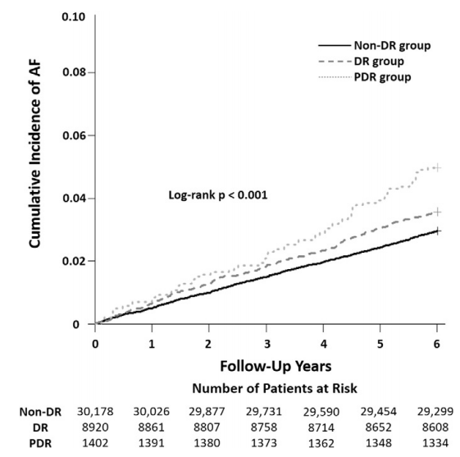
2nd A: Experience from replica study
Target: Type 2 DM with diabetic retinopathy
Comparator: Type 2 DM without diabetic retinopathy
Outcome: incident atrial fibrillation
Adjusted for
HTN, HF, COPD, MI, Stroke, ESRD
Lee et al., International Journal of Cardilogy, 2016
Notes:
Guertin, Jason R., Elham Rahme, Colin R. Dormuth, and Jacques LeLorier. “Head to Head Comparison of the Propensity Score and the High-Dimensional Propensity Score Matching Methods.” BMC Medical Research Methodology 16 (February 19, 2016). doi:10.1186/s12874-016-0119-1.

Slide 14
2nd A: Experience from replica study
HR : 1.13 (CI: 0.93-1.37)
Notes:
Guertin, Jason R., Elham Rahme, Colin R. Dormuth, and Jacques LeLorier. “Head to Head Comparison of the Propensity Score and the High-Dimensional Propensity Score Matching Methods.” BMC Medical Research Methodology 16 (February 19, 2016). doi:10.1186/s12874-016-0119-1.

Slide 15
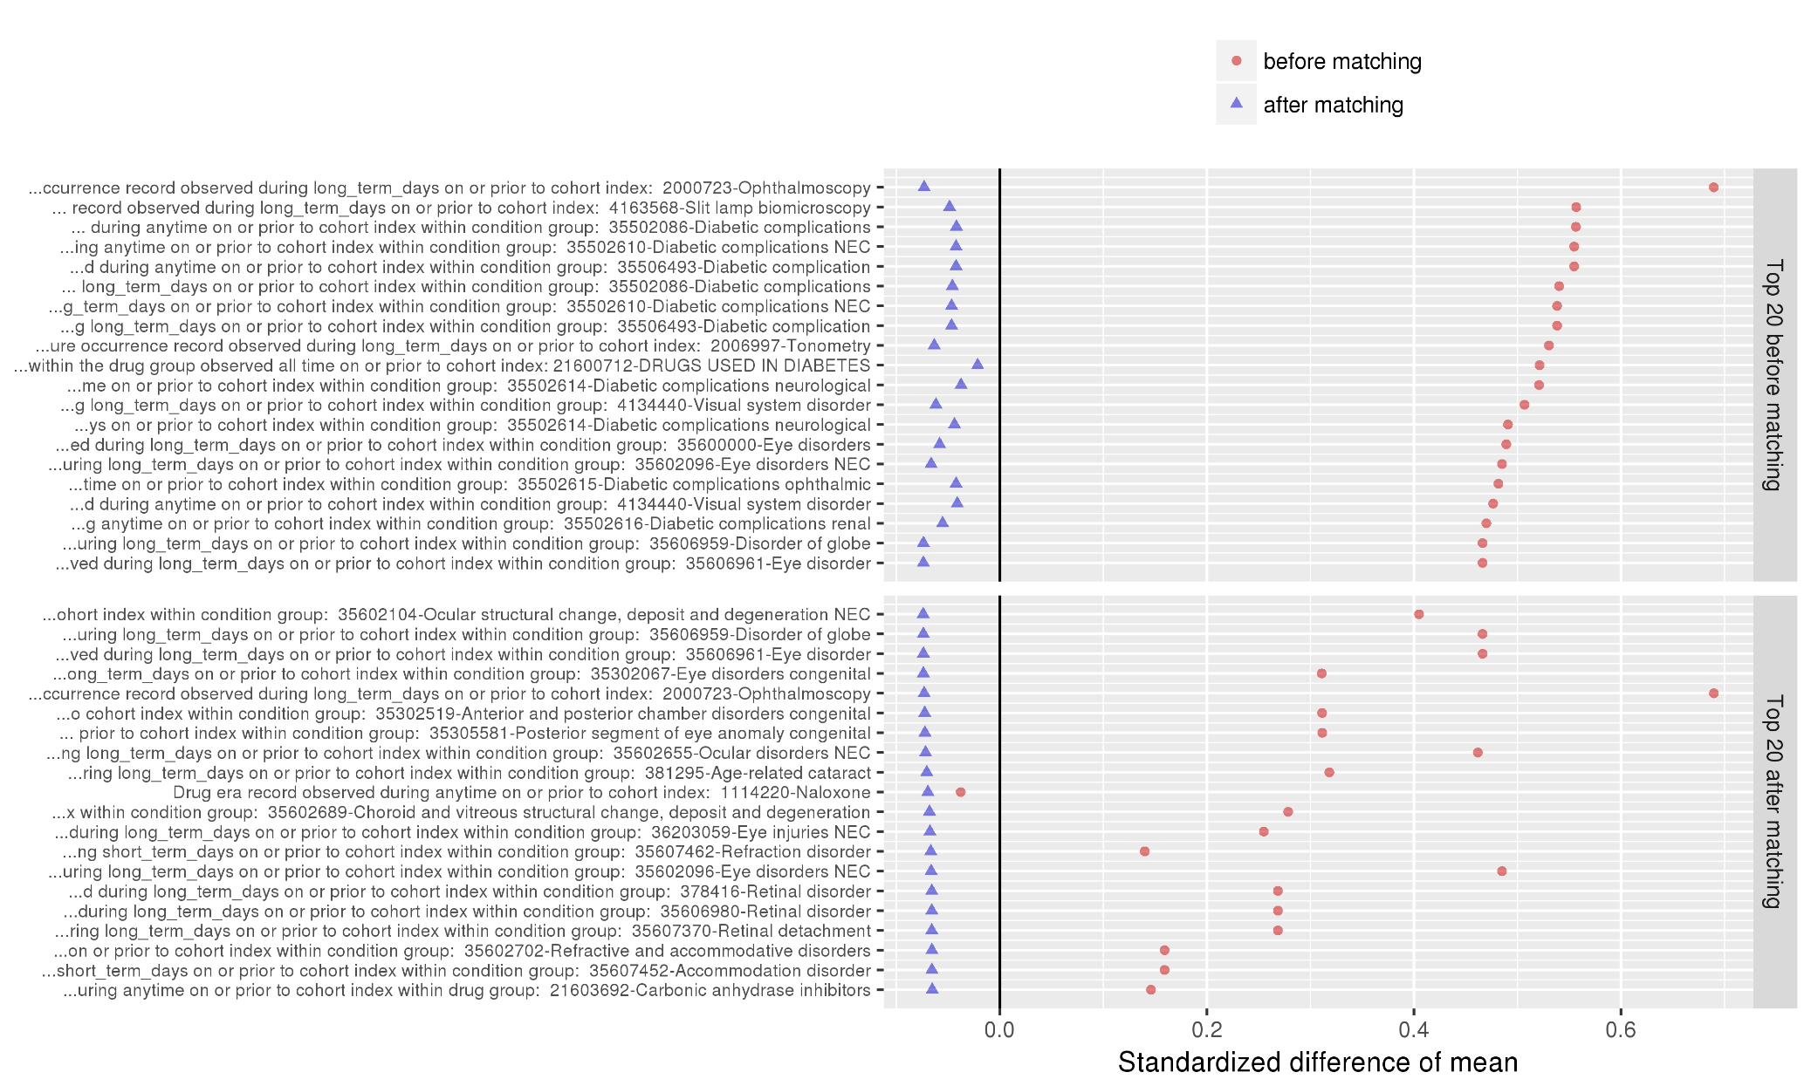
2nd A: Experience from replica study

Slide 16
2nd A: Experience from replica study
Human can miss important confounding factors.

Slide 17
1st Save Our Sisyphus in Korea challenge
Seng Chan You

Slide 18
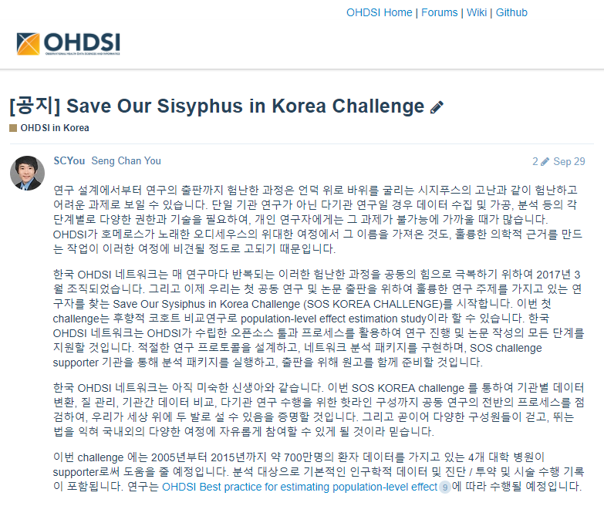
Save Our Sisyphus in Korea
Data supporters
Four tertiary institutions in Korea
2005~2015
Total of 7,000,000 patients
Launch data: 29th Nov 2017
Due date: 18th Nov 2017
Total of 37 research questions were submitted
Two research questions were selected
http://forums.ohdsi.org/t/save-our-sisyphus-in-korea-challenge/3373

Slide 19
Renal toxicity risk between NSAIDs and COX-2 inhibitors
Leader: Ji In Park, MD
Kangwon National University Hospital
Background: Although it is evident that non-steroidal anti-inflammatory drugs (NSAIDs) can cause acute kidney injury, the risk for renal dysfunction of cyclooxygenase-2 (COX-2) inhibitors is controversial. The aim of this study is to compare the risk of acute kidney injury between COX-2 inhibitor and conventional NSAIDs in the large population.
Target Cohort: COX-2 inhibitor users
Comparator Cohort: Conventional NSAIDs users
Outcome: Emergency department admission or admission due to acute kidney injury
Relative risk metrics: Cox proportional hazard

Slide 20
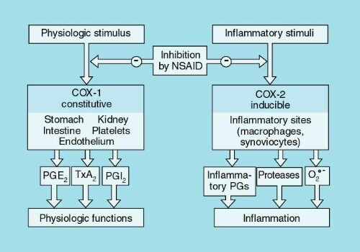
Background
Generally, NSAIDs are commonly associated with renal toxicity

Slide 21
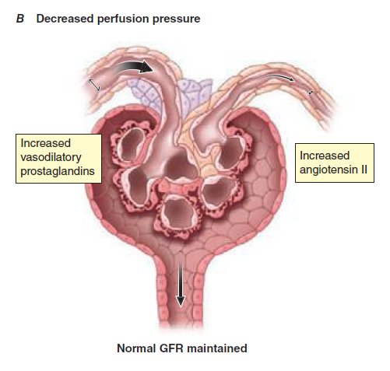
Background
Generally, NSAIDs are commonly associated with renal toxicity

Slide 22
Background
Theoretically, selective COX-2 inhibitors are expected to be safer than conventional NSAIDs regarding to renal toxicity.
COX-2 inhibitor

Slide 23
Background
Theoretically, selective COX-2 inhibitors are expected to be safer than conventional NSAIDs regarding to renal toxicity.
However, the evidences are controversial.
Some favor COX-2 inhibitor, but others do not.
Arch Intern Med. 2000 May 22;160(10):1465-70
Am J Epidemiol. 2006 Nov 1;164(9):881-9.
Am J Med. 2008 Dec;121(12):1092-8.
Pharmacoepidemiol Drug Saf. 2009 Oct;18(10):923-31.
Am J Ther. 2000 May;7(3):159-75.
Ann Intern Med. 2000 Jul 4;133(1):1-9.
Eur J Intern Med. 2015 May;26(4):285-91.
BMC Nephrol. 2017 Aug 1;18(1):256.
Notes:
Theoretically, COX-2 inhibitors are expected to be safer to conventional NSAIDs regarding renal toxicity. However, the previous reports are controversial.

Slide 24
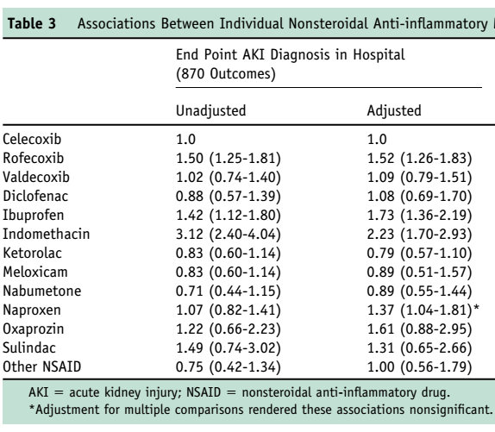
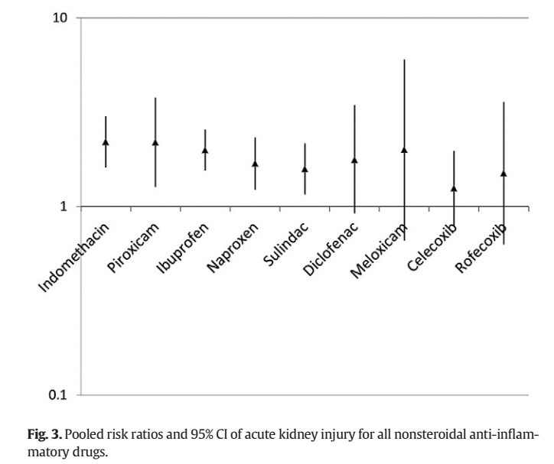
Background
However, the evidences are controversial.
Some favor COX-2 inhibitor, but others do not.
Am J Med. 2008 Dec;121(12):1092-8.
Eur J Intern Med. 2015 May;26(4):285-91.
Notes:
Theoretically, COX-2 inhibitors are expected to be safer to conventional NSAIDs regarding renal toxicity. However, the previous reports are controversial.

Slide 25
AIM
To compare the risk of acute kidney injury between conventional nonsteroidal anti-inflammatory drugs (NSAIDs) and selective cyclooxygenase-2 (COX-2) inhibitors.
Analysis will be conducted in two ways
Hospital EHR: using measurement table (Defining cohort with serum creatinine level)
Claim Data: without using measurement table (Defining cohort with only conditions)
Notes:
To compare the risk of acute kidney injury between conventional nonsteroidal anti-inflammatory drugs (NSAIDs) and selective cyclooxygenase-2 (COX-2) inhibitors.

Slide 26
Method: Two kinds of Data sources
Hospital EHR
7 M patients from 4 hospitals in Korea
Claim data
NHIS-national sample cohort (NHIS-NSC) DB
Consecutive observation for 1M patients between 2002-2013
Lee et al.,
Int J Epidemiol. 2016

Slide 27
Method: Inclusion algorithm (Claim)
Target Cohort
Adults (>=18 years) who initiated selective COX2 inhibitors
With continuous observation at least 365 days before and 30 days after event index date: all events per person
Without COX-2 inhibitors during previous 30 days
Without NSAIDs 30 days before and 30 days after event index date
Comparator Cohort
Adults (>=18 years) who initiated conventional NSAIDs
With continuous observation at least 365 days before and 30 days after event index date: all events per person
Without conventional NSAIDs inhibitors during previous 30 days
Without COX2 inhibitor 30 days before and 30 days after event index date
Notes:
Shouldn’t we exclude CKD patietns?

Slide 28
Method: Outcome (Claim)
Outcome Cohort
Acute kidney injury diagnosed in Emergency room or inpatient settings

Slide 29
Method: Inclusion algorithm (Hospital)
Target Cohort
Adults (>=18 years) who initiated selective COX2 inhibitors
With continuous observation at least 0 days before and 30 days after event index date: all events per person
Without COX-2 inhibitors during previous 30 days
Without NSAIDs 30 days before and 30 days after event index date
With Normal Creatinine level (serum Cr <1.5) during previous 90 days
Comparator Cohort
Adults (>=18 years) who initiated conventional NSAIDs
With continuous observation at least 0 days before and 30 days after event index date: all events per person
Without conventional NSAIDs inhibitors during previous 30 days
Without COX2 inhibitor 30 days before and 30 days after event index date
With Normal Creatinine level (serum Cr <1.5) during previous 90 days
Notes:
Shouldn’t we exclude CKD patietns?

Slide 30
Method: Outcome (Hospital)
Outcome Cohort
Acute kidney injury diagnosed with serum Creatinine elevation (Serum Cr > 1.5 from 30 days before to 30 days after the index date)
Unit for serum creatinine should be added

Slide 31
Method: Statistics
Large scale propensity score matching
Max Ratio: 1:4
Poisson regression with stratification
Time at risk: 1 day after cohort start ~ 30 days from cohort start
Remove both cohort: No
Remove patients with prior outcome: Yes
Sensitivity analysis
Further ITT analysis is planned
Wiki http://www.ohdsi.org/web/wiki/doku.php?id=research:risk_of_acute_kidney_injury_between_conventional_nsaids_and_selective_cox-2_inhibitors#code
Github https://github.com/OHDSI/StudyProtocolSandbox/tree/master/NSAIDsVsCoxib_AKI
Notes:
Martijn J. Schuemie, Marc A. Suchard and Patrick B. Ryan (2017). CohortMethod: New-user cohort method with large scale propensity and outcome models. R package version 2.4.3.

Slide 32
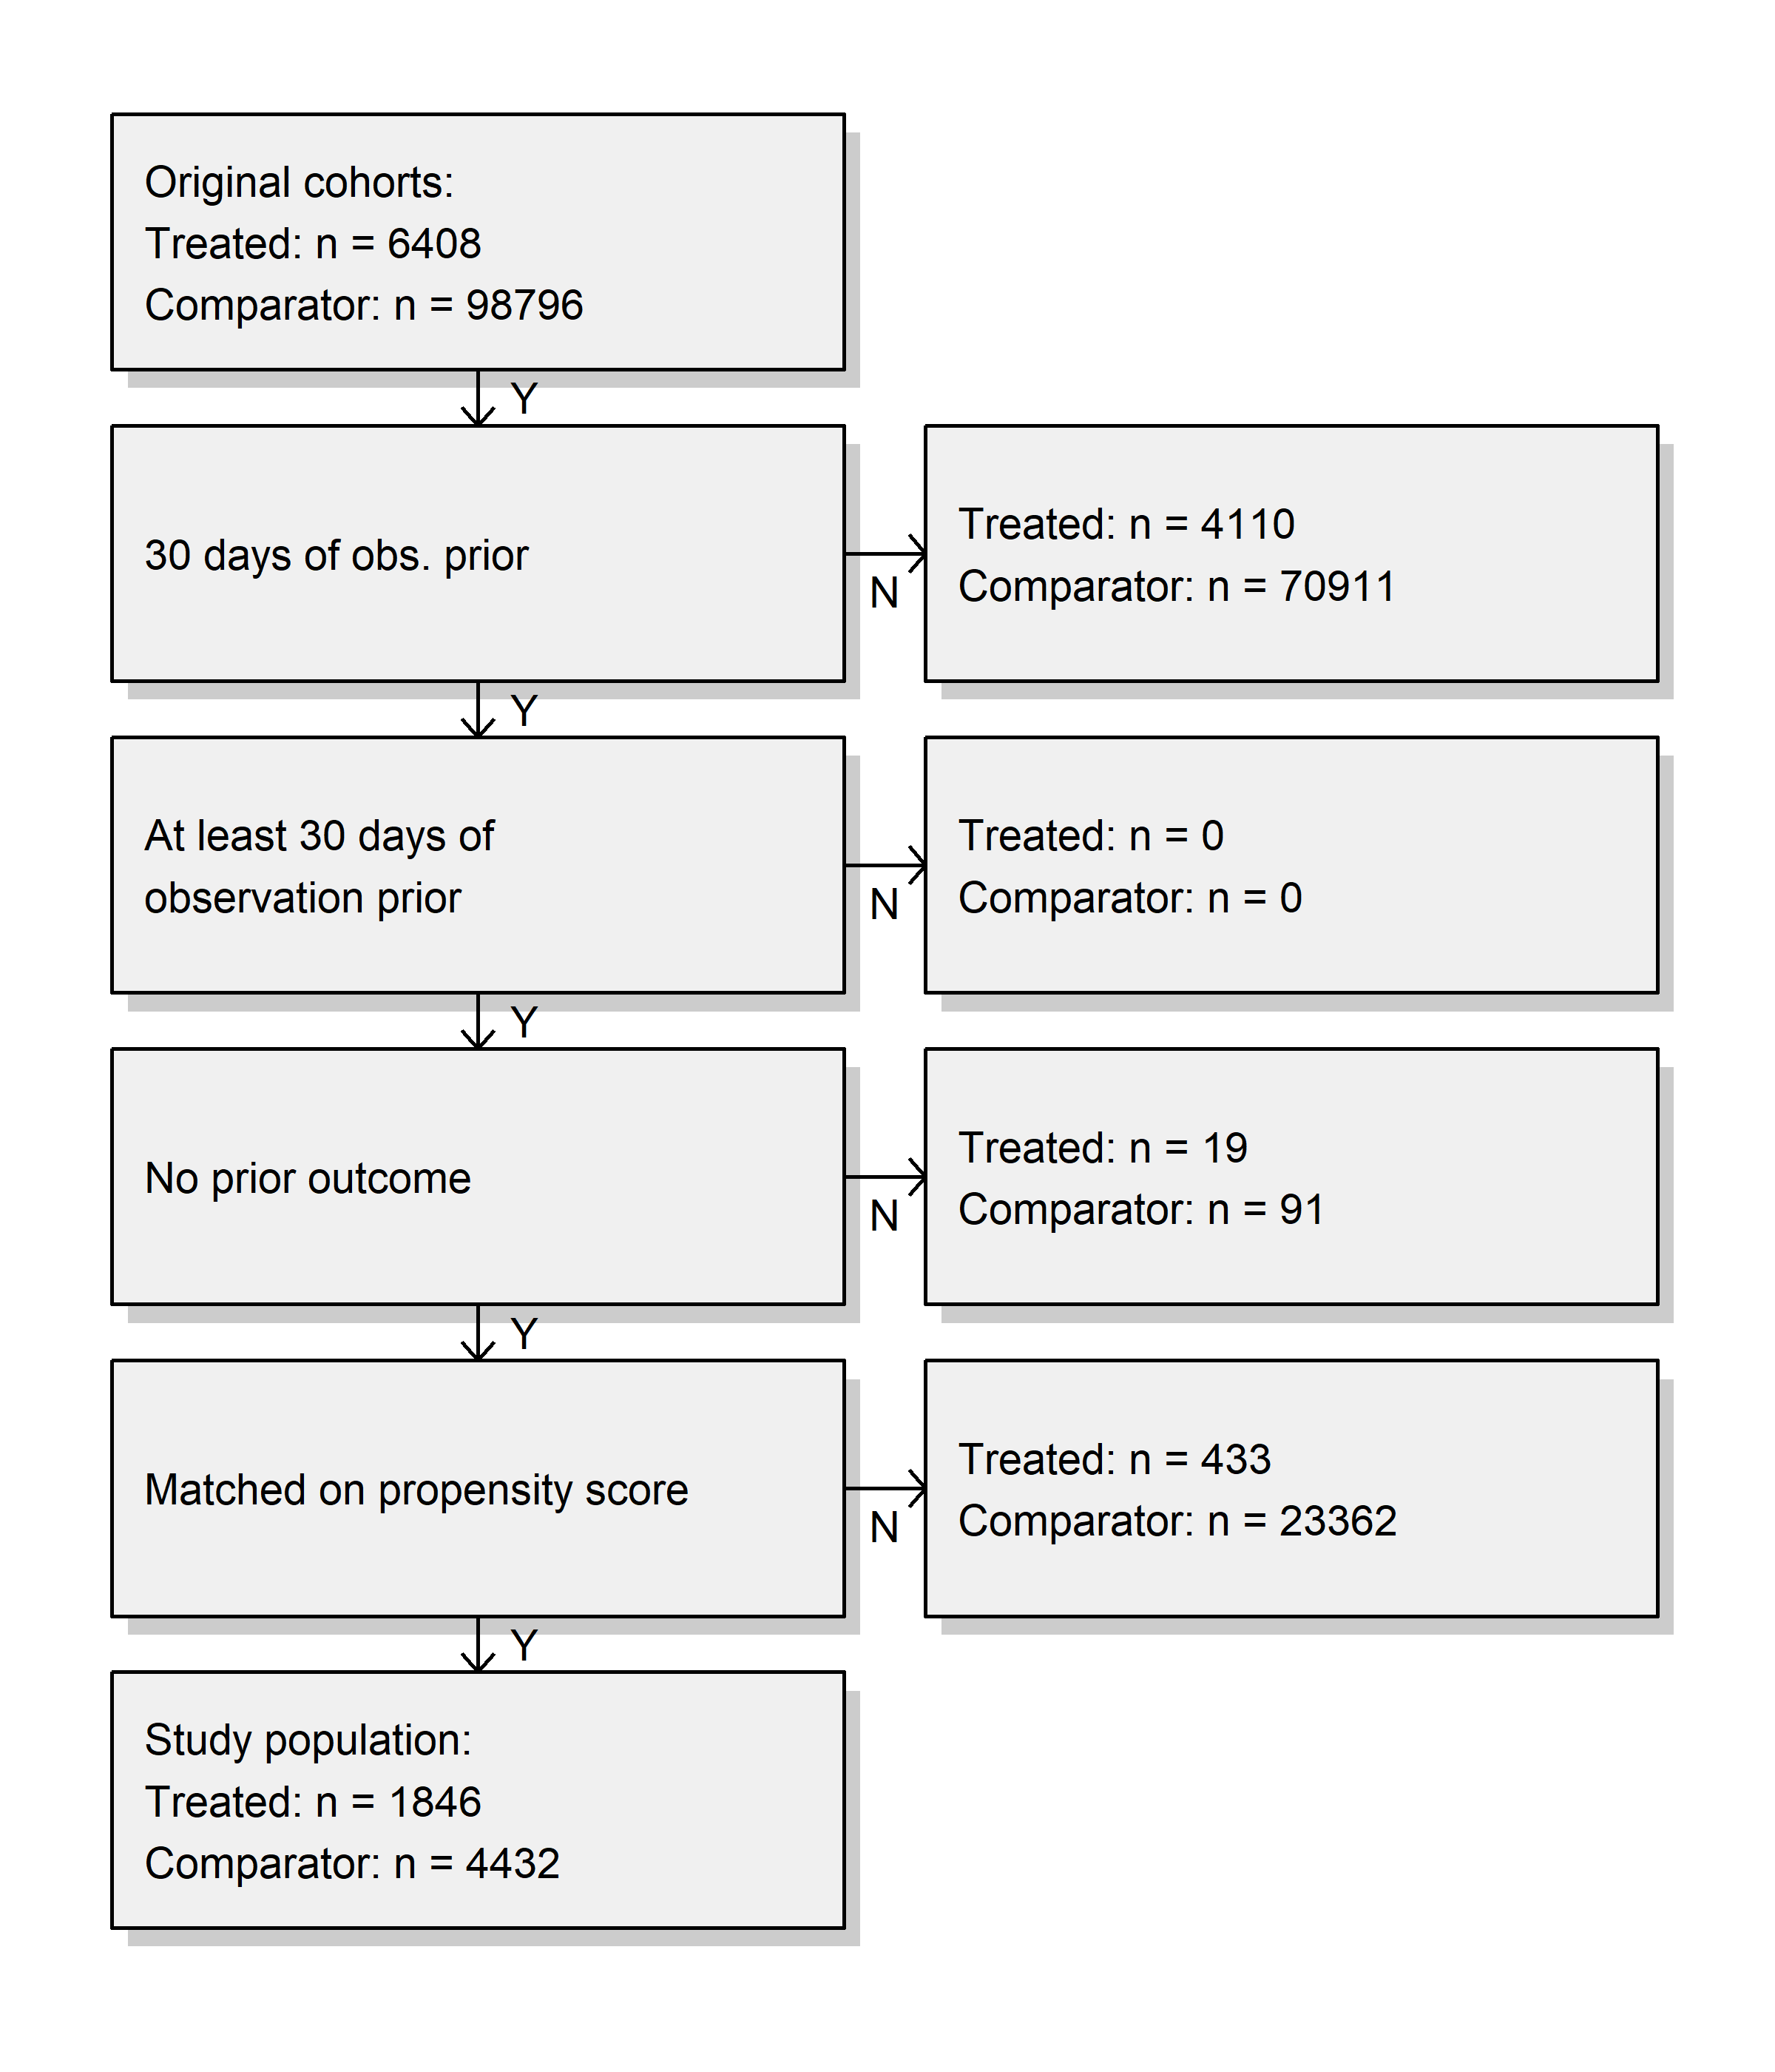
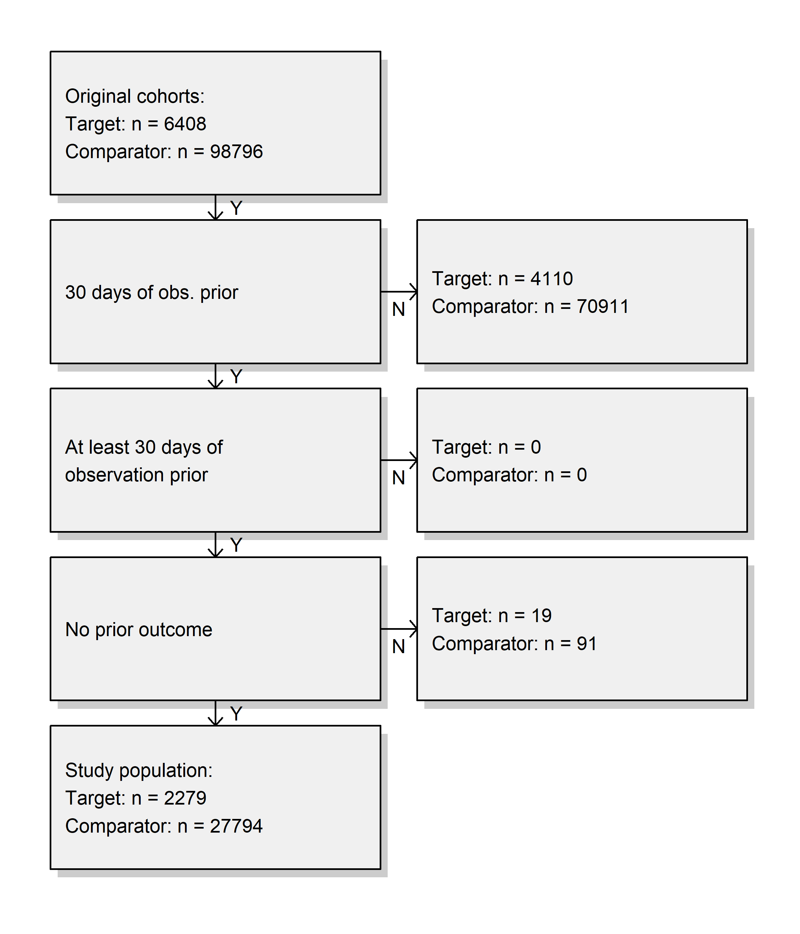
Results: AKI (Hospital)

Slide 33
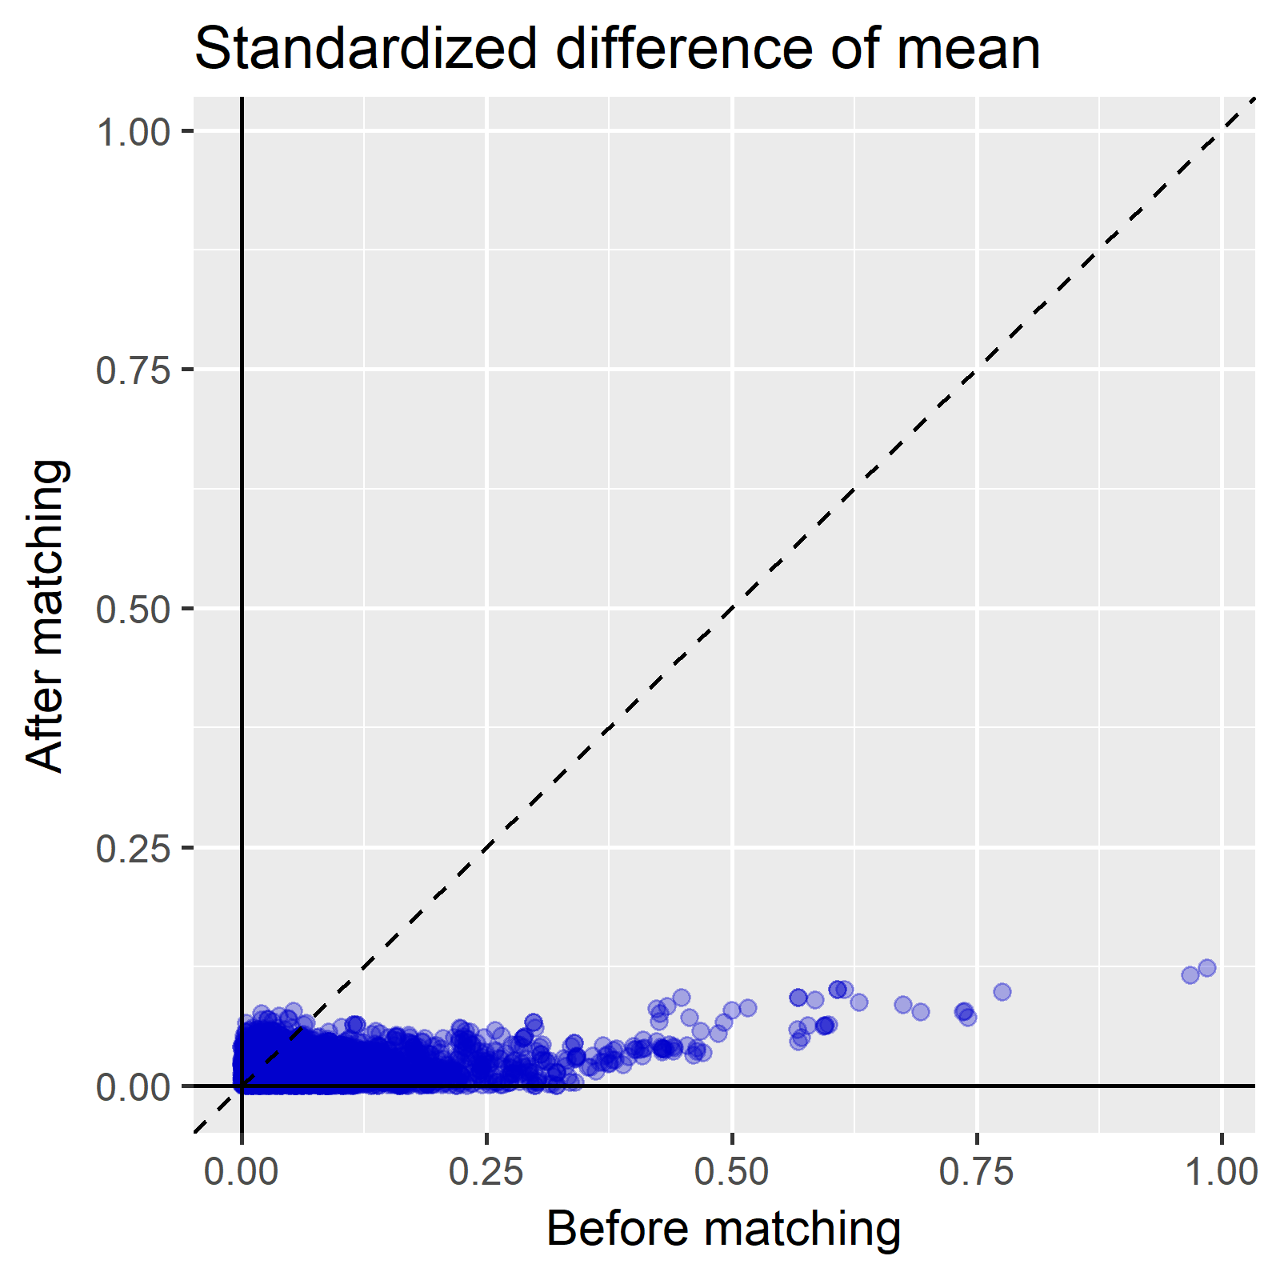
Results: AKI (Hospital)

Slide 34
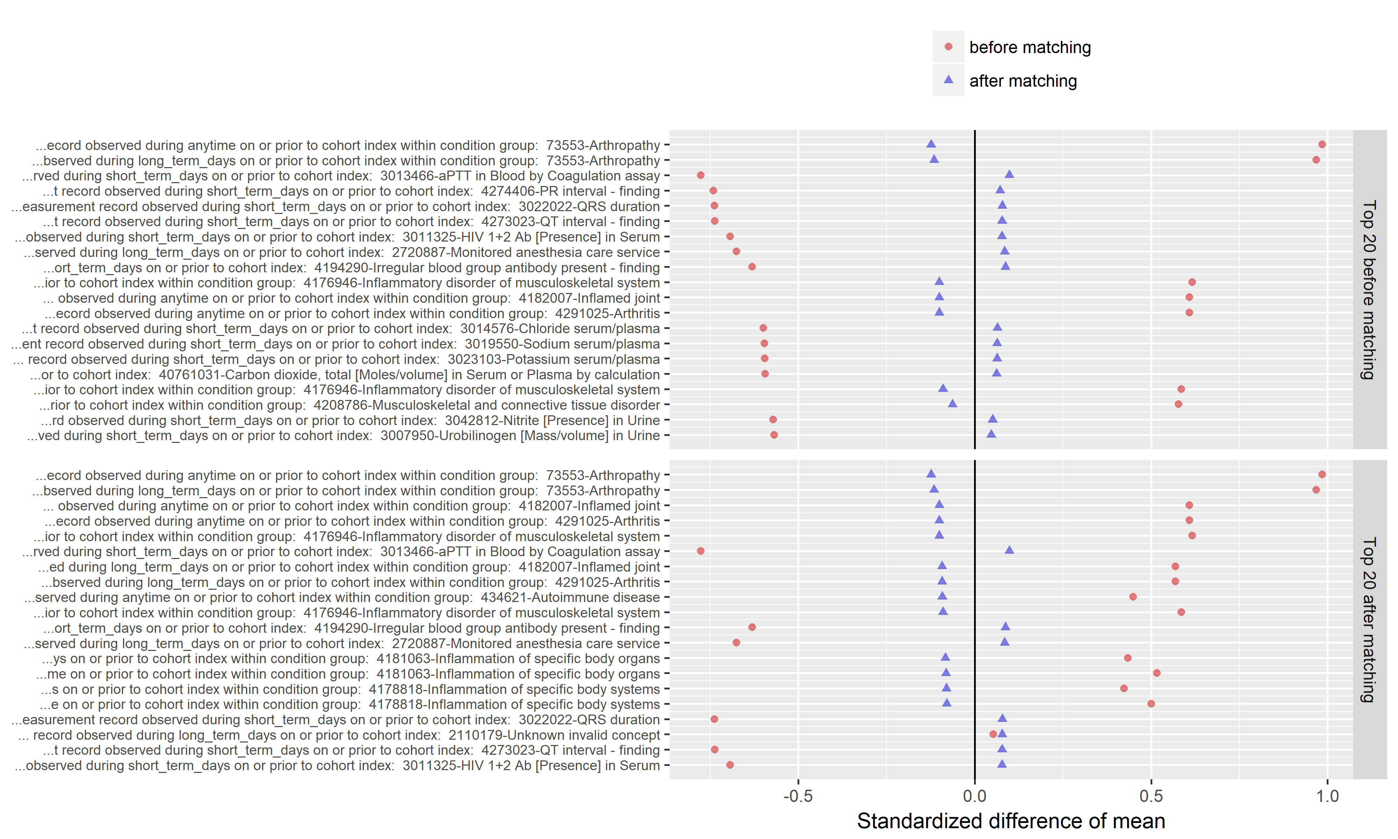
Results: AKI (Hospital)

Slide 35
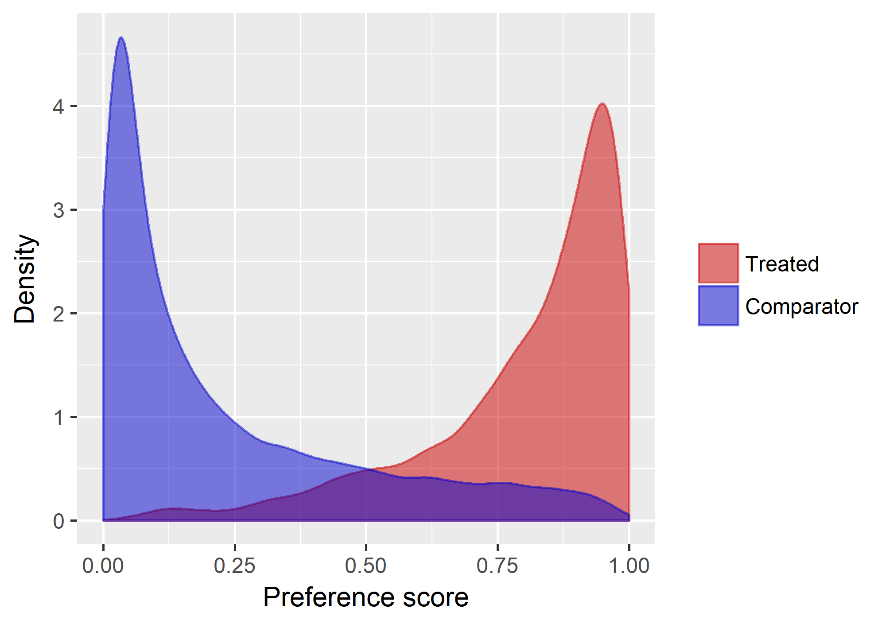
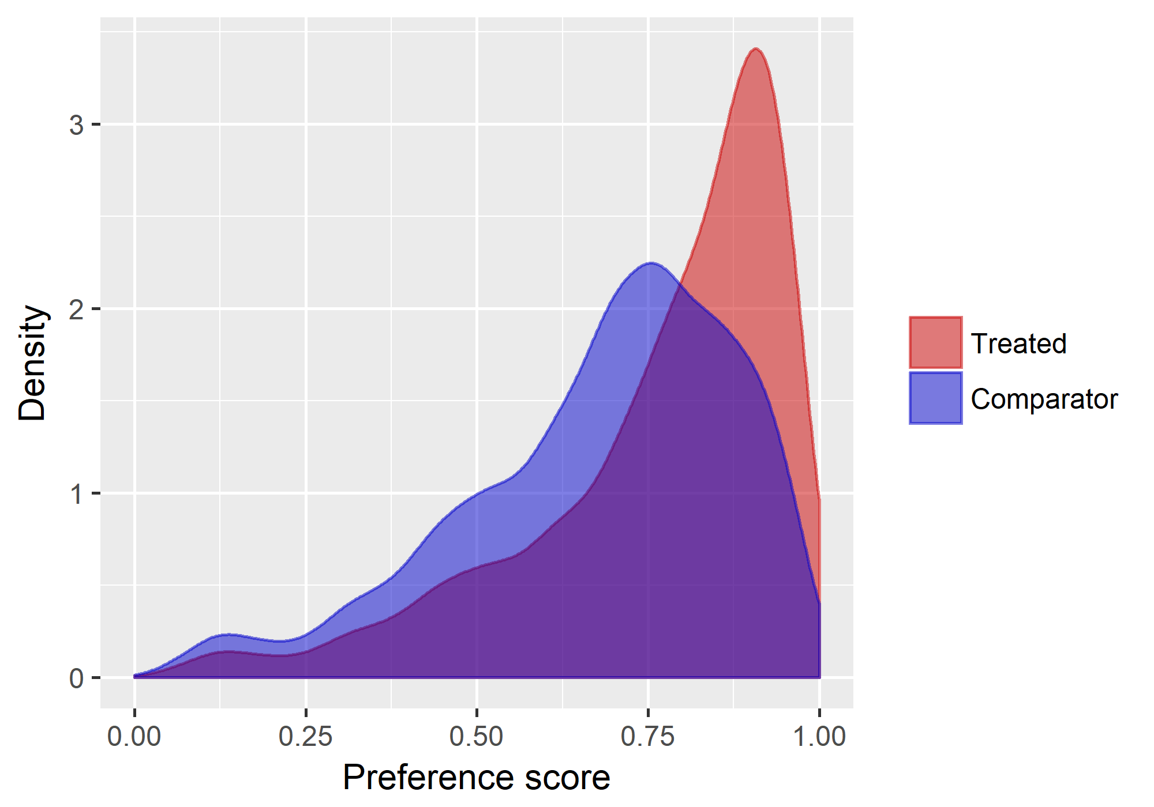
Results: AKI (Hospital)

Slide 36
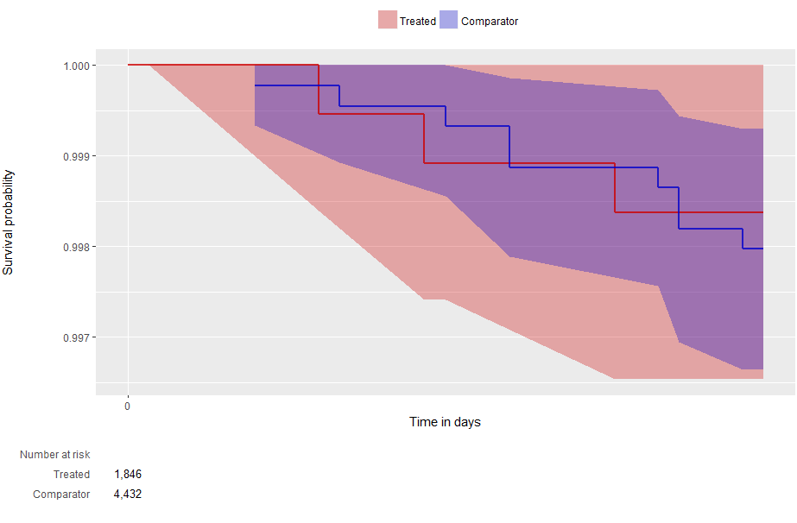
Results: AKI (Hospital)

Slide 37
Results: AKI
Result: AKI risk during 30 days after using selective COX-2 inhibitor or conventional NSAIDs after large scale propensity score matching
Active drug group | Comparator group | Number of active group after matching | Number of comparator group after matching | Hazard Ratio | 95% CI | P value
Coxib (Claim) | NSAIDs (Claim)
Coxib (Hospital) | NSAIDs (Hospital) | 1846 | 4432 | 1.57 | 0.05-25.8
Abbreviations: CI, confidential interval; AKI, acute kidney injury

Slide 38
Hip or femoral fracture risk between tenofovir vs. entecavir
Leader: Youn-i Choi, MD
Gachon University Gil Medical Center
Background: Tenofovir and entecavir are the treatment of choices for chronic hepatitis B patients. Whereas tenofovir exposure has been associated with decreased bone density, it remains unclear whether it is associated with increased risk of fractures. So, we will conduct study head to head comparison between tenofovir and entecavir on the risk of fracture event.
Target Cohort: HBV patient initiating Tenofovir
Comparator Cohort: HBV patient initiating Entecavir
Outcome: The event of fracture risk ( hip or femoral )
Relative risk metrics: Cox proportional hazard

Slide 39
Background
Tenofovir and entecavir are the treatment of choices for chronic hepatitis B patients.
Whereas tenofovir exposure has been associated with decreased bone density, it remains unclear whether it is associated with increased risk of fractures.

Slide 40
AIM
We will conduct head to head comparison research between tenofovir and entecavir on the risk of fracture event.
Notes:
To compare the risk of acute kidney injury between conventional nonsteroidal anti-inflammatory drugs (NSAIDs) and selective cyclooxygenase-2 (COX-2) inhibitors.

Slide 41
Method: Data sources
Hospital EHR
7 M patients from 4 hospitals in Korea
Claim data
NHIS-national sample cohort (NHIS-NSC) DB
Consecutive observation for 1M patients between 2002-2013
Lee et al.,
Int J Epidemiol. 2016

Slide 42
Method: Inclusion algorithm
Target Cohort
Subjects who initiated tenofovir from 2012
With continuous observation at least 0 days before and 0 days after event index date: earliest events per person
With prior HBV diagnosis
Without prior HIV diagnosis
Without Entecavir use during previous 2 years
Comparator Cohort
Subjects who initiated entecavir from 2007
With continuous observation at least 0 days before and 0 days after event index date: earliest events per person
With prior HBV diagnosis
Without prior HIV diagnosis
Without Tenofovir use during previous 2 years
Notes:
We need to restrict the age

Slide 43
Method: Outcome
Outcome Cohort
Any fracture diagnosed in Emergency Room or Inpatient settings

Slide 44
Method: Statistics
Large scale propensity score matching
Max Ratio: 1:4
Cox regression with stratification
Time at risk: 1 day after cohort start ~ cohort end date
Remove both cohort: No
Remove patients with prior outcome: Yes
Sensitivity analysis
Further ITT analysis is planned
Github https://github.com/OHDSI/StudyProtocolSandbox/tree/master/TenfovirVsEntecavir
Notes:
Martijn J. Schuemie, Marc A. Suchard and Patrick B. Ryan (2017). CohortMethod: New-user cohort method with large scale propensity and outcome models. R package version 2.4.3.

Slide 45
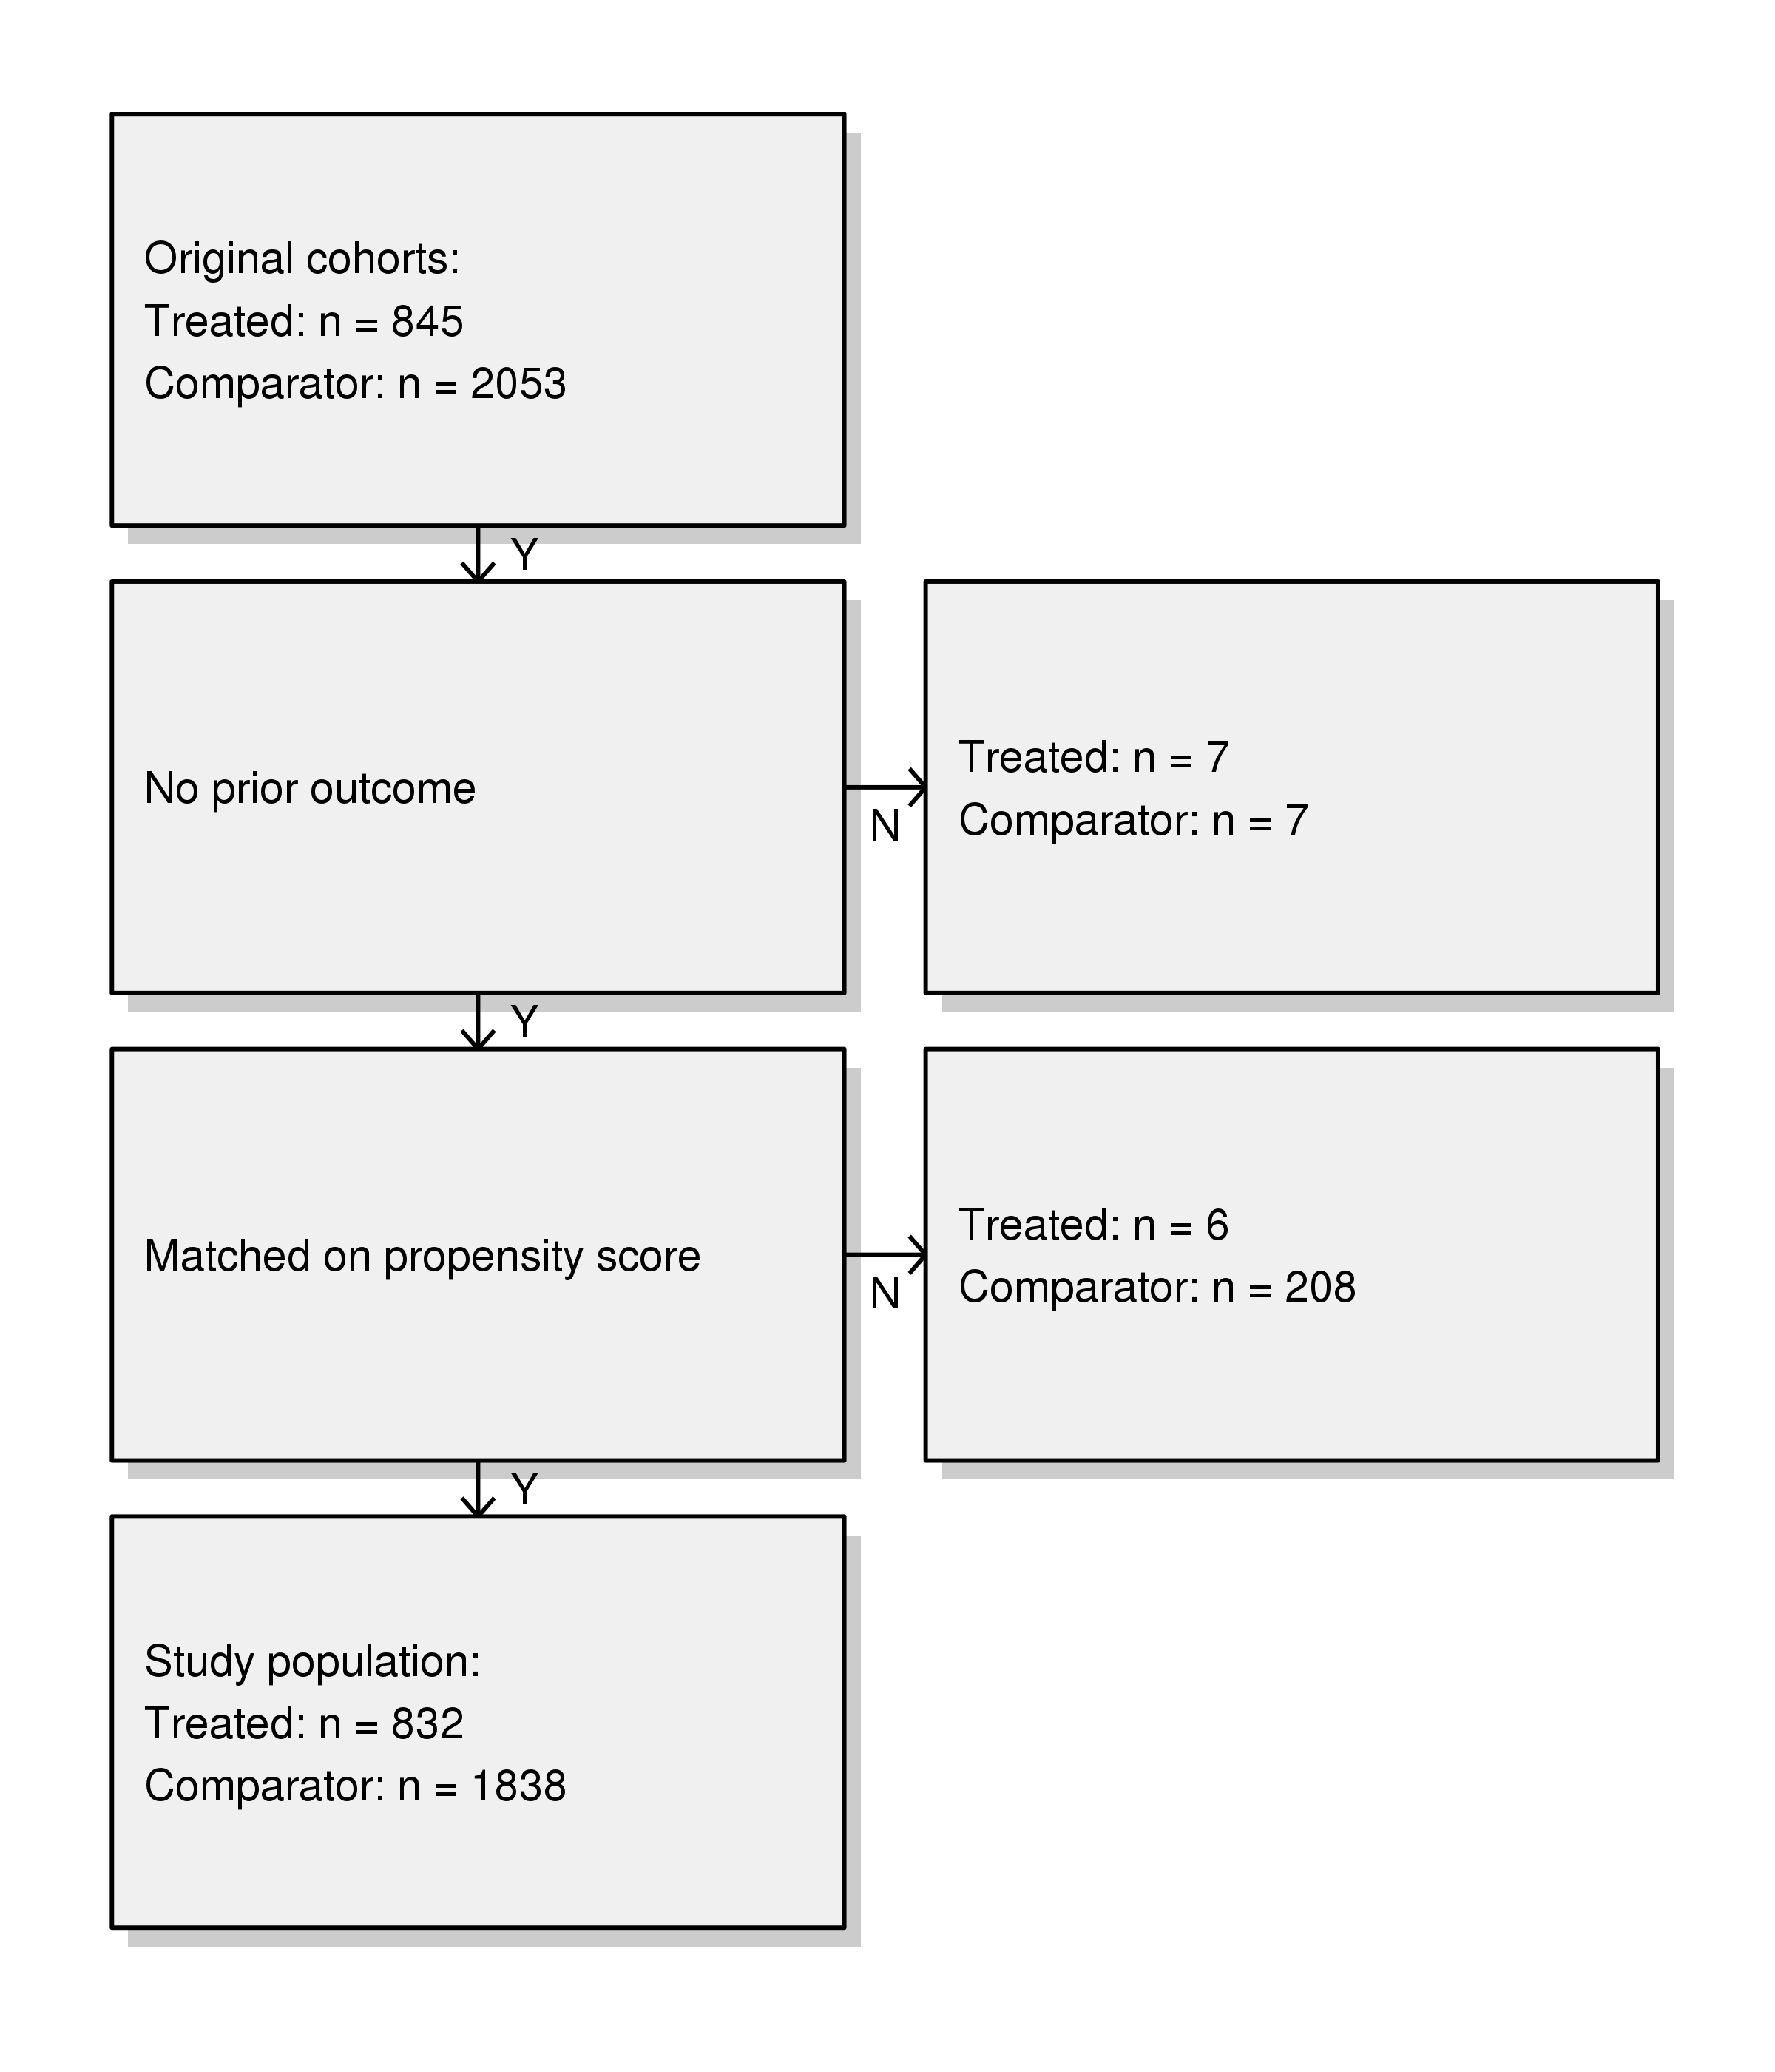
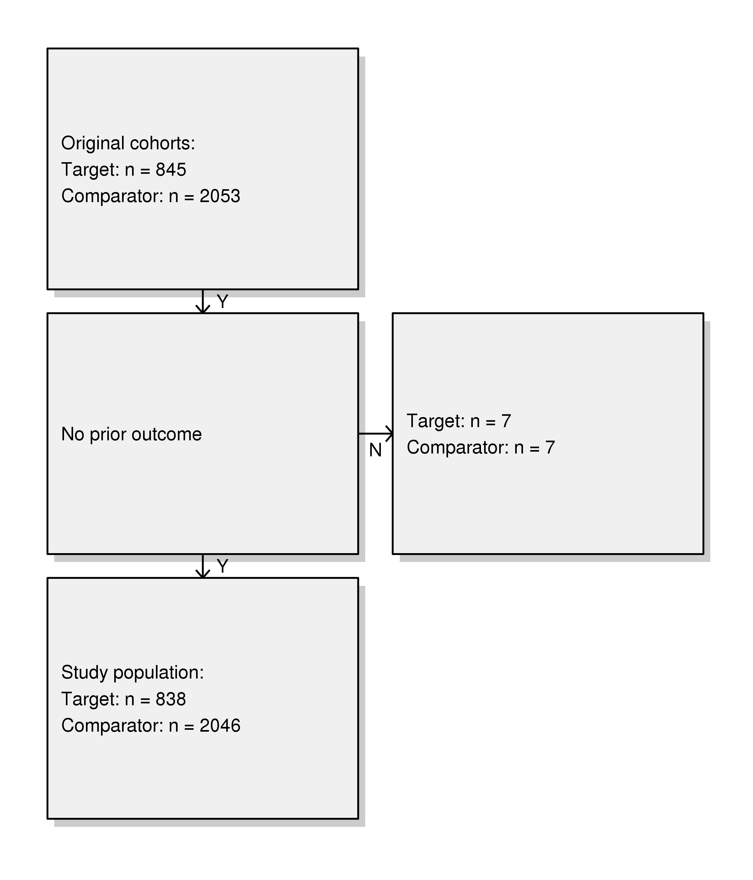
Results: Outcome (AUSOM)
Notes:
(T) Tenofovia
2007년 이후 Earlist event
Entecavir before 730 days & after 7 days
HIV : at most 0
HBV : at least 1 all before and 7 days after
(C) Enticavir
2007년 이후 Earlist event
Tenofovia before 730 days & after 7 days
HIV : at most 0
HBV : at least 1 all before and 7 days after
(O) fracture

Slide 46
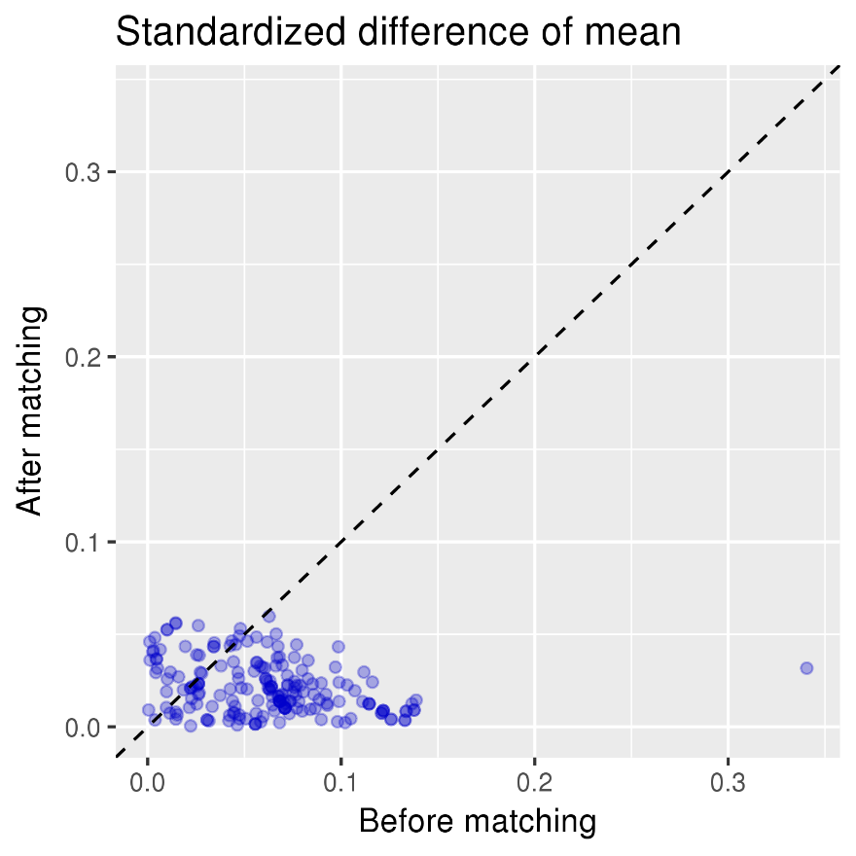
Results: Outcome (AUSOM)

Slide 47
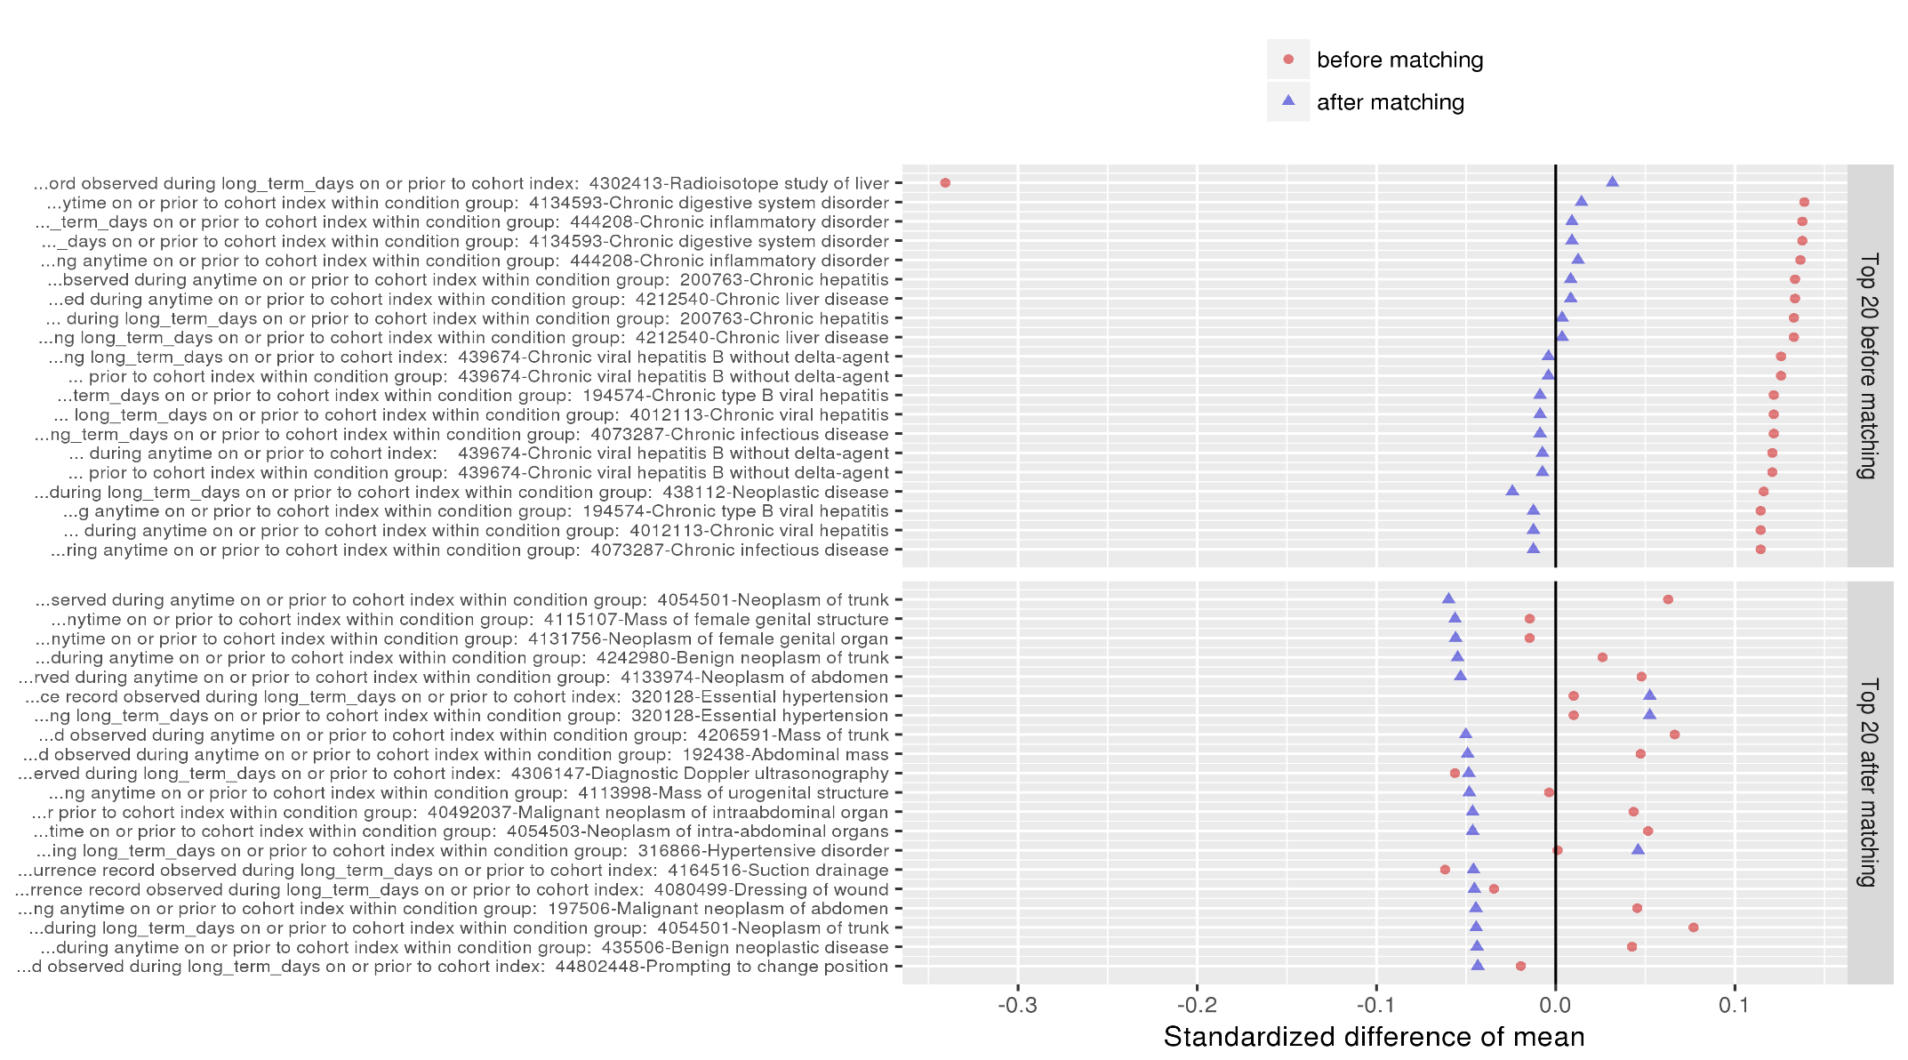
Results: Outcome (AUSOM)

Slide 48
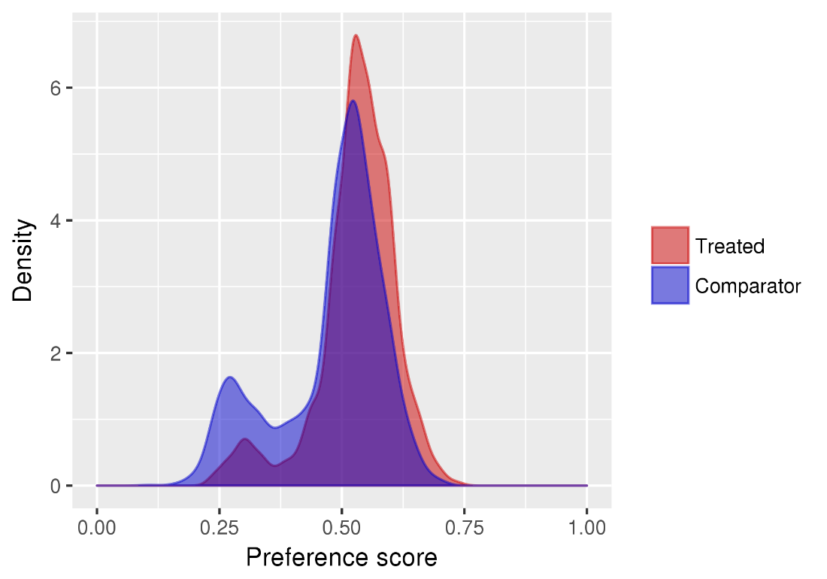
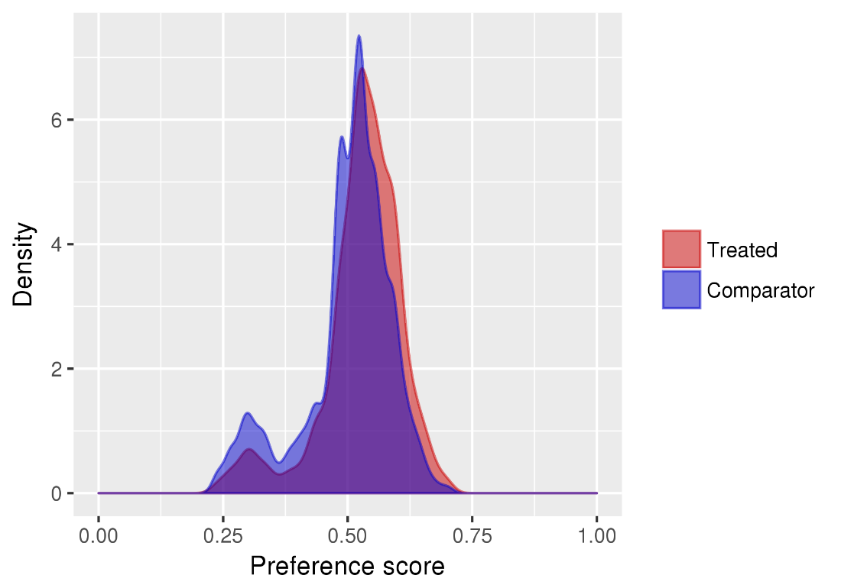
Results: Outcome (AUSOM)

Slide 49
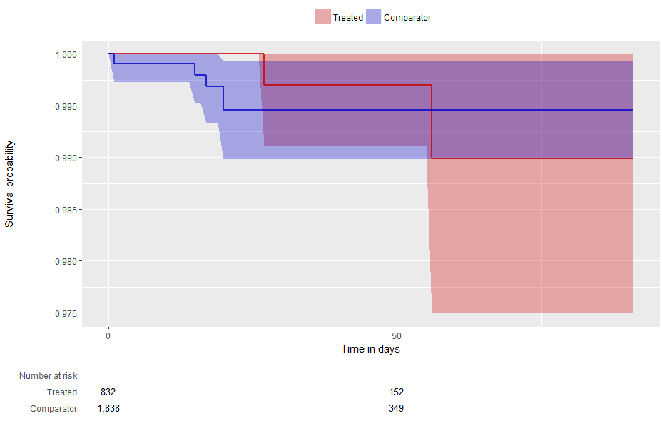
Results: Outcome (Hospital)
Notes:
Treated : Tenofoviar
Compatator : Entecaviar

Slide 50
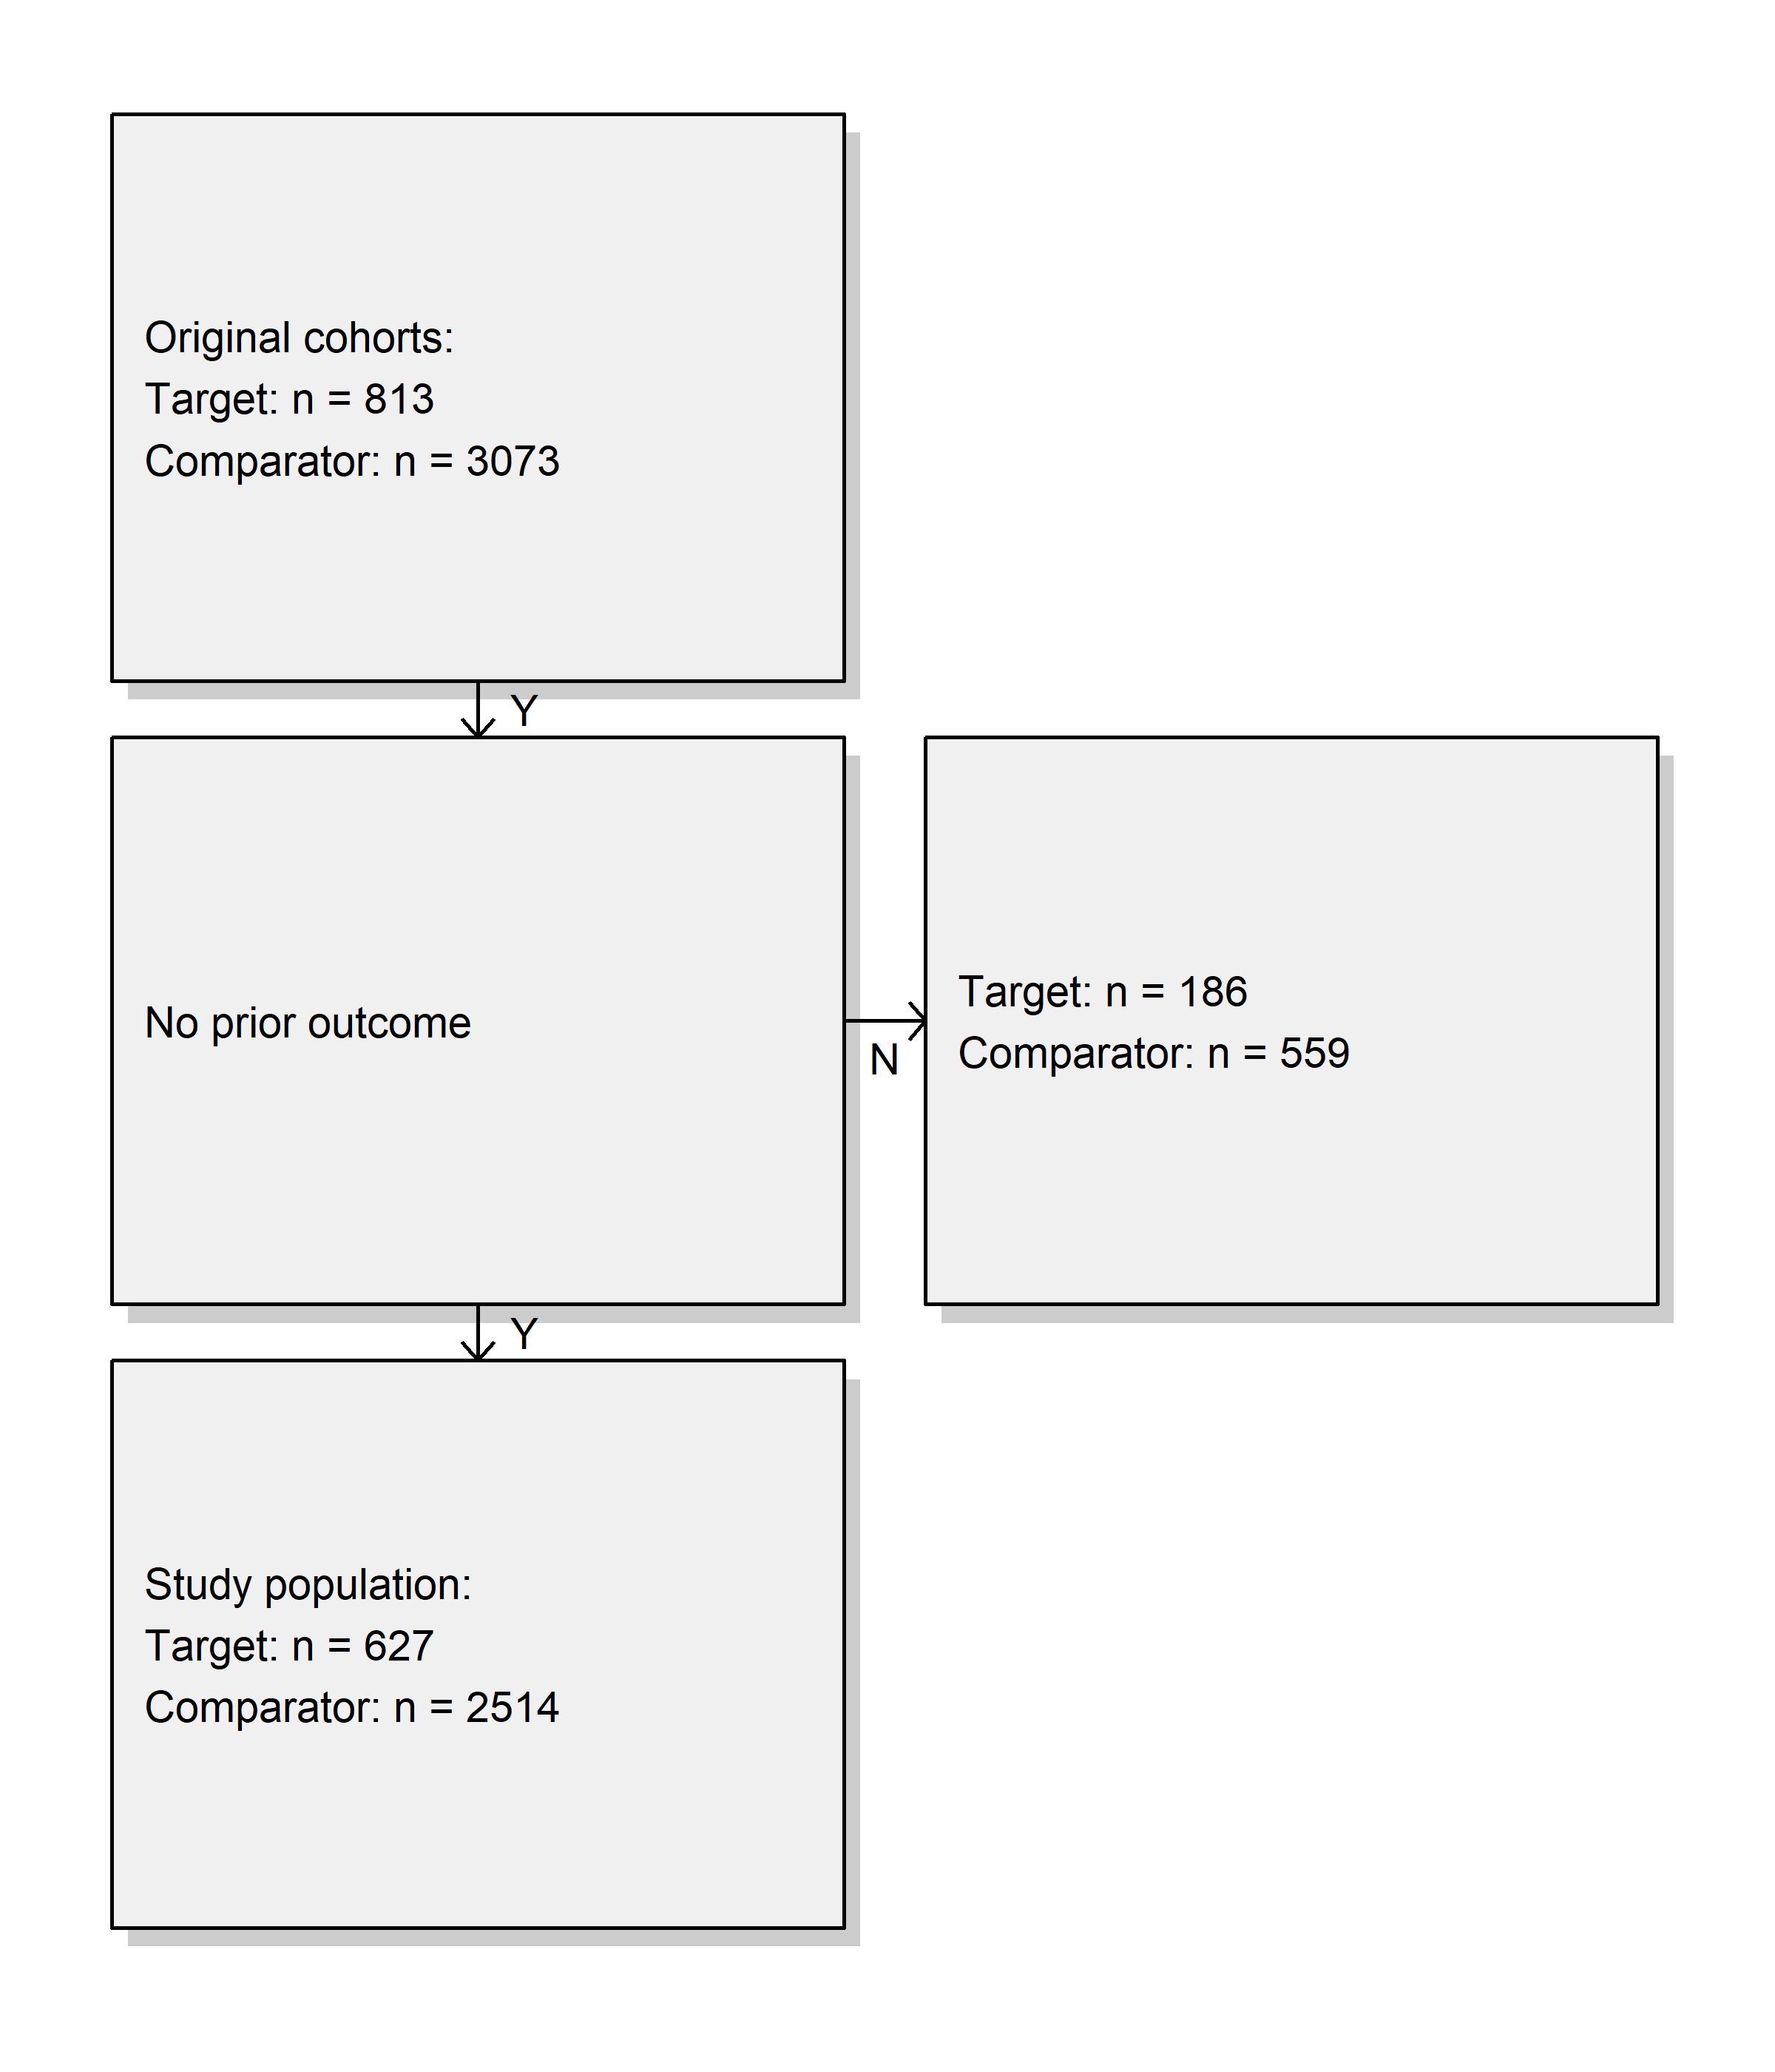
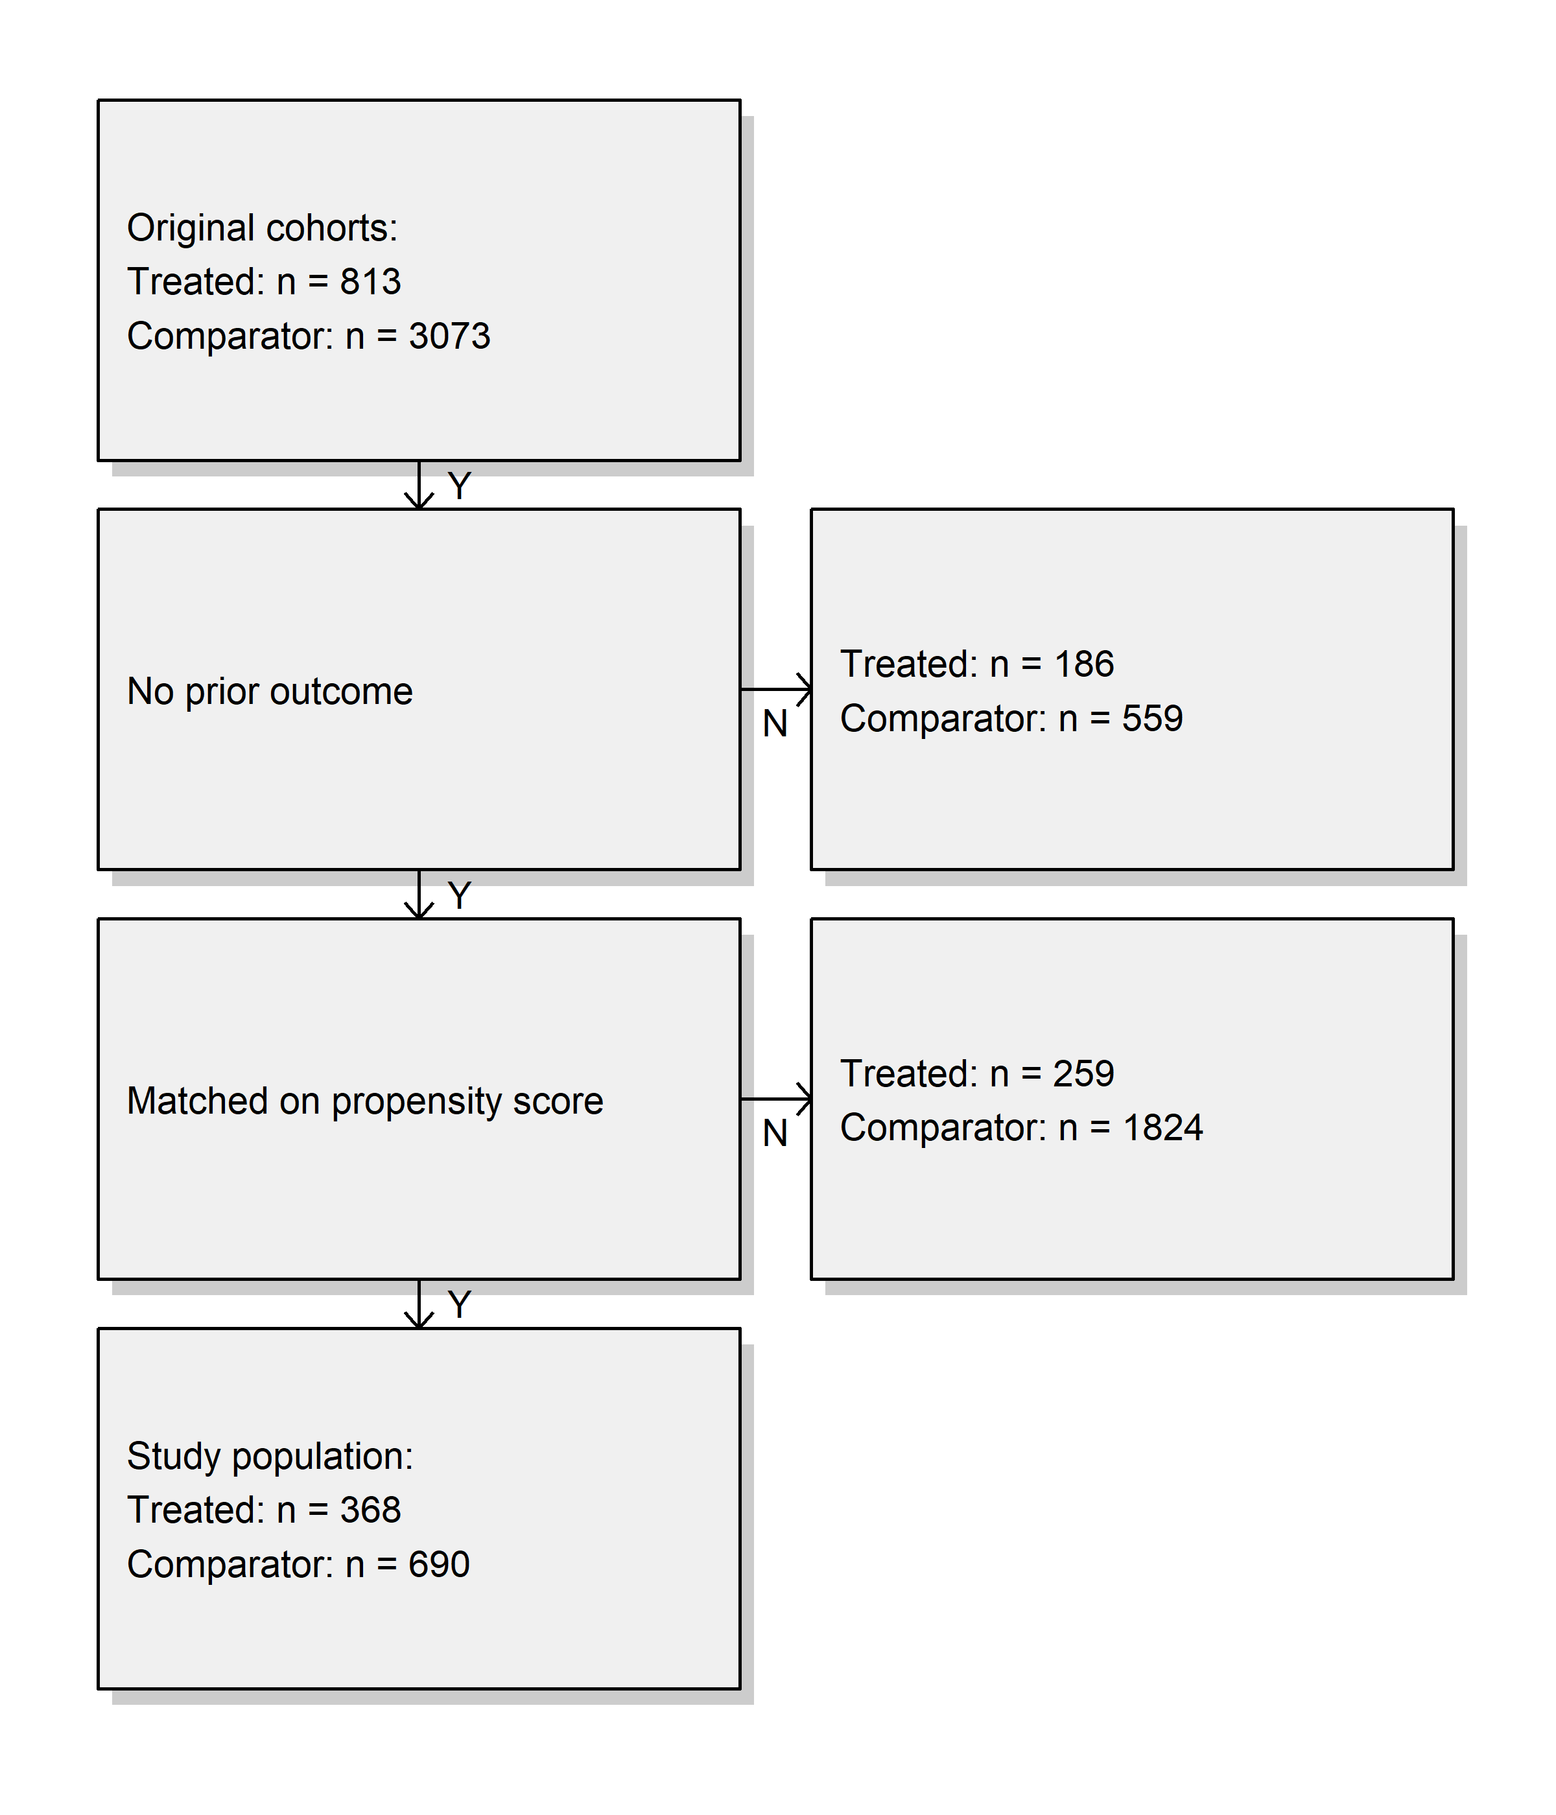
Results: Outcome (Claim)

Slide 51
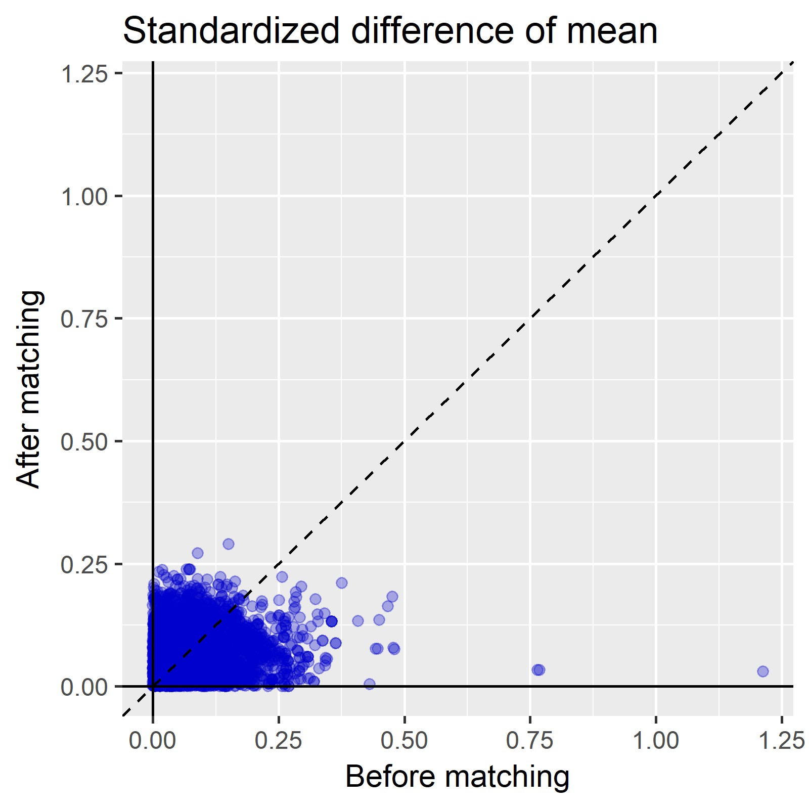
Results: Outcome (Claim)

Slide 52
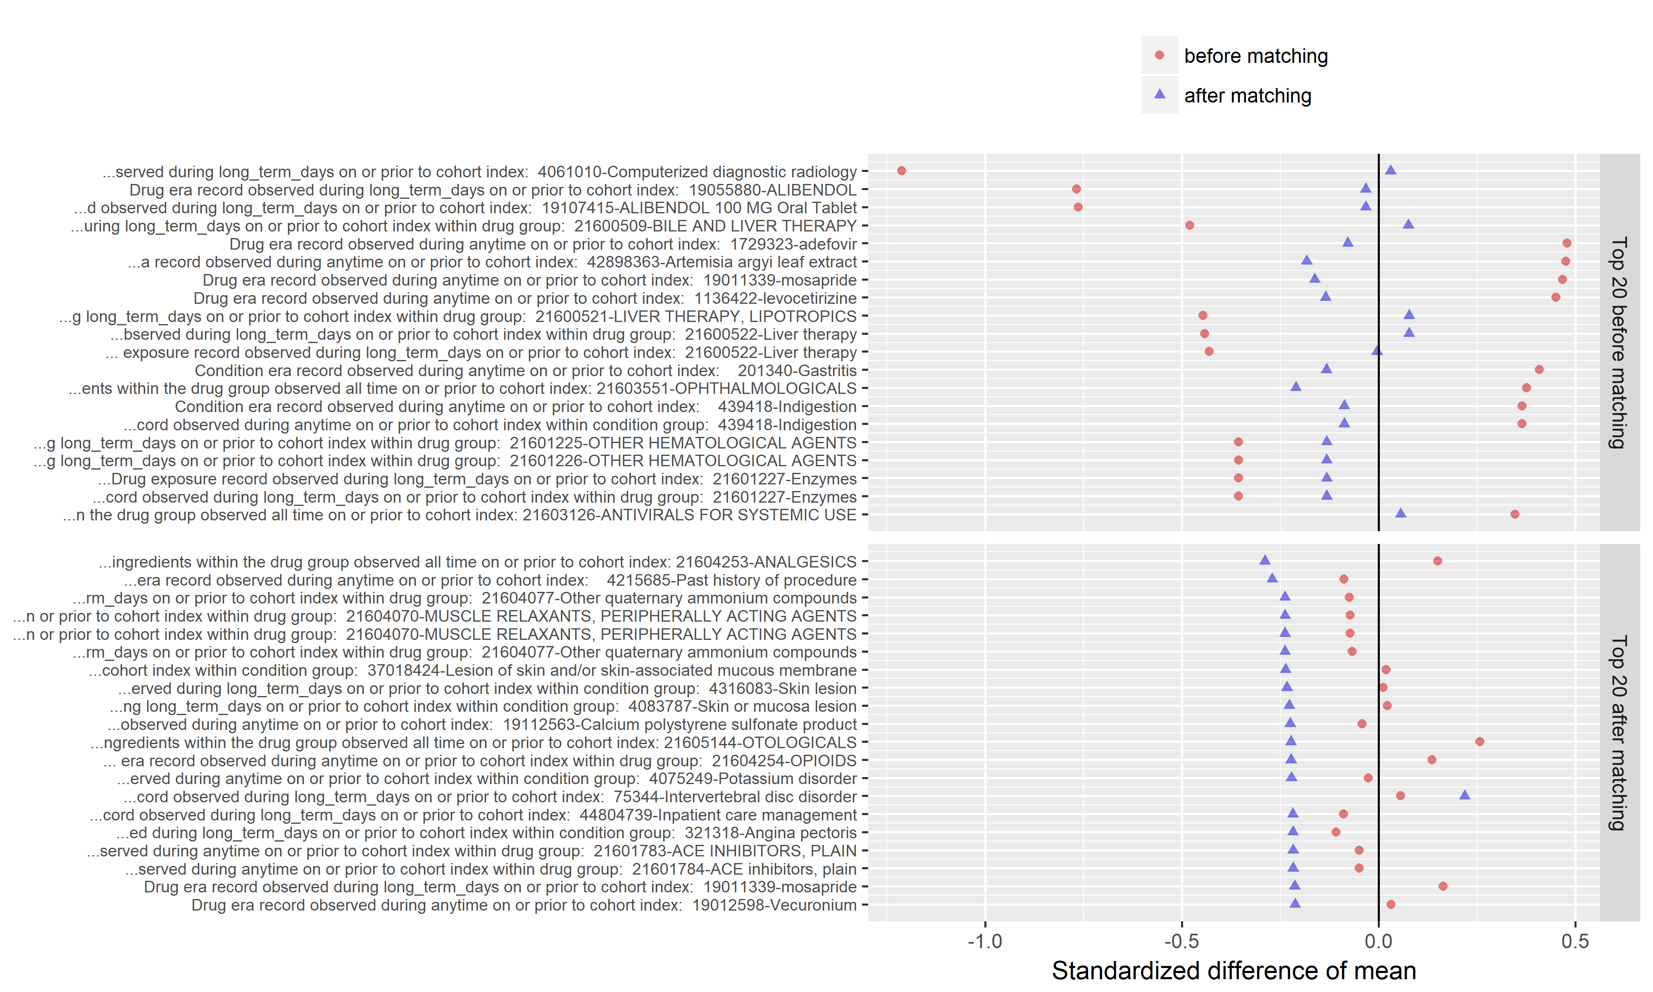
Results: Outcome (Claim)

Slide 53
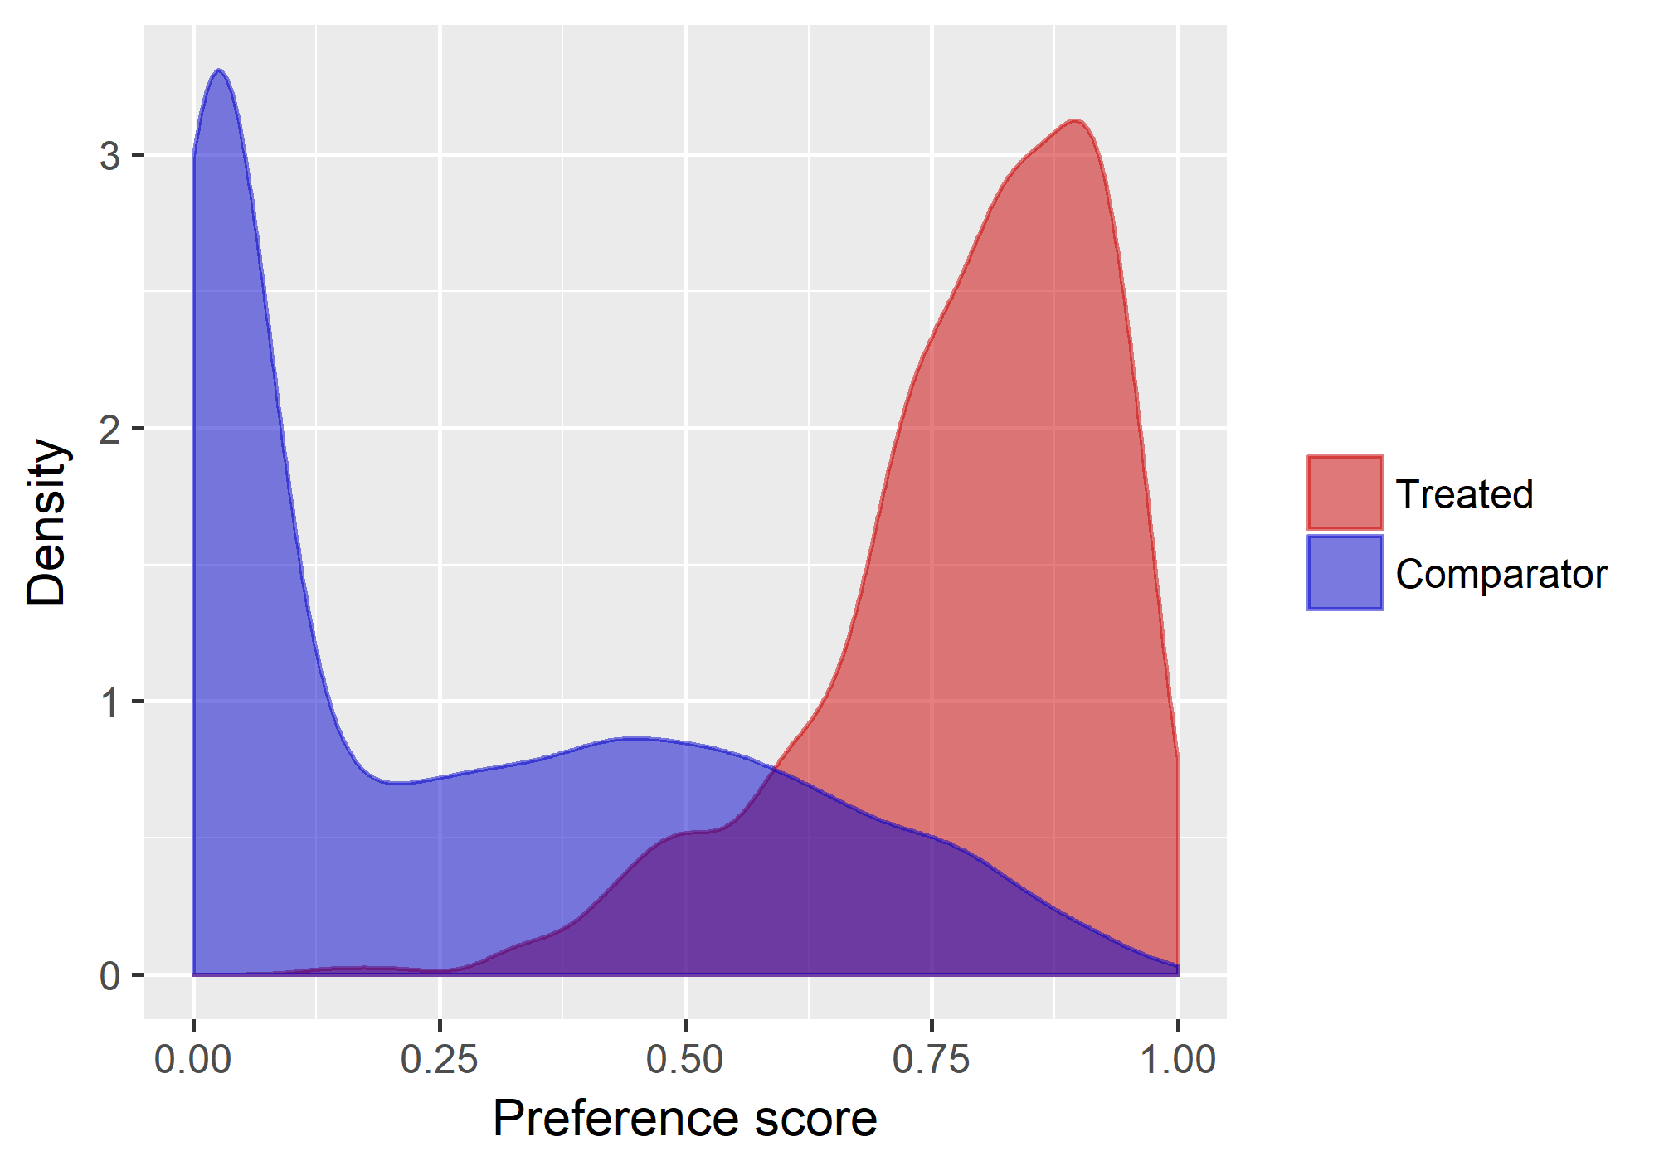
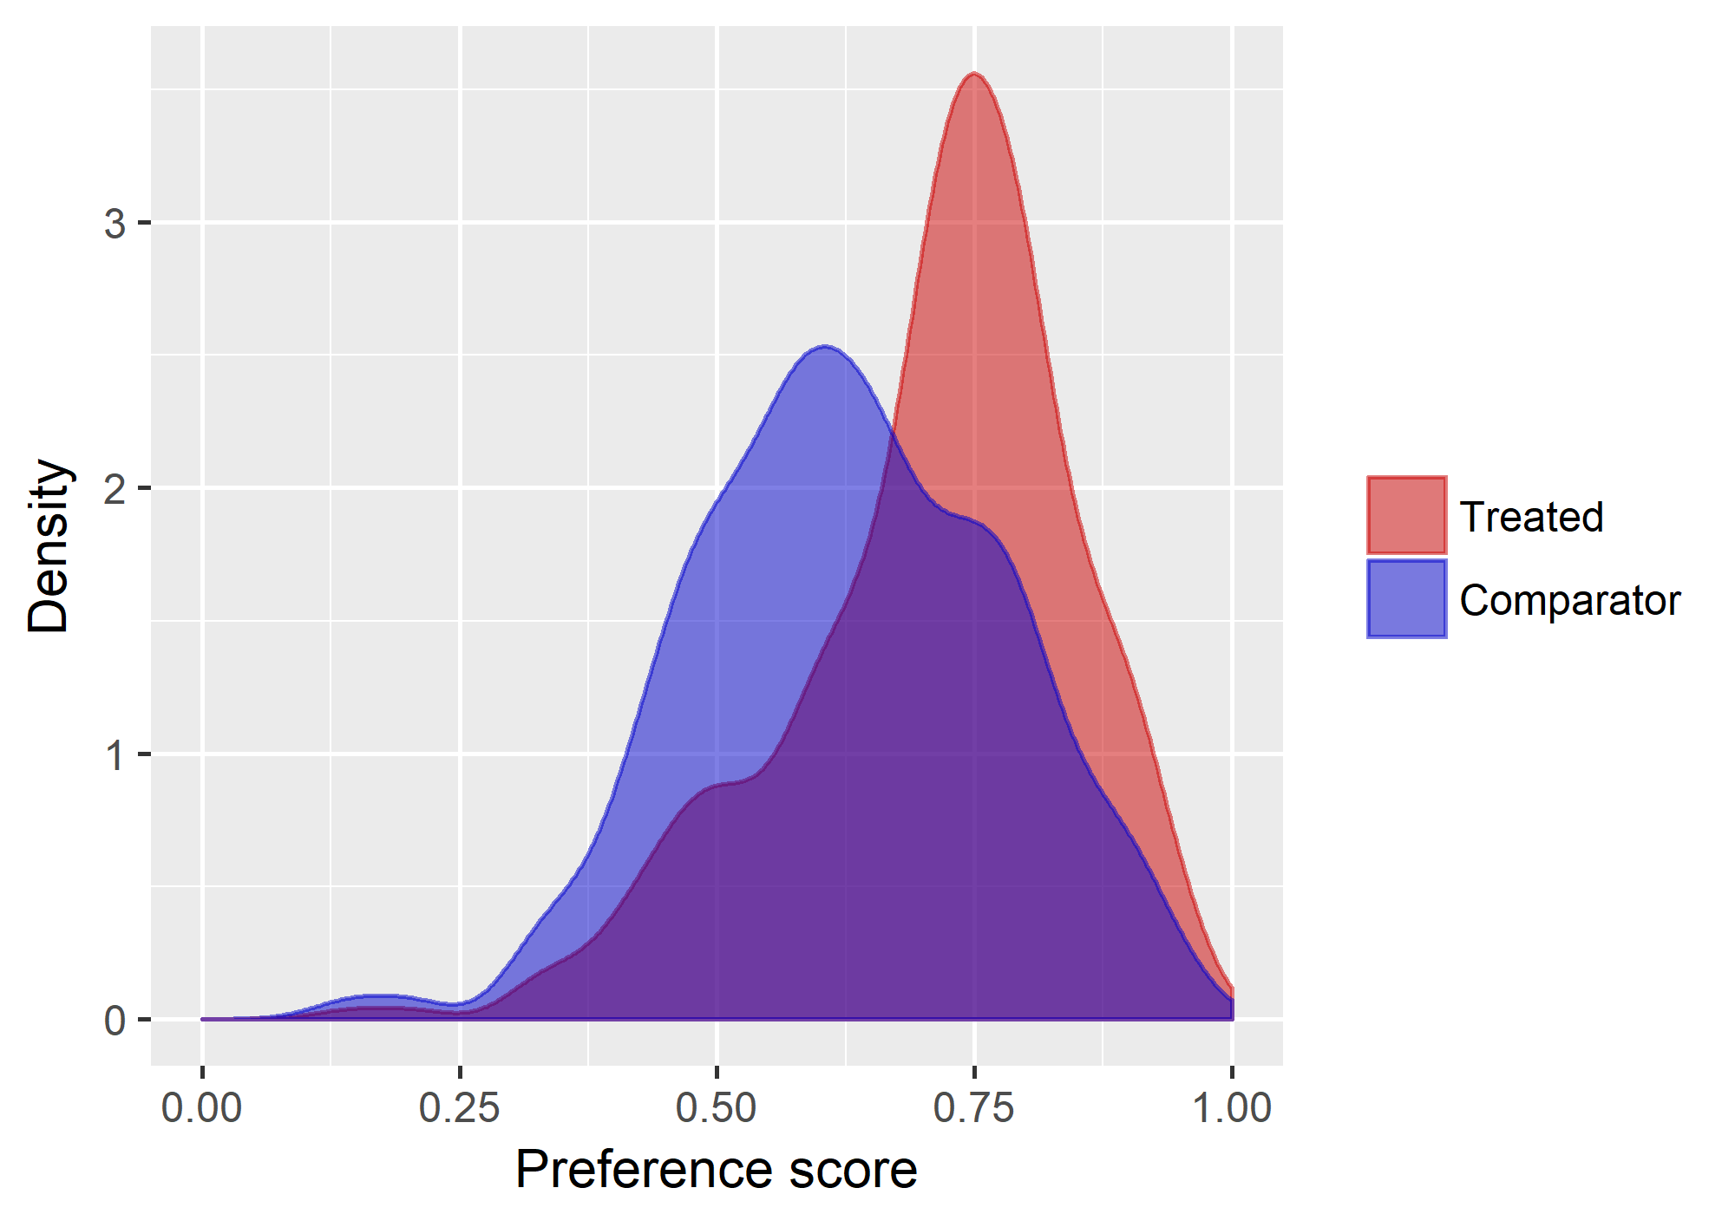
Results: Outcome (Claim)

Slide 54
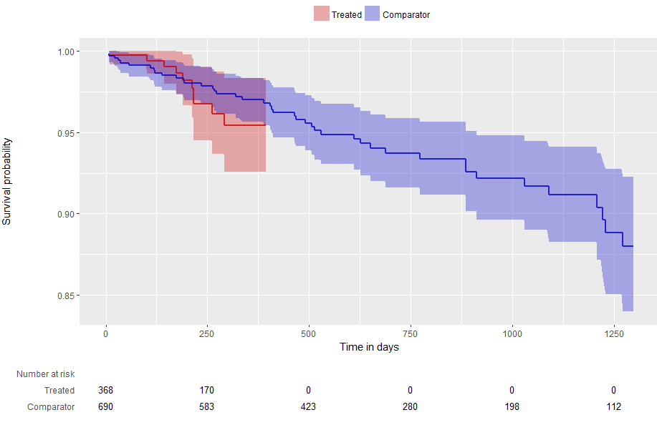
Results: Outcome (Claim)

Slide 55
Results: Outcome
Result: Fracture risk between Tenofovir and Entecavir group after large scale propensity score matching
Active drug group | Comparator group | Number of active group after matching | Number of comparator group after matching | Hazard ratio | 95% CI | P value
Tenofovir (NHIS-NSC) | Entecavir (NHIS-NSC) | 368 | 690 | 2.07 | 0.27-15.0
Tenofovir (AUSOM) | Entecavir (AUSOM) | 832 | 1838 | 0.33 | 0.01-14.88
Abbreviations: CI, confidential interval

