Slide 1
Clinical NLP schemas
Noémie Elhadad noemie@gmail.com
Columbia University

Slide 2
Outline
Types of NLP outputs
Unstructured text → structured output
Unstructured text → bag of words
Unstructured text → word embeddings
The ShARe schema for structured output
Some low level details

Slide 3
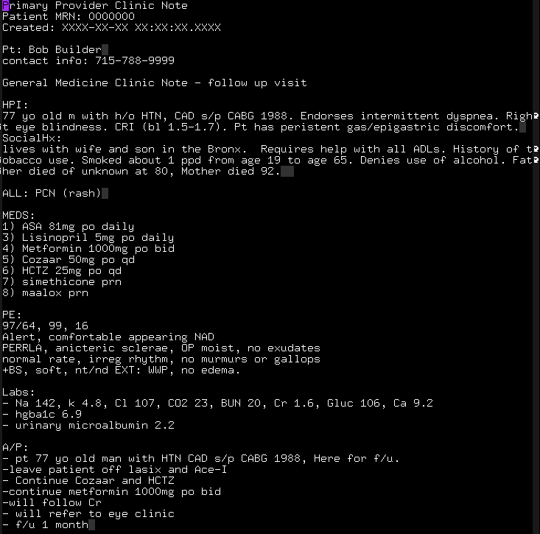
Unstructured text

Slide 4
Structured output
Clinical NLP pipeline output
Terminology
Disorder
span: 35-45 (facial rash)
CUI: C0239521
body location: C0015450 (facial; 27-32)
conditional: true (if; 25-26)
negation: false (NULL)
severity: severe (severe; 28-33)
...
Patient should come back if
severe facial rash occurs

Slide 5
Structured output
Useful for
phenotyping
cohort identification
information extraction
…

Slide 6
Bag of words (observations)
Vocabulary of all the words in the given notes of an institution
Filter out infrequent words, stop words, identifiers
Words are not filtered according to a terminology
Each note is represented as a bag of words
Note n = w₄₃:3, w₁₁₈:9, w₂₁₀:2, w₅₃₄:10, …
Lose the sequence of the words
Less semantic interpretation, more raw individual observations

Slide 7
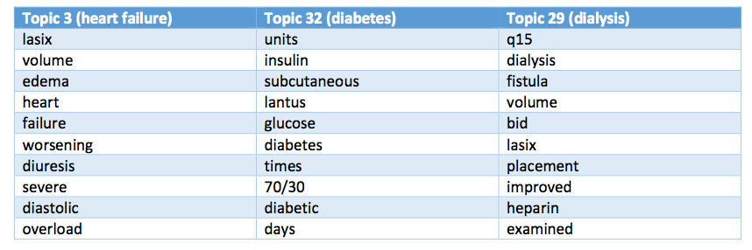
Bag of words (observations)
Let the burden of identifying features to further processes
- Perotte et al (2015) Risk Prediction for Chronic Kidney Disease Progression Using Heterogeneous Electronic Health Record Data and Time Series Analysis. J Am Med Inform Assoc.
- Pivovarov et al (2015) Learning Probabilistic Phenotypes from Heterogeneous EHR Data. J Biomed Inform. In Press.

Slide 8
Bag of observations (words)
Let the burden of identifying features to further processes
- Perotte et al (2015) Risk Prediction for Chronic Kidney Disease Progression Using Heterogeneous Electronic Health Record Data and Time Series Analysis. J Am Med Inform Assoc.
- Pivovarov et al (2015) Learning Probabilistic Phenotypes from Heterogeneous EHR Data. J Biomed Inform. In Press.

Slide 9
Word embeddings
Observations are still words, but now a word is represented as a vector
Dimension reduction
Distributional semantics, word embeddings
For each word, the representation is learned optimized for a particular task
Optimize for language model
Optimize for phenotype recognition
…
Often need to keep some sequential information

Slide 10
Outline
Types of NLP outputs
Unstructured text → structured output
Unstructured text → bag of words
Unstructured text → word embeddings
The ShARe schema for structured output
Some low level details

Slide 11
Structured output schema
Clinical Element Model templates
Data modeling across several initiatives and institutions (ShARe, SHARP, THYME)
Terminology
Disorder
span: 35-45 (facial rash)
CUI: C0239521
body location: C0015450 (facial; 27-32)
conditional: true (if; 25-26)
negation: false (NULL)
severity: severe (severe; 28-33)
...
Patient should come back if
severe facial rash occurs

Slide 12
ShARe disorder annotations
CUI (normalization)
“presented with facial rash”
Facial rash (CUI C0239521)
Negation
“patient denies numbness”
Subject
“son has schizophrenia”
Uncertainty
“evaluation of MI”
Course
“The cough got worse over the next two weeks.”
Severity
“slight bleeding”
Conditional
“Pt should come back if any rash occurs”
Generic
“she went to the HIV clinic”
Body Location
“patient presented with facial rash”
Face (CUI: C0015450)

Slide 13
Other semantic types
Procedure
Associated Code
Body Laterality
Body Location
Body Side
Conditional
Device
End Date
Generic
Method
Negation Indicator
Relative Temporal
Context
Start Date
Subject
Uncertainty Indicator
Sign/Symptom
Disease/Disorder
Alleviating Factor
Associated Code
Body Laterality
Body Location
Body Side
Conditional
Course
Duration
End Time
Exacerbating Factor
Generic
Negation Indicator
Relative Temporal
Context
Severity
Start Time
Subject
Uncertainty Indicator
Alleviating Factor
Associated Sign
or Symptom
Associated Code
Body Laterality
Body Location
Body Side
Conditional
Course
Duration
End Time
Exacerbating Factor
Generic
Negation Indicator
Relative Temporal
Context
Severity
Start Time
Subject
Uncertainty Indicator
Lab
Abnormal Interpretation
Associated Code
Conditional
Delta Flag
Estimated flag
Generic
Lab Value
Negation Indicator
Ordinal Interpretation
Reference Range
Narrative
Subject
Uncertainty Indicator
Medication
Associated Code
Change Status
Conditional
Dosage
Duration
End Date
Form
Frequency
Generic
Negation Indicator
Route
Start Date
Strength
Subject
Uncertainty Indicator
Anatomical Site
Associated Code
Body Laterality
Body Site
Conditional
Generic
Negation Indicator
Subject
Uncertainty Indicator
Slide courtesy of G. Savova

Slide 14
ShARe community task (disorders only)
Task 1 – 16 teams (concept recognition and normalization)
Task 2b – 9 teams (concept + attributes normalization)
- Elhadad et al (2015) SemEval-2015 Task 14: Analysis of Clinical Text. Proc. SemEval’15.
- Pradhan et al (2015) Evaluating the state of the art in disorder recognition and normalization of the clinical narrative. J Am Med Inform Assoc.

Slide 15
Outline
Types of NLP outputs
Unstructured text → structured output
Unstructured text → bag of words
Unstructured text → word embeddings
The ShARe schema for structured output
Some low level details

Slide 16
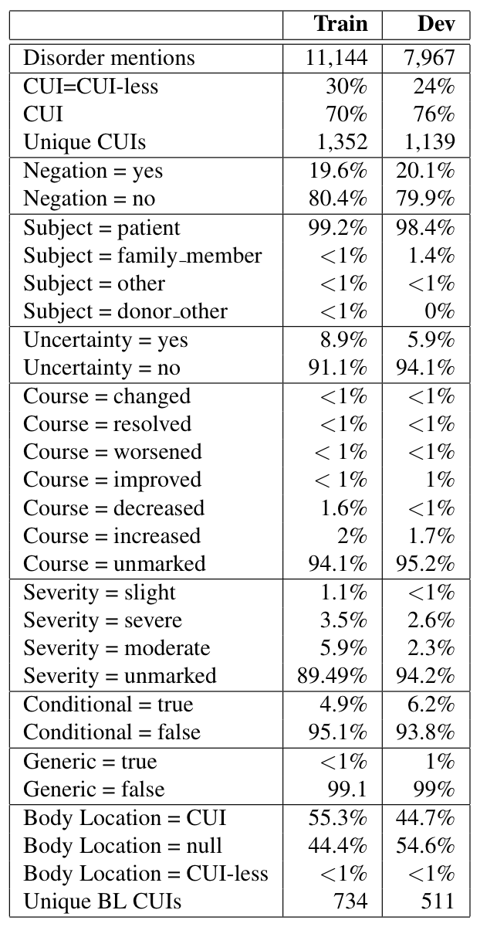
ShARe dataset
Annotated clinical notes
Un-annotated clinical notes
400,000+ notes
122 M words

Slide 17
Many concepts and attributes can be…
Pipe delimited
report name|disorder-span|cui|Norm_NI|Cue_NI|Norm_SC|Cue_SC|Norm_UI|Cue_UI| Norm_CC|Cue_CC|Norm_SV|Cue_SV|Norm_CO|Cue_CO|Norm_GC|Cue_GC|Norm_BL|Cue_BL| Norm_DT|Norm_TE|Cue_TE
09388-093839-DISCHARGE_SUMMARY.txt|30-36|C0040128|*no|*NULL|*patient|*NULL|*no| *NULL|*false|*NULL| *unmarked|*NULL|severe|*NULL|*false|*NULL|C0040132|*NULL| Before|*None|*NULL

Slide 18
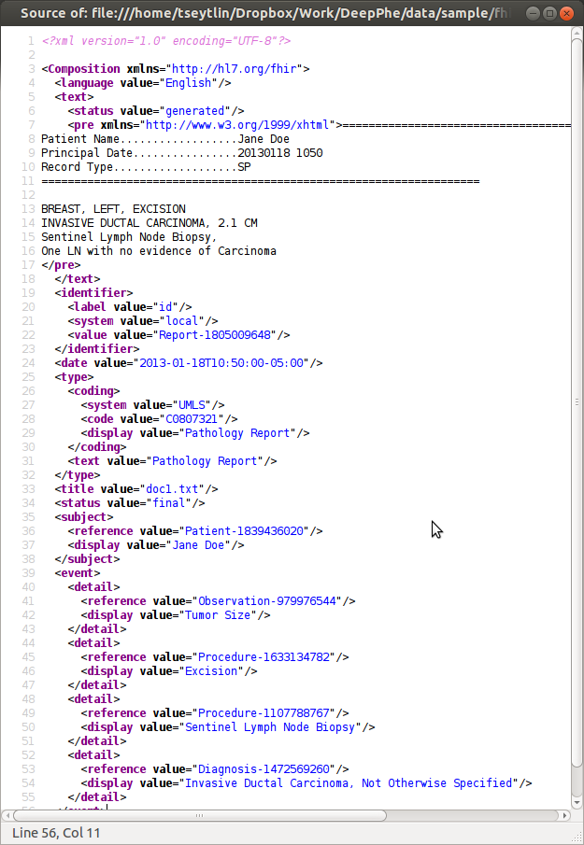
Many concepts and attributes can be…
Pipe delimited
report name|disorder-span|cui|Norm_NI|Cue_NI|Norm_SC|Cue_SC|Norm_UI|Cue_UI| Norm_CC|Cue_CC|Norm_SV|Cue_SV|Norm_CO|Cue_CO|Norm_GC|Cue_GC|Norm_BL|Cue_BL| Norm_DT|Norm_TE|Cue_TE
09388-093839-DISCHARGE_SUMMARY.txt|30-36|C0040128|*no|*NULL|*patient|*NULL|*no| *NULL|*false|*NULL| *unmarked|*NULL|severe|*NULL|*false|*NULL|C0040132|*NULL| Before|*None|*NULL
Composed in
Screenshot courtesy of G. Savova

Slide 19
Many concepts and attributes can be…
Pipe delimited
report name|disorder-span|cui|Norm_NI|Cue_NI|Norm_SC|Cue_SC|Norm_UI|Cue_UI| Norm_CC|Cue_CC|Norm_SV|Cue_SV|Norm_CO|Cue_CO|Norm_GC|Cue_GC|Norm_BL|Cue_BL| Norm_DT|Norm_TE|Cue_TE
09388-093839-DISCHARGE_SUMMARY.txt|30-36|C0040128|*no|*NULL|*patient|*NULL|*no| *NULL|*false|*NULL| *unmarked|*NULL|severe|*NULL|*false|*NULL|C0040132|*NULL| Before|*None|*NULL
Composed in
Lucene indexes
Screenshot courtesy of G. Savova

Slide 20
Points for discussion
NLP for what tasks and requirements on NLP output
Tables and schema as minimum viable products given NLP technology
Note table vs/and NLP output table
How to store many observations and their attributes

