Slide 1

Integration of heterogeneous medical data based on common data model
-2nd Part of FEEDER-NET
Seng Chan You

Slide 2
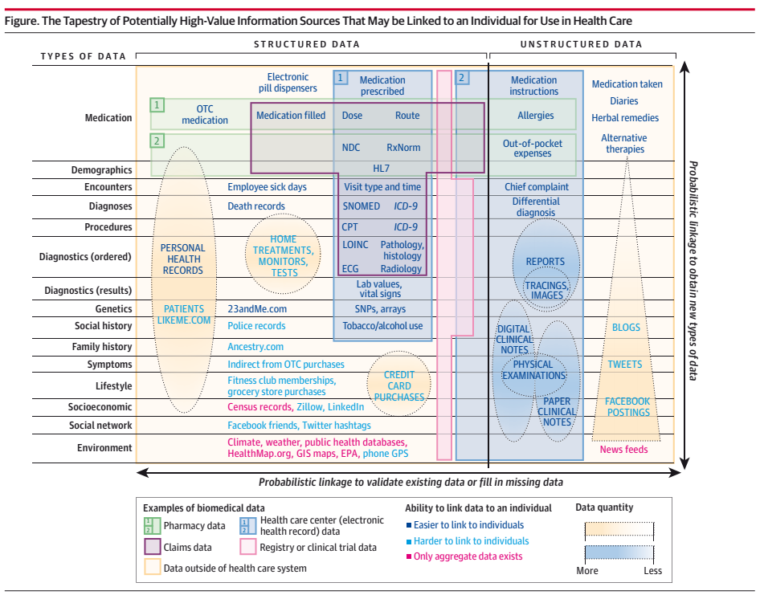
Finding the missing link for big biomedical data
Weber et al., “Finding the Missing Link for Big Biomedical Data.” JAMA (June 25, 2014)

Slide 3
OHDSI: A Journey for Simplicity, Beauty and Symmetry in Medical Data
Symmetry in medical data
  By grand unification across all aspects of health data, various types of medical data, such as clinical, genomic, radiologic, and patient-generated data, would be indistinguishably accessible in the single database
  OHDSI tools ecosystem can work across various types of medical data
Clinical data
Environment
CDM Of Everything
Un-structured Text
Patient-Generated Data
Genomic data
Radiology

Slide 4
Common Data Model of Everything in Medicine
Clinical data
Environment
CDM Of Everything
Un-structured Text
Patient-Generated Data
Genomic data
Radiology
Seng Chan You, MD¹, Youngin Kim, MD², Jaehyung Cho¹, Rae Woong Park, MD, PhD^{1,3}
¹Department of Biomedical Informatics, Ajou University School of Medicine, Suwon, Korea;
²Medicine, Noom, Inc, Seoul, Korea
³Department of Biomedical Sciences, Ajou University Graduate School of Medicine, Suwon, Korea

Slide 5
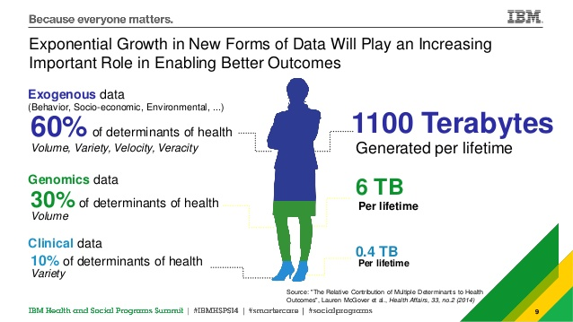
Patient-Generated Health Data

Slide 6
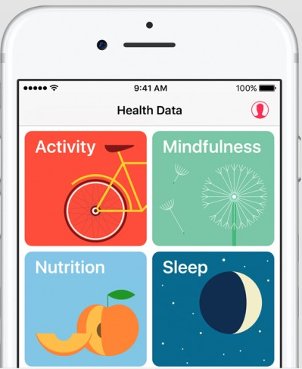
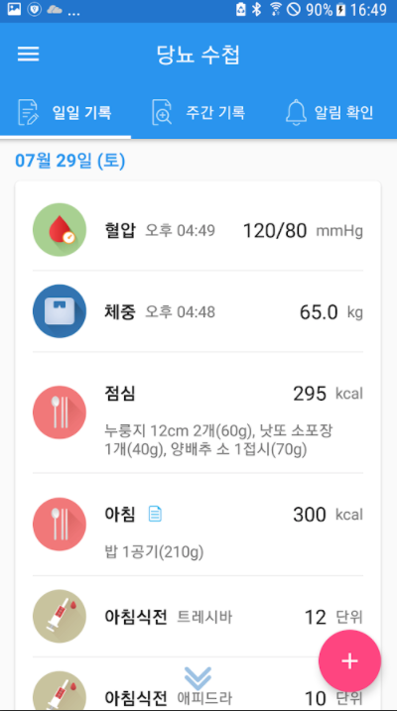
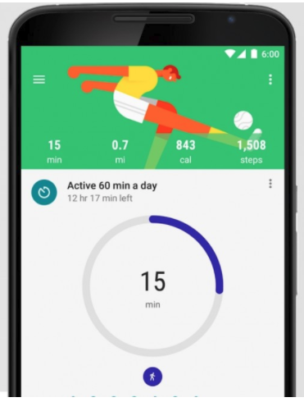
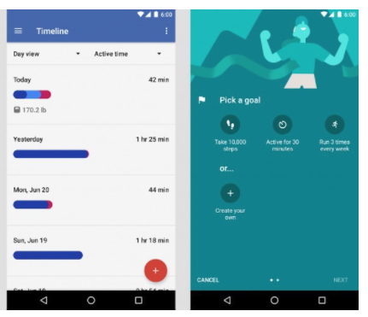
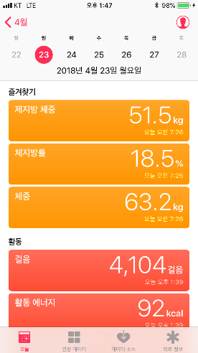
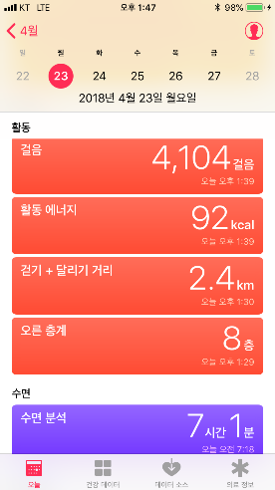

Applications in smartphone collecting health data
Samsung Medical Center
Diabetes Note
Apple Health
Google Fit
NOOM
Efil

Slide 7
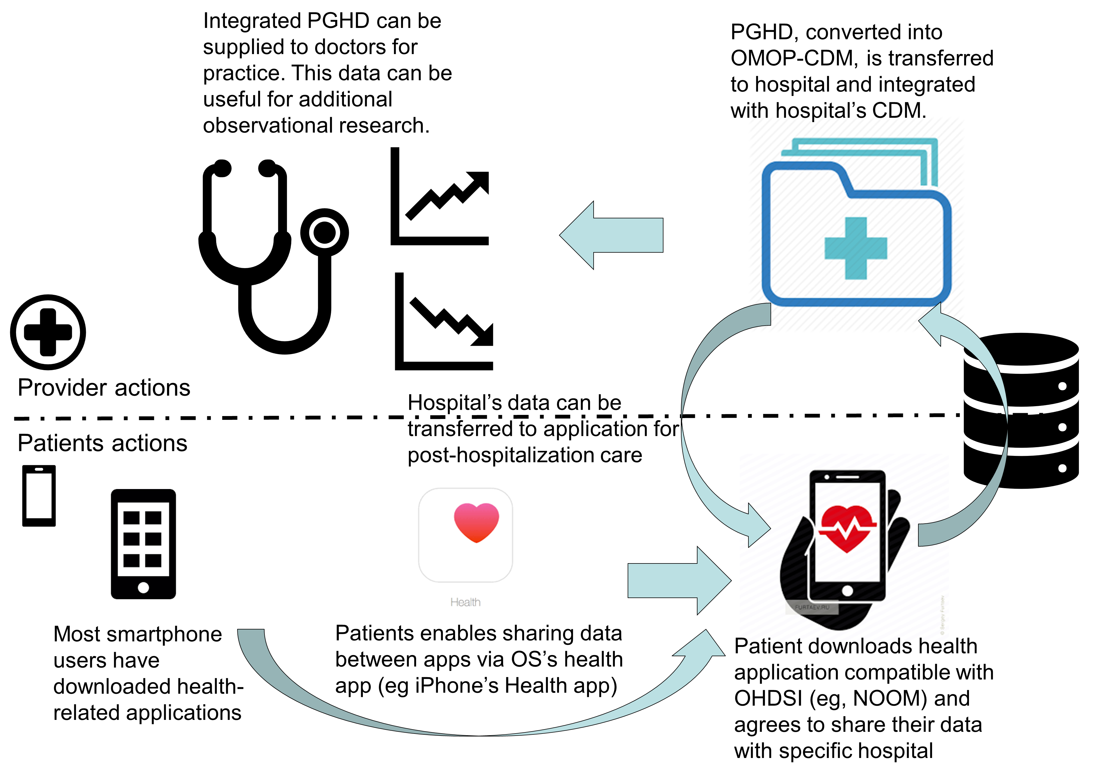
Schematic data flow

Slide 8
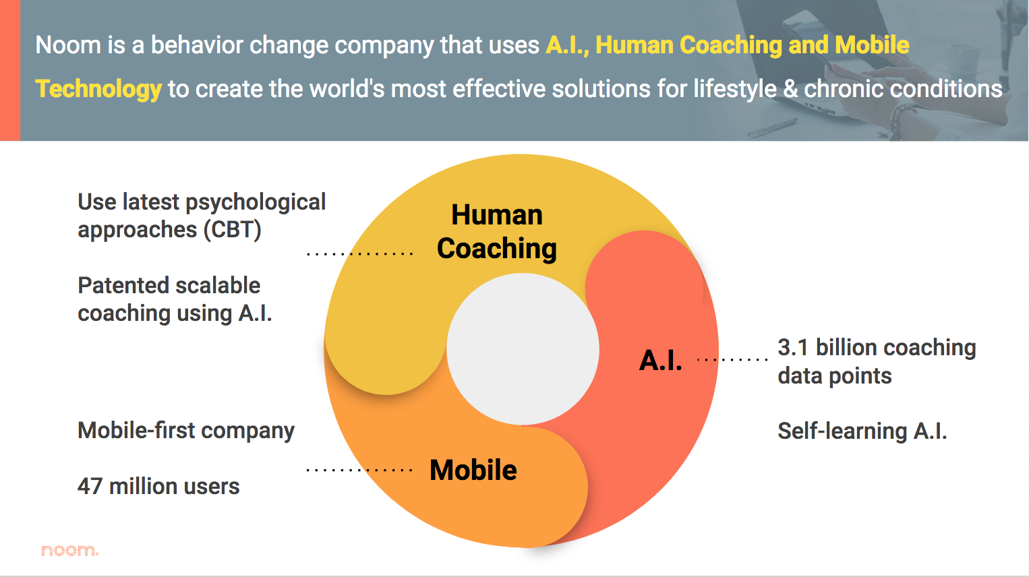
NOOM converted their data into CDM

Slide 9

NOOM converted their data into CDM

Slide 10
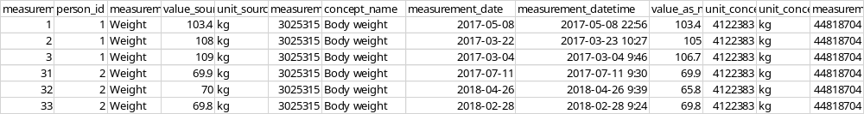
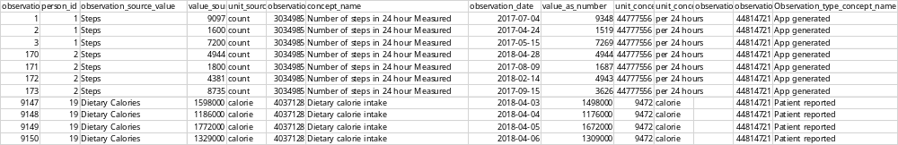
ETL result of sample data from NOOM
NOOM converted their sample data (n=100) into CDM
  weight, daily step count, and daily dietary calories
Notes:
Activity
Acceleration, Angular velocity unit value (GyroMeter)
Nutrition
Temporal relationship to meal
Sleep
Temporal relationship to sleep
Body measurements
Body location, Body posture, Ventilation cycle time
Self-report
Reason single medication does not taken
Environment & Etc
Ambient temperature, Geoposition, Magnetic force

Slide 11
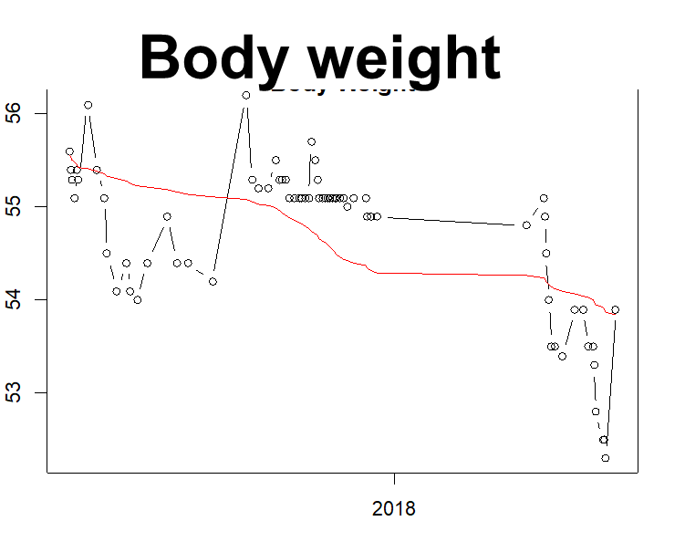
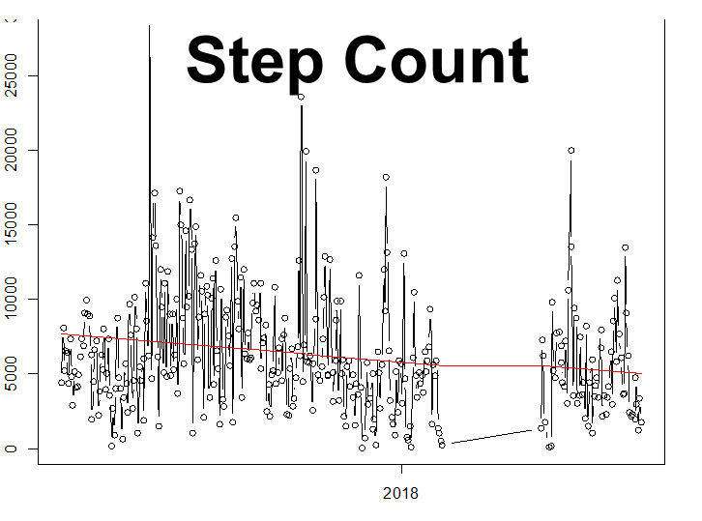
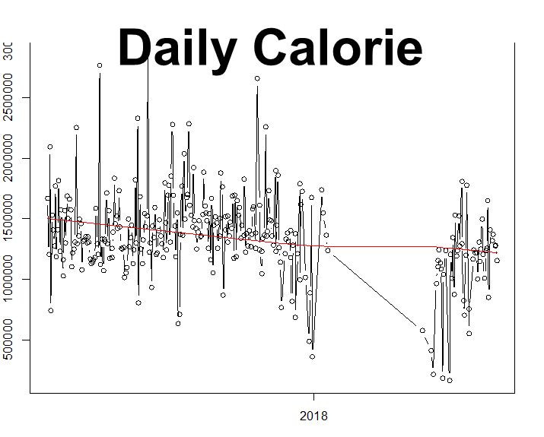
Visualization of irregular time-series data
Identification of trend in time-series data might be very difficult, if the patient records it irregularly.
By using dynamic linear regression, the trend can be shown in the plot (red line) for better understanding of the data.
Notes:
Activity
Acceleration, Angular velocity unit value (GyroMeter)
Nutrition
Temporal relationship to meal
Sleep
Temporal relationship to sleep
Body measurements
Body location, Body posture, Ventilation cycle time
Self-report
Reason single medication does not taken
Environment & Etc
Ambient temperature, Geoposition, Magnetic force

Slide 12
Common Data Model of Everything in Medicine
Clinical data
Environment
CDM Of Everything
Un-structured Text
Patient-Generated Data
Genomic data
Radiology
Seng Chan You, MD, MS¹, Kwang Soo Jeong¹, Si Hyung No², Kwon-Ha Yoon, MD, PhD³, Chang-Won Jeong, PhD², Rae Woong Park, MD, PhD^{1,4}
¹Department of Biomedical Informatics, Ajou University School of Medicine, Suwon, Korea;
²Imaging Science based Lung and Bone Disease Research Center, Wonkwang University, Iksan, Korea;
³Department of Radiology, Wonkwang University Colledge of Medicine
⁴Department of Biomedical Sciences, Ajou University Graduate School of Medicine, Suwon, Korea

Slide 13
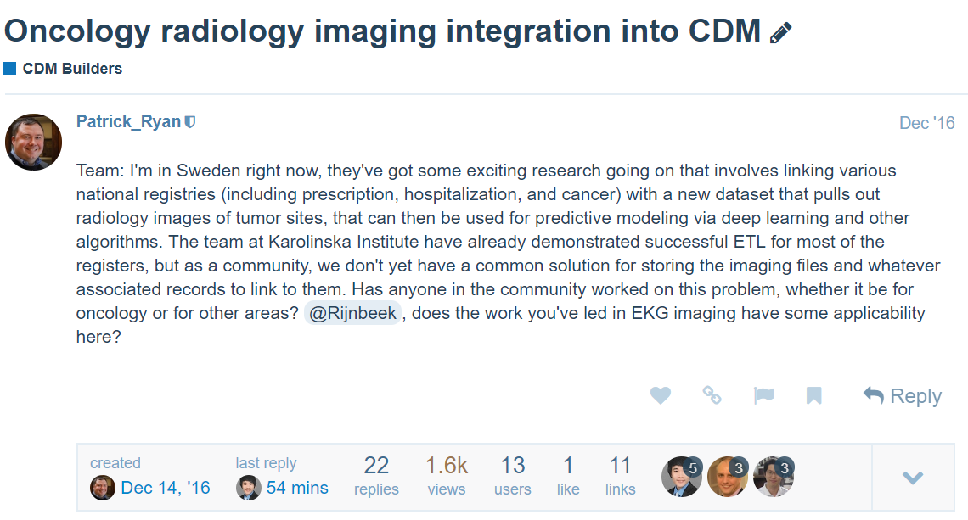
Why do we need
CDM extension for Radiology (R-CDM)?

Slide 14
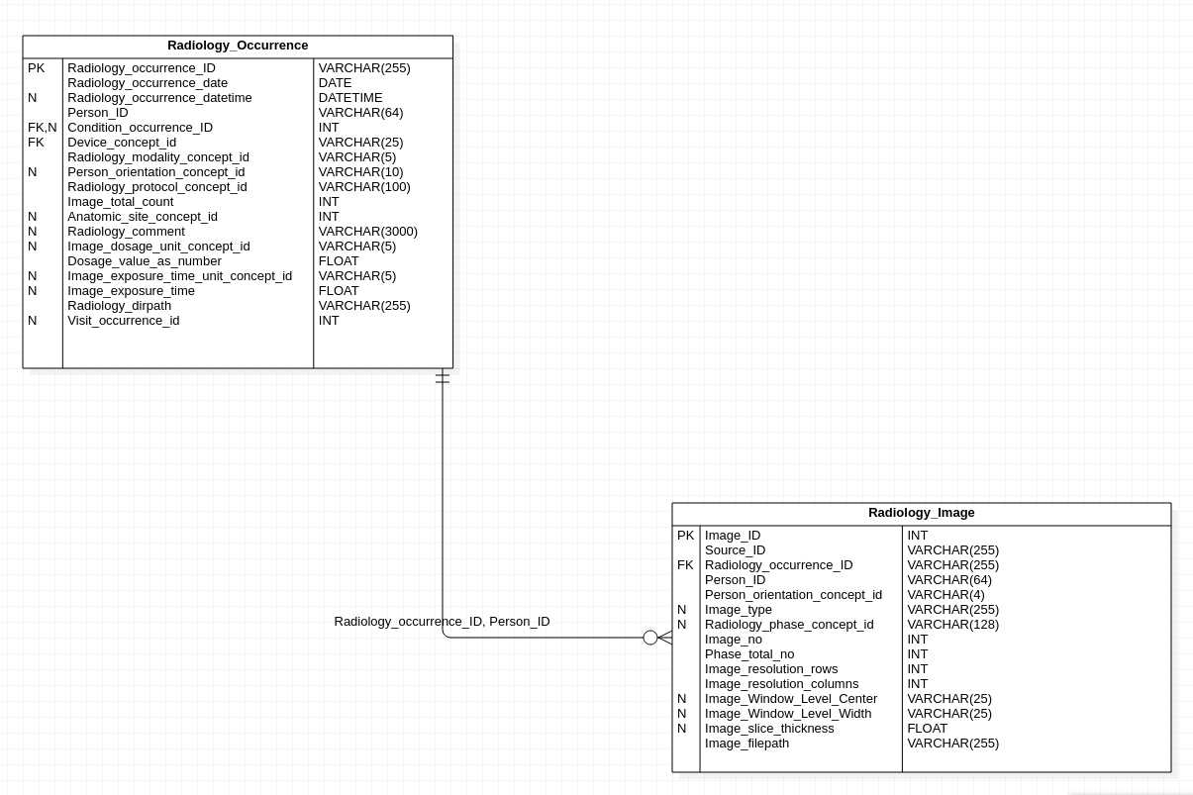
Basic concept for standardization of radiology data (R-CDM)
MetaData and Path of images are stored in two tables
  Radiology_Occurrence: each row represents single radiologic procedure
    Device, Modality(CT/MRI,…), Total image counts, Radiology dosages, path, and etc.
  Radiology_Image: each row represents single image from radiologic procedure
    Phase (Non-contrast/contrast), Image number, pixel data, path, and etc.
http://forums.ohdsi.org/t/oncology-radiology-imaging-integration-into-cdm/2018/23?u=scyou
Notes:
Kohli et al., “Medical Image Data and Datasets in the Era of Machine Learning—Whitepaper from the 2016 C-MIMI Meeting Dataset Session.” Journal of Digital Imaging (2017)
Kohli, Marc D., Ronald M. Summers, and J. Raymond Geis. “Medical Image Data and Datasets in the Era of Machine Learning—Whitepaper from the 2016 C-MIMI Meeting Dataset Session.” Journal of Digital Imaging 30, no. 4 (August 1, 2017): 392–99. https://doi.org/10.1007/s10278-017-9976-3.

Slide 15
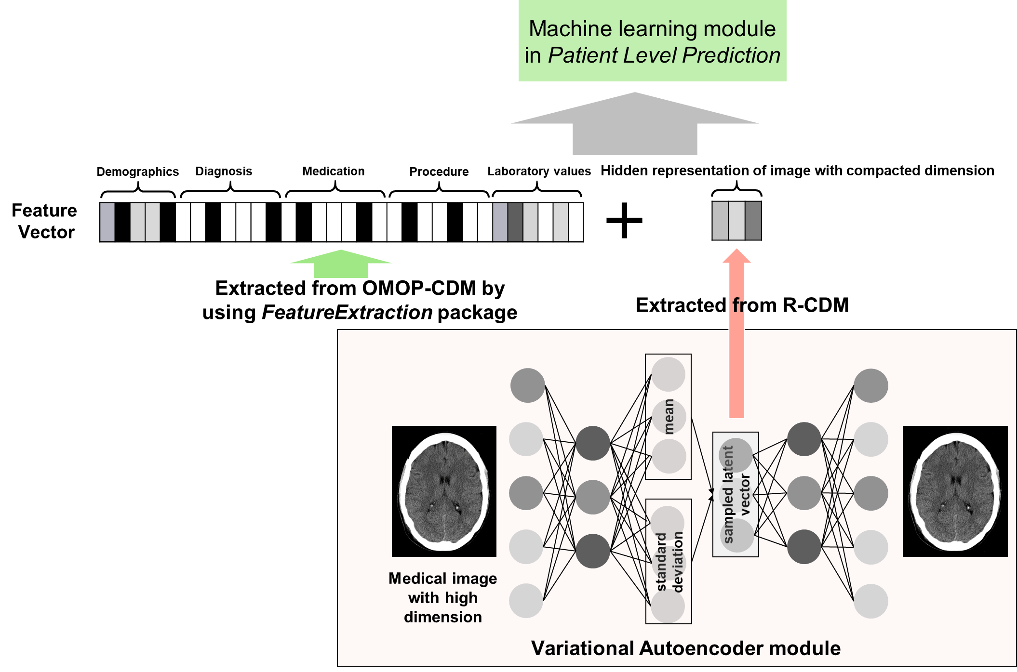
Combining structured medical information with hidden features from
Since usual radiology images have very high dimension, we propose to use hidden representation of images with compacted dimension by using deep learning auto-encoder

Slide 16
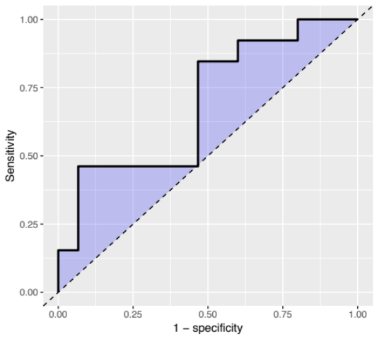
Pilot Study: Prediction of poor functional outcome in ischemic stroke
Study Design
  Target cohort: The patients with ischemic stroke (n= 141)
  Outcome: Poor functional outcome 3 months after stroke, which defined by modified Rankin Scale more than 3 (n= 64)
  Machine learning algorithm: Lasso logistic regression
  Covariates: age group, gender, index year, and procedures combined with latent feature vector extracted from non-contrast phase of brain CT
AUROC = 0.76

Slide 17
Common Data Model of Everything in Medicine
Clinical data
Environment
CDM Of Everything
Un-structured Text
Patient-Generated Data
Genomic data
Radiology
Seo Jeong Shin, MS¹, Seng Chan You, MD, MS¹, Jin Roh, MD, PhD², Rae Woong Park, MD, PhD^{1, 3}
¹Dept. of Biomedical Informatics, Ajou University School of Medicine, Suwon, South Korea; ²Dept. of Pathology, Ajou University Hospital, Suwon, South Korea; ³Dept. of Biomedical Sciences, Ajou University Graduate School of Medicine, Suwon, South Korea

Slide 19
Background: Surge of genomic data
Global waves of ‘precision medicine’
  Precision medicine initiative in US: Population of 1M, $215M
  Precision medicine initiative in China
Insurance coverage of NGS in Korea
  Since March 2017, national insurance coverage for targeted NGS in cancer patients has started in Korea.
  No. of target genes
    level 1: 5~50 (cost paid by the patient: $450)
    Level 2: 51~ (cost paid by the patient: $640)
Despite much progress, genomic and clinical data are still generally collected and studies in silos, in individual institutions, or individual nations

Slide 20
Genomic Test Process
Next Generation Sequencing (NGS)
[Clinvar] Pathogenic
p.Leu858Arg
[PolyPhen] Damaging
Exon19 Deletion
[SIFT] Deleterious
EGFR
[GNOMAD] 0.686792
p.Thr790Met
KRAS
BRAF

Slide 21
Genomic CDM (G-CDM) Structure
Schematic diagram of the relationship between the tables that make up the GCDM.

Slide 22


Conversion of G-CDM
The data structures of the two institutes were unified.
AJOU Data
TCGA Data
AJOU GCDM
TCGA GCDM

Slide 23
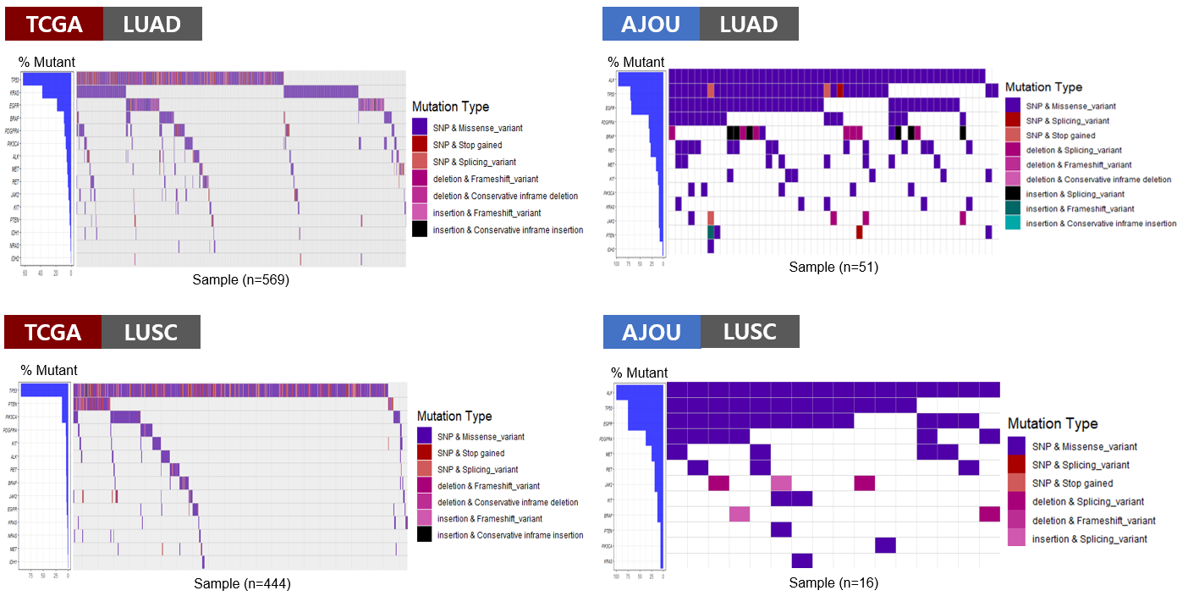
Study Results:
Waterfall plot of adenocarcinoma and squamous cell carcinoma of lung

Slide 24
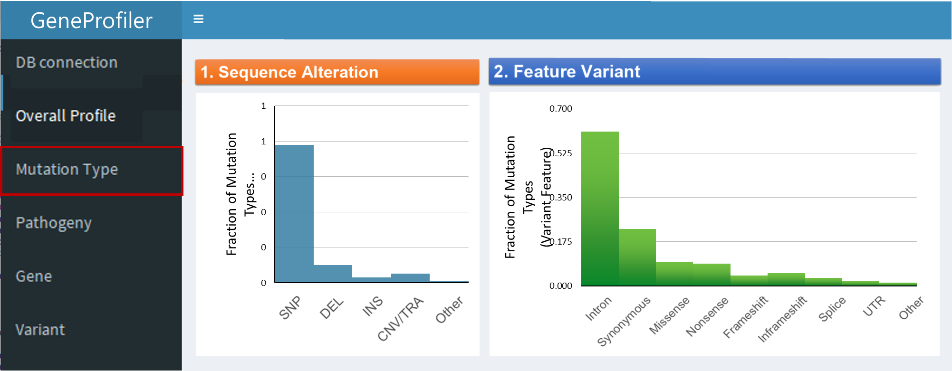
Gene profiler:
Visualization of structural and functional variant

Slide 25
Gene profiler:
Visualization of structural and functional variant

Slide 26
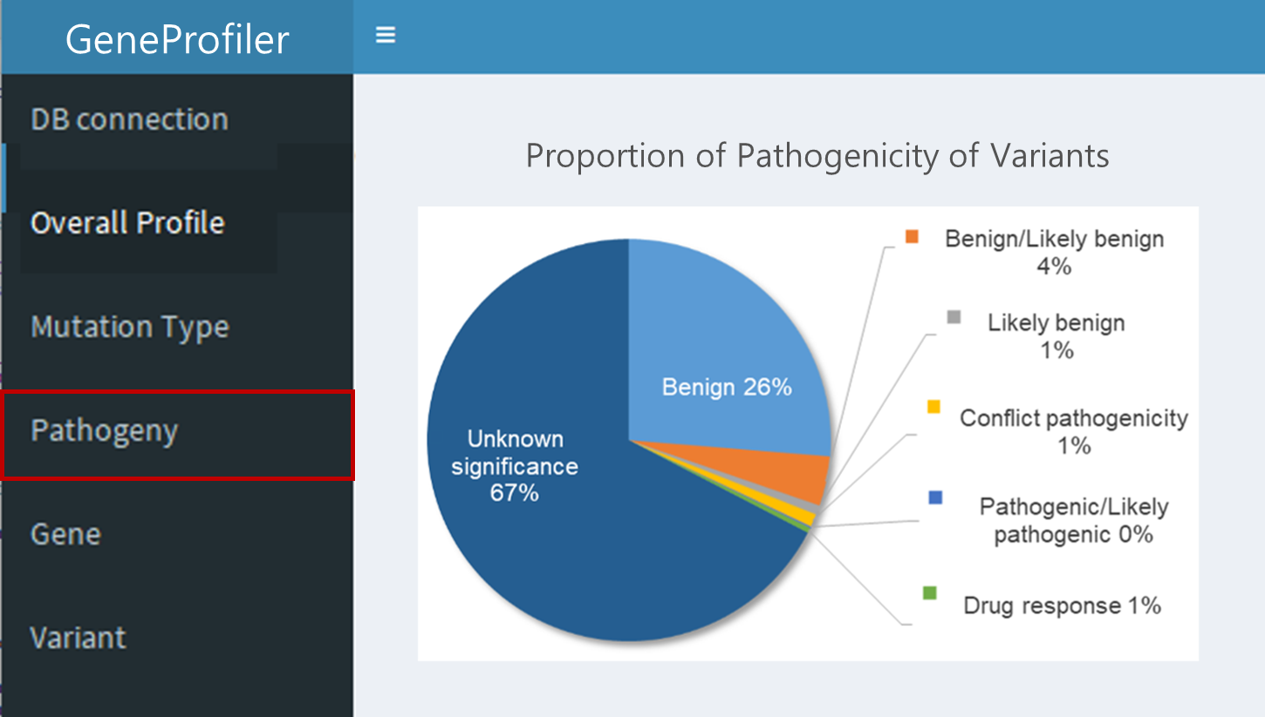
Gene profiler:
Visualization of proportion of pathogenicity of variants

Slide 27
Connecting the missing link for big biomedical data
Weber et al., “Finding the Missing Link for Big Biomedical Data.” JAMA (June 25, 2014)

Slide 28
Common Data Model of Everything in Medicine
Clinical data
Environment
CDM Of Everything
Un-structured Text
Patient-Generated Data
Genomic data
Radiology
Giup Jang¹, Seng Chan You, MD², Dongsu Park², Youngmi Yoon, PhD³, Rae Woong Park, MD, PhD^{2,4}
¹Department of Biomedical Informatics, Ajou University School of Medicine, Suwon, Korea;
²Imaging Science based Lung and Bone Disease Research Center, Wonkwang University, Iksan, Korea;
³Department of Radiology, Wonkwang University Colledge of Medicine
⁴Department of Biomedical Sciences, Ajou University Graduate School of Medicine, Suwon, Korea

Slide 29
Cross-Language Natural Language Processing based on OMOP-CDM
We aim to develop the cross-language natural language processing (NLP) module for medical free-text in OMOP-CDM by using topic modeling.
To demonstrate the feasibility, we build prediction model for 30-day readmission through emergency room by combining features from structured clinical data and unstructured free-text in discharge note in OMOP-CDM

Slide 30
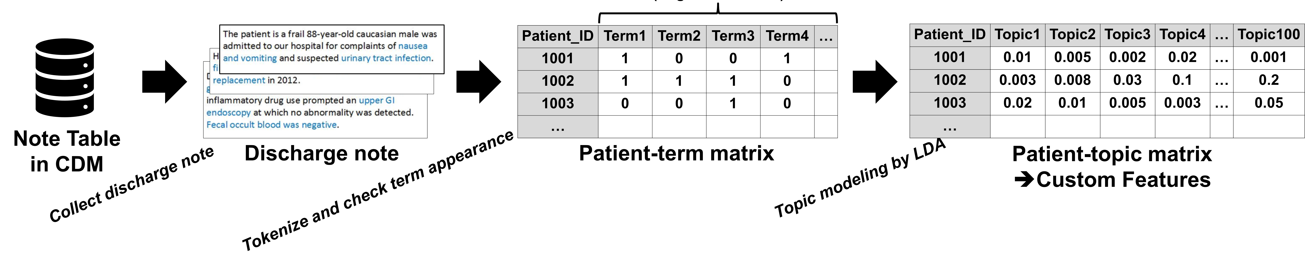
Overall Process
Tokenization of medical free-text based on medical dictionary
Tokenization is to divide a sentence into a minimum number of meaningful units.
Topic modeling by Latent Dirichlet Allocation (LDA)
Topic modeling allows a document to have multiple topics and to analyze the characteristics of the document in more detail than common cluster method.
LDA is one of the topic modeling algorithm, and it is highly modular and can be easily extended.
Extracting features from note
Values for each topic estimated from the note by topic modeling were allocated into individual covariates. We developed noteCoavariateExtraction function, which is compatible with OHDSI tool ecosystem (https://github.com/OHDSI/StudyProtocolSandbox/tree/master/noteCovariateExtraction).

Slide 31
Overall Process
Tokenization of medical free-text based on medical dictionary
Tokenization is to divide a sentence into a minimum number of meaningful units.
Topic modeling by Latent Dirichlet Allocation (LDA)
Topic modeling allows a document to have multiple topics and to analyze the characteristics of the document in more detail than common cluster method.
LDA is one of the topic modeling algorithm, and it is highly modular and can be easily extended.
Extracting features from note
Values for each topic estimated from the note by topic modeling were allocated into individual covariates. We developed noteCoavariateExtraction function, which is compatible with OHDSI tool ecosystem (https://github.com/OHDSI/StudyProtocolSandbox/tree/master/noteCovariateExtraction).

Slide 32
Overall Process
Tokenization of medical free-text based on medical dictionary
Tokenization is to divide a sentence into a minimum number of meaningful units.
Topic modeling by Latent Dirichlet Allocation (LDA)
Topic modeling allows a document to have multiple topics and to analyze the characteristics of the document in more detail than common cluster method.
LDA is one of the topic modeling algorithm, and it is highly modular and can be easily extended.
Extracting features from note
Values for each topic estimated from the note by topic modeling were allocated into individual covariates. We developed noteCoavariateExtraction function, which is compatible with OHDSI tool ecosystem (https://github.com/OHDSI/StudyProtocolSandbox/tree/master/noteCovariateExtraction).

Slide 33
Experiments
Building prediction model for readmission through emergency room to validate feasibility and usefulness of proposed NLP process
Target cohort at risk: Subjects who admitted to the hospital and stayed 7 days or more from 1st January 2005 to 1st December 2017.
Outcome cohort: Subjects who readmitted through emergency room within 30 days after discharge
Covariates from conventional CDM: Gender, age group, race, ethnicity, index year, index month and condition within 30 days

Slide 34
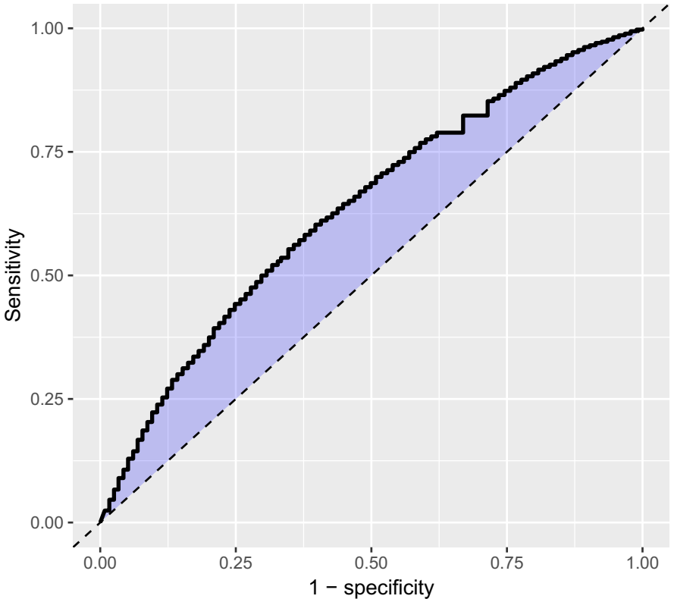
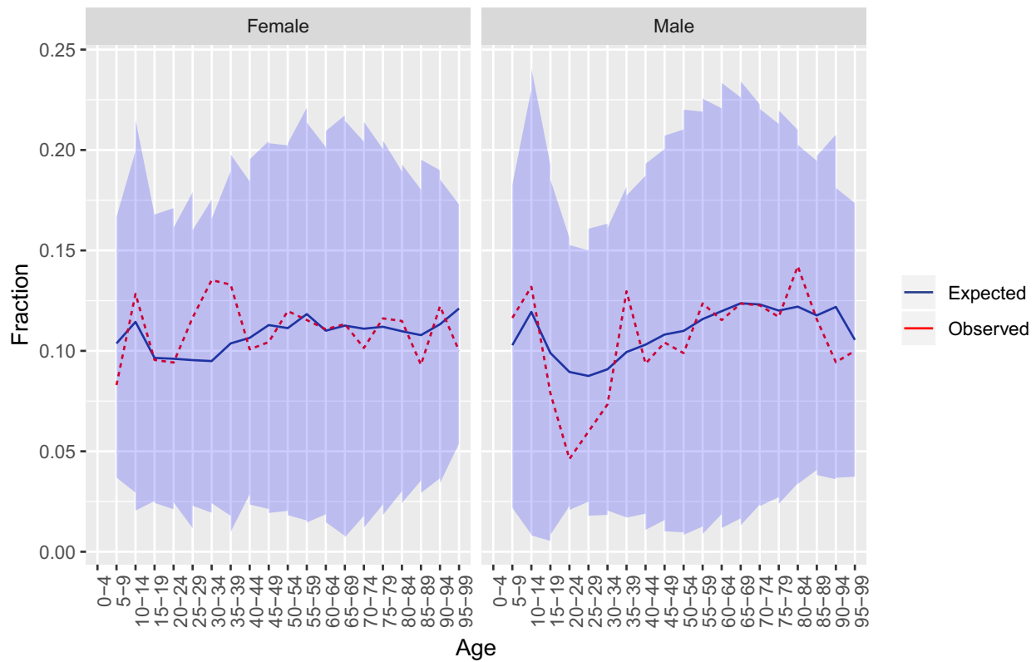
Experiments-result
AUROC: 0.64

Slide 35
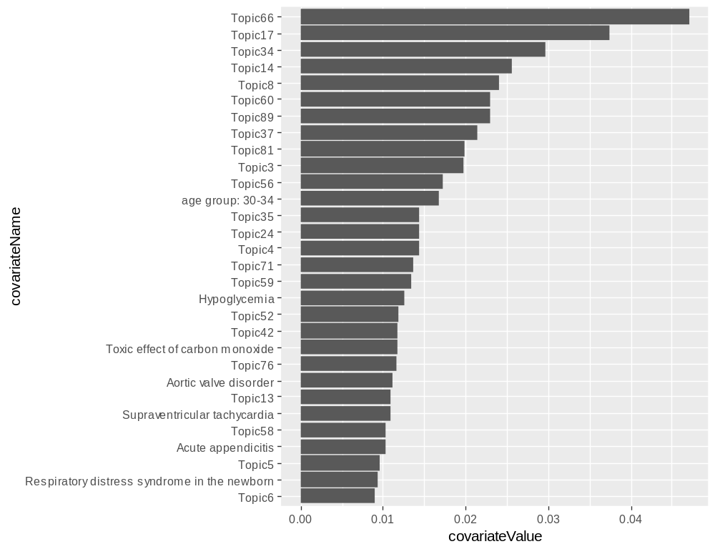
Top 30 most important values
Among the most important top 30 variables, 23 variables (77%) from topics were included. Other than variables from the free-text of discharge note, age group 30 to 34, hypoglycemia, toxic effect of carbon monoxide, aortic valve disorder, supraventricular tachycardia, acute appendicitis and respiratory distress syndrome in newborn were important variables

Slide 36
Connecting the missing link for big biomedical data
Weber et al., “Finding the Missing Link for Big Biomedical Data.” JAMA (June 25, 2014)

Slide 37
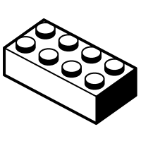
Data are Like Lego Bricks for Phenotyping in CDM
Conditions
Drugs
Procedures
Measurements
Observations
Visits

Slide 38
Data are Like Lego Bricks for Phenotyping in CDM
Conditions
Genomic variants
Drugs
Radiology
Procedures
Topics from Free-Text
Measurements
Patient-Generated Health Data
Observations
Visits
Environment

Slide 39
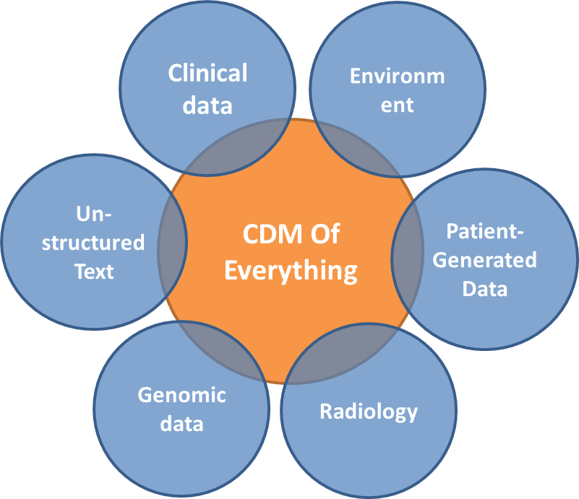

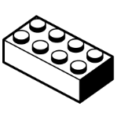
OHDSI Tools Ecosystem with CDM of Everything
CDM of
Everything
DATABASE
CONNECTION
Phenotyping &
Cohort Generation
Feature
Extraction
Prediction &
Estimation
Patient Level Prediction
s
Database Connector
Build and evaluate predictive models for user-specified outcomes, using a wide array of machine learning algorithms.
s
Connect directly to a wide range of database platforms, including SQL Server, Oracle, and PostgreSQL.
ATLAS
Feature Extraction
s
s
Cohort generation by Phenotyping
Automatically extract large sets of features for user-specified cohorts using data in the CDM.
Sql Render
s
Generate SQL on the fly for the various SQL dialects.
Cohort Method
s
New-user cohort studies using large-scale regression for propensity and outcome models
Symmetry in medical data
By grand unification across all aspects of health data, various types of medical data would be indistinguishably accessible in the single database
OHDSI tools ecosystem can work across various types of medical data

Slide 40

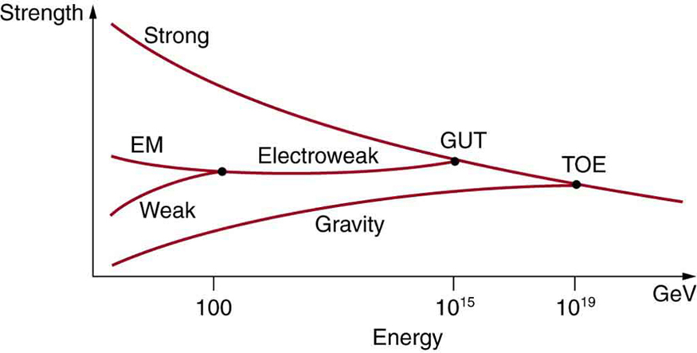
OHDSI: A Journey for Simplicity, Beauty and Symmetry in Medical Data
CDM Of Everything

Slide 41


