Slide 1
External Validation of Existing Stroke Risk Models

Slide 2
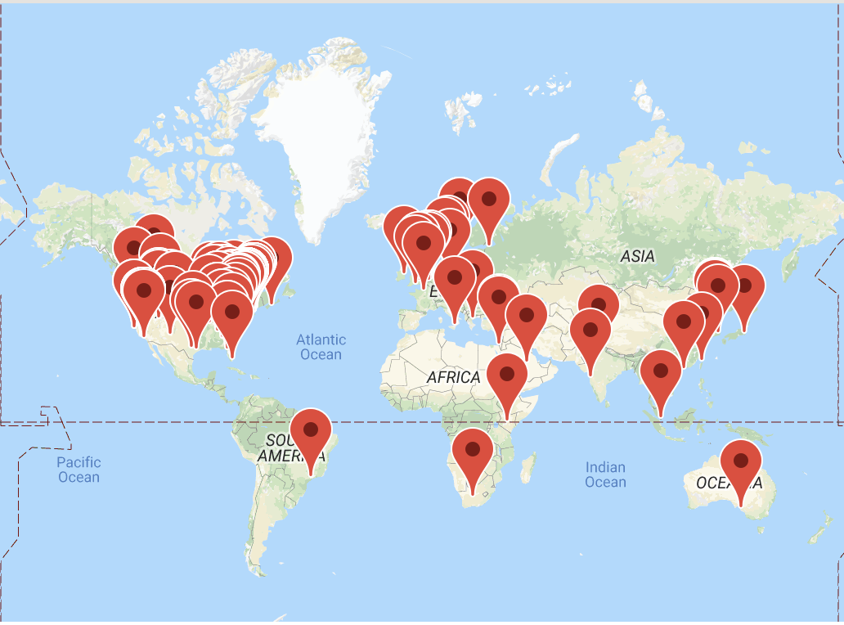
Evaluating Existing Risk Models Using the Patient-Level Prediction Package
We now have functions that enable you to add existing risk score or generalized linear models for evaluation across the OHDSI network
Studies have shown external validation before OHDSI took years… at the symposium we showed it can be done in hours!

Slide 3
Part 1: Evaluating Existing Risk Models Using the Patient-Level Prediction Package
You need three tables:
Model table (specifies the coefficient value for each covariate of the model)
Covariate definition tables (specifies a set of standard covariates from the Feature Extraction package that make up the model covariate)
Intercept table (the intercept value for the model)
You also need to specify the analysis_id settings for the standard covariates with a covariateSetting

Slide 4
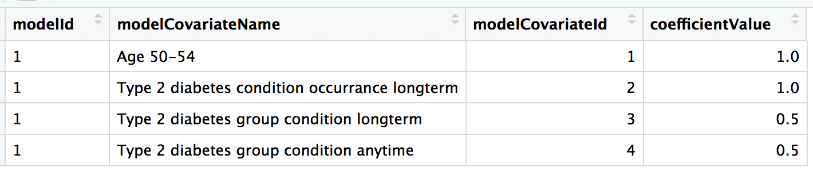
Model table
Add example…
The same model so the id is 1 (can do multiple models at a time by using different modelIds)
Specifies the coefficient value for each of the model’s covariates

Slide 5
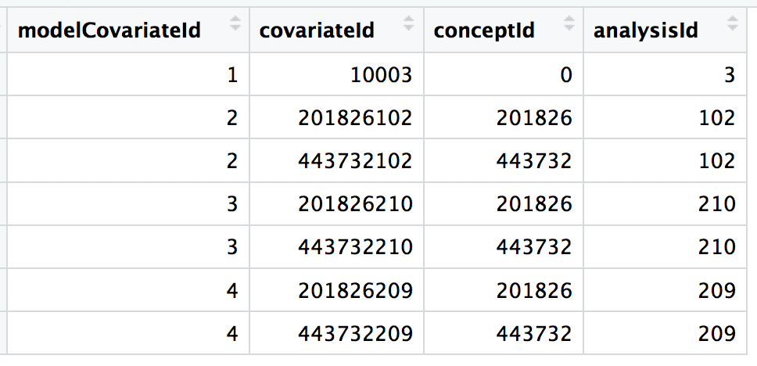
Covariate table
This columns are not needed but are used to construct the covariateId
Add example…
This columns are needed

Slide 6
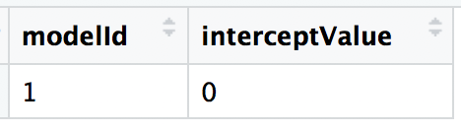
Intercept table
No intercept – so set to 0

Slide 7
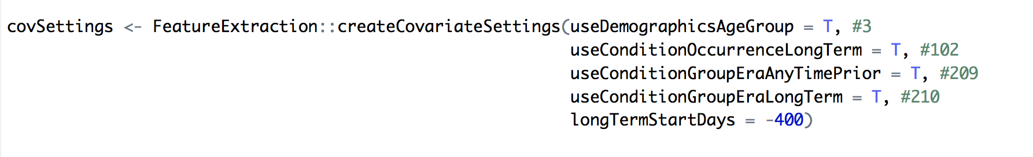
CovariateSettings
This needs to link up to any analysisIds you used in the covariate table (in the example on slide 5 I used analysisIds: 3 (ageGroup), 102 (conditionOccurrenceLongTerm), 210 (conditionGroupEraLongTerm) and 209 (conditionGroupEraAnyTimePrior)
102/209/210 are all longTerm – so I can set the model to use the prior 400 days for the variables by setting longTermStartDays = - 400

Slide 8
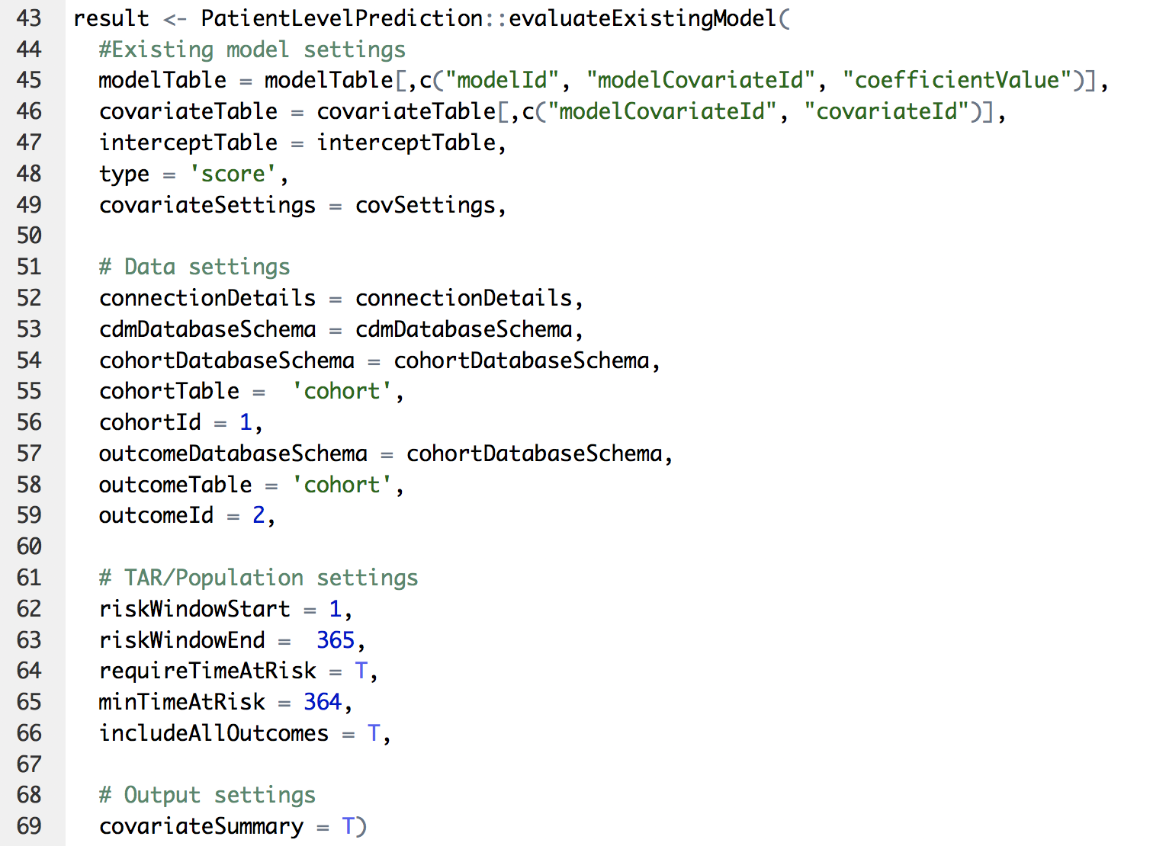
Putting it all together
This code will then apply the score model previously specified for the target population (cohort definition 1 in the cohort table) and evaluate it using the ground truth (outcome defined as cohort definition 2 in the cohort table) where TAR is 1 day to 365 days after the target cohort start date.

Slide 9
Part 2: External Validation of Stroke Risk Models
Prediction Question 1: Within a target population of female patients with newly diagnosed atrial fibrillation predict who will develop a stroke 1 day until 365 days after diagnosis of atrial fibrillation.
Prediction Question 2: Within a target population of female patients ages 65+ with newly diagnosed atrial fibrillation predict who will develop a stroke 1 day until 365 days after diagnosis of atrial fibrillation.

Slide 10
Part 2: External Validation of Stroke Risk Models
We used the framework previously described to add five existing stroke risk models:
Variable | ATRIA | Framingham | CHADS2 | CHADS2VASc | Qstroke
Age | x | x | x | x
Female | x | x |  | x
Diabetes | x | x | x | x | x
CHF | x |  | x |  | x
Prior Stroke or TIA |  | x | x | x
Hypertension | x |  | x | x | x
Systolic blood pressure |  | x |  |  | x
Total cholesterol:HDL cholesterol ratio |  |  |  |  | x
Townsend deprivation score |  |  |  |  | x
Proteinuria | x
eGFR<45 or ESRD | x
Vascular disease |  |  |  | x
CHF or LV disease |  |  |  | x
Smoking status |  |  |  |  | x
Ethnicity |  |  |  |  | x
CHD |  |  |  |  | x
FH of CHD |  |  |  |  | x
Atrial fibrillation |  |  |  |  | x
Rheumatoid arthritis |  |  |  |  | x
Chronic renal disease |  |  |  |  | x
Valvular heart disease |  |  |  |  | x

Slide 11
Part 2: External Validation of Stroke Risk Models
Validation:
 | ATRIA | Framingham | CHADS2 | CHADS2VASc | Qstroke
Internal AUROC
 | 0.72 |  | 0.82 | 0.61 | 0.81
External AUROCs
UK EMR 2015 [8] | 0.7 (0.69-0.71) | - | 0.68 (0.67-0.69) | 0.68 (0.67-0.69) | -
Swedish EMR 2016 [9] | 0.71 (0.70-0.71) | - | 0.69 (0.69-0.70) | 0.69 (0.69-0.70) | -
Taiwan 2016 [10] | - | - | 0.66 | 0.70 | -
New Zealand, Russia and the Netherlands 2014 [11] | - | 0.70 (0.68-0.73) | - | - | 0.71 (0.69-0.73)
UK EMR 2010 [12] | - | 0.65 (0.63-0.68) | 0.66 (0.64-0.68) | 0.67 (0.65-0.69) | -

Slide 12
Part 2: External Validation of Stroke Risk Models
The package is on Github:
https://github.com/OHDSI/StudyProtocolSandbox/tree/master/ExistingStrokeRiskExternalValidation

Slide 13
Results
We have results from 5 databases at the moment:
Target Population | Model | CCAE | MDCD | MDCR | Optum claims | Optum EHR
T1: Females aged 65+ with atrial fibrillation no prior stroke or anticoagulants | ATRIA | - | 0.57 (0.55-0.58) | 0.63 (0.62-0.64) | 0.61 | 0.62
 | CHADS2 | - | 0.54 (0.53-0.56) | 0.60 (0.59-0.61) | 0.59 | 0.60
 | CHADS2VAS | - | 0.55 (0.53-0.57) | 0.60 (0.59-0.61) | 0.59 | 0.62
 | Framingham | - | 0.55 (0.53-0.56) | 0.59 (0.58-0.60) | 0.56 | 0.58
 | QStroke | - | 0.53 (0.52-0.55) | 0.56 (0.55-0.57) | 0.55 | 0.56
T2: Females with atrial fibrillation no prior stroke or anticoagulants | ATRIA | 0.62 (0.60-0.64) | 0.58 (0.56-0.59) | - | 0.65 | 0.65
 | CHADS2 | 0.61 (0.59-0.62) | 0.56 (0.55-0.57) | - | 0.62 | 0.63
 | CHADS2VAS | 0.63 (0.61-0.65) | 0.58 (0.56-0.59) | - | 0.64 | 0.65
 | Framingham | 0.61 (0.59-0.63) | 0.56 (0.55-0.58) | - | 0.61 | 0.62
 | QStroke | 0.61 (0.59-0.63) | 0.54 (0.53-0.56) | - | 0.57 | 0.58

Slide 14
Results
But now we want you to run it:
Target Population | Model | CCAE | MDCD | MDCR | Optum claims | Optum EHR | Your Database
T1: Females aged 65+ with atrial fibrillation no prior stroke or anticoagulants | ATRIA | - | 0.57 (0.55-0.58) | 0.63 (0.62-0.64) | 0.61 | 0.62
 | CHADS2 | - | 0.54 (0.53-0.56) | 0.60 (0.59-0.61) | 0.59 | 0.60
 | CHADS2VAS | - | 0.55 (0.53-0.57) | 0.60 (0.59-0.61) | 0.59 | 0.62
 | Framingham | - | 0.55 (0.53-0.56) | 0.59 (0.58-0.60) | 0.56 | 0.58
 | QStroke | - | 0.53 (0.52-0.55) | 0.56 (0.55-0.57) | 0.55 | 0.56
T2: Females with atrial fibrillation no prior stroke or anticoagulants | ATRIA | 0.62 (0.60-0.64) | 0.58 (0.56-0.59) | - | 0.65 | 0.65
 | CHADS2 | 0.61 (0.59-0.62) | 0.56 (0.55-0.57) | - | 0.62 | 0.63
 | CHADS2VAS | 0.63 (0.61-0.65) | 0.58 (0.56-0.59) | - | 0.64 | 0.65
 | Framingham | 0.61 (0.59-0.63) | 0.56 (0.55-0.58) | - | 0.61 | 0.62
 | QStroke | 0.61 (0.59-0.63) | 0.54 (0.53-0.56) | - | 0.57 | 0.58

Slide 15
Discussion – Methodology
The framework enables quick external validation of risk models (existing or new)
Open repository means people can add new models for benchmarking

Slide 16
Discussion – Clinical
We found the performance of the existing models depended on the definition of stroke (need improved phenotype)
None of the models performed well in older females – do we need a different model for older patients?
Can the kitchen sink approach in PLP lead to an improved model? If it does, is there value in a more complex model?

Slide 17
Conclusion
The OHDSI standardizations mean we can improve the external validation process to see how models perform across a variety of datasets
The github repository for models makes benchmarking easy
Maybe we need better stroke risk models – specifically for older patients
If you want to be involved in this study please run the github package – we will submit this for publication soon and anyone who runs the package will be an author (if you review the paper and are happy with it).

Slide 18


Questions?
jreps@its.jnj.com
Notes:
I like to keep these two slides in, they will not take time.

