Slide 1

Global collaborative research through OHDSI network:
Febuxostat vs Allopurinol
Seng Chan You MD; Ju-Yang Jung, MD; Chang-Hee Su, MD, PhD; Rae Woong Park, MD, PhD
Ajou University School of Medicine, Suwon, Korea

Slide 2
Background: Pharmacologic treatment in gout
Febuxostat is widely used urate-lowering agent because it is more effective than allopurinol to lower serum urate in patients with gout.
Furthermore, febuxostat can be used without dosage adjustment in chronic kidney disease.
Notes:
White, William B., Kenneth G. Saag, Michael A. Becker, Jeffrey S. Borer, Philip B. Gorelick, Andrew Whelton, Barbara Hunt, Majin Castillo, and Lhanoo Gunawardhana. “Cardiovascular Safety of Febuxostat or Allopurinol in Patients with Gout.” New England Journal of Medicine 0, no. 0 (March 12, 2018): null. https://doi.org/10.1056/NEJMoa1710895.

Slide 3
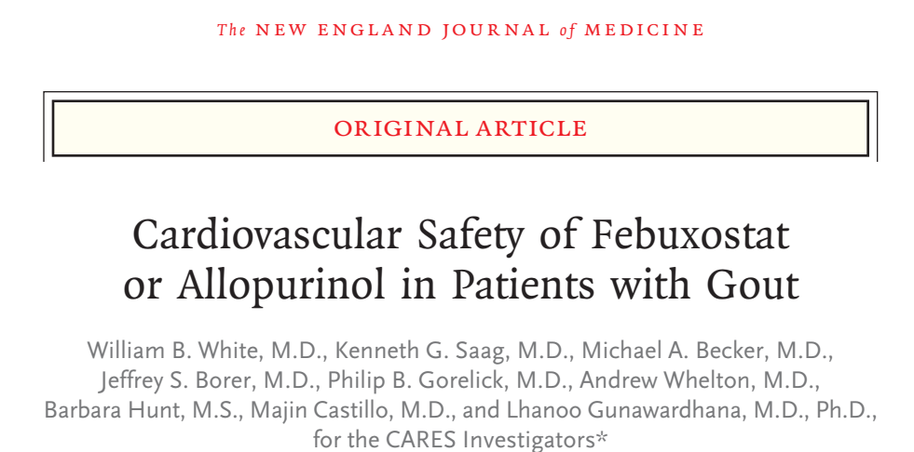
Background: Recent study about cardiovascular safety of febuxostat vs allopurinol in gout
White et al., NEJM, Mar 2018
Notes:
White, William B., Kenneth G. Saag, Michael A. Becker, Jeffrey S. Borer, Philip B. Gorelick, Andrew Whelton, Barbara Hunt, Majin Castillo, and Lhanoo Gunawardhana. “Cardiovascular Safety of Febuxostat or Allopurinol in Patients with Gout.” New England Journal of Medicine 0, no. 0 (March 12, 2018): null. https://doi.org/10.1056/NEJMoa1710895.

Slide 4
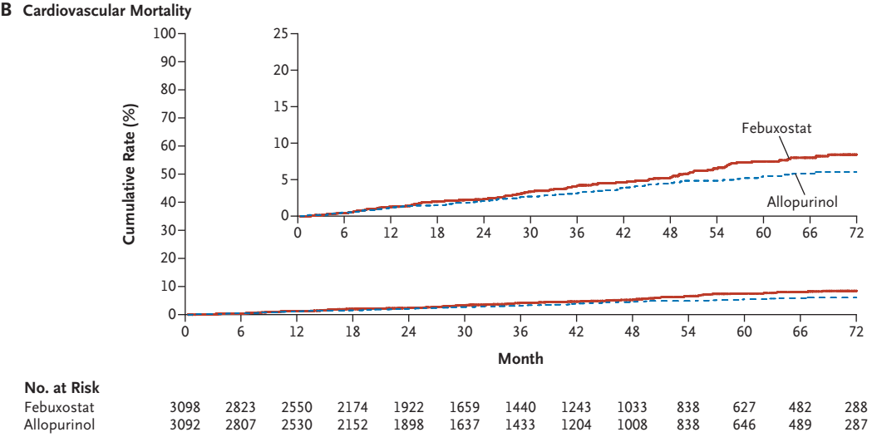
Background: Recent study about cardiovascular safety of febuxostat vs allopurinol in gout
White et al., NEJM, Mar 2018

Slide 5
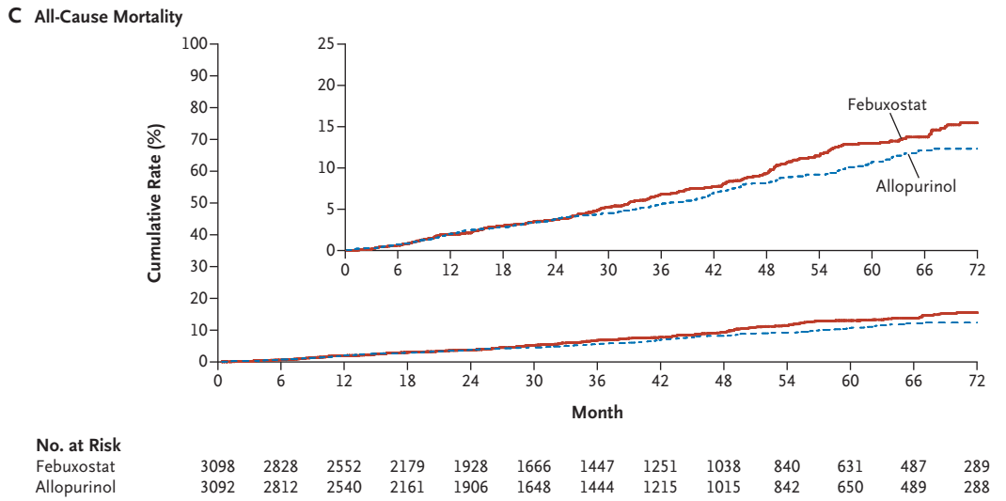
Background: Recent study about cardiovascular safety of febuxostat vs allopurinol in gout
White et al., NEJM, Mar 2018

Slide 6
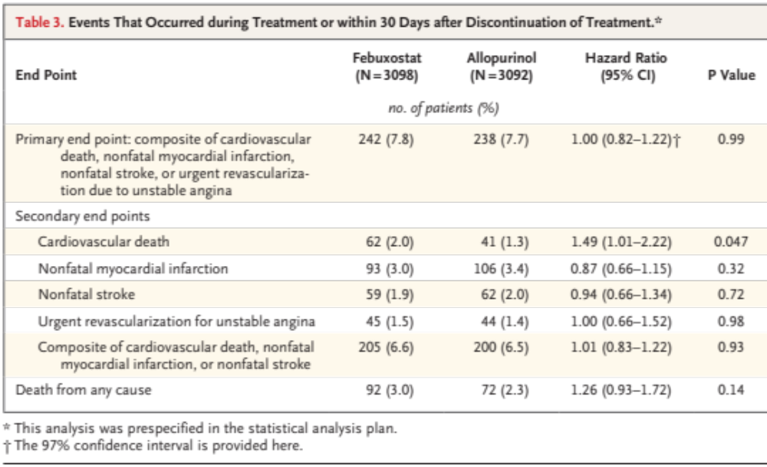
Event between febuxostat and allopurinol
White et al., NEJM, Mar 2018

Slide 7
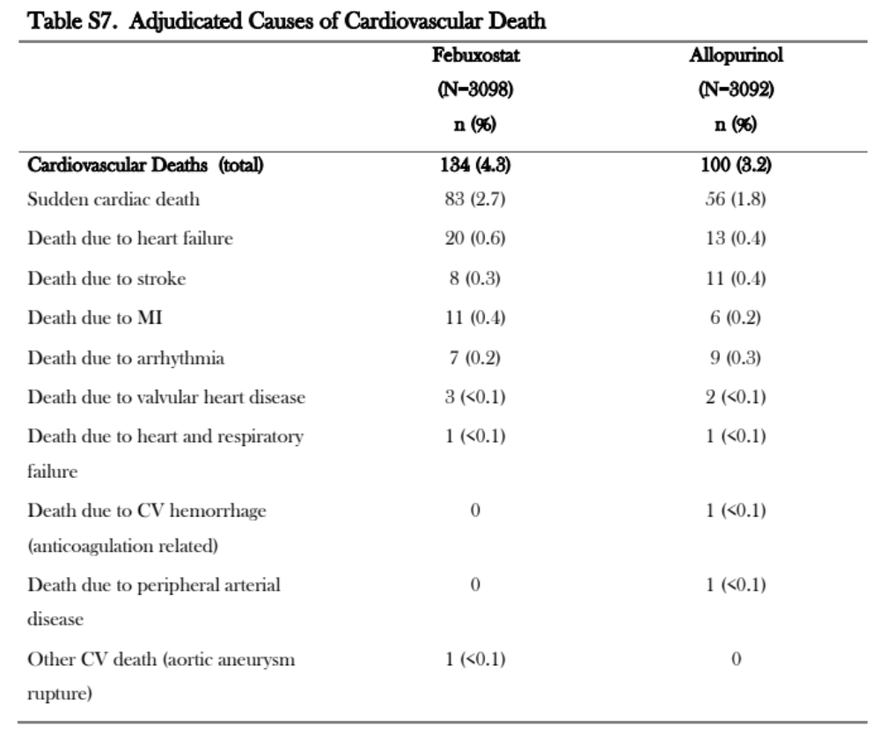
The cause of CV death in CARES
White et al., NEJM, Mar 2018

Slide 8
AIM
Head-to-head comparison of the sudden cardiac death risk between febuxostat and allopurinol across OHDSI network

Slide 9
Method: Study Population
All subjects will be included who meet the following criteria (note: the index date is the start of the first exposure to febuxostat or allopurinol) :
Exposure to febuxostat (treatment) or allopurinol (comparator) more than 30 days
A diagnose of gout disorder on within 30 months prior to the index date
No diagnosis of the myeloproliferative disorder or primary malignant neoplasm of bone marrow preceding the index date
No diagnosis of the xanthinuria preceding the index date
Without other uricosuric drug within preceding 1 year
https://github.com/OHDSI/StudyProtocolSandbox/tree/master/FebuxostatVsAllopurinolCVD

Slide 10
Method: Study Population
Primary endpoint: Sudden Cardiac Death
Defined by diagnosis code for sudden cardiac death or ventricular fibrillation and flutter
Secondary endpoint
All-cause mortality
Hospitalized acute myocardial infarction
Hospitalized heart failure
Hospitalized stroke
Drug hypersensitivity: occurrence of toxic epidermal necrolysis (TEN), Stevens-Johnson syndrome (SJS), or drug reaction with eosinophilia and systemic symptoms (DRESS) syndrome
Gout flare: Emergency room visit with drug for gout flare or procedure for gout flare
https://github.com/OHDSI/StudyProtocolSandbox/tree/master/FebuxostatVsAllopurinolCVD

Slide 11
Method: Statistical Analysis
Time-at-risk: From 1 day after index date to 30 days after termination of the drug of interest. Maximum of 30-day gap was allowed between drug exposures.
Large-scale Propensity score matching:
Sensitivity analyses include:
  No PS model
  Using stratification based on PS with ten equally-sized strata.
  Variable ratio matching on the PS.
All analyses will be repeated using an intent-to-treat risk window definition, which starts on treatment initiation, and ends when observation ends.
Because PS between groups have not been matched because of small sample size, only results without PS matching are shown
https://github.com/OHDSI/StudyProtocolSandbox/tree/master/FebuxostatVsAllopurinolCVD

Slide 12
Method: Data sources
Korea
  NHIS-national sample cohort (NHIS-NSC) DB
    1M patients, 2002-2013
    Febuxostat was adopted in Korea since 2013
Lee et al., Int J Epidemiol. 2016

Slide 13
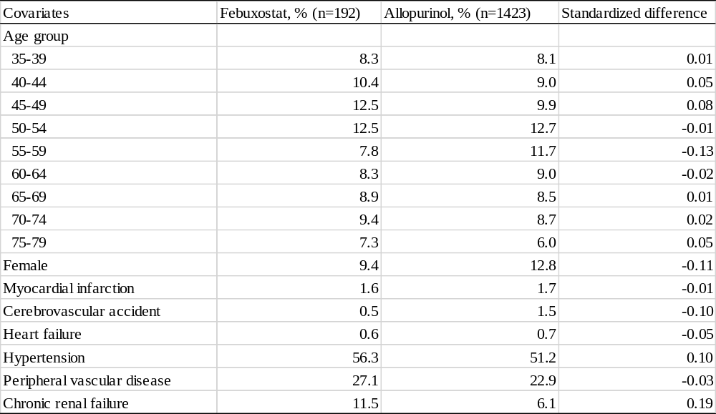
Results: Baseline characteristics

Slide 14
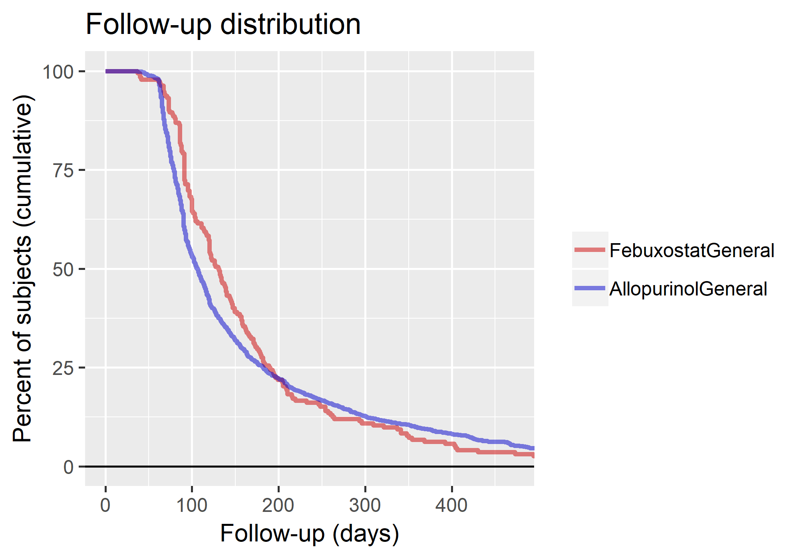
Drug continuation period
Follow-up duration distribution shows that less than 20% of patients with maintained urate-lowering agents more than one year in real-world practice (Fig 1).

Slide 15
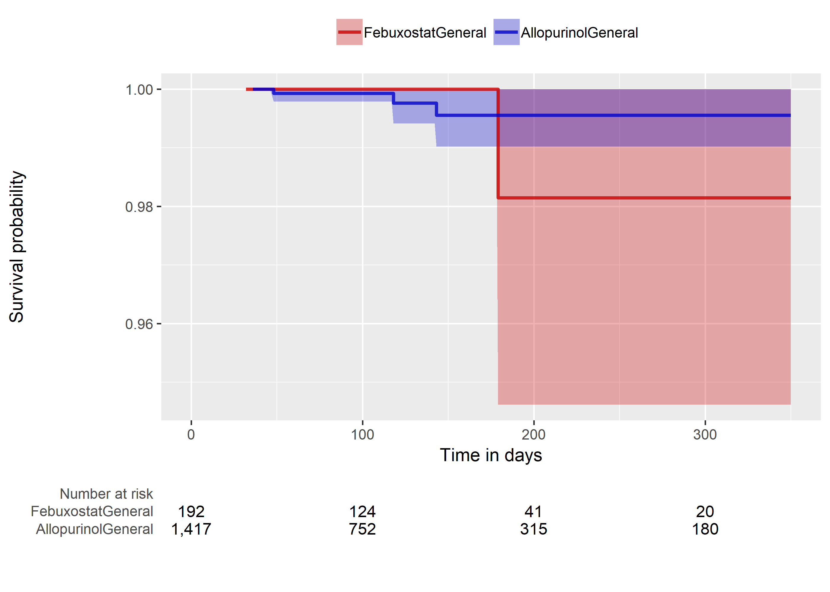
Risk of sudden cardiac death without PS matching
P = 0.56
Sudden cardiac death occurred more in febuxostat compared to allopurinol group. The hazard ratio was not significantly different between groups (HR = 2.1, 95% CI = 0.10-16.5)

Slide 16
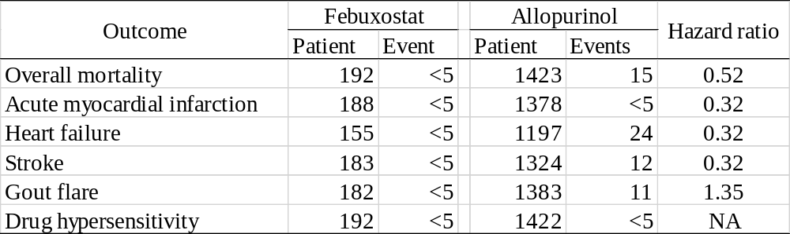
Result: Risk of secondary endpoints without PS matching

Slide 17
Summary
This is inconclusive study because of small sample size
Please join this study!
  applegna@gmail.com
  https://github.com/OHDSI/OhdsiStudies
  https://github.com/chandryou/FebuxostatVsAllopurinolCVD

Slide 18


