Slide 1
Observational Health Data Sciences and Informatics:
2019 state of the collaborative

Slide 2
OHDSI’s mission
To improve health by empowering a community to collaboratively generate the evidence that promotes better health decisions and better care

Slide 3
OHDSI’s values
Innovation: Observational research is a field which will benefit greatly from disruptive thinking. We actively seek and encourage fresh methodological approaches in our work.
Reproducibility: Accurate, reproducible, and well-calibrated evidence is necessary for health improvement.
Community: Everyone is welcome to actively participate in OHDSI, whether you are a patient, a health professional, a researcher, or someone who simply believes in our cause.
Collaboration: We work collectively to prioritize and address the real world needs of our community’s participants.
Openness: We strive to make all our community’s proceeds open and publicly accessible, including the methods, tools and the evidence that we generate.
Beneficence: We seek to protect the rights of individuals and organizations within our community at all times.

Slide 4
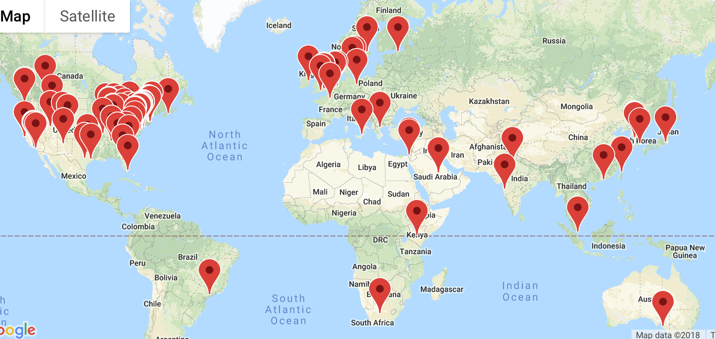
OHDSI community
We’re all in this journey together…

Slide 5
The journey to real-world evidence
Patient-level data in source system/schema
Reliable evidence

Slide 6
OHDSI’s areas of focus:
Continuing our journey in 2018…
Methodological research
Open-source analytics development
Clinical applications
Observational data management
Maintain and evolve open community data and vocabulary standards
Develop and improve tools to enable large-scale analysis
Establish and promote community best practices
Strengthen and expand collaborations across OHDSI research network
Advance scholarship in observational data science through publication, presentations, and education
Generate and disseminate more clinical evidence
Clinical characterization
Population-level estimation
Patient-level prediction

Slide 7
OHDSI workgroup updates
CDM/Vocabulary – Christian Reich
Natural Language Processing – Hua Xu
OHDSI China – Hua Xu
THEMIS - Mui Van Zandt
EHR – Melanie Philofsky
Metadata and Annotation – Ajit Londhe
Pharmacovigilance Evidence Investigation – Erica Voss
ATLAS/WebAPI – Anthony Sena
Population-level Effect Estimation – Martijn Schuemie
Patient-level Prediction – Peter Rijnbeek
Book of OHDSI – David Madigan

Slide 8
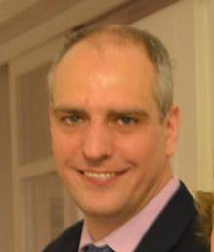

CDM & Vocabulary
Working Group
2019 Update
Christian Reich & Clair Blacketer

Slide 9
2018 Accomplishments
Closed Issues: 43
Ratified Proposals: 11
Notable Releases:
Version 5.3.0
  Added the VISIT_DETAIL table
  Added the METADATA table
Version 6.0.0
  Added the SURVEY_CONDUCT table
  Added the LOCATION_HISTORY table

Slide 10
2019 Goals
As the developers work to incorporate the recent v6.0.0 changes into the tools we would like to take the time to address the issues that have been identified as collaborators adopt the new version.
In addition we would like to create a better testing and proposal ratification process with a focus on supporting vocabulary

Slide 11
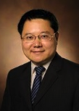
NLP
Working Group
2019 Update
Hua Xu

Slide 12
OHDSI NLP Updates
2018 Summary
  Delivered NLP Tools (https://github.com/OHDSI/NLPTools)
    Wrappers for converting existing NLP systems (MetaMap, cTAKES, CLAMP) outputs to CDM NLP tables
    Mapping of CUIs to standard terminology in CDM
  Other ongoing projects
    Mapping of Note Types to LOINC/standard vocabulary
    Landscape Analysis of section identifier systems and proposal of a standard terminology for use
    Extension and standardization of concept-modifiers from NLP systems
2019 Aims
  Establish ETL for processing textual data into CDM
  Develop tools (within Atlas) to facilitate uses of NLP data for cohort building/phenotyping
  Conduct cross-site studies that use textual data
  Continue developing other NLP resources

Slide 13
China
Working Group
2019 Update
Hua Xu

Slide 14
OHDSI China WG Updates
2018 Summary
  Meetings: F2F meeting (Guangzhou), two hackathon (Shanghai and Beijing), monthly online meetings
  Activities: CDM and vocabulary – version 1.0 limited release; NLP toolkit; studies in China
  Publications: NCCD (Normalized Chinese Clinical Drug) – JAMIA, Chinese vocabulary – OHDSI abstract
2019 Aims
  Continue 2019 F2F meeting and hold two Hackathon (Christian and Mui)
  Develop Chinese Vocabulary 2.0, Chinese version of Atlas
  Promote OHDSI data instances and conduct cross-site studies

Slide 15
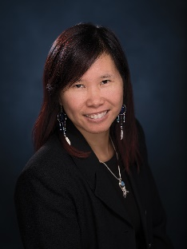
THEMIS
Working Group
2019 Update
Mui Van Zandt

Slide 16
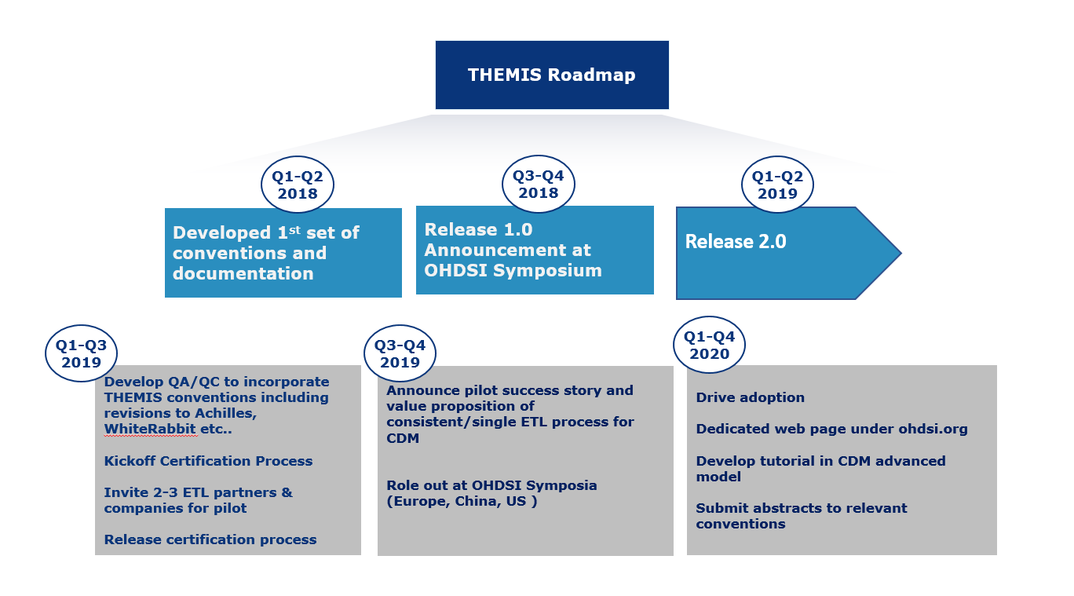
THEMIS Roadmap

Slide 17
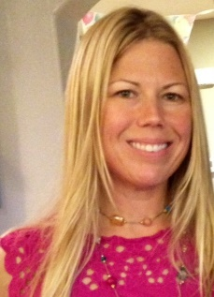
EHR
Working Group
2019 Update
Melanie Philofsky

Slide 18
EHR WG
January 11, 2019 @ 10am EST

Slide 19
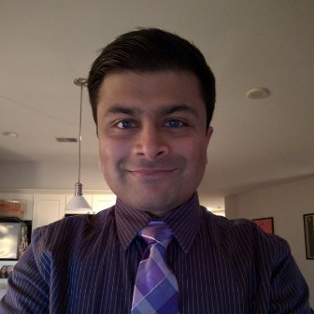
Metadata and Annotations Working Group
2019 Update
Ajit Londhe

Slide 20
2018 Accomplishments
Defined terminology of “metadata” and “annotation” in the context of OHDSI
Collected 30 real-world use cases from CHOP, NIH, Janssen, Tufts
Developed concept hierarchy to help in standardizing metadata values
Developed flexible table structure to add to the results schema to store metadata and annotations

Slide 21
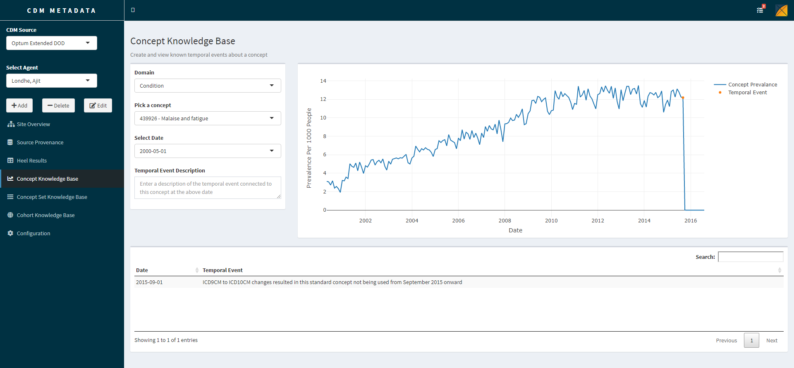
Next Steps: Pilot, Test, Propose
Challenges in proving value of metadata tables: no easy way to manage and consume metadata
R Shiny Application (“CdmMetadata”) will be used as a pilot of the metadata tables to help us gain adoption and build a stronger proposal to the CDM WG

Slide 22
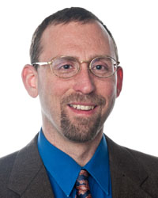
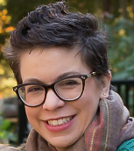
Pharmacovigilance Evidence Investigation WG
Working on the Common Evidence Model,
(formerly LAERTES)
2019 Update
Erica Voss & Rich Boyce

Slide 23
2018 Accomplishments
Common Evidence Model V1.0.0 Release
  All sources updated and the process standardized
  Processing of CEM standardized
  Web API Updated
  All code released in GitHub
Integrated pulling negative controls from CEM into ATLAS
  Tool used at OHDSI F2F
Regular WG meetings, a few new members

Slide 24
2019 Goals
(to be discussed still in WG)
Improve our parsing of product labels
Integrate clinical trial data into CEM
Develop process that allows users to use CEM to go from source code to source code if they are not using the OMOP Vocabulary

Slide 25
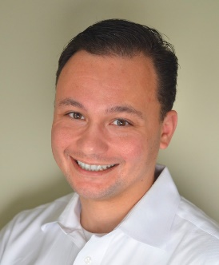
ATLAS & WebAPI
Working Group
2019 Update
Anthony Sena

Slide 26

2018 Accomplishments
2018 Atlas/WebAPI Community Accomplishments, by the numbers:
  4: Releases of Atlas/WebAPI
  19: Community members contributing code
  355: Issues Closed
  551: Pull Requests Reviewed & Approved
Atlas Feature Highlights:
  Cohort Characterization revamp
  Cohort Pathways
  Multi-analysis PLE/PLP Designer
  Security Improvements
Sept 2018: Established Atlas/WebAPI Working Group
  Raising awareness and planning of development activities around Atlas/WebAPI.
  Provide guidance to those that wish to contribute to these tools.

Slide 27
2019 Goals
Release | Goals | Target Date
Atlas/WebAPI 2.7 | Bug Fixes | March 2019
Atlas/WebAPI 2.8 | Performance Optimizations | May 2019
Atlas/WebAPI 3.0 | CDM v6.x Support User Interface revamp Deeper integration with Arachne | US Symposium 2019

Slide 28
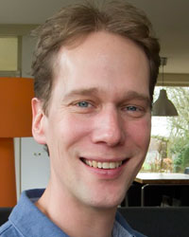

Population-Level Estimation
Working Group
2019 Update
Martijn Schuemie & Marc Suchard

Slide 29
Achievements in 2018
19 workgroup meetings (western and eastern hemisphere)
Further development of the Methods Library
  CohortMethod V3.0
  Methods Library documentation: https://ohdsi.github.io/MethodsLibrary
  ATLAS Estimation Tool: Generation of full study code
Publications
  Evaluation of large-scale propensity scores (International Journal of Epi)
  Some-by-some for depression (Philosophical Transactions)
  Empirical confidence interval calibration (PNAS)
  Methods evaluation (submitted to Harvard Data Science Review)
Awards
  Marc and Martijn received the Titan award for methods development!
LEGEND (Large-Scale Evidence Generation and Evaluation in a Network of Databases)
  Presented at the OHDSI 2018 Symposium
  Several papers in preparation

Slide 30
Goals 2019
Write one or more chapters for the Book of OHDSI
Improve Methods Library
  Usability
  Documentation
  Robustness
  Validation
Continue evidence generation in LEGEND

Slide 31
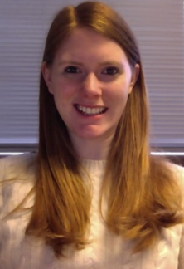
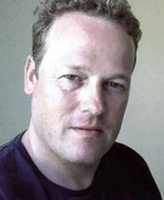
Patient-Level Prediction
Working Group
2019 Update
Peter Rijnbeek & Jenna Reps

Slide 32
Patient-Level Prediction 2018
Exciting year for the PLP Working Group with a lot of progress!
Accepted Publication on the PLP Framework in Jamia
A lot of methodological work: Deep Learning, Learning Curves, Ensemble Training, Validation of existing models, Heterogeneity of Treatment Effect, Smooth Calibration
Nice work of dissemination of results: Several Shiny Applications
A lot of work to incorporate the framework in the OHDSI eco-system: ATLAS integration
Improvements in documentation: multiple vignettes, short videos initiated
www.github.com/OHDSI/PatientLevelPrediction
Jenna M Reps, Martijn J Schuemie, Marc A Suchard, Patrick B Ryan, Peter R Rijnbeek; Design and implementation of a standardized framework to generate and evaluate patient-level prediction models using observational healthcare data, Journal of the American Medical Informatics Association, Volume 25, Issue 8, 1 August 2018, Pages 969–975, https://doi.org/10.1093/jamia/ocy032

Slide 33
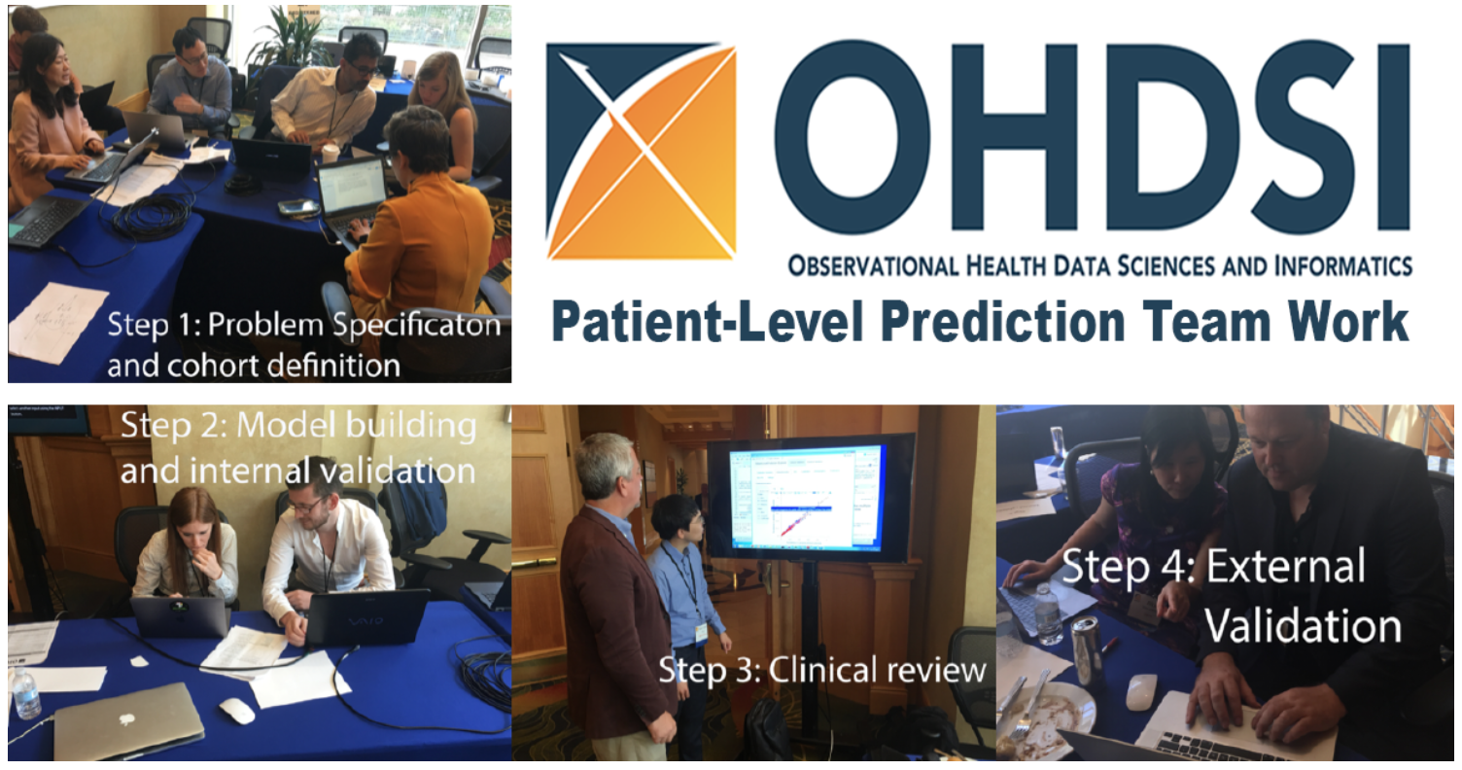
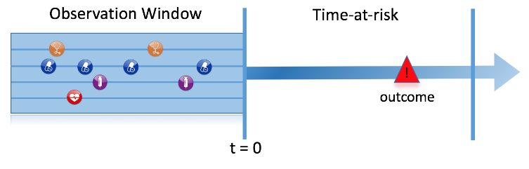
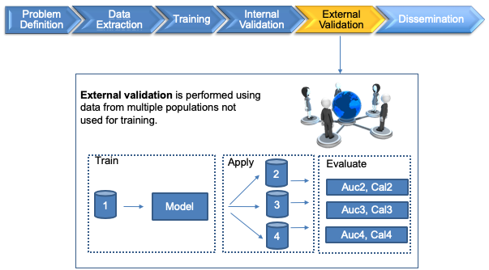
Patient-Level Prediction in Action
Big thank you to all those involved in the exciting PLP Journey!
Looking forward to 2019:
More studies!
Method research, e.g. use of temporal data, HTE
Library of Prediction Models
TRAINING!

Slide 34

The Book of OHDSI
2019 Update
David Madigan

Slide 35
Book of OHDSI
Objective: To write a book that will serve as a central knowledge repository for all things OHDSI.
An electronic book written using the bookdown package. The source material is developed in TheBookOfOhdsi GitHub repository.
Start Date: November 27, 2018
Workgroup Leads: David Madigan, Martijn Schuemie
http://www.ohdsi.org/web/wiki/doku.php?id=projects:workgroups:the_book_of_ohdsi

Slide 36
Pilot Chapters and Leads
Patient-level prediction by @Rijnbeek
Common Data Model by @mvanzandt and @clairblacketer
Network Studies by @gregk

Slide 37
Observational Health Data Sciences and Informatics:
Where are we going together in 2019?

Slide 38
OHDSI’s mission
To improve health by empowering a community to collaboratively generate the evidence that promotes better health decisions and better care

Slide 39
OHDSI’s areas of focus:
Continuing our journey in 2019…
Methodological research
Open-source analytics development
Clinical applications
Observational data management
Maintain and evolve open community data and vocabulary standards
Develop and improve tools to enable large-scale analysis
Establish and promote community best practices
Strengthen and expand collaborations across OHDSI research network
Advance scholarship in observational data science through publication, presentations, and education
Generate and disseminate more clinical evidence
Clinical characterization
Population-level estimation
Patient-level prediction

