Slide 1
Georgia Tech Students’ work building PLP UI
Abhishek khowala

Slide 2
Landscape
CS 6440 – Introduction to Health Informatics course give students opportunity to work on real world high impact healthcare related projects in team supported by External Mentor and TA Mentor
~15 weeks long project
Typical team size of 4-6 students
The delivery of project is broken into 6 milestones
Infrastructure for continuous build and deployment provided
FHIR servers provided

Slide 3
Deliverables
D0 – Team formation & Team Confirmation (WW03)
D1 – Project Topic: Team Topic, Research, Use Cases, Project Plan (WW06)
D2 – Technical Presentation: Technical Architecture (WW09)
D3 – Team Progress: Effectively show elements of application (WW12)
D4 – Full demonstration of the application (WW15)
D5 - Final Project Submission (WW15)
Students provide mentors with weekly update irrespective of any major delivery or not
Each deliverable includes presentation as well as a narrated video link, every student in the team need to participate

Slide 4
DEPLOYMENT INFRASTRUCTURE
For continuous build, CONTAINERIZATION and deployment into a server farm

Slide 5
HDAP – Health Data Analytics Platform
Software platform designed to support students in conducting health oriented projects at Georgia Tech
HDAP role in projects
  Access to FHIR servers
  Application Deployment
HDAP 3 core functions
  Provide synthetic and de-identified sources of healthcare data
  Provide tools to analyze these data
  Provide a healthcare application development and hosting environment and app galleries

Slide 6
HDAP – Continued:
FHIR SERVER ACCESS PROVIDED FOR
  MIMIC (STU3)
    OMOP data
    Endpoint: https://apps.hdap.gatech.edu/gt-fhir/tester/
  SyntheticMass (STU3)
    Endpoint: https://apps.hdap.gatech.edu/syntheticmass/
  HAPI (R4)
    Endpoint: https://apps.hdap.gatech.edu/hapiR4/

Slide 7







Development/Deployment Pipeline
pushes
pulls
Student
notifies
pushes
pushes
pulls
notifies
Load balancer
forwards
Development
Deployment
HTTPS request
Reverse proxies

Slide 8
Process
Student pushes code to GT GitHub
GT GitHub Notifies Jenkins of push
Jenkins builds project and pushes images to the private Docker registry
Jenkins notifies Rancher of the push to the registry
Rancher pulls the images, builds containers, and deploys them to the Docker Swarm

Slide 9
OHDSI PLP UI Project
Fall 2018 sEMESTER: CONSUMER FACING APPLICATION FOR PATIENT LEVEL PREDICTION

Slide 10
TEAM COMPOSITION
TEAM MEMBERS
  MICHAEL GARNER
  JONATHAN FUNG
  ALYSSA DE LEON
  JACOB GILBERT
  CHUREN (CHU) SHAO
TA MENTOR
  ABHISHEK KHOWALA
EXTERNAL MENTOR
  DR. PATRICK RYAN
  DR. DAVID MADIGAN
HEAD TA
  TIA POPE
PROFESSOR
  DR. JON DUKE
Notes:
Michael Garner-Analyst/Dev • Jonathan Fung -Dev/QA • Alyssa De Leon -Dev • Jacob Gilbert -Dev/QA • Churen(Chu) Shao-PM/De

Slide 11
PROJECT GOALS
Analyze 3 example OHDSI PLP Models viz. AfibStroke, DepressionSuicide, NSAIDGIBleed
Create a single interface that takes any PLP results object (such as 3 examples provided) and serve up an ordered set of questions to allow a target population user to estimate a personalized prediction of their risk of the outcome
Use coefficient and covariate summary together with user answers to yes/no questions to produce the predicted probability and estimated confidence interval (CI) around those predictions.
Notes:
AfibStroke - amongst patients newly diagnosed with atrial fibrillation, which patients will go on to have ischemic stroke in next 3 years?
DepressionSuicide - amongst patients diagnosed with depression who initiate antidepressant therapy, which patients will go on to have suicide or suicidal ideation in the next 1 year?
NSAIDGIBleed - amongst patients initiating non-steroidal anti-inflammatory drug treatment, which patients will experience a gastrointestinal bleed while on treatment?
All of these models were built on a large US administrative claims dataset using LASSO logistic regression, with features for demographics (age group, gender, race, ethnicity, index month), and binary indicators for prior conditions, drugs, and procedures. The model object can be loaded into R, and you'll see the model performance characteristics, as well as the model itself (beta coefficients for the logistic regression), and a covariateSummary that provides the prevalence of each of the features in the target population with and without the outcome. In each of the zip folders, just as FYI, i have also included the R script used to generate the model and JSON files that represent the cohort definition for the target and outcome cohorts.

Slide 12
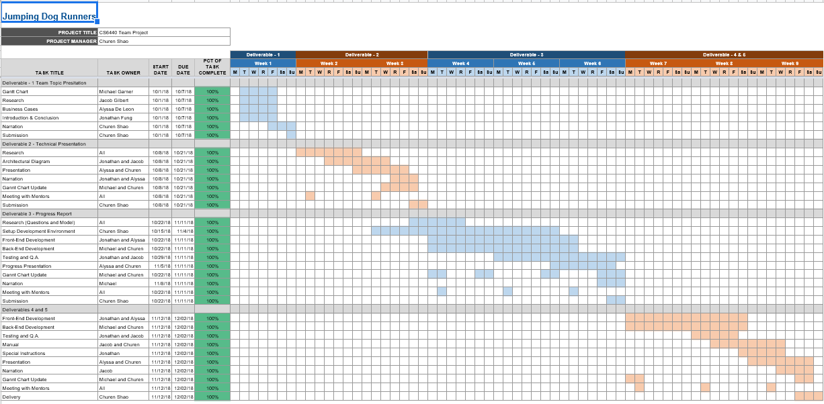
Project Planning: Gantt Chart

Slide 13
Workflow
Choose Prediction Model of Interest
Create Questions from given medical codes used in model
Order questions by impact to prediction (reordering if necessary)
Present questions to user
Update predicted outcome and confidence level as questions are answered

Slide 14
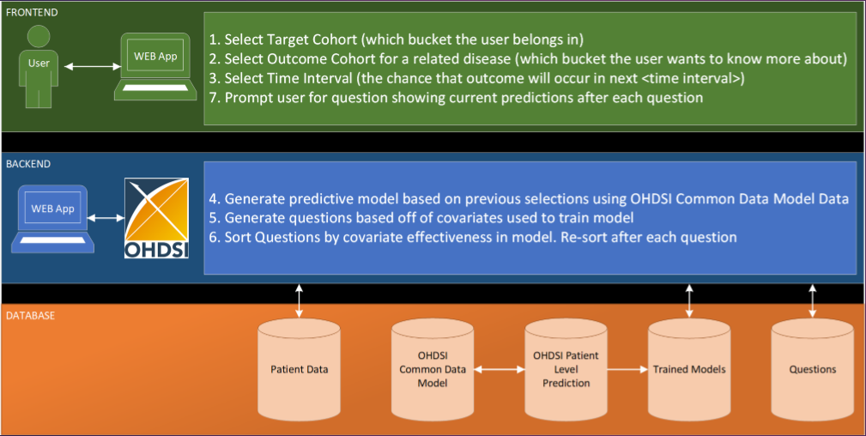
Architecture

Slide 15
Design
Read R models (.rds)
Process Covariate data
Sort Questions
Perform Monte Carlo Estimations
Extendible: Ability to add new PLP models through simple configuration steps

Slide 16
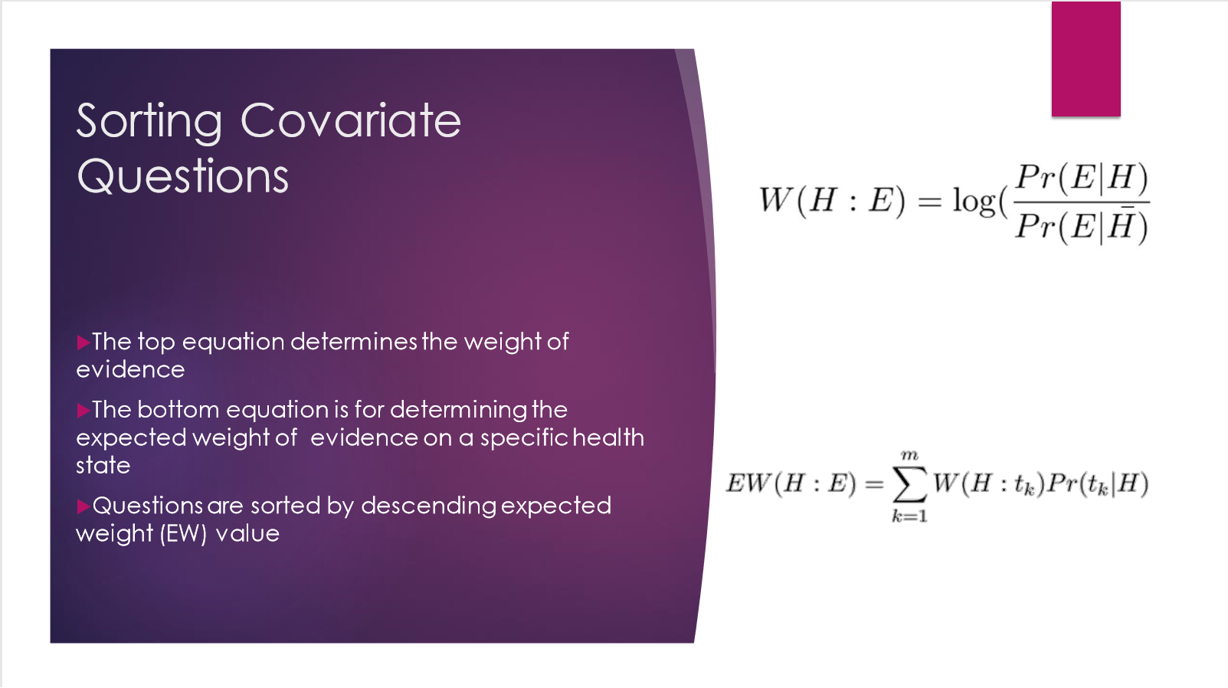

Slide 17
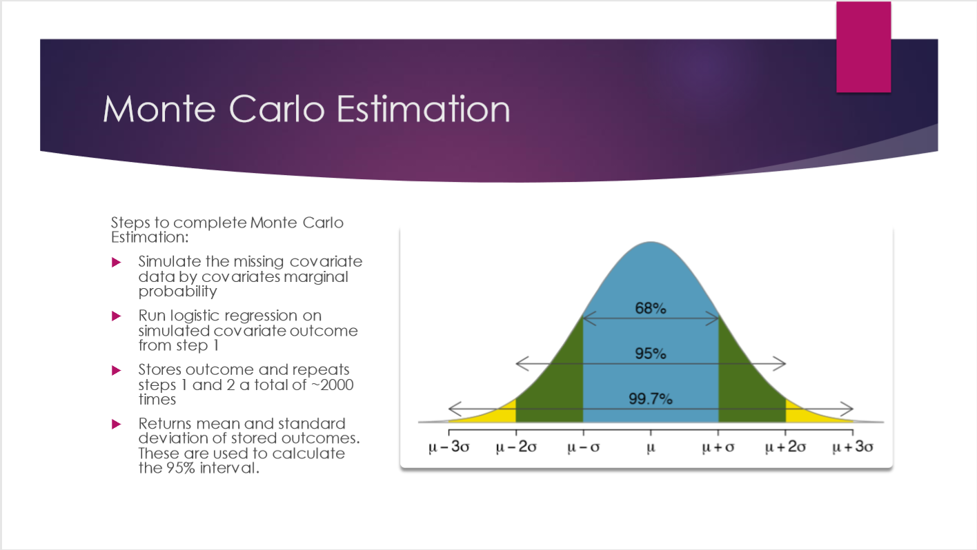

Slide 18
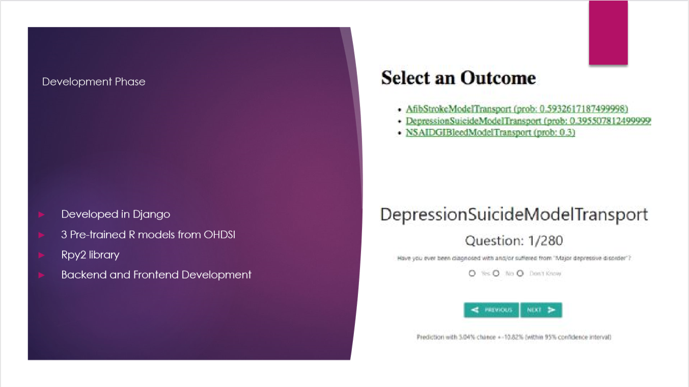

Slide 19
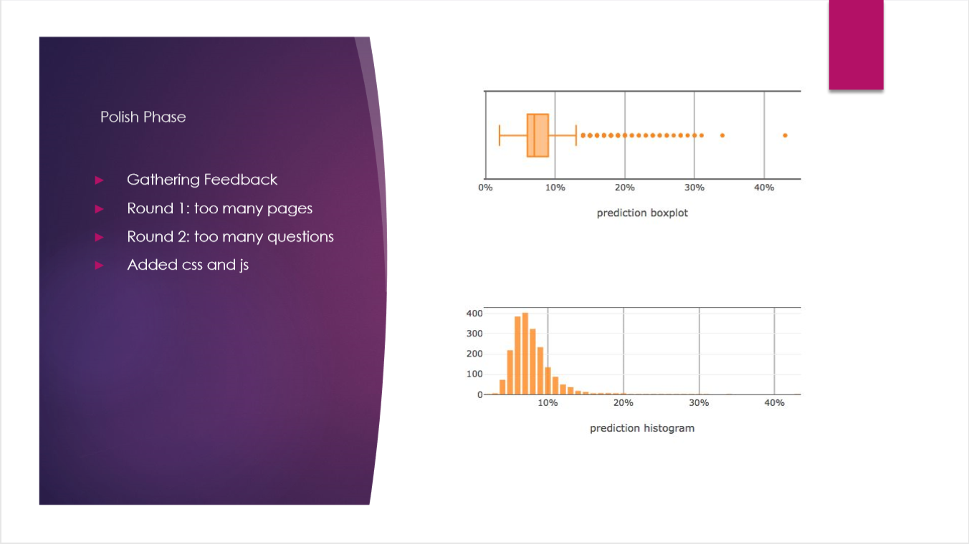

Slide 20
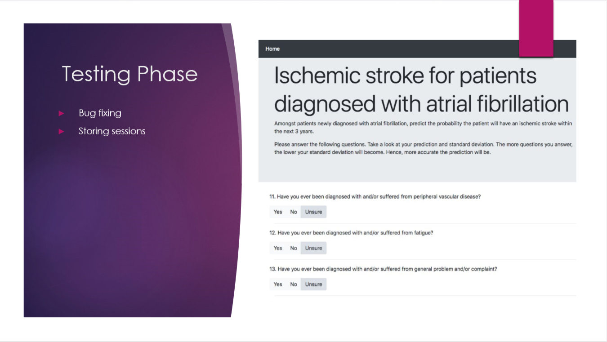

Slide 21
DEMO
https://cs6440-f18-prj14.apps.hdap.gatech.edu/

Slide 22
Links/References
https://drive.google.com/drive/folders/1wcRsUIAIXXxsUMLRLW_vP-sIXz7bzL8V?usp=sharing
Project Public URL: https://cs6440-f18-prj14.apps.hdap.gatech.edu/
PLP objects description: https://github.com/OHDSI/PatientLevelPrediction
3 example PLP models: https://drive.google.com/drive/folders/1wcRsUIAIXXxsUMLRLW_vP-sIXz7bzL8V?usp=sharing
Gantt Chart: https://docs.google.com/spreadsheets/d/1FNK3MJTs4e05rsHUXeUyAzfJcM83Is52t-Lmf0Ywhqo/edit#gid=0

Slide 23
Links/References: Continued
PLP model JAMIA paper: https://academic.oup.com/jamia/article/25/8/969/4989437
Project Git repository: https://github.gatech.edu/gt-cs6440-hit-fall2018/Consumer-facing-application-for-patient-level-prediction

Slide 24
Thank You!
Questions?

