Slide 1

1. Versioned OHDSI docker library
2. Argos Project
Seng Chan You

Slide 2
Mission, Vision, and Values of OHDSI
Our Mission
To improve health by empowering a community to collaboratively generate the evidence that promotes better health decisions and better care.
Our Vision
A world in which observational research produces a comprehensive understanding of health and disease.

Slide 3
Mission, Vision, and Values of OHDSI
Innovation: Observational research is a field which will benefit greatly from disruptive thinking. We actively seek and encourage fresh methodological approaches in our work.
Reproducibility: Accurate, reproducible, and well-calibrated evidence is necessary for health improvement.
Community: Everyone is welcome to actively participate in OHDSI, whether you are a patient, a health professional, a researcher, or someone who simply believes in our cause.
Collaboration: We work collectively to prioritize and address the real world needs of our community’s participants.
Openness: We strive to make all our community’s proceeds open and publicly accessible, including the methods, tools and the evidence that we generate.
Beneficence: We seek to protect the rights of individuals and organizations within our community at all times.

Slide 4


OHDSI: Open Innovation based on the open community
REPRODUCIBILITY
SCALABILITY
BENEFICIENCE
GLOBAL COMMUNITY
STANDARDS
OPENNESS
DATA
COLLABORATION

Slide 5
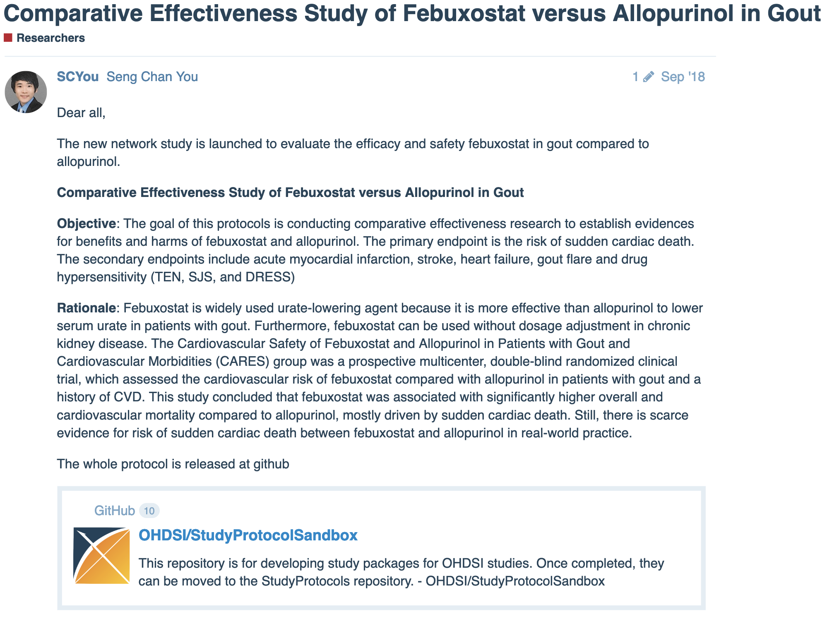
Reproducibility in OHDSI research

Slide 6
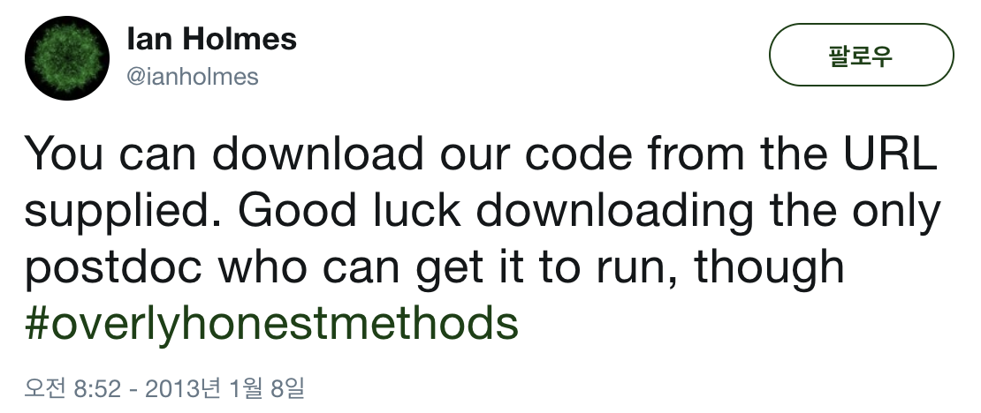
Reproducibility in OHDSI research
https://twitter.com/ianholmes/status/288689712636493824

Slide 7

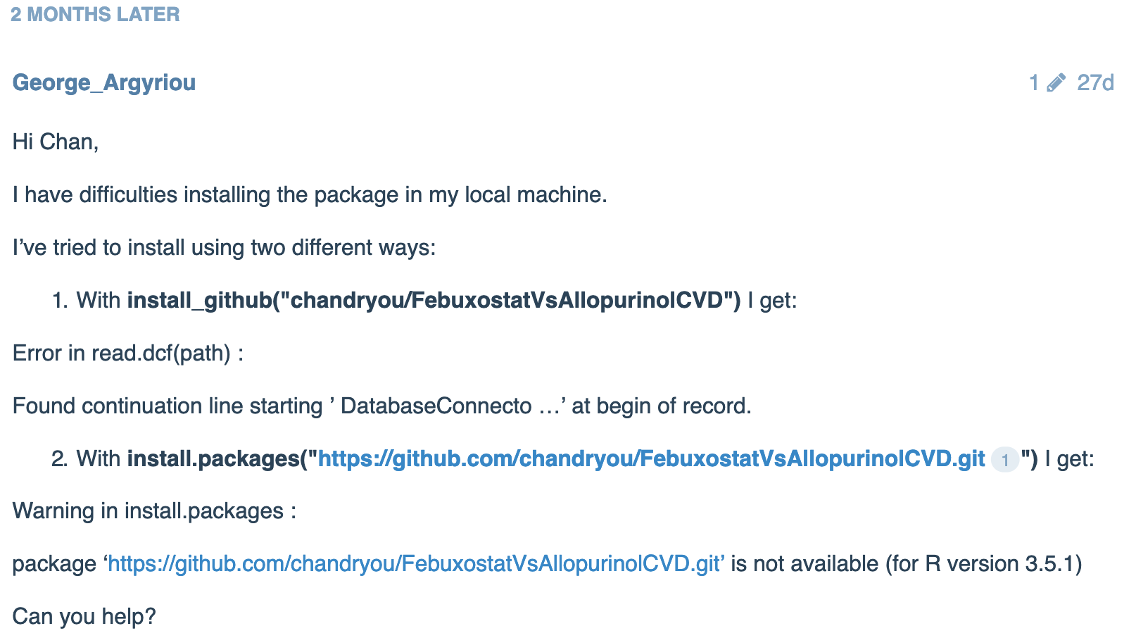
Reproducibility in OHDSI research

Slide 8
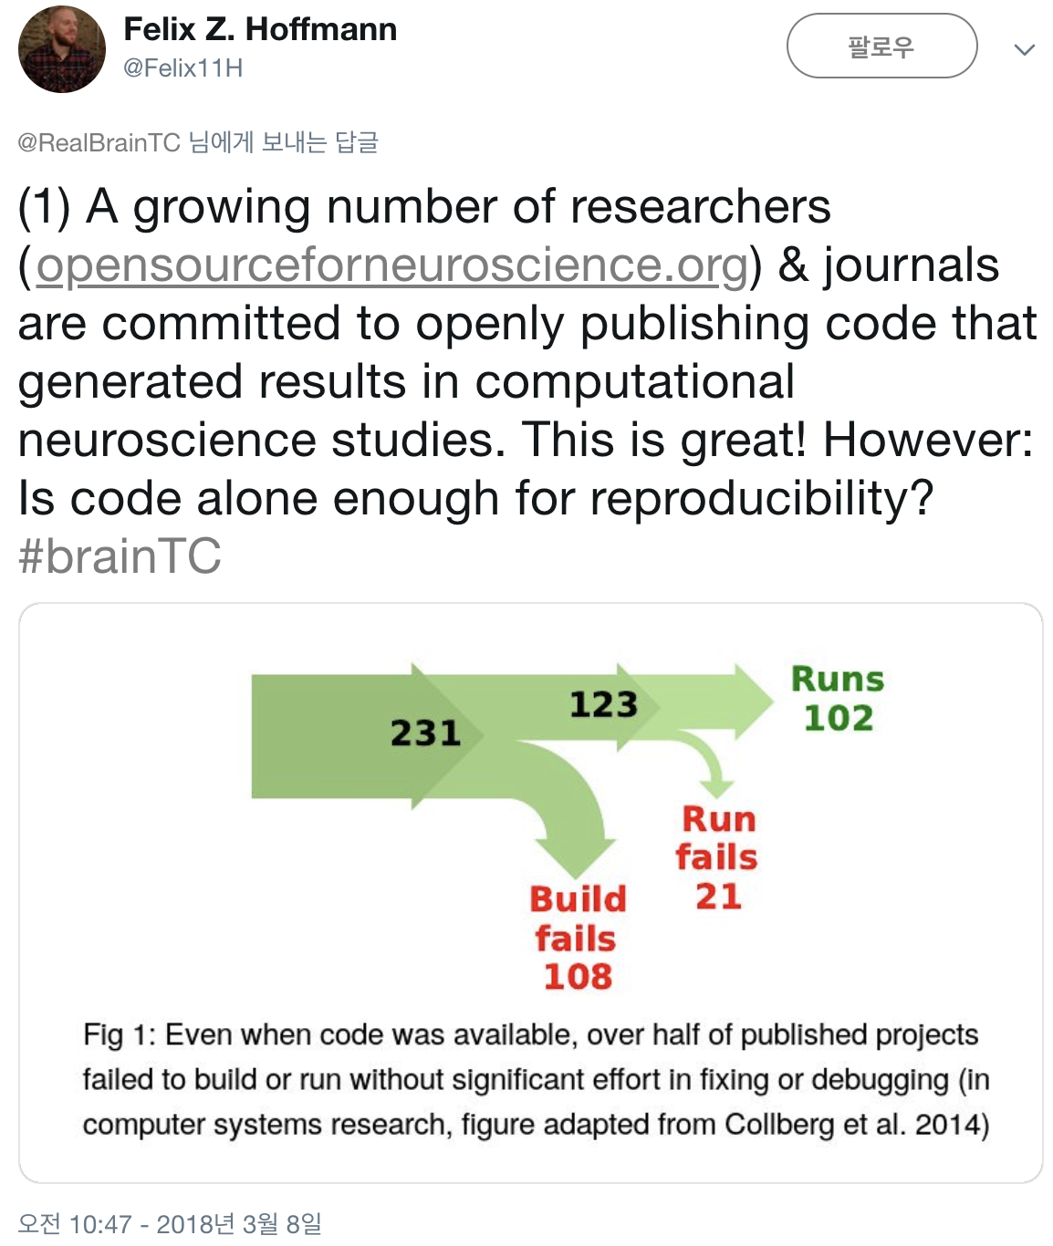
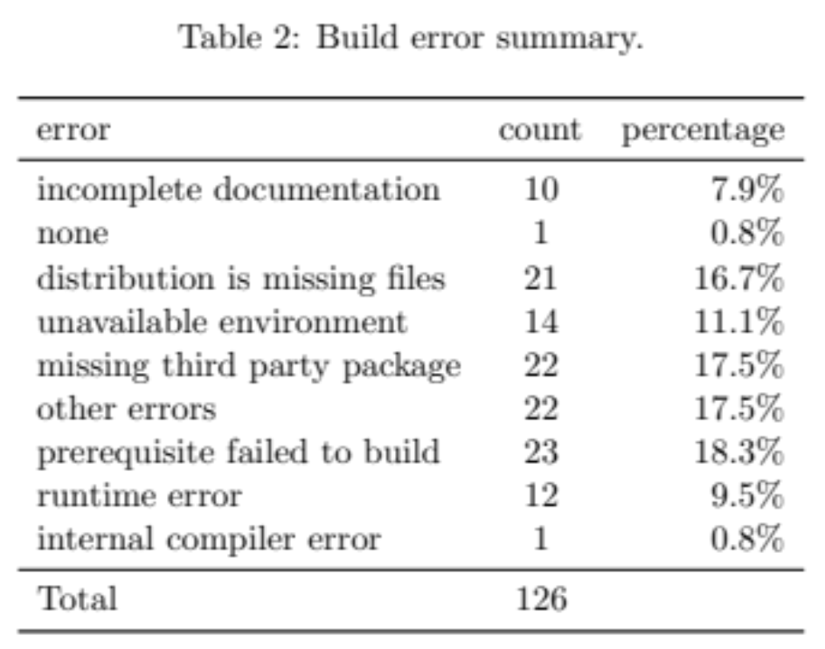
Reproducibility
Collberg et al., Measuring Reproducibility in Computer Systems Research
https://twitter.com/Felix11H/status/971819728040808448

Slide 9
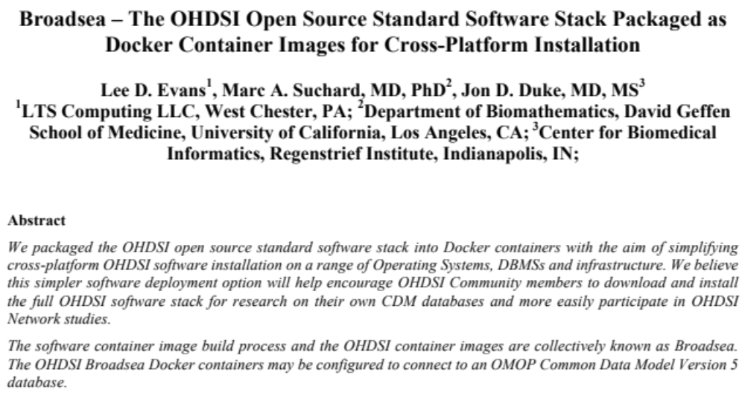
Broadsea
OHDSI symposium, 2016

Slide 10
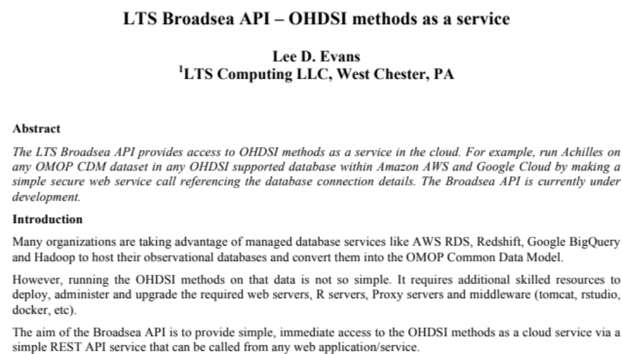
LTS Broadsea API
OHDSI symposium, 2017

Slide 11

Docker,
What is it? and
What for?

Slide 12
What is Docker?
Docker is an open platform for developers and sysadmins to build, ship, and run distributed applications. Consisting of Docker Engine, a portable, lightweight runtime and packaging tool, and Docker Hub, a cloud service for sharing applications and automating workflows, Docker enables apps to be quickly assembled from components and eliminates the friction between development, QA, and production environments.
Text from http://docker.com as of June 24, 2014.

Slide 13
Ok, seriously, what is Docker?
Docker is a very lightweight abstraction using recent Linux kernel features which lets us to run code in cheap (to launch) and easy (to build) units: containers
We can share containers across OSs, across time.
Text from http://dirk.eddelbuettel.com/papers/r_and_docker_sep2014.pdf as of Mar 11, 2019.

Slide 14
Virtual Machine vs Docker
Virtual machine runs one complete OS on top of another OS
A Docker container is like a virtual machine that shares guest OSs, which makes them very lightweight
https://matsen.github.io/2018/04/19/docker.html

Slide 15
Docker and Reproducibility
Capturing the computational environment
  A substantial challenge in reproducing analysis is installing and configuring the web of dependencies of specific versions of various analytic tools.
  Popular VM applications include VirtalBox and VMWare. One challenge of working with VMs is that the files that contain the environment are not small, typically one gigabyte or more, which can be awkward to share.
From http://ropensci.github.io/reproducibility-guide/sections/introduction/
http://www.cascadia-analytics.com/docs/user2018-docker-r-tutorial-slides.pdf

Slide 16
Docker Advantage for Reproducibility
Small footprint
Easier deployment
Easier sharing and publication
Open source platform
Standard scripting of image setup with Dockerfile
Rocker images as baseline
From http://ropensci.github.io/reproducibility-guide/sections/introduction/
http://www.cascadia-analytics.com/docs/user2018-docker-r-tutorial-slides.pdf

Slide 17
Docker Advantage for Reproducibility
Small footprint
Easier deployment
Easier sharing and publication
Open source platform
Standard scripting of image setup with Dockerfile
Rocker images as baseline
From http://ropensci.github.io/reproducibility-guide/sections/introduction/
http://www.cascadia-analytics.com/docs/user2018-docker-r-tutorial-slides.pdf

Slide 18
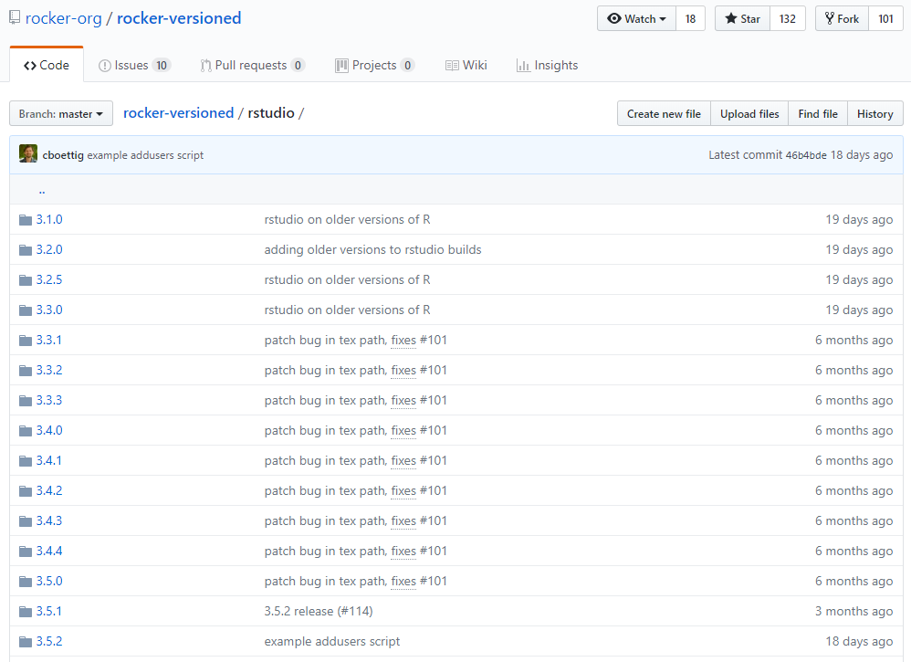
Versioned docker library for Rstudio:
ROCKER project
https://github.com/rocker-org/rocker-versioned/tree/master/rstudio

Slide 19
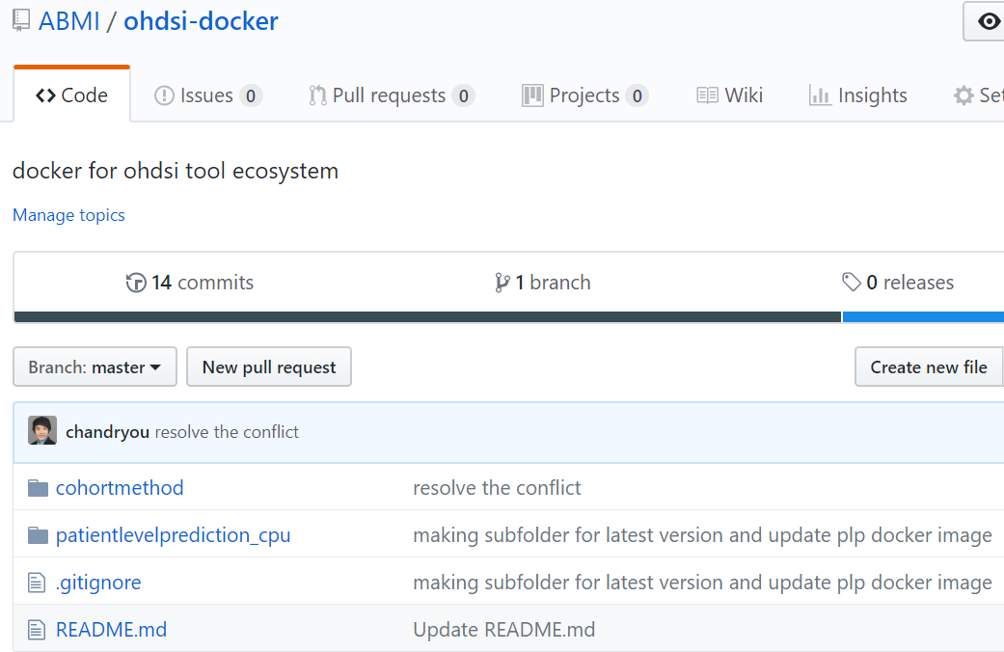
Versioned docker library for OHDSI Tools
https://github.com/ABMI/ohdsi-docker

Slide 20
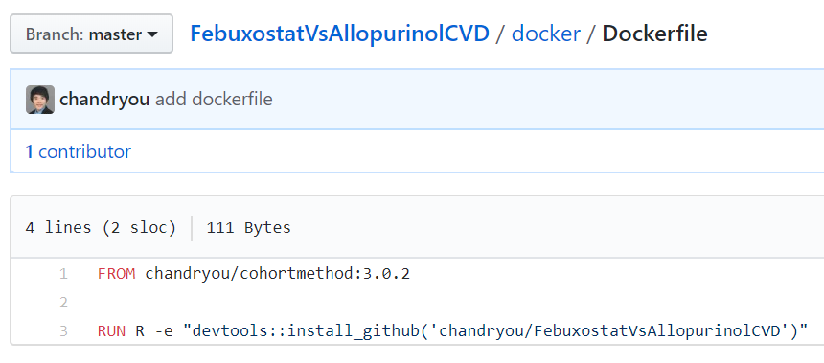
How to build docker image for individual research
Make a Dockerfile for the individual research based on versioned OHDSI docker image
https://github.com/chandryou/FebuxostatVsAllopurinolCVD/blob/master/docker/Dockerfile

Slide 21
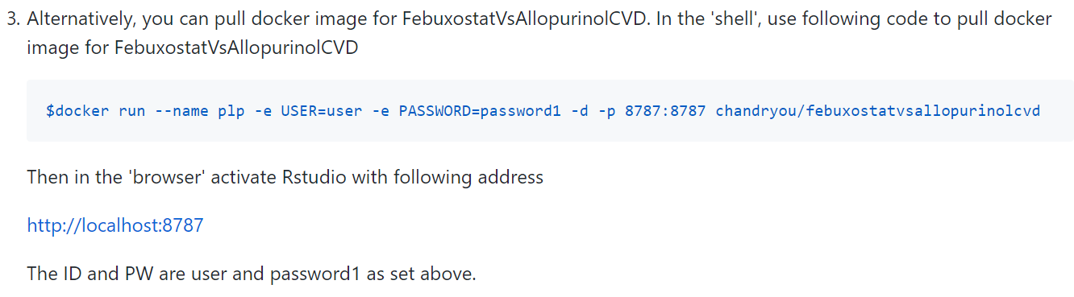
Run Docker
https://github.com/chandryou/FebuxostatVsAllopurinolCVD/

Slide 22
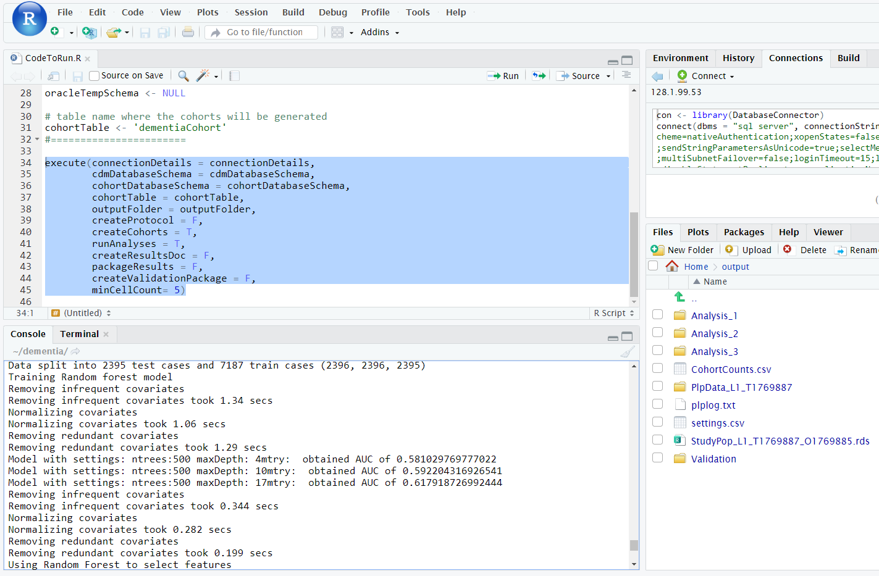
Run entangled system of PLP package (R + Python + Deep learning) in Docker

Slide 23
Suggestion for better reproducibility in OHDSI
Build and maintain versioned Docker image library for OHDSI tools
  I hope this versioned docker image library to be merged with BroadSea project
Release docker image for each OHDSI research

Slide 24
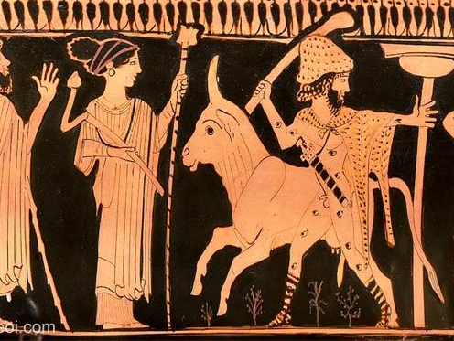
ARGOS
A Rigorous Global Observation System for burden of diseases
Monitoring system of disease burden across OHDSI community
  Temporal trends in
  Incidence
  Mortality
  Cost
  DALY (Disability-Adjusted Life Year)
https://github.com/ABMI/Argos

Slide 25
Measuring the Global Burden of Disease
To improve population health, it is crucial to estimate the burden of disease and understand how it changes over time.
For obtaining comprehensive and consistent information for global burden of disease, the World Bank and the WHO launched the Global burden of Disease (GBD) study in 1991
World Bank. World Development Report 1993 — investing in health: world development indicators. Oxford, United Kingdom: Oxford University Press, 1993.

Slide 26
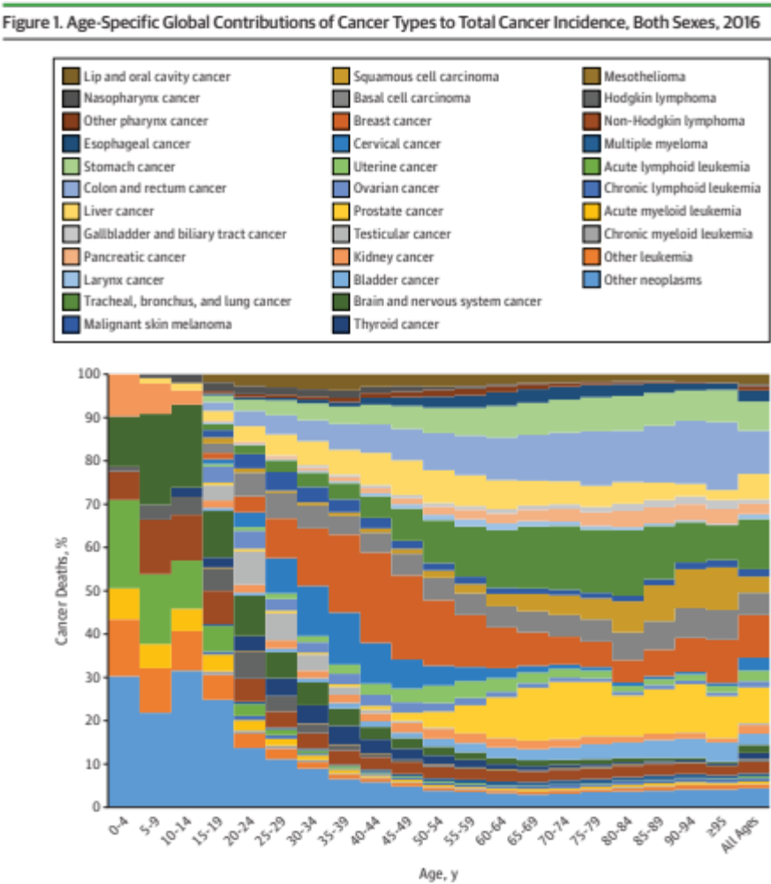
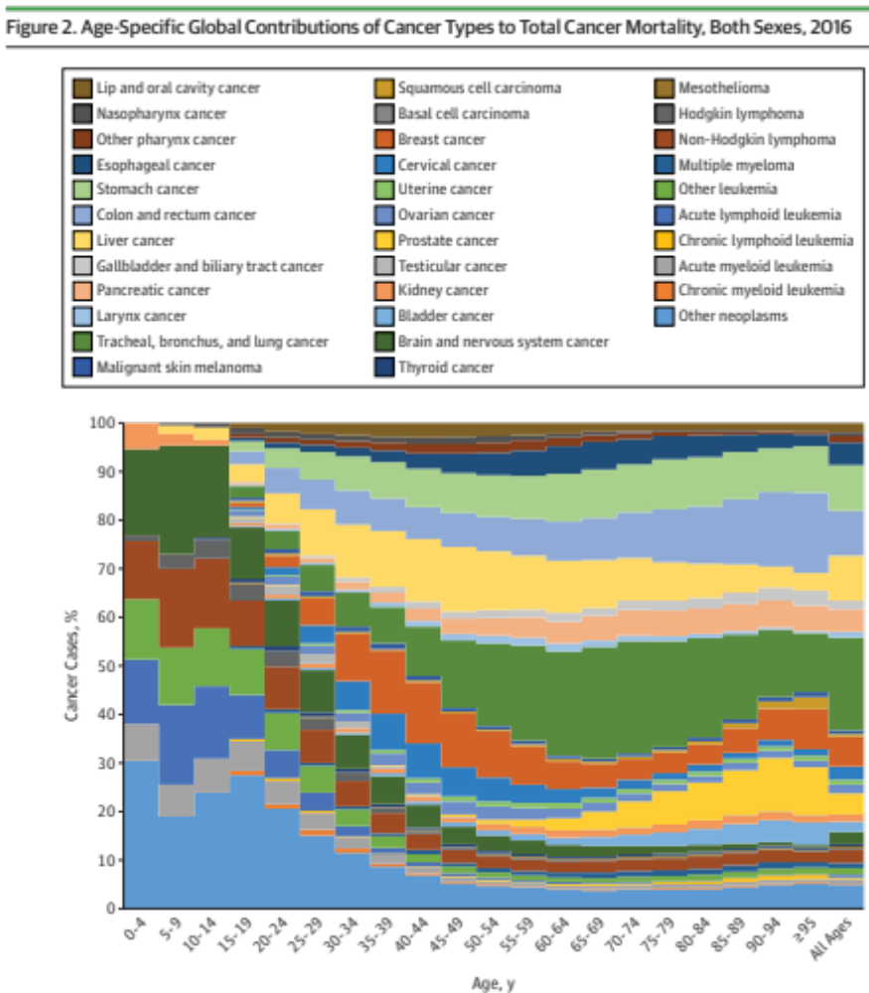
The result from GBD 2016
Fitzmaurice et al., JAMA Oncology 4, no. 11 (November 1, 2018)
Notes:
Fitzmaurice, Christina, Tomi F. Akinyemiju, Faris Hasan Al Lami, Tahiya Alam, Reza Alizadeh-Navaei, Christine Allen, Ubai Alsharif, et al. “Global, Regional, and National Cancer Incidence, Mortality, Years of Life Lost, Years Lived With Disability, and Disability-Adjusted Life-Years for 29 Cancer Groups, 1990 to 2016: A Systematic Analysis for the Global Burden of Disease Study.” JAMA Oncology 4, no. 11 (November 1, 2018): 1553–68. https://doi.org/10.1001/jamaoncol.2018.2706.
Fitzmaurice et al., JAMA Oncology 4, no. 11 (November 1, 2018): 1553–68. https://doi.org/10.1001/jamaoncol.2018.2706.

Slide 27
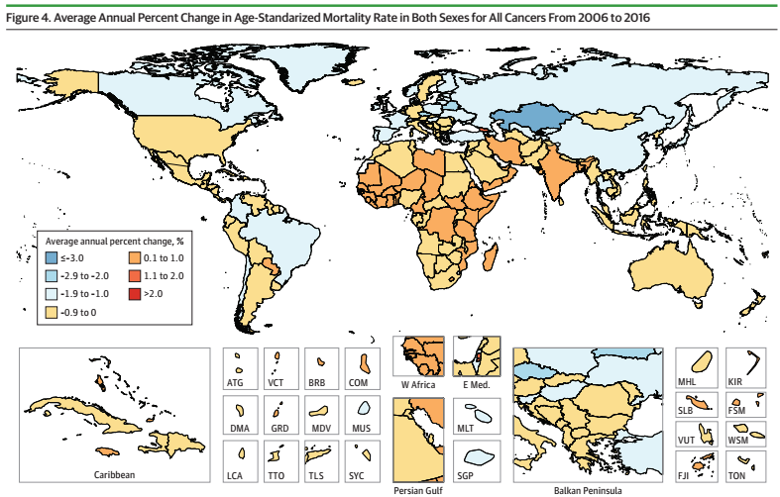
The result from GBD 2016
Fitzmaurice et al., JAMA Oncology 4, no. 11 (November 1, 2018)

Slide 28
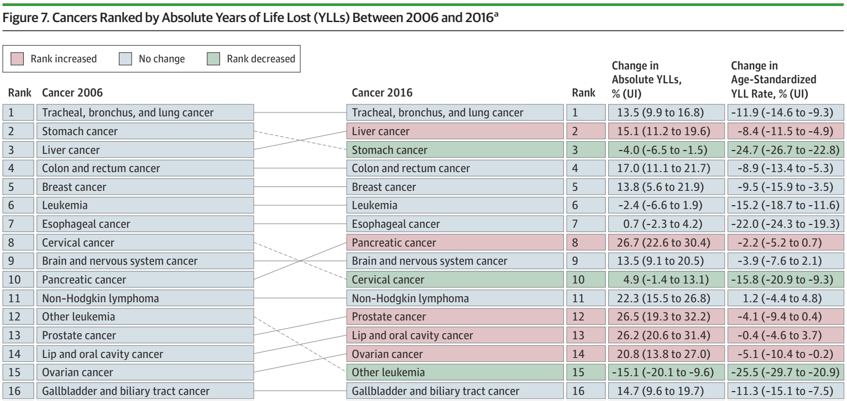
Comparison between
GBD 2006 and GBD 2016
Fitzmaurice et al., JAMA Oncology 4, no. 11 (November 1, 2018)

Slide 29
Lesson from GBD study
Large disparities exist between countries
  In cancer incidence
  In mortality of cancer patients
  In cancer associated disability
Large disparities exist across a decade
Differences in data collection practices and coding systems, as well as quality of data sources, remain major challenges, as do underreporting of cancers requiring advanced diagnostics in low-resource settings

Slide 30
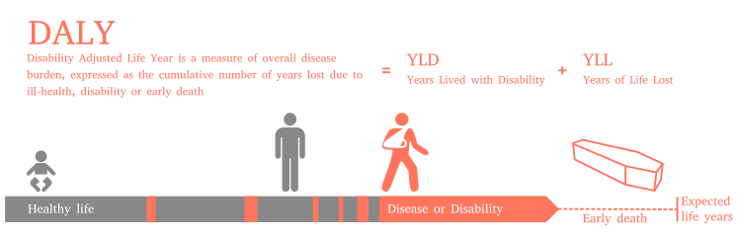
Disability-Adjusted Life Loss (DALY)
A measure of overall disease burden, expressed as the number of years lost due to ill-health, disability or early death.
One of fundamental estimates for cost-effectiveness research
https://en.wikipedia.org/wiki/Disability-adjusted_life_year

Slide 31
Objectives of ARGOS project
Development of ARGOS package based on OHDSI tool ecosystem, which provides semi-automatic process to monitor burden of user-defined conditions in OMOP-CDM database by assessing
  Temporal trend in incidence
  Incidence according to age, gender, and birth year
  Temporal trend in outcome of care
  Disability-Adjusted Life Loss (DALY)
In Korea
  Conversion of HIRA DB for whole cancer patients from 2007~2017
Under development
  Today’s result is based on NHIS-NSC (2003-2013, 1M sample)
  Today’s result is not fully evaluated.
https://github.com/ABMI/Argos

Slide 32
Validation of temporal trend in Incidence of cancers
 |  | Incidences (cases per 100,000 persons)
Cancer site |  | 2003 | 2004 | 2005 | 2006 | 2007 | 2008 | 2009 | 2010 | 2011 | 2012
Colorectal | Argos | 32.6 | 32.0 | 36.4 | 37.2 | 39.3 | 39.0 | 41.7 | 47.4 | 51.4 | 53.0
 | Statistics Korea | 30.5 | 33.6 | 37.6 | 40.7 | 43.8 | 47.0 | 51.4 | 53.4 | 57.1 | 58.5
Lung | Argos | 32.2 | 31.8 | 30.8 | 33.3 | 32.7 | 33.4 | 30.9 | 33.1 | 42.8 | 40.5
 | Statistics Korea | 31.5 | 33.8 | 35.4 | 36.3 | 37.6 | 40.4 | 42.7 | 44.3 | 44.6 | 46.4
Stomach | Argos | 44.2 | 42.9 | 44.3 | 43.3 | 42.3 | 48.1 | 46.5 | 43.7 | 54.1 | 49.9
 | Statistics Korea | 49.5 | 48.8 | 54.2 | 54.1 | 54.6 | 57.5 | 60.5 | 61.6 | 63.8 | 61.8
Liver | Argos | 34.9 | 29.9 | 32.0 | 28.4 | 26.1 | 30.1 | 28.0 | 26.3 | 29.3 | 32.4
 | Statistics Korea | 29.1 | 29.9 | 31.1 | 30.6 | 31.3 | 32 | 32.2 | 32.4 | 32.7 | 32.0
Breast | Argos | 16.1 | 16.4 | 15.8 | 18.1 | 20.0 | 21.7 | 20.2 | 25.1 | 26.6 | 27.8
 | Statistics Korea | 17.7 | 19.0 | 21.1 | 22.4 | 24.5 | 26.0 | 27.5 | 29.4 | 32.3 | 33.2
Thyroid | Argos | 16.9 | 18.7 | 23.9 | 31.9 | 40.0 | 51.6 | 66.8 | 62.6 | 81.0 | 87.6
 | Statistics Korea | 15.6 | 21.5 | 26.3 | 33.0 | 43.3 | 55.3 | 65.5 | 73.7 | 82.4 | 88.6
Table. Comparison of estimated cancer incidence from Argos with the findings of relevant published report
https://github.com/ABMI/Argos

Slide 33
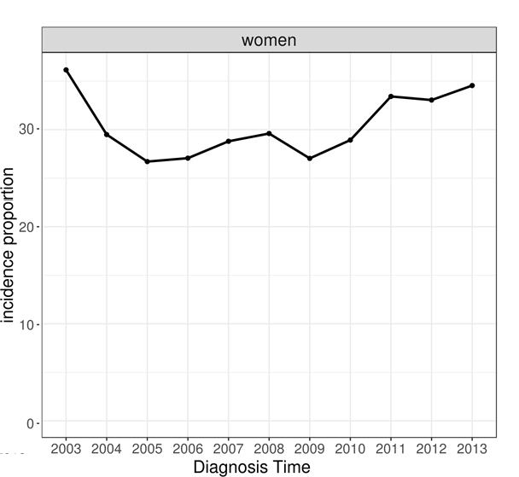
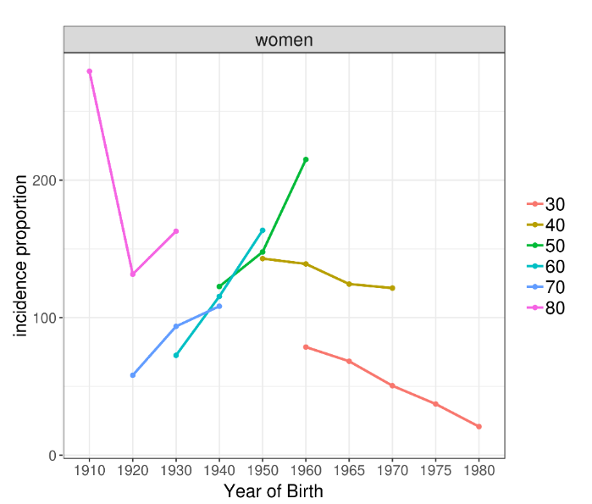
Temporal trends of incidence, incidence according to birth year:
Is breast cancer really increasing in Korea?
Though overall age standardized incidence of breast cancer increases,
the incidence of breast cancer decreases in women born after 1960
https://github.com/ABMI/Argos

Slide 34
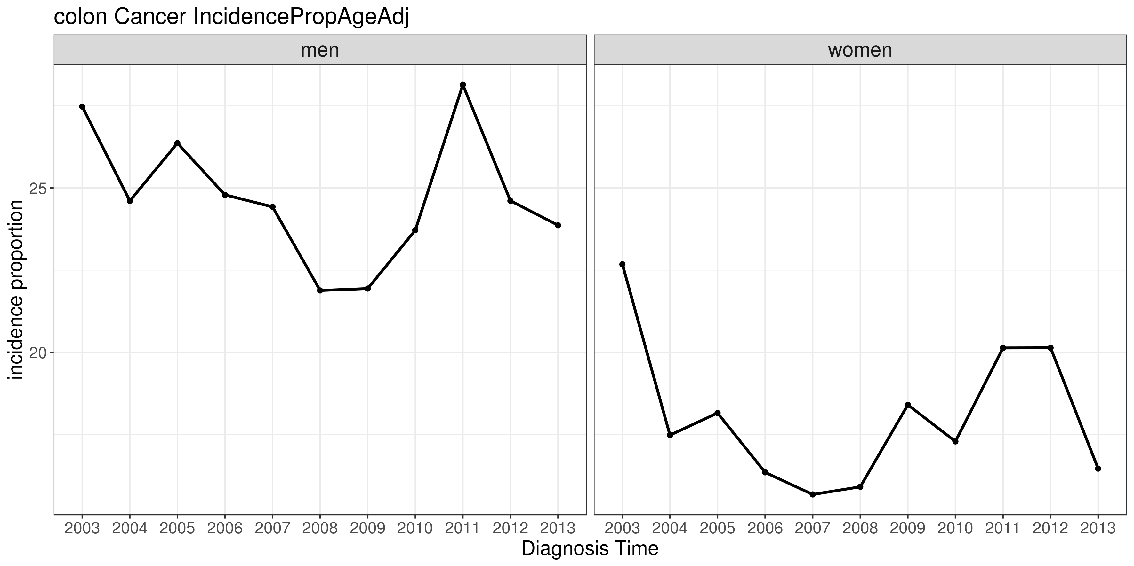
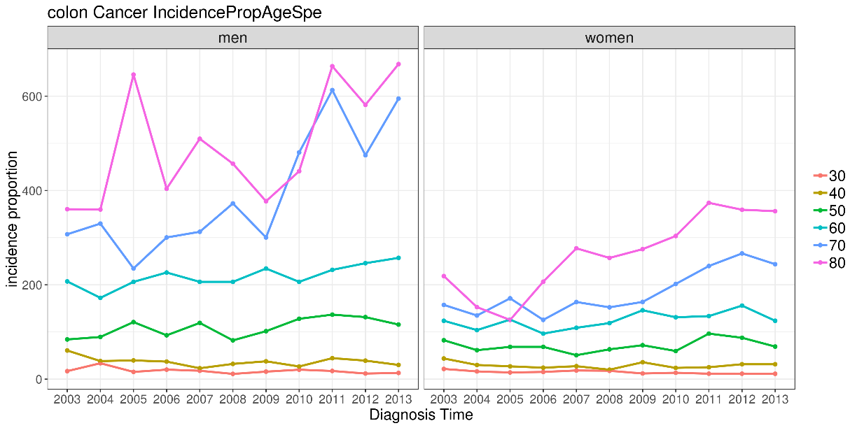
Temporal trends of incidence according to year:
For which age group should we promote screening for prevention of colon cancer?
After rapid increase of incidence in colon cancer, overall incidence of colon cancer decreased in Korea.
Still, the incidence of colon cancer increases in old ages.
We are neglecting these population in national screening system
https://github.com/ABMI/Argos

Slide 35
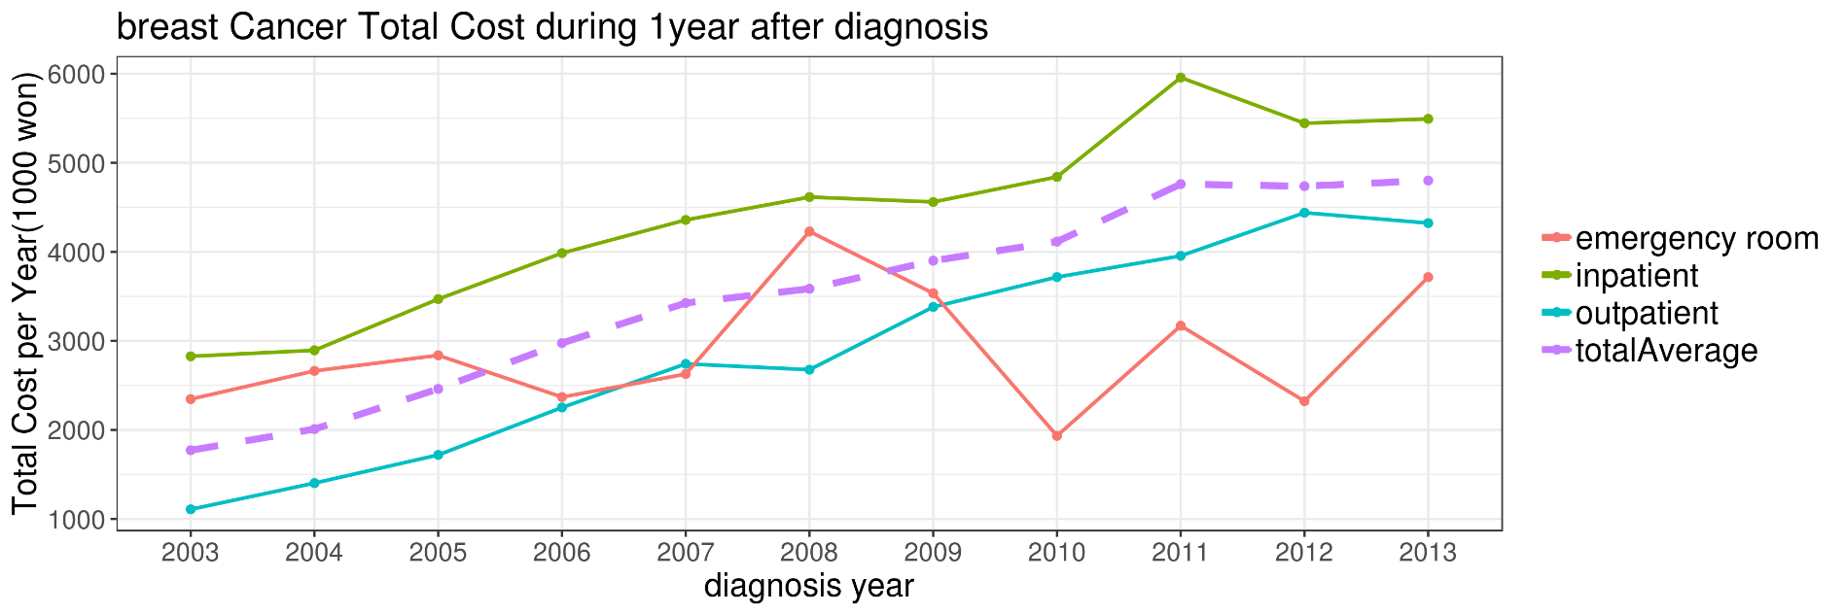
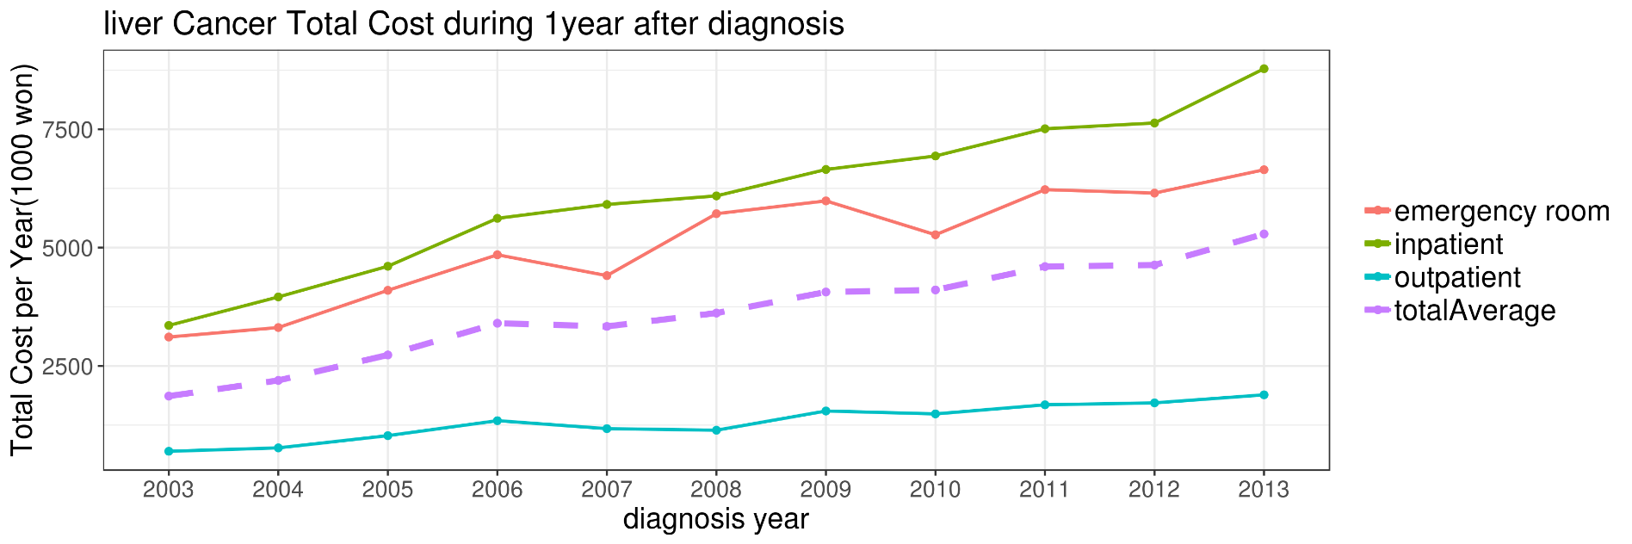
Temporal trend of overall cost in cancer patients
https://github.com/ABMI/Argos

Slide 36
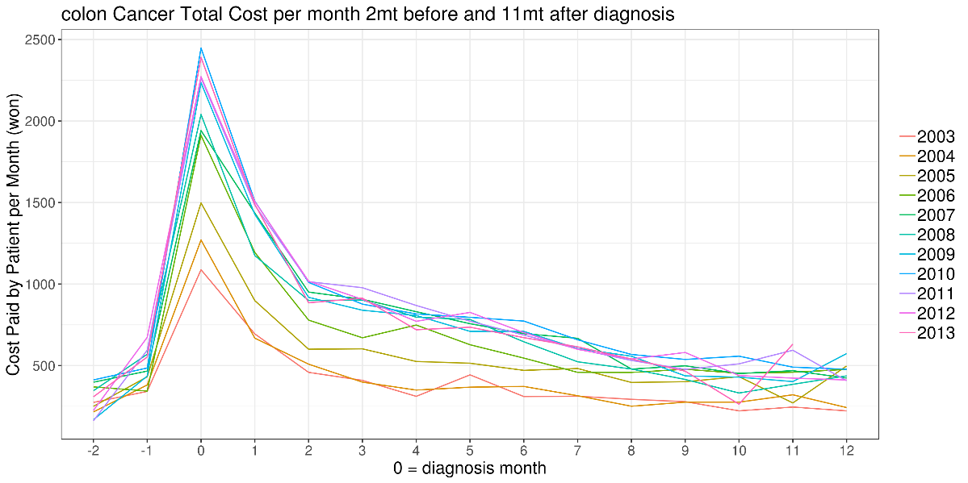
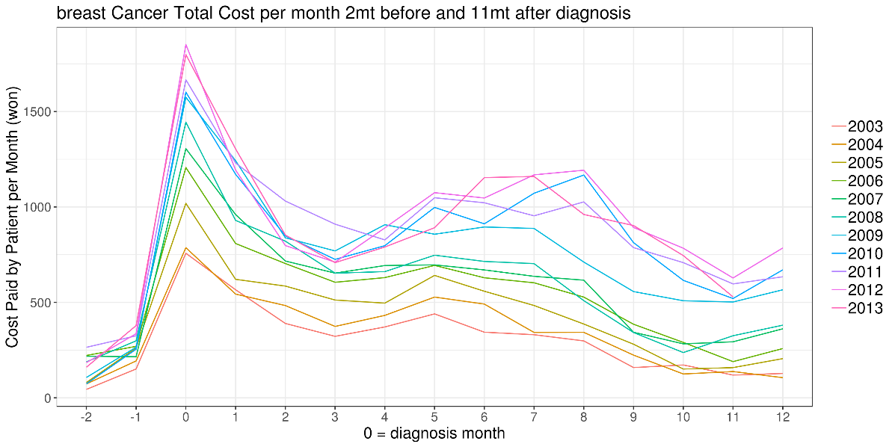
Cost plot according to the time before and after diagnosis

Slide 37
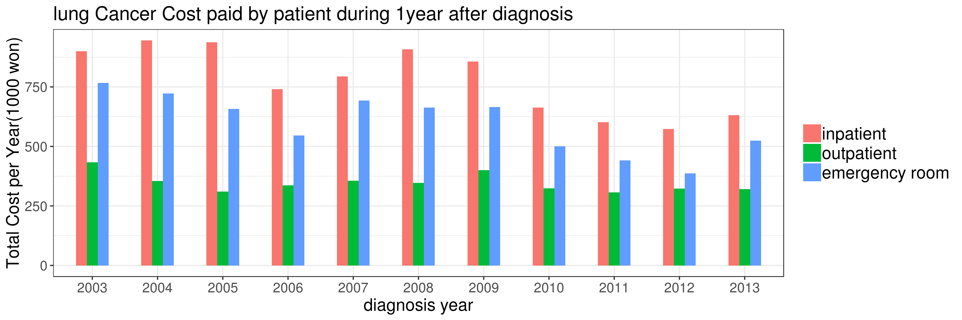
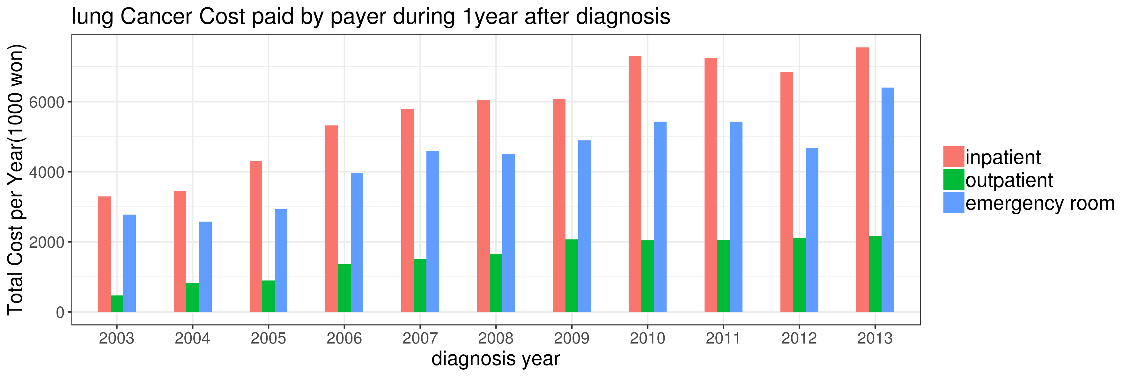
Temporal trend of overall cost in lung cancer paid by patient and national insurance

Slide 38
Assessing temporal trends in DALY based on incidence data
DALYs per 100,000 persons during 2003-2008
YLLs per 100,000 persons during 2003-2008

Slide 39
OHDSI: Open Innovation based on the open community
REPRODUCIBILITY
SCALABILITY
BENEFICIENCE
GLOBAL COMMUNITY
STANDARDS
OPENNESS
DATA
COLLABORATION

Slide 40
Mission, Vision, and Values of OHDSI
Our Mission
To improve health by empowering a community to collaboratively generate the evidence that promotes better health decisions and better care.
Our Vision
A world in which observational research produces a comprehensive understanding of health and disease.

Slide 41
Mission, Vision, and Values of OHDSI
Innovation: Observational research is a field which will benefit greatly from disruptive thinking. We actively seek and encourage fresh methodological approaches in our work.
Reproducibility: Accurate, reproducible, and well-calibrated evidence is necessary for health improvement.
Community: Everyone is welcome to actively participate in OHDSI, whether you are a patient, a health professional, a researcher, or someone who simply believes in our cause.
Collaboration: We work collectively to prioritize and address the real world needs of our community’s participants.
Openness: We strive to make all our community’s proceeds open and publicly accessible, including the methods, tools and the evidence that we generate.
Beneficence: We seek to protect the rights of individuals and organizations within our community at all times.

Slide 42


