Slide 1
The Association Between Preoperative 3D Rendering Prior to an Elective Total Knee, Shoulder or Hip Arthroplasty and Postoperative Outcomes:
Real World Evidence from the OHDSI Network
Matthew Spotnitz, M.D., M.P.H., Edward Burn, D. Phil., Thomas W. Hamilton, M.D., D. Phil., Jeffrey A. Geller, M.D., Karthik Natarajan Ph.D.

Slide 2
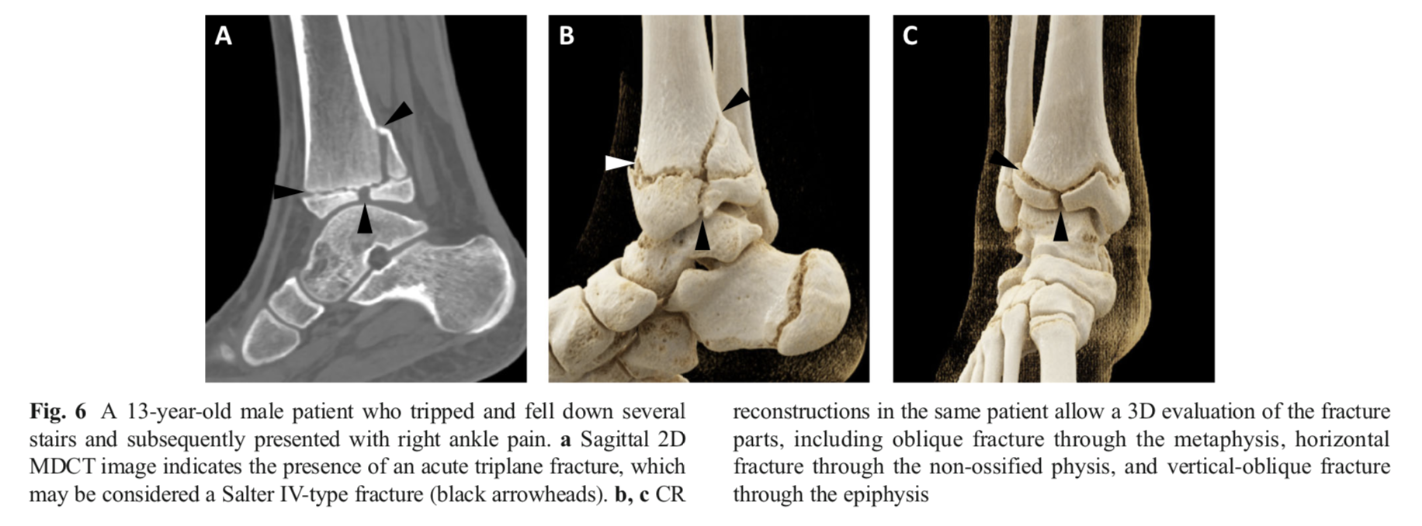
3D Ankle Fracture
Rowe SP, Fritz J, Fishman EK Emerg Radiol (2018) 25:93–101

Slide 3
Background: 3D Rendering
3D renderings are reconstructed from cross sectional images (CT, MRI, etc..)
Widely used for visualizing complex anatomy and pathology
CPT codes 76376 and 76377 introduced in 2006
Without or with an independent workstation (i.e. CT scan vs. 3D Lab)
Reimbursement policies for 3D renderings vary by insurance providers
We are interested in large scale, observational data about preoperative use of 3D rendering before a total knee arthroplasty (TKA), total shoulder arthroplasty (TSA) and total hip arthroplasty (THA)

Slide 4
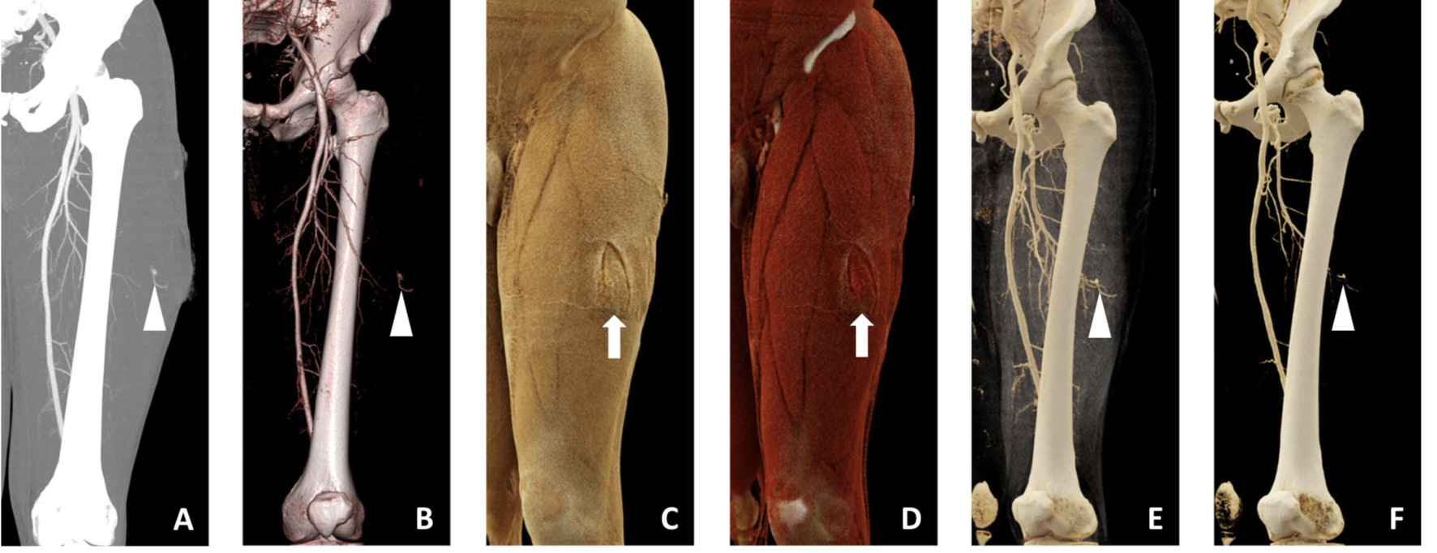
MIP < 1995
VR 1995
CR 2015
CR 2015
CR 2015
CR 2015
Rowe SP, Fritz J, Fishman EK Emerg Radiol (2018) 25:93–101

Slide 5
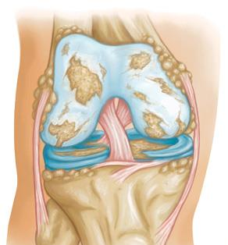
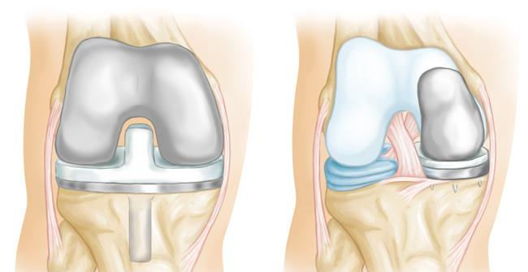
Background: Arthritis and Arthroplasties
Arthritis
TKA
UKA
https://orthoinfo.aaos.org/en/treatment/unicompartmental-knee-replacement/
https://orthoinfo.aaos.org/en/treatment/total-knee-replacement/

Slide 6
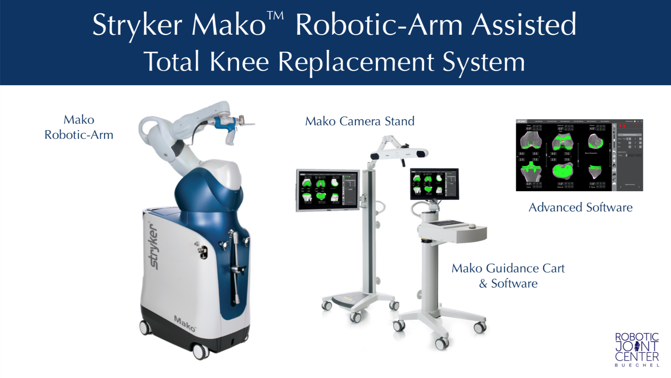

Slide 7
Public Health Impact: Revision Arthroplasties
Revision arthroplasties cost more than $3.5 Billion to the United States Healthcare System
Aseptic mechanical loosening is a leading cause of TKA, TSA, and THA revision
3D rendering use may reduce incidences of mechanical loosening and revision arthroplasties
Delanois RE, Mistry JB, Gwam CU, et. al. The Journal of Arthroplasty 32 (2017) 2663-2668
Gwam CU, Mistry JB, Mohamed NS, et. al. The Journal of Arthroplasty 32 (2017) 2088-2092.
Aibinder WR, Schoch B, Schleck C. J Shoulder Elbow Surg 2017 Mar;26(3):443-449

Slide 8
Preop 3D Rendering: Hypothetical Advantages
Create Intuitive Visualization of Anatomy and Pathology
Provide Quantitative Measurements
Improve Decisions about Surgical Access
Improve Choice of Prosthetic
Improve Communication among Patients, Healthcare Providers and Trainees

Slide 9
Study Design
A set of retrospective, observational, cohort studies
Study Period: 01/01/2006 – Present
Comparison 1: 3D prior to TKA vs. No 3D prior to TKA
Comparison 2: 3D prior to TSA vs. No 3D prior to TSA
Comparison 3: 3D prior to THA vs. No 3D prior to THA
Outcomes Cohorts: TKA, TSA, THA Revision
Time-At-Risk: POD#1 – End of Study Period
Propensity Score, Negative Controls, Positive Controls

Slide 10
3D TKA Cohort
TKA is the index event, first procedure occurrence, on or after 1/1/2006, 365 days of medical records prior
At least 1 3D Rendering within 90 days prior to index event
Not a robotic or computer-assisted procedure
Age 40+
No prior knee revision procedure
No prior knee arthroplasty procedure, observation or condition
No fracture of bone of knee joint within 90 days prior to index event

Slide 11
Preliminary Results and Analysis Plan
Preliminary results suggest that 3D rendering cohorts consist of patients who are more complex and are use medical imaging more often than the patients in the comparator cohort
Consistent with another analysis of an NYC based central data repository, the proportions of 3D renderings done without and with an independent workstation are similar
Time to Revision
Proportion of Revisions
Cost Effectiveness
Variance by Site and Insurance Provider

Slide 12
Discussion Outline
Changes to preoperative arthroplasty imaging workup
Insurance Coverage
Imaging Nuances
Evolution of 3D Rendering Technology
3D Printing/Patient Specific Instrumentation
Preop planning vs. Computer-Assisted or Robotic Guidance
Limitations of Codes and Phenotypes
Uncontrolled Confounding

Slide 13
Thanks!
Study Authors (Columbia and Oxford)
Dr. Patrick Ryan
Maura
Future OHDSI Collaborators

