Slide 1
Bayesian Calibration
George Hripcsak, David Madigan, Jami Jackson Mulgrave

Slide 2
LEGEND
Reproducible, systematized, open source approach at scale
Negative controls
  Drugs and outcomes “known” to have no causal association
  Literature, product labels, spontaneous reports
  Empirical p-values
Positive Controls
  Inject signals onto negative controls with known effect size
  Calibrated confidence intervals
Notes:
2

Slide 3
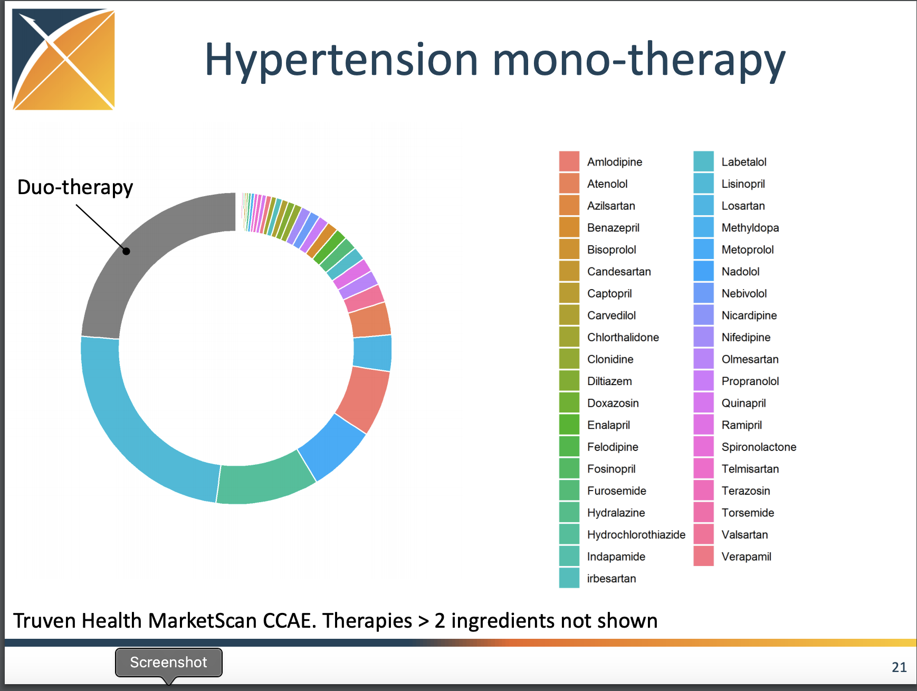

Slide 4
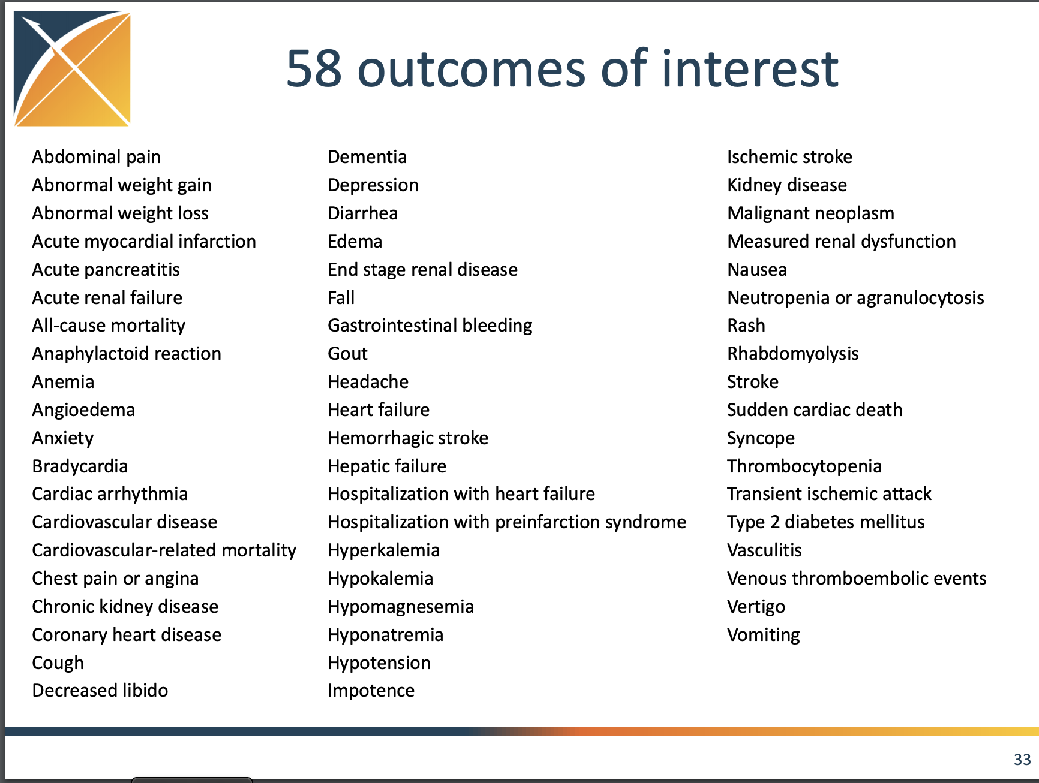

Slide 5
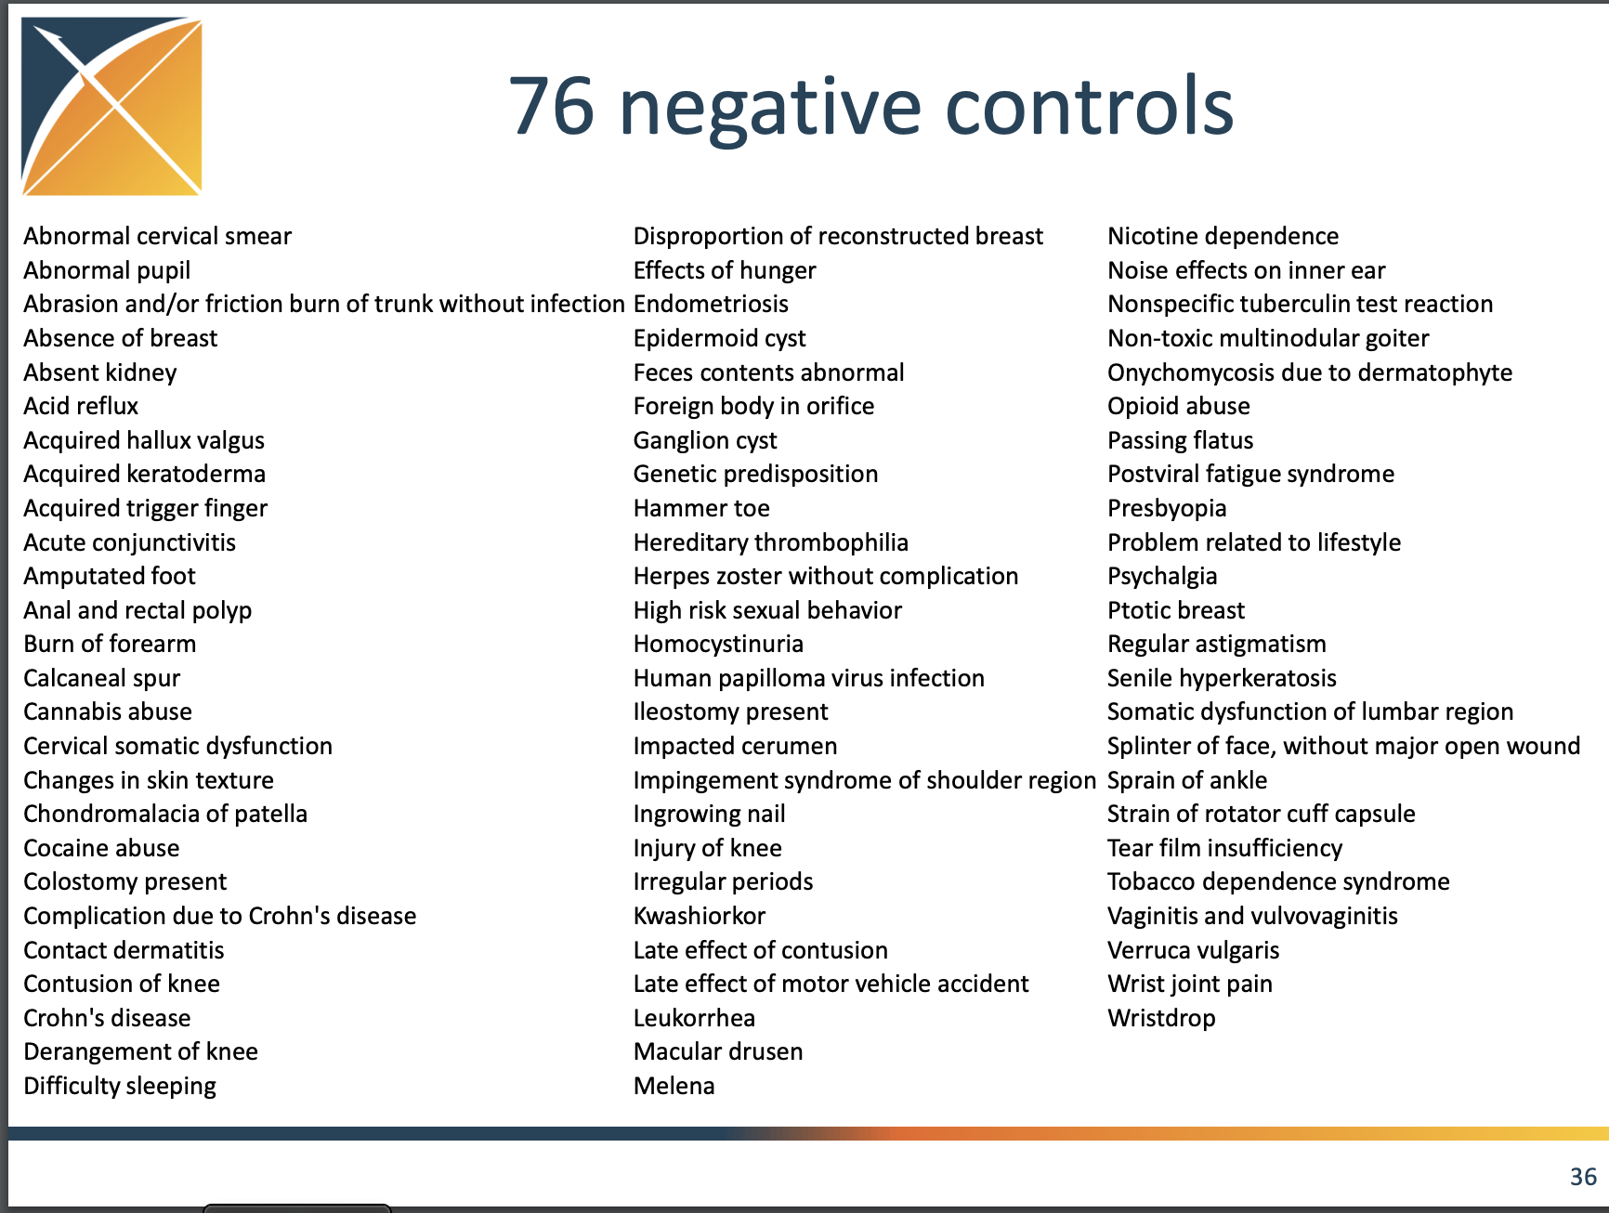

Slide 6
Method: Study design (LEGEND)
Treatment strategies:
Atenolol
Nebivolol
Causal contrasts of interest:
On-treatment effect
Intent-to-treat effect
Atenolol
Atenolol
PS matching
Medical history
Follow-up time
Eligibility criteria:
Diagnosis of hypertension during previous 1 year
No prior antihypertensive drug
No prior cardiovascular outcome
Nebivolol
Nebivolol
Outcome (Major Adverse Cardio-Cerebrovascular Event):
Hospitalized myocardial infarction, heart failure, stroke and sudden cardiac death
  https://github.com/OHDSI/LEGEND

Slide 7
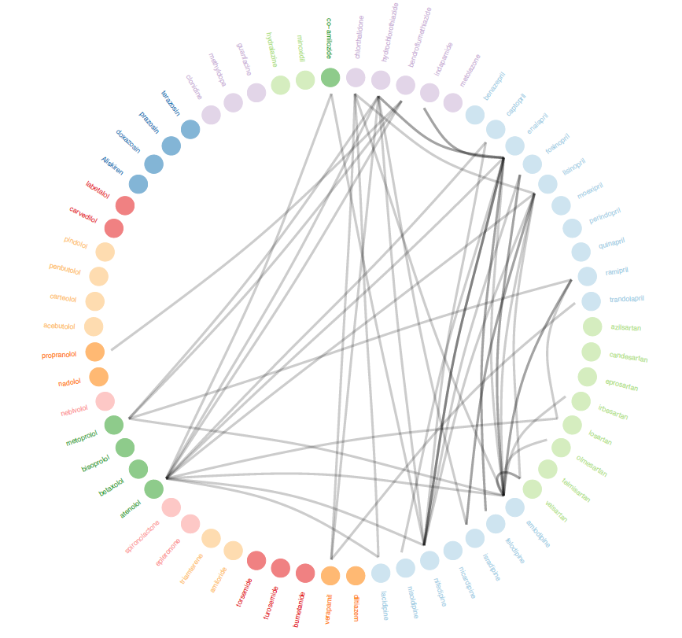
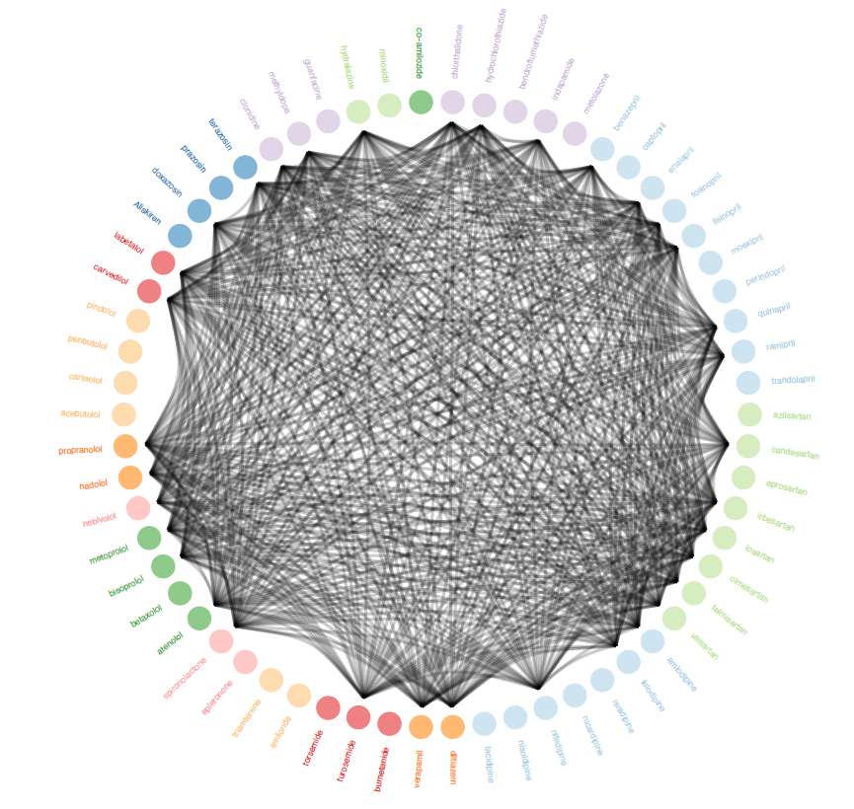
Method: LEGEND (Large-scale Evidence Generation and Evaluation in a Network of Databases
All randomized trials
LEGEND
40 trials
10,278 comparisons
US Insurance databases
  IBM® MarketScan® CCAE (Commercial Claims and Encounters)
  IBM® MarketScan® MDCD (Multi-state Medicaid)
  IBM® MarketScan® MDCR (Medicare Supplemental Beneficiaries)
  Optum® Clinformatics®
Japanese insurance database
  Japan Medical Data Center (JMDC)
Korean National insurance database
  NHIS-national sample cohort (NHIS-NSC) DB
US EHR databases
  Columbia University medical Center
  Optum® PANTHER®
German EHR database
  QuintilesIMS Disease Analyzer (DA) Germany
  https://github.com/OHDSI/LEGEND

Slide 8
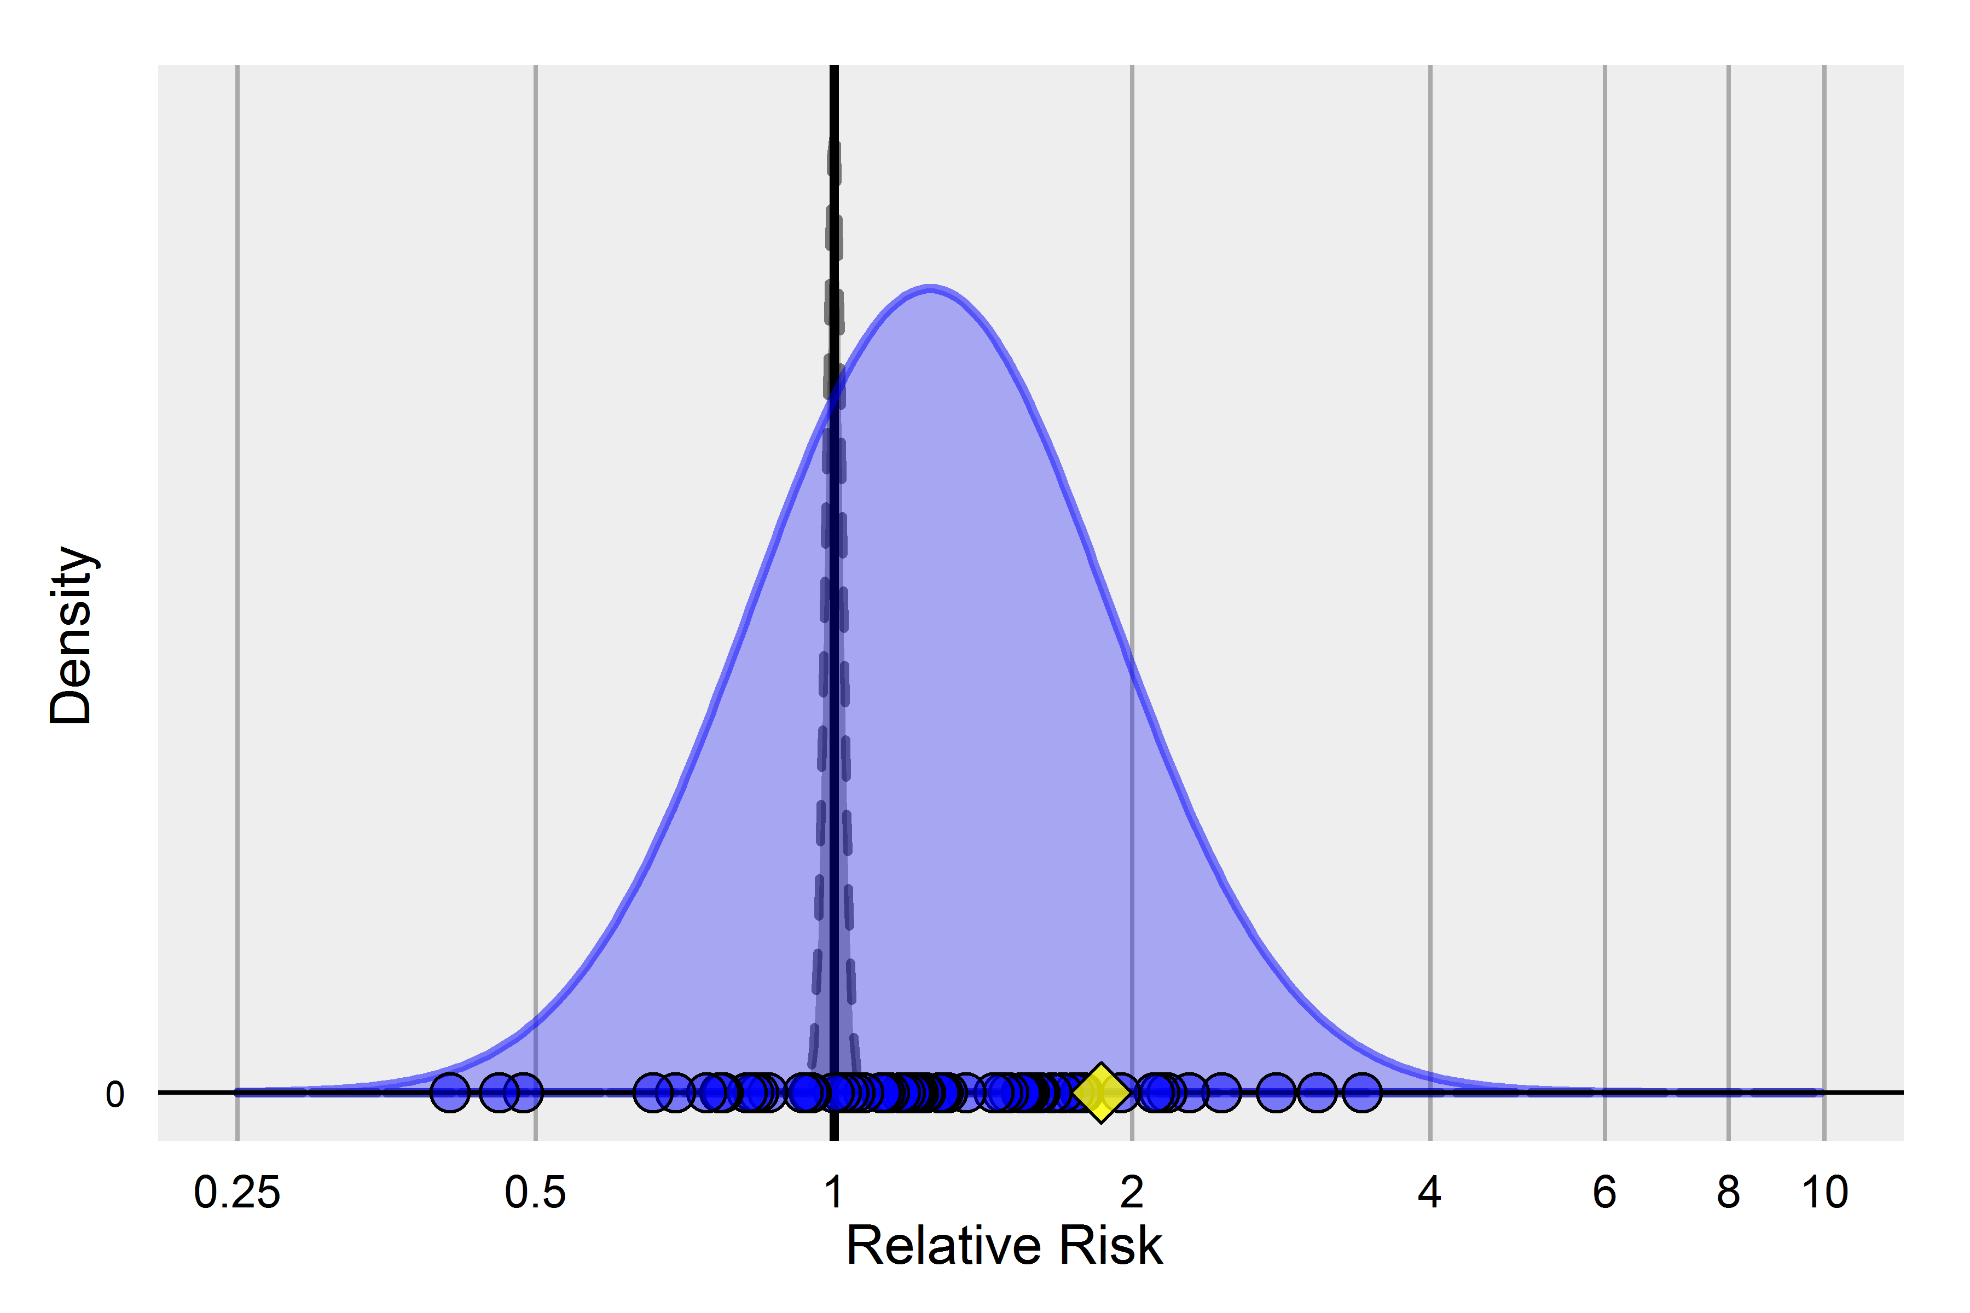
Negative controls & the null distribution
CC: 2000314, CCAE, GI Bleed

Slide 9
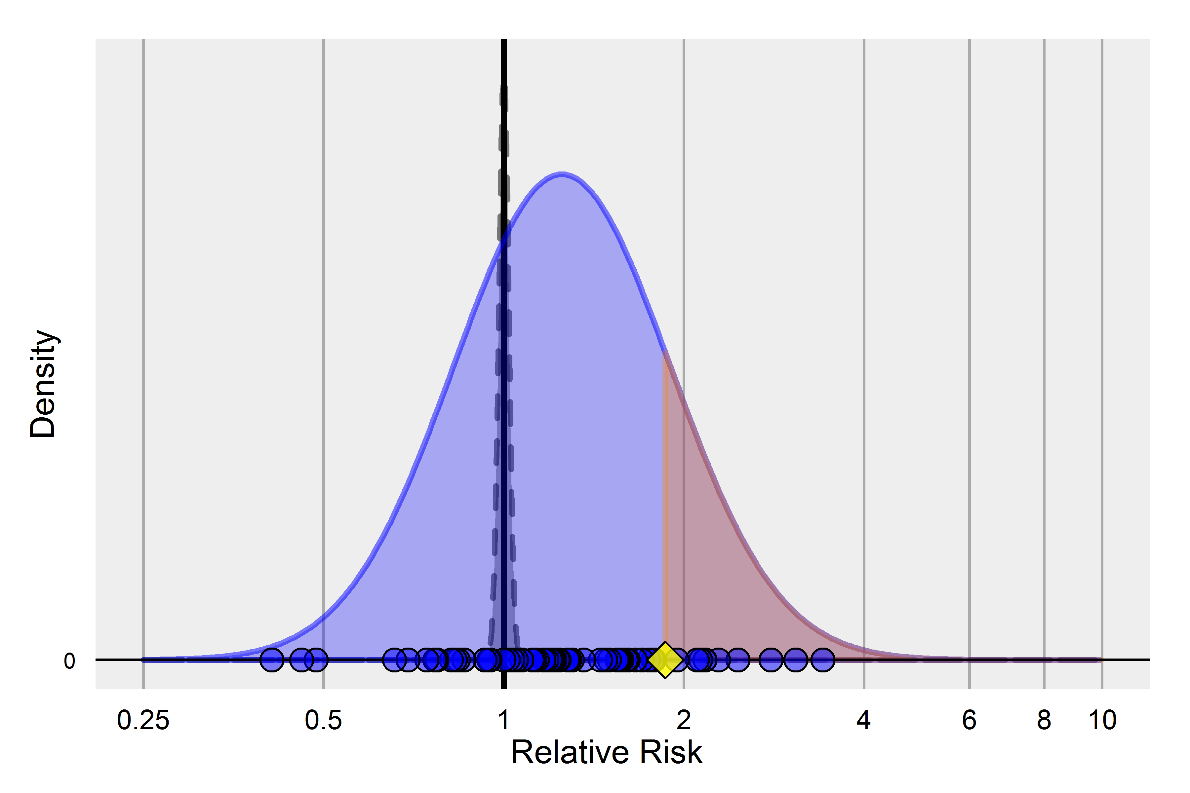
Negative controls & the null distribution
CC: 2000314, CCAE, GI Bleed

Slide 10
Bayesian Approach
Compute the posterior distribution of the TCO effect of interest, conditional on:
  Directly estimated effect for the TCO
  Estimated effects on all negative and positive controls
  Across all databases
  Across all “methods” (e.g. matching versus stratification)
MCMC

Slide 11
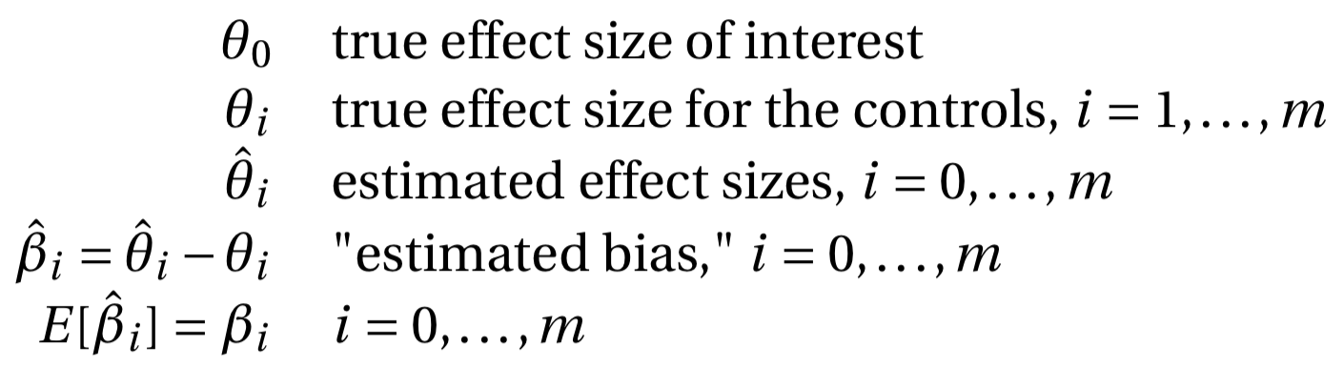
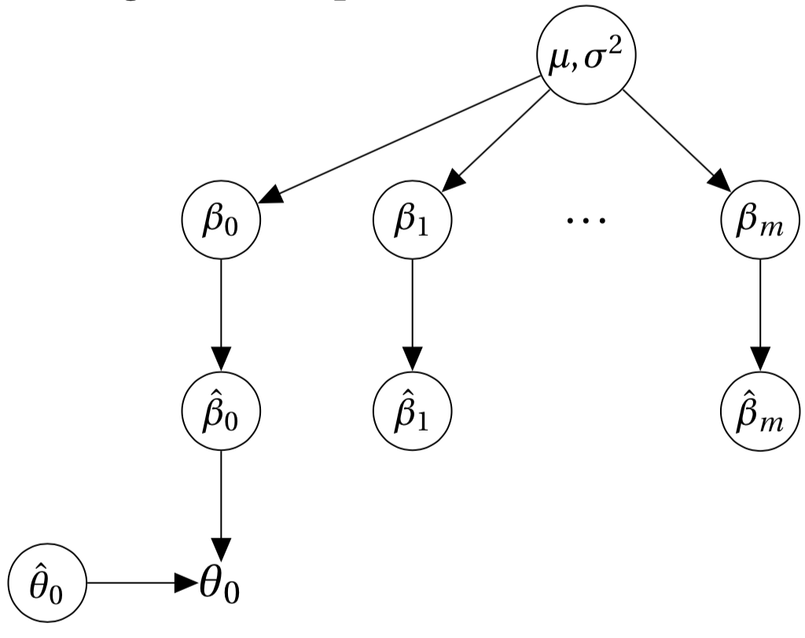
One model, one database (V1)

Slide 12
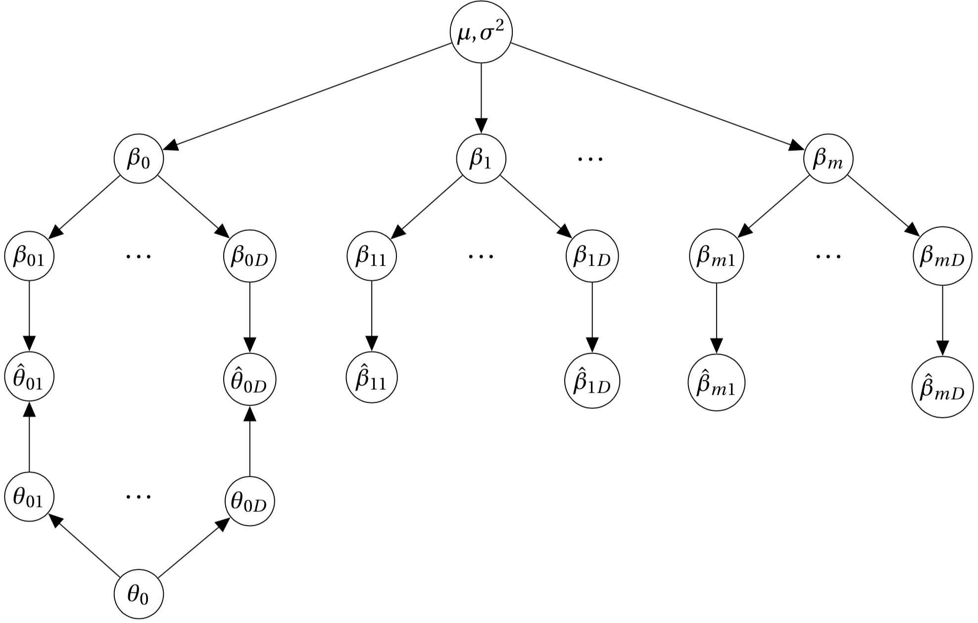
One model, many databases (V2)
Combining calibration with random effects meta-analysis

Slide 13
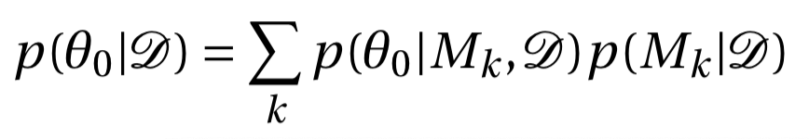
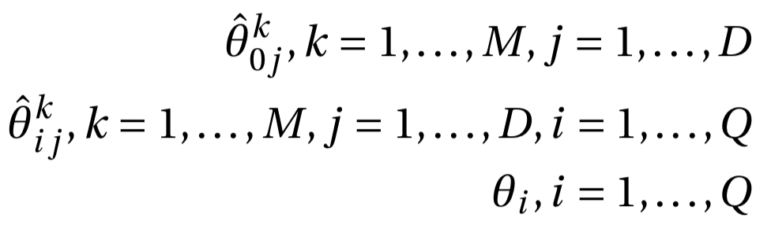
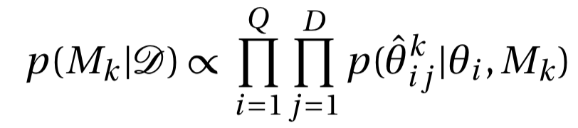

Many models, many databases (V4, BMA)
Combining calibration with random effects meta-analysis and BMA

Slide 14
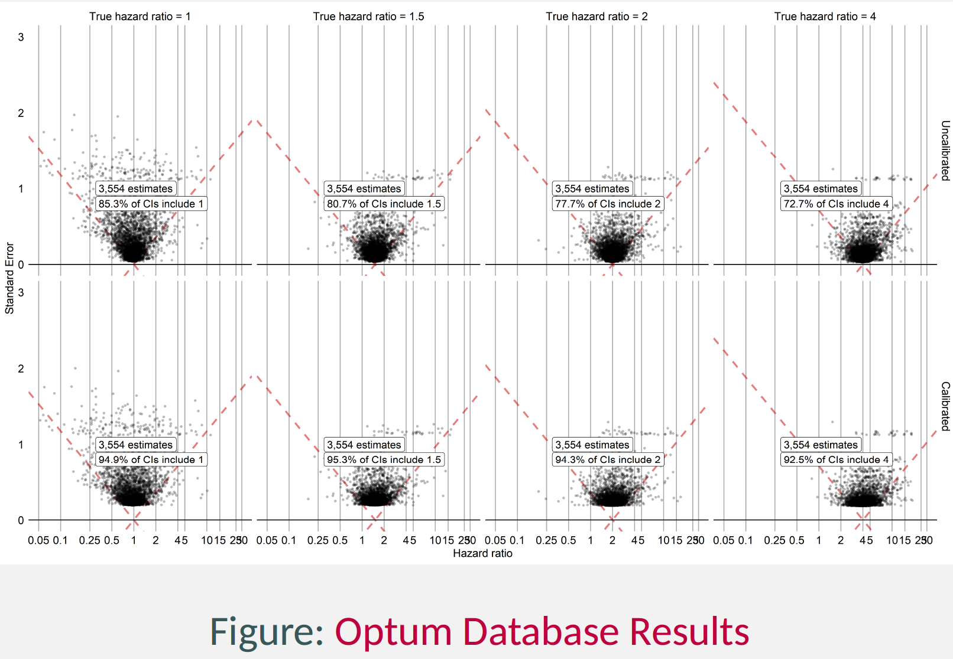
Initial results (V1)

Slide 15
