Slide 1
ICD10PCS to SNOMED standardization
Notes:
1

Slide 2
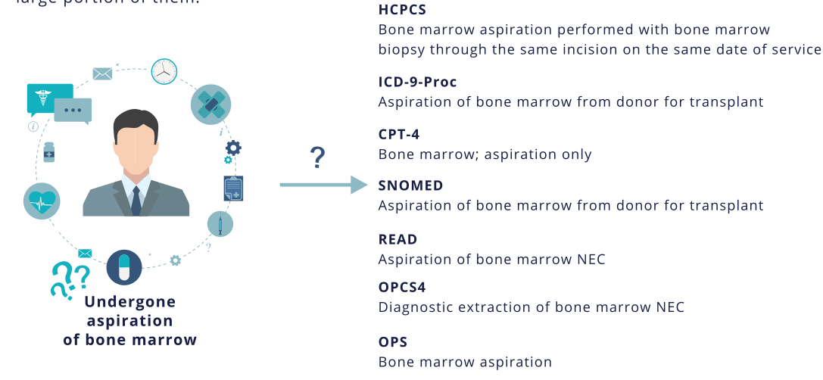
The problem: Standardization
SNOMED CT is the common target for standardization.

Slide 3
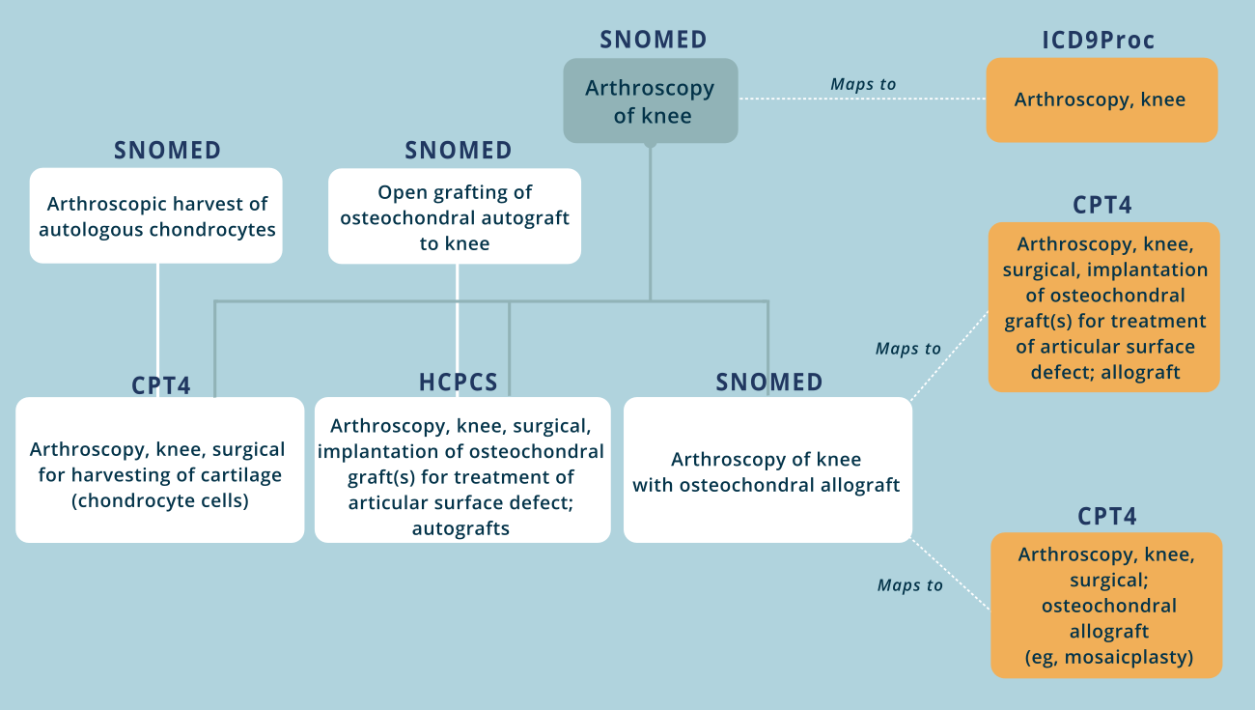
Solution: comprehensive hierarchy

Slide 4
Idea behind ICD10PCS
ICD10PCS has 7 attributes (body sites, surgical approach, type of device or drug used)
0D16479 Bypass Stomach to Duodenum with Autologous Tissue Substitute, Percutaneous Endoscopic Approach
0. Medical and Surgical
D. Gastrointestinal System
1. Bypass
6. Stomach
4. Percutaneous Endoscopic
7. Autologous Tissue Substitute
9. Duodenum
Out of ~80 000 codes, only 40 000 exist.
Examples:
00UM3JZ Supplement Facial Nerve with Synthetic Substitute, Percutaneous Approach
3E0604Z Introduction of Serum, Toxoid and Vaccine into Central Artery, Open Approach
Notes:
4

Slide 5
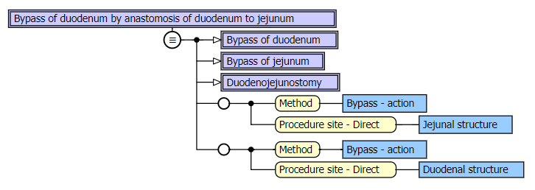
SNOMED model:
SNOMED procedures also have attributes
  Own attribute-value pairing mode, multiaxial hierarchy
Inherited from ancestor concepts, normally with increased granularity
Parents:
Attributes:
Notes:
5

Slide 6
Attribute translation for ICD10PCS
Less than 2000 unique attributes - mapped manually
0D16479 "Bypass Stomach to Duodenum with Autologous Tissue Substitute, Percutaneous Endoscopic Approach"
0. Medical and Surgical | removed as direct ancestor of «Bypass graft»
D. Gastrointestinal System | removed as direct ancestor of «Stomach»
1. Bypass | 48537004 Bypass graft (procedure)
6. Stomach | 69695003 Stomach structure (body structure)
4. Percutaneous Endoscopic | 37270008 Endoscope (device)
7. Autologous Tissue Substitute | 413675001 Body tissue material (substance)
9. Duodenum | 38848004 Duodenal structure (body structure)
Bypass
Bypass graft
Notes:
6

Slide 7
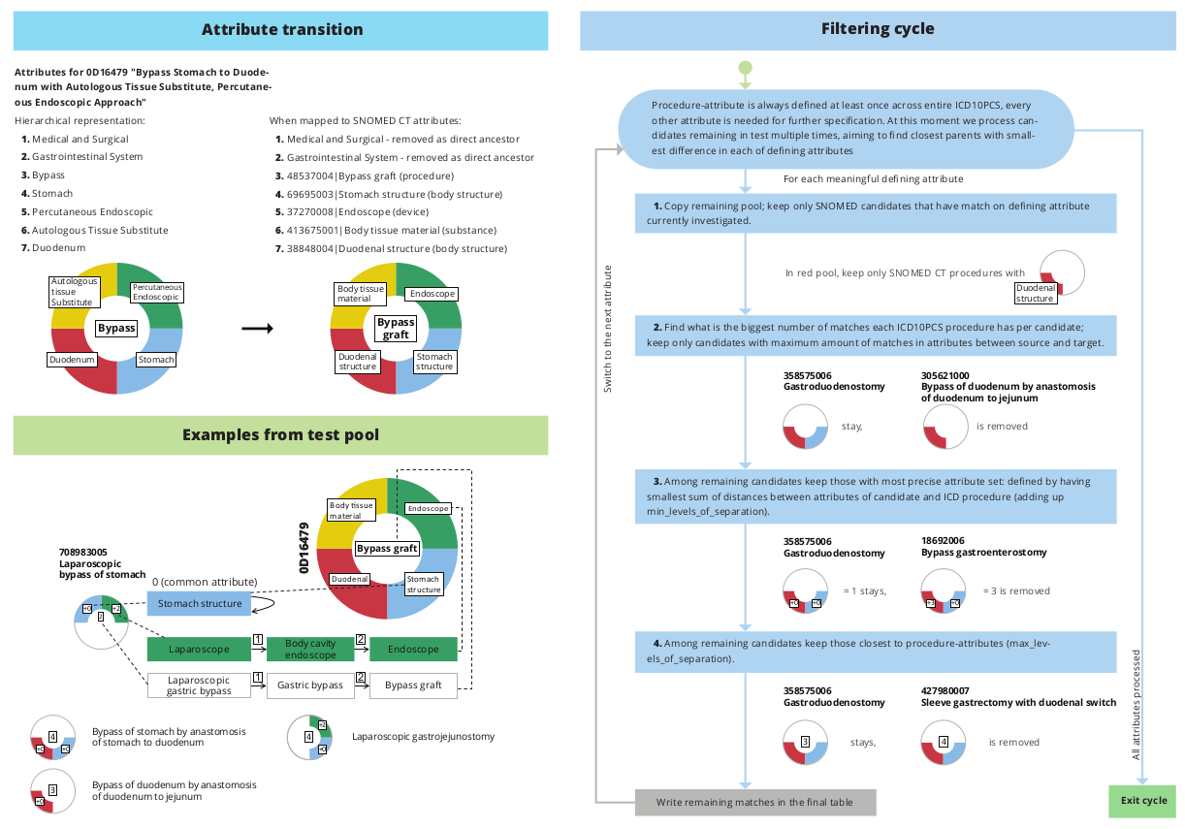
Filtering cycle - automated part

Slide 8
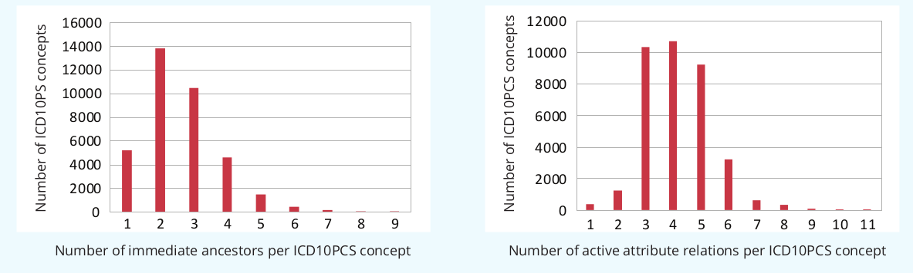
Results (in numbers)
We have found direct parents for more than 40 000 leaf-level ICD-10-PCS concepts most
commonly encountered in patient data.
Multiple parents for ICD10PCS concepts exist because of high granularity and the need to represent each aspect of the procedure
High number of attributes (>5) is caused by inheriting new attributes from SNOMED parents
Open repair of kidney or renal pelvis (SNOMED)
Bypass Left Kidney Pelvis to Left Ureter, Open Approach (ICD10PCS)
Bypass of ureter (SNOMED)
Notes:
8

Slide 9
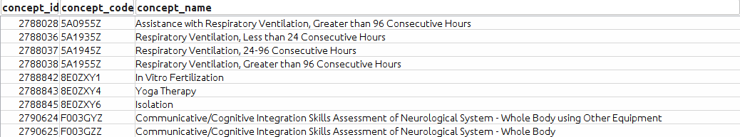
Marginal cases: Low number of parents & attributes:
Psychotherapy, Yoga, Osteopathic procedures, Counselling etc.
Such procedures fall outside of SNOMED attribute-value model and have generic ancestors
Notes:
9

Slide 10
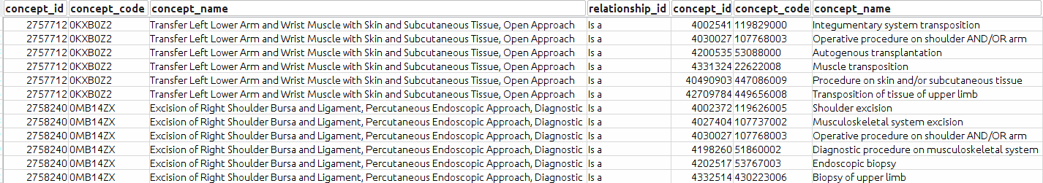
Marginal cases: High number of parents:
1.Dublicating branches in SNOMED (transfers, grafts, autotransplantations)
2. Complex procedures which belong to multiple subhierarchies: Biopsies (both biopsies and excisions)
Transfer Left Lower Arm and Wrist Muscle with Skin
and Subcutaneous Tissue, Open Approach
Excision of Right Shoulder Bursa and Ligament,
Percutaneous Endoscopic Approach, Diagnostic
Notes:
10

Slide 11
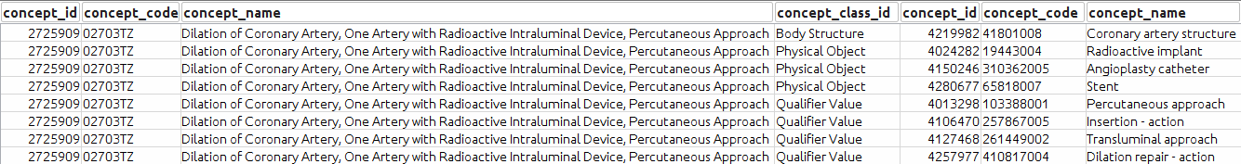

Marginal cases: High number of attributes:
Extremely specific procedures without close enough representation.
Inherit different attributes from their SNOMED ancestors:
Dilation of Coronary Artery, One Artery with Radioactive
Intraluminal Device, Percutaneous Approach
Should have been one attribute!
Notes:
11

Slide 12
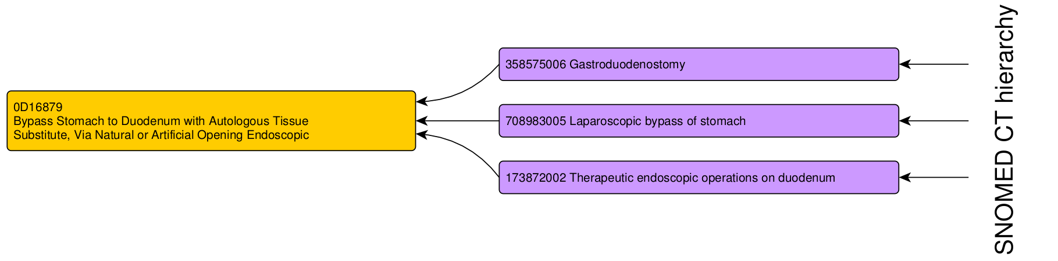
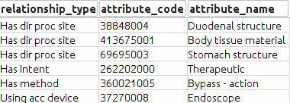
Results - seamless extension of SNOMED model inside CDM tables
Attributes for
0D16879 Bypass Stomach to Duodenum with Autologous Tissue Substitute, Via Natural or Artificial Opening Endoscopic
Notes:
12

Slide 13
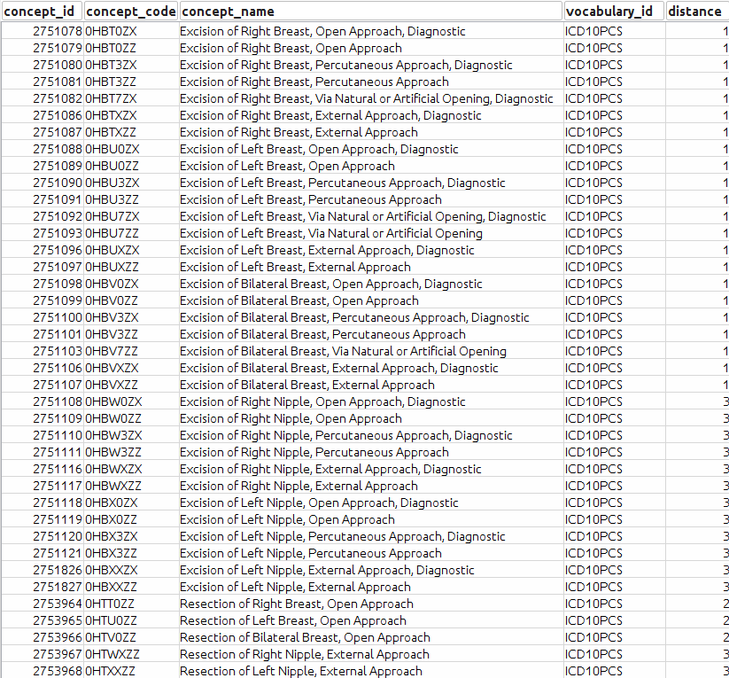
ICD10PCS descendants of SNOMED concepts
39 ICD10PCS concepts are now descendants

Slide 14

Why are all concepts kept Standard?
Why not 'Maps to'?
00800ZZ Division of Brain, Open Approach exists next to 00870ZZ Division of Cerebral Hemisphere, Open Approach in ICD10PCS vocabulary
If we build 'Maps to' for 00800ZZ, clinical procedures coded 00870ZZ would become a subset of such procedures.
Citing B4.1a of official ICD10PCS guidelines:
If a procedure is performed on a portion of a body part that does not have a separate body
part value, code the body part value corresponding to the whole body part.
Example: A procedure performed on the alveolar process of the mandible is coded to the
mandible body part.
That means 00800ZZ actually is "Division of Other Brain, Open Approach"
Possible, but requires additional analysis and rules!

Slide 15
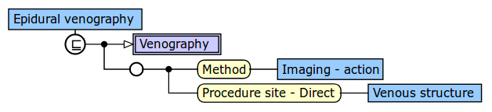
What problems have we faced?
Main problem: Inconsistency
Generic attributes and parents of specific concepts.
Often we have trouble finding the right concept due to their ‘sloppy’ assigned attributes.
Problematic concepts need to be excluded manually during debugging process
This will lead to any venous imaging
procedure being matched directly to
Epidural Venography
Notes:
15

Slide 16
Next steps
Extend hierarchy to all leaf-level ICD10PCS concepts
SNOMED automated QA and attributes reassignment
Generalization of algorithm to accommodate other possible sources (currently testing for German OPS)
Integration of ICD10PCS Hierarchy concepts and ICD10PCS own attributes to also exist in SNOMED hierarchical tree
Notes:
16

Slide 17
Procedure domain
done:
ICD9Proc, OPCS4, ICD10PCS, HCPCS
upcoming
OPS – we are working on them using ICD10PCS approach
CPT4 – no attributes defined, needs investigation
The same principles as for ICD10PCS are used

