Slide 1
OHDSI Vocabulary Development and Release Process
Notes:
1

Slide 2
OHDSI Vocabulary Management
New Vocab. Request
Prioritization & Funding
Estimate Effort
Plan & Schedule
Demand
Integrate Vocabulary
Development
Obtain Data
Perform Testing
Publish into ATHENA
Create New Vocabulary
Obtain New Data Feed
Update Mappings
Perform Testing
Publish into ATHENA
Support & Maintenance
Raise Issue in GitHub
Fix Mappings
Perform Testing
Publish into ATHENA
User / Requestor
OHDSI Vocabulary Team

Slide 3
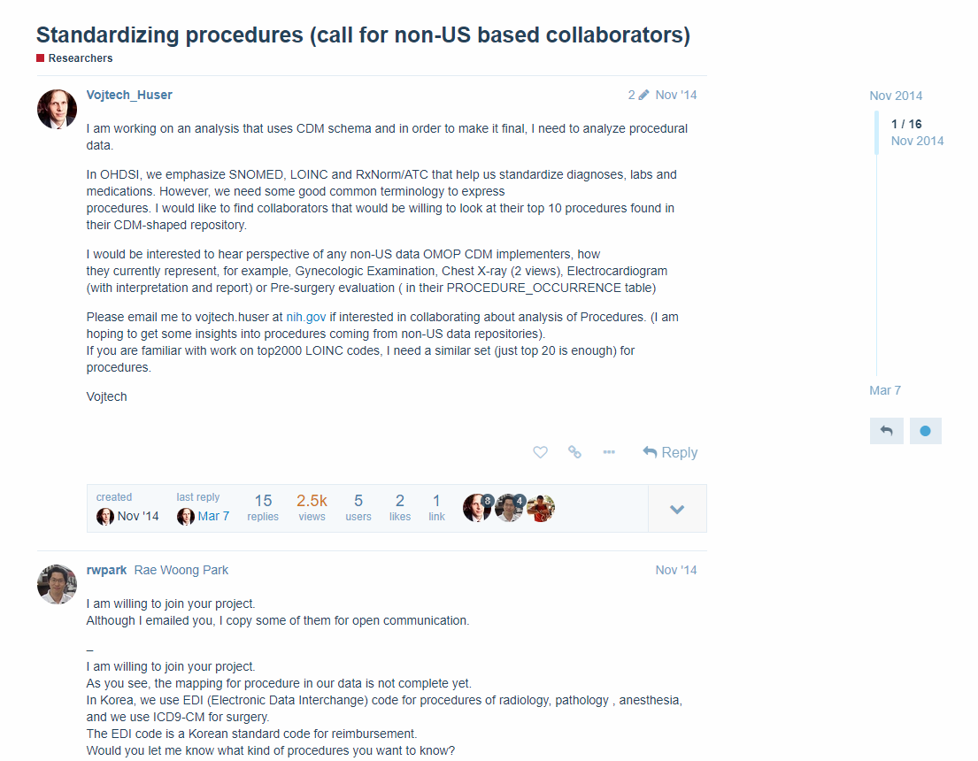
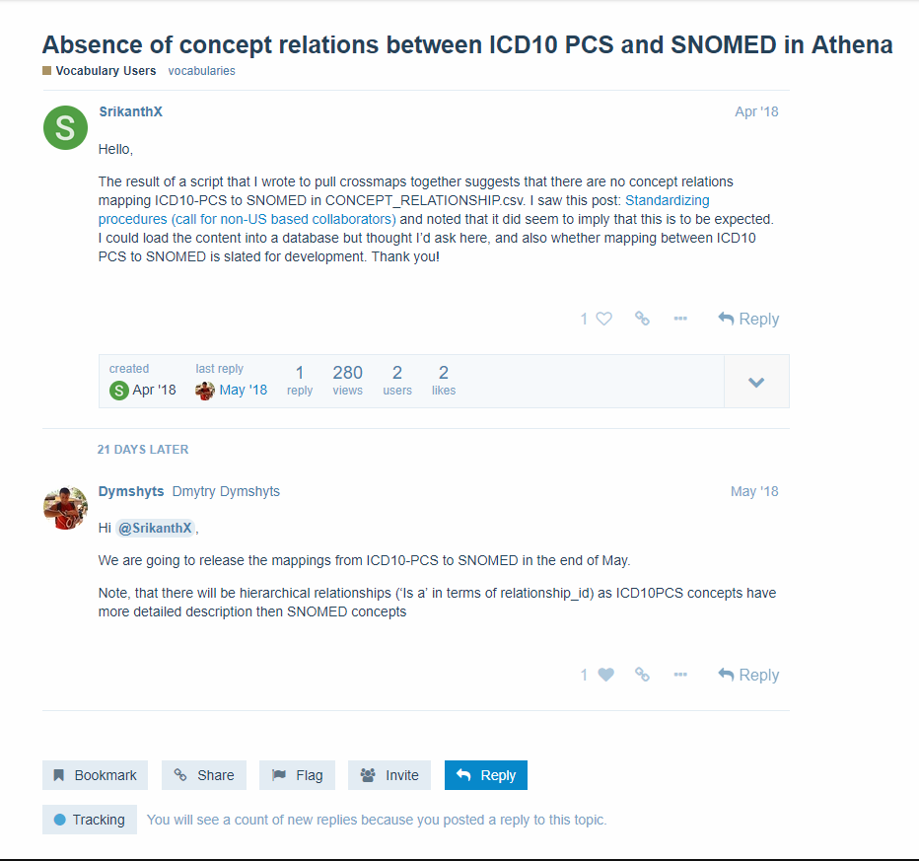
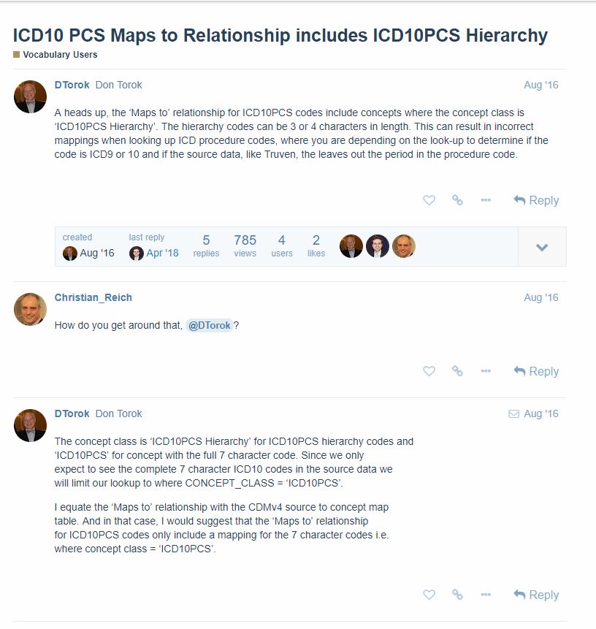
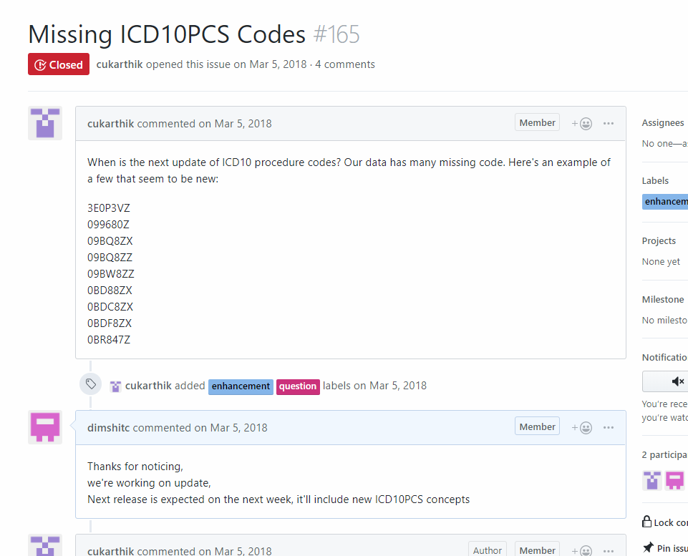
Raising Requests
http://forums.ohdsi.org
https://github.com/OHDSI/Vocabulary-v5.0/issues

Slide 4
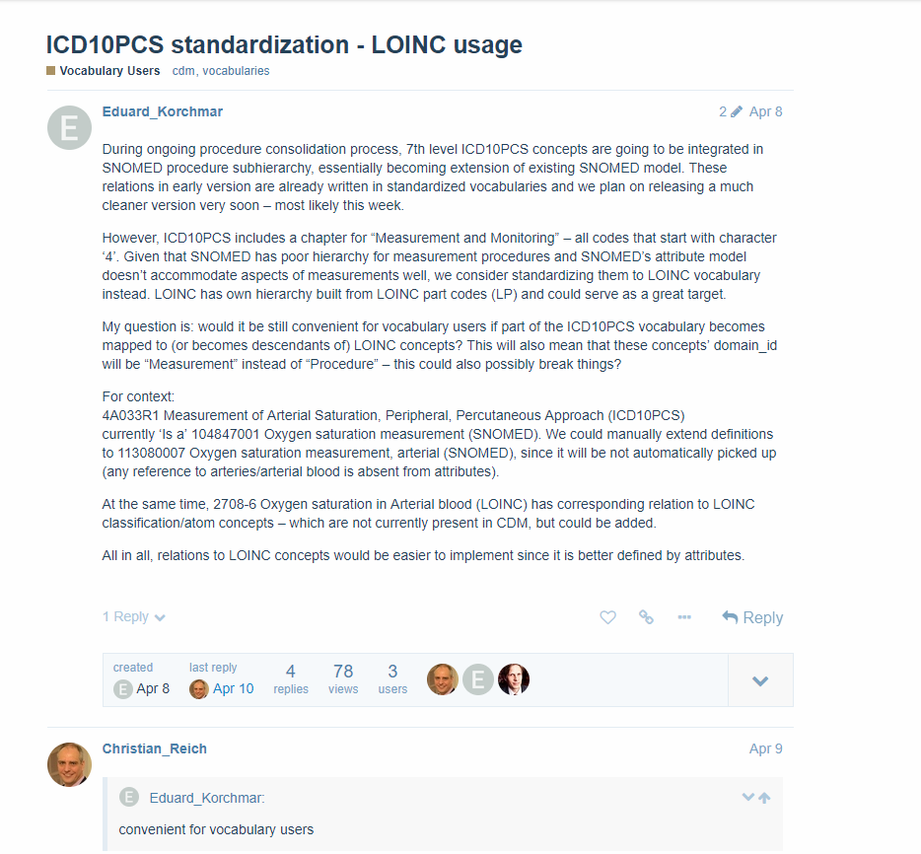
Discussing details
http://forums.ohdsi.org

Slide 5
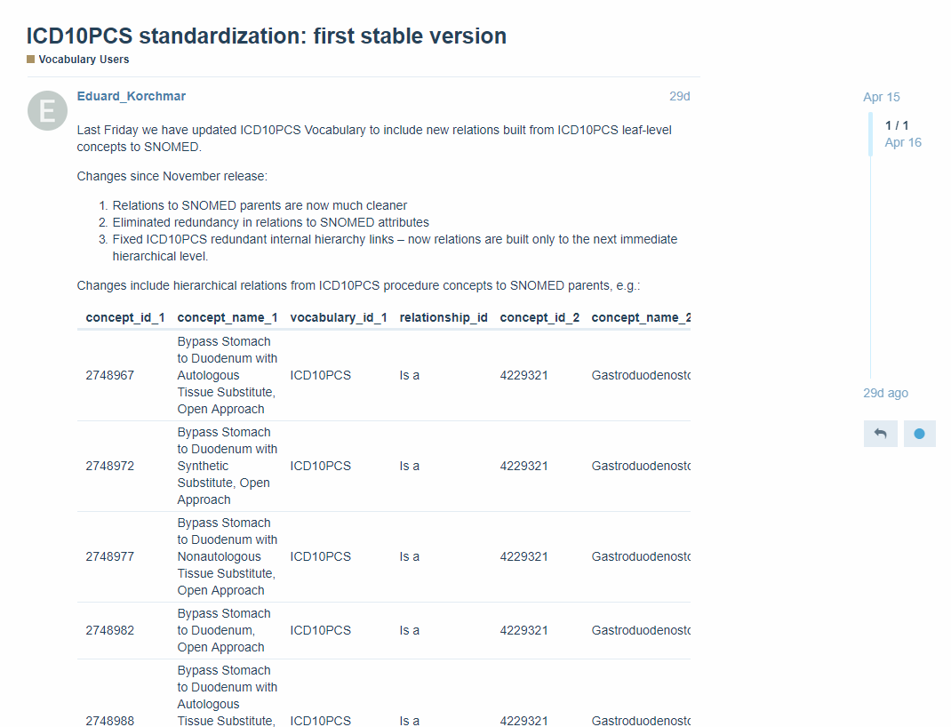
Release announcement
http://forums.ohdsi.org

Slide 6
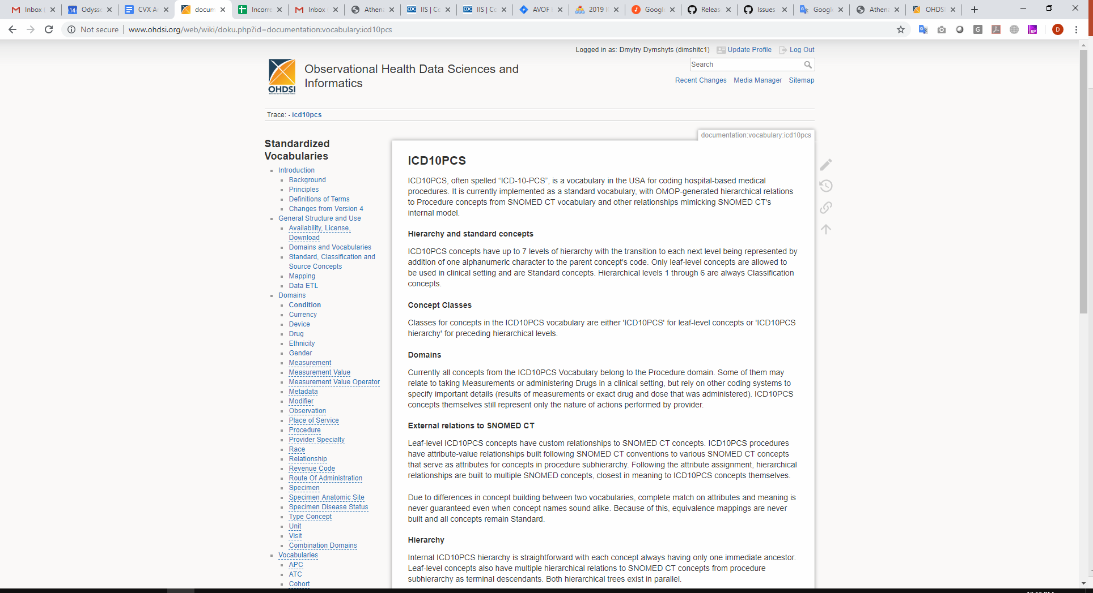
Documentation
http://www.ohdsi.org/web/wiki/doku.php?id=documentation:vocabulary

Slide 7
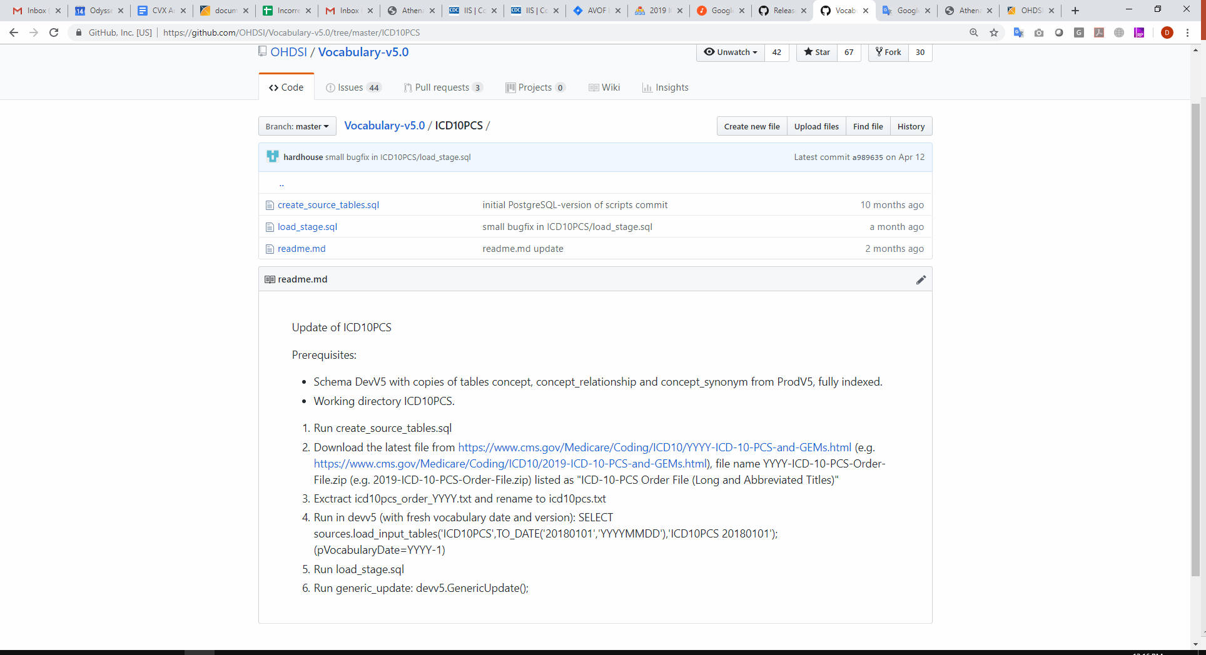
Github repository
https://github.com/OHDSI/Vocabulary-v5.0/issues

Slide 8
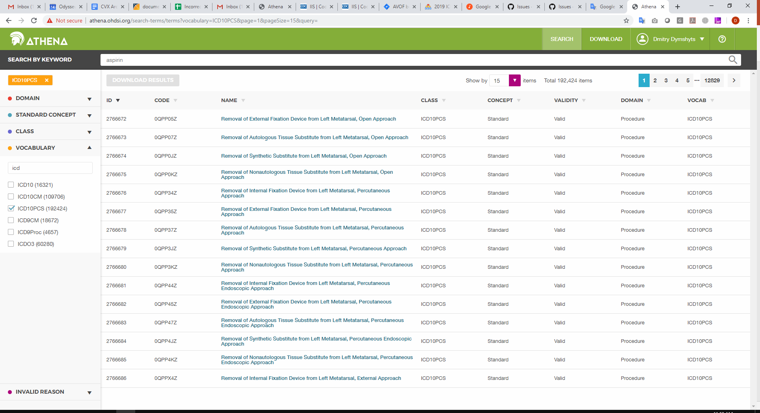
Athena search page
http://athena.ohdsi.org/search-terms/terms

Slide 9
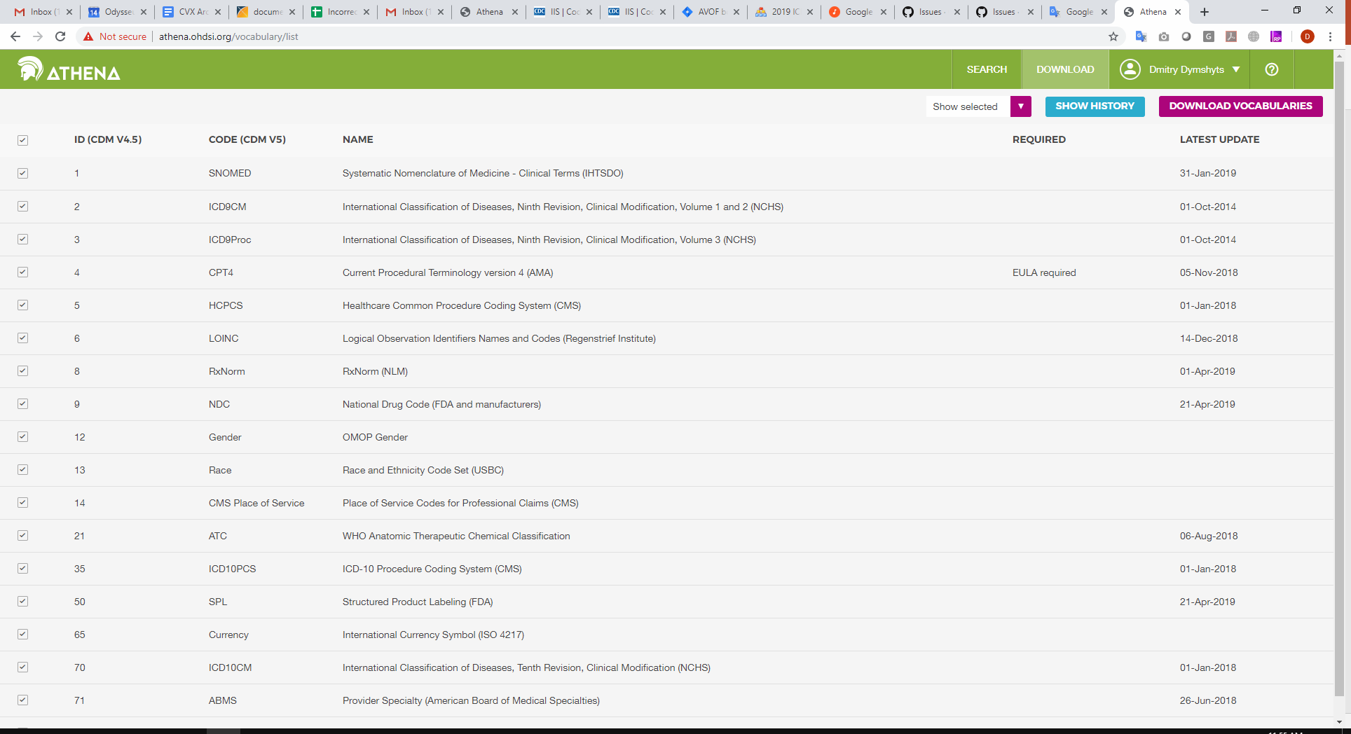
Athena download page
http://athena.ohdsi.org/vocabulary/list

Slide 10
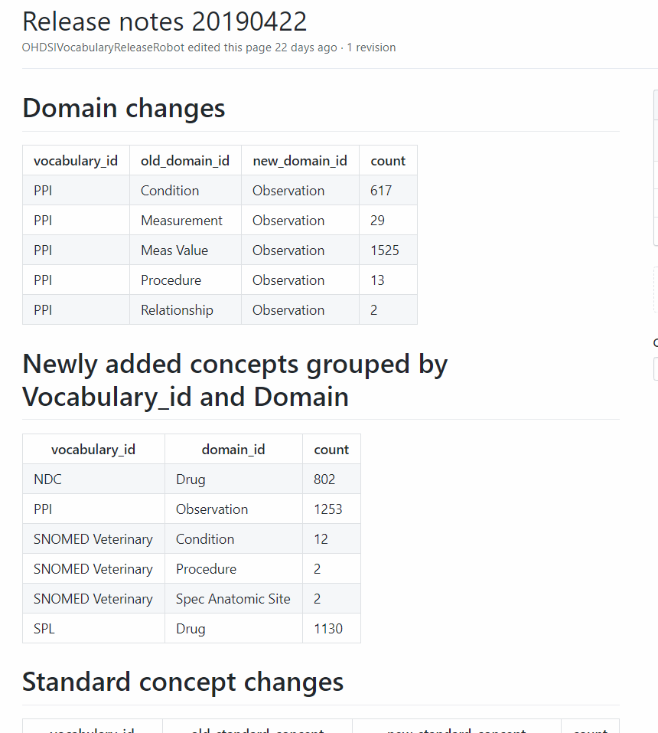
Release notes
https://github.com/OHDSI/Vocabulary-v5.0/releases/

Slide 11
What was done lately and what we are going to do

Slide 12
Procedure domain
done:
ICD9Proc, OPCS4, ICD10PCS, HCPCS
upcoming
OPS – we are working on them using ICD10PCS approach
CPT4 – no attributes defined, needs investigation
The same principles as for ICD10PCS are used

Slide 13
Drug domain
Done:
Added:
JMDC - Japan Medical Data Center Drug Code (JMDC)
KDC - Korean Drug Code (HIRA)
Improved:
dm+d, Gemscript, GGR, BDPM, DPD, AMT, HCPCS drugs,
added missing NDC concepts and missing mappings

Slide 14
Drug domain
Upcoming
additions
European drug vocabularies - article 57 database
HemOnc as a Oncology Drug Regimen vocabulary
improvements
CVX - it needs better hierarchy
ATC - it still gaps and some ambiguity
NDC - still has gaps
make drug vocabularies updates as much as possibly automated

Slide 15
Condition domain
Added:
SNOMED Veterinary
Improved:
ICD9CM, ICD10CM, ICD10, ICDO

Slide 16
Multiple domains
Done
More accurate domain assignment for LOINC, MedDRA, SNOMED
Upcoming
NAACCR as a Cancer Registry source vocabulary
https://github.com/OHDSI/OncologyWG/issues
Genomic vocabularies
http://forums.ohdsi.org/t/genomic-data-in-the-cdm/3483
https://github.com/OHDSI/Genomic-CDM
SNOMED Extension allowing to map conditions flawlessly

Slide 17
Structural changes
done:
- Outdated HCPCS and CPT4 remain standard if they don't have replacement, as these concepts existed in the patient data and still need to be represented in CDM
to do:
make ATC concepts standard
support concepts changing their meaning over time (HCPCS, NDC, DRG)
We’ll discuss this on the next CDM workgroup;
see forum threads:
http://forums.ohdsi.org/t/hcpcs-codes-change-their-meaning-over-time/6182
http://forums.ohdsi.org/t/ndcs-changing-over-time/903
http://forums.ohdsi.org/t/drg-codes-change-their-meaning-over-time/6529

Slide 18
Other gaps and improvements
Improvement - more automation is needs to be added for refreshes
Opportunity - Better collaboration and curation capabilities with web-based interfaces that do not require deep SQL and database structure knowledge (for example, the mapping tool from France?)
Improvement - how to better enable accepting external contributions (see new OHDSI process proposed by Patrick R. on http://forums.ohdsi.org/t/a-proposal-for-maturing-our-open-community-development-activities/6728/1)
Improvement - more streamlined and consistent release process
Opportunity - enabling the diff between new and previous vocab releases with Tantalus https://github.com/OHDSI/Tantalus

