Slide 1
OHDSI Japan
Tatsuo Hiramatsu
Mui Van Zandt

Slide 2
Introduction
Tatsou Hiramatsu, MD, PhD
  Professor at Innovation & Research Support Center, International University of Health and Welfare
  Experience working with the OMOP CDM for 3 year at the University of Tokyo
  Host and lead of OHDSI Japan initial meeting

Slide 3
OHDSI Japan Initial Meetig
Thursday, June 20th at the International University of Health and Welfare
Attendees:
  International University of Health and Welfare
  Kyushu University Hospital
  Jichi Medical University
  Okayama University
  National Cancer Center Hospital East
  University of Tsukuba

Slide 4
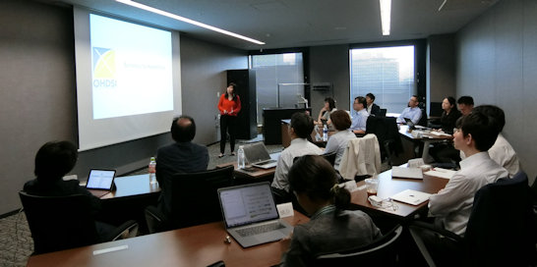
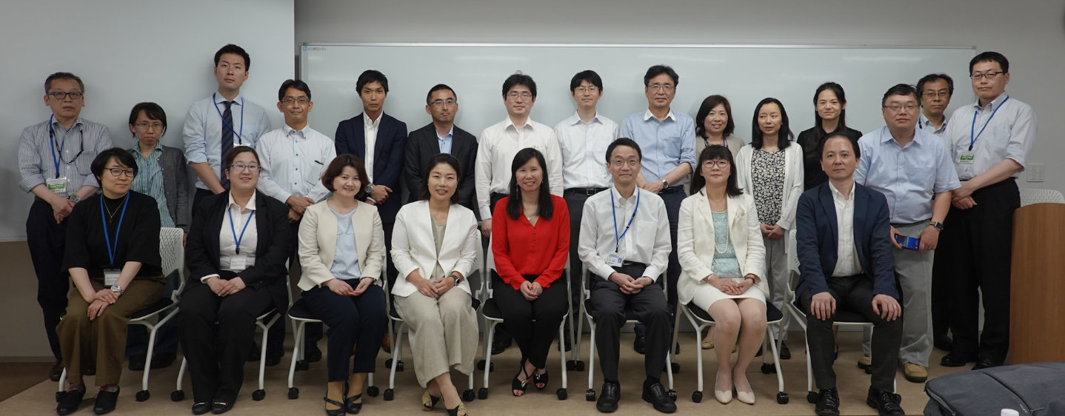
OHDSI Japan Initial Meeting (cont)
Attendees (cont.)
  Janssen
  Lilly
  Astellas Amgen
  Celgene
  IQVIA
  Fujitsu
  MDV
  JMDC

Slide 5
Agenda Discussed
OHDSI/OMOP introduction
Self-introduction
OHDSI activities around the world
Secondary clinical data usage in Japan
  4 university hospitals have conducted OMOP conversions with 3 more in preparation
OMOP vocabulary mapping strategy
OHDSI Japan chapter discussions
OMOP CDM mini tutorial

Slide 6
Types of clinical databases in Japan
EHR
Registries
semi Real-time
Hospitals
Register
(by hand or automatic)
Detailed record
incl. lab data
Clinics
Claims-DB
Pharmacies
DPC data
(Quarterly, Anonymized)
Claims
(Monthly)
Claims-DB
Insurers
MHLW
National-DB
Anonymized Claims Data
All data by patient
(Cross hospital)
All patients data

Slide 7
Major Japanese Databases
■Hospital-based
DB name | admin | # uniq ID | Data Source
MID-NET | PMDA | >4M | SS-MIX2, DPC, Claims
EBM Provider | MDV Co.,Ltd. | 25M | DPC, Claims, Lab, others
RWD-DB | RWD Co.,Ltd. | 20M | DPC, Claims, EMR, Lab
MIA | NHO | 20M | DPC, Claims
JMDC C. DB | JMDC | 5.4M | DPC, Claims
CCT | CCT K.K. | 3.6M | DPC, Claims, EMR, Lab
NCDA | NHO | 1.6M | SS-MIX2, Lab, etc.
High Quality
Major in HB
1 stop service
1 stop service
Reference:
Pharmacoepidemiology & Database Taskforce, Japanese Society for Pharmacoepidemiology.
Survey of Japanese databases in Japan available for clinical/pharmacoepidemiology.
7

Slide 8
Major Japanese Databases
■Insurance-based
DB name | admin | # uniq ID | Data Source
NDB | MHLW | All Patients | Claims
JMDC C. DB | JMDC | 5.6M | Claims
MinaCare | MinaCare | 5.6M | Claims, others.
Medi-Scope | Kyowa Kikaku | 5.5M | Claims, others
JammNet | JammNet | 2.8M | Claims
The Big One, non-profit use only
Major in IB
Reference:
Pharmacoepidemiology & Database Taskforce, Japanese Society for Pharmacoepidemiology.
Survey of Japanese databases in Japan available for clinical/pharmacoepidemiology.

Slide 9
Major Japanese Databases
■Pharmacy-based
DB name | admin | # uniq ID/year | Data Source
IQVIA NPA | IQVIA Sol. JP | 30M | Pha. Claims
JMIRI | JMIRI | 11M | Pha. Claims
Medi-Trend | Kyowa Kikaku | 3.5M | Pha. Claims
NihonChouzai | a.k.a.Nihon-Chouzai | 3.1M | Pha. Claims, others
PFR | CCT K.K. | 1.6M | Others
Reference:
Pharmacoepidemiology & Database Taskforce, Japanese Society for Pharmacoepidemiology.
Survey of Japanese databases in Japan available for clinical/pharmacoepidemiology.

Slide 10
Next Steps
Discussion of a second meeting in Japan to continue discussion of OHDSI Chapter
  Working towards the end of August for second meeting
OHDSI Tutorial
OHDSI Japan kick-off
OMOP vocabulary phased approach
  Map to Japan National Standard (first priority)
  Map to OMOP Standard (second priority)

