Slide 1
Creating Terminology Server for FHIR using OMOP CDM
OMOP on FHIR Project
By CHAI @ Georgia Tech

Slide 2
What is Terminology Server?
a piece of software providing a range of terminology-related software services through an applications programming interface to its client applications.
- Wikipedia (https://en.wikipedia.org/wiki/Terminology_server)

Slide 3
Why do we need a Terminology Server?
We have needs for terminology.
  Interoperability using same vocabulary
  Easy of getting meanings from concept sets
  And more…
Terminology Server enables the programmatic access of terminology content
With standard terminology services, the access technology can be reused
Updates on terminology can be available to all client applications

Slide 4
ValueSet, ConceptMap, CodeSystem
FHIR RestAPI
Terminology API
OMOP CDM
Concept/Vocabulary Database
concept, concept_relationship,
concept_ancestor, relationship, vocabulary

Slide 5
Terminology in FHIR
CodeSystem: a set of codes with meanings.
ValueSet: a set of codes from those defined by one or more code systems to specify which codes can be used in a particular context.
ConceptMap: a mapping from a set of concepts defined in a code system to one or more concepts defined in other code systems.
ExpansionProfile: used to configure the behavior of the terminology server for expansions and validations.
NamingSystem: a curated namespace that issues unique symbols within that namespace for the identification of concepts, people, devices, etc.

Slide 6
Concept/Vocabulary in OMOP
concept: a record that represents clinical information in all domains.
concept_relationship: defines direct relationships between concepts
concept_ancestor: hierarchical relationships between concepts
relationship: defines type of a relationship.
concept_class: list of classifications used to differentiate concepts.
vocabulary: list of vocabularies used in concept.

Slide 7
ValueSet in FHIR
Concept and concept_ancestor in OMOP CDM can be used to create ValueSet resources.
Example: Cholesterol | Bld-Ser-Plas (LOINC Codes for Cholesterol in Serum/Plasma)
Find concepts with parent = LP43571-6 from concept_ancestor.
Add the concepts to expansion of valueset resource
Example: https://www.hl7.org/fhir/valueset-example-expansion.json.html
ConceptMap in FHIR
concept_relationship in OMOP CDM can be used to create ConceptMap resources
Example: translate one concept in a domain to another concept in a different domain
Use relationship ID to define equivalence
Return target coding system
FHIR equivalnce:
relatedto | equivalent | equal | wider | subsumes | narrower | specializes | inexact |
unmatched | disjoint
Need to find matching relationship from relationship table in OMOP.

Slide 8
Current implementation of Terminology Server
concept_relationship
ConceptMap
$translate
concept_ancestor
ValueSet
$expand
$translate operation
Local code system import for mapping to standard
How it works:
http://localhost:8080/fhir/ConceptMap/$translate?system=http://www.nlm.nih.gov/research/umls/rxnorm&code=311040&targetsystem=http://hl7.org/fhir/ndfrt
  Source:
  RxNorm | 311040 | Insulin, Aspart, Human 100 UNT/ML Injectable Solution
  Target:
  NDFRT | ??

Slide 9
{
"resourceType":"Parameters",
"parameter":[
{
"name":"result",
"valueBoolean":true
},
{
"name":"match",
"part":[
{
"name":"equivalence",
"valueCode":"equivalent"
},
{
"name":"concept",
"valueCoding":{
"system":"http://hl7.org/fhir/ndfrt",
"code":"4014955",
"display":"INSULIN,ASPART,HUMAN 100 UNT/ML INJ"
}
}
]
}
]
}

Slide 10
Local code system to standard code system mapping CSV file
# Coding map document.
# 1st line: defines mapping. Must be OMOP vocabularies (eg. RxNorm). Comma separated. 1st value is source, 2ne is target.
# 2nd line: defines same mapping but with FHIR coding system name.
# If vocabulary does not exist, it will be created in the database.
# 3rd line: Definition of column. There are three required columns (if standard coding, descripiton column is optional).
# SOURCE_CODESYSTEM, SOURCE_CODE, SOURCE_DESC, TARGET_CODE
# Other columns will be ignored.
MUSCLabOb^MUSC Lab Observation,LOINC
urn:hssc:srhs:la01:observation:code,http://loinc.org
SOURCE_CODESYSTEM,SOURCE_CODE,SOURCE_DESC,TARGET_CODE,LOINC Code Description,
urn:hssc:srhs:la01:observation:code,789,"% ALBUMIN, SERUM",13980-8,Albumin/Protein.total in Serum or Plasma by Electrophoresis,
urn:hssc:srhs:la01:observation:code,796,"% ALBUMIN, URINE",13992-3,Albumin/Protein.total in Urine by Electrophoresis,
urn:hssc:srhs:la01:observation:code,790,"% ALPHA 1, SERUM",13978-2,Alpha 1 globulin/Protein.total in Serum or Plasma by Electrophoresis,

Slide 11

Public VSAC Terminology Server
Provider’s
FHIR Terminology Server
$expand
$translate
$translate
micro-service
CQL/FHIR Engine Service
OMOP on FHIR Terminology Service
micro-service
micro-service
micro-service
micro-service
Docker Deployment Platform

Slide 12
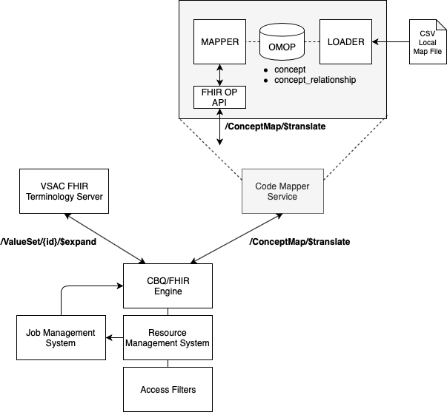
Bit more detail between the services
Get value set from Value Set Authority Center
Load local code system mapping and get it using local terminology server

Slide 13
Questions ?? http://omoponfhir.org/ for more about OMOP on FHIR

