Slide 1

Facilitating phenotype transfer using the OMOP common data model in eMERGE
Biomedical Informatics
discovery and impact
George Hripcsak, MD, MS
Biomedical Informatics, Columbia University
Medical Informatics Services, NewYork-Presbyterian

Slide 2

Facilitating phenotype transfer using a common data model
Hripcsak G, Shang N, Peissig PL, Rasmussen LV, Liu C, Benoit B, Carroll RJ, Carrell DS, Denny JC, Dikilitas O, Gainer VS, Howell KM, Klann JG, Kullo IJ, Lingren T, Mentch FD, Murphy SN, Natarajan K, Pacheco JA, Wei WQ, Wiley K, Weng C
Journal of Biomedical Informatics,
accepted for publication

Slide 3
eMERGE Network
Electronic medical records and genomics (eMERGE) Network
  Funded by NIH’s National Human Genome Research Institute (NHGRI)
Combine DNA biorepositories with electronic health record systems for large scale, high-throughput genetic research in support of implementing genomic medicine
10 sites, 12 years, 136K patients, 64 phenotypes
  PheKB.org repository

Slide 4
eMERGE Phenotype
Generally a knowledge-engineered, rule-based definition of a disease or condition.
Each site has its own local data model, terms
Aim for high positive predictive value (PPV)
  Precision
  Genome-wide association studies require precision
Primary site creates the definition and generally aims for >90% PPV
  Secondary site implements and tests PPV
  Rest of the network implements

Slide 5
Phenotype
Can take months to create a new phenotype
Comes with
  Narrative description
  Lists of terms (mostly ICD9), drug names
  Graphical flow chart
  Sometimes pseudocode
Generally takes months to then implement it across the network
  Effort is 2-3 weeks per site
Much eMERGE research aims to improve phenotype development and sharing
  Repeatable patterns, tools, specification language
  Machine learning

Slide 6
Study Design
NHGRI eMERGE OMOP supplement 2016
Site converts local database to OMOP
Select phenotypes (structured data only)
  Type 2 diabetes mellitus (T2DM)
    Complex with many data types
  Attention deficit and hyperactivity disorder (ADHD)
    Simpler
Evaluators convert eMERGE phenotype to OMOP (Atlas)
  Generate Atlas JSON and SQL

Slide 7
Study design
Share the new phenotype
  Each site implements and runs it
Ask each site
  Time and effort to complete
  Compare to original eMERGE phenotype
  Record issues: coding, data, query, DBMS, software stack, organizational, other

Slide 8
Study design
(Evaluators)

Slide 9
Results: Database conversion
All 10 sites converted database to OMOP
  4 to 12 months elapsed time
  2 sites report still converting lab and procedure
  Lab data in local codes, so many did not convert
    Instead map labs as needed
  5 sites installed the stack with Atlas
    Reasons for not: security, DBMS, effort

Slide 10
Results: phenotyping
9 sites did phenotyping exercise
  7/9 T2DM and 6/8 ADHD ran phenotype in 1 day
  Rest took 14 to 144 days elapsed time
    Other priorities or had to reload data
Prevalence of condition varied
  0.3%-22.4% T2DM
  0.1%-12.3% ADHD
  Age groups, disease cohorts

Slide 11
Results: phenotype
5 sites compared OMOP to old phenotype
  Reasons for not: joined after phenotype was shared, low expected case count, lost original results, change in privacy policy
Agreement varied 100% to 43%

Slide 12
Results: T2DM
Overlap between original and OMOP phenotypes (number) |  |  |  | Positive specific agree-ment | Negative specific agree-ment
Overlap | Original only | OMOP only | Neither
38 | 0 | 4 | 5465 | 0.950 | 1.000
1179 | 95 | 30 | 4086 | 0.950 | 0.985
242 | 381 | 250 | 4804 | 0.434 | 0.938
735 | 1165 | 18 | 396 | 0.554 | 0.401
3139 | 819 | 1588 | 19143 | 0.723 | 0.941

Slide 13
Results: ADHD
Overlap between original and OMOP phenotypes (number) |  |  |  | Positive specific agree-ment | Negative specific agree-ment
Overlap | Original only | OMOP only | Neither
7 | 0 | 0 | 5500 | 1.000 | 1.000
23 | 11 | 1 | 5355 | 0.793 | 0.999
1761 | 507 | 48 | 12282 | 0.864 | 0.978
65 | 15 | 19 | 4861 | 0.793 | 0.997

Slide 14
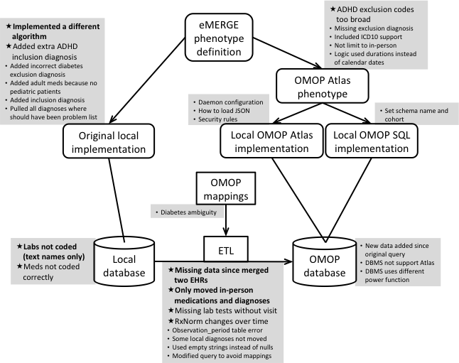
Results

Slide 15
Results: local data
Labs not coded (text names only)
Meds not coded correctly
*Bold >2%
*Plain 0.2-2%
. Plain <0.2%

Slide 16
Results: local ETL
Missing data since merged two EHRs
Only moved inpatient diagnoses and meds
Missing lab tests without visit
RxNorm changes over time
Observation_period table error
Some local diagnoses not moved
Used empty strings instead of nulls
Modified query to avoid mappings

Slide 17
Results: original implementation
Implemented a different algorithm
Used only inpatient diagnoses for inclusion
Added incorrect exclusion diagnosis
Added inclusion diagnosis not included in definition
Added adult meds because no pediatric patients
Pulled all diagnoses where should have been problem list
Skipped some encounters

Slide 18
Results: Altas implementation
ADHD exclusion codes too broad
Erroneously missing one ADHD inclusion diagnosis
Missing exclusion diagnosis
Optimized to include ICD10 instead of just ICD9
Logic used durations instead of calendar dates

Slide 19
Results: local Atlas implementation
Daemon configuration
How to load JSON
Security rules

Slide 20
Results: local SQL implementation
Set schema name and cohort

Slide 21
Results: OMOP mappings
Diabetes ambiguity

Slide 22
Results: local OMOP database
New data added since original query
DBMS not support Atlas
DBMS uses different power function

Slide 23
Findings
Sharing of a single computable query uncovered differences among the original implementations despite starting from the same narrative description, codes lists, pseudocode, and flowchart
  Sharing is hard

Slide 24
Findings
The eMERGE network was able to convert its databases into the OHDSI OMOP Common Data Model
  Primary challenge conversion of local laboratory test codes to the LOINC standard
  ICD* and drugs straightforward

Slide 25
Findings
Efficiency of sharing phenotypes improved dramatically with most sites able to execute the query within a day
Is it worth it?
  Cost of converting database to OMOP (4 months)
  Savings in implementing phenotype (2 weeks)
  Breakeven point about 10 to 20 phenotypes

Slide 26
Findings
Agreement between the OMOP phenotype query and the original eMERGE query varied from perfect to mediocre
  Problems in the original query
  Problems in the OMOP query
  Changes in data
  Issues in the database
  (More about data and database than logic)

Slide 27
Limitations
Only 2 phenotypes
Half sites could not compare to original
Only structured data

Slide 28
Conclusion
Implementing original phenotypes over a network of electronic health record databases had been labor intensive and error prone
The potential for a common data model to improve efficiency and consistency

Slide 29
Thanks
eMERGE Network
Co-authors
NHGRI
  This phase of the eMERGE Network was initiated and funded by the NHGRI through the following grants: U01HG008657 (Group Health Cooperative/University of Washington); U01HG008685 (Brigham and Women’s Hospital); U01HG008672 (Vanderbilt University Medical Center); U01HG008666 (Cincinnati Children’s Hospital Medical Center); U01HG006379 (Mayo Clinic); U01HG008679 (Geisinger Clinic); U01HG008680 (Columbia University Health Sciences); U01HG008684 (Children’s Hospital of Philadelphia); U01HG008673 (Northwestern University); U01HG008701 (Vanderbilt University Medical Center serving as the Coordinating Center); U01HG008676 (Partners Healthcare/Broad Institute); U01HG008664 (Baylor College of Medicine); and U54MD007593 (Meharry Medical College).
  In addition, this work was funded by R01LM006910, Discovering and applying knowledge in clinical databases; R01HG009174, Developing i2b2 into a Health Innovation Platform for Clinical Decision Support in the Genomics Era, OT2OD026553, The New England Precision Medicine Consortium of the All of Us Research Program. Vanderbilt University Medical Center’s BioVU is supported by numerous sources: institutional funding, private agencies, and federal grants, including the NIH funded Shared Instrumentation Grant S10RR025141; and CTSA grants UL1TR002243, UL1TR000445, and UL1RR024975.

