Slide 1
The Green Button Project
Delivering on-demand evidence via an informatics consultation service
Alison Callahan MISt PhD, Research Scientist
School of Medicine, Stanford University
November 26 2019

Slide 2
Agenda
Origin of the Green Button
Anatomy of the consult service
Learning from the first 100 consults
Deploying the service at a new site
Ongoing efforts
2
2

Slide 3






Acknowledgements
Informatics Consult team
Stanford Health Care partners
Saurabh Gombar
Alison Callahan
Vladimir Polony
Ken Jung
David Entwistle
Tip Kim
Nigam Shah
Robert Harrington
Rob Tibshirani
Trevor Hastie
Christopher Sharp
Funding: NLM, NIGMS, Stanford School of Medicine, Department of Medicine, Department of Biomedical Data Science, Center for Population Health Sciences, an anonymous donor

Slide 4


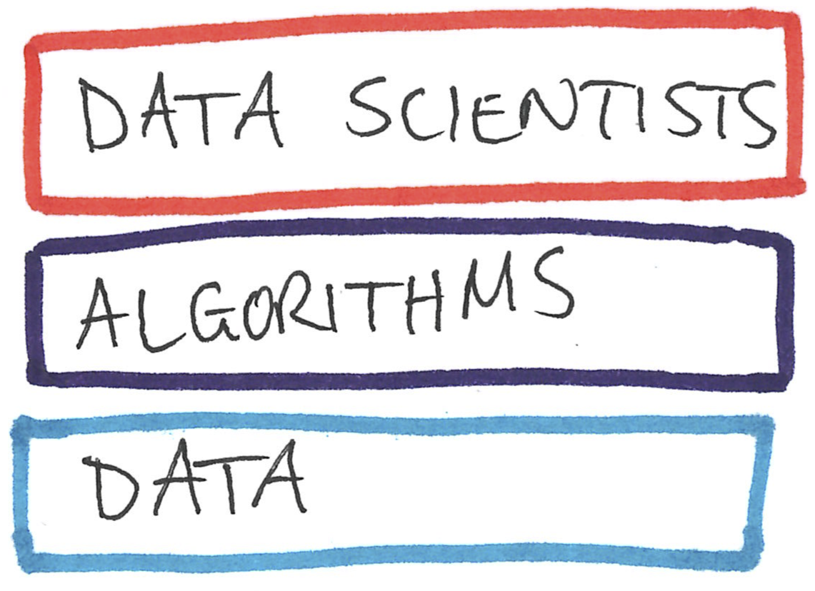







Slide 5
Timeline
2014 | Green button: using aggregate patient data at the bedside (vision paper in Health Affairs)
2015 | Outlined steps for rapid cohort studies at the bedside
2016 | Built a search engine for patient timelines
2017 | Launched a pilot of the service
2018 | Described the methods used in the consult service, and a perspective on why “It is time to learn from similar patients”
2019 | Completed the pilot study (writing up results)
5

Slide 6

The Green Button project
Given a specific case, provide a summary of similar patients in Stanford’s clinical data warehouse, the common treatment choices made, and the observed outcomes.
An institutional review board approved study (IRB # 39709), which served 150 consultations across all service lines.
Invented novel technology to search medical timelines.
http://greenbutton.stanford.edu
6

Slide 7
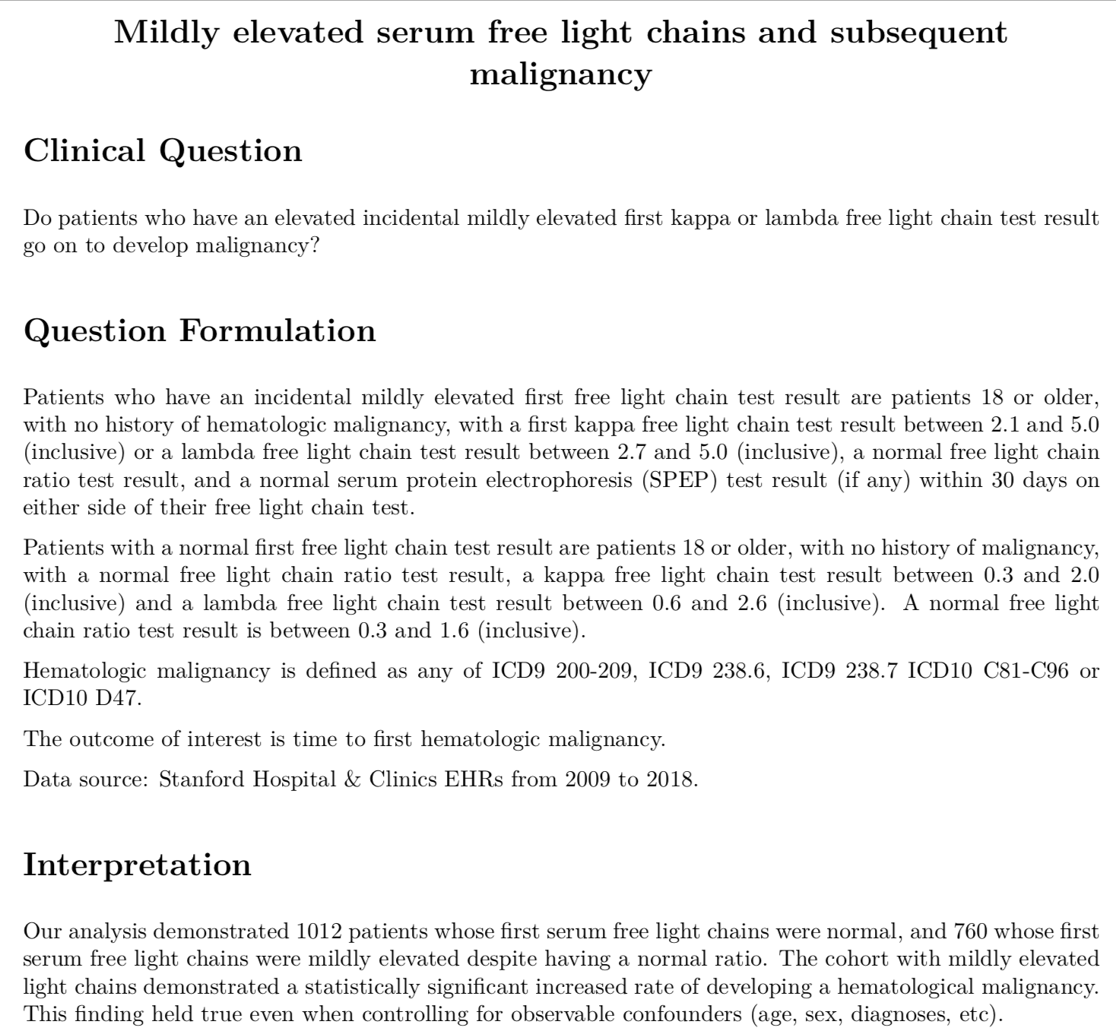
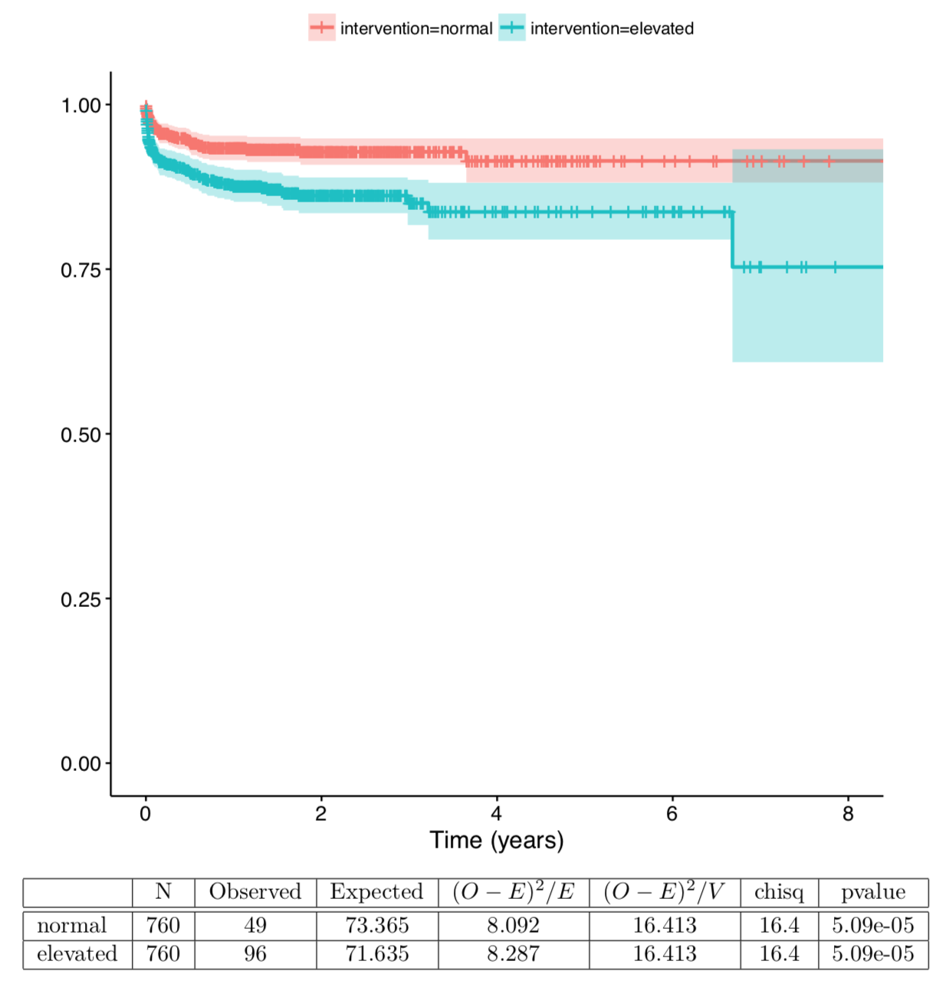
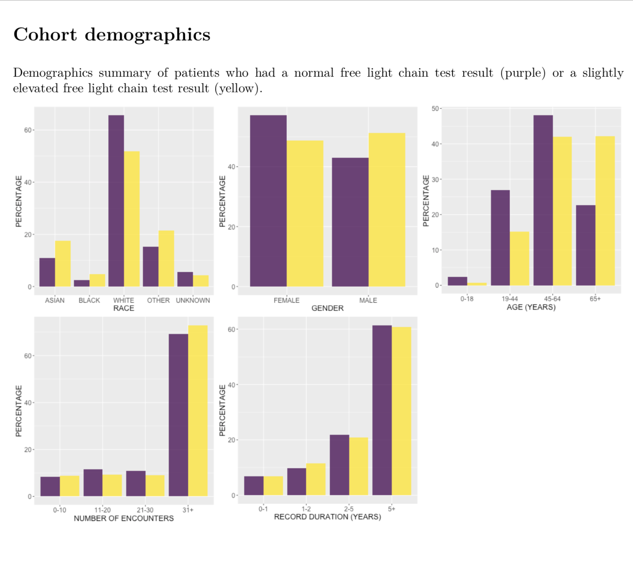
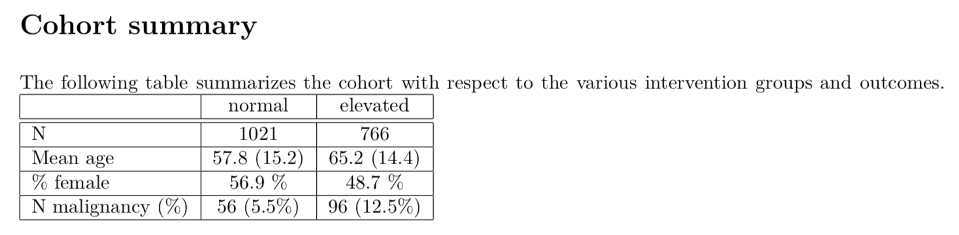
An example report

Slide 8
Service = software, data, and personnel
Informatics Consult Service
Software
Data
Personnel
ACE search engine
For patient timelines
EMRs
Claims
Informatics Physician
EMR Data Specialist
Data
Scientist

Slide 9
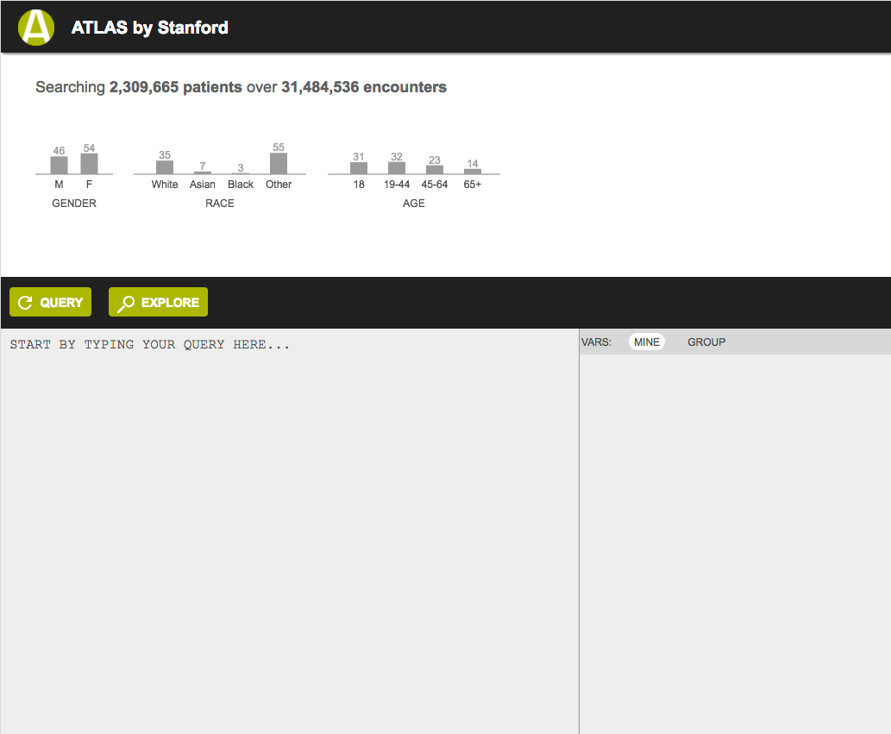
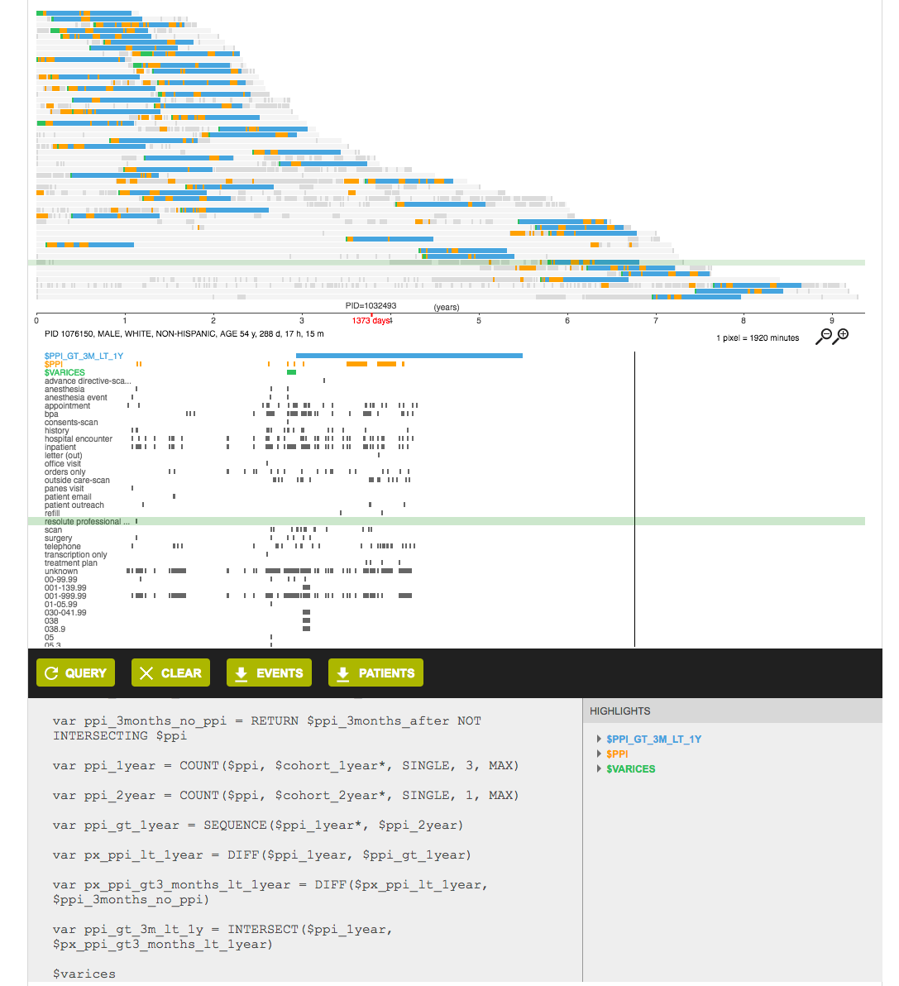
The search engine
www.tinyurl.com/search-ehr
Diagnosis and procedure codes
Clinical notes
Lab results
Vital signs
Inpatient and outpatient visits

Slide 10
The data
Stanford EMRs
ETL
ACE over Stanford data
3 million
Postgres DB
Optum
ACE over Optum data
53 million
Postgres DB
IBM MarketScan
ACE over IBM MarketScan data
OMOP CDM v5.3
124 million
Postgres DB

Slide 11
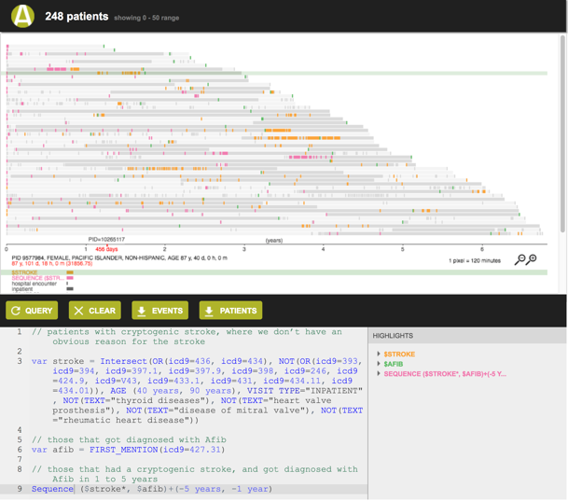
The process: 24 to 72 hours
Requesting
physician
Request consult
Refine clinical question
Review results
Apply evidence to clinical decision
Create definitions for exposures and outcomes
Write consult report
Informatics
physician
Phenotype definition
Knowledge graph use
Cohort generation
Searching timelines
Build patient cohorts
EHR data specialist
Data scientist
Perform statistical analysis
ACE search engine

Slide 12
The software
ACE search engine
    Available via Odysseus Inc. with support, or academic license via Stanford with no support
    Push button installation and deployment
  Statistical analysis
    Uses publicly available R libraries, including OHDSI CohortMethod
    Push button environment setup and installation

Slide 13
What we do to not be wrong
Use CohortMethod’s data diagnostics
Use negative controls
E-values to quantify the degree of confounding that can produce the observed effect
Ask the question using multiple datasets
Schedule an in-person debrief

Slide 14
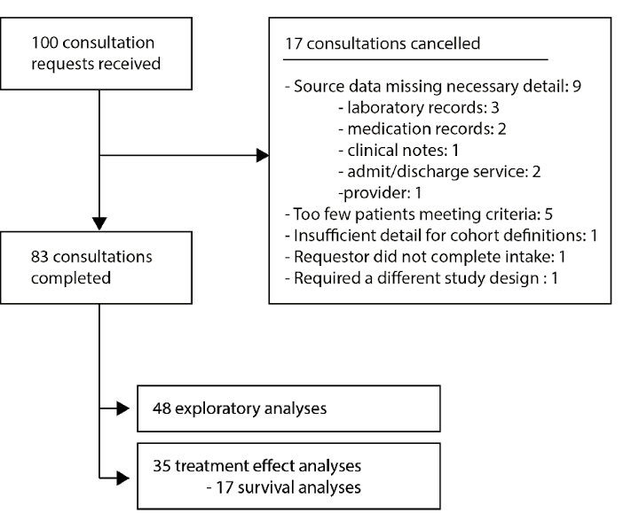
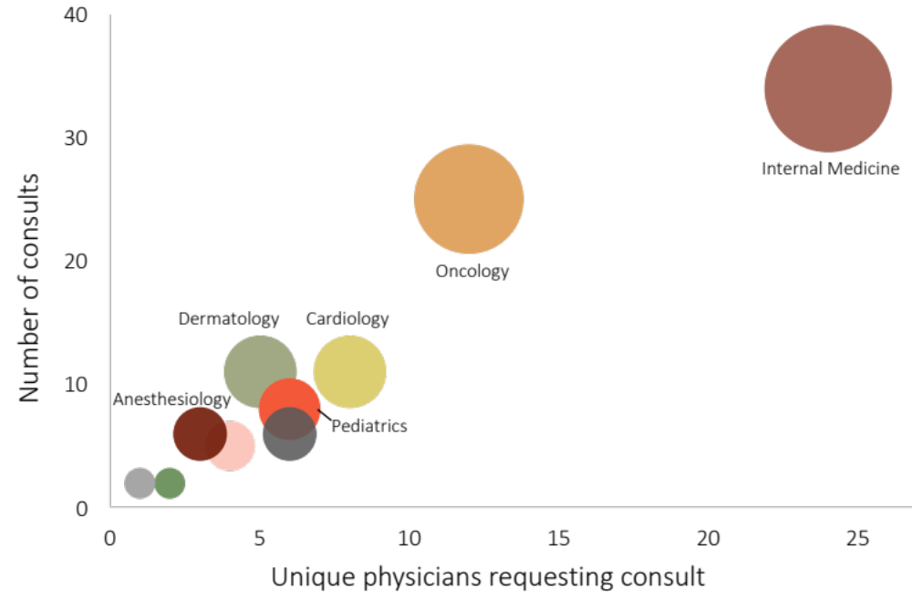
Learning from the first 100 consults

Slide 15
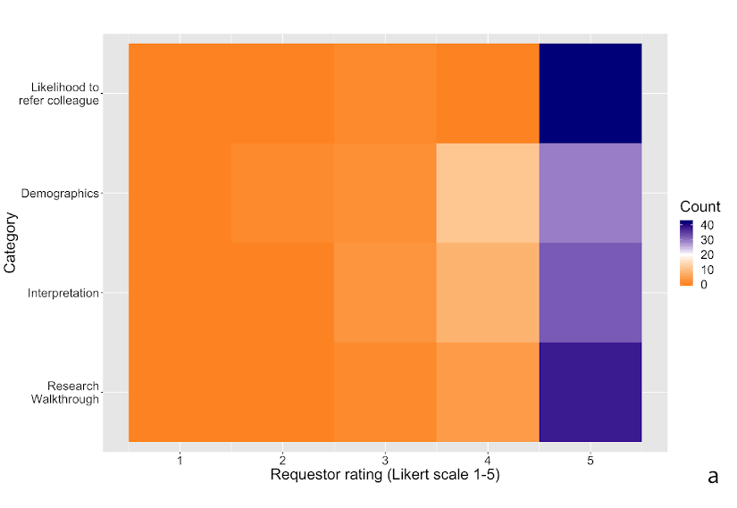

Learning from the first 100 consults

Slide 16
Learning from the first 100 consults
Access to EMRs has a substantial impact on our ability to complete consultations
    36-40% of consultations completed using EMR data could be completed using insurance claims
High levels of agreement across datasets and patient matching methods
    Comparing with two reference sets
      13-22% were “false discoveries”
      Applies to the 18 treatment effect estimation consults
    Comparing across datasets (Truven, Optum)
      Agreed 68-74% of the time
      About the same rate as how often RCTs agree with each other
    Comparing patient matching strategies
      Agreed 79% of the time

Slide 17
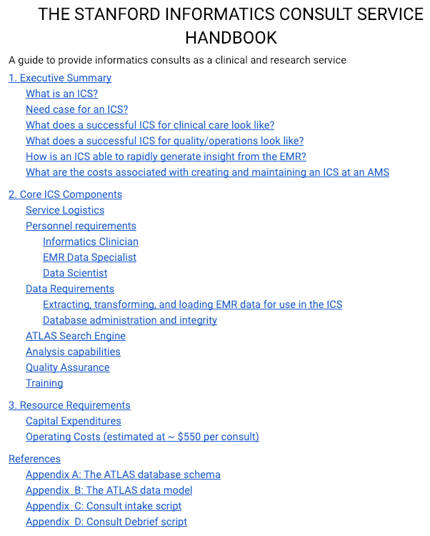
Deploying the service at your site
Institutional support
Data science expertise
Marketing
A process to sanity-check data and consult findings

Slide 18
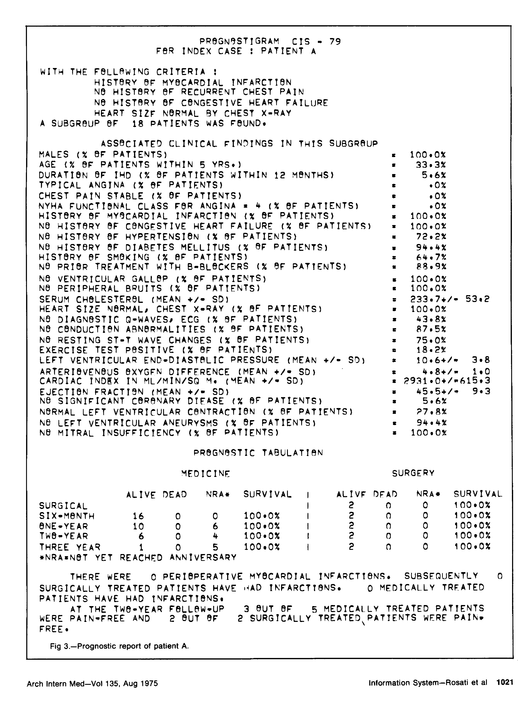
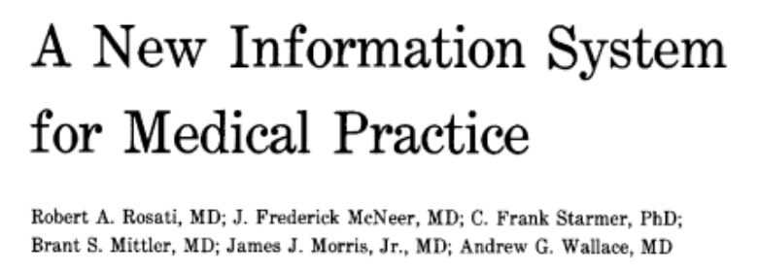

Related prior efforts
Notes:
1972 – Feinstein et al, https://www.ncbi.nlm.nih.gov/pubmed/4554880
1974 – Rosati et al, https://jamanetwork.com/journals/jamainternalmedicine/article-abstract/584728
3) 2011 – Frankovich et al, https://www.nejm.org/doi/full/10.1056/NEJMp1108726

Slide 19
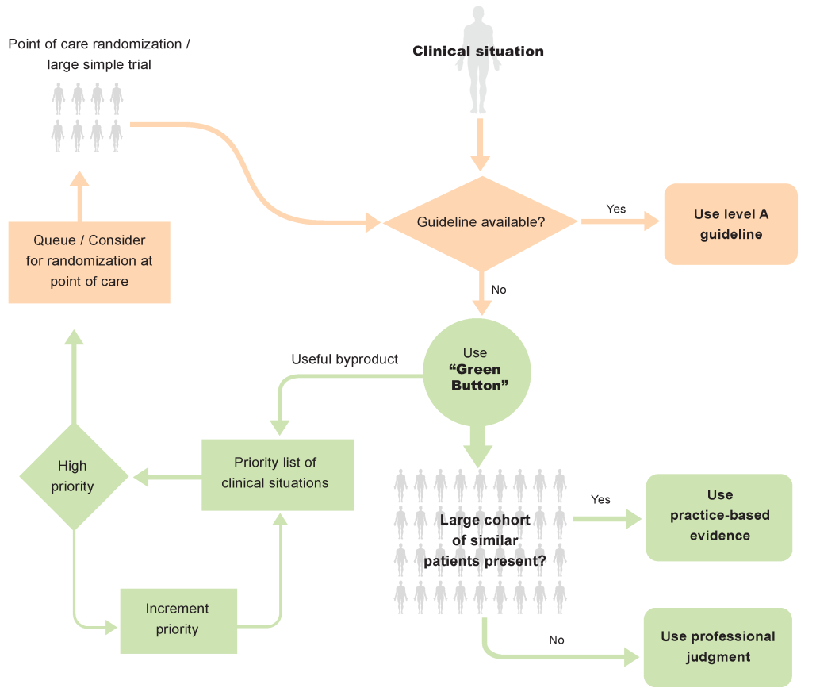
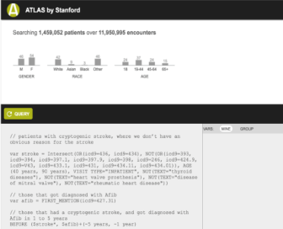
Green button Informatics Consult
Consult Service
Analysis + Report
The question as posed
How we asked the question
Our interpretation
Research walkthrough

Slide 20
Questions that remain
Does having such a consult service change patient outcomes?
How could we enable such consults nationwide?
Could we automate such analyses to be “always on”?
Could we get such a “curbside consult” from multiple health systems?
Could patients benefit from having access to such reports?
20

Slide 21
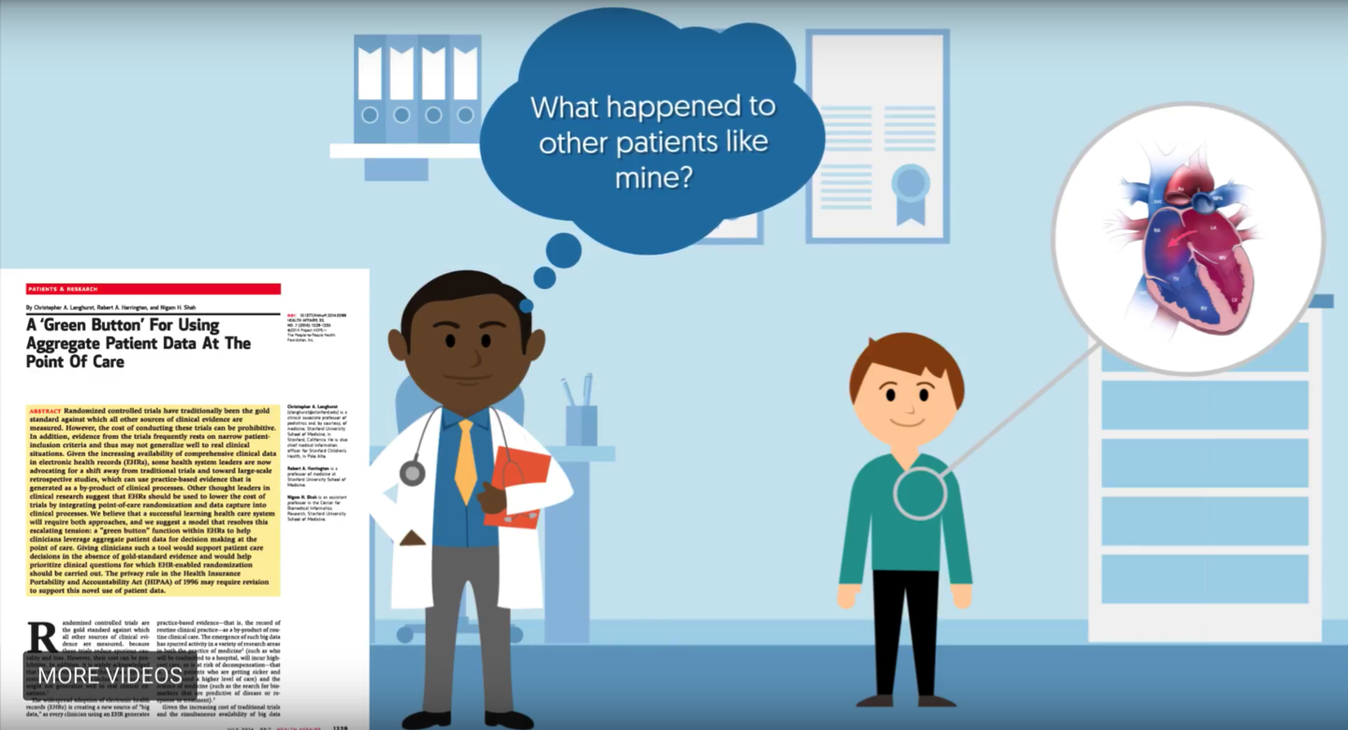
http://greenbutton.stanford.edu
Ask me about the next phase of our study on measuring utility, and deploying the Green Button at Stanford Health Care
Notes:
https://www.youtube.com/watch?v=zRwKm-Uhkiw

Slide 22


Thank you! Questions?
acallaha@stanford.edu
@clssfr

