Slide 1
Relative risk of cervical neoplasms among copper and levonorgestrel intrauterine device users
Matthew Spotnitz, M.D., M.P.H.¹, Karthik Natarajan, Ph.D.¹, Patrick B. Ryan, Ph.D.², Carolyn L. Westhoff, M.D., M.Sc.¹
¹Columbia University Irving Medical Center, ²Janssen Pharmaceuticals
Notes:
Hi Everyone, today I will be presenting our. study about the relative risk of cervical neoplasms among copper and levonorgestrel intrauterine device users. I am excited to say that our work has been accepted for publication in obstetrics and gynecology, also known as the green journal.

Slide 2
Intrauterine Devices (IUDs)
Variable | Cu-IUD (“Copper”) | LNG-IUS (“Hormonal”)
Available in US | 1988 (Paragard) | 2000 (Mirena)
Number of Users | ~80 Million | ~20 Million
Prevents Pregnancy | >99% | >99%
Inhibits Sperm | Yes | Yes
Thins Uterine Lining | No | Yes
Thickens Mucous | No | Yes
Decreases Bleeding | No | Yes
Decreases Pain | No | Yes
Approximate Cost | $700 | $800
https://www.theverge.com/2015/4/7/8364721/best-teen-birth-control-iud-implant-cdc
https://clearhealthcosts.com/blog/2014/01/much-iud-birth-control-cost-draft/
Nelson A et. al. Open Access J Contracept. 2016; 7: 127–141.
Notes:
Intrauterine devices (IUDs) are long-term, reversible forms of contraception. On the left, we see a schematic of an intrauterine device within the uterus, the lower portion of which is known as the cervix. After placement, IUDs typically remain in the uterus for years until removal. They are among the most prevalent medical devices and their use is rising within the United States. The two most common types of IUDs are Copper intrauterine device (Cu-IUDs) and levonorgestrel releasing intrauterine systems (LNG-IUSs), which are compared in the table on the right. Alternatively, they are referred to as ”Copper” and “Hormonal” IUDS. The copper IUD was available for clinical use in the United States in 1988 and the hormonal in the year 2000. There are more than 100 million IUD users worldwide. Approximately 80% of them use the copper and 20% use the hormonal. Both are more than 99% effective at preventing pregnancy and inhibiting sperm from fertilizing an egg. The hormonal thins the uterine lining and thickens the cervical mucous to inhibit the ascent of sperm. Additionally the hormonal decreases the pain and bleeding associated with menses. It is approximately $100 greater than the Cu-IUD.

Slide 3
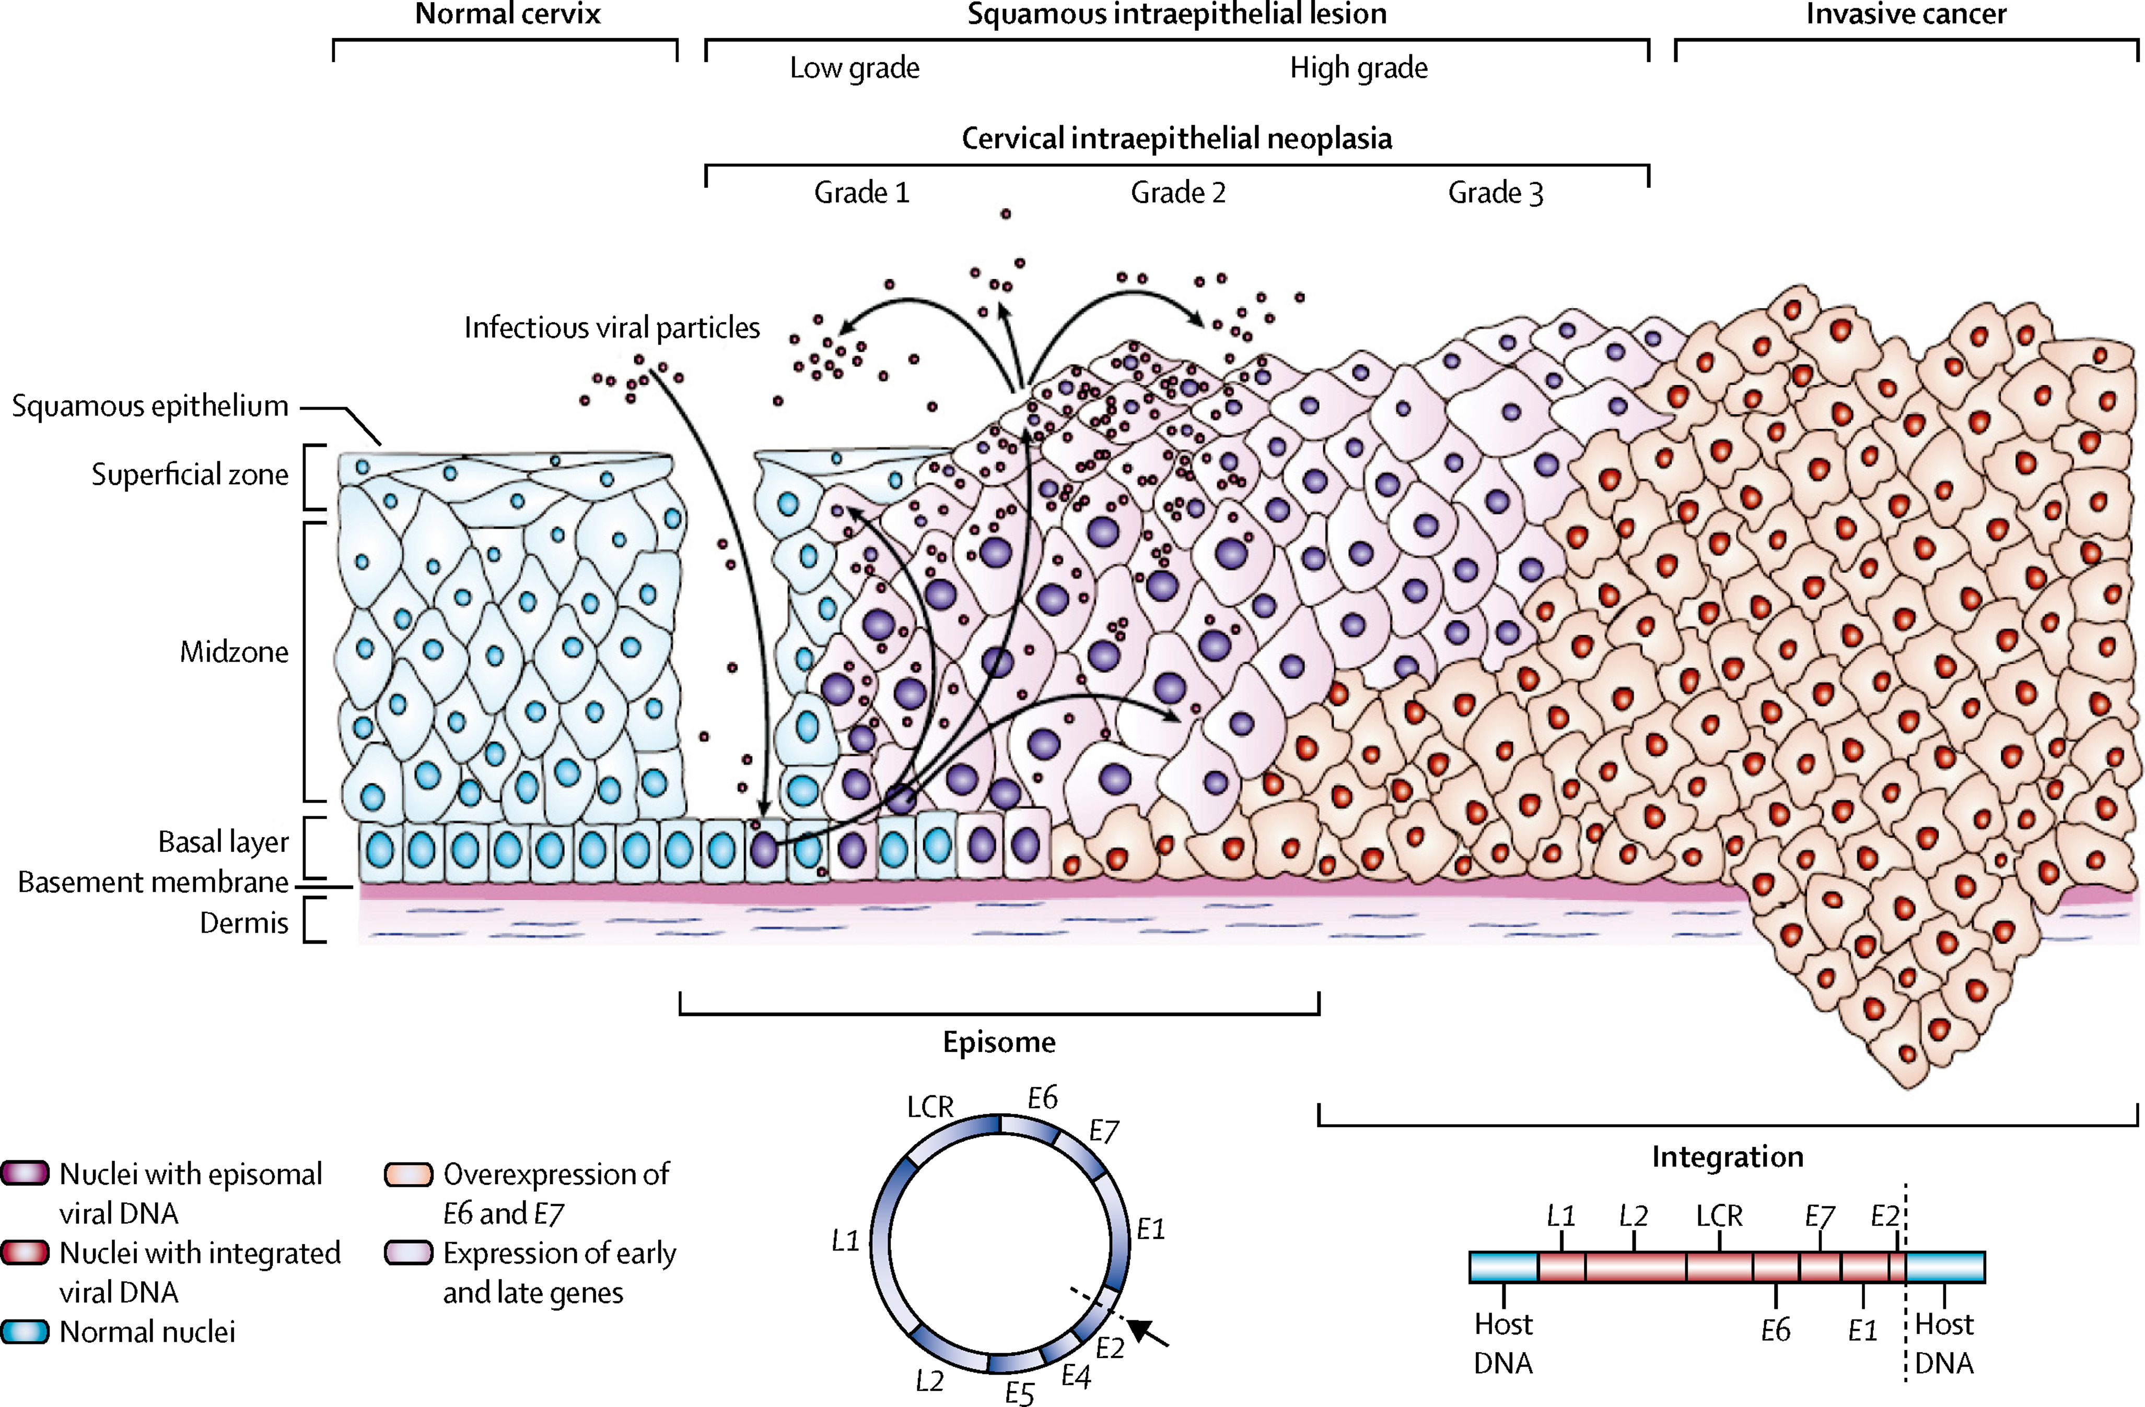
Cervical Cancer Pathophysiology
Cohen PA et. al. Lancet 2019 Jan 12;393(10167):169-182.
Notes:
Many IUD users have regular cervical cancer screening. Cervical cancer is the fourth most common female malignancy worldwide. As illustrated in this schematic, chronic infection of cervical cells with high risk strains of the human papillomavirus (HPV) can result in precancerous lesions, such as cervical intraepithelial neoplasia grades 2 and 3 (middle) as well as invasive cervical cancer (right). Risk factors for cervical cancer include those associated with HPV infection, impaired response to HPV infection and smoking. HPV vaccination and cervical cancer screening are inversely associated with cervical cancer incidence.

Slide 4
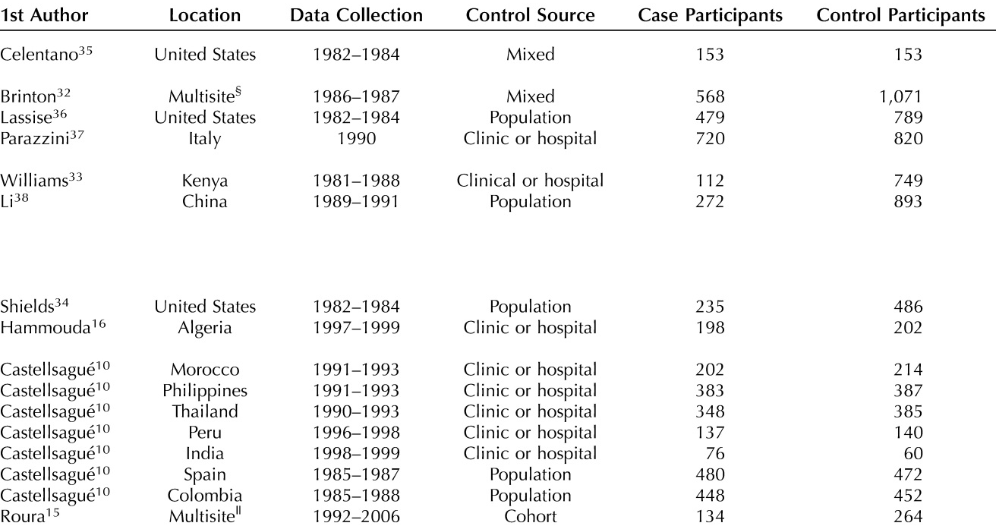
IUDs and Cervical Cancer: Systematic Review
Cortessis VK, Barret M, Wade NQ et. al. Obstetrics & Gynecology (2017) 130(6): 1226-1236.
Notes:
A recent systematic review of case-control studies concluded that IUDs were protective against cervical cancer. However, the studies harmonized for meta-analysis did not report on device type and were concluded before hormonal IUDs were available for clinical use. For example, the US studies were completed prior to 1990. We are interested in a direct comparison between copper and hormonal IUD users with observational data.

Slide 5
Methods: Cohorts
Retrospective observational cohort study
Cohorts and estimation analysis were designed in ATLAS
Cu-IUD Cohort (T): CPT Code for first IUD placement, no subsequent LNG-IUS exposure
LNG-IUS Cohort (C): CPT Code for first IUD placement, at least 1 subsequent LNG-IUS exposure
Cervical Neoplasm Cohort (O): Condition code of a high grade cervical neoplasm (i.e. SNOMED ”Primary Malignant Neoplasm of Uterine Cervix”)
All study patients had 365 days prior observation, no history of endometrial or cervical cancer, and were 45 years or younger
Notes:
Our study was designed as a retrospective observational cohort study. The cohorts and estimation analysis were designed in ATLAS. The copper cohort, which was the target cohort, used the CPT code for first IUD placement as the index event. Those patients had no subsequent hormonal IUD exposure. The hormonal cohort was the comparator cohort and differentiated by at least 1 subsequent hormonal IUD exposure following the placement. The outcome cohort was identified by a condition code of a high grade cervical neoplasm such as the SNOMED code (“Primary Malignant Neoplasm of Uterine Cervix”). All study patients had at least 365 days of prior observation, no history of endometrial or cervical cancer, and were 45 years of age or younger.

Slide 6
Methods: Analysis
Study Window: 1/1/2003 – 12/15/2018
Study Period: 30 days to 15 years post placement
Subgroup Analysis: 1 to 15 years post placement
Propensity score stratification, propensity score matching, and propensity score matching for the subgroup were performed
Adjusted over more than 10,000 covariates in each analysis and balance was achieved
Notes:
The study window was from 1/1/2003 – 12/15/2018. The study period was from 30 days to 15 years post placement. The subgroup analysis was from 1 to 15 years post placement. Propensity score stratification and matching analyses were performed. For the subgroup, we performed propensity score matching with the subgroup time window as well. We adjusted over more than 10,000 covariates in each analysis and balance was achieved.

Slide 7
Cervical Neoplasm Phenotype Validation
Under CUIMC IRB approval (IRB #AAAO7805), we identified 115 cervical neoplasm patients with our phenotype
90% of cervical neoplasm cases had concordant biopsy diagnosis
100% of LNG-IUS exposures were identified properly
10% of Cu-IUD exposures were actually LNG-IUS exposures
Notes:
To validate our phenotype, we identified 115 cervical neoplasm patients under IRB approval. 90% of cervical neoplasm cases had a concordant biopsy diagnosis. 100% of hormonal iud exposures were identified properly. 10% of copper iud exposures were actually hormonal exposures.

Slide 8
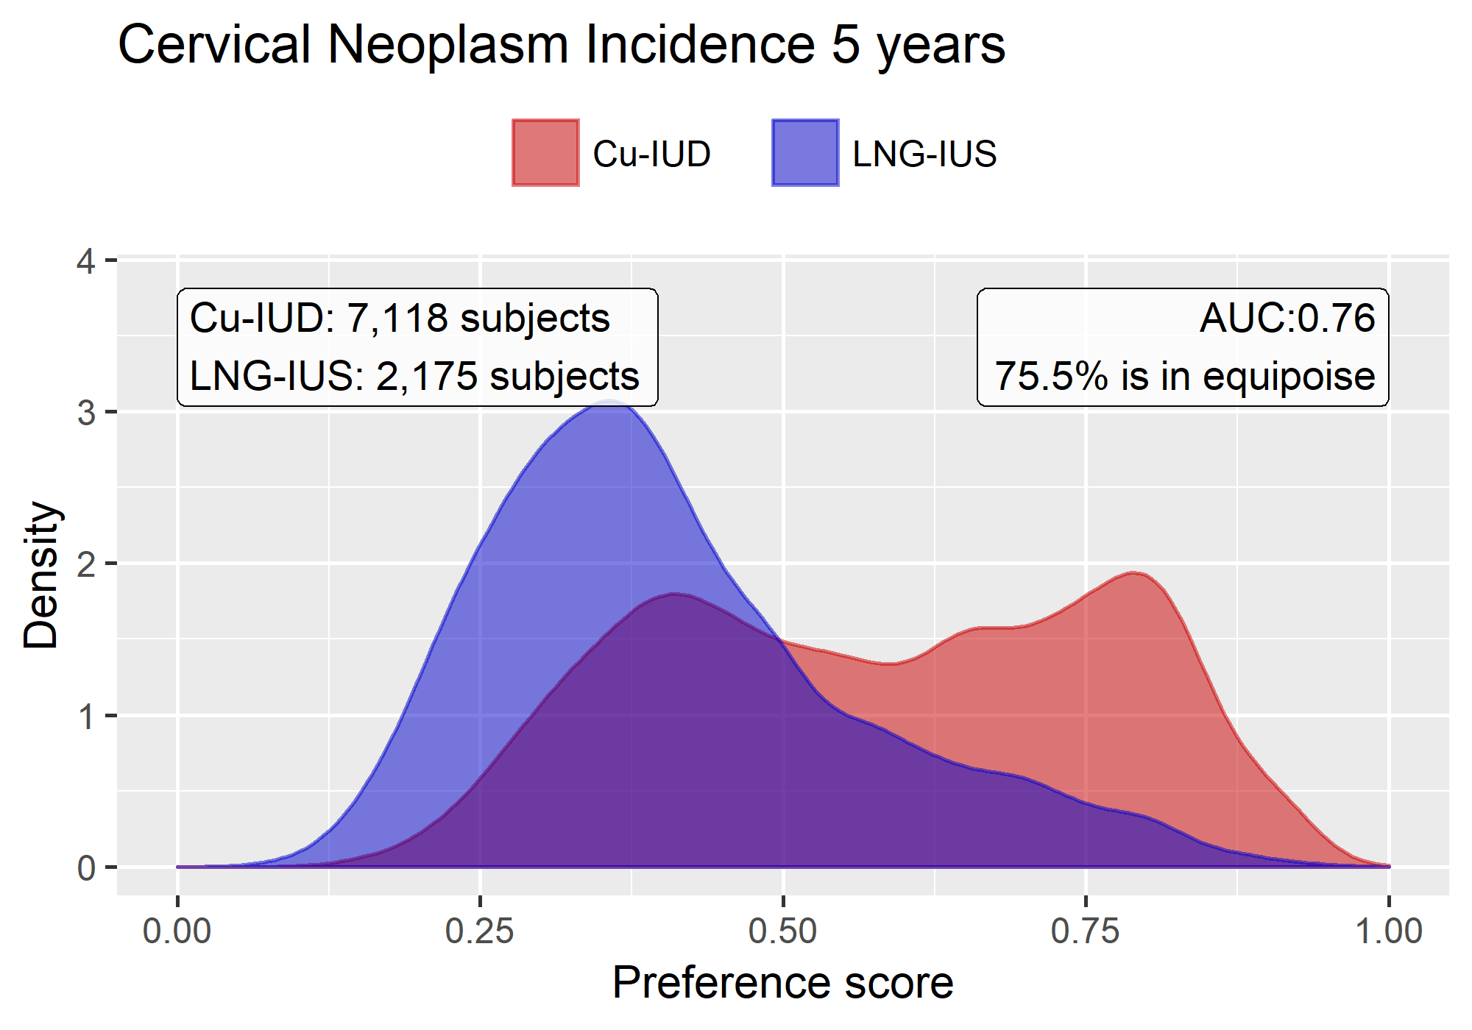
Propensity Score Distribution
Notes:
Our cohorts were similar at baseline, with respect to many variables. For example, the median age for both groups was 29 years. However, we wanted to minimize confounding between the cohorts with ps models. Using a regularized logistic regression model, we identified which among more than 10,000 variables warranted inclusion in the propensity score model. This plot shows the propensity score distribution for the copper and hormonal cohorts shown in red and purple, respectively. By inspection, there is a robust overlap between the cohorts, consisting of 7118 patients in the copper group and 2175 patients in the hormonal group. We stratified or matched patients by propensity score and used a cox proportional hazard model to calculate the relative risk of cervical neoplasms between the cohorts.

Slide 9
Matched Cervical Cancer Risk Factors
Variable (n, %) | Copper Before Matching (n=8274) | Hormonal Before Matching (n=2400) | Before PS Matching Std. Diff | Cu-IUD after PS Matching (n=2039) | LNG-IUS after PS Matching (n=2039) | After PS Matching Std. Diff
Tobacco Smoking Behavior | 3261 (39.4%) | 1290 (53.8%) | 0.49* | 1077 (52.8%) | 1060 (52.0%) | 0.02
HPV Vaccine | 43 (0.5%) | 27 (1.1%) | -0.07 | 18 (0.9%) | 23 (1.1%) | -0.02
HPV Test Positive | 210 (2.5%) | 59 (2.5%) | 0.03 | 38 (1.9%) | 55 (2.7%) | -0.06
Notes:
This slide exemplifies how cervical neoplasm risk factors were balanced with propensity score matching. Prior to matching there were 8274 patients in the copper cohort and 2400 in the hormonal cohort. A greater proportion of hormonal IIUD users had a documented smoking history compared to copper users (53.8 vs 39.4) with a standard deviation of the mean was 0.49. By contrast, the proportion of patients who had either HPV Vaccination or a positive HPV test were balanced, as indicated by a std deviation of the mean with a magnitude that was less than of 0.1. After matching, there were 2039 patients in each cohort. The proportions of patients who had tobacco smoking behavior became balanced, as indicated by. Std. deviation of the mean that decreased to a new magnitude of 0.02. The proportions of patients who had a hpv vaccine or test become more similar after matching. In summary, with matching, we made two similar cohorts balanced with respect to these cervical cancer risk factors and more than 10,000 other variables.

Slide 10
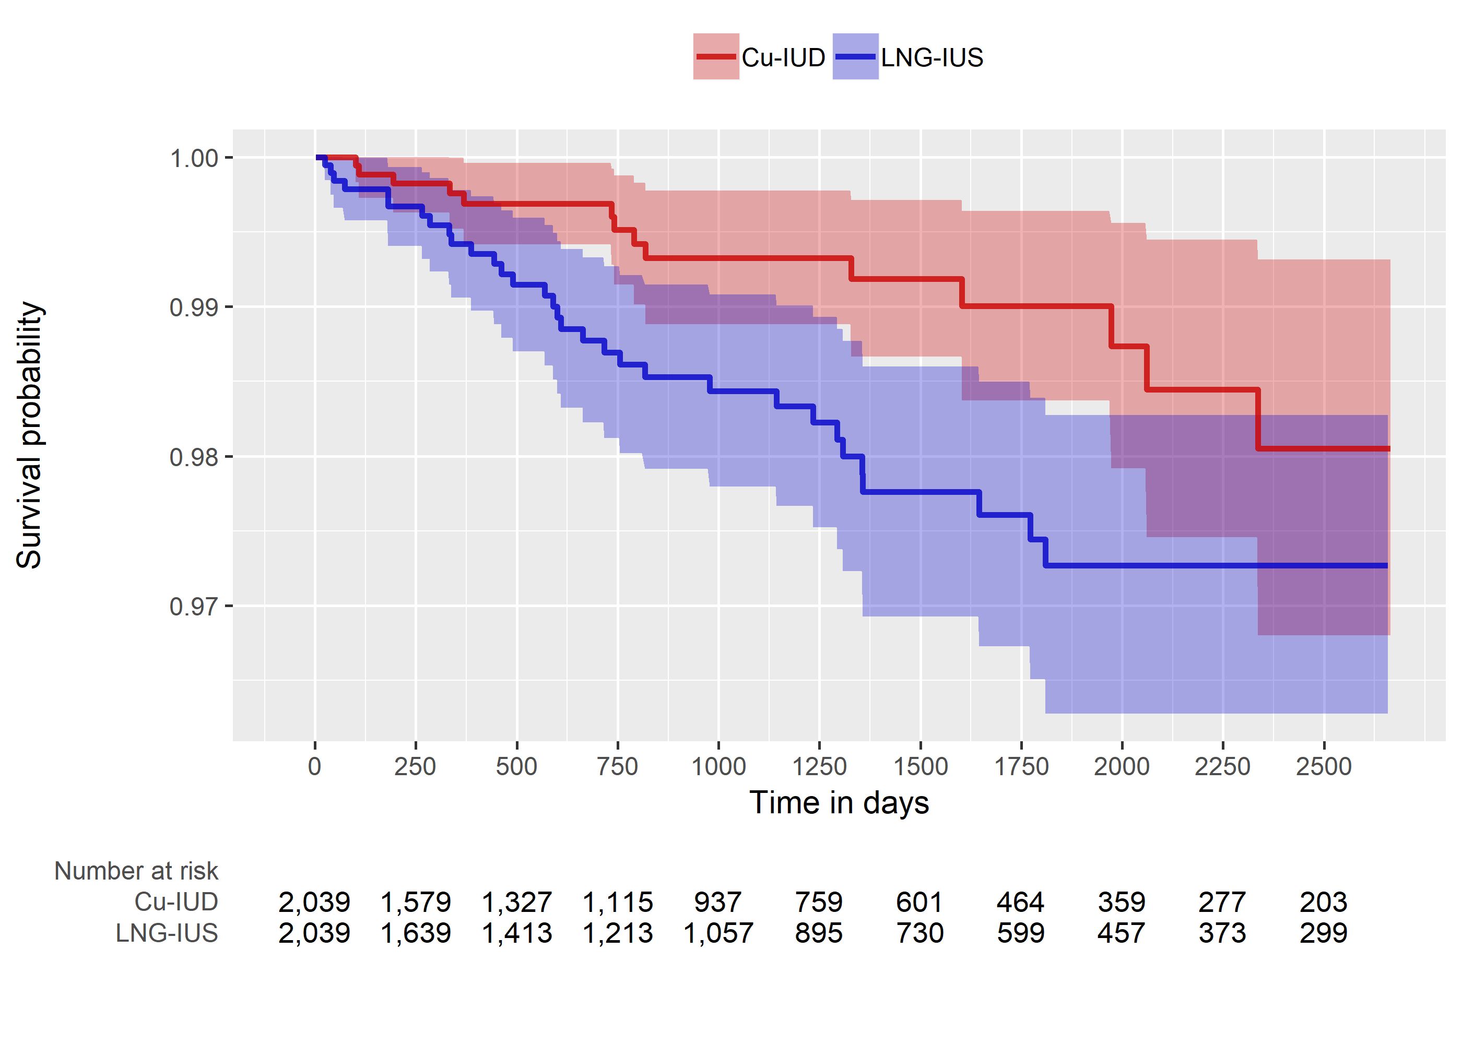
Kaplan-Meier Plot: PS Matching
Notes:
This KM plot shows the cervical neoplasm free survival as a function of time in days for the ps matching analysis. The copper curve is in red and the hormonal in purple. By inspection, the curves start to diverge at 1 year.

Slide 11
Possible Explanations for Effect
Differences in risk factors or screening uptake
Harmful effect of synthetic hormones
Protective effect from copper
Notes:
Although it may border on speculation, it is worth considering what factors might contribute to the magnitude of the observed effect and and why the divergence occurs at approximately 1 year following device placement. Some overlapping hypothesis include differences in risk factors or screening uptake, a harmful effect from synthetic hormones or a protective effect from copper.

Slide 12
Screening Uptake Characterization
Variable (n, %) | Copper (n=8274) | Hormonal (n=2400)
Median Follow-Up Years | 2.8 [0.5-6.5] | 2.6 [0.6-5.0]
Subsequent Cervical Cancer Screening | 2560 (30.9%) | 835 (34.8%)
Subsequent Preventive Health Visits | 1893 (22.9%) | 695 (29.0%)
Notes:
This slide shows crude characterization of variables that are related to screening uptake. The median follow up period for both cohorts was less than 3 years. The proportion of patients who underwent subsequent cervical cancer screening or preventive health visits was less in the Copper than the hormonal group (30.9 and 22.9 vs 34.8 and 29.0). Although we did not adjust on these post index date variables directly to avoid confounding, they likely became balanced after adjusting for other related variables that occurred prior to the index date. Therefore, we believe that we balanced on screening uptake appropriately. Additionally, the fact that the effect became apparent at 1 year makes differences in uptake a less likely explanation.

Slide 13
Premarket Randomized Control Trial (RCT): Mirena FDA Application, 2000
“In the study report based on annual PAP smear data from 2758 women, investigators reported no difference in the rate of dysplasia or cancer between women using Mirena (1821) and those using a copper IUD (937). There were 46 subjects who developed abnormal cervical cytology (Class III, IV, V), 13 in the copper IUD group and 33 in the Mirena group. There was one invasive cervical cancer in the Mirena group (described in section 3.10.1). These differences were not statistically significant.”
No reporting of cervical neoplasms in peer reviewed publications
https://www.accessdata.fda.gov/drugsatfda_docs/nda/2000/21-225.pdf_Mirena_Medr.pdf
Notes:
The risk of cervical neoplasms in hormonal IUDs was measured in the premarket randomized control trial (RCT) that compared copper and hormonal IUDs. To quote “”. The authors collected the data regarding cervical neoplasms, but concluded that the risk was equivalent between the cohorts and did not publish the results.

Slide 14
Proportional Copper vs. Hormonal Results
Cohort | RCT | CUIMC PS Strat | CUIMC PS Match | CUIMC Crude
Cu-IUD | 1.4% | 1.1% | 0.7% | 0.9%
LNG-IUS | 1.8% | 1.7% | 1.8% | 1.5%
Notes:
I have tabulated the proportions of cervical neoplasms in each cohort in this table for the premarket RCT, our ps stratified analysis, ps matched analysis and the crude analysis. In the RCT, the proportion of copper and hormonal IUD users who had a cervical neoplasm were 1.4 and 1.8%. Similarly in our study, the adjusted incidences of cervical neoplasms in these groups were 1.1% and 1.7% in the stratification and 0.7 and 1.8% in the matching analyses. The crude incidences were 0.9 and 1.5%. The internal consistency between our adjusted results and the crude analysis suggests that the magnitude of confounding in our analysis was small at baseline. The consistency between our results and the results of a premarket RCT that was conducted over 30 years ago and outside of the United States makes a social explanation for our effect less likely.

Slide 15
Analysis Summary
Analysis | RR [95% CI]
Propensity Score Stratification | 0.49 [0.32-0.76]
Propensity Score Matching | 0.38 [0.16-0.78]
Propensity Score Matching Subgroup | 0.64 [0.27-1.47]
Premarket RCT (n=2758) | 0.76 [0.40-1.40]
https://www.accessdata.fda.gov/drugsatfda_docs/nda/2000/21-225.pdf_Mirena_Medr.pdf
Notes:
This table shows the relative risks of cervical neoplasms for our PS stratification, matching, and subgroup analyses as well as an estimate of RR from the premarket RCT. By inspection, we see that the point estimates range from 0.38 to 0.64. For the PS stratification and matching, both the point estimates and confidence intervals were below 1. The subgroup analysis confidence interval crossed 1, however that may have been due to an underpowered analysis. The RCT that had an estimated RR of 0.76 that crossed the null and also may have been underpowered. However, overall multiple analyses regarding the relative risk of cervical neoplasms between our cohorts are concordant..

Slide 16
Hormonal Device Toxicity
“The local endometrial concentrations of levonorgestrel, however, are over 100 times higher in Mirena users than in users of oral contraceptive containing 0.25 mg levonorgestrel.”
Continuous intrauterine exposure for years
https://www.accessdata.fda.gov/drugsatfda_docs/nda/2000/21-225.pdf_Mirena_Medr.pdf
Notes:
There is a sentence from the FDA application for the Mirena that raises concern about the possibility of hormonal device toxicity. Unlike oral contraception, hormonal IUDs cause continuous intrauterine exposure for years.

Slide 17
Endometrial Effects of Progesterone Exposure
Increased Angiogenesis
Increased MMP Activity
Guttinger A, Critchley HOD. Contraception (2007) 75 S93-S98.
Notes:
This slide shows the Kaplan-Meier plot on the left and a schematic of how intrauterine hormone exposure affects the endometrium on the right. On the right, we see that the progesterone receptors become downregulated at approximately 1 year following hormonal IUD placement, and both angiogenesis and matrix metalloproteinase (mmp) activity increase. Since the time to KM curve divergence following device placement is approximately the same as the time from hormonal IUD placement to endometrial changes, I believe that a toxic effect of hormonal IUDs may contribute to progression of cervical neoplasms. By contrast, the protective effects of a copper iud from inflammation should be apparent sooner than 1 year after device placement.

Slide 18
Absolute vs. relative effects
Although a direct comparison between IUD users and non-IUD users would be informative, it is difficult to do so in practice
Confounding by intermittent vs. continuous contraception use, and number of pregnancies during the study interval
Therefore, we focus on relative effects of Cu-IUD vs. LNG-IUS
Notes:
(Read slide)

Slide 19
Conclusion
The relative risk of cervical neoplasms for Cu-IUD users was less than that of LNG-IUS users
Our findings were internally consistent and consistent with a premarket RCT
High external validity with healthcare implications for approximately 1 million women
OHDSI is uniquely situated to study the relative risk for other device related adverse events
K. Heinemann et. al. Contraception 91(4) (2015) 274-279.
Notes:
(Read slide)

Slide 20
Future Studies
IUD Cervical Neoplasms Network Study
IUD Cervical Neoplasms Prediction Studies
IUD Ovarian Cancer Network Study

Slide 21
Thanks!
Dr. Carolyn Westhoff
Dr. Karthik Natarajan
Dr. Patrick Ryan
CUIMC DBMI
Maura Beaton
OHDSI Community

