Slide 1
OHDSI Collaborator Meeting
  Oncology WG Presentation
12/3/2019

Slide 2
Agenda
Introduction to the Oncology WG (Christian)
What’s Been Accomplished (Rimma)
Next Steps (Michael/Meera/Dima)
Community Engagement in Development & Research (Andrew)

Slide 3

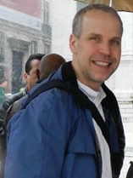
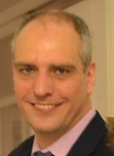
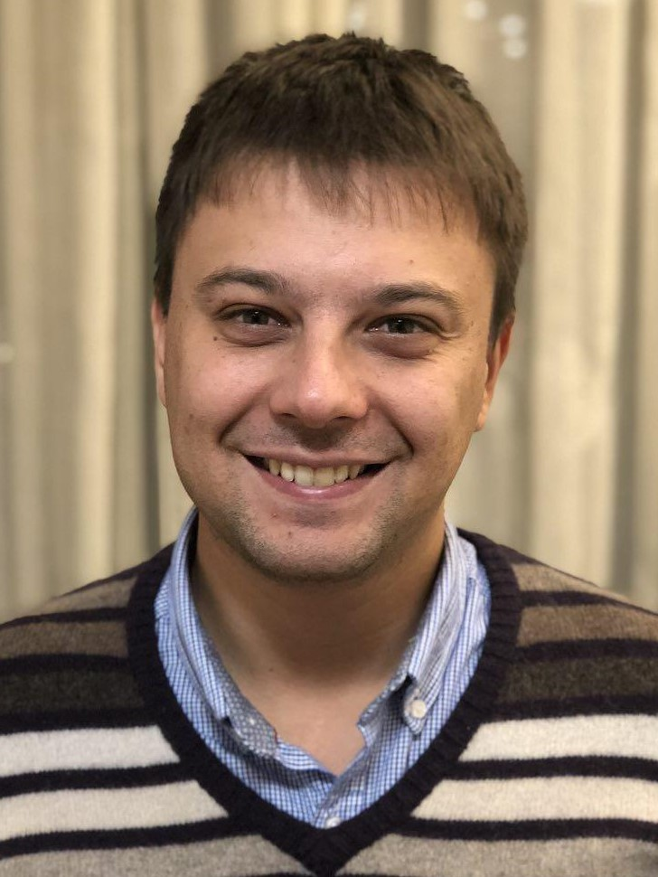
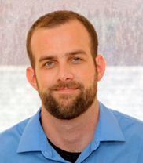



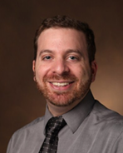
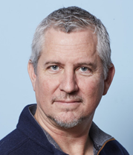

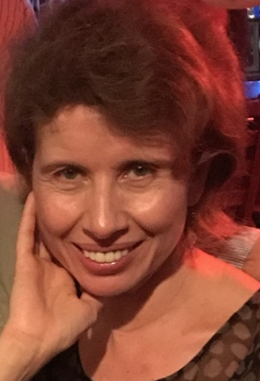



Oncology WG Core Team
Michael Gurley
Christian Reich
Dmitry Dymshyts
Robert Miller
Jeremy Warner
Andrew Williams
RuiJun Chen
Rimma Belenkaya

Slide 4
Contributors
Charles Bailey, Children’s Hospital of Philadelphia
Scott Campbell, University of Nebraska
Rachel Chee, IQVIA
Mark Danese, Outcome Insights
Asieh Golozar, Regeneron
George Hripcsak, Columbia University
Ben May, Columbia University
Maxim Moinat, The Hyve
Anna Ostropolets, Columbia University
Meera Patel, MSK
Joseph Plasek, Aurora
Gurvaneet Randhawa, NCI
Mitra Rocca, FDA
Anastasios Siapos, IQVIA
Firas Wehbe, Northwestern University
Seng Chan You, Ajou University School of Medicine, Suwon, Korea

Slide 5

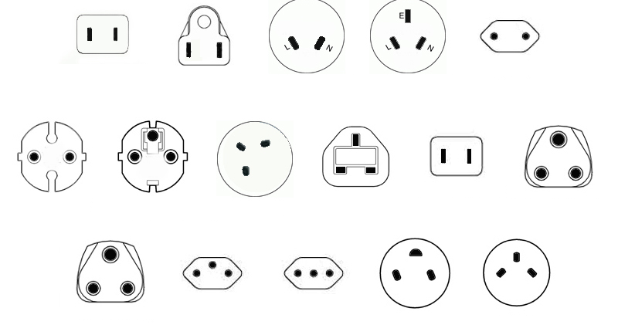



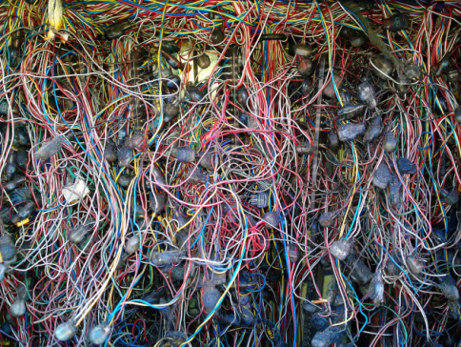
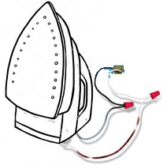
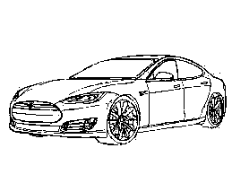
Data Standardization to OMOP Enables Systematic Research
Traditional way
OHDSI approach
Analytical method: Adherence to Drug
North America
China
North America Southeast Asia China
Southeast Asia
OMOP
CDM
Europe
UK
Japan
India
Europe UK Japan India
So Africa
Switzerland
Italy
Israel
So Africa Switzerland Italy Israel
Adherence
Mortality
Prediction
One SAS or R script for each study
Not scalable
Not transparent
Expensive
Slow
Prohibitive to non-expert routine use
OHDSI
Tools
Safety Signals

Slide 6
Cancer Research is different from other diseases
It needs more detail:
“What is the overall survival for patients with non-metastatic carcinoma of the neck of bladder in remission after first line of gemcitabin-containing chemotherapy?“
Concepts in this research question currently not standardized:
Concept | Category
Carcinoma | Histology
Neck of bladder | Anatomical site
Non-metastatic disease | Tumor attribute
Disease in remission | Condition Episode
First line treatment | Treatment Episode
Chemotherapy regimen | Regimen
Gemcitabin | Component of regimen

Slide 7
Five Goals
Build standards on top of OMOP
  Vocabularies Oncology Module
  Data model
Create algorithms and heuristics
  Infer Disease Episodes (automatic abstraction)
  Infer chemo regimens
Build network of data nodes
Build network of researchers
Do research

Slide 8
Working Group Detail
Participants
OHDSI
Ajou University
AstraZeneca
Center for Surgical Science, Region Sjaelland
Children’s Hospital of Pennsylvania
Columbia University
Digital China Health
Integraal Kankercentrum Nederland
IQVIA
Memorial Sloan Kettering Cancer Center
Merck
Montefiore
Mount Sinai
Multiple Myeloma Foundation
NIH
Northwestern University
Odysseus
Oncology Analytics
Pittsburgh University
Providence Health
Vanderbilt
Subgroups
Leadership
Outreach/Research
Development
CDM/Vocabulary
Genomic
Vocabularies implemented/under Consideration
ICD-O-3
NAACCR
CAP
IMO
HemOnc
OROT

Slide 9
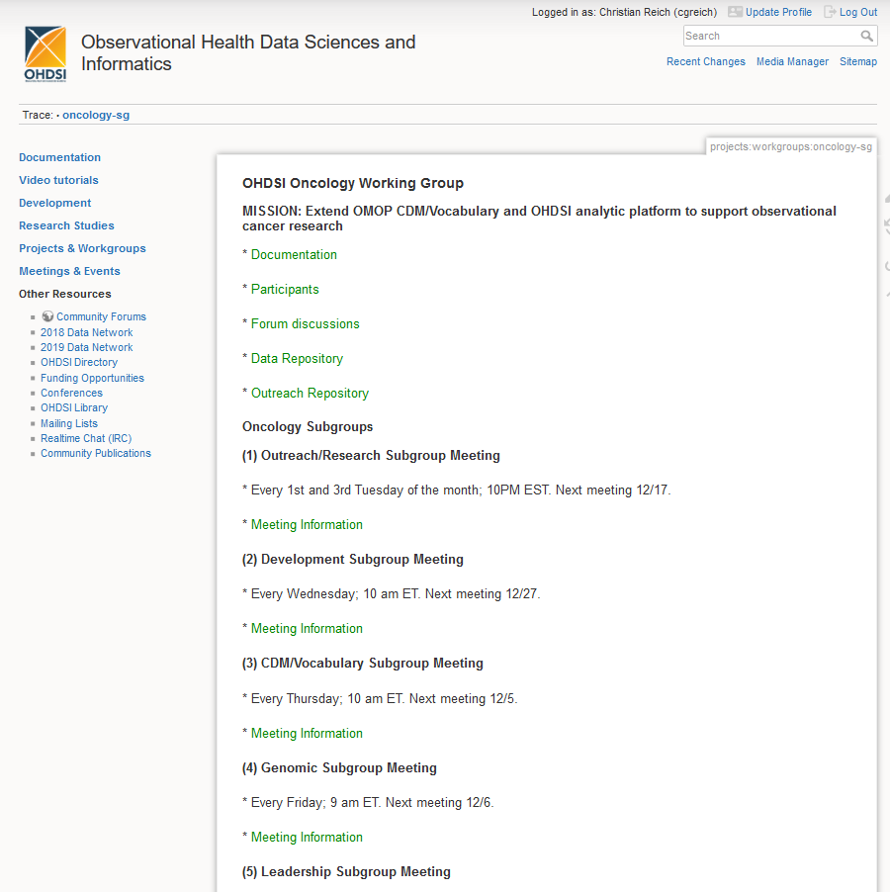

Slide 10
Use Cases
Survival
  Overall
  Disease-free
  Symptom-free
  From diagnosis
  From treatment
Time
  From diagnosis to treatment
  From screening to diagnosis
  From symptoms/initial primary care visit to diagnosis
Variations in outcomes of bladder cancer with and w/o liver metastases
Define uptake of genomic test
Identify treatment regimens
Compare tumor registry chemo with identified chemo regimens
Validate identified chemo regimens against Beacon
Compare uptake of newer medications vs. older medications
Number of medications taken daily by a cancer patient
Speed of drug administrations and the risk of allergic reaction/rejection
Time of administration
Comparative effectiveness of adhering to the administration rules vs deviations
Metastatic hormone–sensitive prostate cancer and non-metastatic castration-resistant pros

Slide 11
What’s Been Accomplished
Extension of CDM and Vocabulary to support required granularity of cancer representation
  Incorporation of ICD-O into vocabulary
  Incorporation of NAACCR into vocabulary
  CDM support for cancer modifiers
Extension CDM and Vocabulary to support abstractions required for cancer representation
  Incorporation of HemOnc into vocabulary
  Development of the Episode CDM module
Development of ETL from US Tumor Registries to OMOP
Testing typical use cases

Slide 12
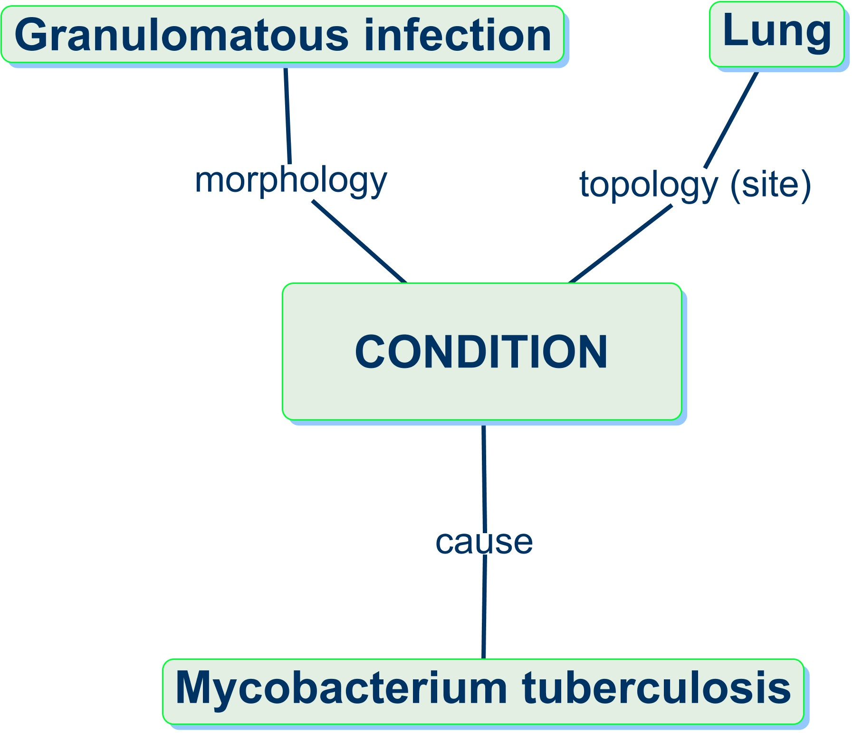
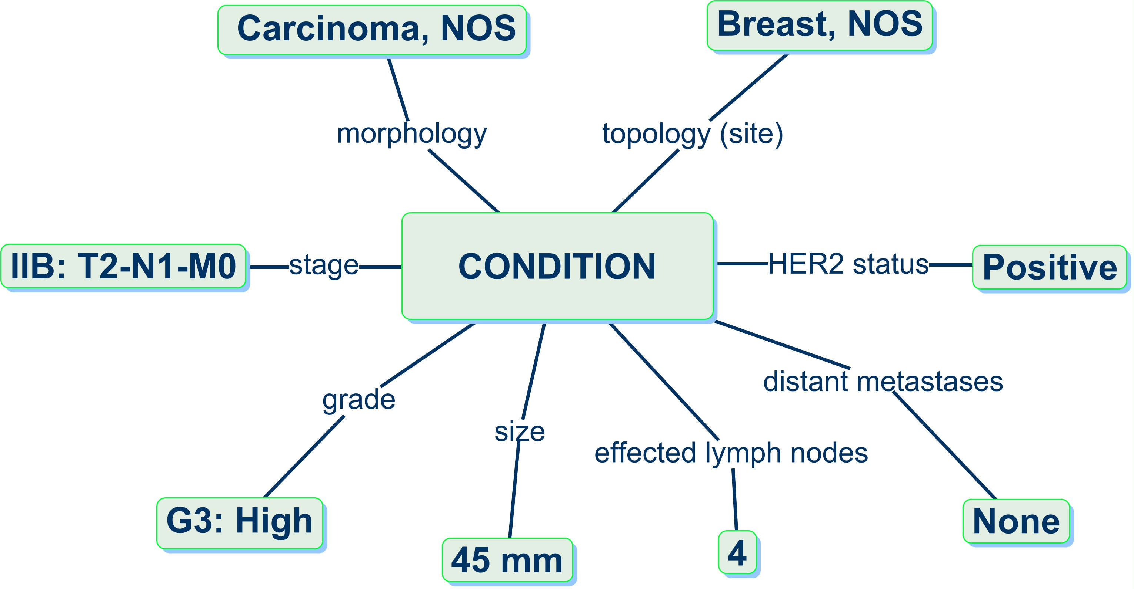
Challenges: Granularity
Normal Condition
Most normal conditions
are defined by three main
dimensions implicitly,
plus some extra attributes
Cancer
Cause is not known, but morphology and topology are detailed and explicit
The many tumor attributes (modifiers) are also explicit and well defined
Notes:
Change pictures
Granularity Challenge
Observational research in cancer requires substantially more detail to represent diagnoses, treatments, and outcomes than most other therapeutic areas.
It is this constellation of attributes (Constellation of Cancer) that determines:
Prognosis
Patient care (Treatment pathway)
Treatment outcomes

Slide 13
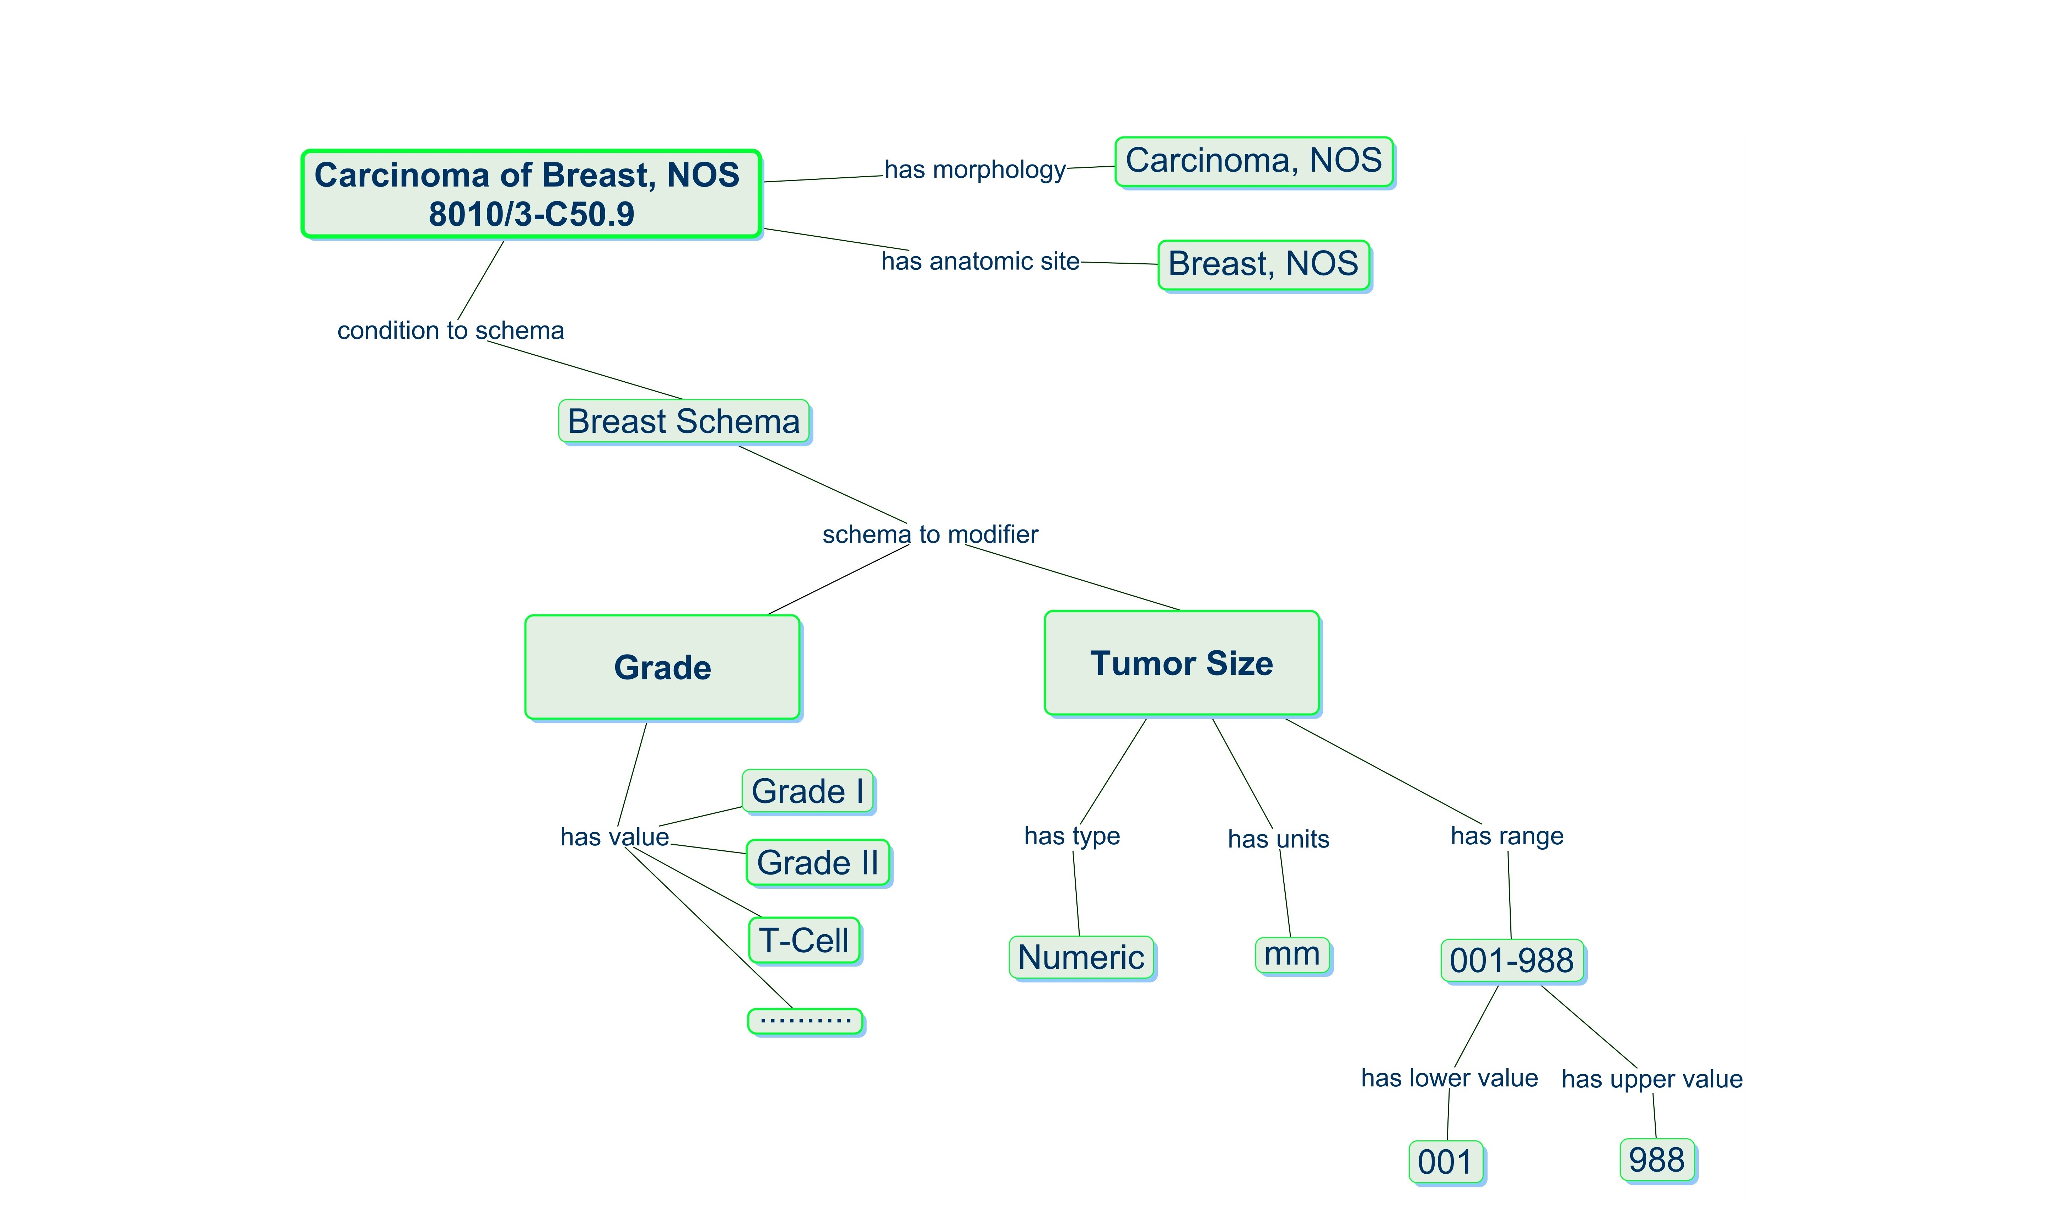


Solving Granularity Challenge
Cancer Diagnosis Model in the OMOP Vocabulary
Added vocabularies:
Notes:
Add ICD-O and mapped to SNOMED, NAACCR,

Slide 14
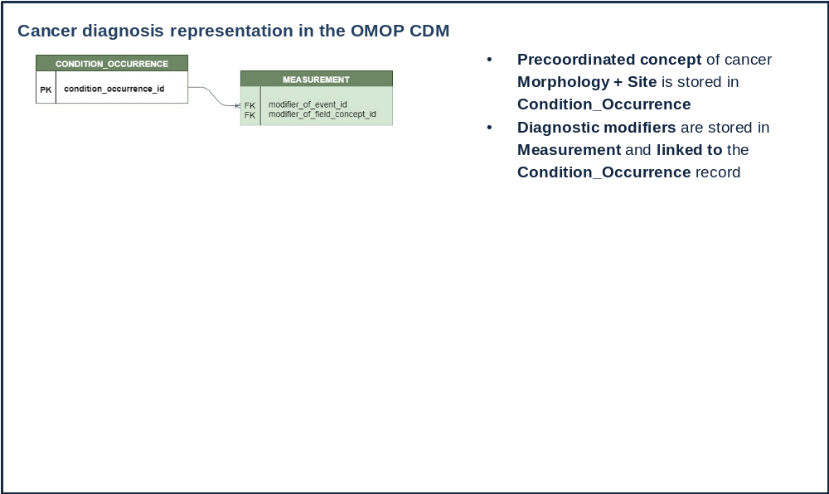
Solving Granularity Challenge

Slide 15
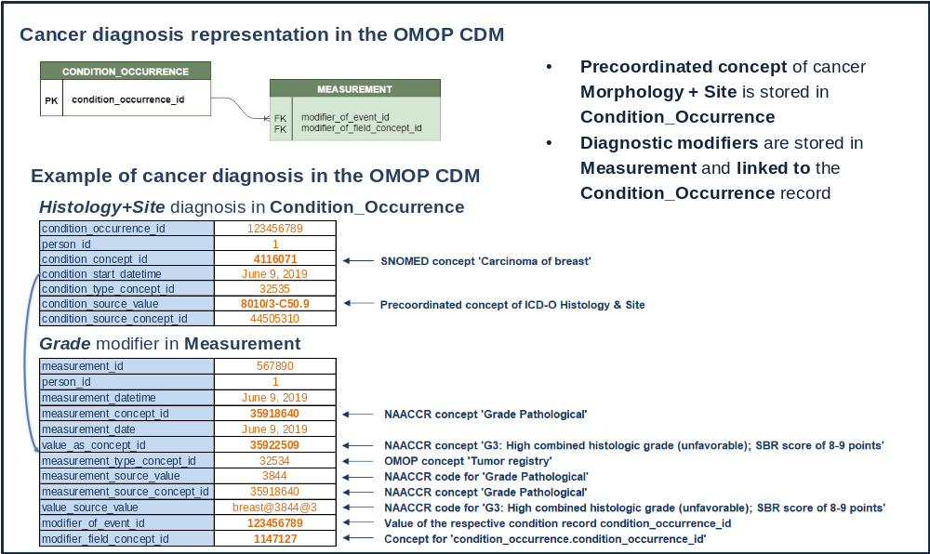
Solving Granularity Challenge

Slide 16
Challenges: Abstraction
Clinically and analytically relevant representation of cancer diagnoses, treatments, and outcomes requires data abstraction
  Not readily available in the source data
  Traditionally not supported in OMOP CDM
1st disease occurrence
Remission
Progression
Stable disease
Progression
Diagnosis
Palliative Care
Hospice/EOL
Treatments
1st treatment course
2nd treatment course
3rd and 4th treatment courses
Notes:
Abstraction Challenge
Clinically and analytically relevant representation of cancer diagnoses, treatments, and outcomes requires data abstraction (e.g. recurrence, remission, end-of-life events, chemotherapy regimens, treatment cycles, response to treatments)
It is those abstractions that are used in the typical analytical use cases:
Survival from diagnosis
Disease free survival
Time to progression
Prediction of EOL
Time from diagnosis to treatment start

Slide 17
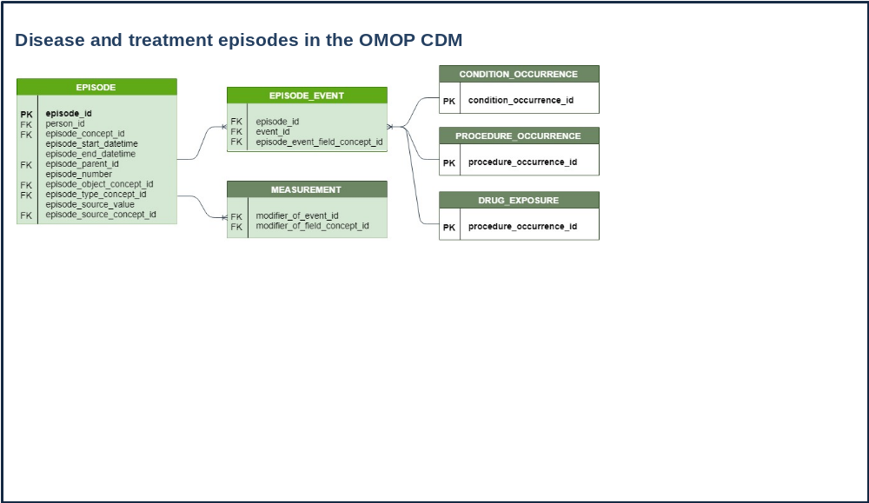

Solving Abstraction Challenge
Added vocabularies:

Slide 18
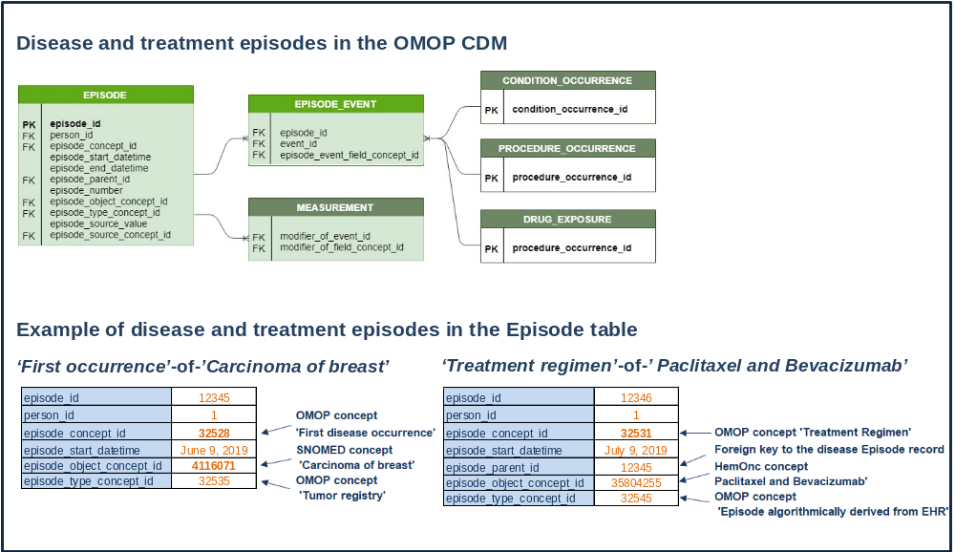
Solving Abstraction Challenge
Added vocabularies:

Slide 19
Testing
Developed ontology-driven ETL for data conversion from Tumor Registry
Converted EHR and Registry data from four participating institutions
Tested clinical characterization use cases
  Survival from initial diagnosis
  Time from diagnosis to treatment
  High-level treatment course for 1st cancer occurrence
  Derivation of chemotherapy regimens from atomic drugs

Slide 20
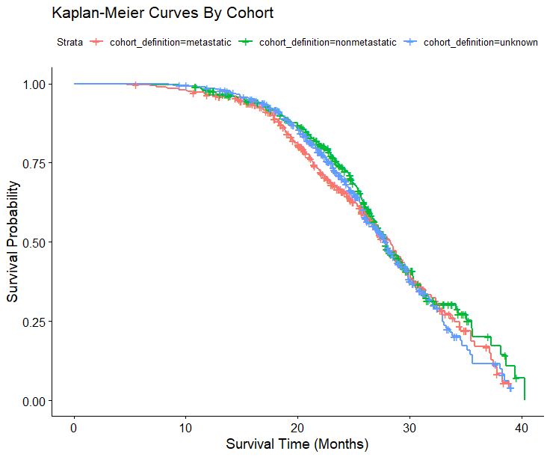
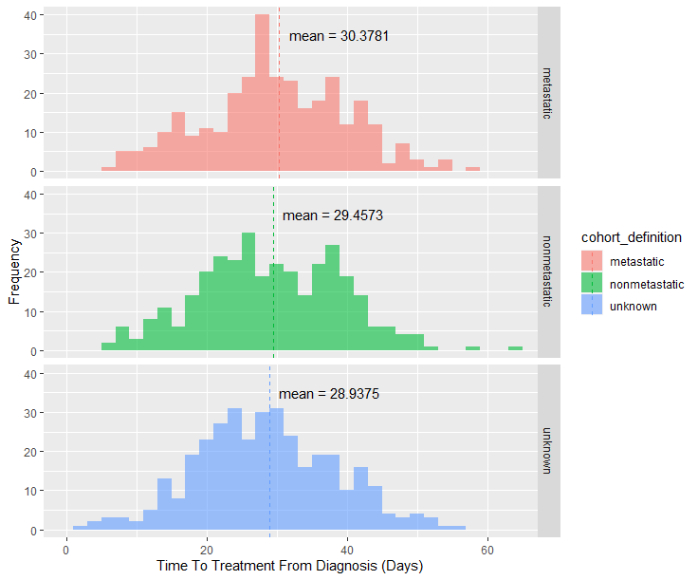
Results
  Survival from diagnosis
  Time from diagnosis to treatment

Slide 21
What You Can Do Now
Represent most granular cancer diagnosis based on ICD-O
Ingest Tumor Registry data using standardized ETL
Identify cancer patient cohorts based on multiple diagnostic features
Ingest or derive chemotherapy regimens
Ingest of derive cancer disease and treatment episodes
Test existing use cases and implement your own

Slide 22
Next Steps – Development Subgroup
      Drug Regimen Algorithm and the challenge we plan to organize at the Hackathon
      Data quality checks for NAACCR ETL
      Robust NAACCR ETL including different dialects
      Analytical package and expansion with additional use cases
      Algorithm for the identification of disease progression and other episodes

Slide 23
Next Steps – Vocabulary Subgroup
      De-duplicate NAACCR variables and values and map duplicates to a selected primary code
      Ingest CAP
      Compare CAP variable-value pairs to NAACCR variable-value pairs
      Map NAACCR items (variables) and values to equivalent LOINC and SNOMED concepts
      Map CAP items (variables) and values to LOINC and SNOMED concepts.
      Align this effort with the ongoing Nebraska Lexicon and CAP standardization efforts and with the evolving mCODE standard

Slide 24
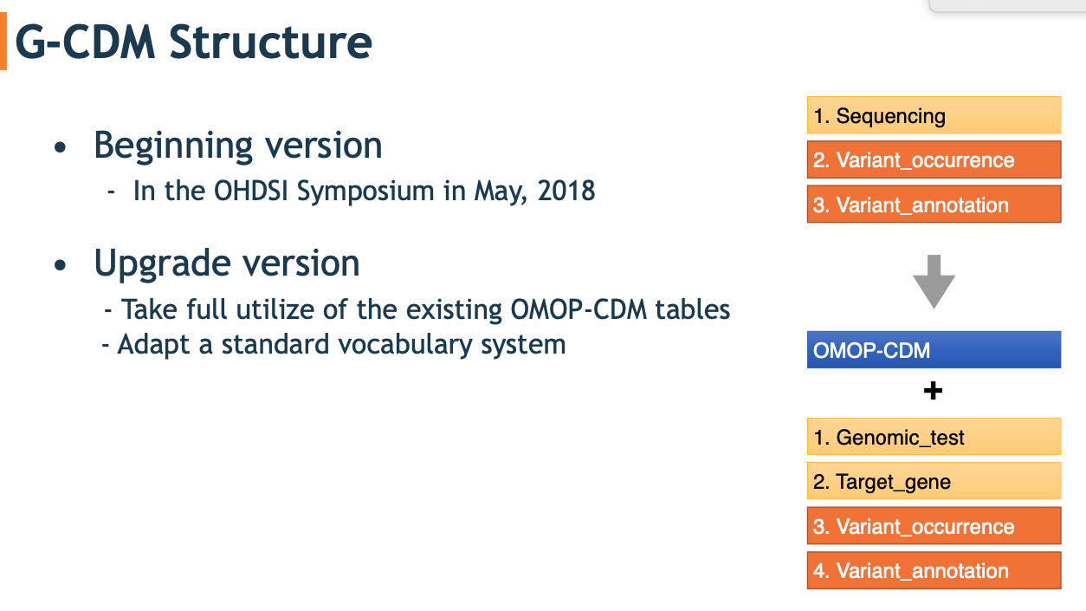
Next Steps – Genomic Subgroup

Slide 25
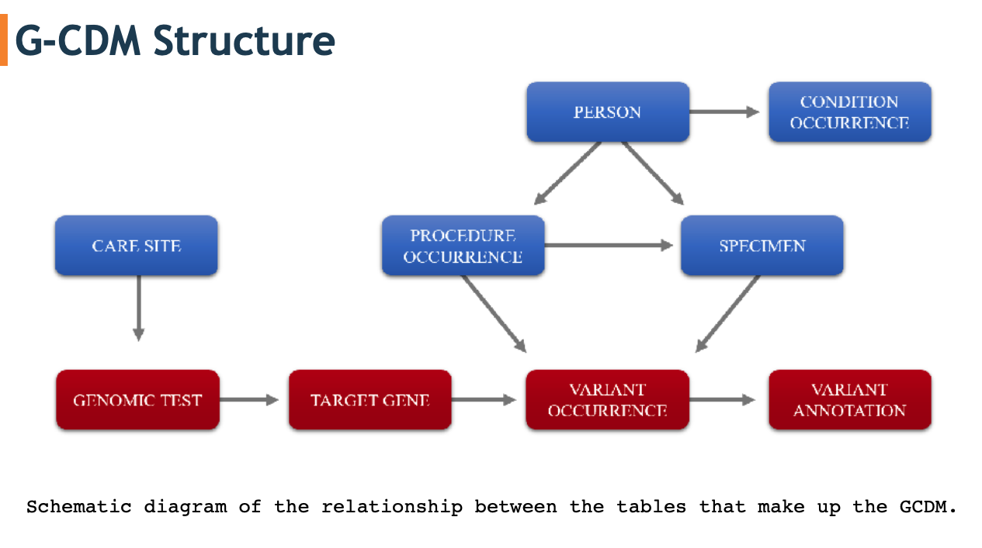
Next Steps – Genomic Subgroup

Slide 26
Community Engagement in Development & Research
      Data: US tumor registry, non-US tumor registry, EHR, Claims, trial (Future)
      Research questions: High impact use cases
      Domain modelers and vocab developers: Radiology, surgery, precision medicine
      ETL developers
      Methodologists: Support of best practices

Slide 27
Questions?

