Slide 1
OHDSI Community in Action:
Where have we been in 2019?
Where should we go in 2020?
Patrick Ryan, PhD
Vice President, Observational Health Data Analytics, Janssen Research and Development
Assistant Professor, Adjunct, Department of Biomedical Informatics, Columbia University Medical Center

Slide 2
OHDSI’s mission
To improve health by empowering a community to collaboratively generate the evidence that promotes better health decisions and better care

Slide 3
OHDSI’s areas of focus:
Recapping our journey in 2019…
Methodological research
Open-source analytics development
Clinical applications
Observational data management
Maintain and evolve open community data and vocabulary standards
Develop and improve tools to enable large-scale analysis
Establish and promote community best practices
Strengthen and expand collaborations across OHDSI research network
Advance scholarship in observational data science through publication, presentations, and education
Generate and disseminate more clinical evidence
Clinical characterization
Population-level estimation
Patient-level prediction

Slide 4
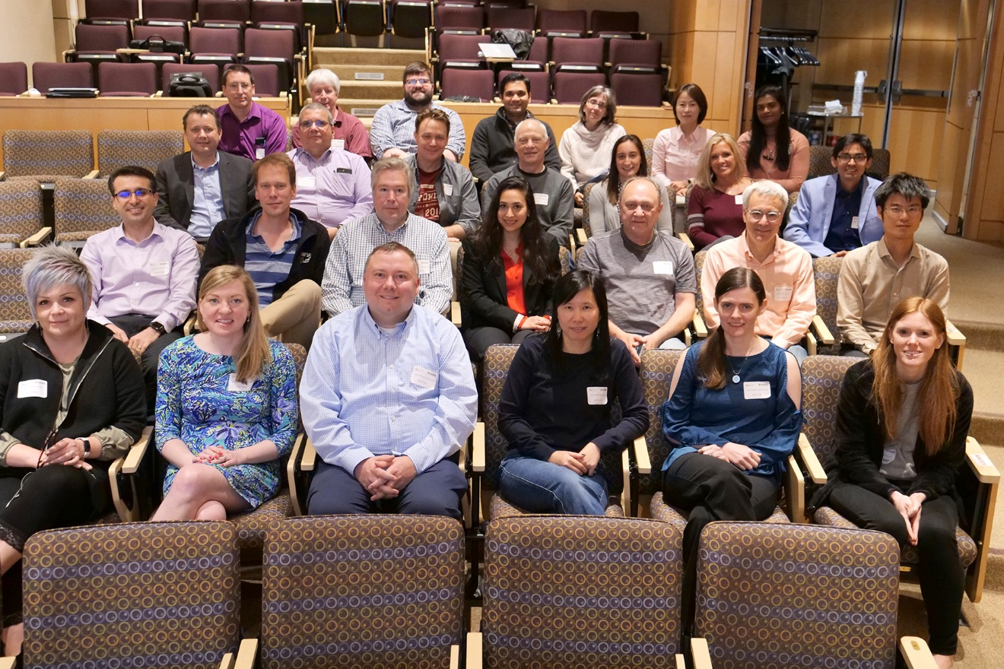
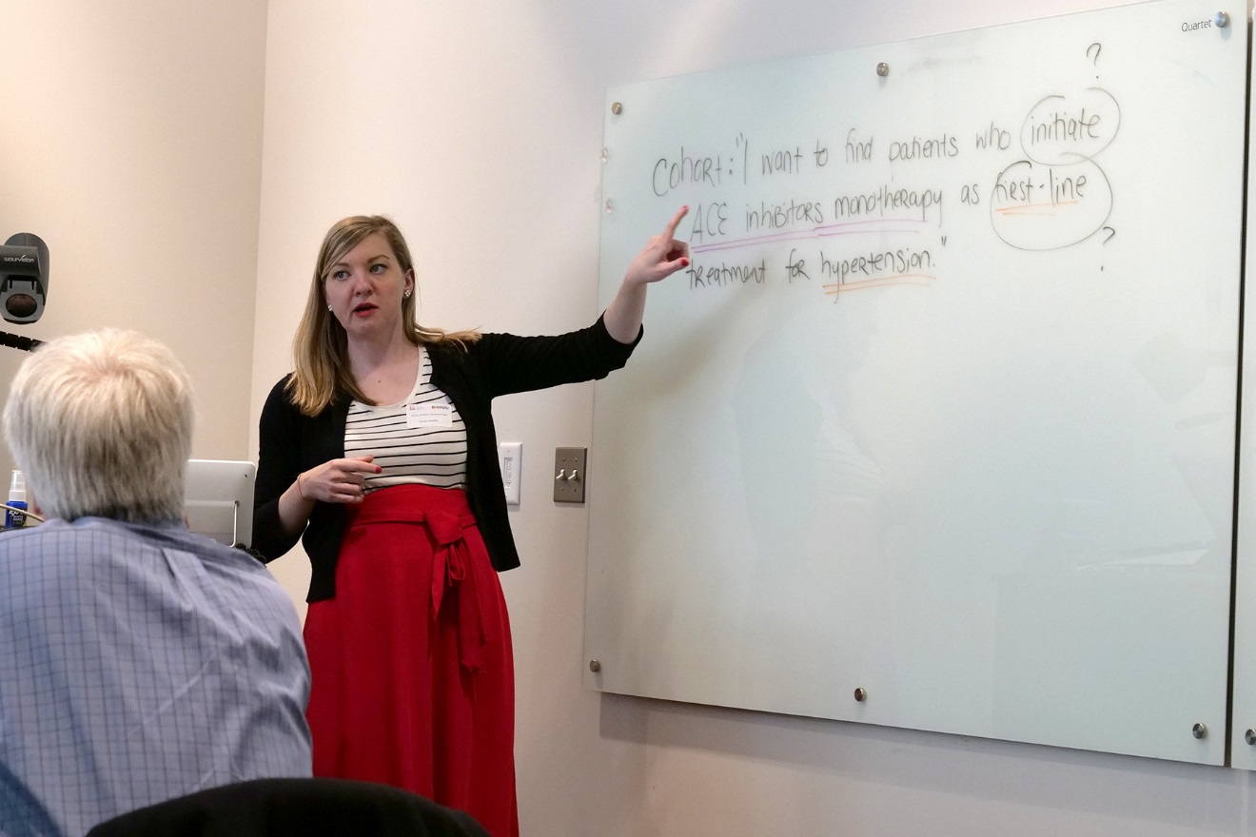
Case Western Reserve University :
OHDSI face-to-face documentation-a-thon

Slide 5
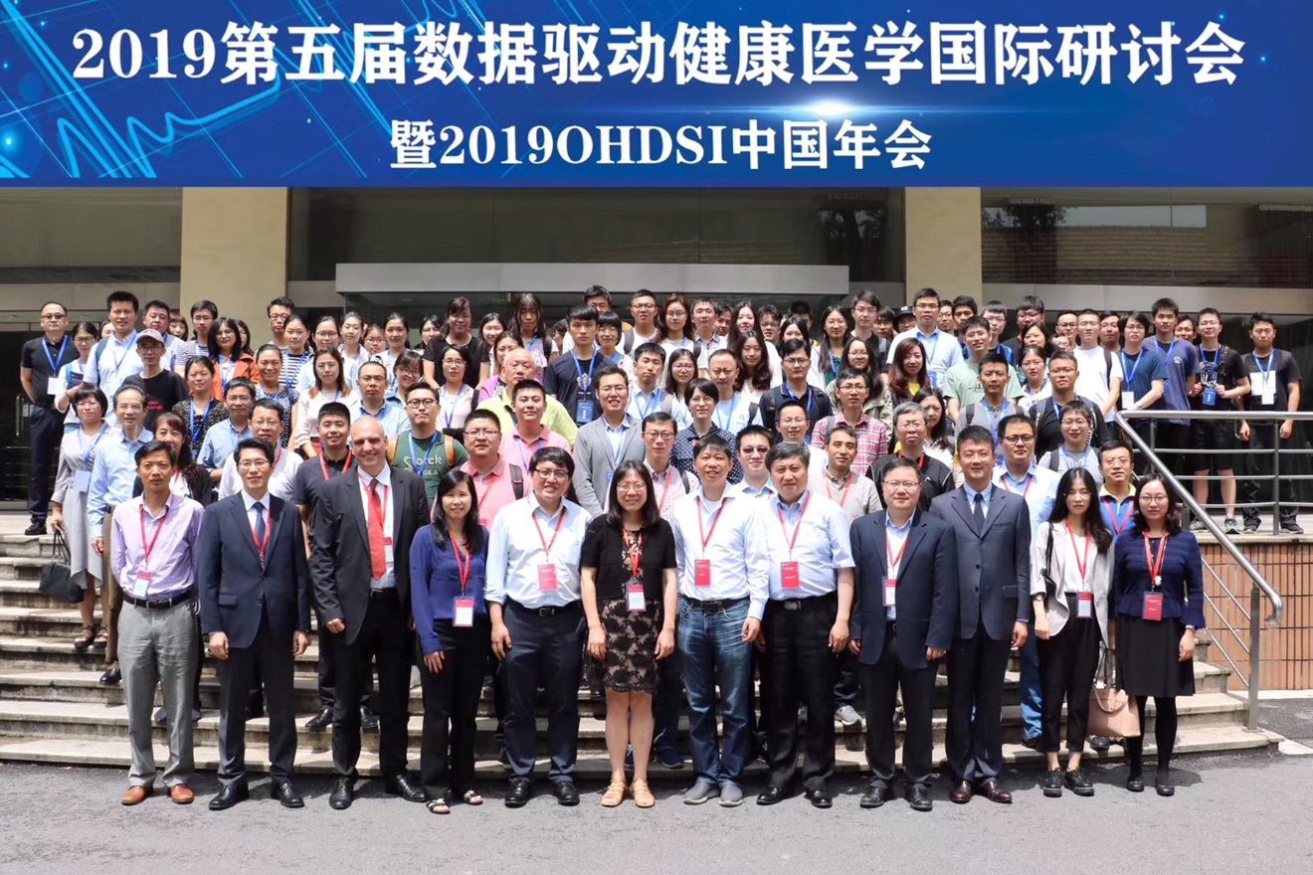
OHDSI China Symposium 2019

Slide 6
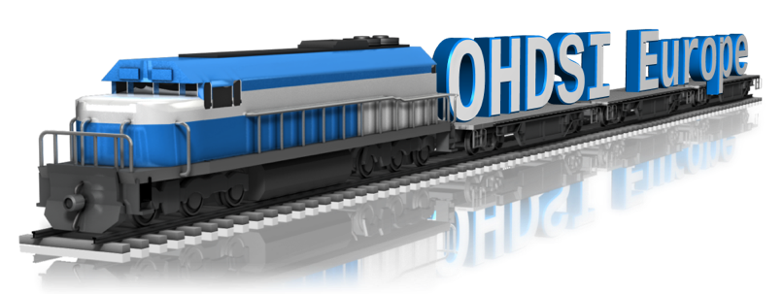
The Journey From Data to Evidence OHDSI Europe 2019
A platform to stimulate community building: 250 participants from 27 countries
OHDSI Europe in action: 35 posters, 8 software demos
Educate and train the community: 5 full day tutorials
www.ohdsi-europe.org

Slide 7
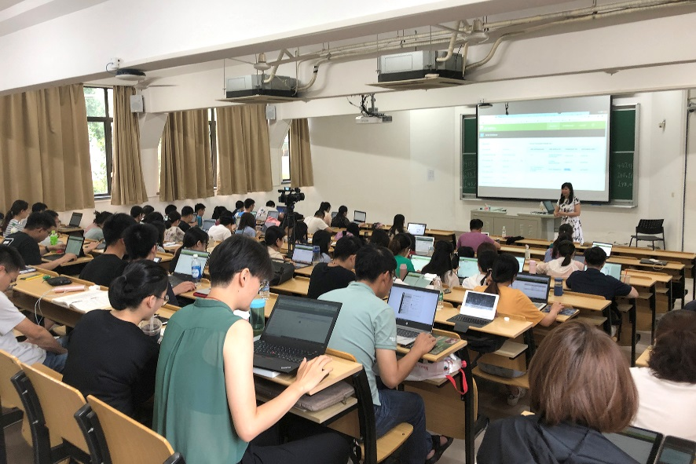
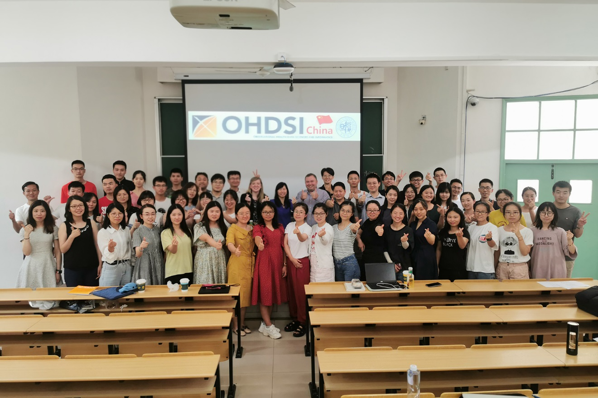
Fudan University – OHDSI tutorials

Slide 8
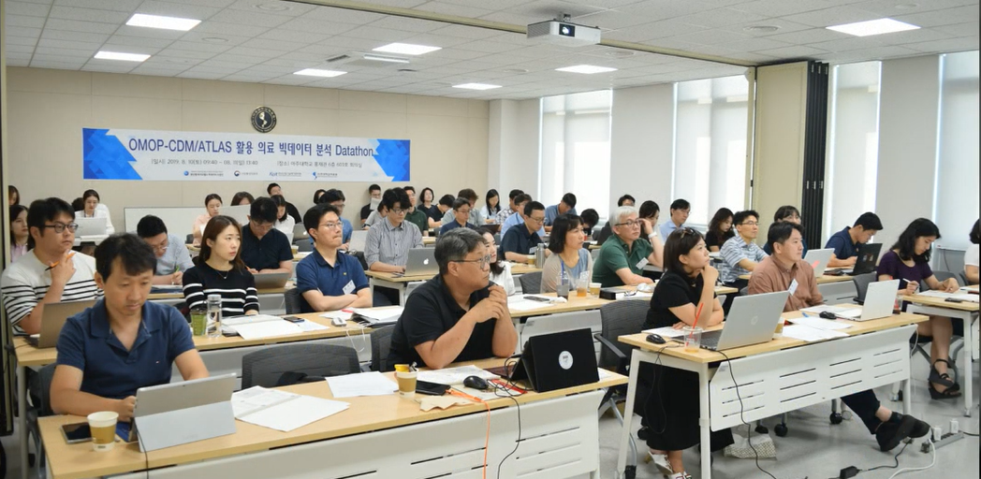
OHDSI Korea – Study design datathon

Slide 9

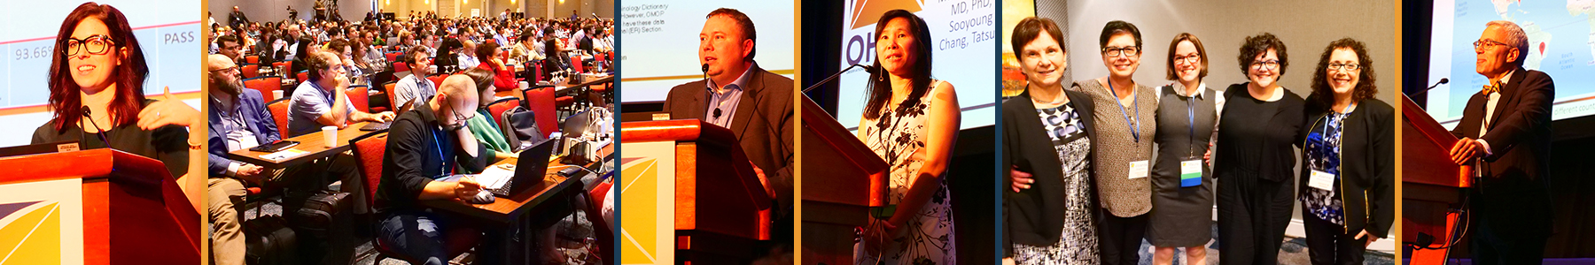

Slide 10


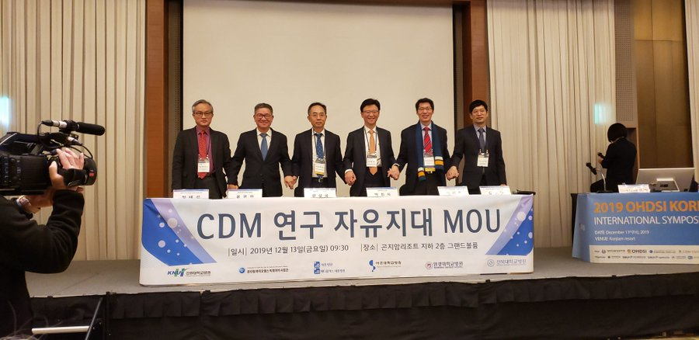
OHDSI Korea Symposium
12-14th December 2019,
KONJIAM Resort, Gwangju, Gyeonggi-Do, Republic of Korea

Slide 11
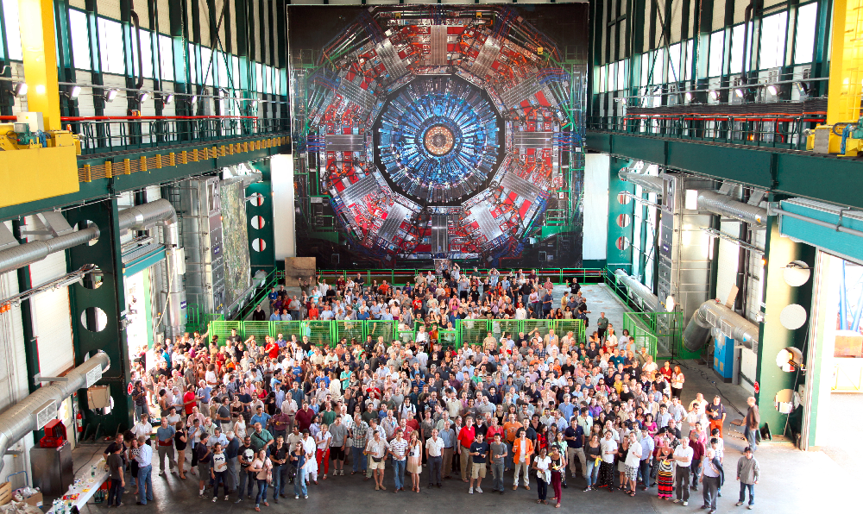
Building the LHC of observational data science?

Slide 12
ICMJE guidelines
The ICMJE recommends that authorship be based on the following 4 criteria:
Substantial contributions to the conception or design of the work; or the acquisition, analysis, or interpretation of data for the work; AND
Drafting the work or revising it critically for important intellectual content; AND
Final approval of the version to be published; AND
Agreement to be accountable for all aspects of the work in ensuring that questions related to the accuracy or integrity of any part of the work are appropriately investigated and resolved.
http://www.icmje.org/recommendations/browse/roles-and-responsibilities/defining-the-role-of-authors-and-contributors.html

Slide 13
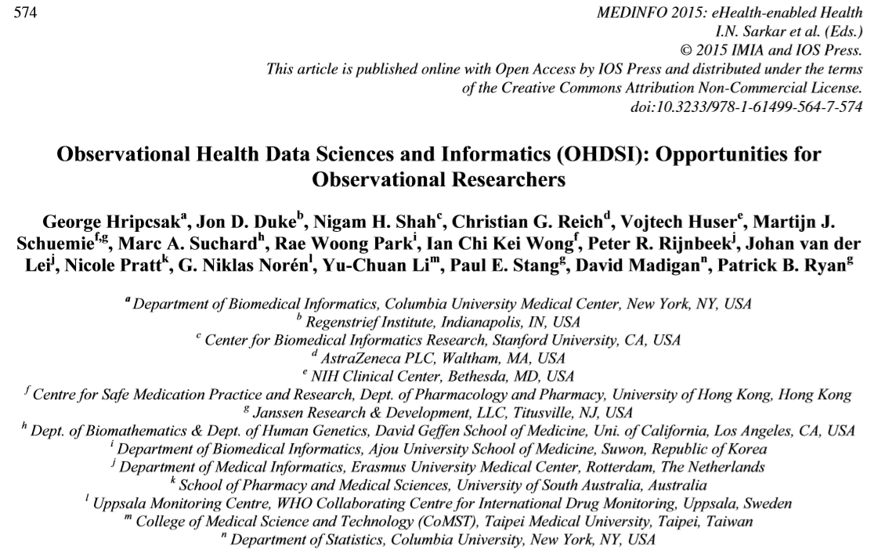
OHDSI in action
2015:
17 authors
1 promise

Slide 14
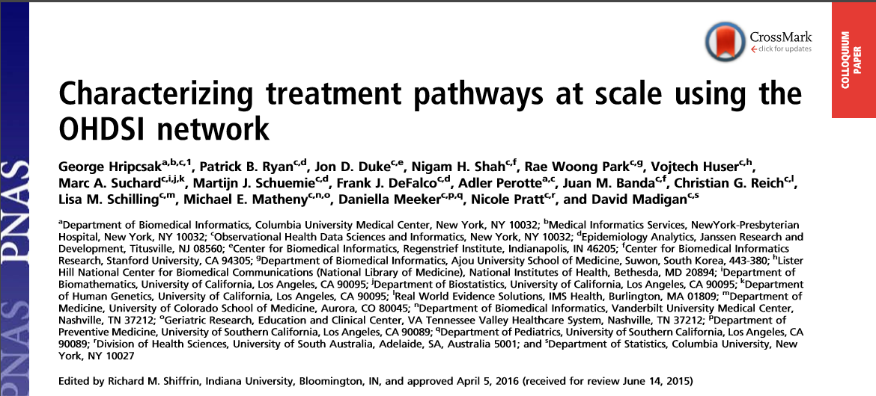
OHDSI in action:
Treatment Pathways
2016:
17 authors
11 data sources

Slide 15
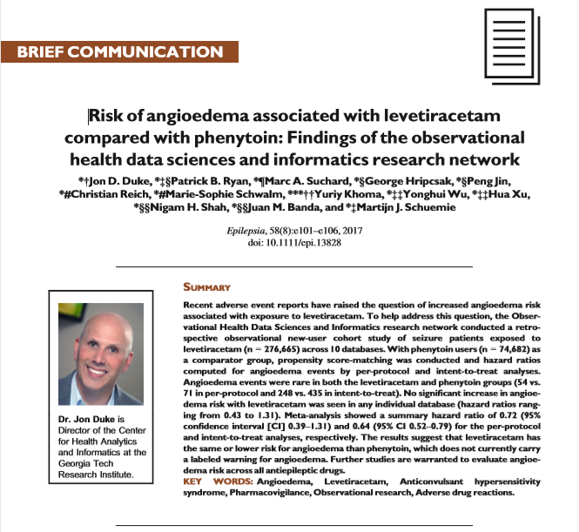
OHDSI in action:
Safety surveillance
2017:
13 authors
10 data sources

Slide 16
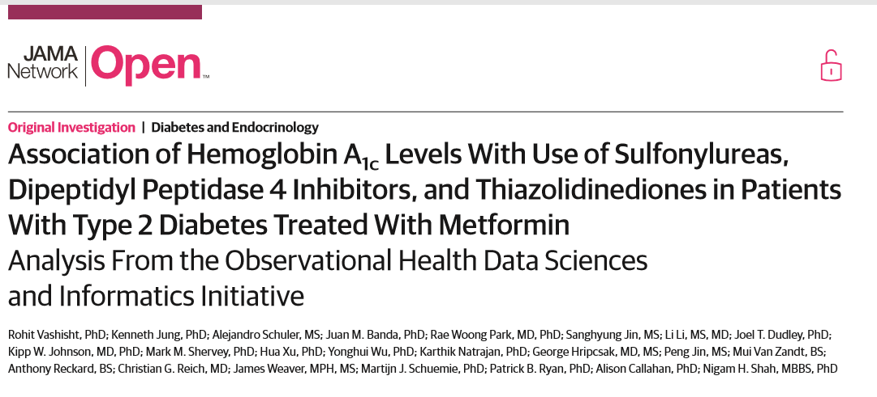
OHDSI in action:
Comparative effectiveness
2018:
22 authors
8 data sources

Slide 17
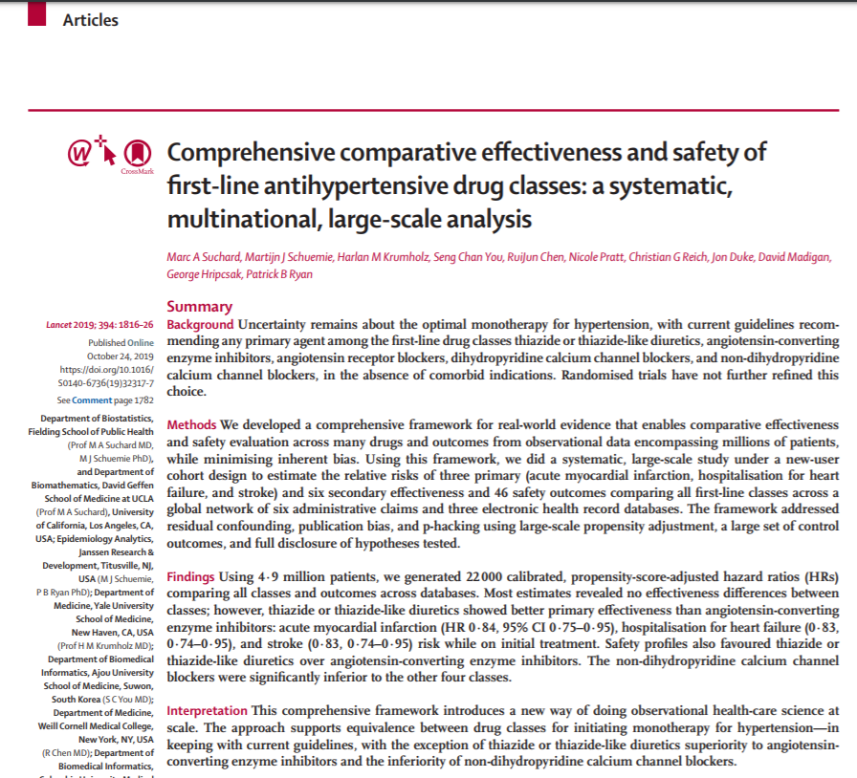

OHDSI in action:
LEGEND-HTN
Oct2018→2019:
11 authors
9 sources
1.4m TCOs

Slide 18
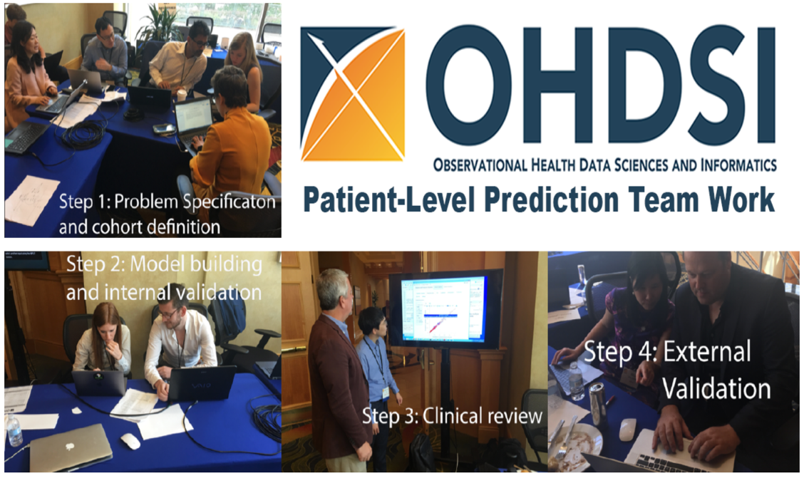

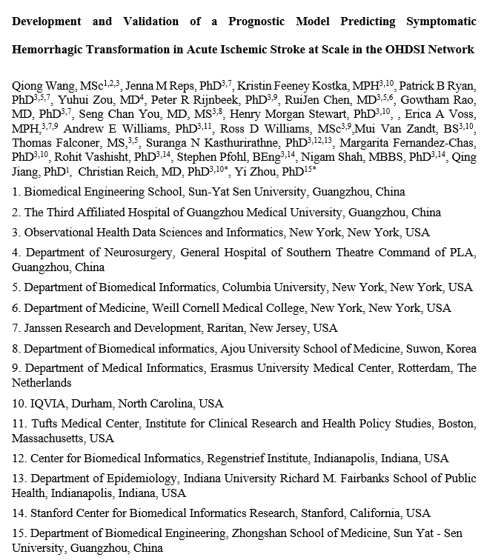
OHDSI In Action:
Patient-Level Prediction Live at OHDSI’18
accepted
Oct2018→2019:
23 authors
11 data sources
From question to preliminary results in 1 day!

Slide 19
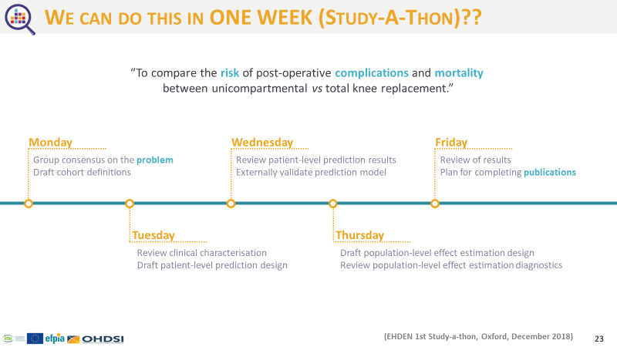
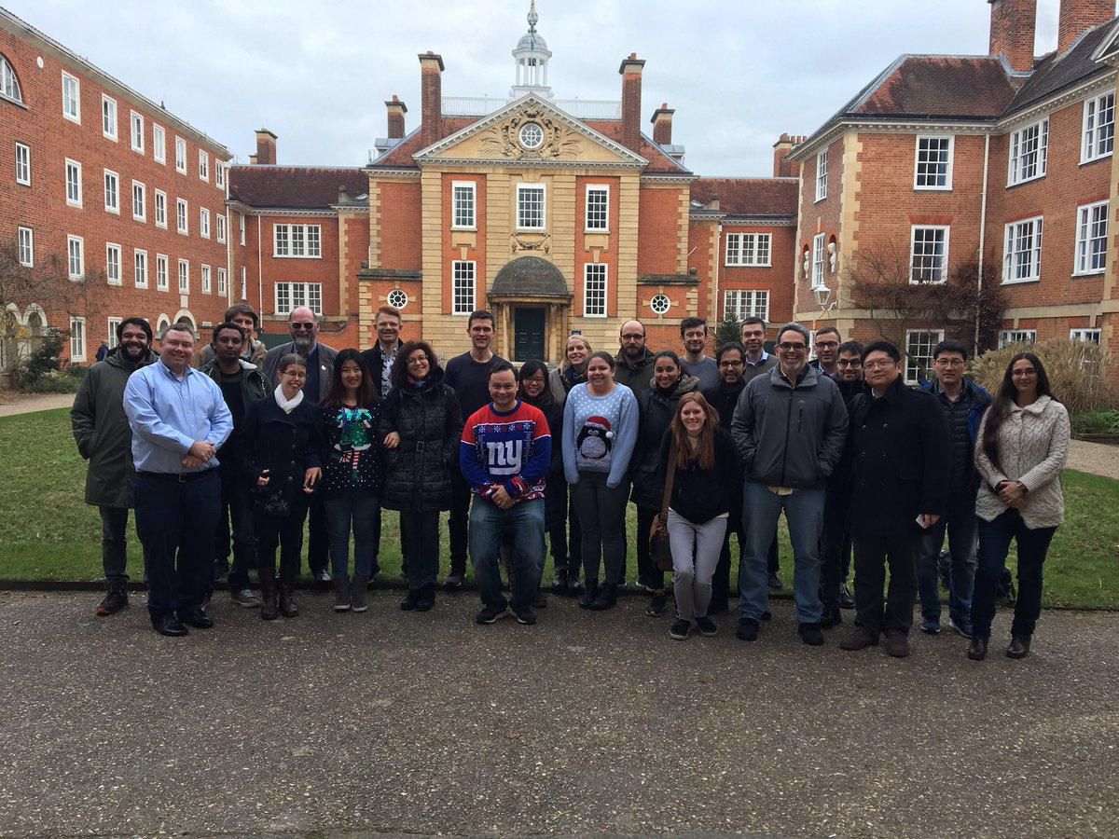
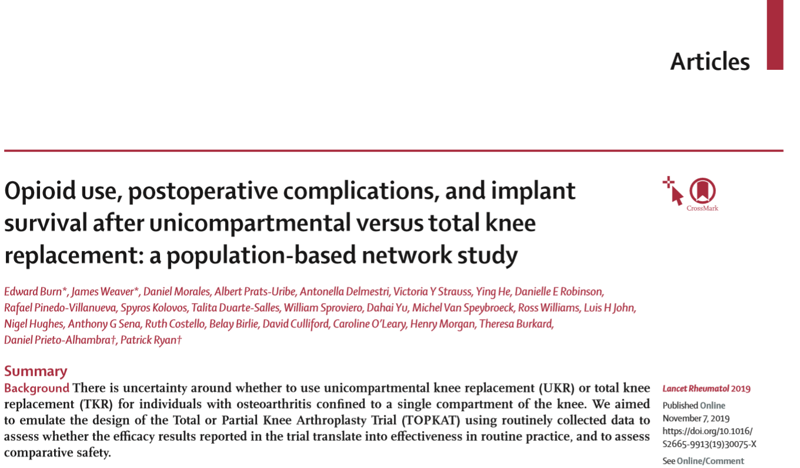

OHDSI in action:
Oxford study-a-thon
Dec2018→2019:
26 authors
5 sources

Slide 20

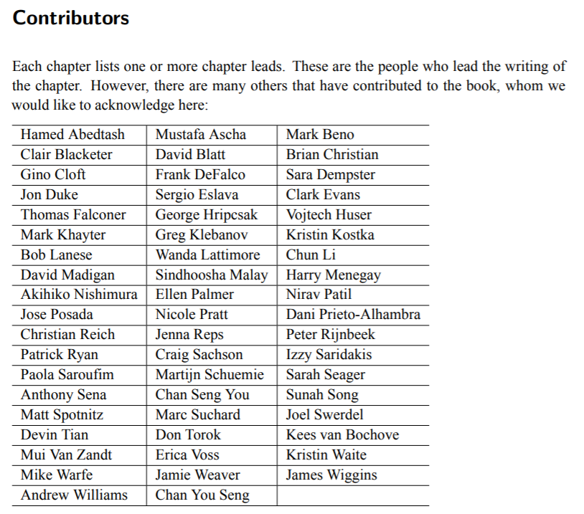

OHDSI in Action:
Book of OHDSI
2019:
56 contributors!

Slide 21
Why do we need more collaboration?
We want to learn from as many data sources as the world as possible (replicability, generalizability, heterogeneity)
  Each data partner contributes source data understanding and shares in interpreting their results in the context of the entire network
As we grow the number of data partners, it is likely that the number of patient records per source will become smaller, which introduces new methodological challenges to overcome → METIS
Large scale evidence generation requires large scale collaboration for interpretation
  LEGEND : One causal evidence system → Many clinical insights to inform different health decisions

Slide 22
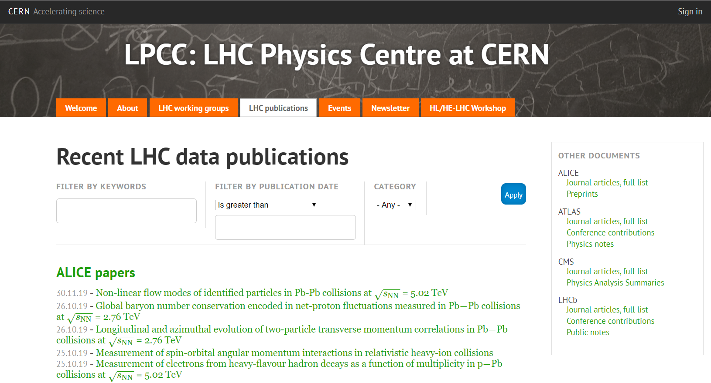
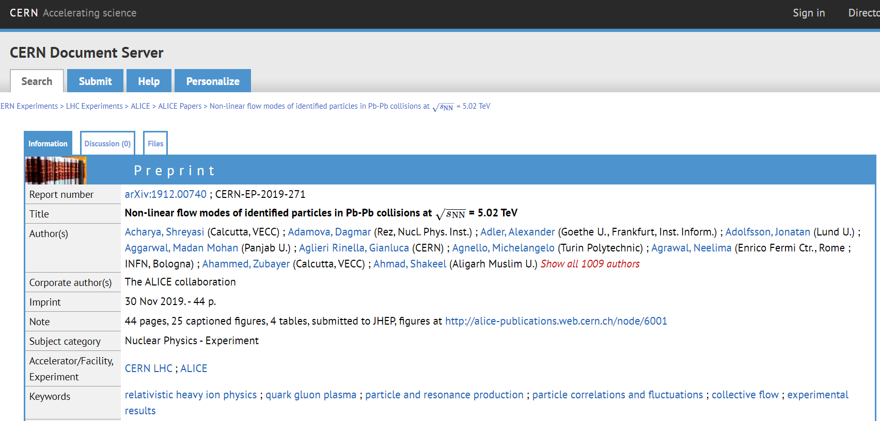
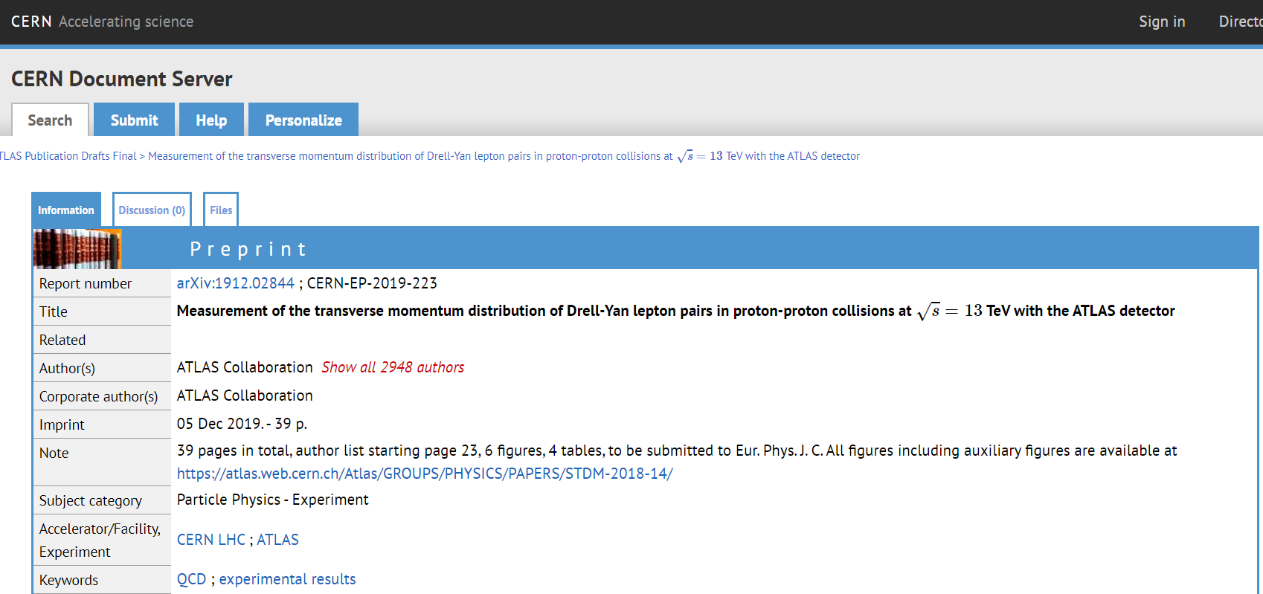
Building the LHC of observational data science?

Slide 23
What will be the research we do together that generates >1000 co-author papers?
Methods research:
  “Examining data heterogeneity across a global health network”
  “Development and evaluation of methods for integrating causal inference design and machine learning algorithms for patient-level estimation”
Open-source development:
  “Implementation of a large-scale analytics ecosystem to enable evidence generation within health systems and across a global health network”
  “Validation of a international phenotype library to define and identify disease across electronic health record systems”
Clinical applications:
  “Characterization of disease incidence and treatment utilization patterns across the world”
  “Comprehensive comparative safety and effectiveness of treatments for <every disease>: an OHDSI LEGEND study”

Slide 24
OHDSI strategic priorities in 2020
Finish publications from completed research before initiating new research
Execute the world’s largest network study – characterizing concept prevalence
  simple yet impactful research
  allow us to know who is (currently) interested and able to participate in network research moving forward
  target: get >67 of 133 databases participating
Collaboration on shared goals
  Phenotype library
  CDM documentation - ETL conventions, use guide
  Open-source development – expand community design, implementation and testing
Community Education through EHDEN Academy
  more materials provided in public forum in structured curriculum
  less requirement of in-person tutorial sessions
  coordination of materials with EHDEN and Book of OHDSI
Cultivate other network studies which follow OHDSI best practices

Slide 25
OHDSI’s areas of focus:
Continuing our journey in 2020…
Methodological research
Open-source analytics development
Clinical applications
Observational data management
Evidence generation and dissemination: Evolve from promising proof-of-concept to impactful production
Expand engagement of the OHDSI data network in the evidence generation process, starting with characterization of concept prevalence
Increase adoption of existing community data standards through improved documentation on shared ETL conventions and user guide
Improve community connections between methods research, open-source development, and clinical applications to promote greater adoption of community best practices
Clinical characterization
Population-level estimation
Patient-level prediction

Slide 26
OHDSI Collaboration activities in 2020
OHDSI events on the books:
EHDEN Study-a-thon – Barcelona ESP Jan13-18
CMS AI Health Outcomes Challenge
OHDSI Europe – Oxford UK Mar27-29
OHDSI US - Bethesda MD Oct 18-21
Face-to-face sessions being considered:
Phenotype development and validation
ATLAS design-a-thon
OHDSI Asia

Slide 27
Join the journey
More info: ohdsi.org
Discussion: forums.ohdsi.org
Code: github.com/OHDSI
contact@ohdsi.org

