Slide 1


From Synergy to Impact: A Vision for An OHDSI-CISNET Partnership
Ruth Etzioni
Fred Hutch Cancer Center
Knight Cancer Institute

Slide 2
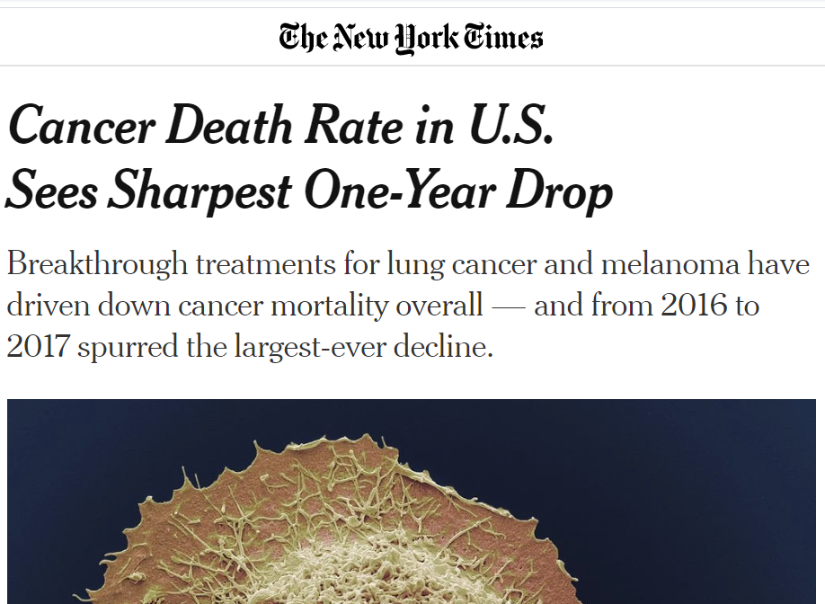
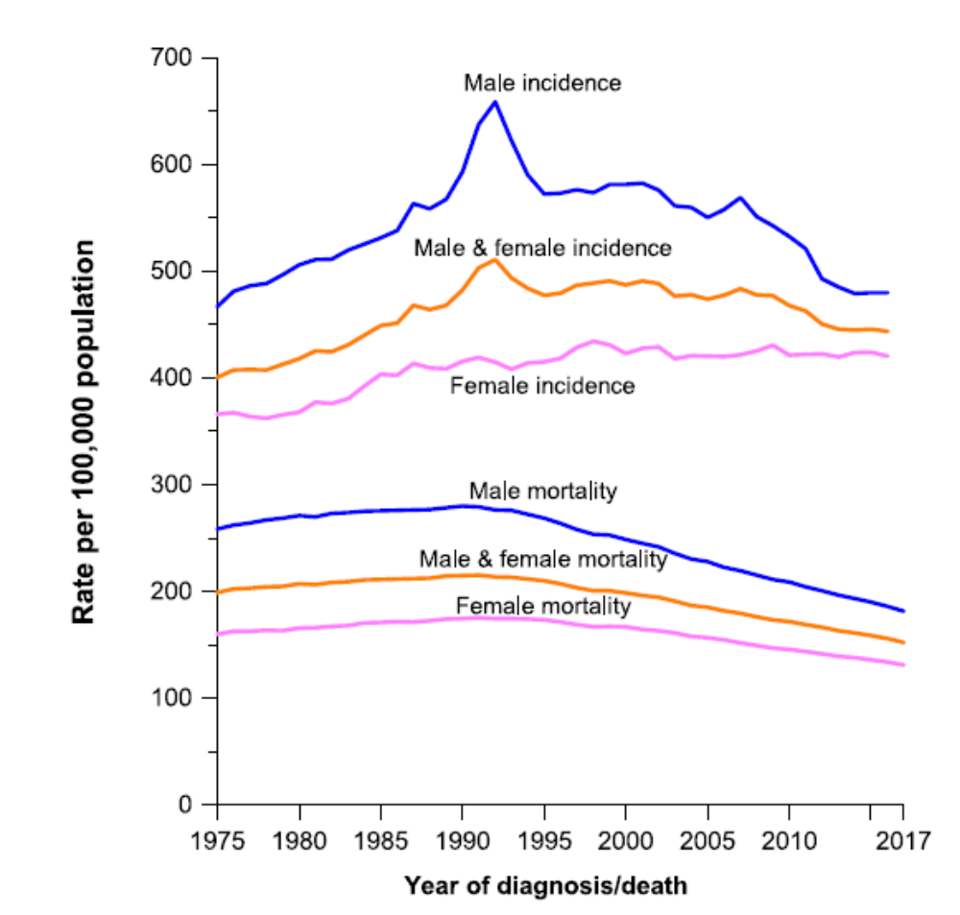
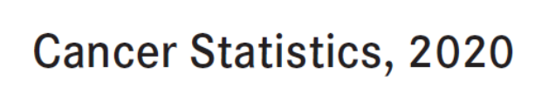

Slide 3
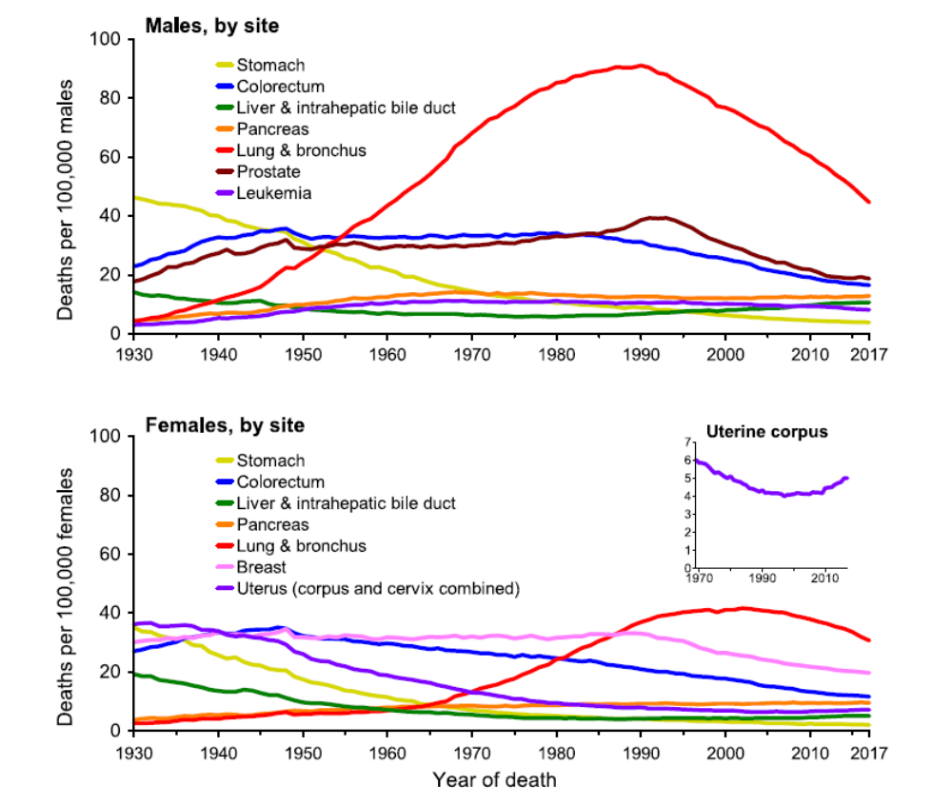
Mortality by site
LUNG CANCER
PROSTATE CANCER
COLORECTAL CANCER
BREAST CANCER

Slide 4
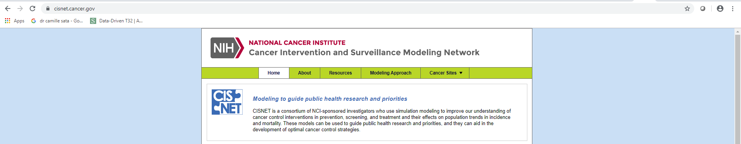
What is CISNET?
NCI Sponsored Collaborative Consortium (U01) of simulation modelers in Breast, Prostate, Colorectal, Lung, Esophagus, and Cervical cancers formed in 2000
Formed to learn about the drivers of population trends in cancer incidence and mortality
Extend evidence provided by trial, epidemiologic, and surveillance data using disease modeling to guide public health research and priorities
https://cisnet.cancer.gov/

Slide 5
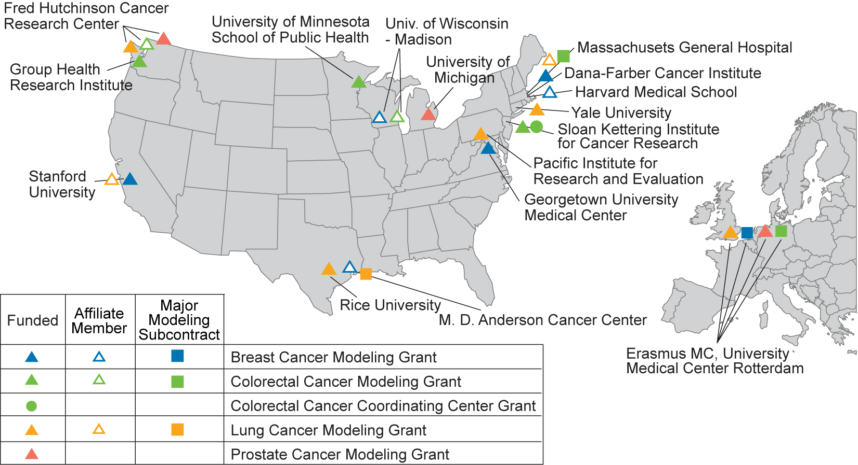
CISNET sites

Slide 6
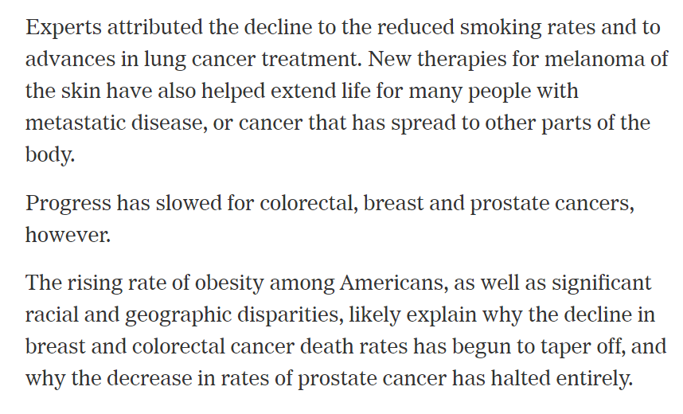

Slide 7
How would you check whether advances in treatment explain mortality declines?
Why is this of interest ?

Slide 8
How would you check whether advances in treatment explain mortality declines?
Disease incidence by stage and type
Survival without new treatments by stage and type
Patterns and efficacy of new treatments
Survival with new treatments by stage and type
Mortality
Without new treatments
With new treaments

Slide 9
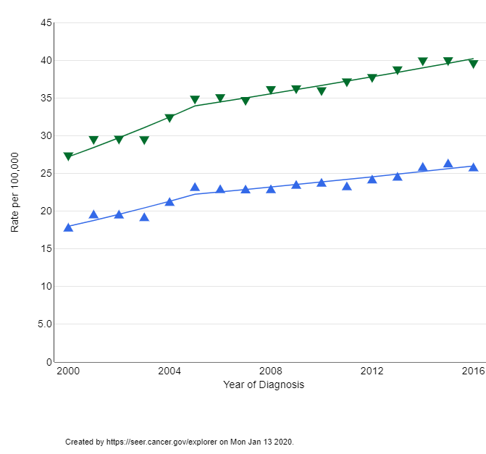
Example: Melanoma
Incidence by gender
MEN
WOMEN
Source: SEER

Slide 10
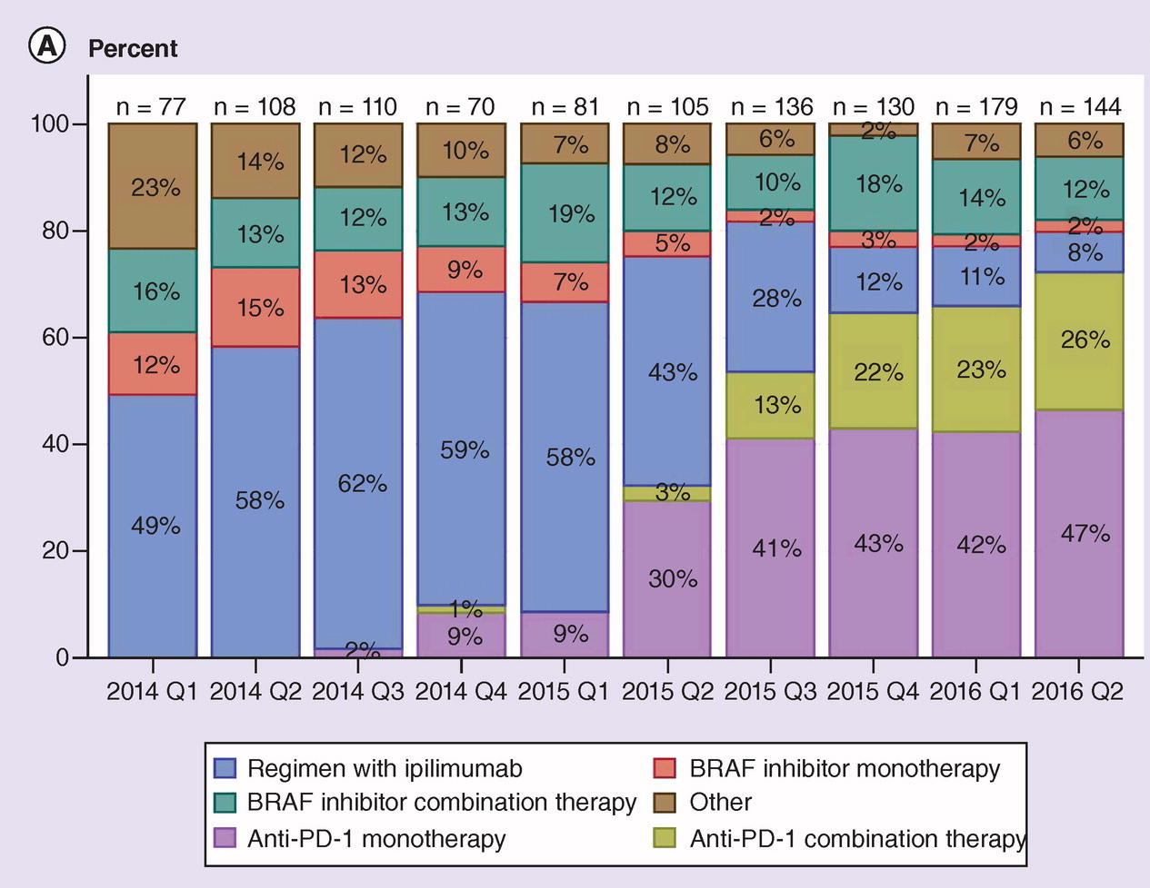
Melanoma
Treatments
2014-2016
Flatiron data: Whitman et al, Future Oncol, Feb 2019

Slide 11
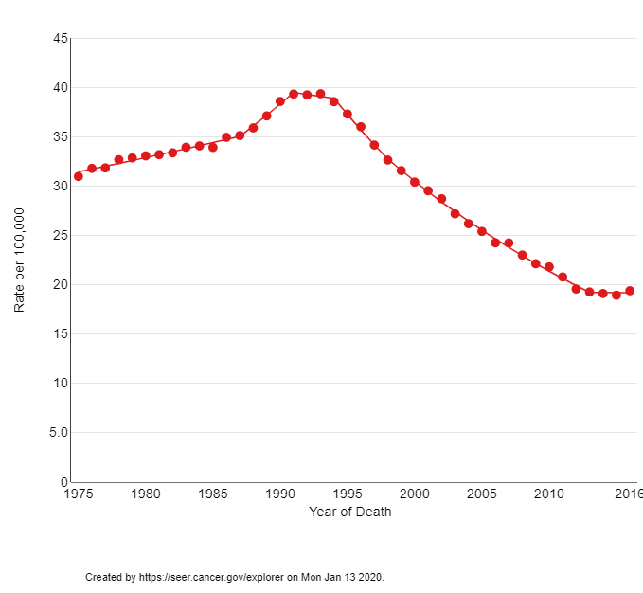
What explains prostate cancer mortality declines?
Age-adjusted Prostate Cancer Mortality
1975-2016
Screening? Treatment?
Both? Other?
PSA SCREENING
STARTS

Slide 12
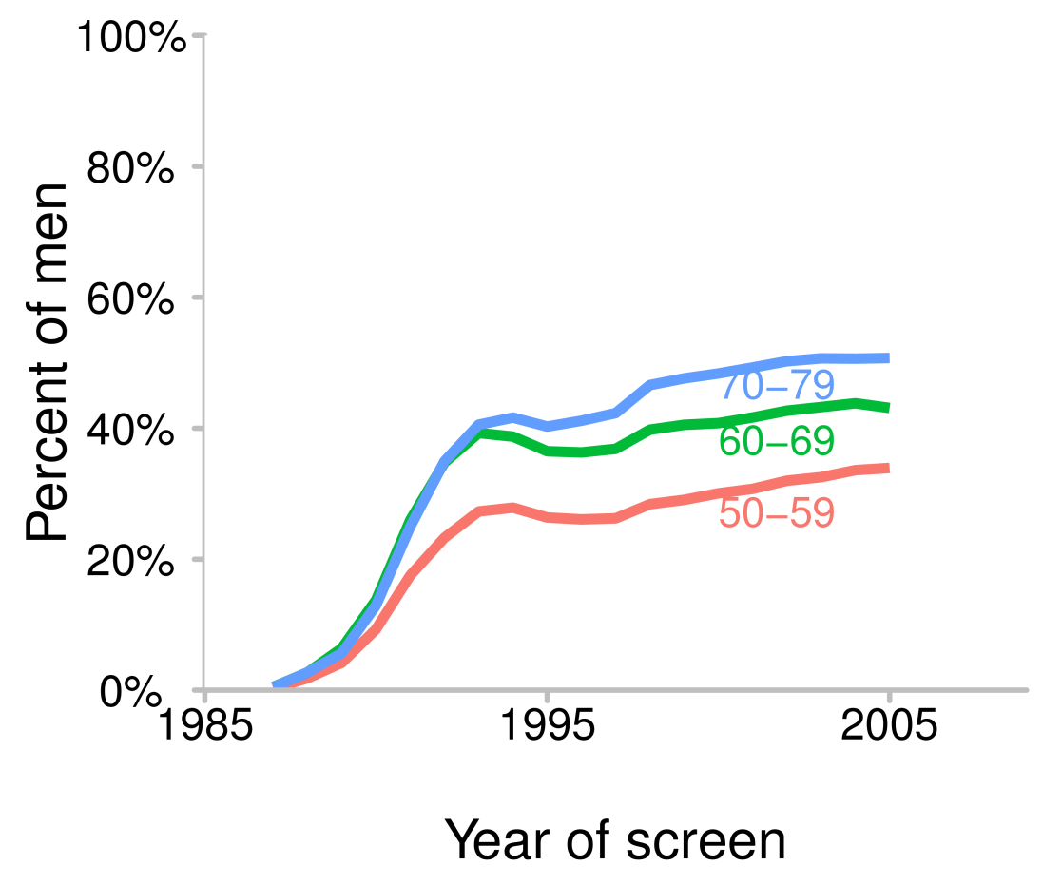
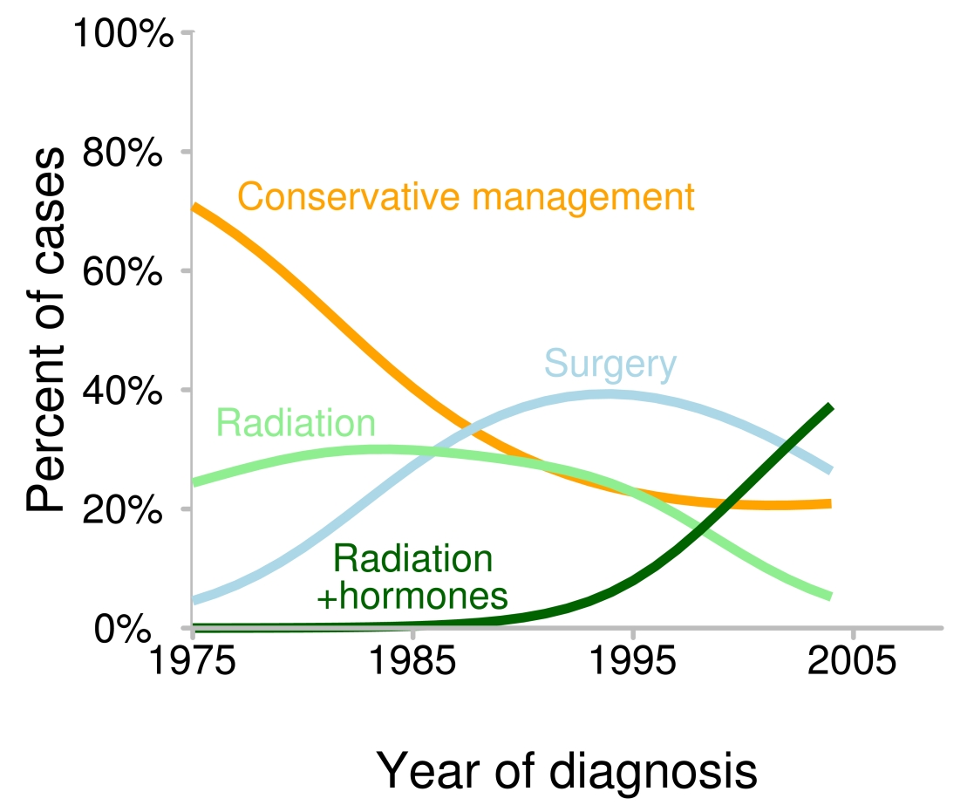
Screening and treatment dissemination
PSA screening
Initial treatments
Mariotto et al., Cancer, 2007: NHIS and SEER-Medicare data
SEER and CaPSURE data

Slide 13
Steps to answer this question
Understand latent incidence and progression (disease natural history)
    Onset
    Stage transitions
    Survival without screening or new treatments
Quantify screening and treatment practices
Superimpose screening and treatment practices on natural history
  Screening → project implied disease stage shift and survival benefit
  Treatment → project implied survival improvement

Slide 14
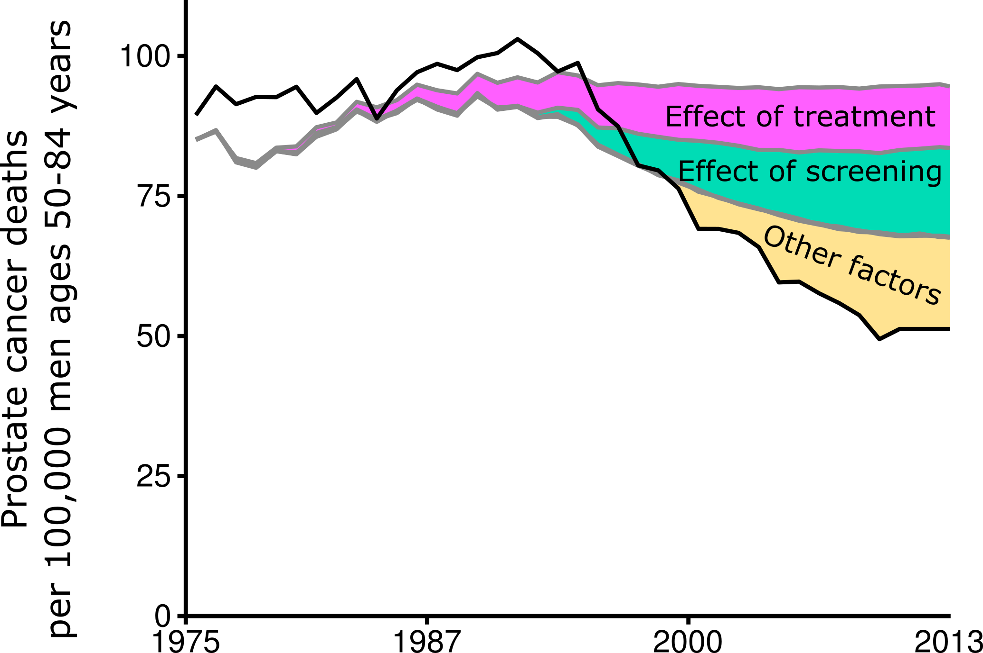

Screening, primary treatment and prostate cancer mortality
FHCRC model

Slide 15
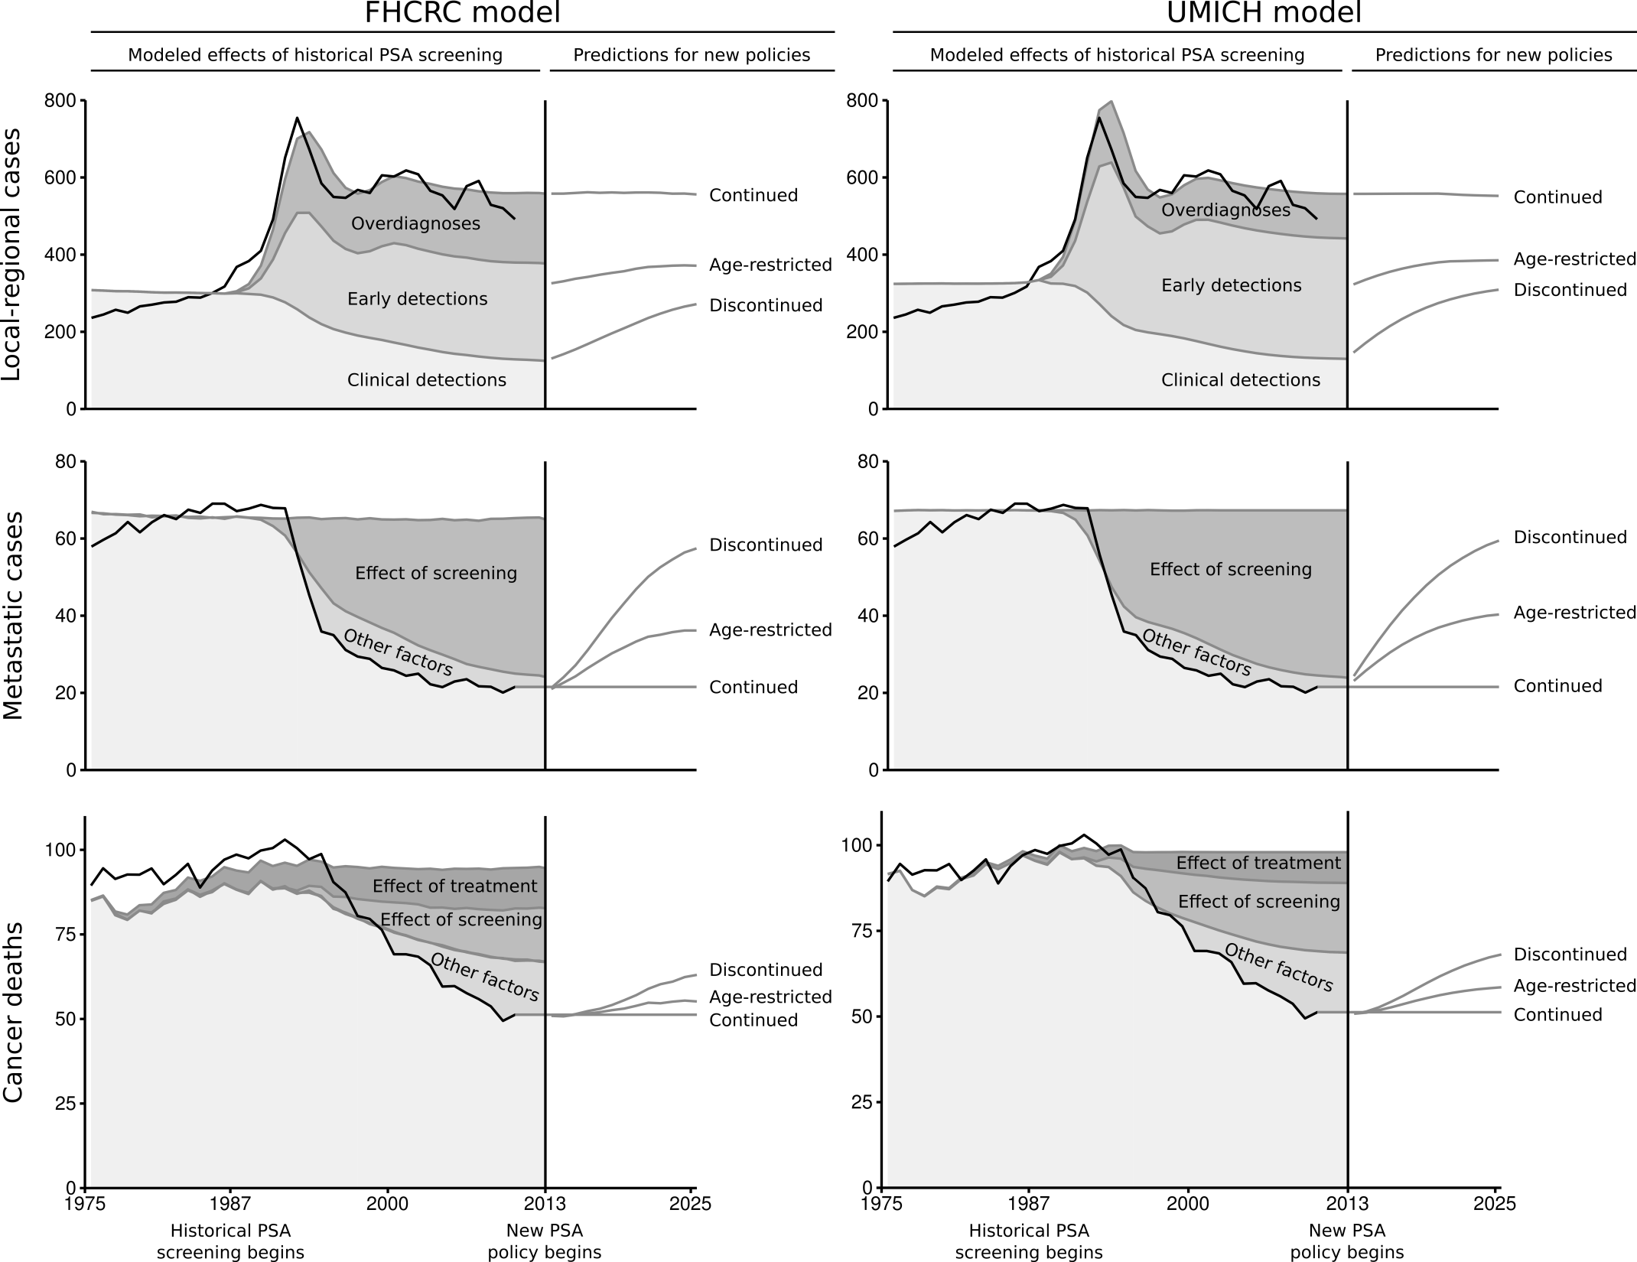
The power of comparative modeling
FHCRC model
UMICH model
Gulati et al, Cancer 2014

Slide 16
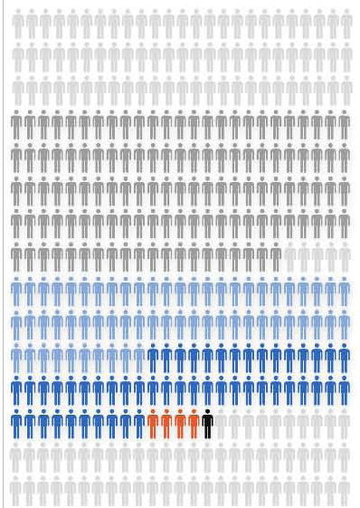
The power of a calibrated model
Level 1 evidence for policy recommendations is frequently lacking
  Age to start and stop screening
  Screening intervals and thresholds
  Tailoring recommendations for high-risk populations
Modeling is a way of conducting “virtual trials”
  Simulate population based on calibrated model
  Superimpose candidate policies
  Project harm-benefit tradeoffs

Slide 17
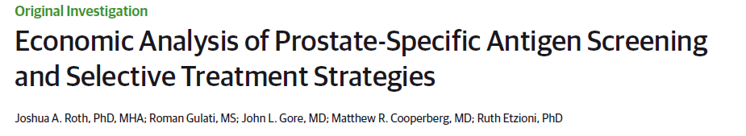
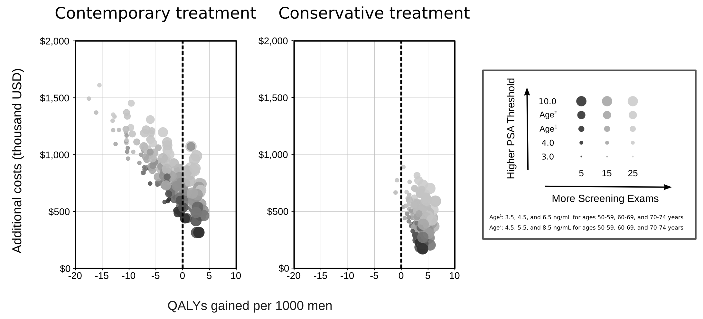
Reduced QOL
Roth et al JAMA Oncology 2016
Preferred strategies are the most conservative!

Slide 18
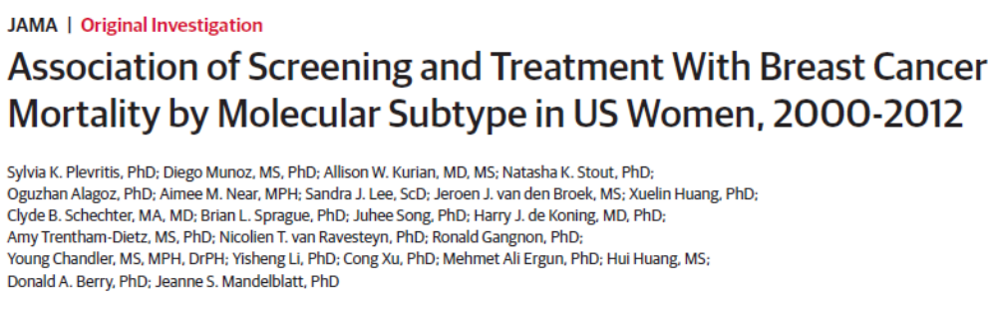
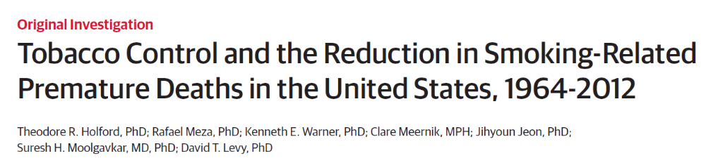
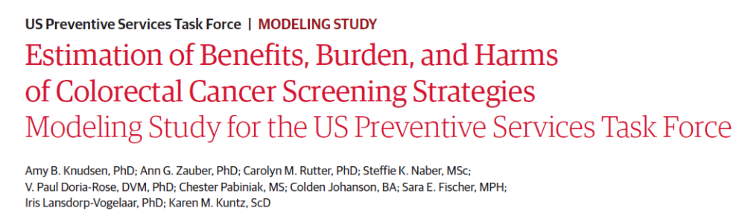
https://cisnet.cancer.gov/

Slide 19
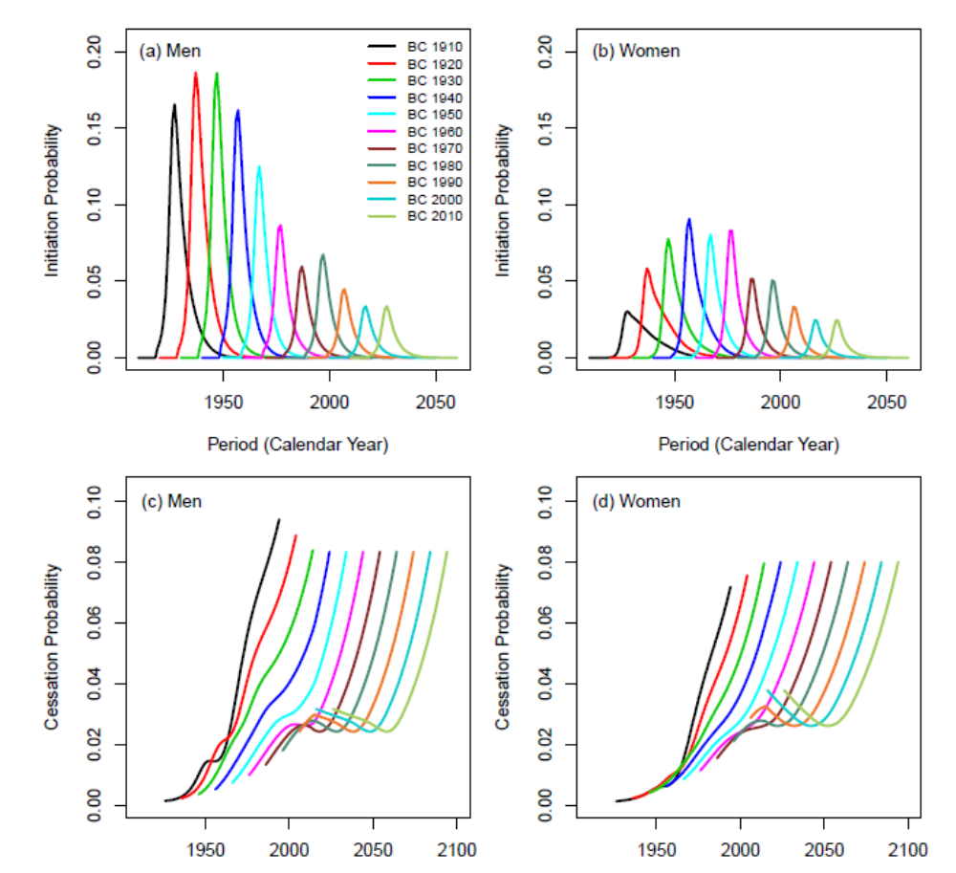
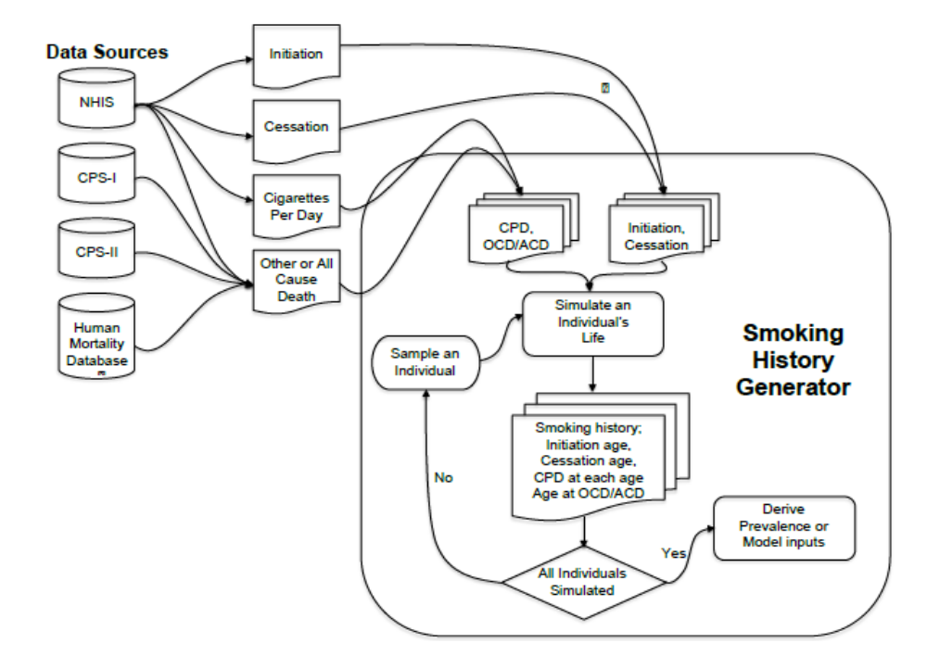
Smoking generator for CISNET lung models
Appendix to Jeon et al, Annals of Internal Medicine November 2018

Slide 20
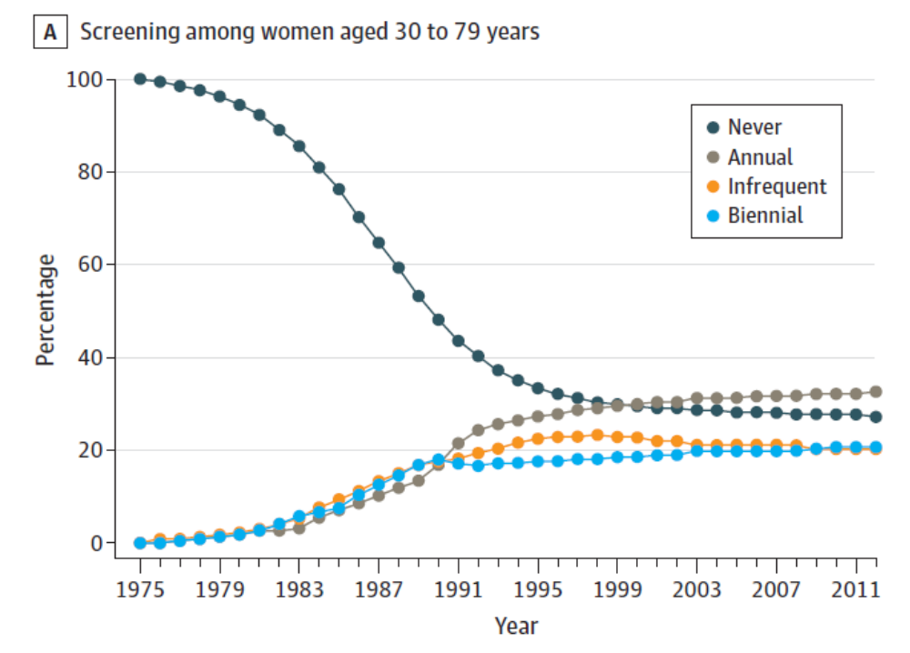
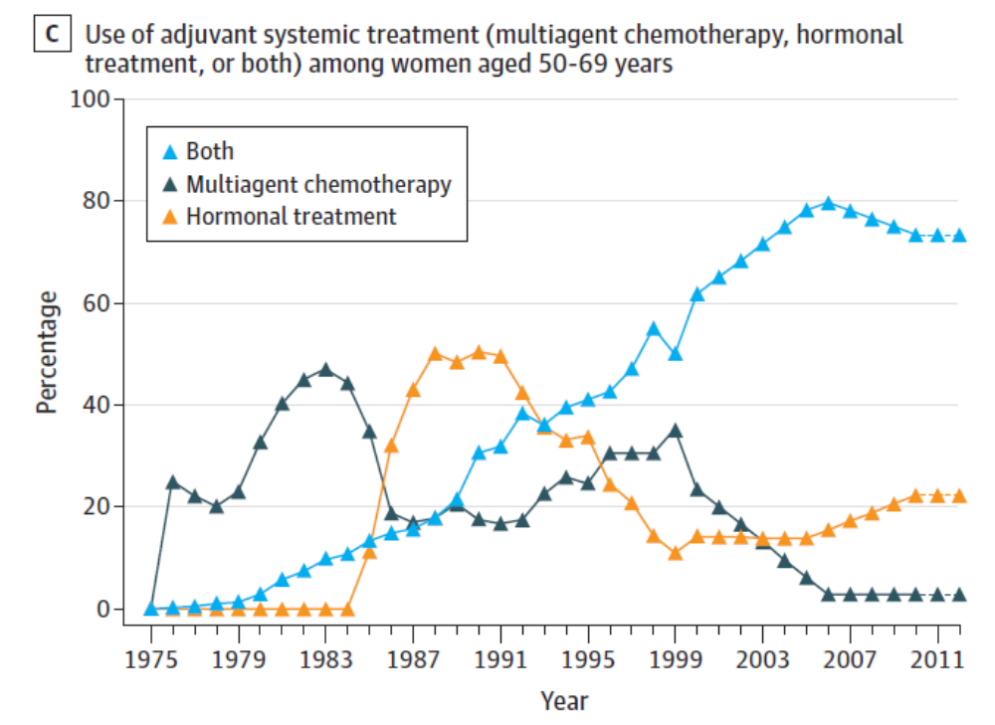
Screening and treatment for CISNET breast models
Plevritis et al JAMA 2018

Slide 21
In conclusion
Cancer trends are a potential treasure trove of information
  Effectiveness of new interventions and treatments on outcomes
  Benefits and harms of novel diagnostic technologies
  Disparities in disease
Cancer trends are also easily misinterpreted
Validly learning from cancer trends requires close study of the patterns of exposure and care driving outcomes

Slide 22
CISNET models driven by practice patterns
Etiology, exposures, behaviors driving disease onset
  Smoking
  Obesity
Early detection and diagnosis
  Screening frequencies
  Biopsy referral criteria and compliance
  Imaging technologies for diagnosis and staging
Treatment
  Primary treatment following diagnosis
  Secondary and salvage treatment following recurrence
  Surveillance following diagnosis

Slide 23
CISNET models driven by practice patterns
Etiology, exposures, behaviors driving disease onset
  Smoking
  Obesity
Early detection and diagnosis
  Screening frequencies
  Biopsy referral criteria and compliance
  Imaging technologies for diagnosis and staging
Treatment
  Primary treatment following diagnosis
  Secondary and salvage treatment following recurrence
  Surveillance following diagnosis

Slide 24
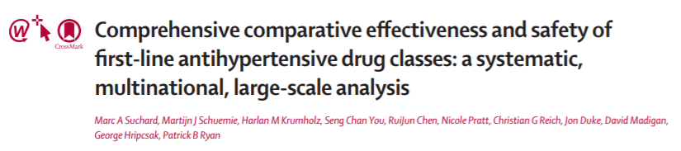
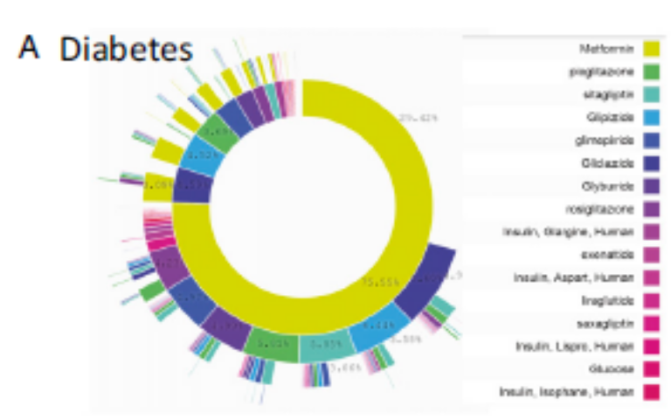
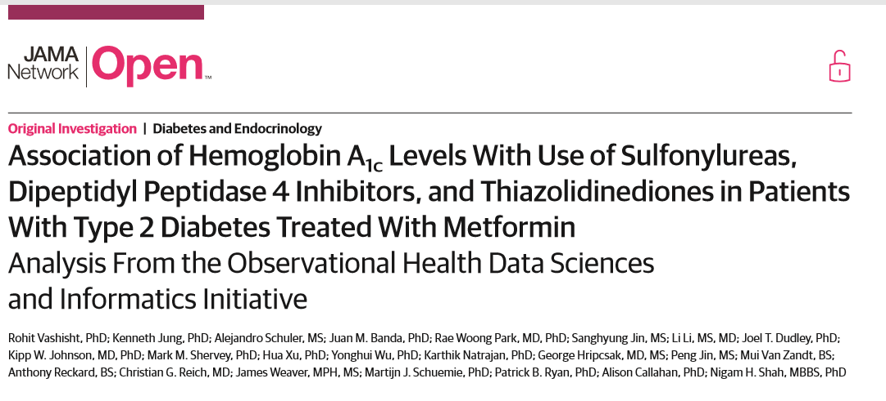
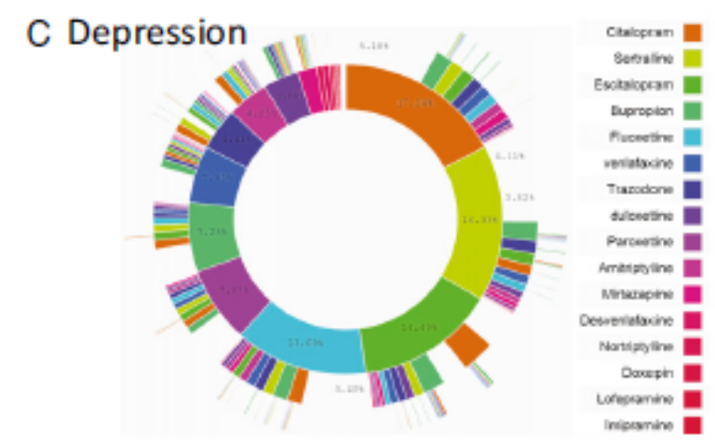
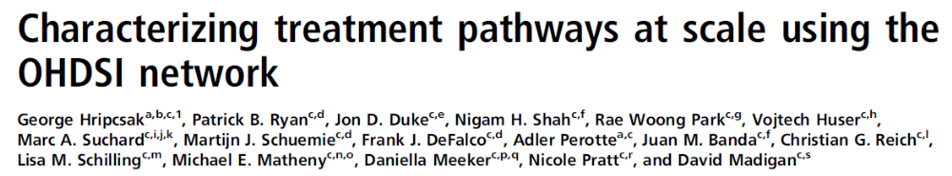
Salivating over
OHDSI

Slide 25
Questions of intense interest
Recent trends in novel androgen-targeting treatments for prostate cancer? Immunotherapies for melanoma?
Changes in dose of radiation therapies and cancer-specific survival?
Changes in imaging technologies used in cancer staging? Has this changed the definition of early versus late stage?
How do hormonal treatments for prostate and breast cancer impact risk of cardiovascular disease and other-cause death?
Distributions of various sequences of therapies for ovarian cancer?
For all of these questions
  Racial/ethnic disparities
  Geographic variation

Slide 26
Discussion
Thank you!
If interested in discussion potential collaborations with the prostate or other CISNET groups please email me!
retzioni@fredhutch.org
CISNET website is at https://cisnet.cancer.gov/
Many thanks to Roman Gulati

