Slide 1



Clinical characterization of the cancer treatment using the Oncology CDM
2020-02-25
Hokyun Jeon, Seng Chan You MD, MS,
Rae Woong Park MD, PhD

Slide 2

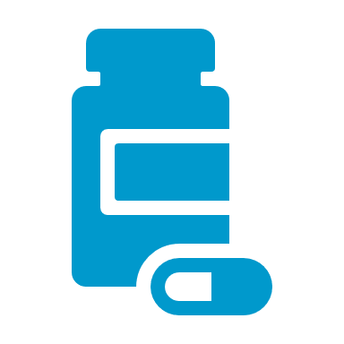
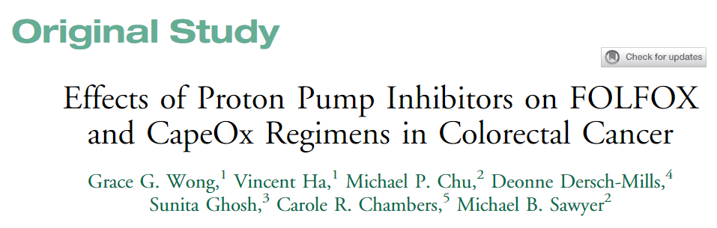
Backgrounds
FOLFOX
FOL - FOLinic acid (leucovorin)
F - Fluorouracil (5-FU)
OX - OXaliplatin
Malignant Neoplasm
X 12 cycles
Cancer patients are treated with combination of the multiple drugs in several cycles.
Treatment studies for cancer patient are based on regimen-level comparison.

Slide 3
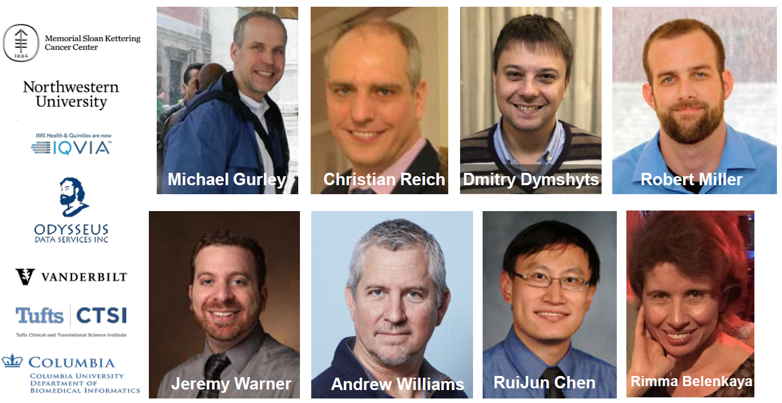
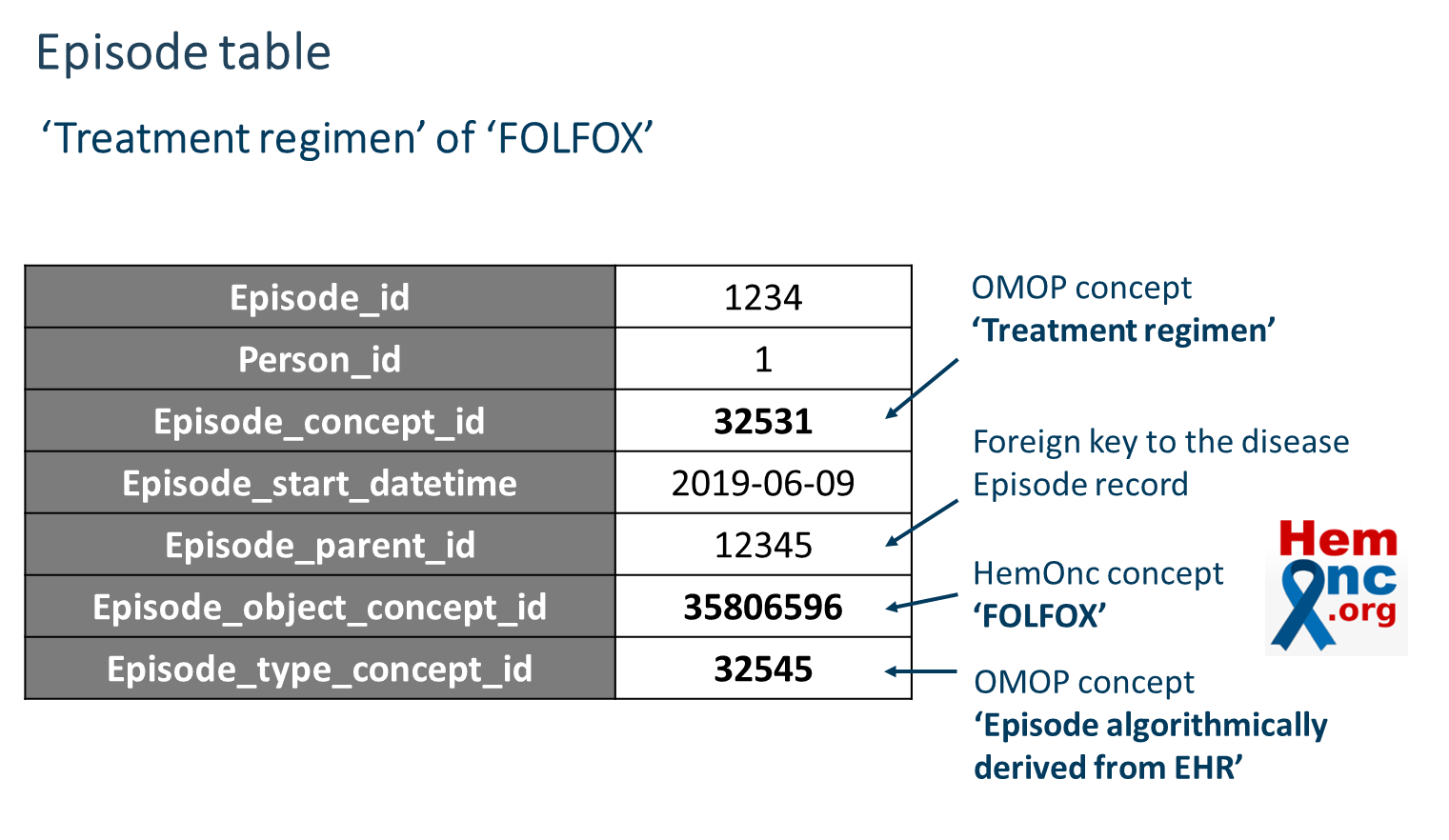
Backgrounds
- Oncology working group proposed Episode / Episode_event table to curate regimen-level records of the cancer patients in Common Data Model.

Slide 4
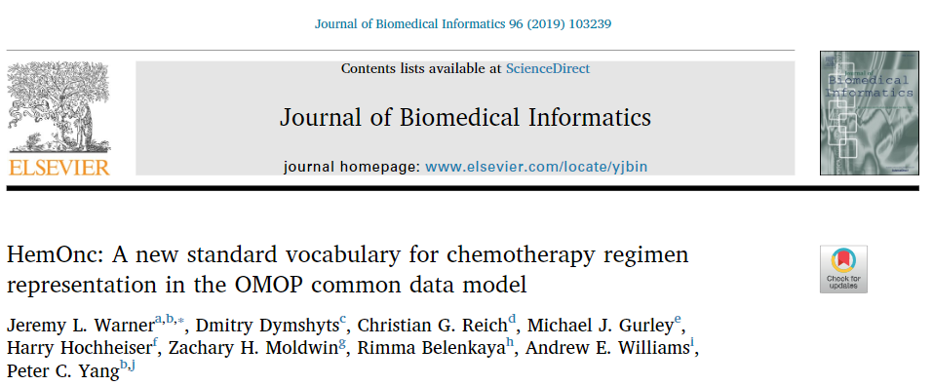
As the standard reference and vocabulary of the chemotherapy regimen, the oncology WG used HemOnc database.

Slide 5
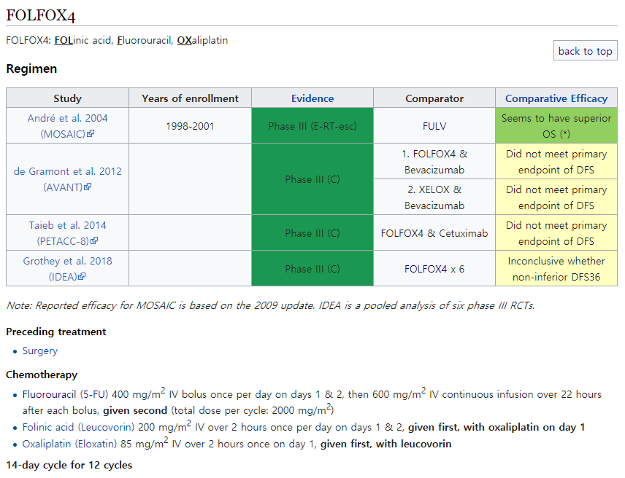
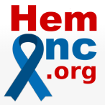
Backgrounds
HemOnc Database includes 3,362 of chemotherapy regimen descriptions.
The composition of the drugs in 1 cycle treatment
Gap dates between each cycle
The recommended number of cycles

Slide 6




Backgrounds
Regimen data in EHRs ..
Although the structure for chemotherapy records are constructed by Oncology WG, it is not easy to extract chemotherapy regimen from Electronic Health Records (EHRs) compared to registry data.
Most of the cases, the chemotherapy regimen descripted in narrative medical notes.
So, manual process is inevitable to extract chemotherapy regimen information from EHRs.

Slide 7
Objective
1. Development of R packages for
A package to extract regimen-level treatment records from EHRs / Claim data.
An R package to generate episode / episode_event table based on extracted treatment.
An R package to visualize of cohort pathways.
- Validation of suggested algorithm
2. Proof-of-concept study:
The onset time identification of the chemotherapy-induced neutropenia after various chemotherapy regimens

Slide 8
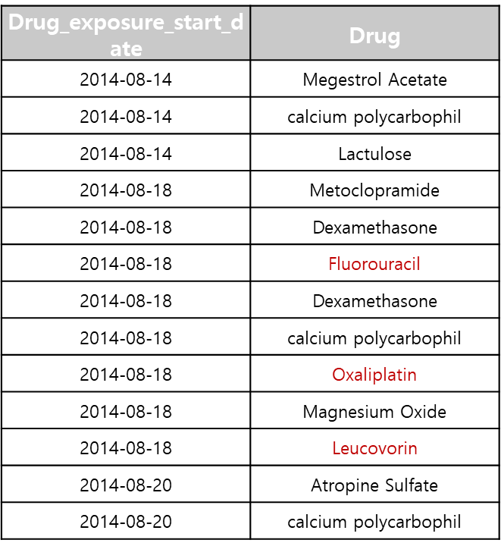
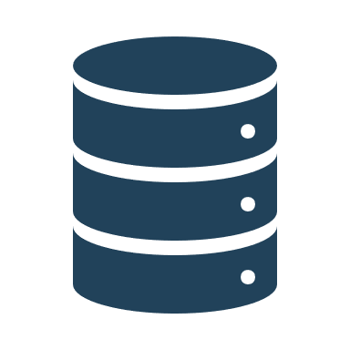


Study Schema
Drug Exposure
Treatment Episode table
 | Episode_source_ concept_id | Episode_ Number | Episode_start_ Datetime | Episode_end_ datetime
FOLFOX | 35804199 | 1 | 2005-10-14 | 2005-10-14
FOLFOX | 35804199 | 2 | 2005-11-14 | 2005-11-14
FOLFOX | 35804199 | 3 | 2005-12-12 | 2005-12-12
We generated an R package for extract chemotherapy regimen records and generate episode / episode_event table from single medication records in the CDM database.
In this package, we used HemOnc database as a reference of the regimen and parameterized the regimen descriptions as a JSON (JavaScript Object Notation) to leverage in the package.
Notes:
구조화된 JSON 형태의 요법 정보를 활용하여 기존 CDM내에 존재하는 단일 약물 기록으로 부터 항암 요법 단위의 record를 생성하여 Oncology CDM에서 제안하는 episode 테이블 형태로 생성해주는 알고리즘을 개발하였다.

Slide 9
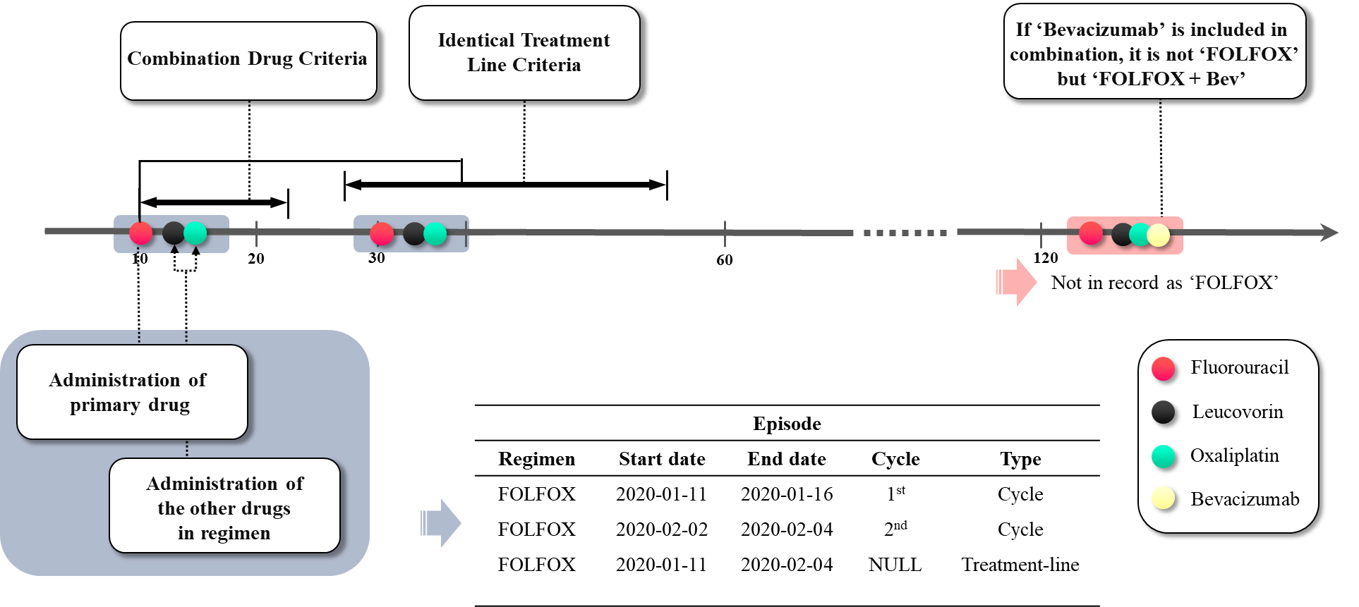
Study Methods
Based on parameterized JSON regimen descriptions, R package extract chemotherapy records considering:
After the dispense date of ‘primary drug’ indexing the first date of chemotherapy, whether the combination drugs of the regimen are dispensed or not.
When each combination of prescribed dates is regard as one cycle, whether the cycles are in the identical treatment line or different treatment line.

Slide 10
Study Methods
We validated this algorithm by manual reviewing the clinical notes of 300 patients with colorectal cancer.
Targeted regimens were FOLFOX, FOLFIRI, XELODA .
We confirmed an accuracy for :
The types of regimen are matched to clinical notes.
The repeated cycle number of each patient is matched to clinical notes.

Slide 11
Study Methods
Colorectal Cancer (n = 3,217)
Breast Cancer (n = 5,924)
Malignant Neoplasm Patients
With Chemotherapy
(1994 ~ 2018)
Visualization
The annual usage change of the chemotherapy regimen in each cancer types (2010~2018).
The trends of the iteration number for the chemotherapy compared to recommended number of cycle in HemOnc database.
Treatment pathway of the cohorts including surgery and chemotherapy.

Slide 12


Study Methods
Chemotherapy treatment
“Neutropenia”
First incidence of the Grade 1 Chemotherapy Induced Neutropenia
(1500 mm³ < Absolute Neutrophil Count < 2000 mm³)
As a proof-of-concept study, we demonstrated the onset timing of the neutropenia.
First, the number of neutropenia patients on each cycle number
Second, the neutropenia onset dates after the first chemotherapy

Slide 13
Study Results
Validation of the chemotherapy regimen extraction accuracy
Treatment Regimen | No Information in Clinical Note | Regimen type Positive Predictive Value | Cycle Number Accuracy | Cycle Difference Average | RMSE
FOLFOX | 8 | 100% | 87% | 0.3 | 0.64
FOLFIRI | 21 | 100% | 88.60% | 0.4 | 1.36
XELODA | 65 | 100% | 69% | 0.65 | 1.5
In all cases, the extracted chemotherapy episode records were matched in regimen types.
The repeated cycle number of the patients were matched with note in average 81.5% cases.
There were only 1 or 2 cycle differences between clinical notes and algorithm results.

Slide 14
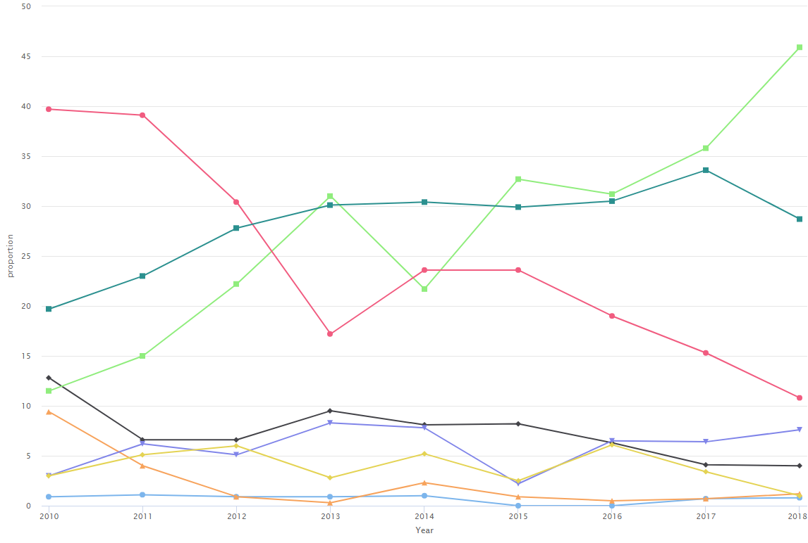
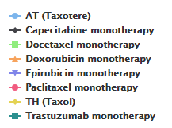
Study Results
The annual usage proportion change of the chemotherapy regimen in breast cancer
- The graph shows the proportion of each regimen usage for total chemotherapy records.
- The proportion of the Docetaxel monotherapy usage in breast cancer patients is increasing and Paclitaxel monotherapy usage is decreasing

Slide 15
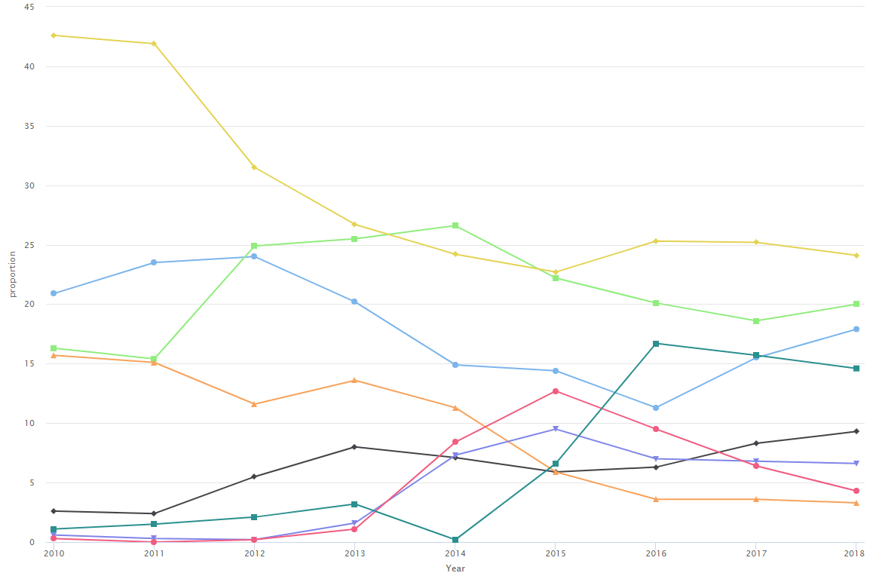
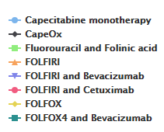
Study Results
The annual proportion change of the chemotherapy regimen in colorectal cancer
- The FOLFOX is the prevalently used regimen for the most part of the years in colorectal cancer, but the proportion of the regimen including biological agents are increasing gradually.

Slide 16
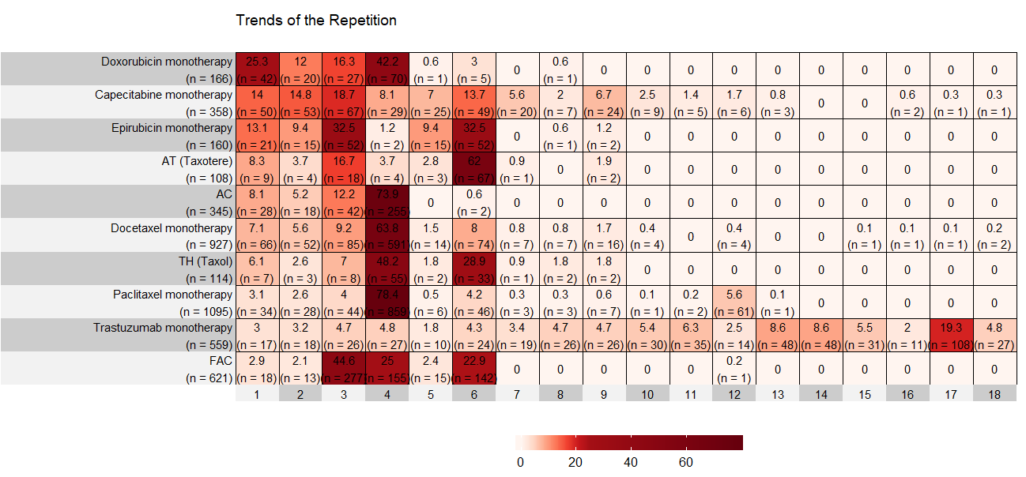
Study Results
The distribution of the patients in iteration number of breast cancer chemotherapy
- The heatmap shows the number of patients in each treatment iteration counts
- Most of the patients who received Doxorubicin monotherapy, AC and Paclitaxel monotherapy were treated 4 cycles of chemotherapy which is a standard regimen iteration number in HemOnc

Slide 17
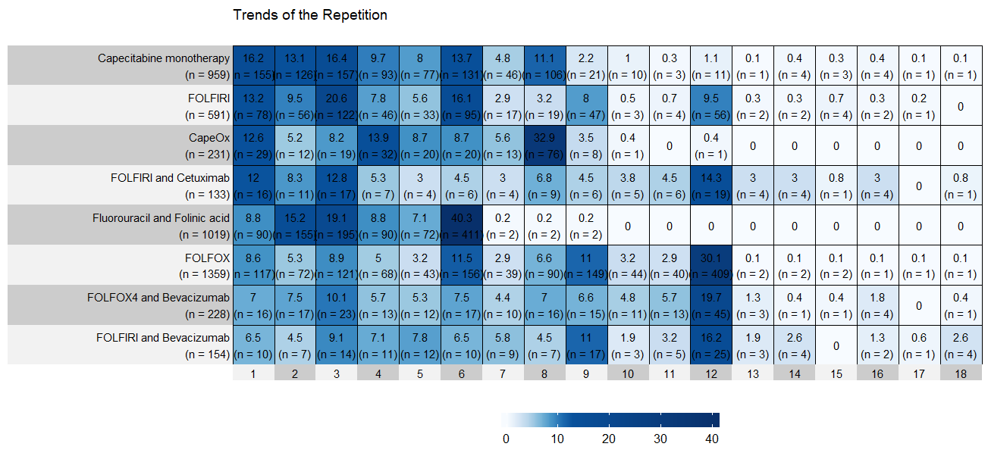
Study Results
The distribution of the patients in iteration number of colorectal cancer chemotherapy
- Also, the iteration numbers of the colorectal cancer regimen are matched to HemOnc recommended cycle iteration number (FOLFOX and FOLFIRI are recommended to 12 cycles).

Slide 18
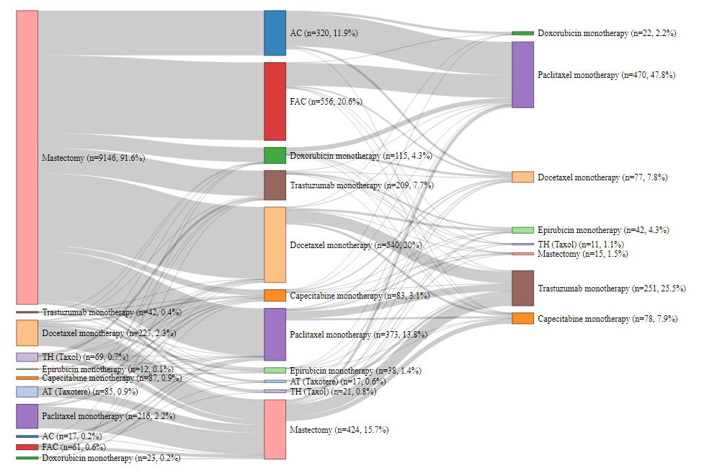
Study Results
Treatment patterns in sequential treatment line of the breast cancer
The flow chart shows which regimen is used as a before and after the surgery
In breast cancer, FAC was frequently used as an adjuvant chemotherapy.
Paclitaxel monotherapy was the most prevalently used neoadjuvant chemotherapy.

Slide 19
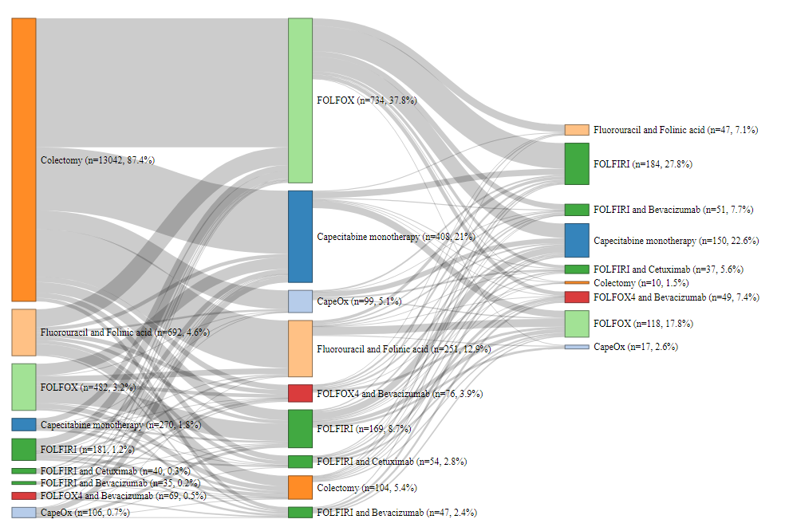
Study Results
Treatment patterns in sequential treatment line of the colorectal cancer
In colorectal cancer, the largest portion of the patients were treated FOLFOX regimen after the surgery
However, patients received Fluorouracil and Folinic acid most frequently before the surgery, which is excluded oxaliplatin from FOLFOX regimen.

Slide 20
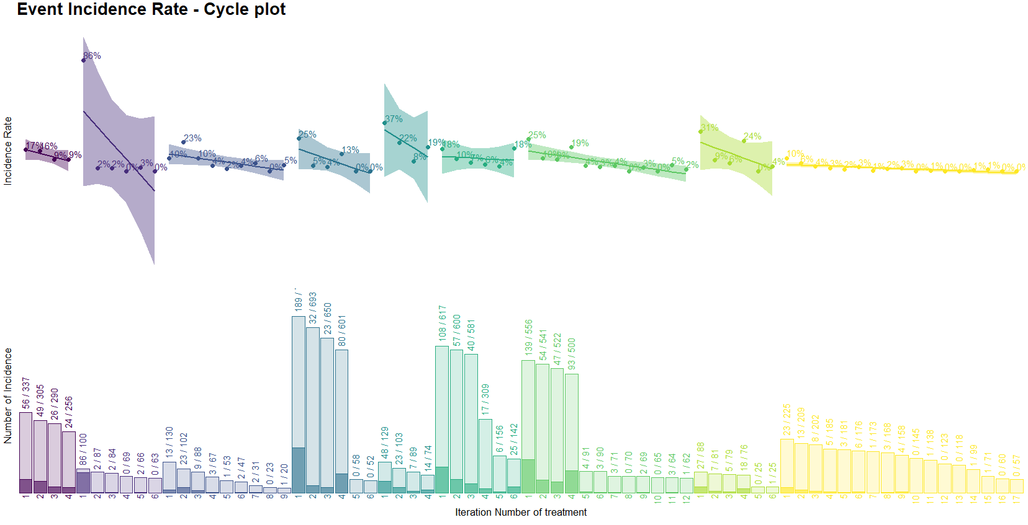
Study Results
The incidence of first neutropenia in each repeated iteration number of the breast cancer
- The chart shows the distribution of the patients for first neutropenia onset cycle of the regimen
- The neutropenia was occurred in large portion after the first AT regimen cycle

Slide 21
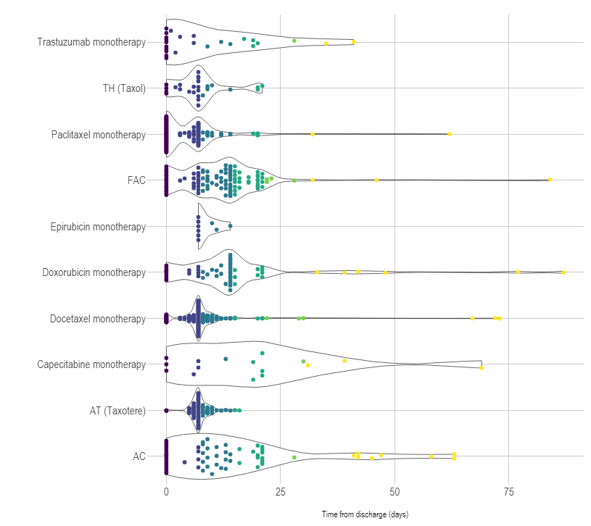
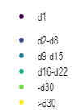
Study Results
The distribution of the patients for neutropenia onset date after the first chemotherapy in breast cancer
The chart shows the distribution of patients for first neutropenia onset date.
The clustered points of the patients are described as a violin plot.
Docetaxel and Paclitaxel included chemotherapy (TH, AT, Paclitaxel monotherapy, Docetaxel monotherapy) induced neutropenia not only D1 also D7.

Slide 22
Conclusions
- We suggested the extraction method for chemotherapy regimen from Electronic Health Records or the other database which is deficient in chemotherapy regimen data
- Based on extracted chemotherapy regimen data, we demonstrated the treatment pathway and patterns of the breast and colorectal cancer
- Also, we suggested the neutropenia onset timing analysis as a proof-of-concept study
All the codes are uploaded on GitHub page (https://github.com/ABMI/CancerTxPathway/
https://github.com/ohdsi-studies/CancerTxPathway).

Slide 23
How can you join in?
Leadership group
  Overseeing the whole project
  Leads: current core group (m-gurley@northwestern.edu, rimma.belenkaya@gmail.com)
  Meetings: monthly
Research group
  Defining use cases, cohorts, phenotypes, consulting other groups on clinical/research matters.
  Leads: Andrew + Christian (awilliams15@tuftsmedicalcenter.org)
  Meetings: monthly
CDM/Vocabulary group
  CDM, vocabulary, ETL conventions issues, Data Quality checks.
  Leads: Rimma + Dima (rimma.belenkaya@gmail.com)
  Meetings: weekly
Development group
  Implementation of ETL, DQ checks, cohorts, algorithms. Help all participating institutions to implement scripts locally.
  Leads: Michael + Robert (m-gurley@northwestern.edu or shilpa.ratwani@iqvia.com)
  Meetings: weekly
Genomic group
  Extending CDM/Vocab to support Genomic Oncology use cases
  Leads: Meera + Chan (PatelM9@mskcc.org)
  Meetings: weekly
Outreach group
  Communicating with standard organizations, collaborators, conferences/publications
  Leads: Andrew + Christian (awilliams15@tuftsmedicalcenter.org)
  Meetings: monthly

Slide 24
Thank you for listening !

