Slide 1
Drug Utilization Study - First line treatment with conventional synthetic Disease Modifying Antirheumatic Drugs in Rheumatoid Arthritis.
Anthony Sena

Slide 2
Objectives
Characterize treatment patterns in newly diagnosed RA population from 2000-2018
Compare treatment patterns observed in real-world data to international guidelines (ACR, EULAR)
Gather evidence internationally via the EHDEN & OHDSI data network

Slide 3
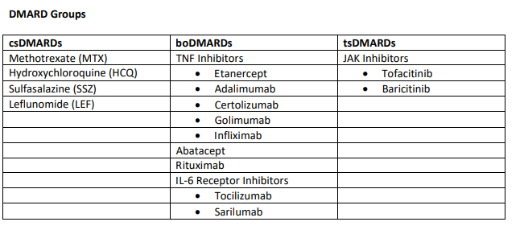
Methods – Treatment Pathways via ATLAS
Target cohort: newly diagnosed RA Patients
Event cohorts: One cohort for each DMARDs + Minocycline (16 total)

Slide 4
Target cohort definition
365d prior observation required
365d post observation time required
Index
End
Patient observation period
- No inflammatory arthropathies any time prior
- No prior RA diagnosis in history
1. Earliest of:
First diagnosis of RA in their history
Exposure to DMARD with RA diagnosis between 0 and 30 days from exposure
2. Age >= 18
3. Event must have occurred between Jan 1-Dec 31 of calendar year *
End cohort membership after fixed duration of 365d from index
* One cohort created for each calendar year (2000-2018)

Slide 5
Event cohort definitions
A cohort for each DMARD and Minocycline were created with a 90 day persistence window *.
* Rituximab used a 365d persistence window with 180d surveillance window

Slide 6
Treatment Pathway Analysis
Analysis Settings:
1. Combination Window: 30 Days
2. Minimum Cell Count: 5 persons
3. Maximum Path Length: 10
Methotrexate (MTX)
Hydroxychloroquine (HCQ)
Event cohorts (DMARDs + Minocycline)
Pathway: MTX -> MTX + HCQ -> HCQ
Index
Time in target cohort
End
365 days

Slide 7
Methods (continued)
ATLAS Pathways Design specification included as part of the OHDSI Study package:
  https://github.com/ohdsi-studies/EhdenRaDrugUtilization
Each site participating in the study ran the analysis using ATLAS on their data
Results were retrieved and packaged using R
Aggregated results were reviewed as a team with eye towards abstract and manuscript authoring

Slide 8
Results
Focused on first-line treatments with conventional synthetic DMARDs for EULAR abstract
Investigated secular trends for first line treatments across all available time per database for ISPE abstract
Notes:
15 DMARDs and Minocycline were included for analyses, but only MTX, Hydroxychloroquine (HCQ), Sulfasalazine (SSZ) and Leflunomide (LEF) were available in all databases.

Slide 9
Study Data Sources
Data Collected: 2000-2018. Data availability indicated per database by min/max year
COUNTRY | DATABASE | DATA COLLECTION | NEW RA PATIENTS | RECEIVED TREAMENT IN 1st YR | % With Treatment | MIN_YEAR | MAX_YEAR
US | AmbEMR | EHR | 193,397 | 84,137 | 43.5% | 2005 | 2018
AU | Australia | GP | 1,645 | 539 | 32.8% | 2008 | 2017
BE | Belgium | GP | 2,163 | 775 | 35.8% | 2009 | 2018
US | CCAE | Claims | 208,355 | 51,409 | 24.7% | 2001 | 2018
ES | Estonia | Inpatient/Outpatient | 6,144 | 1,837 | 29.9% | 2010 | 2015
FR | France | GP | 2,087 | 337 | 16.1% | 2010 | 2018
NL | IPCI | GP | 1,974 | 732 | 37.1% | 2000 | 2017
JP | JMDC | Claims | 24,233 | 3,982 | 16.4% | 2006 | 2018
US | MDCD | Claims | 60,292 | 5,480 | 9.1% | 2007 | 2017
US | MDCR | Claims | 77,175 | 15,093 | 19.6% | 2001 | 2018
US | Optum_DOD | Claims | 226,249 | 37,883 | 16.7% | 2001 | 2018
US | Optum_Panther | EHR | 311,677 | 113,410 | 36.4% | 2007 | 2018
ES | SIDIAP | GP | 14,254 | 1,550 | 10.9% | 2007 | 2016
UK | THIN | GP | 20,812 | 6,383 | 30.7% | 2000 | 2017
 | TOTAL |  | 1,150,457 | 323,547 | 28.1%
Notes:
14 databases, 9 countries with 1.1M new RA patients and 323K receiving treatment in the 1st year from diagnosis. Desp

Slide 10
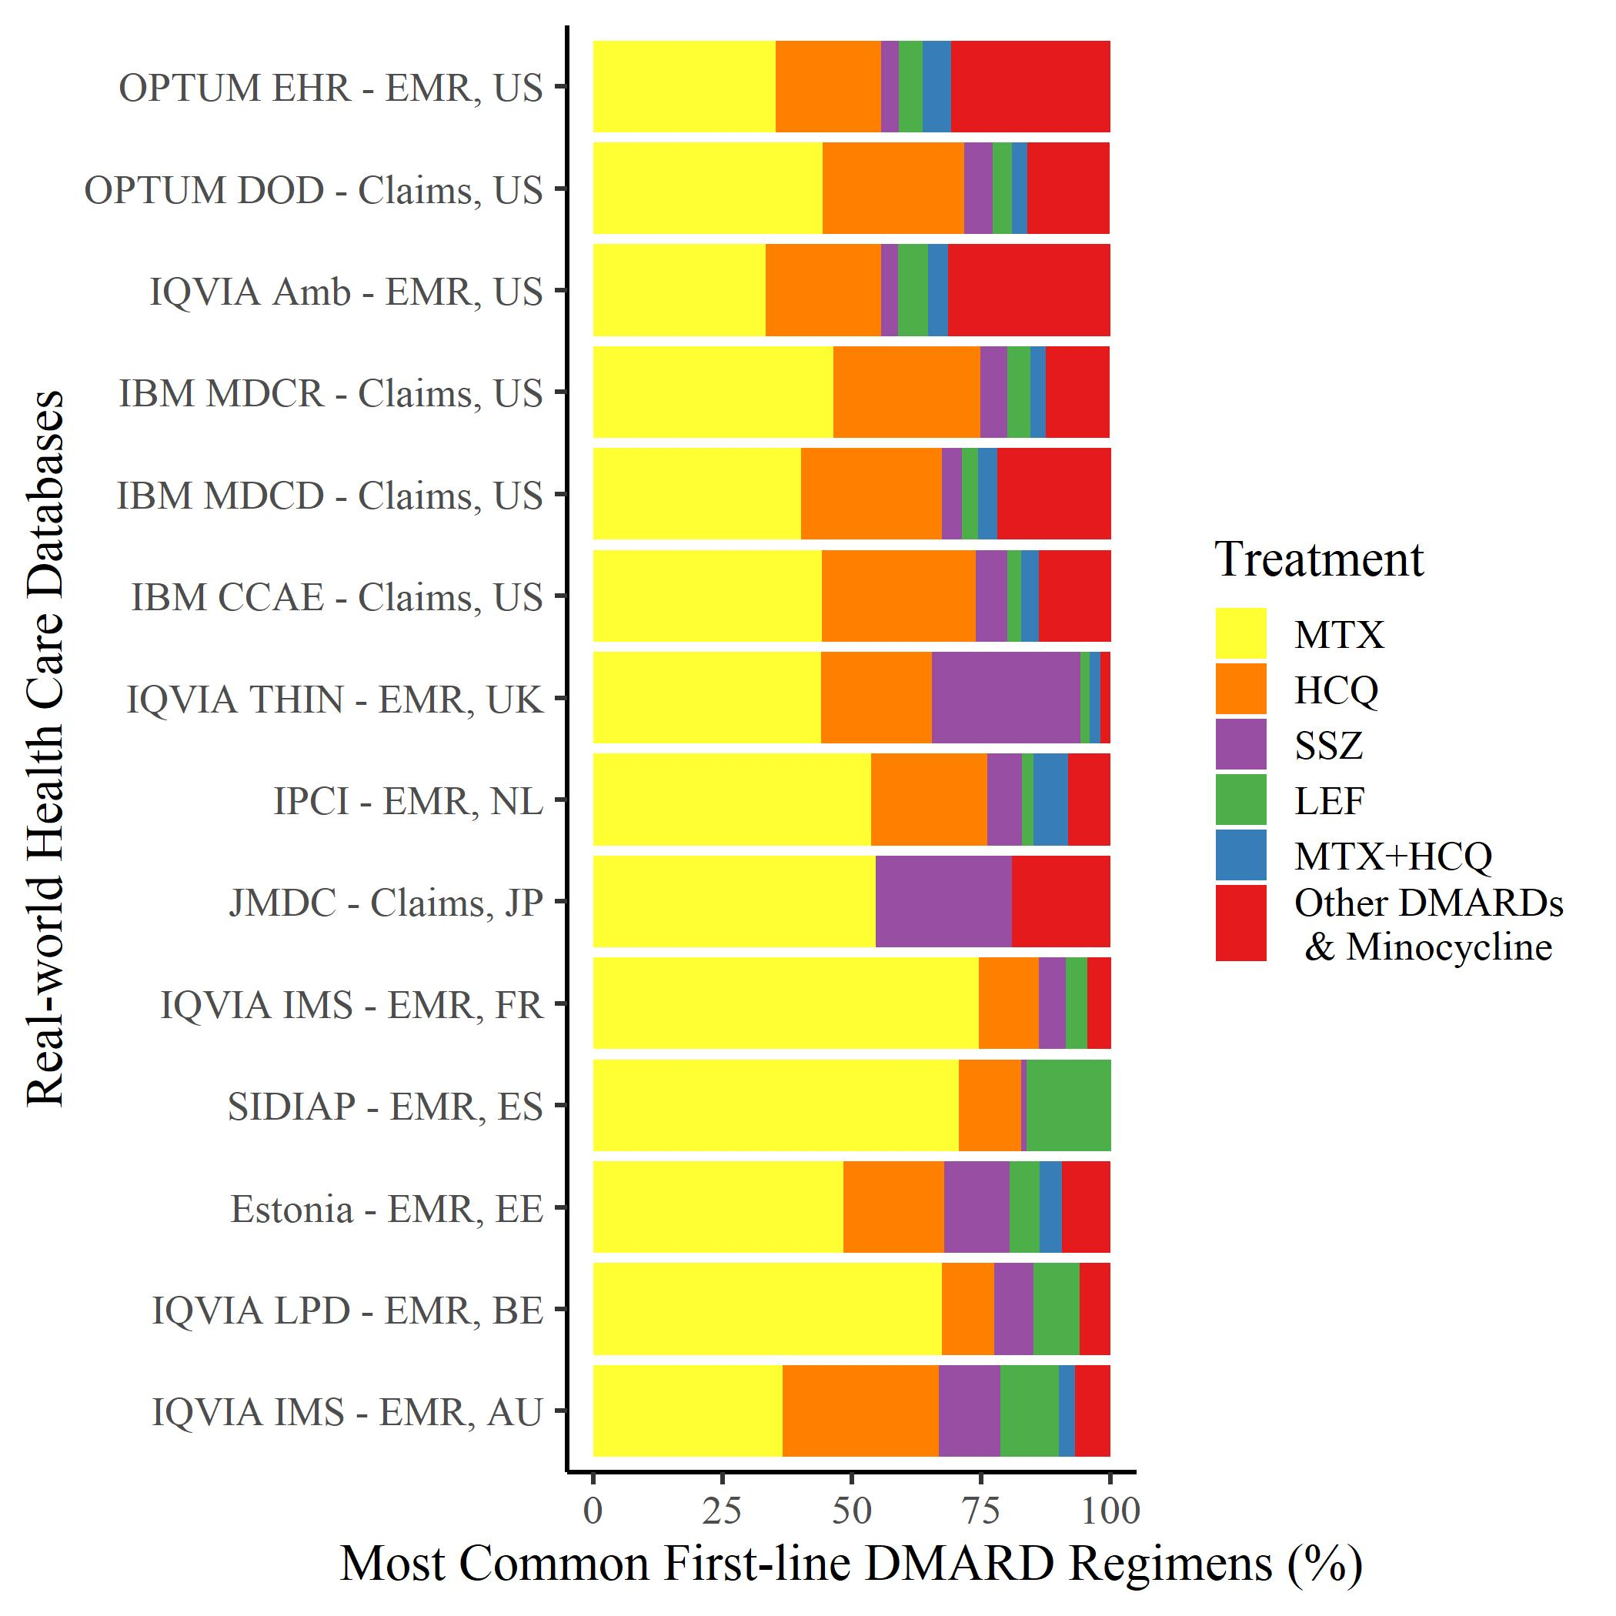
Results – First Line Treatments Overall
Notes:
A large variation between databases was observed (Figure 1). Overall, MTX as first-line monotherapy ranged from 33.3% to 74.5%, and in combination with HCQ from 2.1% to 6.7%. Three additional csDMARDs were used as first-line monotherapy: HCQ ranged from 10.1% to 30.2%, SSZ from 0.9% to 28.7%, and LEF from 1.8% to 15.2%. Despite guideline recommendations for MTX to be first line therapy, data suggest that a large proportion of patients receive another csDMARD. HCQ seems to be used as monotherapy in a significant number of patients, although not recommended in guidelines.

Slide 11
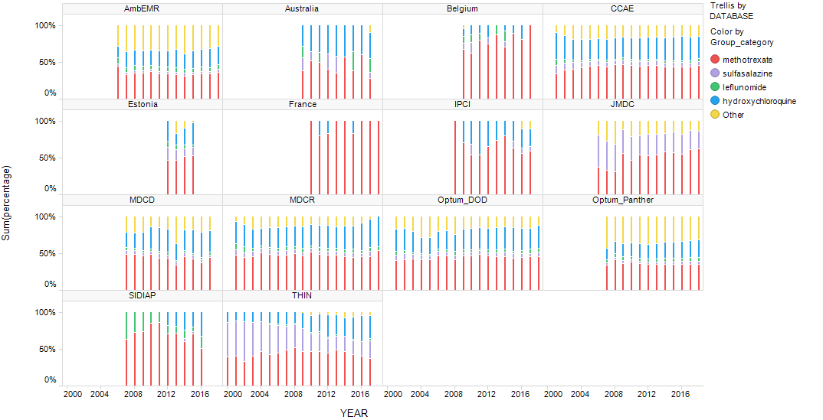
Results – First Line Treatment Secular Trends
Notes:
We identified 323,547 newly diagnosed RA patients with a first-line csDMARD during the first year from the index date. MTX was the most prevalent first-line therapy with a consistent usage across all databases. HCQ was the next most prevalent first-line therapy in Australia, Belgium, Estonia, France, Netherlands, and USA, with LEF as second most used in Spain until 2012 then changing also to HCQ. In the UK, SSZ was the next most prevalent first-line therapy with an increase in patients using HCQ instead of SSZ starting in 2009. Despite consistent guidelines, the use of MTX as a first line treatment remained low (around 50%) in the US, Australian and UK data with no clear change in use over time. Use of MTX as first-line therapy increased in Spain and the Netherlands until 2012, then decreased in favor of HCQ. Belgium and France had the highest % of MTX first-line users, with an increased uptake in the study period. Japan and Estonia had low use of MTX at <50% initially, but slowly increased over time.
We observed evidence of heterogeneity in the management of RA across 9 countries. Despite published guidance for MTX to be first line therapy, data suggest that a large proportion of patients receive another csDMARD. The proportion of first-line MTX initiators has not increased over time despite international recommendations.

