Slide 1
Oral Antibiotic Therapy for Acne
Project leads:
Robert Dellavalle, Professor of Dermatology
Lisa Schilling, Professor of Medicine
University of Colorado School of Medicine

Slide 2
Team
Dermatology Research Fellows:
Chandler Rundle
Chante Aksut
Statistician:
Megan Branda
Participating Sites:
Dylan Ray (U. Colorado Hospital-Health Data Compass),
Sara Deakyne (Colorado Children's Hospital)
Dermatologist advisors:
John Barbieri (U. Penn), Jonathan Silverberg (Northwestern)
David Margolis (U. Penn)
Protocol advisors:
Chris Knoll, Patrick Ryan, Martijn Schuemie

Slide 3
Funding
Pfizer Independent Grants for Learning and Change (PI: Dellavalle) 7/1/18-6/30/20 Inflammatory and Immune-mediated Skin Disease Fellowship
Data Science to Patient Value (D2V)

Slide 4
Goals
Update community on current status
Recruit collaborating sites/partners
Gain clarity on use of clinical vs. claims data
  -? Difference in query design, ? Overlapping patients
Concerns regarding abx prescribing data (clinical data sources) – i.e., use of refill info in prescriptions, definitions ‘courses of antibiotics’
Ensure data request to partners meets their criteria (ie, de-identified data, efficient, SQL dialect)
Ensure we follow OHDSI protocol

Slide 5
Study Objectives
Notes:
To characterize the international distribution of oral antibiotic use, specifically antibiotic type and duration, for acne in two age groups: youth (ages 12 to 20) and adults (ages 21 to 40).

Slide 6
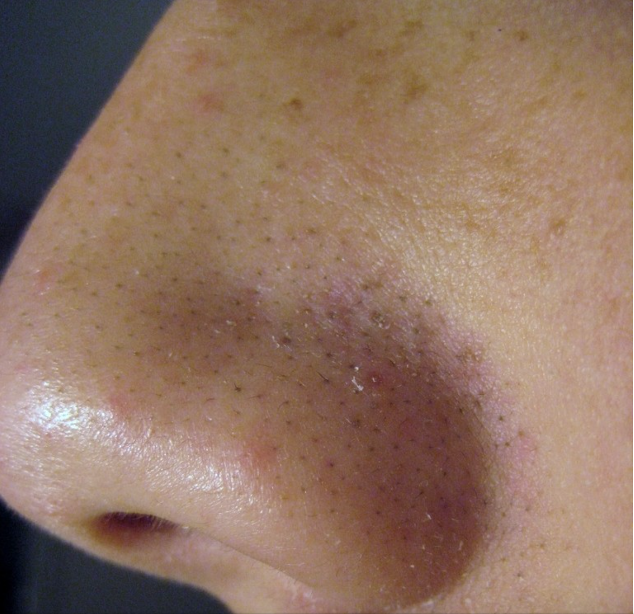
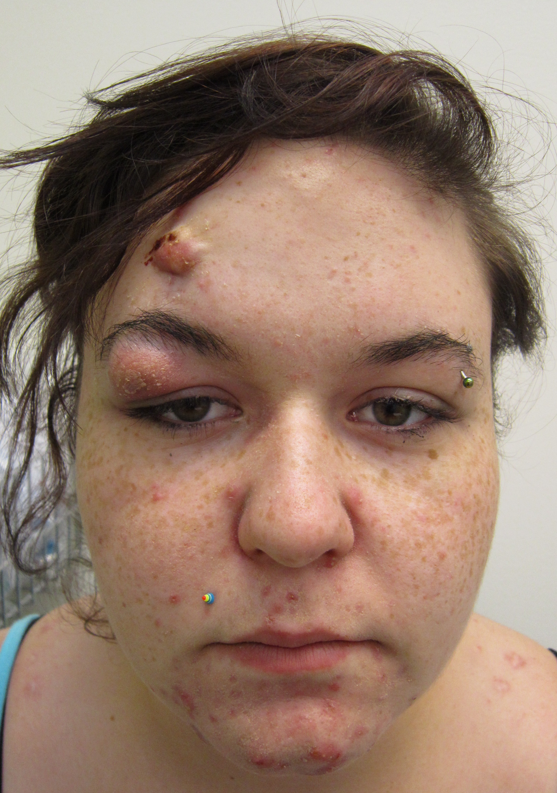
Why take antibiotics?
- Photo credits Wikipedia
Notes:
Why take antibiotics
- Acne is a common and disabling medical condition, particularly amongst adolescents and young adults.

Slide 7
To prevent big nasty scarring pimples!
- Photo credits Wikipedia
Notes:
In addition to physical disfigurement, the profound psychosocial effects of acne have been recognized for over half a century.³

Slide 8
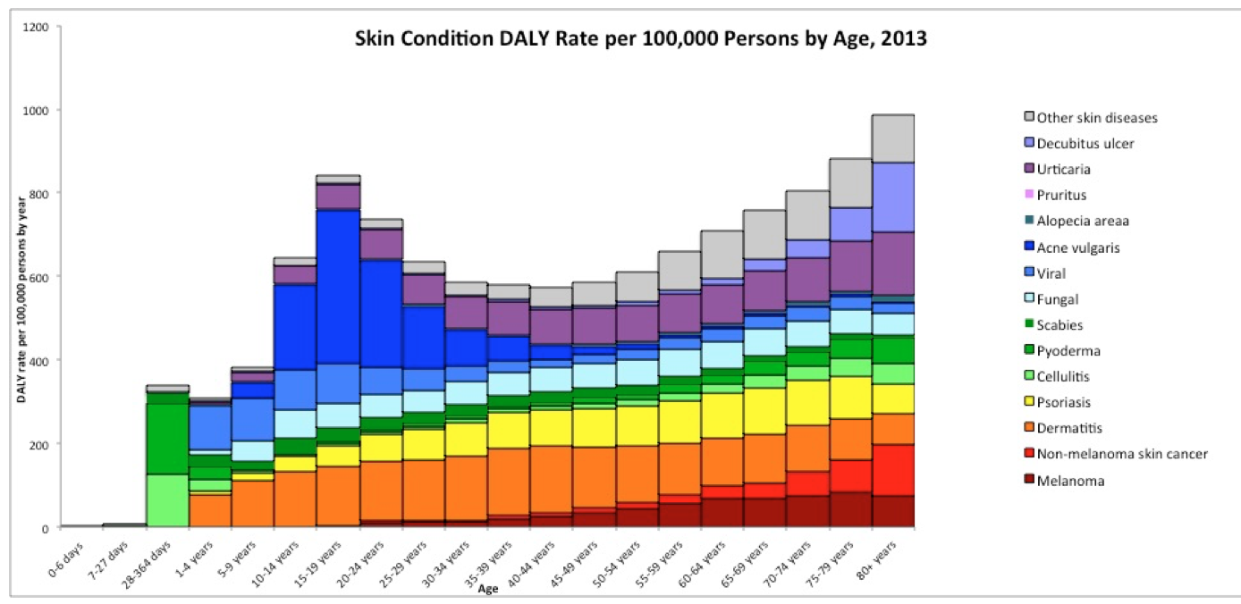
Acne Disability
Notes:
According to the Global Burden of Disease Study 2016, acne is the most disabling skin condition worldwide.²
{Explain what the slide means}
Guidelines established by the American Academy of Dermatology recommend minimizing the duration of systemic antibiotics for the management of acne to the shortest possible duration, ideally to 3-4 months, in order to decrease the risk of bacterial resistance.¹

Slide 9
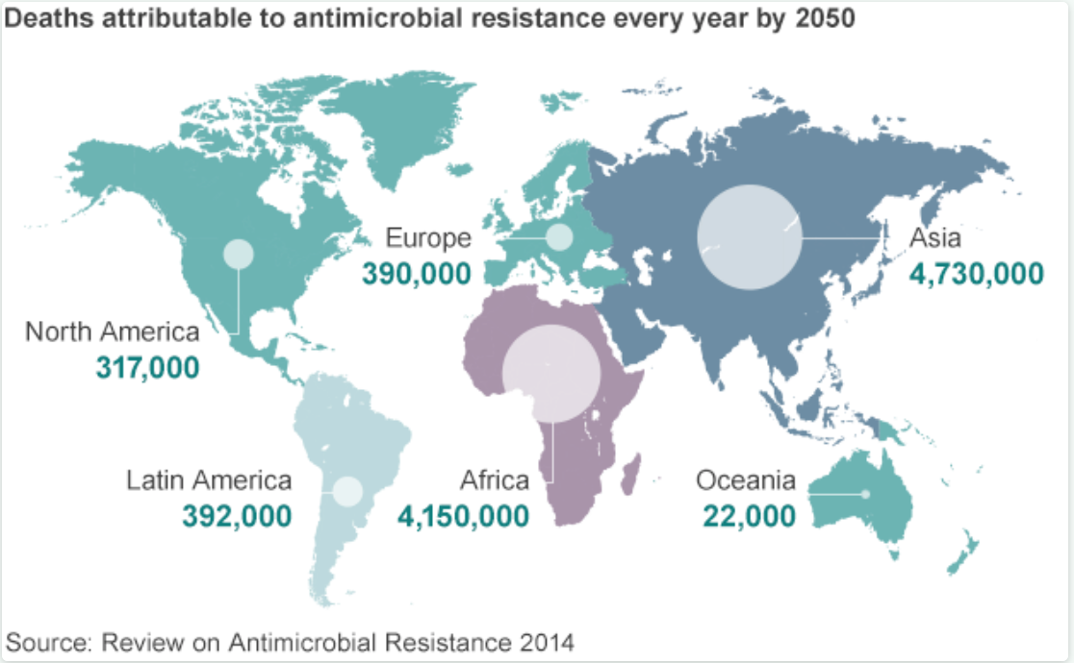
Notes:
A recent systematic review demonstrated that over 50% of P. acnes strains are reported as resistant in all major regions of the world.⁴
2 studies, UK (29%) and US (18%) exceeded 6 months
A large retrospective cohort study of teenagers in the UK revealed that 29% of antibiotic courses prescribed by general practitioners exceeded 6 months in duration.⁵ A similar retrospective cohort study of teenagers and young adults in the US found that 18% of antibiotic courses exceeded 6 months.⁶
Problems
In addition to promoting resistance, long-term oral antibiotic use has been associated with a number of adverse events including microbiome disruption and pharyngitis, as well as possible associations with inflammatory bowel disease and obesity.⁵
Despite these adverse effects, oral antibiotics are often prescribed for acne for longer durations than acne guidelines recommend.⁵

Slide 10
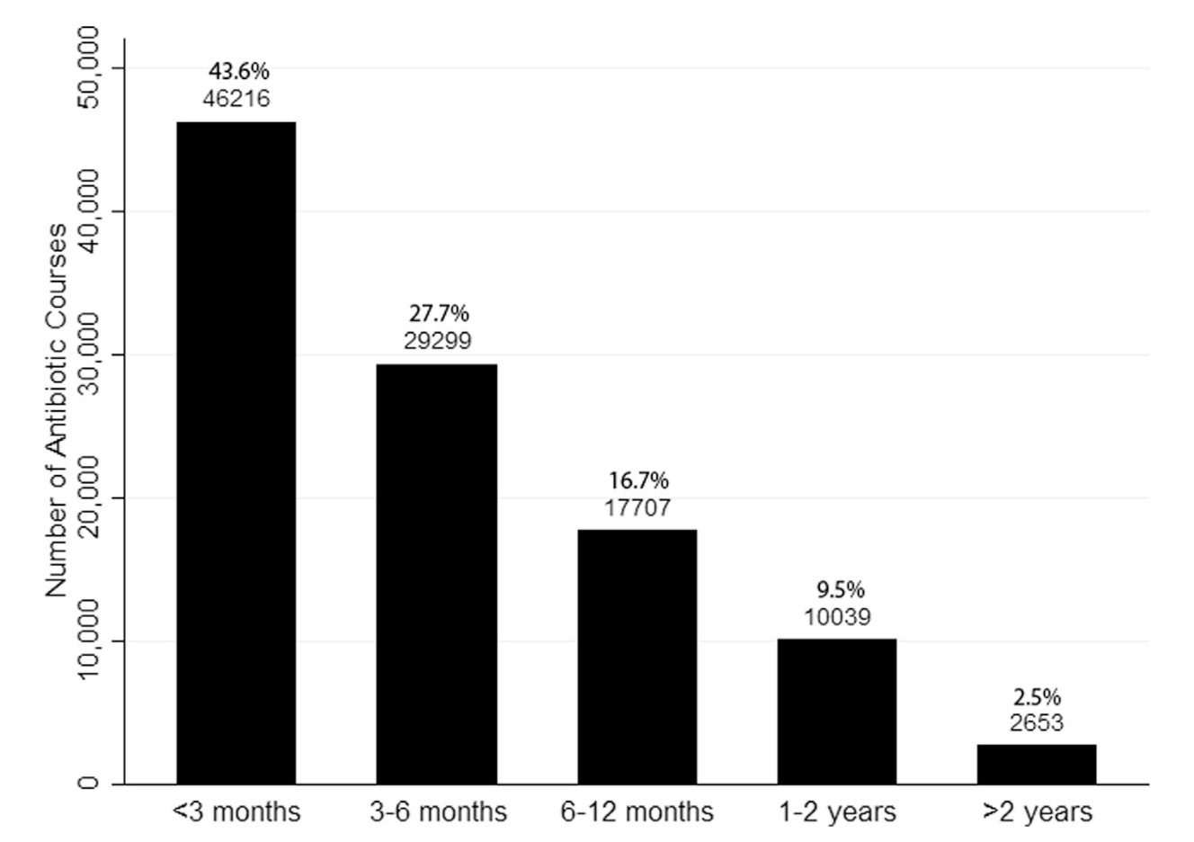
Course Duration
-Barbieri et al, JAAD 2016
Notes:
In a study by Barbieri et al, titled, “Duration of oral tetracycline-class antibiotic therapy and use of topical retinoids for the treatment of acne among general practitioners (GP): A retrospective cohort study"

Slide 11
Hypothesis
Type and duration of oral antibiotic therapy will vary and often duration of courses will exceed guideline recommendations.
Notes:
Our study will investigate oral antibiotic use for acne over the last five years across the globe in both pediatric/young adult and adult populations. OHDSI network evidence will identify areas of the globe most in need of improving guideline concordance.

Slide 12
Methods
Study Design
  Retrospective observational cohort study
Data Sources
  Electronic health record or Claims via the OMOP CDM
  Time period: 1/1/2015 to 12/31/2019
Data Collection
  SQL query
Notes:
Data Sources
Gain clarity on use of clinical vs. claims data
-we’ve only looked at clinical data
-? Difference in query design, ? Overlapping patients
Data Collection
Used Atlas to generate our initial code
Working with Children’s hospital and University of Colorado’s Health Data Compass
Data analysis suggested it may be easier to write code from scratch
Atlas generated code 2-3x longer
Another problem: not straightforward to ask for length of antibiotics
Any tips?

Slide 13
Inclusion Criteria
Age
  Persons between 12 and 40 years of age
Minimum observation period
  ≥12 months
Diagnosis
  Concept IDs representing acne
Notes:
Age
Persons between 12 and 40 years of age during the study period of treatment that occurs between 1/1/2015 and 12/31/2019.
Minimum observation period
Look at Index date: date of first antibiotic prescription for acne
Look at 18 months prior to determine that there are no oral antibiotics prescribed
Inclusion criteria is 12 months, but we will look at 18 months so that patients are not unnecessarily excluded

Slide 14
Inclusion Criteria
Included antibiotic types and start dates
  Sarecycline?
Antibiotic duration
  1 course: ≥ 28 days and < 5 years
  Prescription break of >30 days separates courses
Notes:
Included abx
- Antibiotics not commonly recognized for the treatment of acne will not be captured.

Slide 15
Antibiotic Courses
Notes:
-Diagnosis of acne vulgaris as defined by ICD-9 (706.1) and ICD-10 (L70.0) codes
-Prescriptions with <30 day gap between start or prescription will be considered as being part of one course of therapy
-Start date= date of first prescription
- End date= date of last prescription in series + number of days of medication supplied
- Definition of concomitant retinoid use will be defined as a prescription for retinoid or retinoid/benzoyl peroxide at any point during course of treatment

Slide 16
Exclusion Criteria
Diagnoses that may require long-term antibiotic use
  Folliculitis decalvans, rosacea, etc
Medications known to exacerbate acne
  Hormones, neuropyschotherapeutic drugs, targeted therapies, etc
Oral antibiotic courses > 5 years
Notes:
-folliculitis decalvans [Karimkhani- folliculitis decalvans]
-rosacea [Karimkhani- rosacea]
-Lyme disease [Karimkhani- lyme disease]
-RMSF [Karimkhani- RMSF]
-chlamydia [Karimkhani- chlamydia]
Hormones:
Corticosteroids
Corticotropin
Androgens
Anabolic Steroids
Hormonal contraceptive medications
Neuropyschotherapeutic drugs
TCAs
Lithium
Antiepileptic drugs
Aripiprazole
SSRIs
Targeted therapies
Epidermal growth factor receptor inhibitor
Multitargeted tyrosine kinase inhibitors
Vascular endothelial growth factor inhibitor
Proteasome inhibitor
TNF-alfa inhibitors
Histone deacetylase inhibitor
Courses >5 years
- Outside our study time period and these cases are often attributable to data miscoding

Slide 17
Primary Outcome
To describe type of oral antibiotic prescribed
Duration of oral antibiotic therapy used among patients with diagnoses of acne
Characterize acne antibiotic pathways
Long-term antibiotic class prescribing patterns
Notes:
To describe type of oral antibiotic prescribed
Calculate the count and percentage of courses within a drug class
Duration of oral antibiotic therapy used among patients with diagnoses of acne
Concerns regarding abx prescribing data (clinical data sources) – i.e., use of refill info in prescriptions, definitions ‘courses of antibiotics’
Characterize acne antibiotic pathways
First and second line options for acne
Long-term antibiotic class prescribing patterns
Figure
- Outcomes will be assessed for differences across groups defined as above for age, gender and country. We will report all findings of clinical importance.
- Sensitivity studies will be conducted to determine the sensitivity of our outcomes.

Slide 18
Limitations and Caveats
Coding
  ICD codes
Country-to-country variation in antibiotic use

Slide 19
Protection of Human Subjects
Use of de-identified data
Necessity of ensuring data request to partners meets their criteria
Notes:
Ensure data request to partners meets their criteria (ie, de-identified data, efficient, SQL dialect)

Slide 20
Results Dissemination
OHDSI website
Peer-reviewed scientific journal
Notes:
The study results will be posted on the OHDSI website after completion of the study and published in a peer-reviewed scientific journal.

Slide 21
Study Protocol
Draft protocol now available on OHDSI Wiki

Slide 22
Next Steps
Invite collaborators!
Receive commentary from collaborators
Post finalized code on GitHub
Obtain data from participating sites

Slide 23
Thank You!

