Slide 1
The 2nd EHDEN-OHDSI Study-A-Thon
The true story …
Dani Prieto-Alhambra
Prof of Pharmaco- and Device Epi
University of Oxford

Slide 2
The villain … Rheumatoid Arthritis (RA)

Slide 3
RA
RA affects 0.5-1%
Auto-immune -> antibodies against your own joints (and bones, and vessels...)
Loads of treatments available
Heterogeneity in guidelines (and potentially in care?)
Seymour et al. Arthritis
Research & Therapy 2012 14:R19

Slide 4
EULAR recommendations for the management of rheumatoid arthritis – 2019 Update
Smolen J et al. Ann Rheum Dis 2020 Feb
We knew this was coming…
After 7 years of silence …

Slide 5
EULAR 2019 RA Guidelines: Methods/methodological approach
Methods: According to the EULAR Standardized Operating Procedures*
Consensual approach
A specific SLR on the safety of
the different DMARDs was
conducted …
Systematic literature research
Consensual approach
FINAL Recommendations
* van der Heijde et al Ann Rheum Dis 2016,75:3-15

Slide 6
Just published this week ….
RCT and (loads of) Observational Data ….
But not much on the comparative safety of csDMARDs

Slide 7
Individual Recommendations 1-4
EULAR 2019 RA Guidelines: TOP RECOMMENDATIONS
Recommendations 1-5 – 2019
1. | Therapy with DMARDs should be started as soon as the diagnosis of RA is made. (A)
2. | Treatment should be aimed at reaching a target of sustained remission or low disease activity in every patient. (A)
3. | Monitoring should be frequent in active disease (every 1-3 months); if there is no improvement by at most 3 months after the start of treatment or the target has not been reached by 6 months, therapy should be adjusted. (B)
4. | MTX should be part of the first treatment strategy. (A)

Slide 8
STUDY AIMs
To characterise treatment patterns in rheumatoid arthritis, in actual practice, in as many countries as possible... -> DUS
To assess the comparative safety of alternative first-line csDMARD treatment strategies commonly used in rheumatoid arthritis -> Population-level estimation (PLE)
To predict the risk of safety outcomes for individuals initiating treatment with csDMARDs -> Patient-level prediction (PLP)

Slide 9
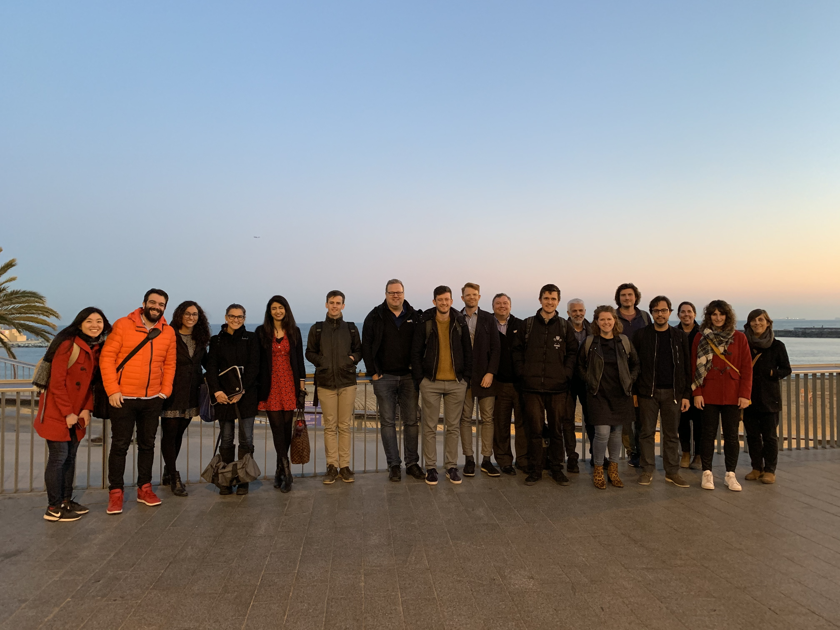
The heroes … a brilliant team!

Slide 10
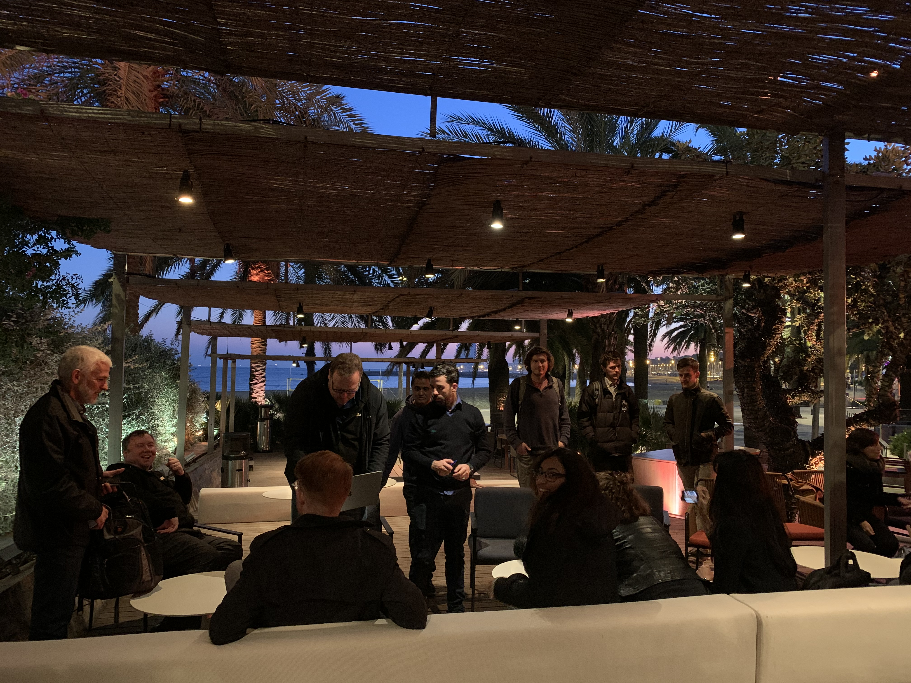
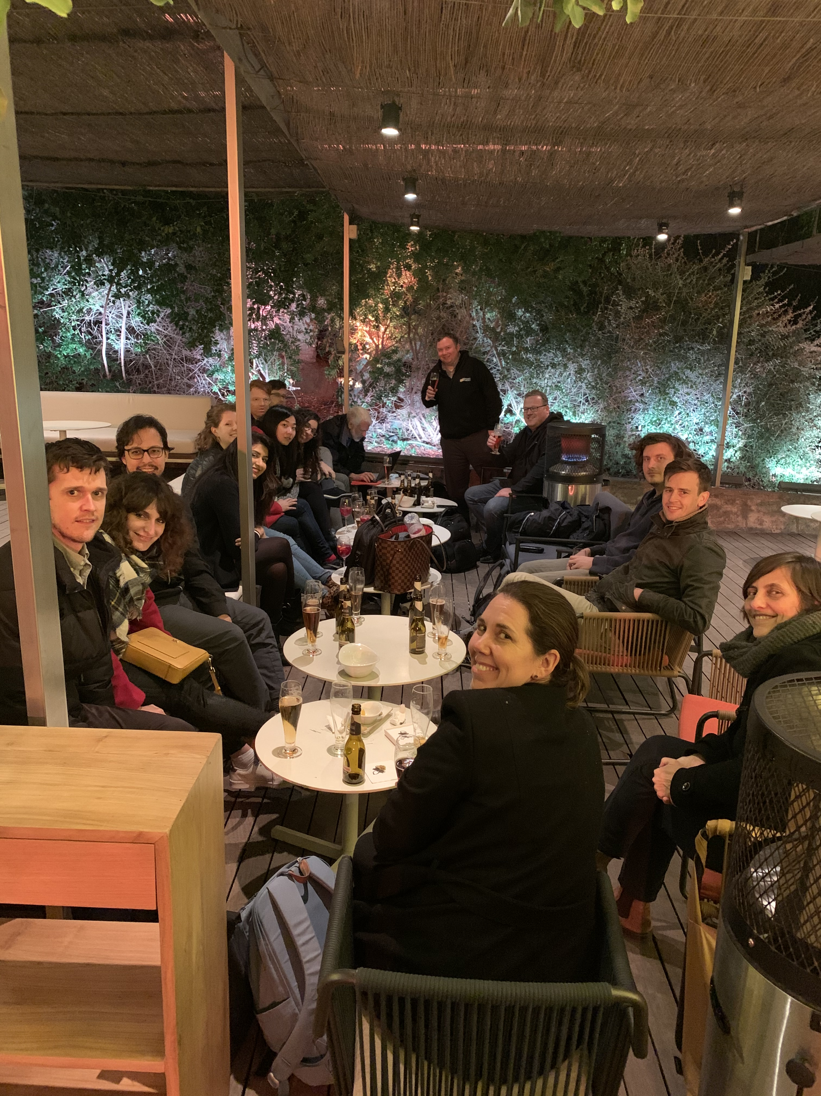
… working real hard!

Slide 11
… working real hard!

Slide 12
Our weapons: tones of awesome data!
IQVIA-provided data in ATLAS:
Country | Dataset Name | Patient #
Australia | LPD EMR | 6.16 M
Belgium | LPD EHR | 2.34 M
France | Disease Analyser EHR | 7.10 M
France | LPD EHR | 7.8 M
Germany | Disease Analyser EHR | 38.7 M
US | Ambulatory EMR | ~73 M
US | Hospital Charge Data Master | 91.4 M

Slide 13
And even MORE data!
EHDEN partners in the room:
    SIDIAP-CMBD (primary care and linked hospital from Catalonia)
    IPCI (primary care from the Netherlands)
    Estonian central e-health database
With remote access for J&J team
    MarketScan CCAE/MDCD/MDCR
    Optum ClinFormatics, Optum EHR

Slide 14
PREP WORK

Slide 15
APPROVED (high level) PROTOCOL
Utilisation and comparative safety of disease-modifying anti-rheumatic drugs (DMARDs) for the treatment of rheumatoid arthritis: protocol for a multi-database real-world cohort study
AUTHORS: Ed Burn, Anthony Sena, Talita Duarte-Salles, Meghna Jani, Peter Rijnbeek, Patrick Ryan, and Dani Prieto-Alhambra + Other contributors/reviewers [tbc]
Previously approved by SIDIAP (ES), IPCI (NL) and THIN (UK)

Slide 16
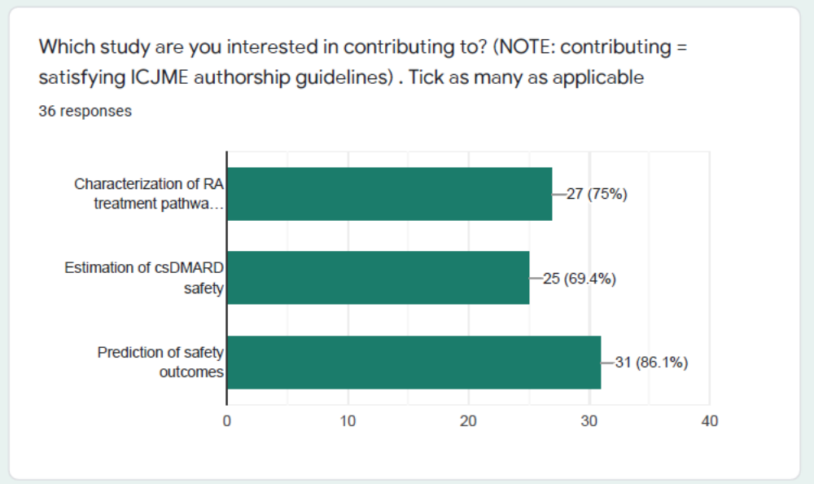
GOOGLE FORM -> Data, Interests, Skills, …
Three teams:
DUS
PLE
PLP
All three of interest (at least to all of us) ☺

Slide 17
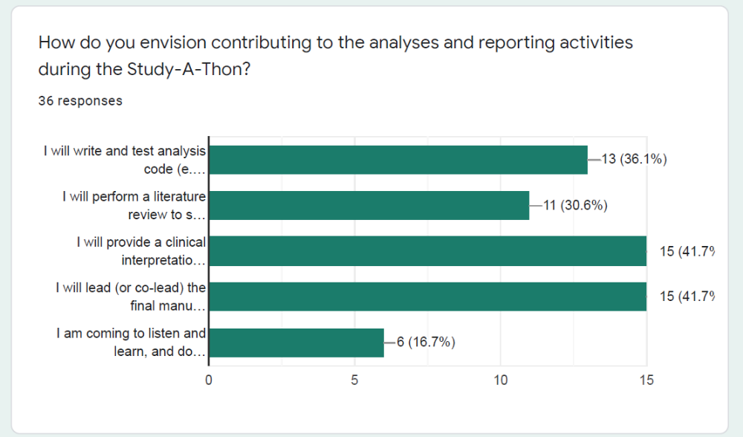
the beauty of multidisciplinary collaboration

Slide 18
Three WORKING TEAMS with clear tasks
DUS -> A Sena
PLE -> Ed + J Weaver
PLP -> Cynthia
Dani + Patrick to lead DUS/PLE
Peter (Rijnbeek) to lead PLP
Volunteers to co-lead (left) will be recognised as first/joint first authors

Slide 19
TEAMS and TASKS - DUS
Dani/Patrick to co-ordinate
A Sena to lead/co-lead abstract+paper
DN and NH -> literature review AND writing of Background
KV and KC -> clinical interpretation AND Discussion/Conclusions
A Sena, C, Y -> R coding/analytics AND Methods and Results

Slide 20
TEAMS and TASKS - PLE
Dani/Patrick to co-ordinate
Ed Burn and James W to lead/co-lead abstract+paper
AP, R, DV -> literature review AND writing of Background section
L, D, JL, EB -> clinical interpretation AND Discussion/Conclusions
James W, Ed B, R, H to lead on R coding/analytics AND writing of Methods and Results

Slide 21
TEAMS and TASKS - PLP
P Rijnbeek to co-ordinate
Cynthia to lead/co-lead abstract+paper
A, W, E, L-> literature review AND writing of Background section
W, M, T > clinical interpretation AND Discussion/Conclusions
C, W, J, S, R -> R coding/analytics AND Methods and Results

Slide 22
The AGENDA WE DID NOT FOLLOW…
Monday 13/01/2020
Introduction to ATLAS & clinical problem
Cohort definitions for 1 vs 2/3
Review of cohort/s and start DUS
Finalise study protocols
Wednesday 15/01/2020
PLE diagnostics and further analytics
Finalise PLP design
Draft DUS abstract/s and manuscript/s
Friday 17/01/2020
Final tweaks, conclusions, outputs
Plan/s for completing publications
Closure
Tuesday 14/01/2020
Review DUS
Finalise PLE design
Registration of final protocols (EU PAS)
Thursday 16/01/2020
Review PLE and PLP results
Draft PLE and PLP abstracts and manuscripts
(EHDEN-OHDSI 2nd Study-a-thon, Barcelona, January 2020)
Notes:
The Oxford Study-a-thon is a brilliant example of the power of what we can achieve – it took only five days to produce a Lancet paper.
Similarly, it's EHDEN's goal to speed up the analysis process, whilst ensuring a high level of quality – and this higher efficiency is one of the core aspects that underpins define our mission, vision & values. Include link to webinar (QR code?)
Go to next slide...

Slide 23
TO BE CONTINUED ...

