Slide 1
EHDEN Study-a-thon 2020
Patient-Level Prediction Study
Ross Williams
Development and validation of patient-level prediction models for adverse health outcomes amongst adult RA patients initiating first-line treatment of methotrexate monotherapy: a multinational real-world cohort analysis including 164,735 subjects

Slide 2


Motivation
EULAR guidelines recommend the early initiation of methotrexate (MTX) monotherapy as soon as possible after the diagnosis of rheumatoid arthritis (RA).
Mentions infections as the main side effect of DMARDs
  Discusses using risk scores to stratify patients and provide more personalised treatments.
https://ard.bmj.com/content/annrheumdis/early/2020/01/22/annrheumdis-2019-216655.full.pdf

Slide 3
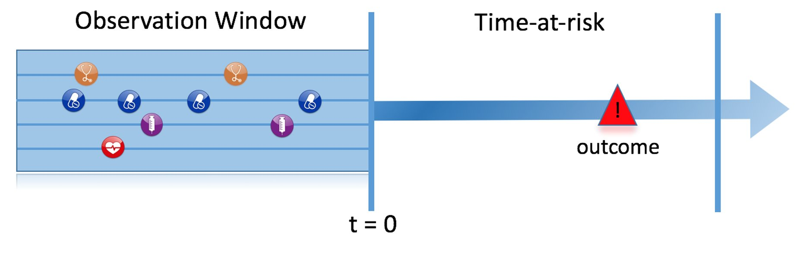
Problem Specification
Index date: New init. of MTX therapy
: 3m, 2y, 5y
Leukopenia, Pancytopenia,
Infection (serious, opportunistic, all)
MI and Stroke
Cancer (breast, colorectal, uterus)
Min. 365 days observation period

Slide 4
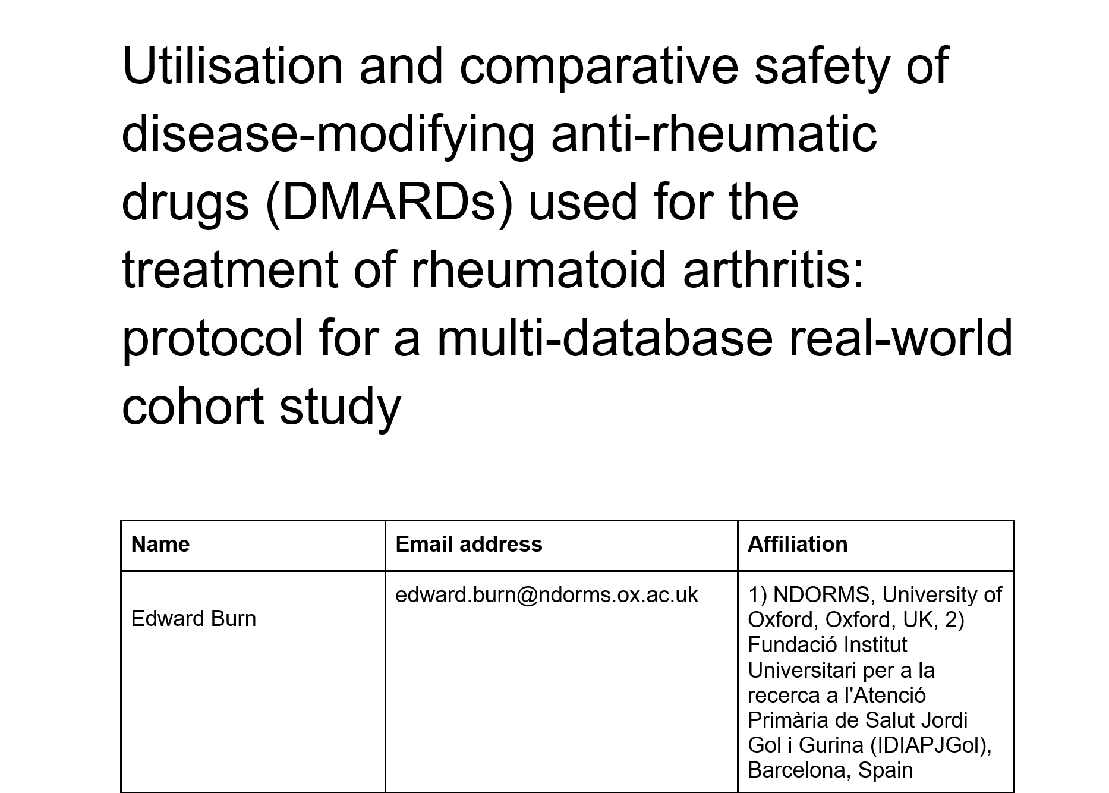
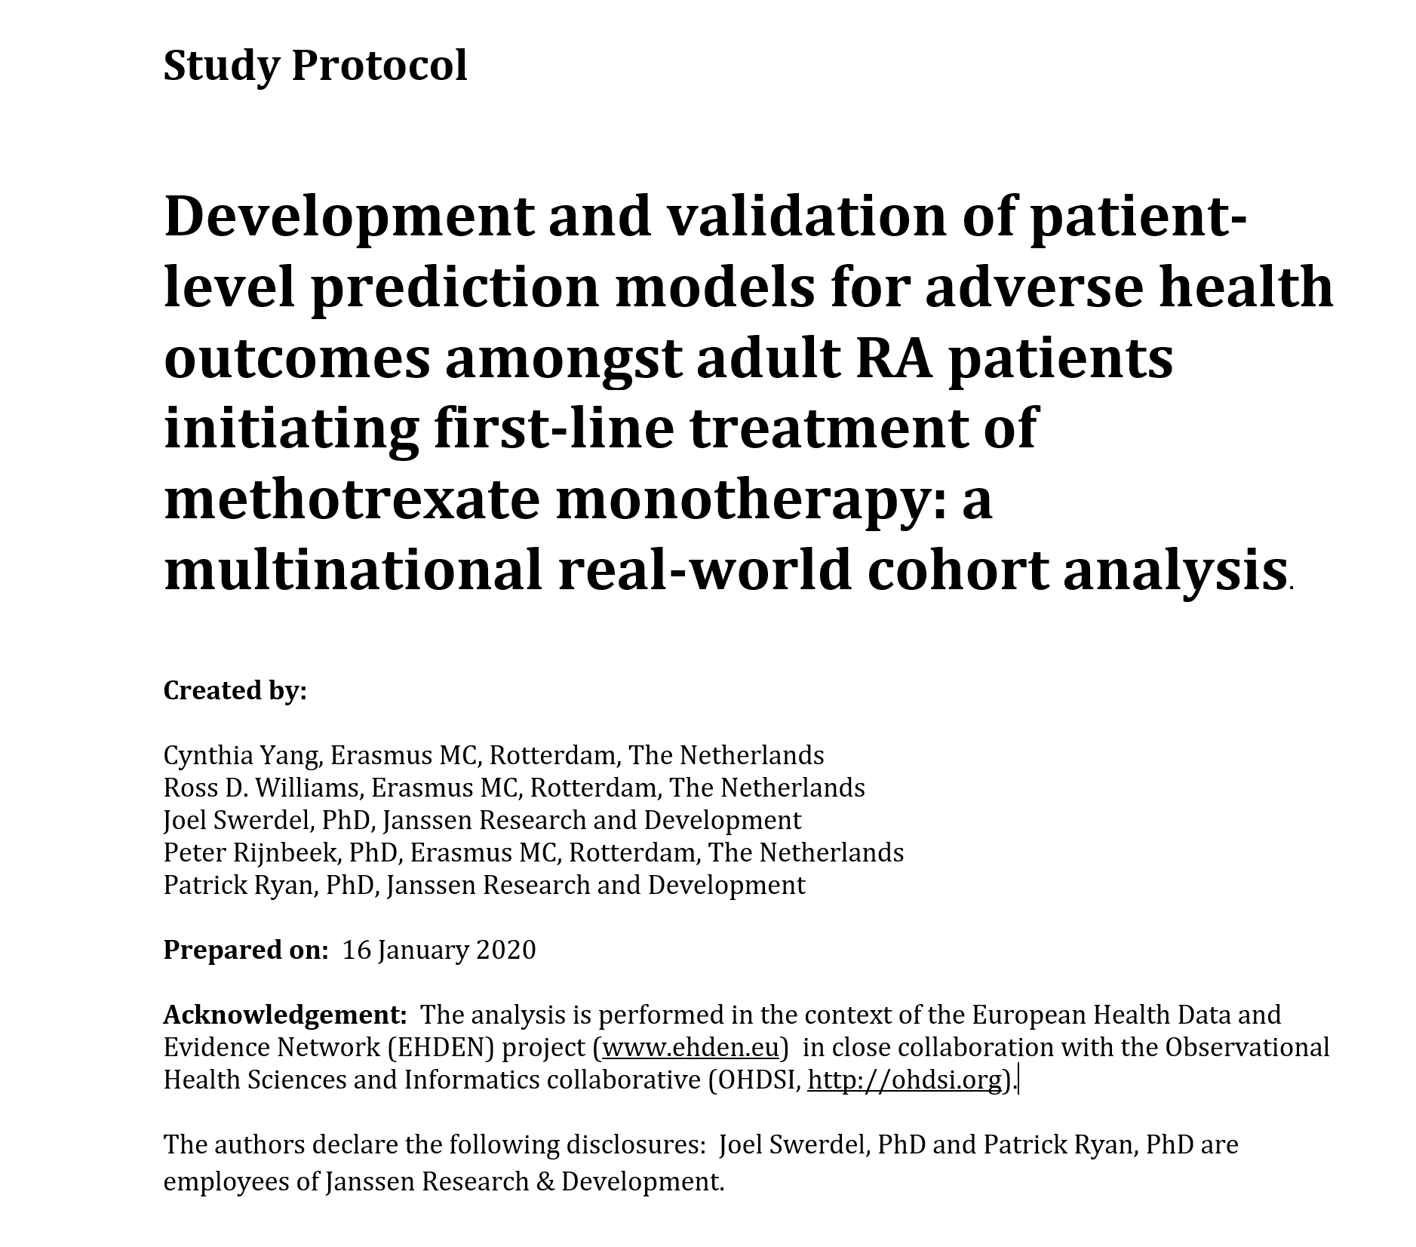
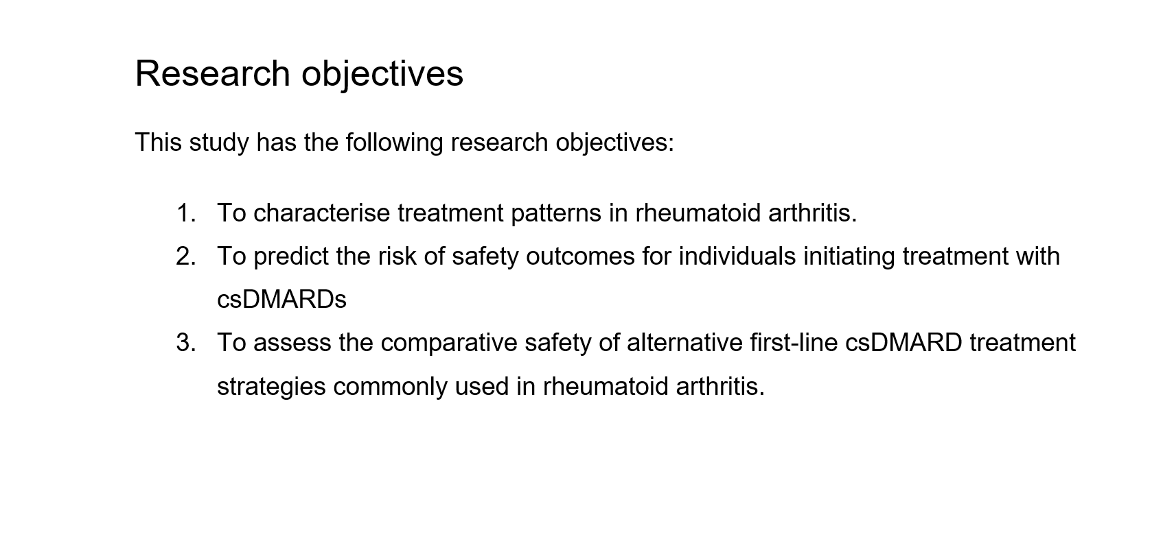
Protocol Development
Notes:
We developed based upon the characterisation

Slide 5
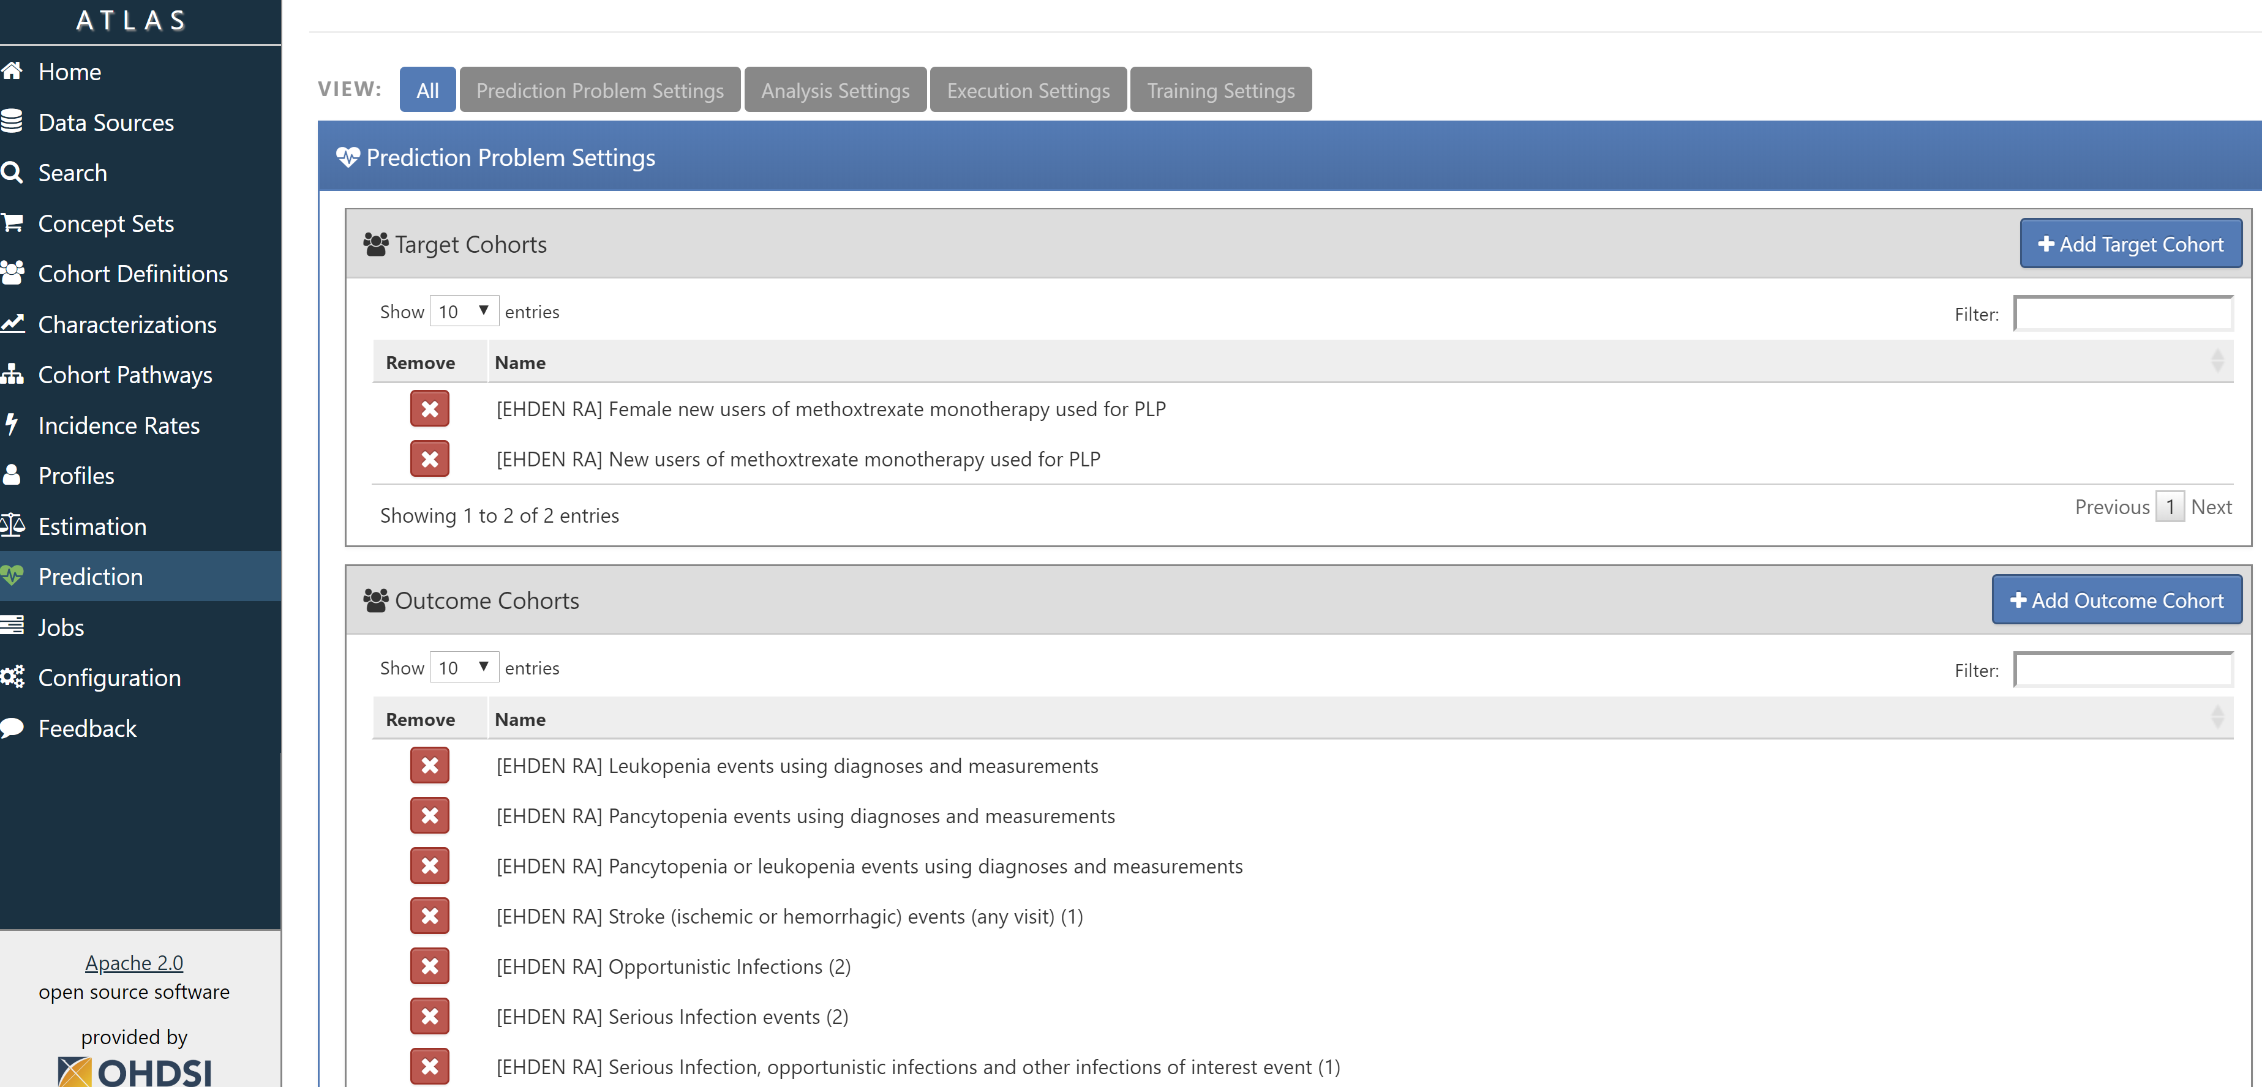
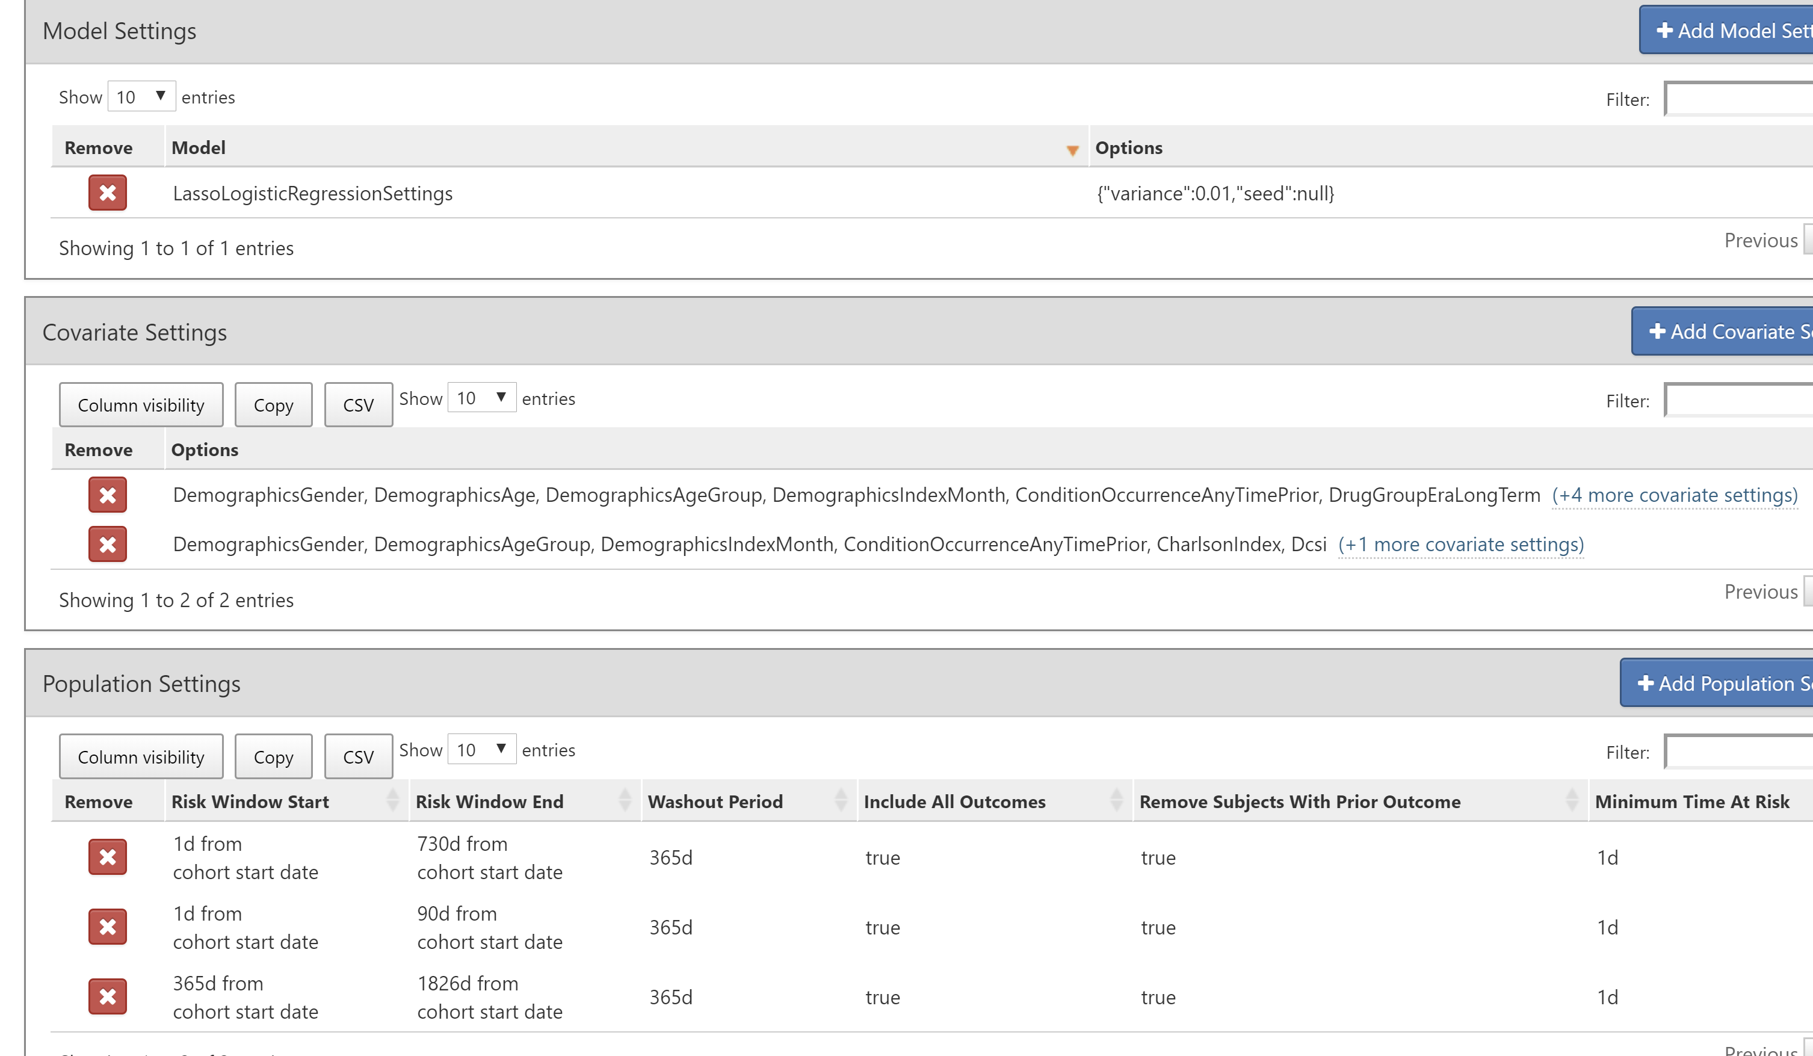
Model Specification

Slide 6
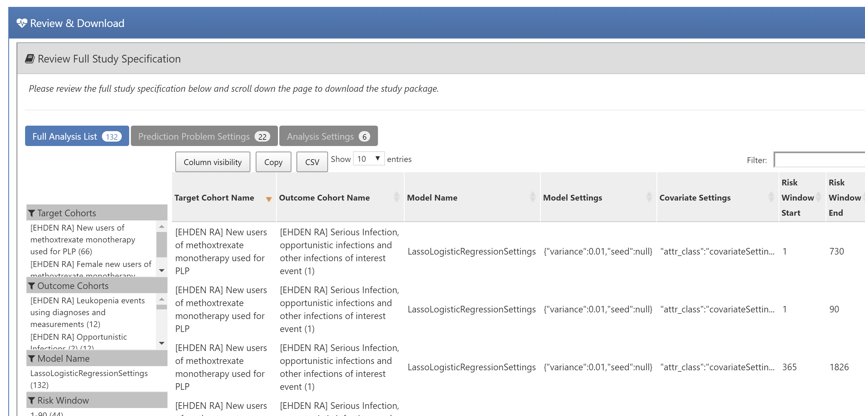

Generate R-Package and share with the world

Slide 7
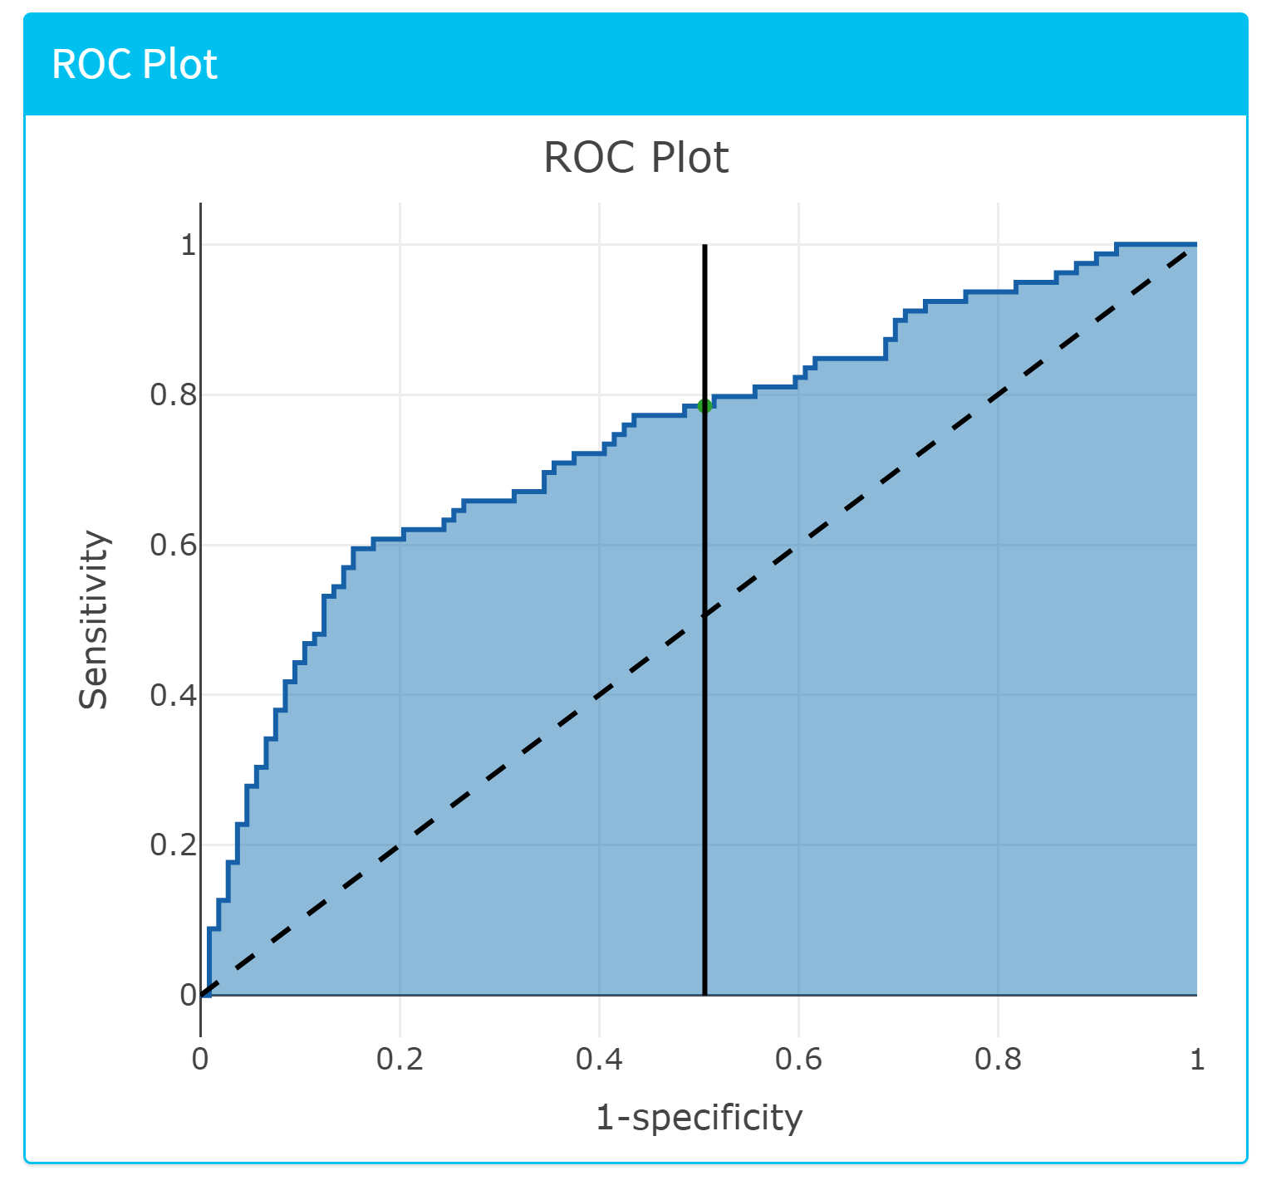
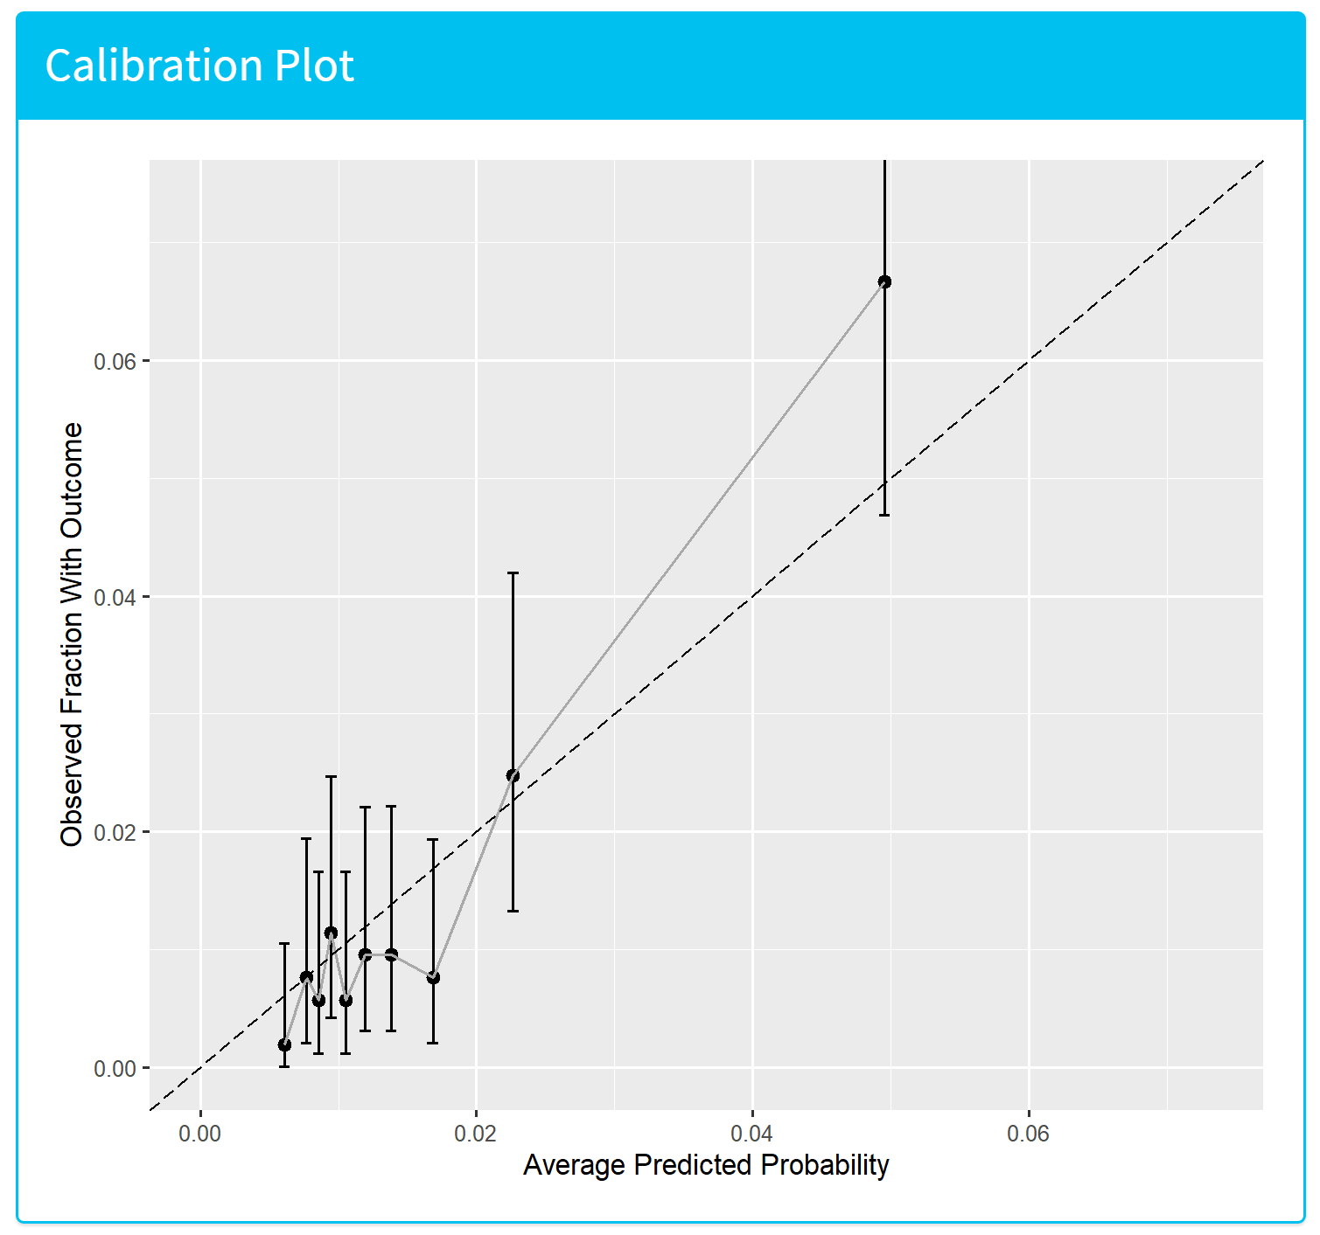
Methods
Evaluation
  AUROC
  Calibration (graphical assessment)
We performed both internal (test) and external validation

Slide 8
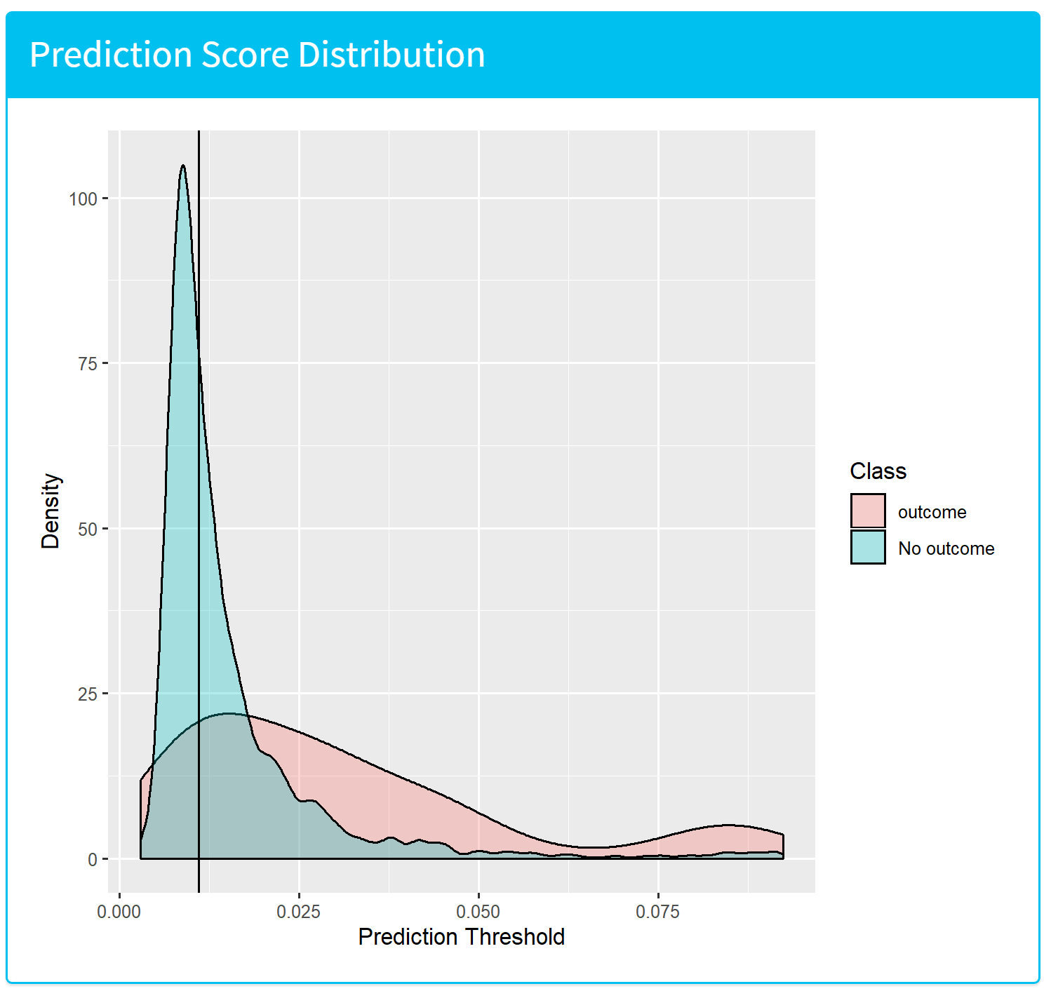
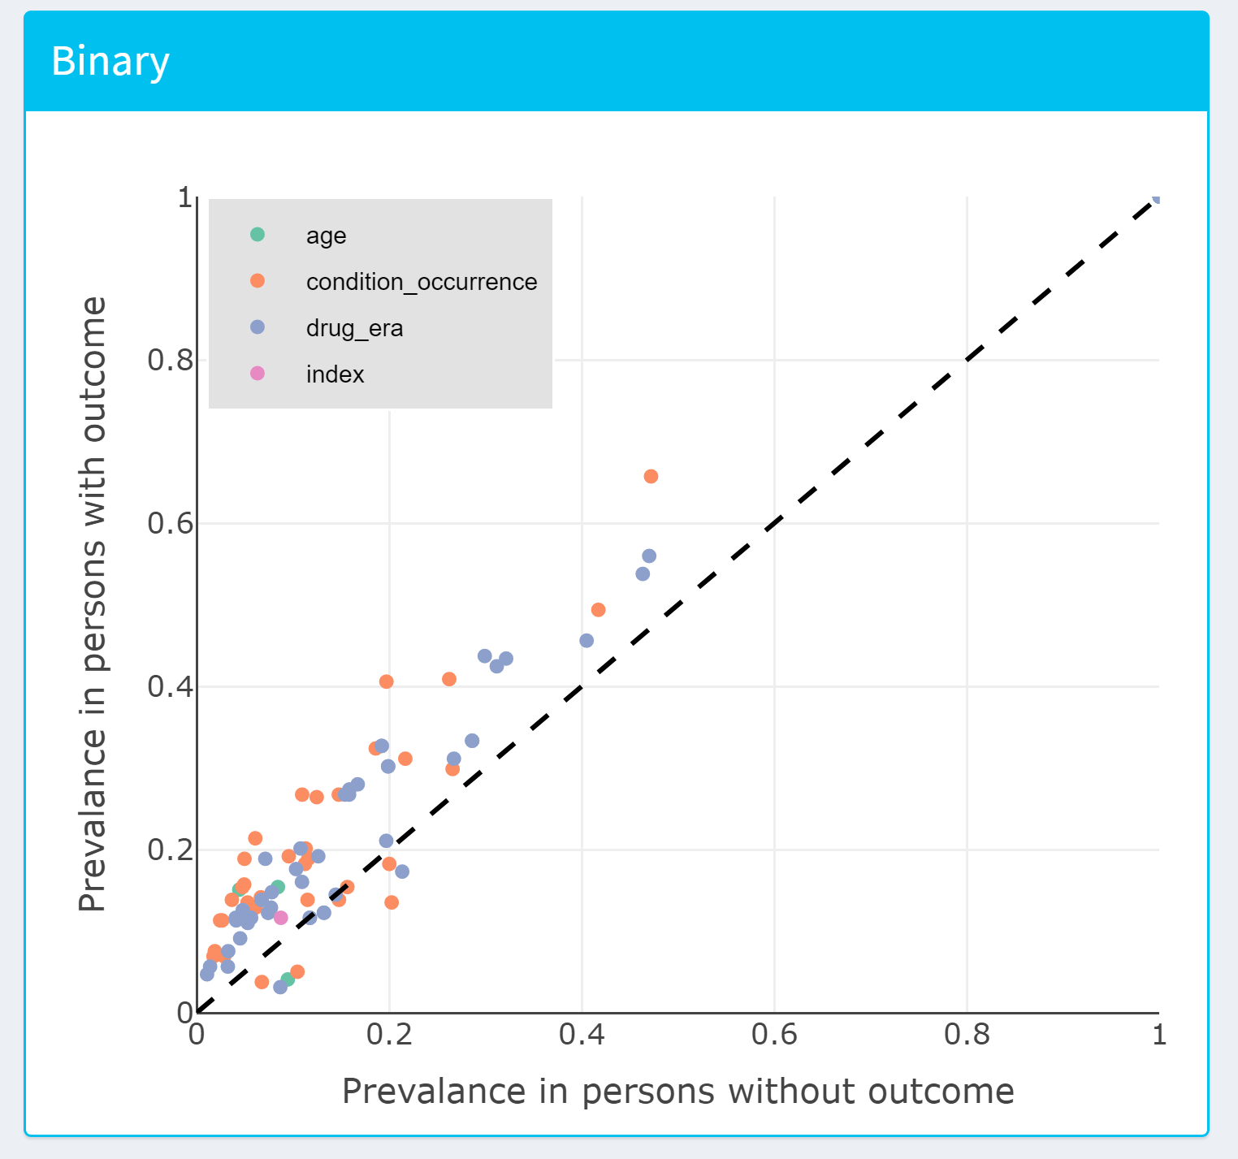
Share model and performance

Slide 9
results
Database | Acute MI within 2y | Stroke within 2y | Serious Infection within 3m
Optum (internal) | 0.77 | 0.78 | 0.75
PanTher | 0.76 | 0.78 | 0.74
IQVIA_AMBEMR | 0.76 | 0.72
CCAE | 0.73 | 0.73 | 0.66
IQVIA_GERMANY | 0.64 | 0.70
IQVIA_THIN | 0.62 | 0.65
MDCR | 0.68 | 0.68 | 0.67
IQVIA_HOSPITAL | 0.67 | 0.63 | 0.61
MDCD | 0.72 | 0.79 | 0.63
JMDC | 0.49 | 0.75 | 0.71
IQVIA_LPDFRANCE | 0.69
Estonia | 0.67 | 0.77 | 0.82
IQVIA_AUS | 0.58
IPCI | 0.68
SIDIAP | 0.65 | 0.75
https://data.ohdsi.org/ehdenRaPrediction/
Notes:
Estonia for the first time had a prediction done on omop cdm

Slide 10
Conclusions
For short-term opportunistic and all infections, as well as 5-year cancer models, we were unable to achieve a high enough AUROC to warrant validating externally
Clinical tools were developed that successfully identify subjects at risk of MI, stroke and serious infection at the initiation of first-line MTX therapy
Good transportability
Models with high AUROC
  adequate internal calibration
  although some external validations show they could benefit from recalibration.

Slide 11
Next Steps
Thanks to team!
Validation Package
  https://github.com/ohdsi-studies/EhdenRaPrediction/tree/master/validationPackage/EHDENRAPredictionValidation
  Contact Cynthia Yang: c.yang@erasmusmc.nl
Development Package
  https://github.com/ohdsi-studies/EhdenRaPrediction

