Slide 1
Population-Level Estimation Workgroup
Martijn Schuemie
&
Marc Suchard

Slide 2
Meetings
Merged meetings with PLP workgroup. One meeting per hemisphere per month
  1st Wednesday of the month: East
  1st Thursday of the month: West
  For details, see OHDSI Wiki: http://www.ohdsi.org/web/wiki/doku.php?id=projects:workgroups:est-methods

Slide 3
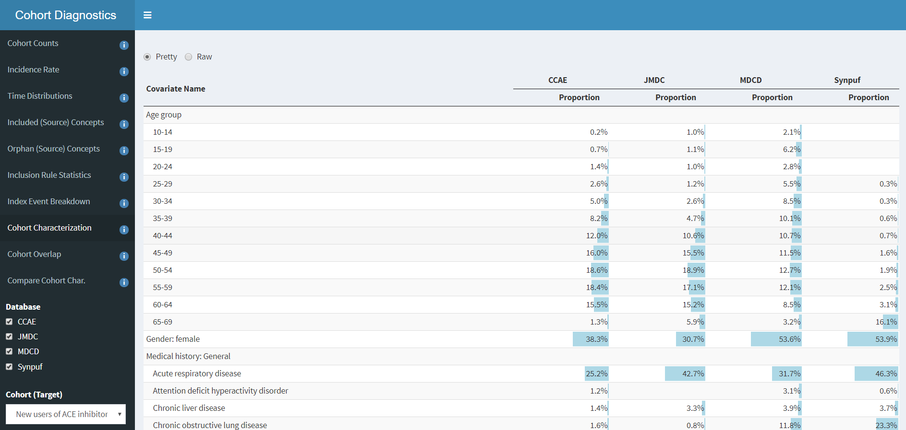
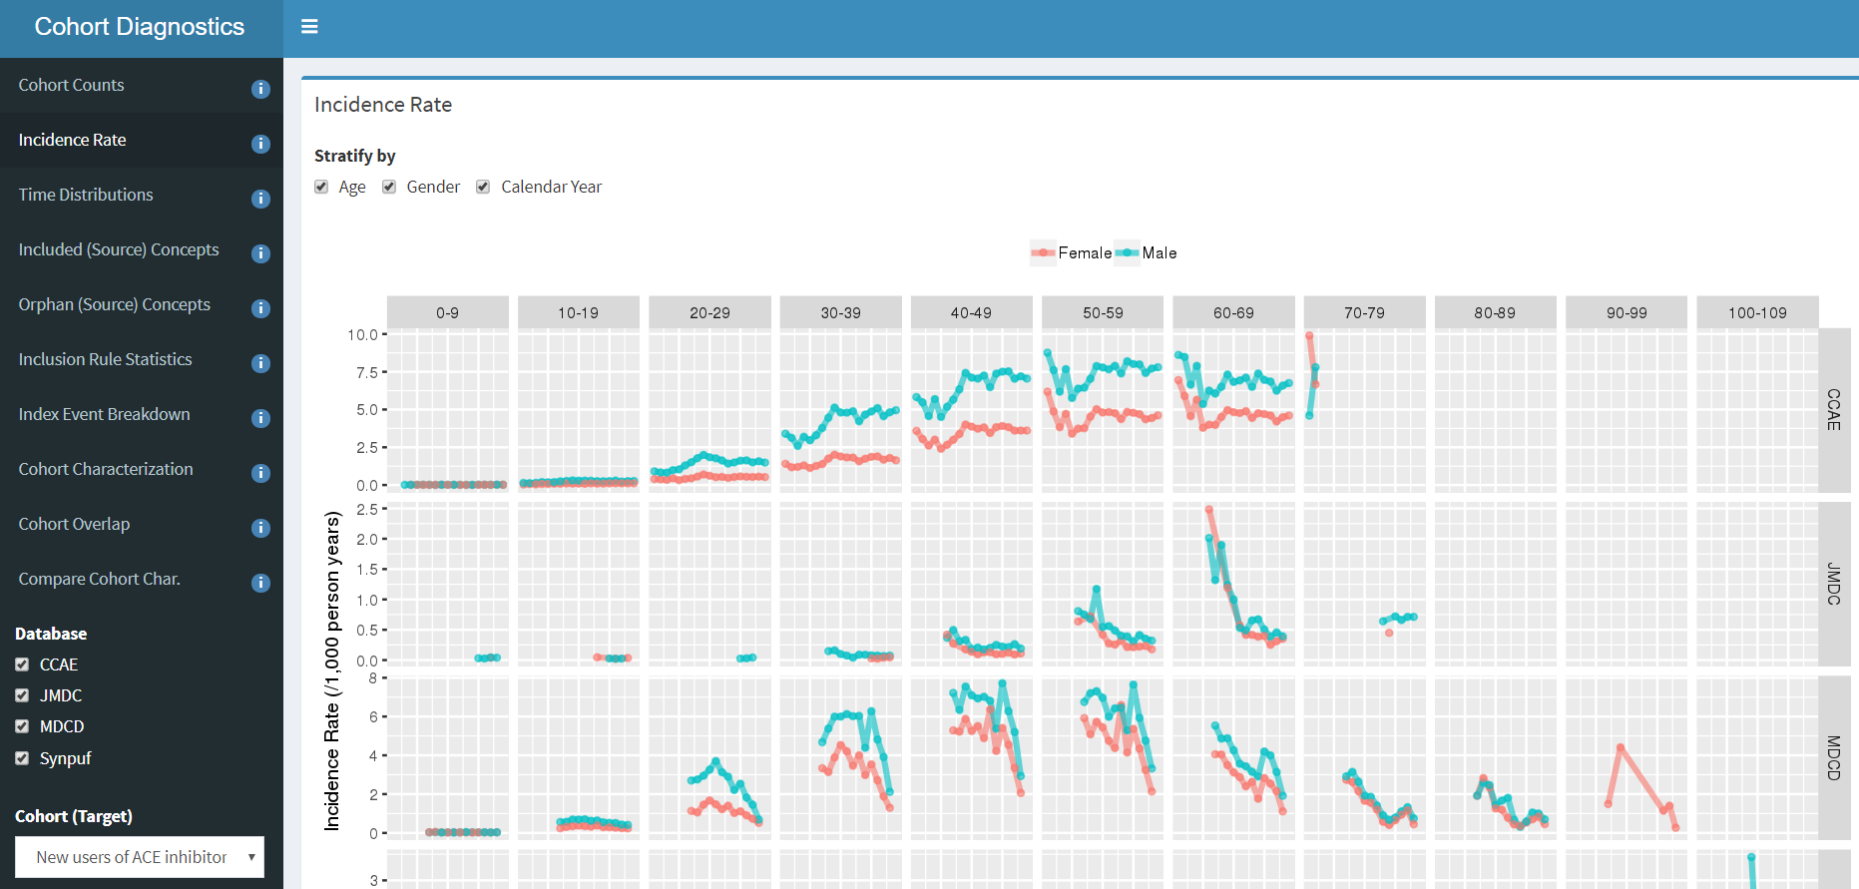
Development: CohortDiagnostics package
Package with Shiny app for diagnosing cohorts
Will be embedded in estimation and prediction study packages
Can be used in a network research setting

Slide 4
Research: small-counts meta-analysis
Network studies produce estimates per site, combine using meta-analysis.
When (outcome) counts are low, the normality assumption in standard meta-analysis doesn’t hold.
Simulations show this can lead to large bias, especially when there are many sites (n > 10)
We have develop a viable solution for this.
Lead: Martijn Schuemie

Slide 5
Research: Balance on unmeasured confounders?
Large-scale propensity models include > 10,000 covariates.
Anecdotal evidence suggests balancing on this many covariates leads to balance on unmeasured covariates.
Performing systematic evaluation, by removing (whole sets of) covariates, and see if balance on the held-out covariates.
Lead: Ray Chen

Slide 6
Research: other ML algorithms for propensity models
We currently use large-scale regularized logistic regression (LASSO) to fit our propensity models.
Evaluating other machine-learning (ML) algorithms
Evaluating on simulated data, will move to real data
Lead: Yuchen Guo (Mimi)

