Slide 1
OHDSI Latin America Working Group
Tuesday, March 10 2020
Leadership:
Gerardo Machnicki,
Jose Posada,
Juan Banda,
Kristin Kostka

Slide 2

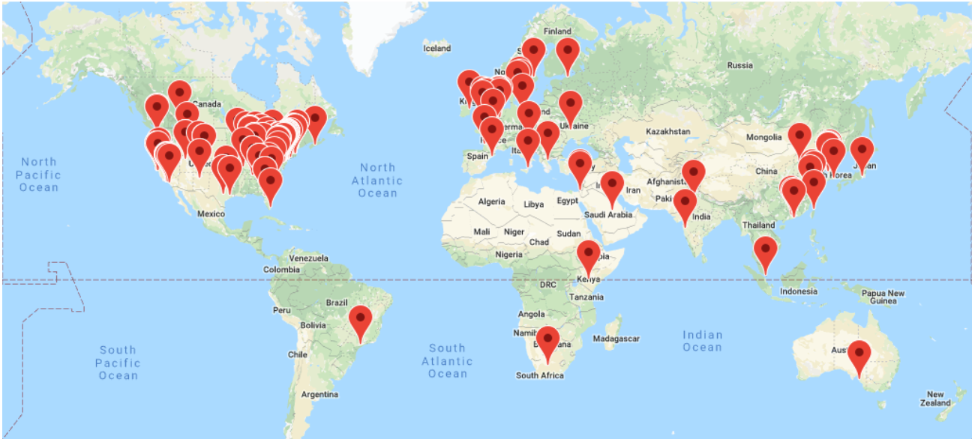

OHDSI needs help reaching Latin America
S
S
S
S

Slide 3
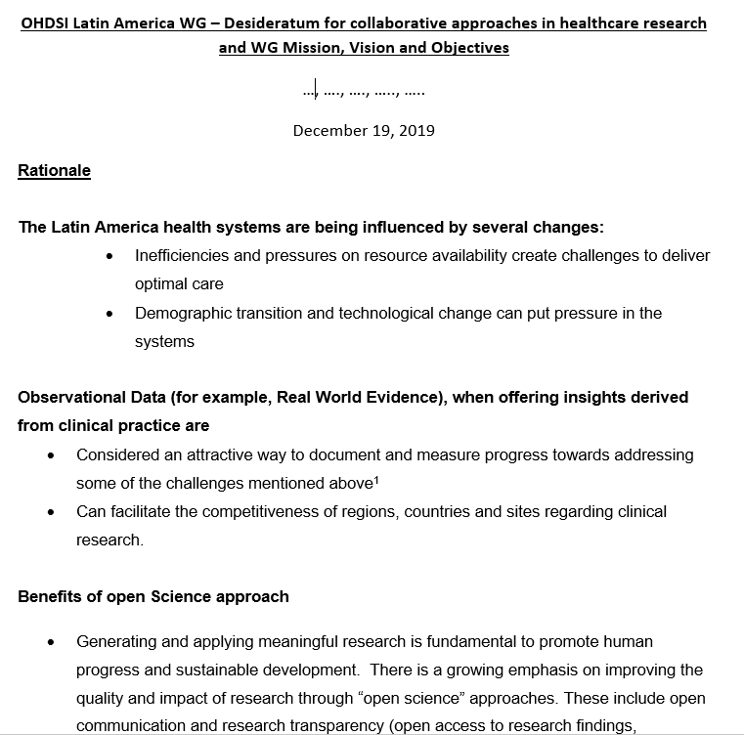
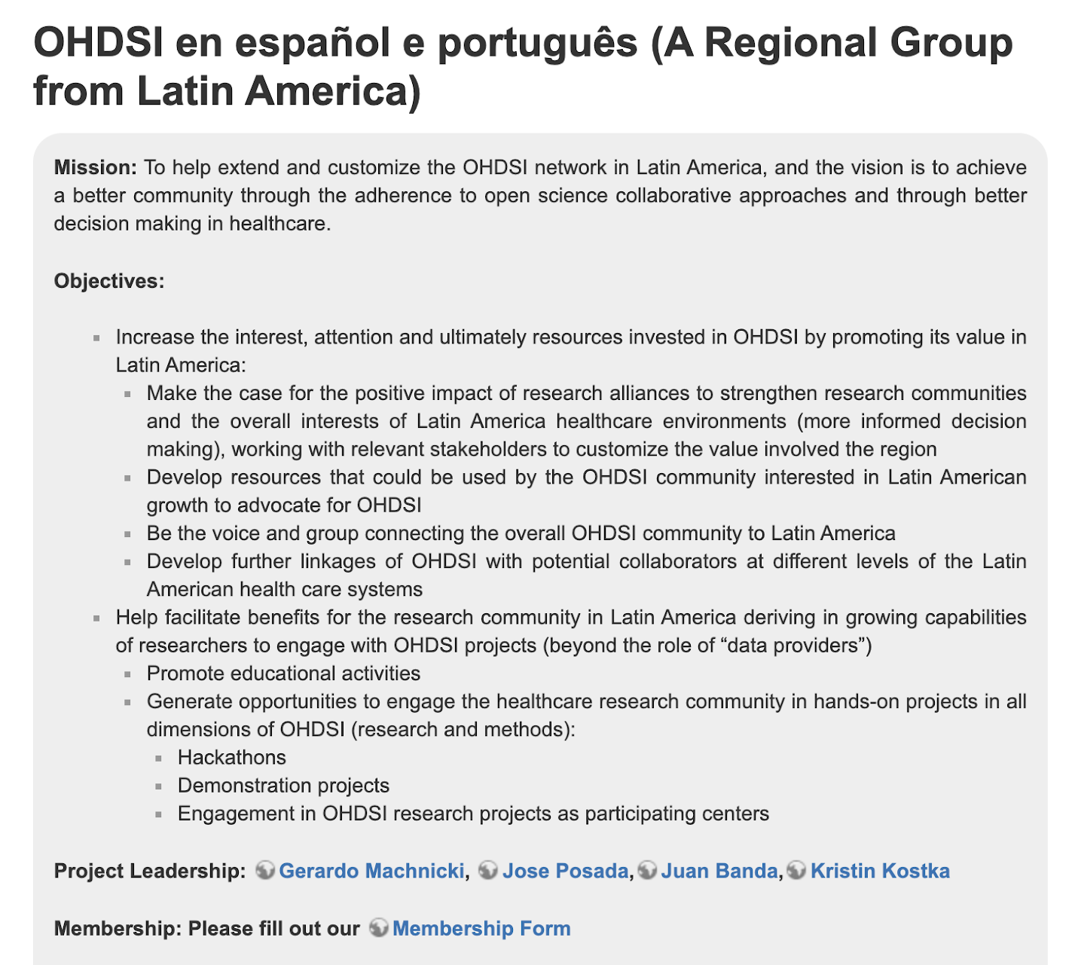
OHDSI Latin America – Desideratum for collaboration and Wiki
Join our WG Membership List and Tell Us About Yourself: https://docs.google.com/forms/d/1Ho_0jpvNvpNpy6w4vbNnQfTfdWjBbnt_Obz-jKaHZSE/edit?usp=drive_web
Notes:
Most of respondents are from academia, have access to data, some of them in OMOP-CDM, however not latam data and th esupport for a study-a-thon and ETL support cases are among the strongest desired activities.

Slide 4
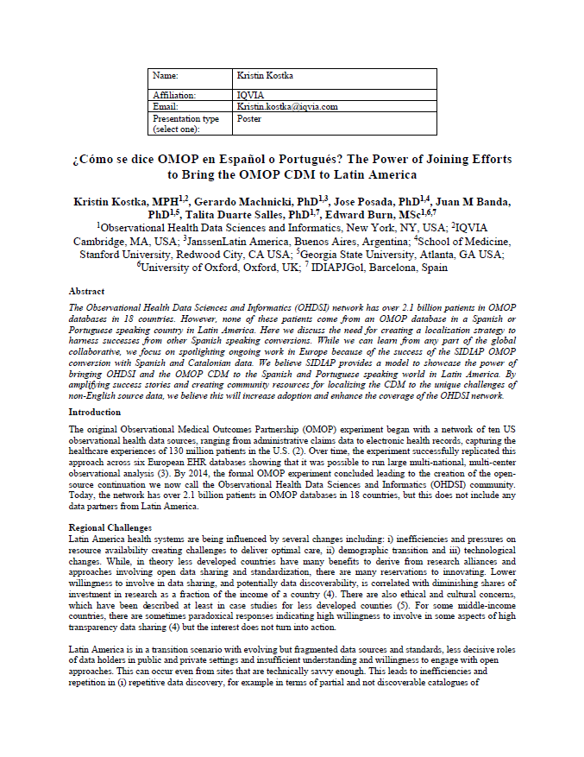

EU Abstract Submission
As of March 6:
Due to conference cancellation, we will pursue digital dissemination of our poster content.

Slide 5

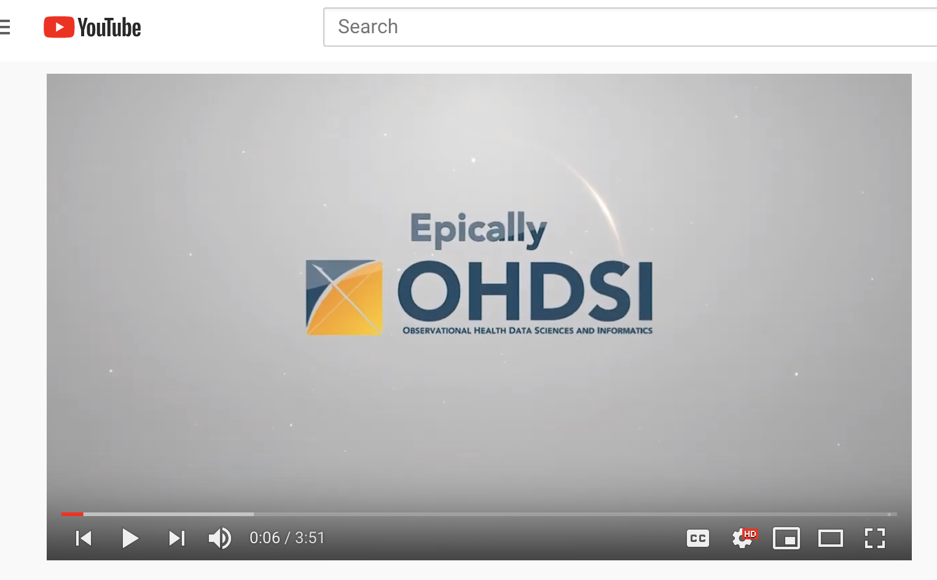

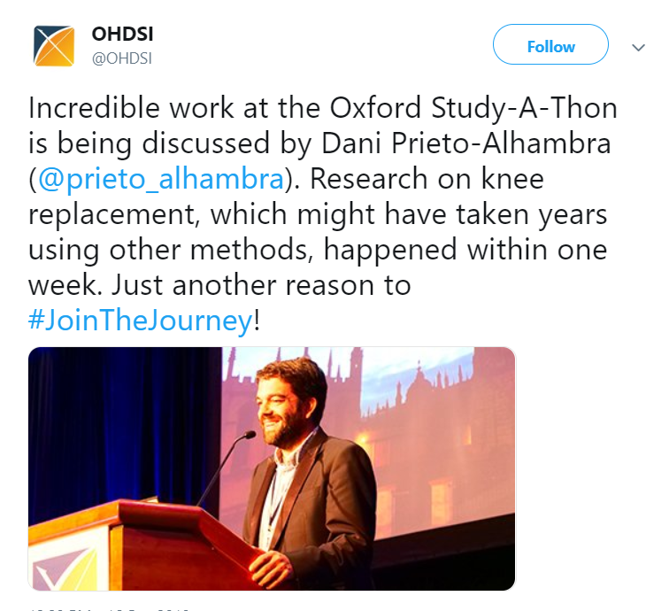
Goal: Prioritize Localization Efforts
Epicamente OHDSI ..
El libro de OHDSI
F2F in LATAM*
*May be adjusted to virtual meeting due to COVID-19 concerns.

Slide 6
Join the Journey
https://www.ohdsi.org/web/wiki/doku.php?id=projects:workgroups:latin_ohdsi

