Slide 1

Jeremy Warner MD, MS, FAMIA, FASCO
OHDSI Collaborator Meeting
April 7th, 2020

Slide 2


Origins
#covid19nCancer
~3/16
Aakash Desai
#CCC19
Symplur
@COVID19nCCC
>300 followers as of today

Slide 3


Slide 4
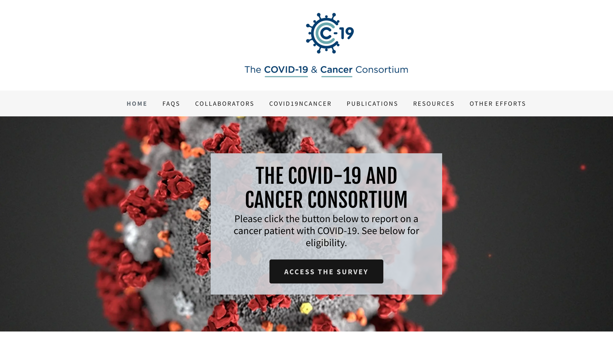

Slide 5
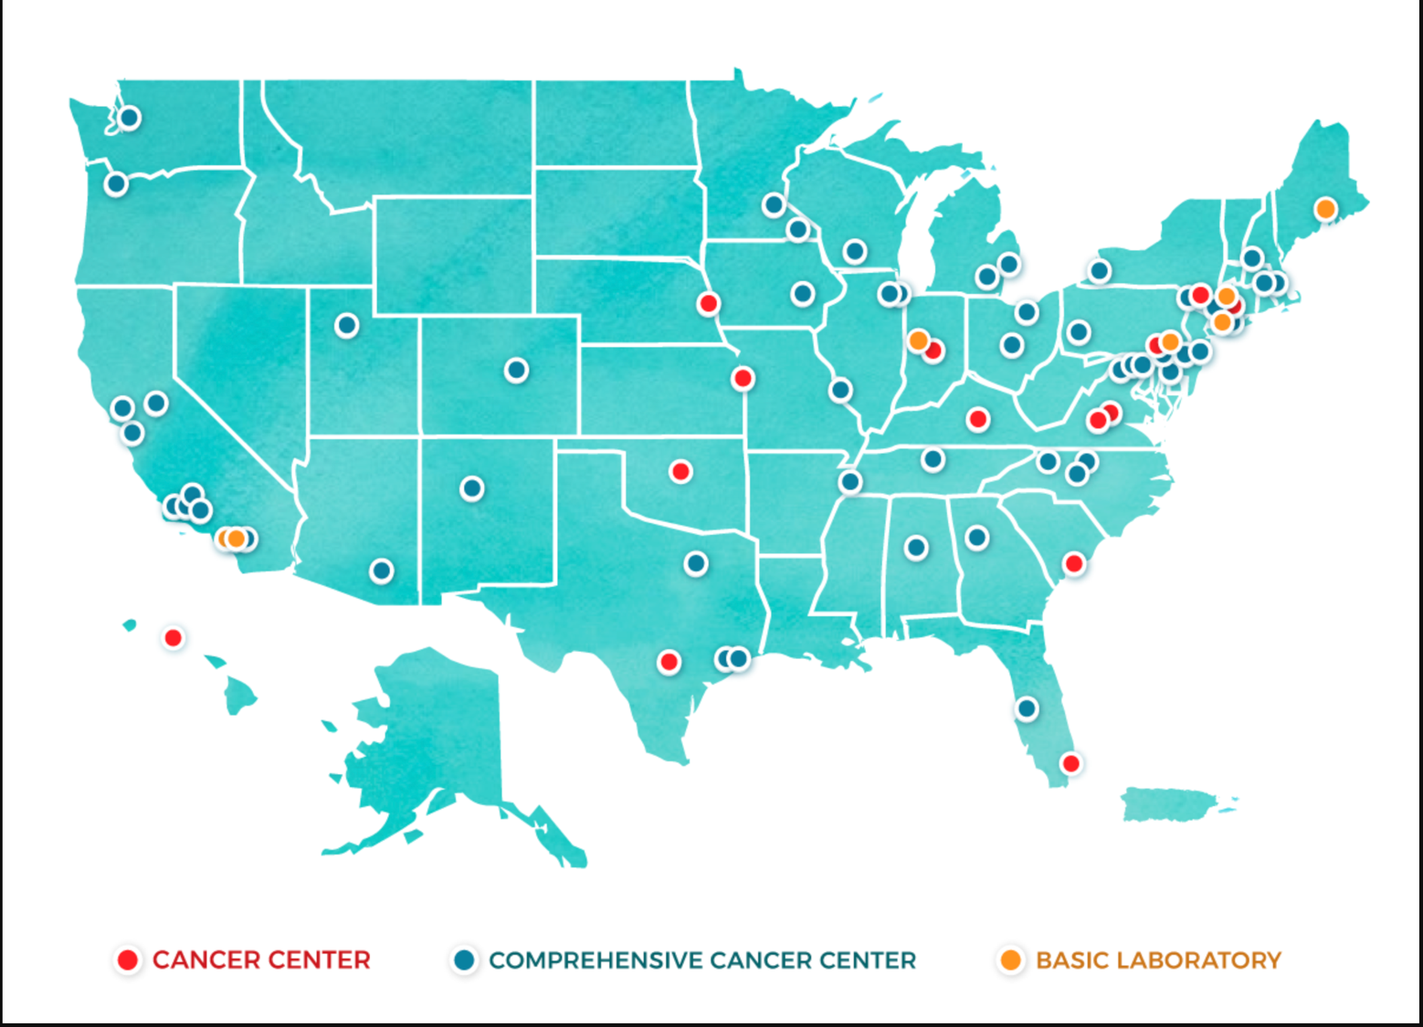

Participating Institutions, March 17th (N=14)
x2

Slide 6
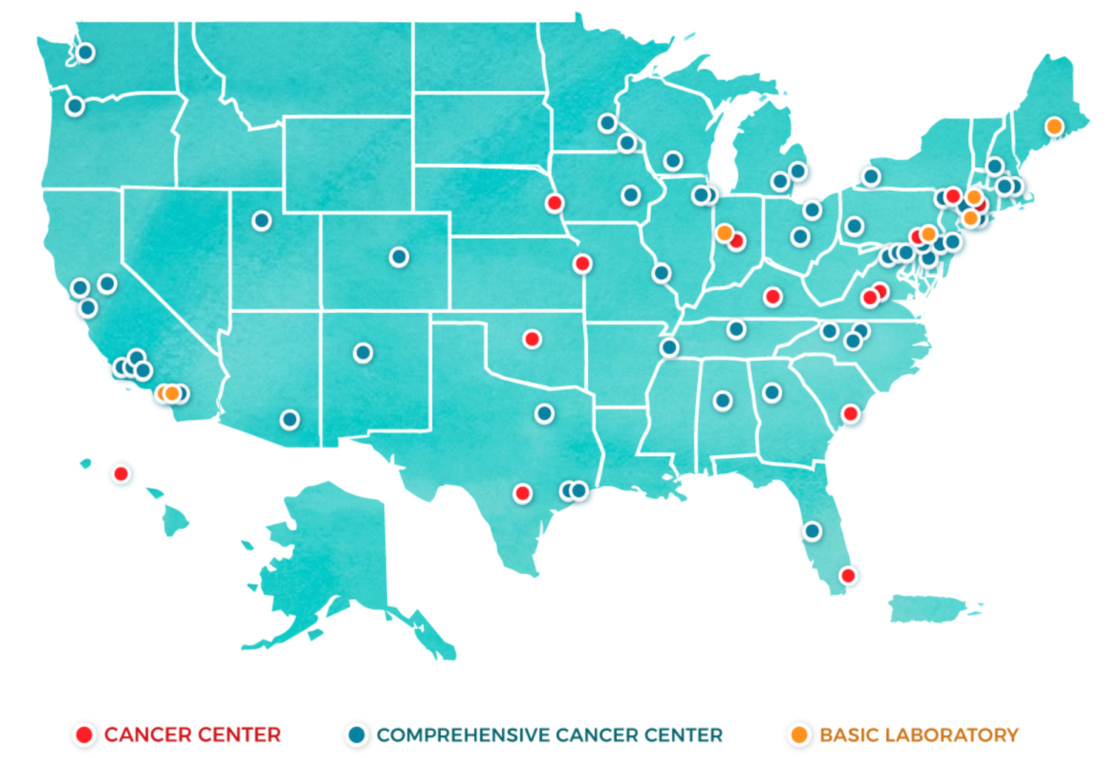
Participating Institutions (N=62)
April 3rd
x3
x2
x4
x3
x4
x2
x2
Adapted from NCI

Slide 7
Participating Institutions (N=72)
April 7th
x5
x2
x2
x4
x2
x3
x5
x2
x2
x2
x2
x2
x2
x2

Slide 8
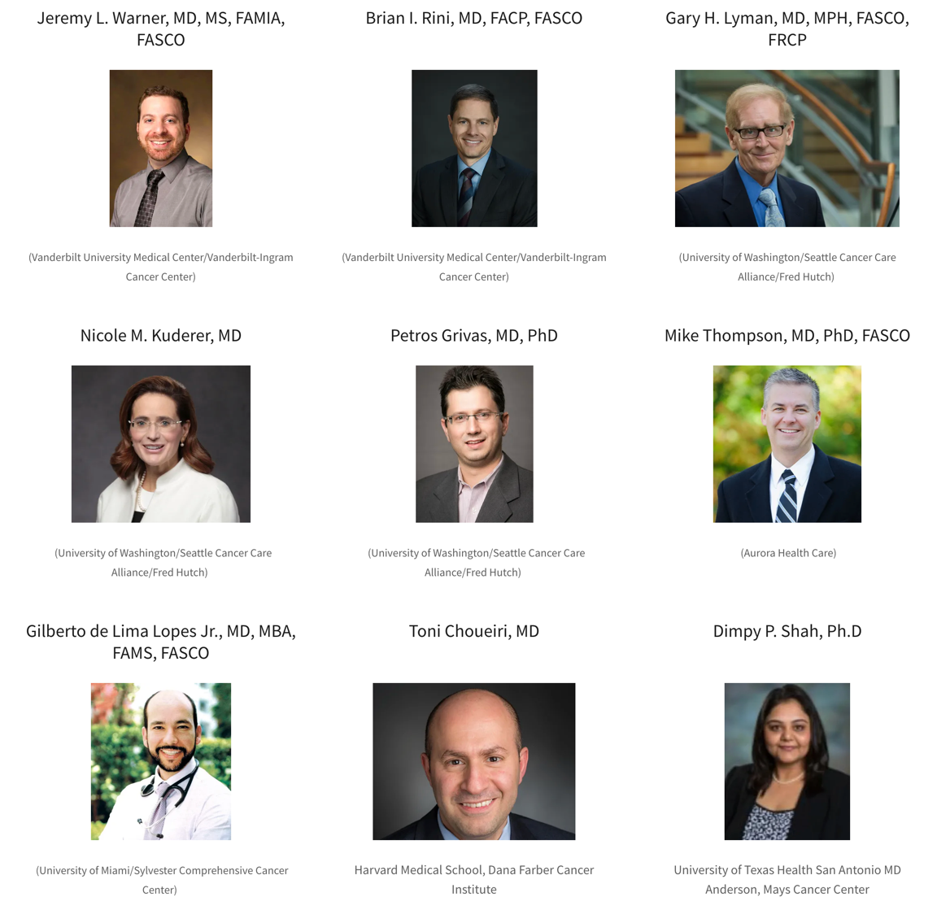

Steering Committee
Corrie A. Painter, PhD
Count Me In
Solange Peters, MD, PhD
Lausanne/ESMO

Slide 9
Mission Statement
The driving goal of the consortium is to collect prospective, granular, uniformly organized information on cancer patients infected with COVID-19 at scale and as rapidly as possible.

Slide 10


We have a very large and active community of users for an electronic data capture system called
Courtesy of Paul Harris

Slide 11


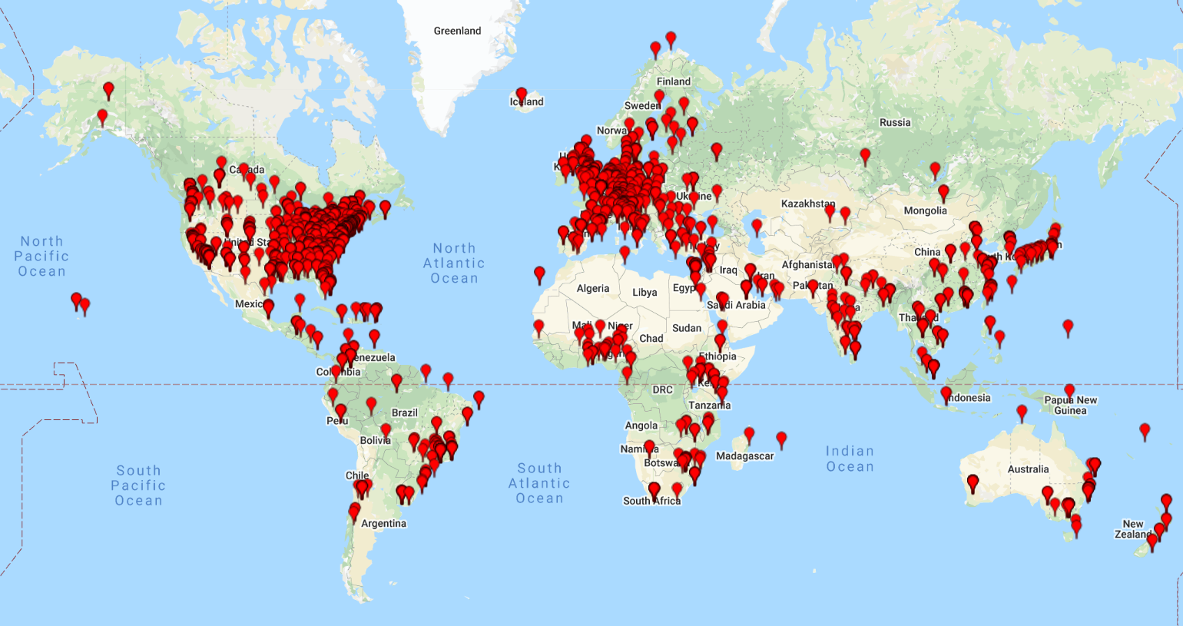
Available at no cost to academic, government, non-profit partners
Map of REDCap Consortium Partners
Courtesy of Paul Harris

Slide 12

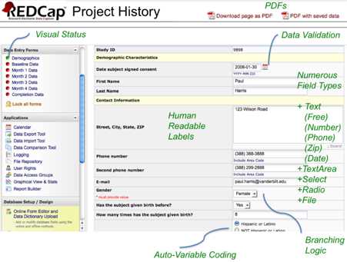
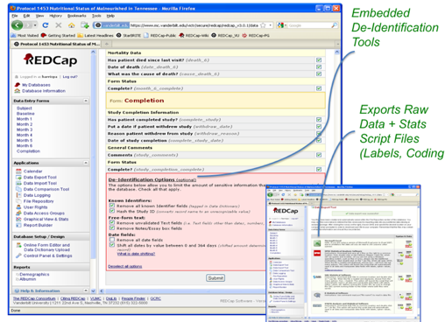
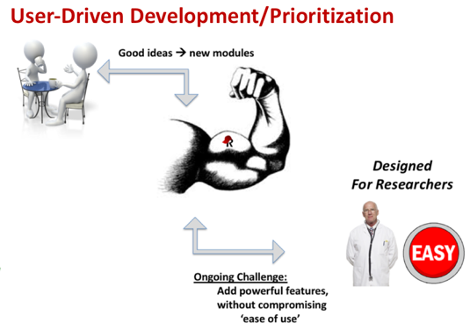
Summary:
Data Planning (“easy way to do the right thing” with data capture, management, audits, security)
Data Collection (researcher, provider, participant, patient)
Data Export (all major statistical packages)
Data Import (file or via API)
Data Integration (API services)
Consortium-wide REDCap library of shared instruments (e.g. validated scales, PROs)
Consortium-wide repository of REDCap “plugins” to extend user interface and functionality
Offline App Version (iOS, Android)
Text/Audio/Video capabilities
Multi-modal (web, SMS, phone)
RCT features – randomization, data query workflow
Document Repository
E-consent (new)
MyCap Integration (new)
EHR Interoperability - via FHIR (new)
Courtesy of Paul Harris

Slide 13
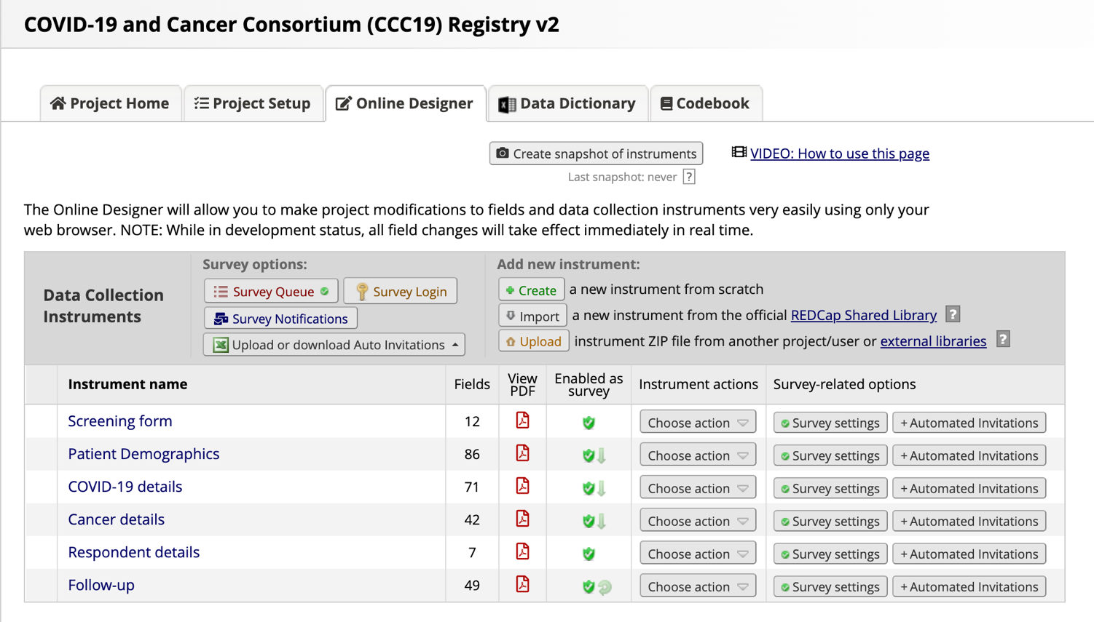
REDCap Survey – current status
Steph Duda
TY!!!!!!!!!!!

Slide 14
Data Collection Schema
Patient Demographics and Predisposing Conditions
Age, gender, race/ethnicity
ECOG
Smoking status
Surgical and medical history
Concomitant medications
COVID-19 Initial Course of Illness
Timing
Presenting symptoms
Presenting labs
Diagnostic testing
Initial severity of illness
Co-infections
Complications
Treatments including trials
Clinical status
Cancer Details
Cancer type, stage, status
Treatment details: recency, modality, context, irAEs
Transplant & cellular therapy details
History of cardiopulmonary toxic treatment
COVID-19 follow-up & Outcomes
Interval severity of illness
Co-infections
Complications
Treatments including trials
Interval clinical status
Final status
Effects on anti-cancer treatment plans
Repeating

Slide 15
Mapping to standards from (almost) the get-go
Terminology bindings
Encoding | Number of variables
ATC | 12
HemOnc | 8
NAACCR | 1
NCIT | 2
PHIN VADS | 2
SNOMED | 16
Y/N/UNK | 30
Direct entry | 41
Custom | 57

Slide 16
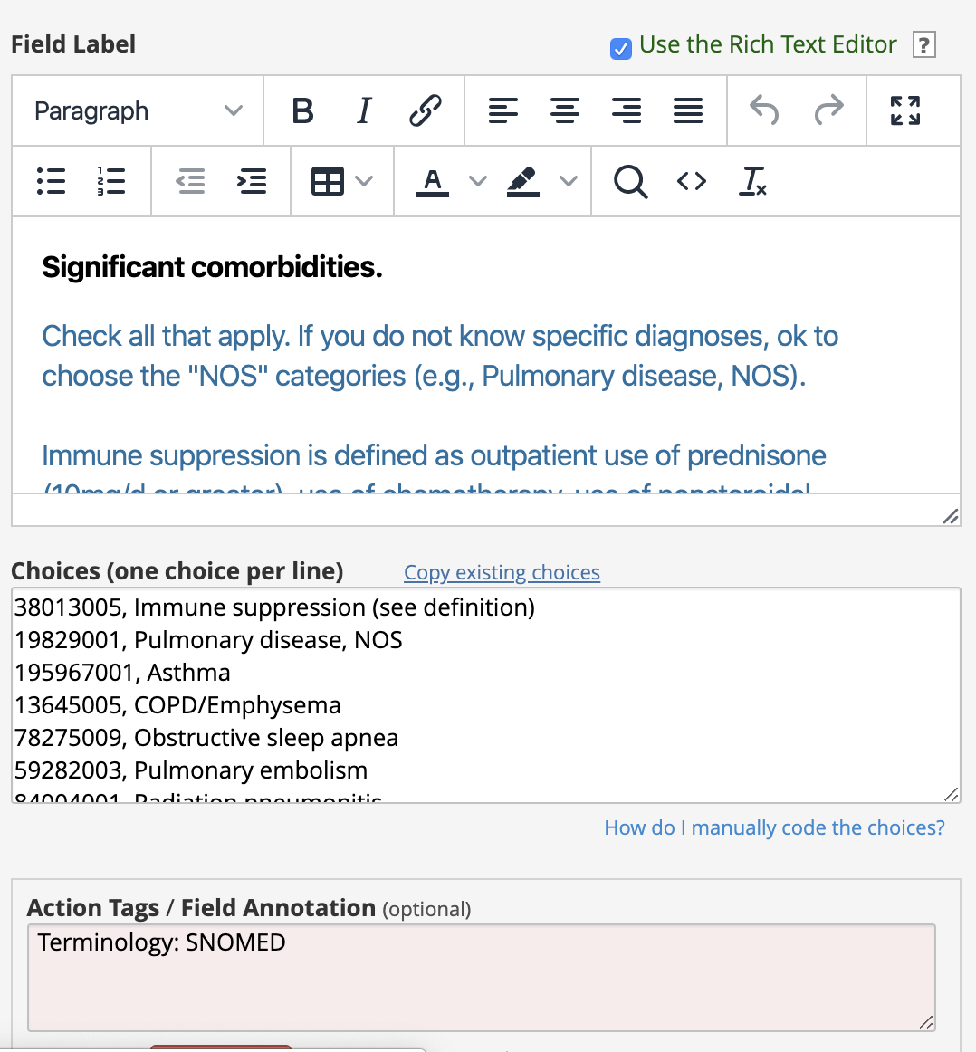
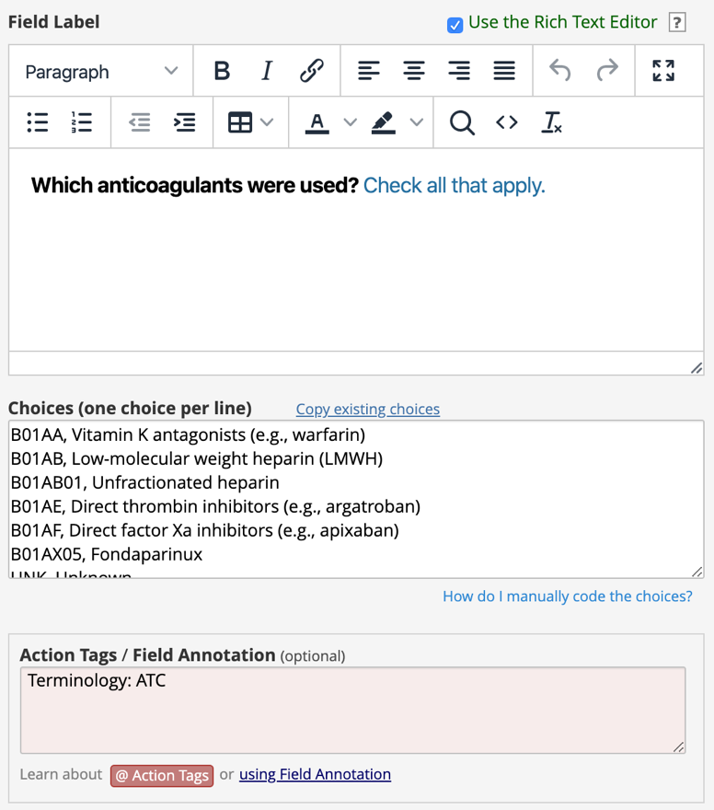
Mapping to standards from (almost) the get-go

Slide 17
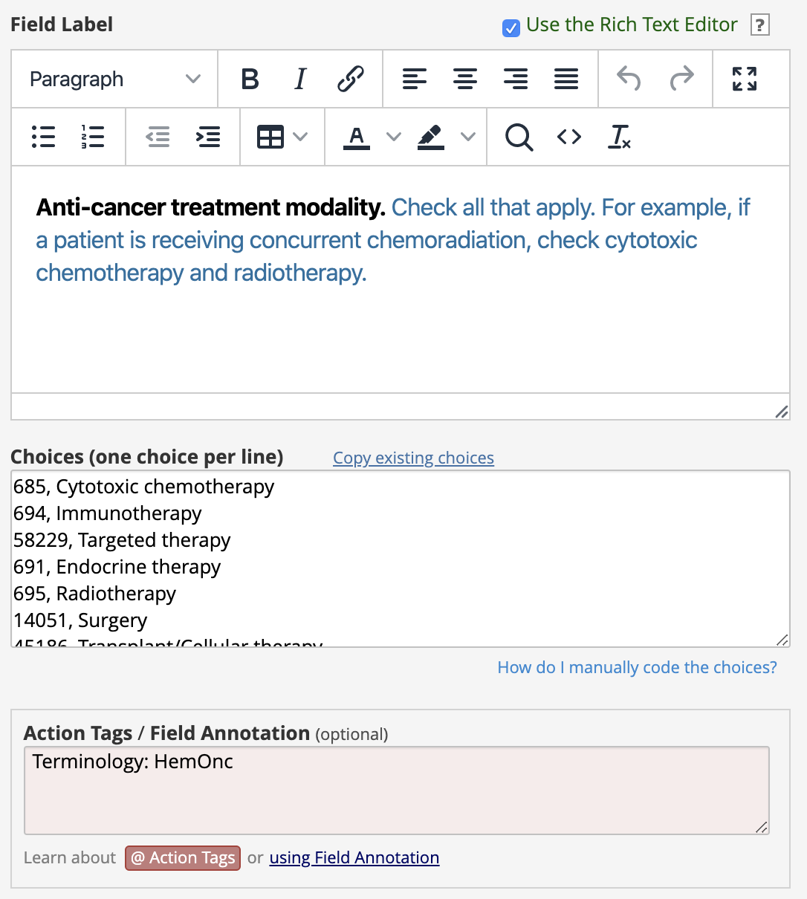
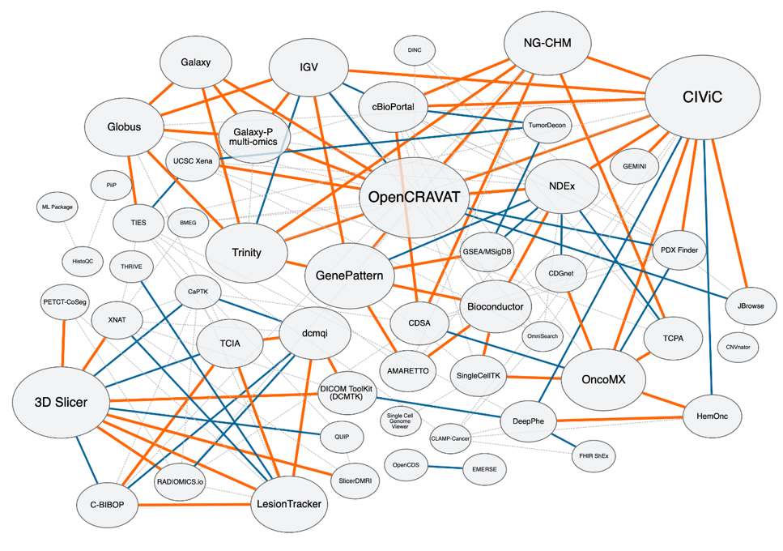
Shameless plug for HemOnc (U01 CA231840)
https://hemonc.org/wiki/Ontology

Slide 18
Regimen
Was studied in
Study
Has study group
Study Group
Was studied in
Has context
Context
Has modality
Was studied in
Has reference
PMID
Has…component
Modality
Has…
Has accepted use
Reference
URL
Component
Condition
Antineoplastics
First author
Middle author
Last author
Title
Has…Rx
Was published…
Supportive medications
NCIT
SNOMED
Oncotree
RxNorm
Journal
Year
Local therapy
Internal relationships
Included in current OHDSI release
Future OHDSI releases
External relationships
Third OHDSI release (planned)
HemOnc Regimen Model (simplified)

Slide 19
Episodes
Disease and treatment abstractions are modeled as episodes
Disease abstractions include: first occurrence, remissions, relapses, and end of life event.
Treatment abstractions include: treatment course, treatment regimen, and treatment cycle.
These abstractions may be derived algorithmically pre- or post-ETL or extracted from the source data directly.
  In addition to the regular OMOP type concept ID, we propose to store references to the derivation algorithms in the vocabulary.
Courtesy of OHDSI Oncology Subgroup

Slide 20
Advantages of Using Episodes
Supports levels of abstraction that are clinically and analytically relevant
Supports explicit connection between a disease/treatment abstraction and lower level events (conditions, procedures, drugs) that are linked to this abstraction
Persists provenance of episode derivation (e.g. directly from source data, algorithmically)
Is generalisable to:
  abstraction of other chronic diseases
  Representation of episode of care
Courtesy of OHDSI Oncology Subgroup

Slide 21
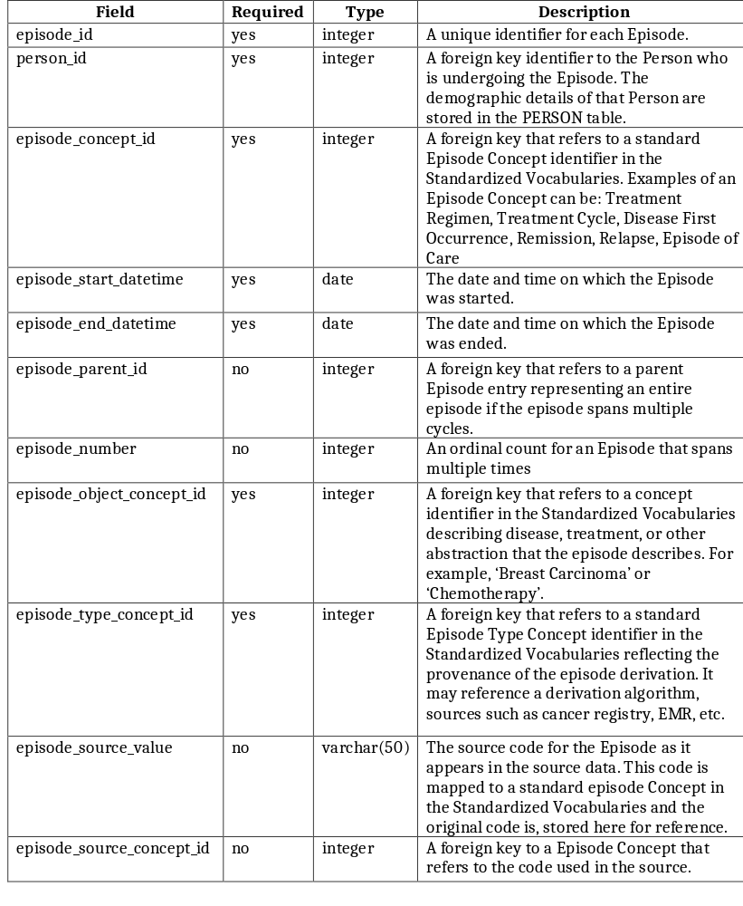
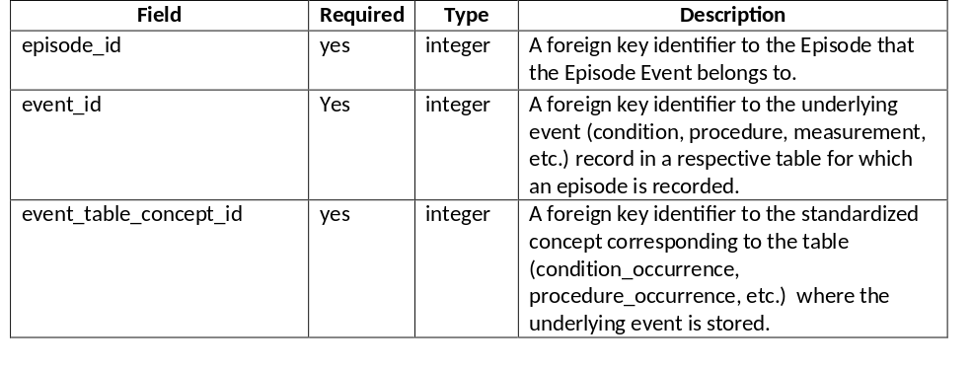
EPISODE and EPISODE EVENT Tables
Courtesy of OHDSI Oncology Subgroup

Slide 22
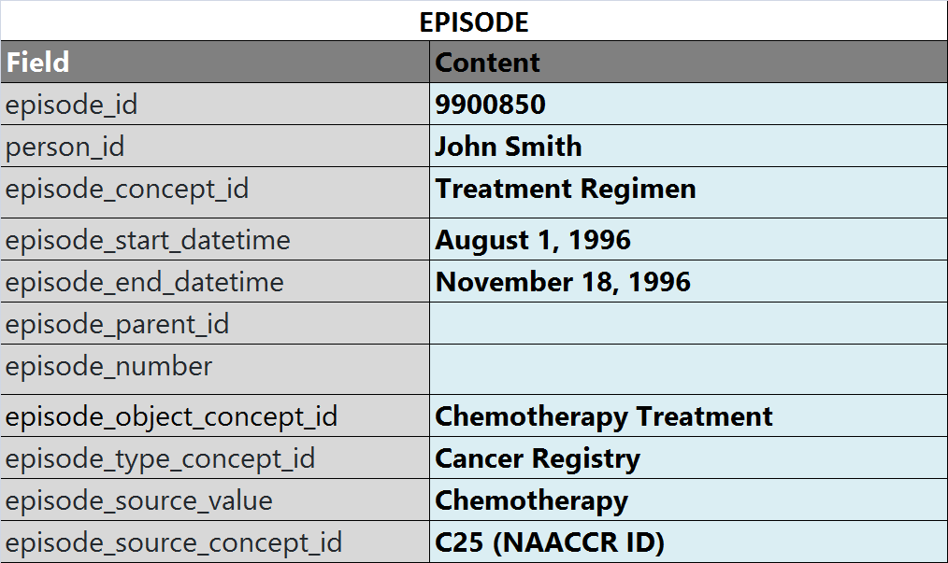
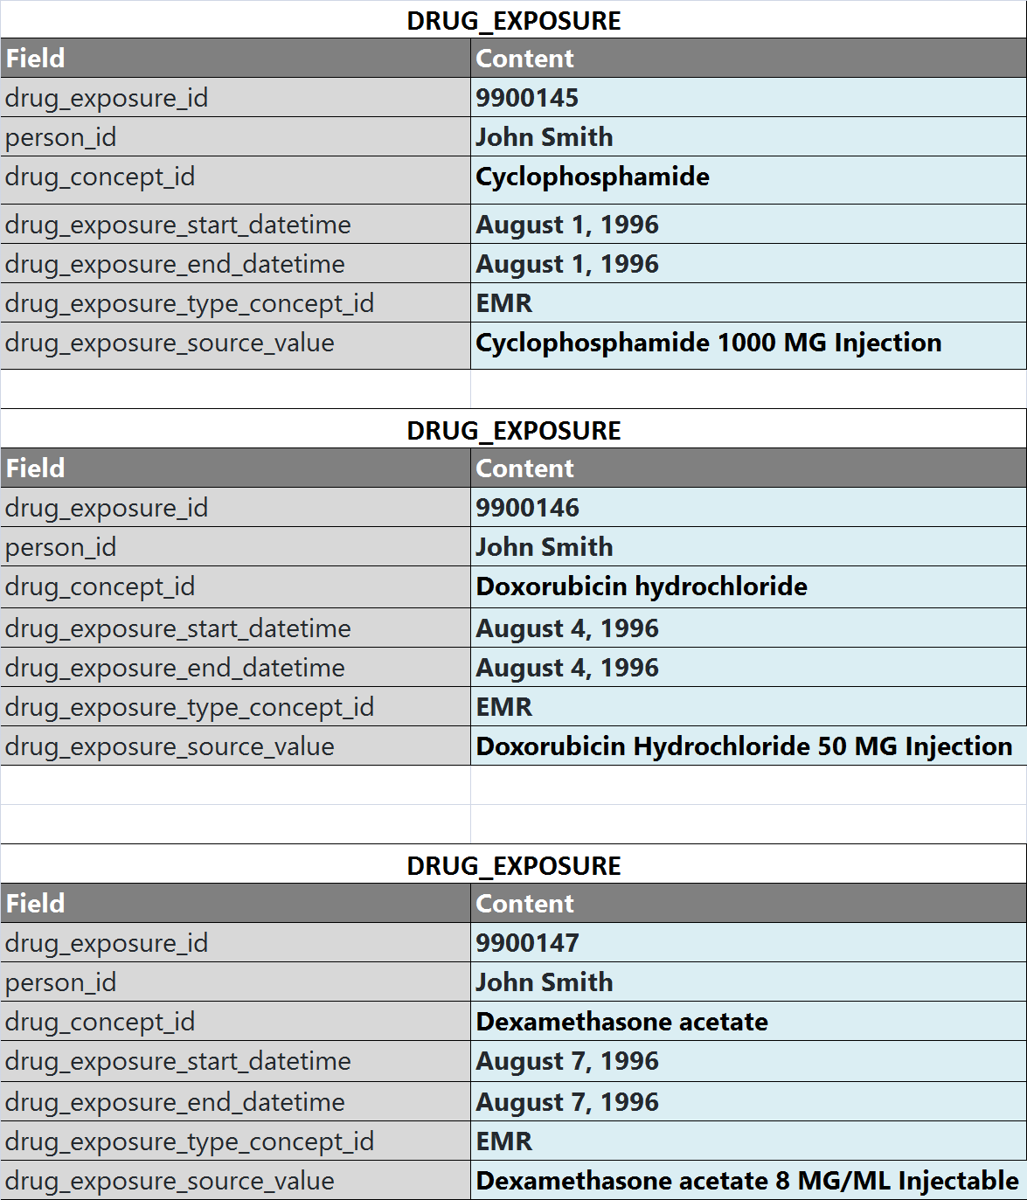
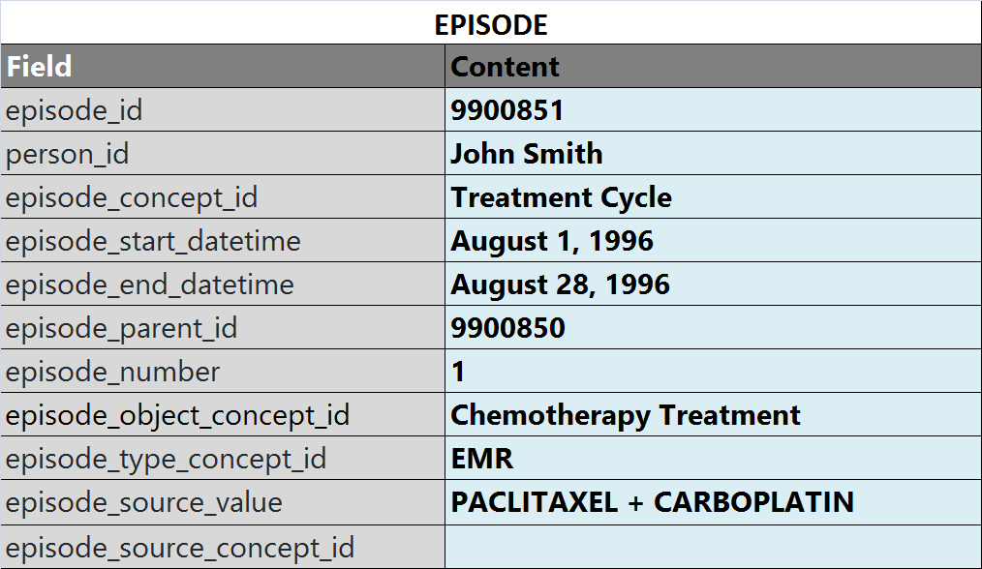
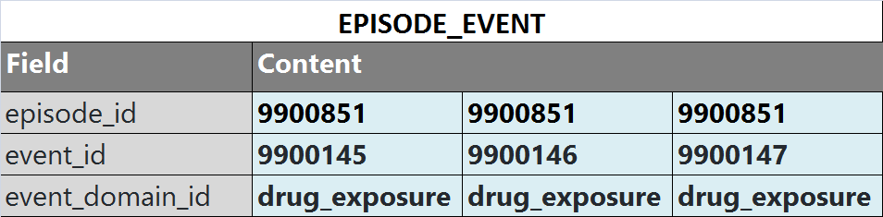
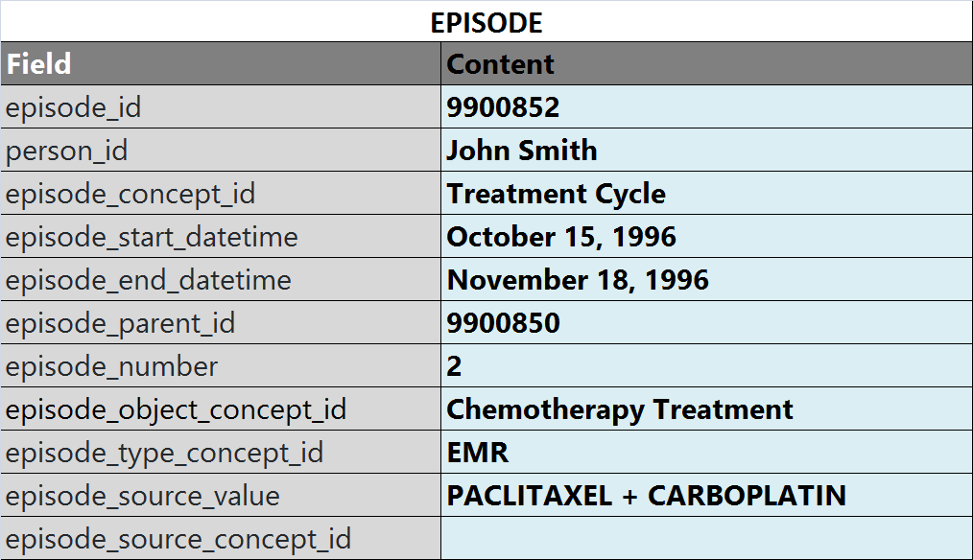
Example of a Treatment Episode record
Courtesy of OHDSI Oncology Subgroup

Slide 23
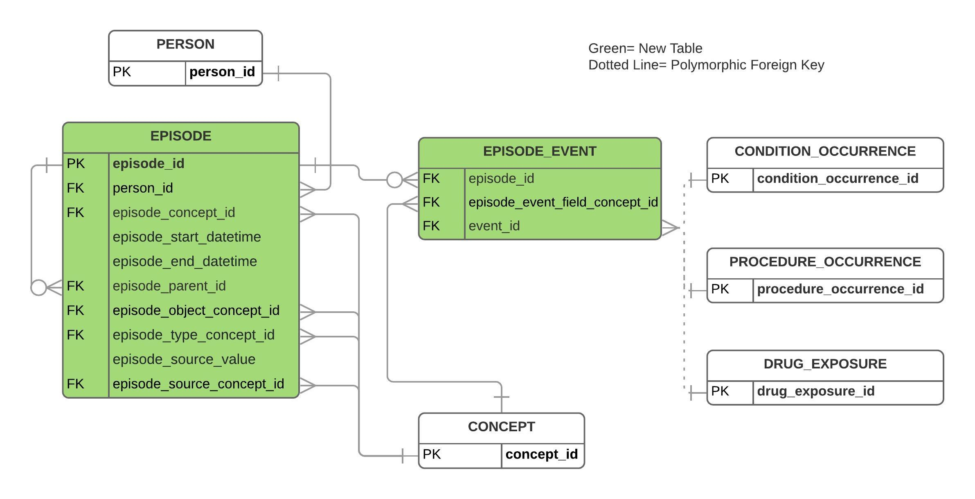
Oncology CDM Extension Proposal
https://doi.org/10.1016/j.jbi.2019.103239

Slide 24
Surveys are good; EMR extracts are better!
CDP/CDIS

Slide 25

Acknowledgments (130+ participants)
Aurora Health Care
Brown University
City of Hope
Cleveland Clinic
Columbia University/New York Presbyterian
Dana-Farber Cancer Institute
Duke University
Einstein Medical Center
Emory University/Winship Cancer Institute
Fred Hutchinson Cancer Research Center/University of Washington/Seattle Cancer Care Alliance
Gundersen Health System
Hartford HealthCare Cancer Institute
Houston Methodist Cancer Center
Inova Schar Cancer Institute
Intermountain Healthcare
Johns Hopkins University
Karmanos Cancer Institute
Loyola University Medical Center
LSU Health Sciences Center
Massachusetts General Hospital
Mayo Clinic, Rochester
Mays Cancer Center at UT Health San Antonio
MD Anderson Cancer Center
Medical University of South Carolina/Hollings Cancer Center
Moffitt Cancer Center
Mount Sinai/Tisch Cancer Institute
Northwell Health
Northwestern University/Lurie Cancer Center
NYU Langone Health/Perlmutter Cancer Center
Oregon Health & Sciences University/Knight Cancer Institute
Penn State Cancer Institute
Roswell Park Comprehensive Cancer Center
Rutgers Cancer Institute of New Jersey
SSM Health Cancer Care
Stanford University
St. Elizabeth Healthcare
The Ohio State University/The James
University Hospitals, Cleveland
University of California, Davis
University of California, San Diego
University of California, San Francisco
University of Chicago
University of Colorado Cancer Center
University of Connecticut
University of Kansas
University of Maryland
University of Miami/Sylvester Comprehensive Cancer Center
University of Michigan/Rogel Cancer Center
University of Minnesota/Masonic Cancer Center
University of North Carolina/Lineberger Comprehensive Cancer Center
University of Rochester Medical Center
Vanderbilt University Medical Center/Vanderbilt-Ingram Cancer Center
Washington University in St. Louis/Siteman Cancer Center
West Cancer Center
Yale New Haven Health/Smilow Cancer Hospital

