Slide 1

An academic perspective on drug discovery & repositioning for COVID-19
http://druggablegenome.net/
http://datascience.unm.edu/
Tudor I. Oprea
with contributions from Sorin Avram, Giovanni Bocci, Cristian Bologa, Oleg Ursu, Lars Juhl Jensen, Praveen Kumar, Vishal B. Siramshetty, and Gergely Zahoranszky-Kohalmi and many others
Funding: U24 CA224370, U24 TR002278, U01 CA239108 (NIH)
4/14/2020
OHDSI Community Call
Albuquerque, NM, via ZOOM

Slide 2
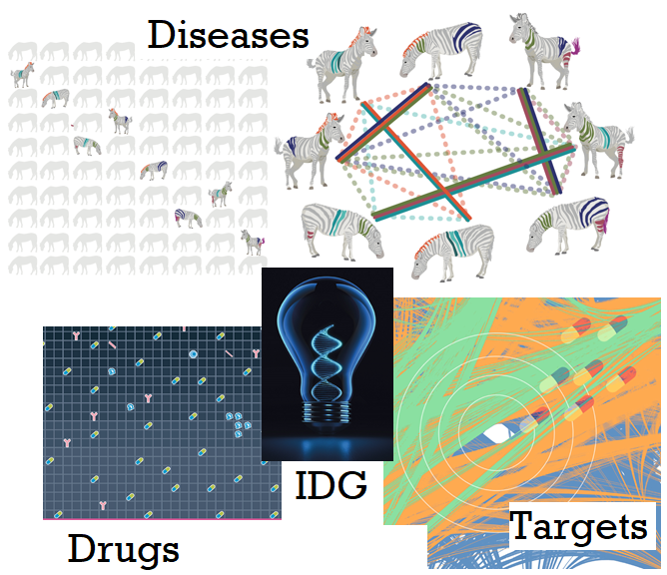

Three pillars of drug discovery
There are 3 main pillars at the root of successful drug discovery programs.
Informatics, Data Science and Machine Learning (“AI” according to the hype cycle) are successfully used, as follows:
Diseases: Significant improvements in EMR processing, nosology, ontology, and EMR-based ML for Dx & mechanisms
Targets: Knowledge graph methods, coupled with ML, for biological discovery, target selection & validation
Drugs: From virtual screening to vaccine design, therapeutic modalities benefit from predictive methods across the board
IDG is developing methods applicable to each of these 3 areas
Diseases image credit: Julie McMurry, Melissa Haendel (OHSU).
All other images credit: Nature Reviews Drug Discovery
2/5/20 revision

Slide 3
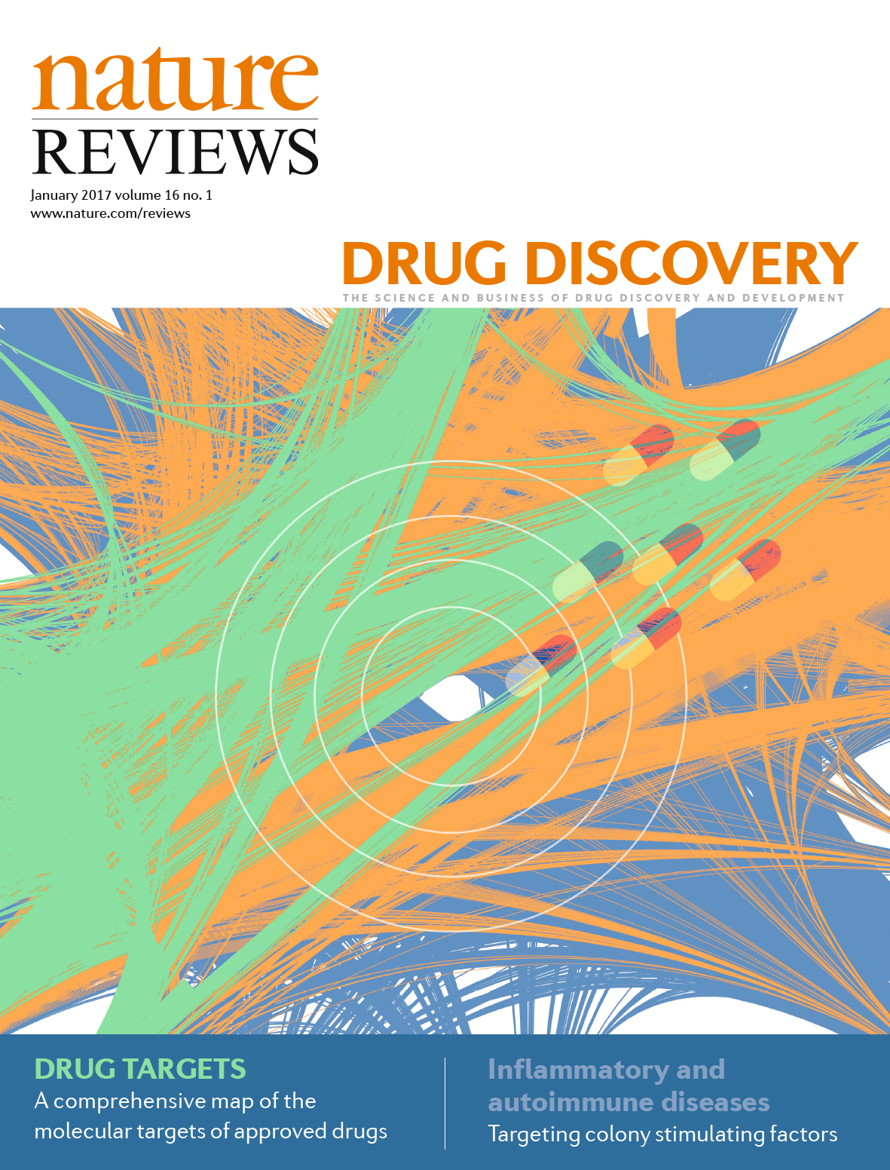
A Comprehensive map of molecular drug targets
We curated 667 human genome-derived proteins and 226 pathogen-derived biomolecules through which 1,578 US FDA-approved drugs act.
This set included 1004 orally formulated drugs as well as 530 injectable drugs (approved through June 2016).
Data captured in DrugCentral (link)
R. Santos et al., Nature Rev. Drug Discov. 2017, 16:19-34 link
2/4/20 revision
Notes:
Current IDG awardees for the different components.
Note that CEIT – Cutting Edge Informatics Tool RFA is out and applications are due July 9th. This RFA focuses on developing predictive models and improved data visualization tools.
Links to further information and news updates.

Slide 4
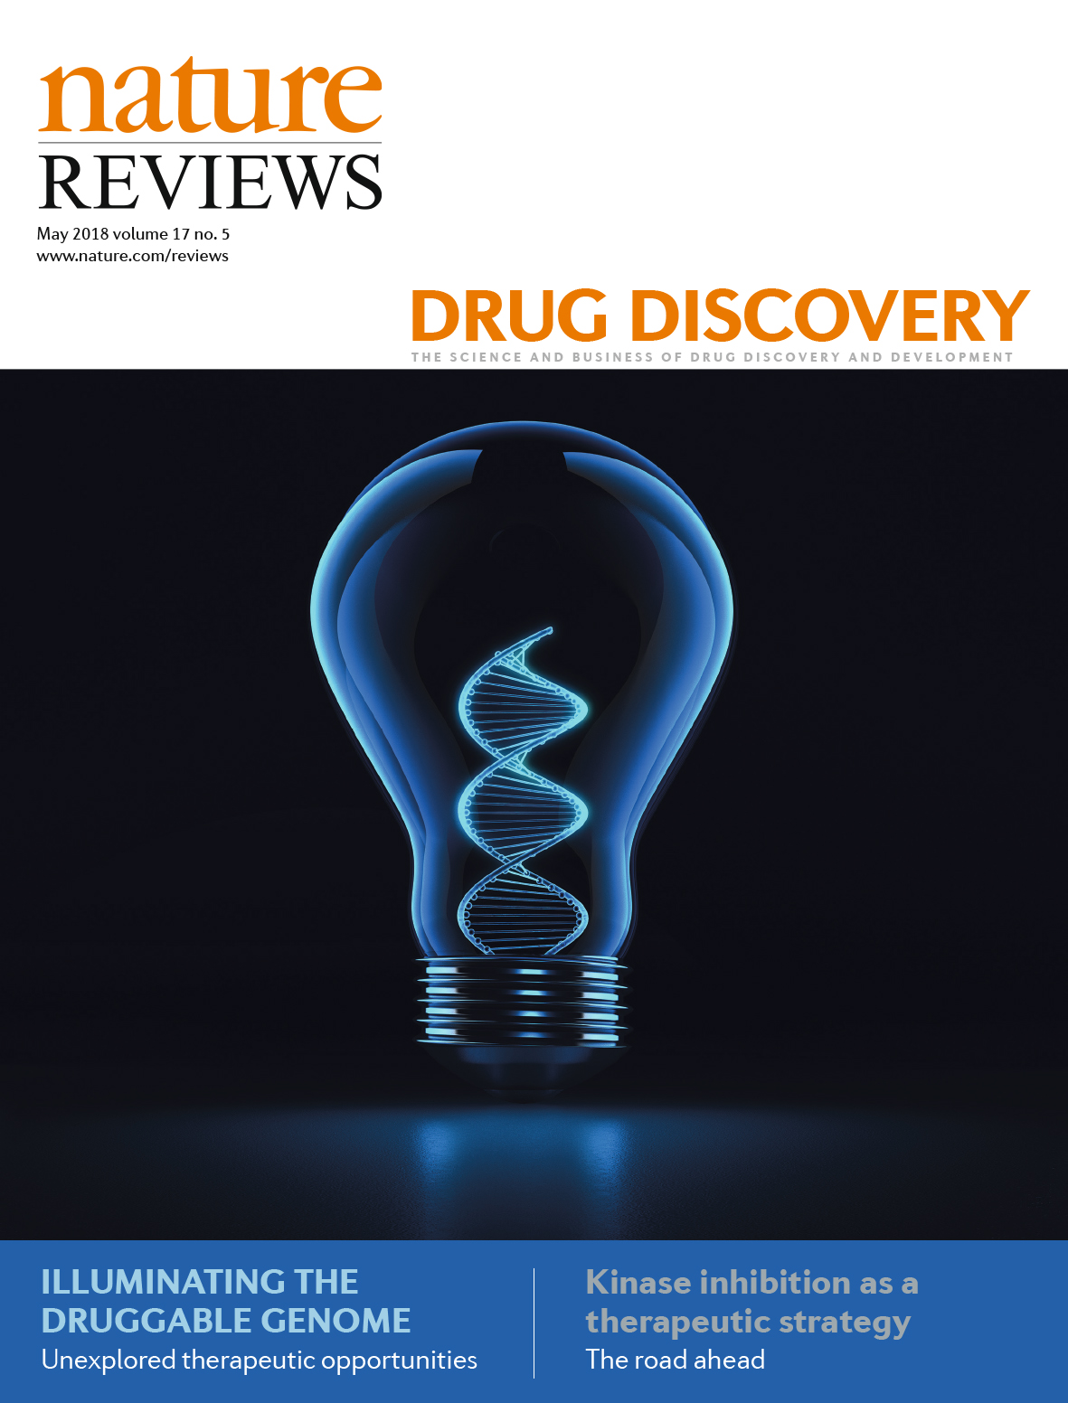
Illuminating the druggable genome
RFA-RM-16-026 (DRGC) | GPCRs | U24 DK116195: Bryan Roth, M.D., Ph.D. (UNC) Brian Shoichet, Ph.D. (UCSF)
 | Ion Channels | U24 DK116214: Lily Jan, Ph.D. (UCSF) Michael T. McManus, Ph.D. (UCSF)
 | Kinases | U24 DK116204: Gary L. Johnson, Ph.D. (UNC)
RFA-RM-16-025 (RDOC) | Outreach | U24 TR002278: Stephan C. Schürer, Ph.D. (UMiami) Tudor Oprea, M.D., Ph.D. (UNM) Larry A. Sklar, Ph.D. (UNM)
RFA-RM-16-024 (KMC) | Data | U24 CA224260: Avi Ma’ayan, Ph.D. (ISMMS) U24 CA224370: Tudor Oprea, M.D., Ph.D. (UNM)
RFA-RM-18-011 (CEIT) | Tools | U01 CA239106: N Kannan, PhD & KJ Kochut (UGA) U01 CA239108: PN Robinson, MD PhD (JAX), CJ Mungall (LBL), T Oprea (UNM) U01 CA239069: G Wu, PhD (OHSU), PG D’Eustachio PhD (NYU), Lincoln D Stein, PhD (OICR)
T. Oprea et al., Nature Rev. Drug Discov. 2018, 17:317-332 link
2/4/20 revision
Notes:
Current IDG awardees for the different components.
Note that CEIT – Cutting Edge Informatics Tool RFA is out and applications are due July 9th. This RFA focuses on developing predictive models and improved data visualization tools.
Links to further information and news updates.

Slide 5
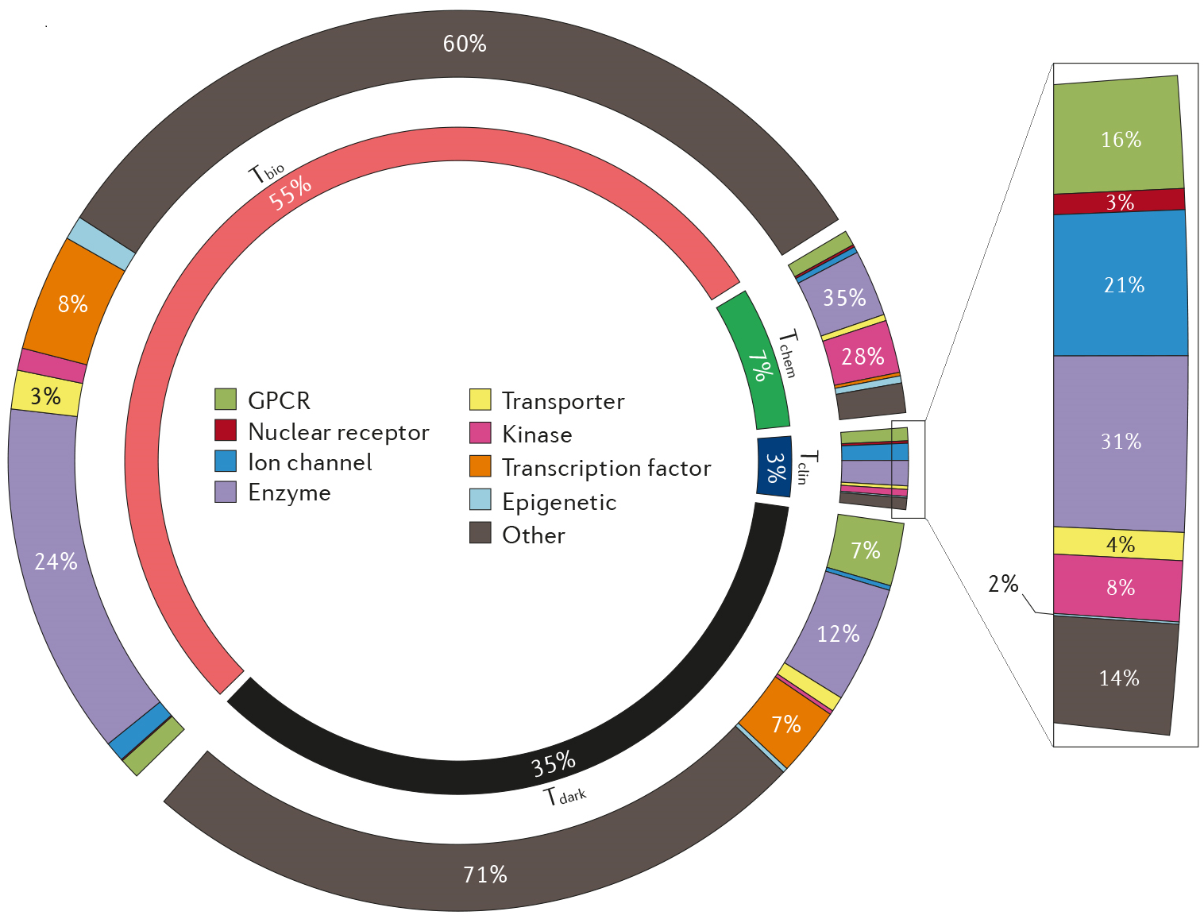
Target Development LevelS
Most protein classification schemes are based on structural and functional criteria.
For therapeutic development, it is useful to understand how much and what types of data are available for a given protein, thereby highlighting well-studied and understudied targets.
Tclin: Proteins annotated as drug targets
Tchem: Proteins for which potent small molecules are known
Tbio: Proteins for which biology is better understood
Tdark: These proteins lack antibodies, publications or Gene RIFs
2020 Update: Tdark 31.2%; Tbio 57.7%; Tchem 8%; Tclin 3.1%
T. Oprea et al., Nature Rev. Drug Discov. 2018, 17:317-332 link
2/10/20 revision

Slide 6
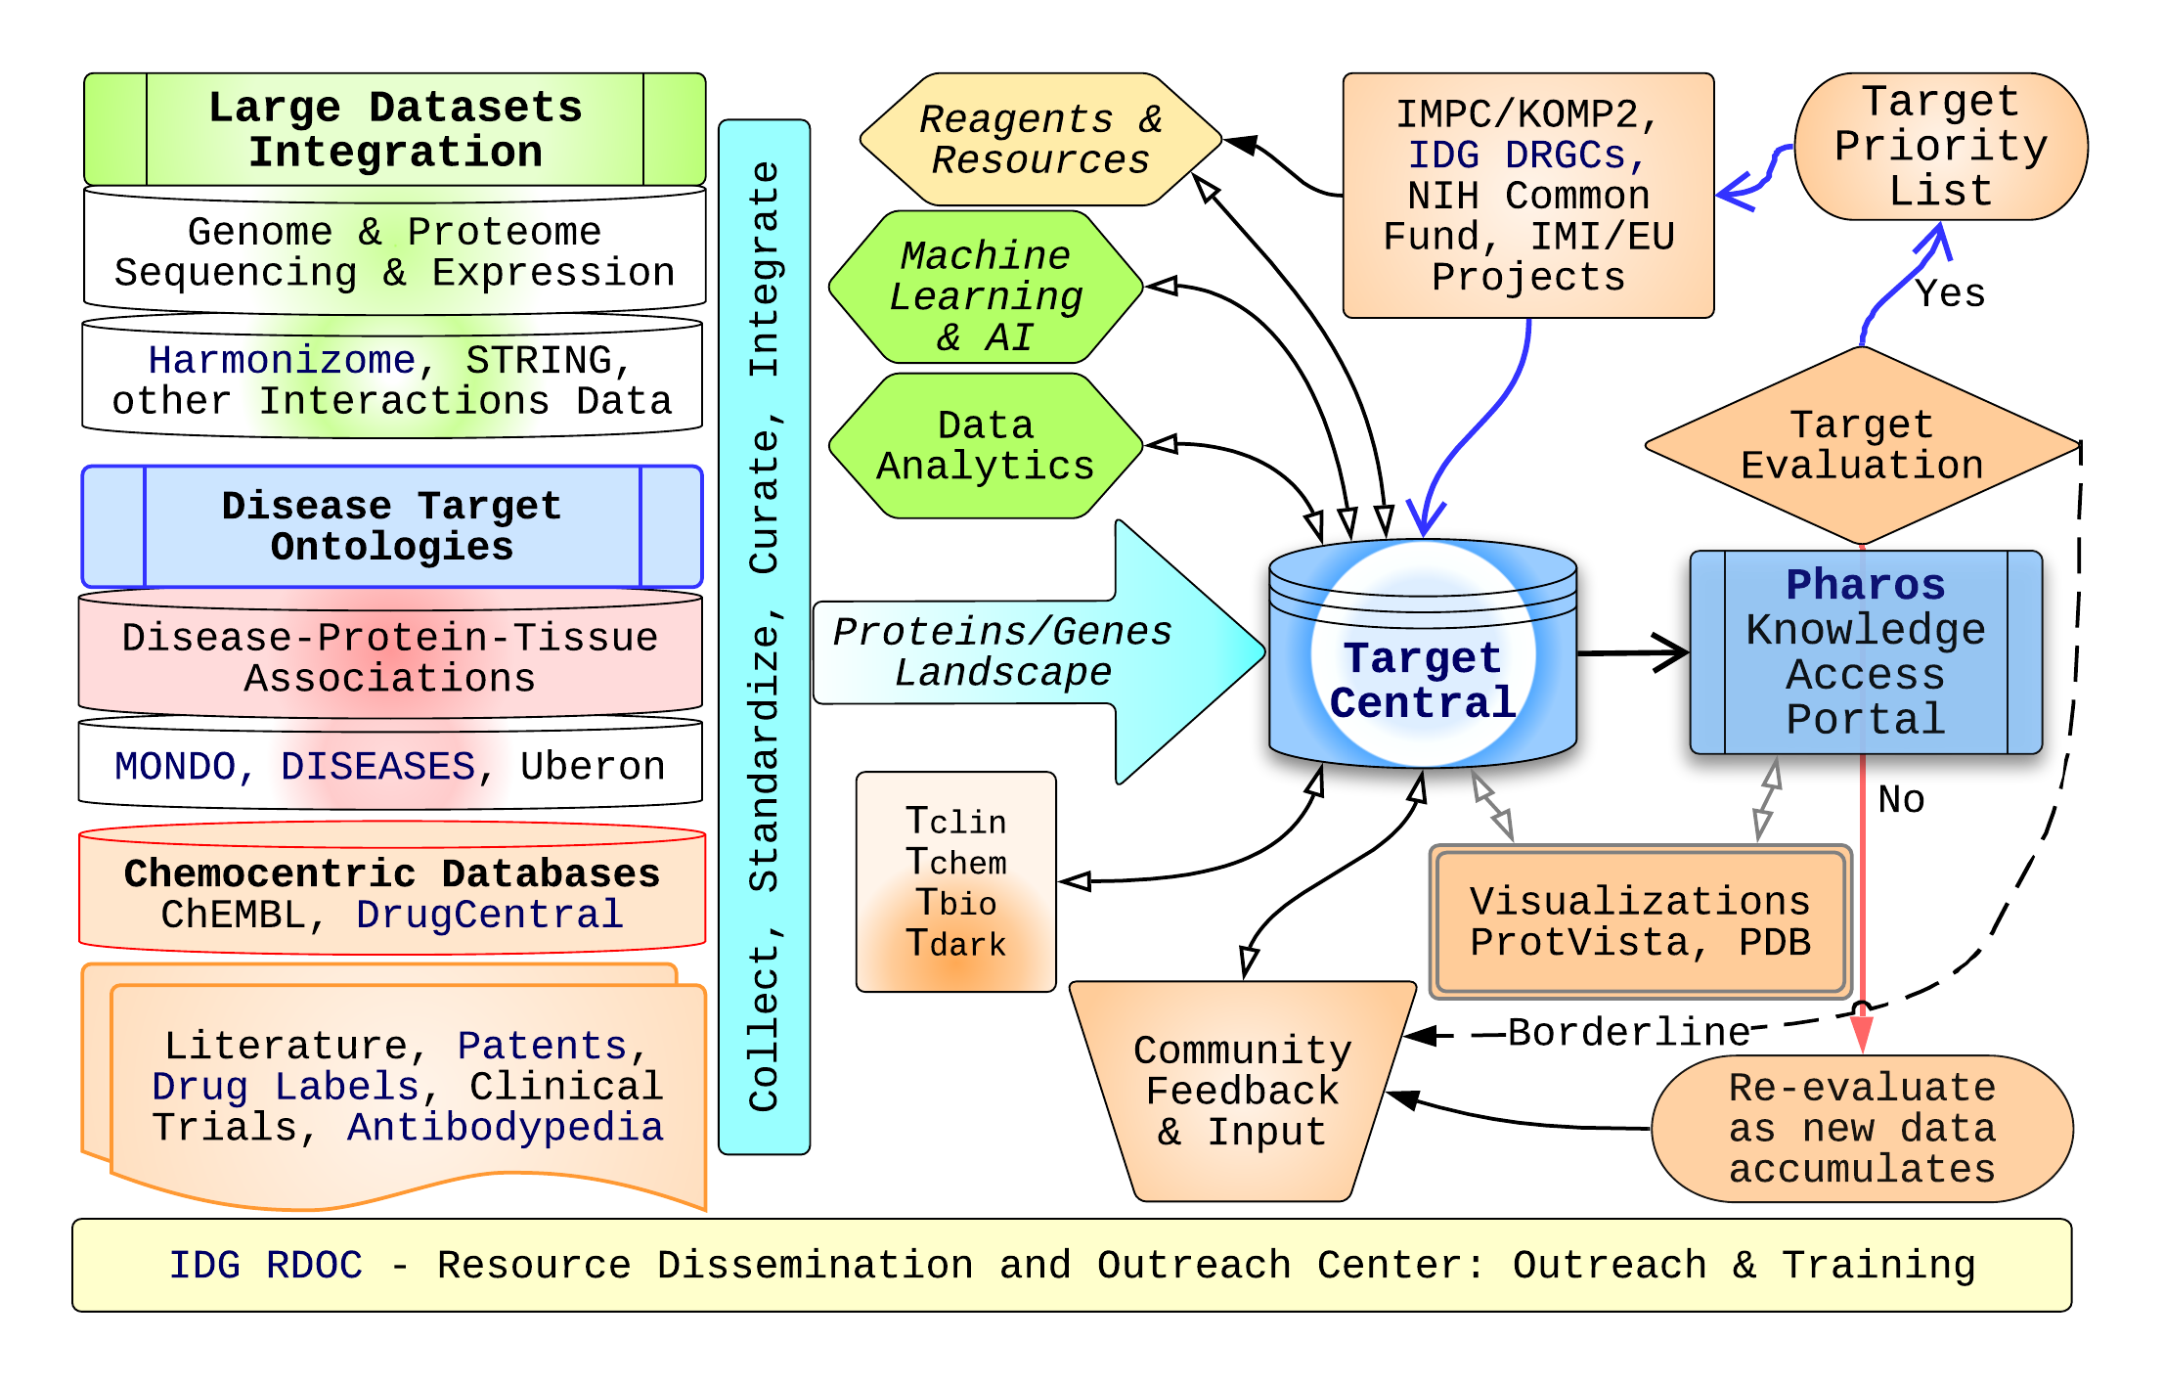

IDG KMC annotation process
Further information
Email: idg.rdoc@gmail.com
Follow: @DruggableGenome
URLs:
https://druggablegenome.net/
https://commonfund.nih.gov/idg/
IDG Knowledge User-Interface
Email: pharos@mail.nih.gov
Follow: @IDG_Pharos
URL: https://pharos.nih.gov/
IDG databases are interfaced in UniProt
https://www.uniprot.org/news
/2019/09/18/release
GTEx, LINCS, IMPC: Data from 3 CommonFund programs is already in Pharos
T. Oprea, Mammalian Genome, 2019, 30:192-200 https://bit.ly/2NUK0BK
4/25/19 revision

Slide 7
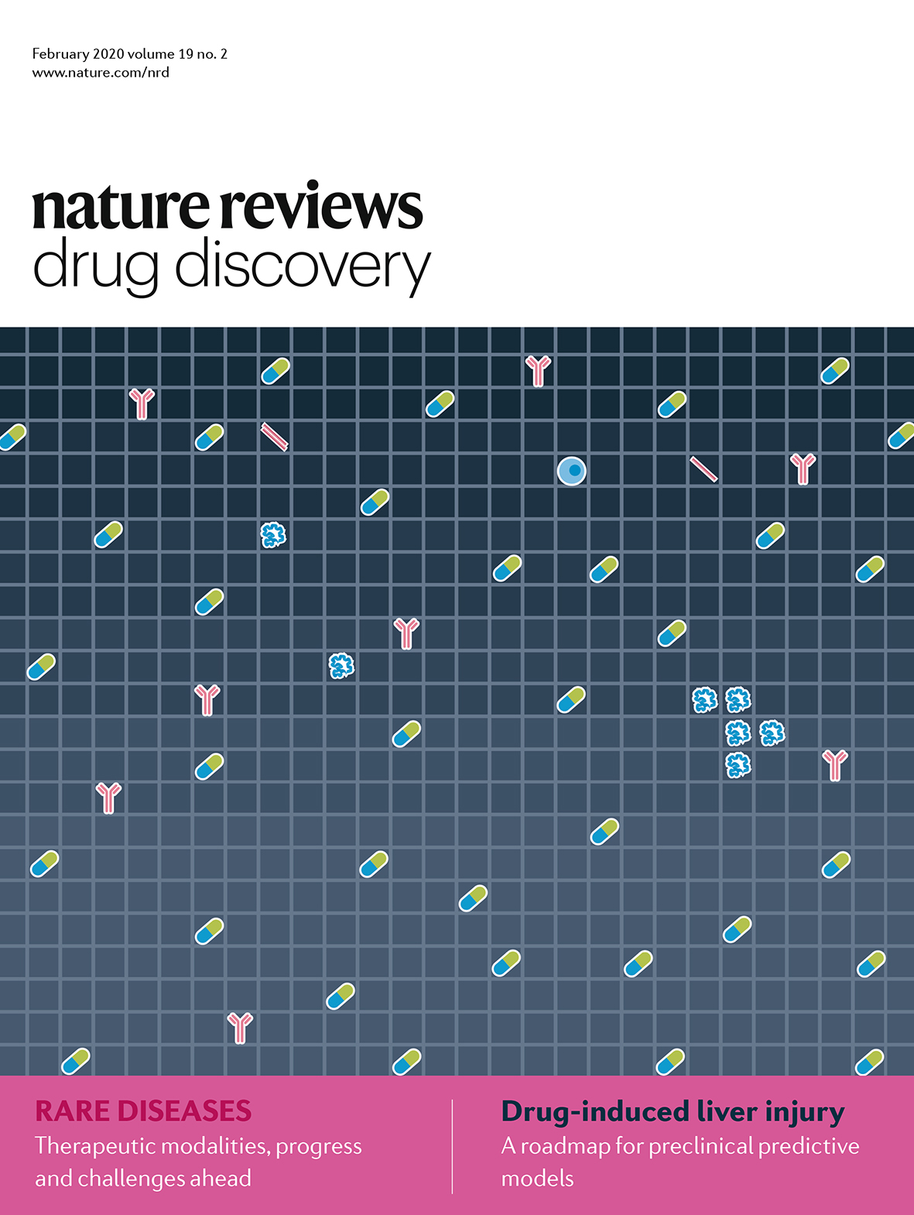
Rare diseases: an informatics survey
We revised the number of RDs from ~7,000 to 10,393 using Disease Ontology, OrphaNet, GARD, NCIT, OMIM and the Monarch Initiative MONDO system
We also pointed out the lack of a uniform definition for rare diseases, and called for coordinated efforts to precisely define them
We surveyed therapeutic modalities available to translate advances in the scientific understanding of rare diseases into therapies, and discussed overarching issues in drug development for rare diseases.
Haendel M, et al. Nature Rev. Drug Discov. 2020 19:77-78 link
2/4/20 revision
Notes:
Current IDG awardees for the different components.
Note that CEIT – Cutting Edge Informatics Tool RFA is out and applications are due July 9th. This RFA focuses on developing predictive models and improved data visualization tools.
Links to further information and news updates.

Slide 8
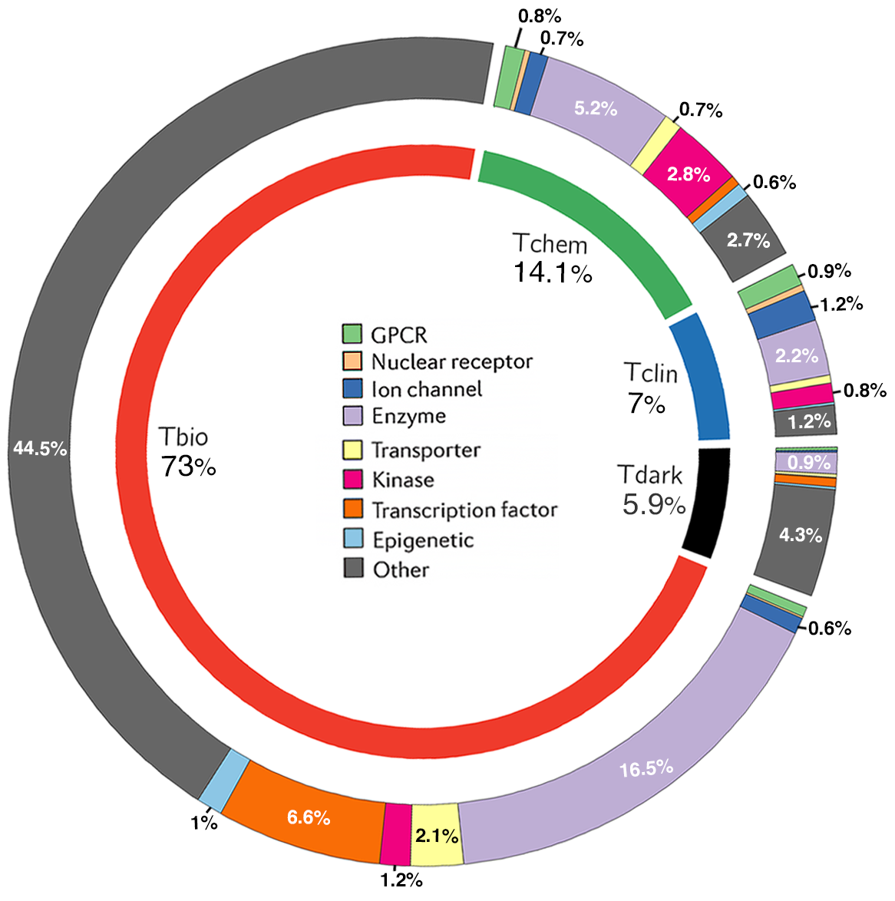
The target space OF rare diseases
6077 human proteins are associated with at least one Rare Disease.
Sources: Disease Ontology (RD-slim), eRAM and OrphaNet
~50% agreement (gene level)
Contrast: Tclin at 3% & Tchem at 7% overall vs. RD subset: 6.94% Tclin and 14.1% for Tchem.
20% of the RD proteome is Tclin & Tchem. This means hope for cures.
Potentially significant opportunities for target & drug repurposing.
Tambuyzer E, et al. Nature Rev. Drug Discov. 2020 19:93-111 link
2/4/20 revision

Slide 9
Take Home Message
There is a Knowledge Deficit
~31% of the proteins remain understudied (Tdark, ignorome)
that number is steadily decreasing
~11.1% of the Proteome (Tclin & Tchem) are currently targeted by small molecule probes and drugs – that number is slowly increasing
With help from rare disease patient advocacy groups, rare disease research is likely to witness a significant increase in translation
2/5/20 revision

Slide 10
COVID-19 Clinical Trials
To date, no drug is expressly approved for SARS-CoV-2 infections except the emergency authorization for (hydroxyl)chloroquine.
Until such time that effective vaccines and/or therapeutics are approved, our “best guess” is “drug repositioning” (aka drug repurposing) followed by drug discovery
As of 4/13/20, there were 469 clinical trials for “COVID-19”.
Of these 469 clinical trials, 222 are for a “drug” intervention.
https://clinicaltrials.gov/ct2/results?cond=COVID-19
4/14/20 revision

Slide 11
Curating COVID-19 Clinical Trials
Manual curation (by intervention), e.g., identify experimental (novel) drug vs. already approved drug; reconcile spelling errorls (e.g., hidroxicloroquin; abidol)
Five general categories: Placebo (63), Antiviral (40), Experimental (29), Repurposed (165), Biologic (50)
Twenty-one “specific” categories: HCQ (63), CQ (8), Azithromycin (20), -navir (20), Oseltamivir (4), Favipiravir (3), Umifenovir (5), Remdesivir (9), -tinib (8), RAS drugs (13), NSAIDs (4), Steroid (13), TMPRSS2 (4), Traditional Chinese (8), Colchicine (4), Gases (10), Tocilizumab (14), Anakinra (4), IFN (12), Ig-based (4), Supplements (6)
https://clinicaltrials.gov/ct2/results?cond=COVID-19
4/14/20 revision

Slide 12
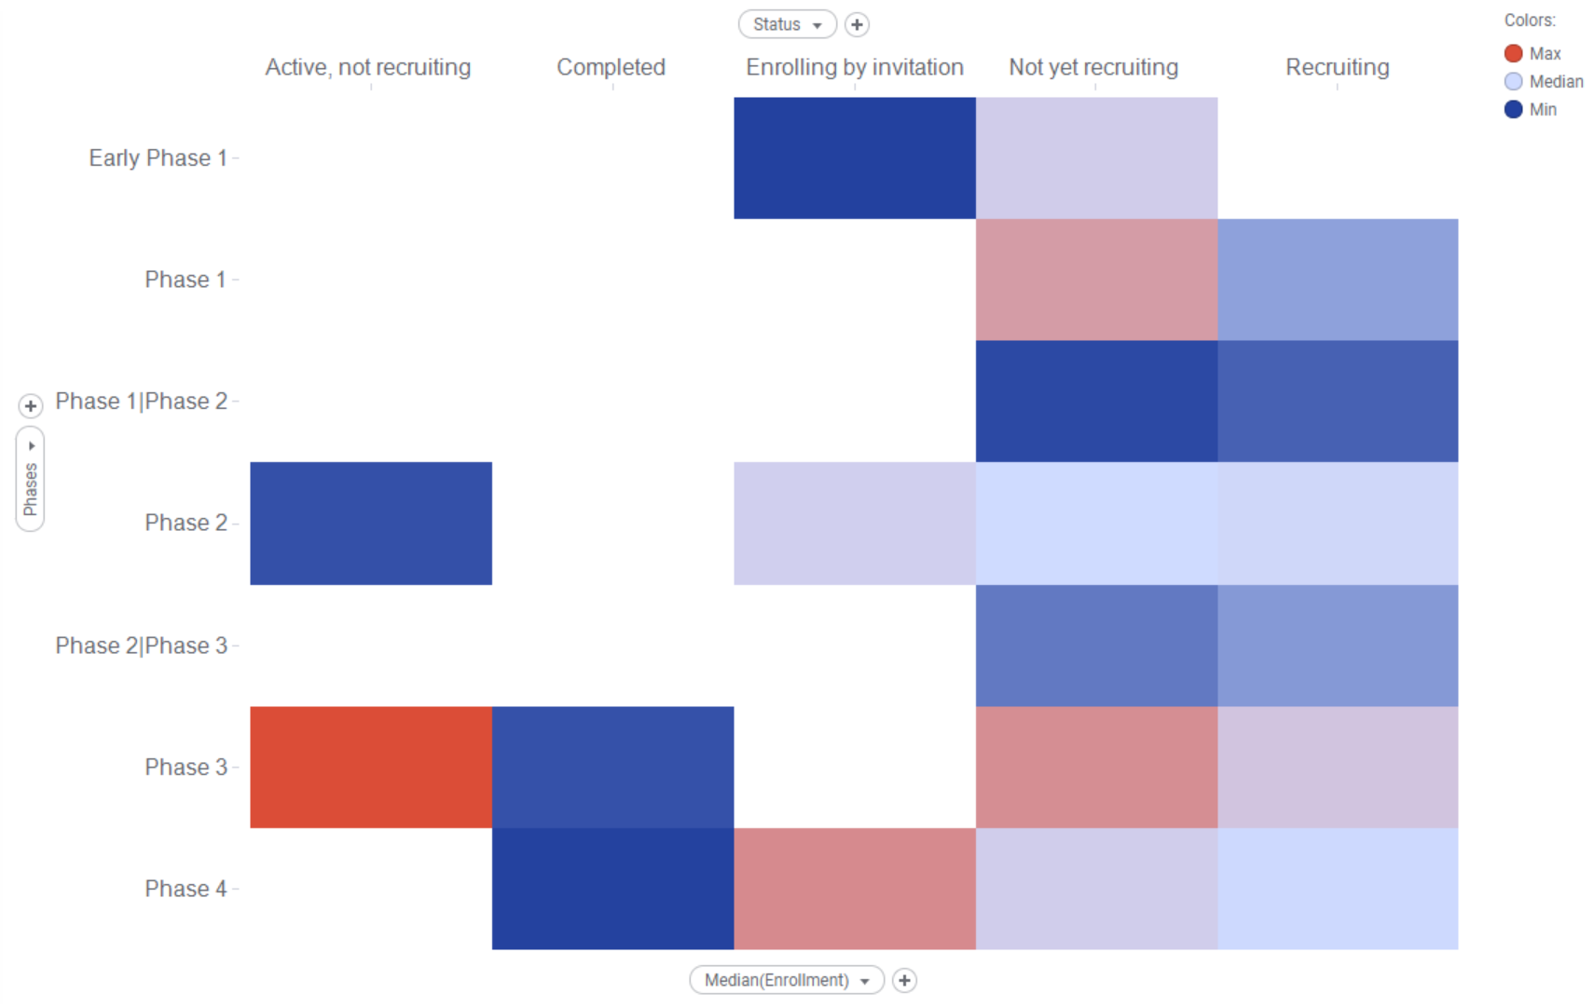
repositioning Clinical Trials: enrollment
COVID-19 only
Filtered out: Observational studies; “not repurposed” (e.g., experimental); withdrawn; “Phase” N/A, or not applicable).
Median: 205 patients
https://clinicaltrials.gov/ct2/results?cond=COVID-19
4/14/20 revision

Slide 13
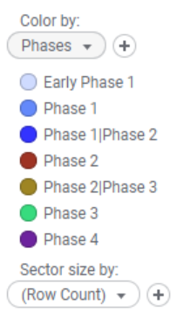
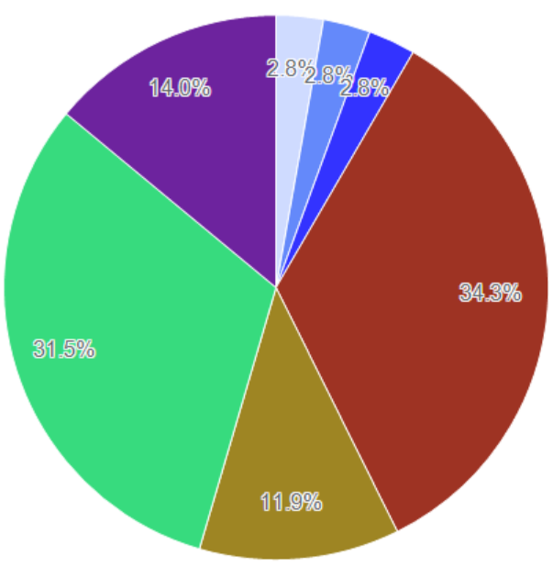
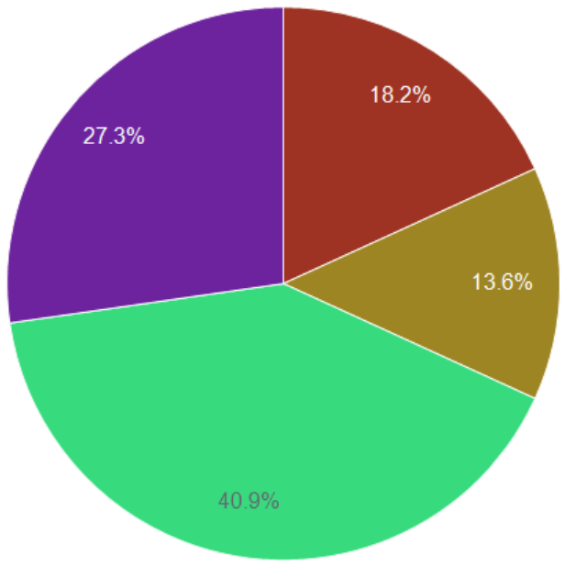
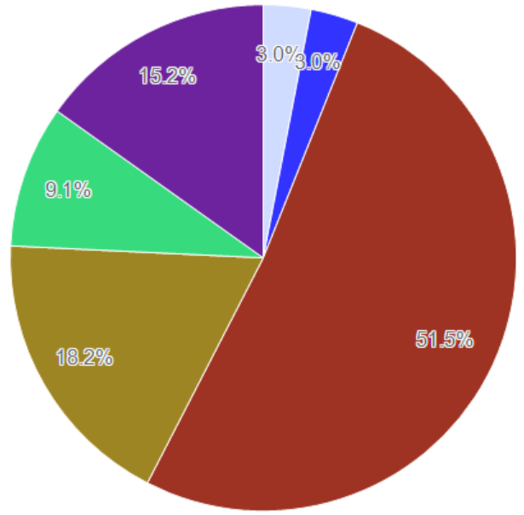
repositioning Clinical Trials: Summary
All repurposed; N = 143
Antiviral; N = 22
Biologics; N = 33
https://clinicaltrials.gov/ct2/results?cond=COVID-19
4/14/20 revision

Slide 14
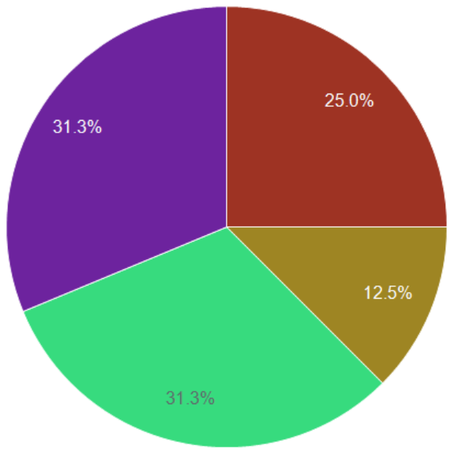
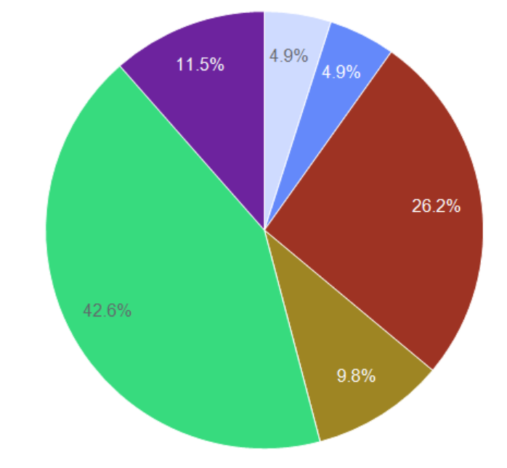
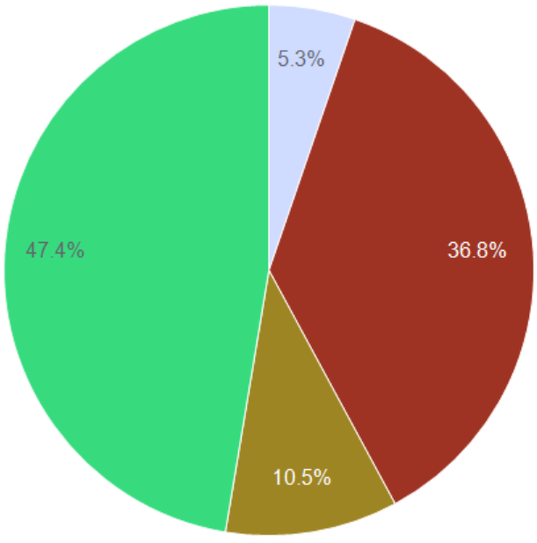
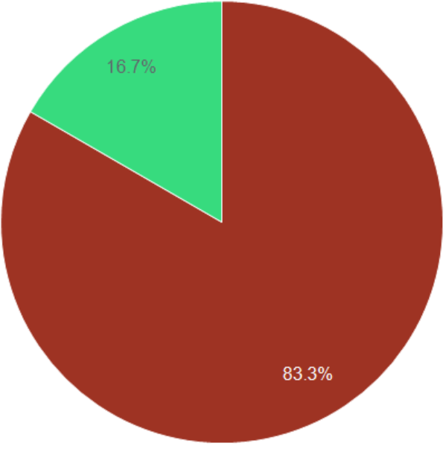
Repositioning trials by drug
-navir; N = 16
HCQ; N = 61
Azithromycin; N = 19
Tocilizumab; N = 12
https://clinicaltrials.gov/ct2/results?cond=COVID-19
4/14/20 revision

Slide 15
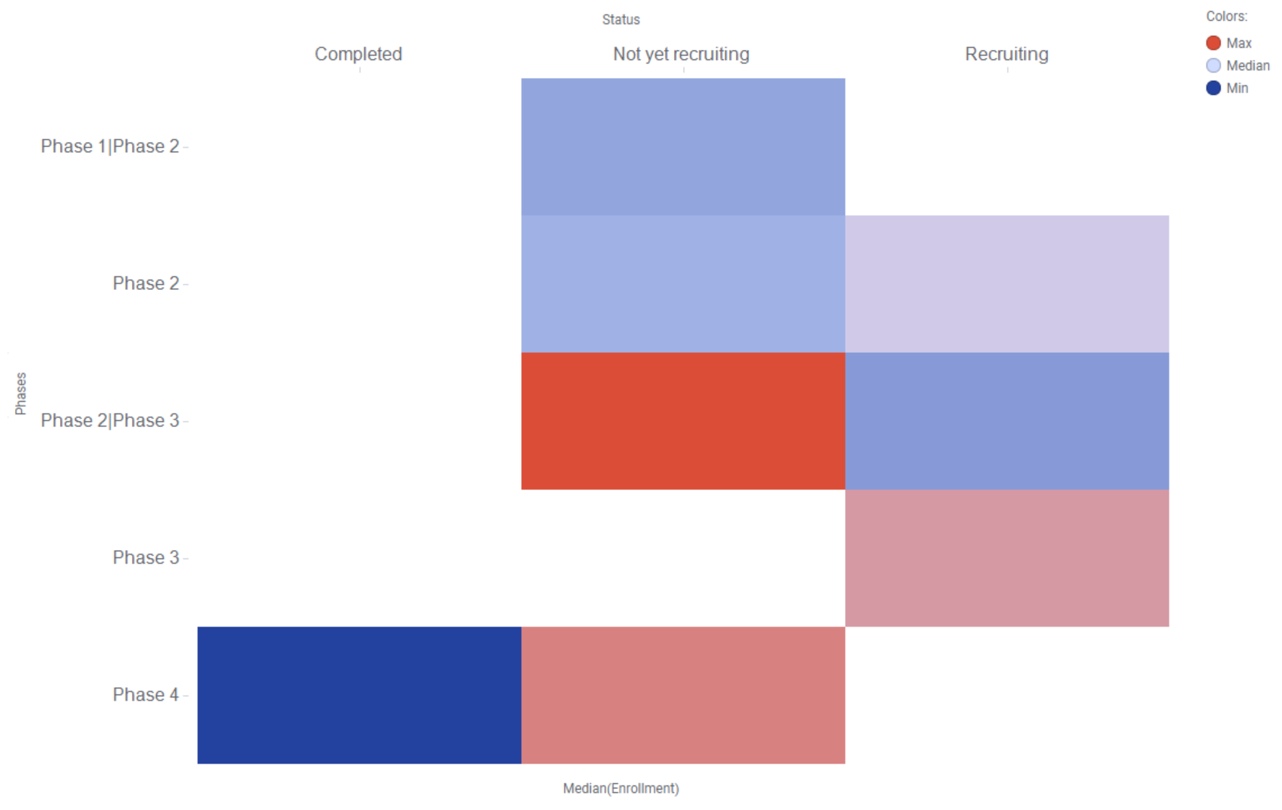
Experimental Clinical Trials: enrollment
COVID-19 only
Filtered out: Observational studies; “not repurposed” (e.g., experimental); withdrawn; “Phase” N/A, or not applicable).
Experimental drugs shown.
Median: 216 patients
https://clinicaltrials.gov/ct2/results?cond=COVID-19
4/14/20 revision

Slide 16
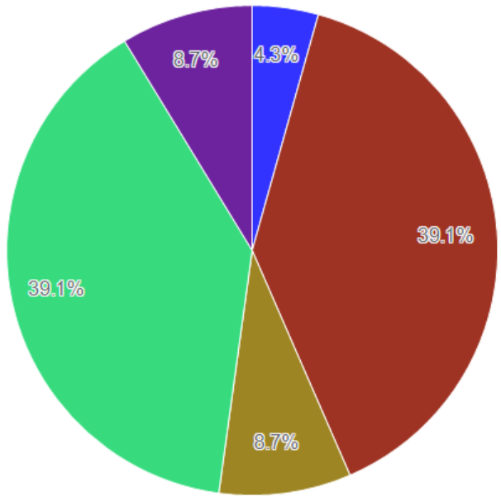
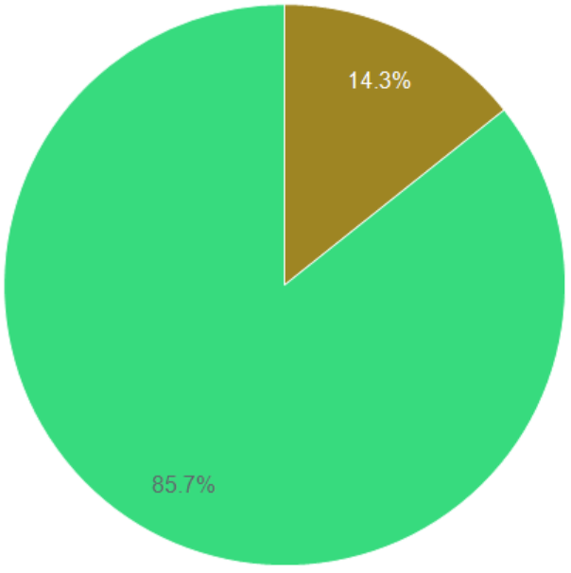
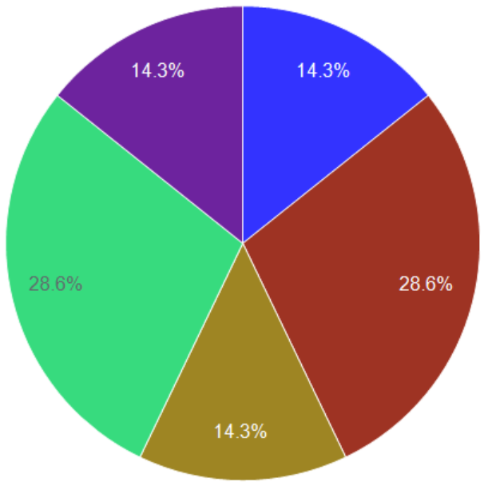
experimental Clinical Trials: Summary
Experimental; N = 23
Remdesivir; N = 7
Biologics; N = 7
https://clinicaltrials.gov/ct2/results?cond=COVID-19
4/14/20 revision

Slide 17
Take Home Message most covid-19 interventional clinical trials are focused on drug repositioning
The majority study HCQ (61 out of 143)
2/5/20 revision

Slide 18
How many drugs for repositioning?
 | Drug Product Forms (Patents)* | Drug Products | Type N Drug Products | Drugs (Patents)* | RX Drugs **
On-Patent | 12236 (4585) | 1057 | 1057 | 785 (738) | 762
Off- Patent | 22131 | 11874 | 1906 | 1454 | 1404
Discontinued | 16963 | 11388 | 2801 | 680^ | n.a.
All Drugs | 51330 | 22362 | 5042 | 2557 | 1828 (1258)
Analysis based on the archived OrangeBook (2016 – 2019) and the latest Orange Book Data Files (OBDFs; EOBZIP_2019_10.zip content current as of: 10/18/2019) combined with the lists of Newly Added Patents and Delisted Patents
  * Number of Patents; ** Number of RX drugs as single ingredient; ^ 1833 total, only 680 discontinued
    Drug Product Forms = # of PIDs (all drug forms, routes, strengths etc)
    Drug Products = # of Application Numbers
    Type “N” Drug Products = # of Application Numbers of type “N”. i.e., NDA (new drug application). The rest of the Drug products are “ANDA”, i.e., abbreviated new drug applications.
    Drugs = # of (active) ingredients, i.e., actual drug (includes combinations)
    RX Drugs = # of drugs on prescription. The rest of the drugs are OTCs.
Up to 1772 active ingredients may be eligible for “off patent” repurposing
S. Avram & T. Oprea, unpublished.
12/04/19 revision

Slide 19
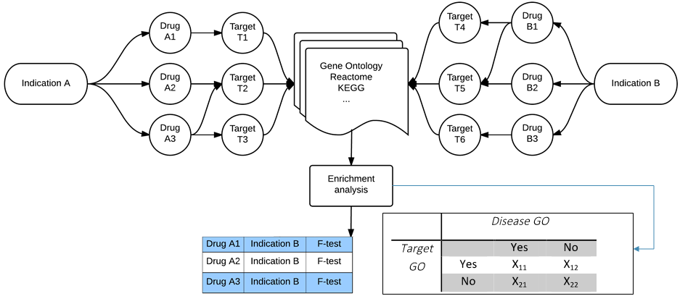
How many targets for repositioning?
Indications from DrugCentral were mapped onto proteins with bioactivity for Drugs in DrugCentral: 881 proteins x 1091 unique Indications (over 873k pairs).
Pearson's chi-squared statistics and Fisher test p-values were applied with the False Discovery Rate correction to p-values (P.adj).
At χ² > 1000 and P.adj ≤ 10⁻⁹, we found up to 60258 novel protein-indication pairs.
X₁₁ – GO terms count annotated for Disease and Target
X₁₂ – GO terms count annotated for Target and not Disease
X₂₁ – GO terms count annotated for Disease and not Target
X₂₂ – GO terms count annotated for not Target and not Disease
Note: this set has not been yet been filtered for off-patent drugs
O. Ursu, C. Bologa & T. Oprea, unpublished.
12/04/19 revision

Slide 20
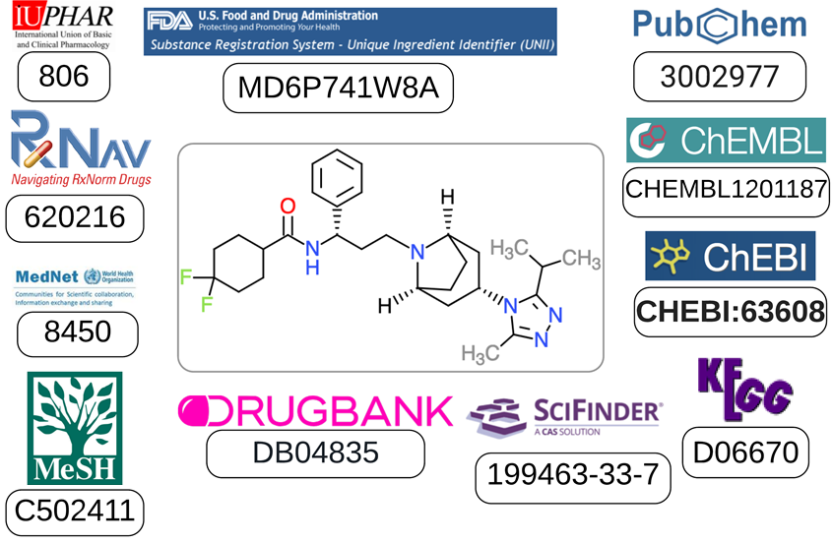
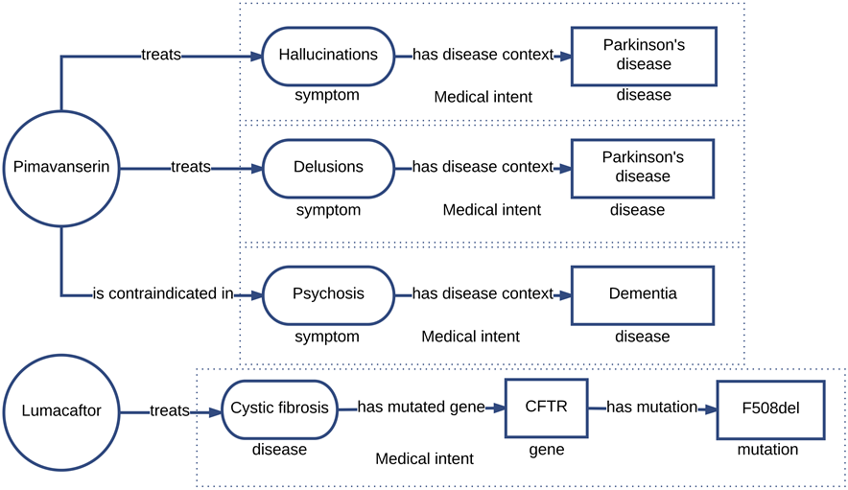
ID mapping & therapeutic DRUG intent
Left: Keeping track of multiple identifiers (to navigate across many resources) is a full-time job
Right: Automated drug repositioning systems are likely to fail because, as of today, no system is capable of capturing therapeutic intent. If it cannot be captured, it cannot be modeled.
S.J. Nelson et al, J Am Med Info Assn, 2017, 24:1169-1172. doi: 10.1093/jamia/ocx064
9/25/17 revision

Slide 21


Drug repositioning intelligence
Algorithmic Evaluation of Drug Repositioning Opportunities
Physico-Chemical Characteristics | Target & Ligand Based Virtual Screening | Disease-Target-Drug Associations
Chemical fingerprints, chemotypes, derivative chemical descriptors | Shape & electrostatics derived similarity or complementarity | Disease & Drug target GO Annotations from STRING, GO, KEGG, other sources
Solubility, Permeability, Distribution, relevant PK properties | 3D models for intended targets, followed by molecular docking | Contigency Tables, e.g., Fisher test for associations augmented via AI/ML
Metabolism, efflux transporters, toxicity end-points | Multiple tautomers / protomers / conformers / binding modes per protein | Prioritize novel disease-target associations for off-patent drugs
Iteratively Compare, Integrate, Cross-check, Prioritize, Evaluate
Phase II / Phase III
clinical trials
Biomolecular screen
Biology-Chemistry-Informatics-Clinical Team Interactive Evaluation
Confirmation of
clinical effects
New Target Activity:
In vitro animal
In vivo animal
Human studies
Disease relevance
Efficacy/Safety
Virtual screen
Implement exact annotations for drug indications and off label uses.
Mandate rigorous validation for computational models.
Support community-based therapy-area specific research.
Turn DR into an international effort, preferably focused on diseases that lack cure
12/04/19 revision

Slide 22
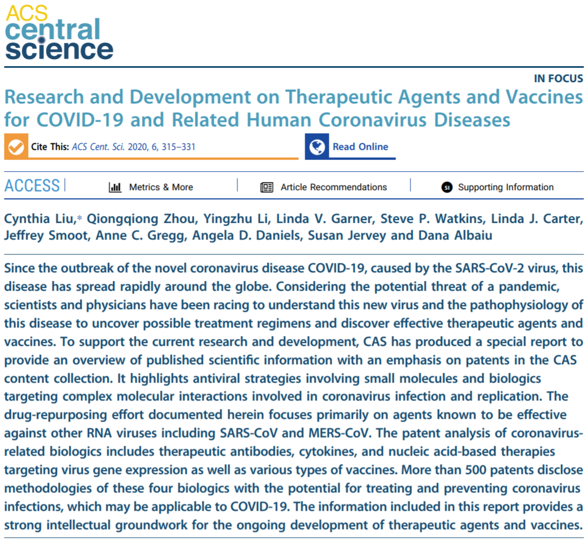
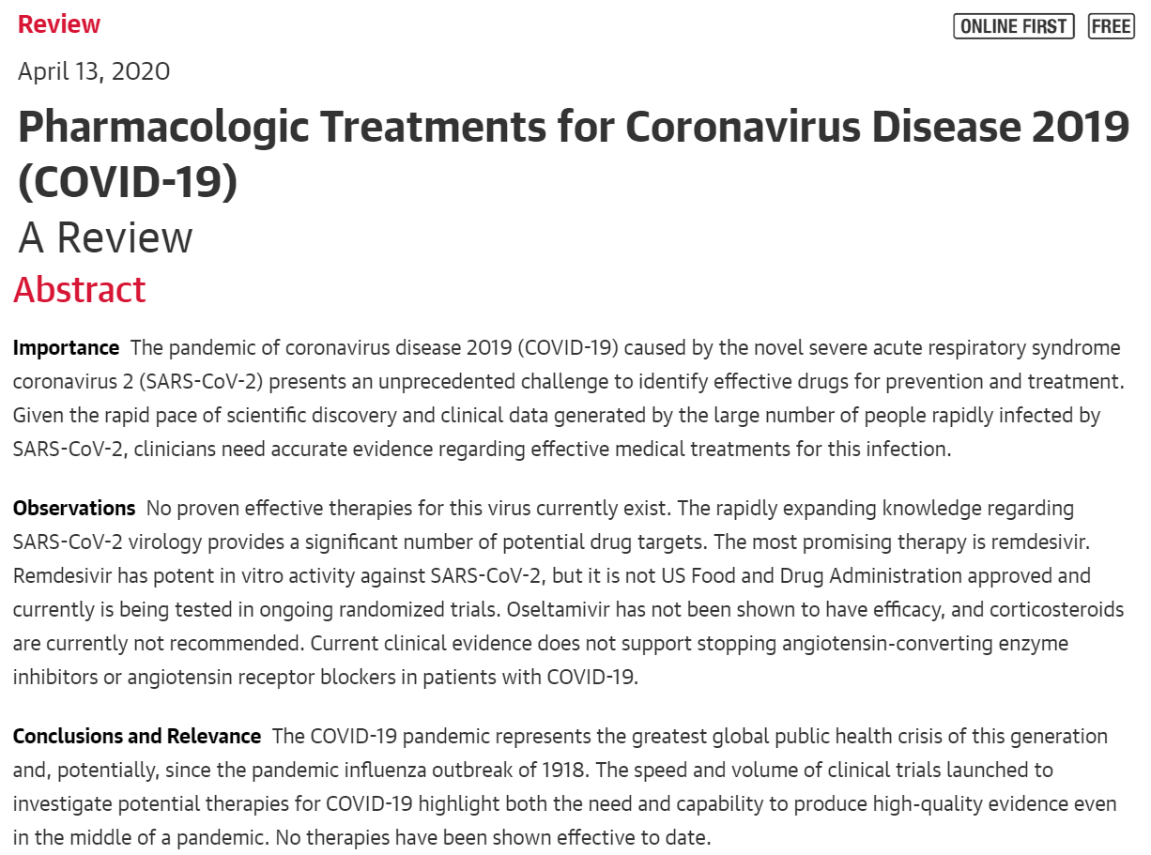
Some repositioning papers
https://pubs.acs.org/doi/pdf/10.1021/acscentsci.0c00272
https://jamanetwork.com/journals/jama/fullarticle/2764727
04/14/20 revision

Slide 23
The SARS-CoV-2 Human
Protein Interactome
04/14/20 revision

Slide 24
Data Sources and Methods
Krogan et al., preprint (cleaned-up by Lars Jensen, PhD)
P-HIPSTER predictions
Metapath/XGBoost AIML predictions
STRING analysis (StringApp, Cytoscape)
04/02/20 revision

Slide 25
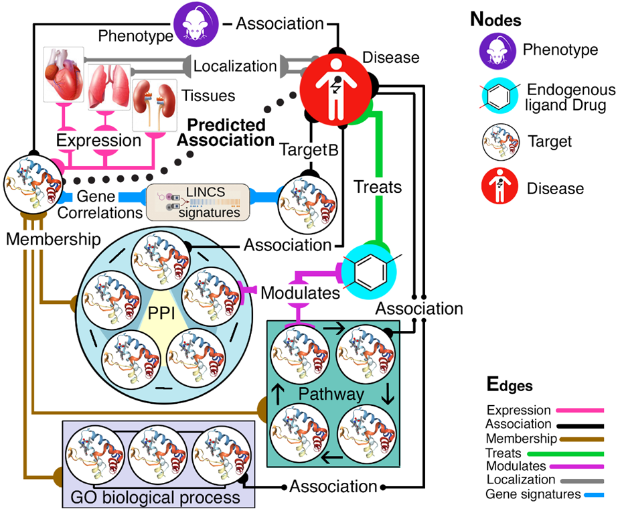
Protein knowledge graphs
IDG KMC2 seeks knowledge gaps across the five branches of the “knowledge tree”:
Genotype; Phenotype; Interactions & Pathways; Structure & Function; and Expression, respectively.
We can use biological systems network modeling to infer novel relationships based on available evidence, and infer new “function” and “role in disease” data based on other layers of evidence
Primary focus on Tdark & Tbio
O. Ursu, T Oprea et al., IDG2 KMC
2/1/18 revision

Slide 26
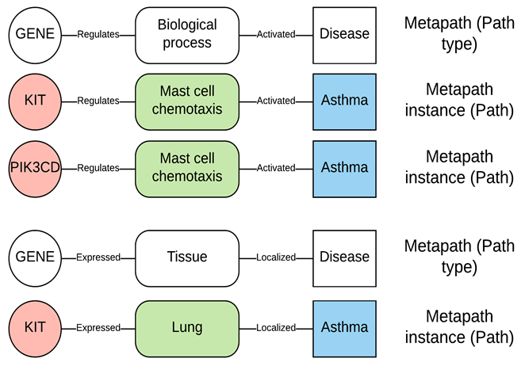
The Metapath approach
a meta-path is a path consisting of a sequence of relations defined between different object types (i.e., structural paths at the meta level)
Our metapaths encode type-specific network topology between the source node (e.g., Protein) and the destination node (e.g., Disease).
This approach enables the trans-formation of assertions/evidence chains of heterogeneous biological data types into a ML ready format.
Similar assertions or evidence form metapaths (white).
Instances of metapath (paths) are used to determine the strength of the evidence linking a gene to disease/phenotype/function.
G. Fu et al., BMC Bioinformatics 2016, 17:160 is an early example for drug discovery
10/18/18 revision

Slide 27
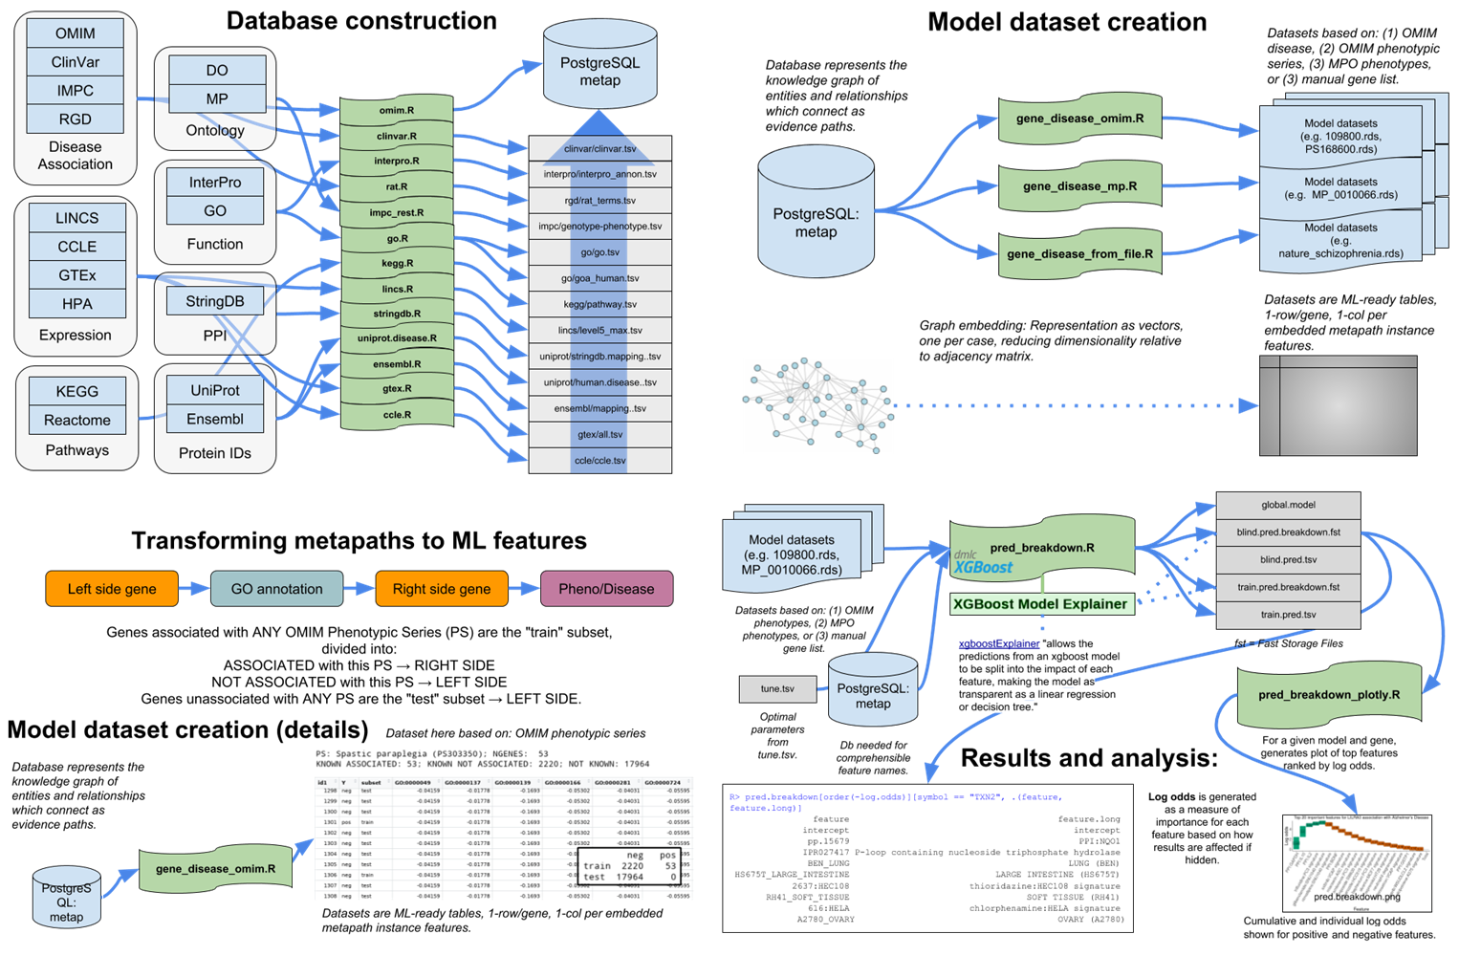
Metapath/XGBoost ml workflow
All datasets are merged, via R scripts, into a PostgreSQL. Python under development.
Graph embedding transforms evidence paths into vectors, converting data into matrices.
Input genes are positive labels. OMIM (not input) are negative labels (we prefer true negatives where possible).
XGBoost runs 100 models. The “median model” (AUC, F1) is then selected for analysis and prediction to avoid overfitting.
J.J. Yang, P. Kumar, D. Byrd et al., IDG2 KMC
10/15/19 revision

Slide 28
MetaPath / XGBoost model Input
P-HIPSTER: ACE2 (experimental) plus 25 other predicted proteins
CD147 (experimental)
71 proteins (mass proteomic pull-down, Krogan et al paper)
Total 98 positives
Another 120 negatives from the Krogan paper
6 models built, based on variations of this input
04/02/20 revision

Slide 29
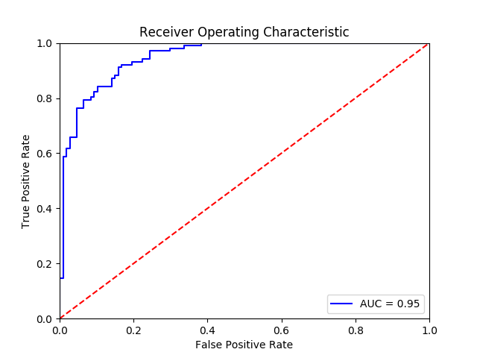
MetaPath / XGBoost model output
986 proteins were predicted with “high confidence” by the 6 models
136 are predicted by 3 or more models.
99 of the 3x predicted proteins were Tbio/Tchem/Tclin
These were used in combination with the input proteins plus the viral proteins from Krogan et al to examine the network models.
04/02/20 revision

Slide 30
Network Workflow
Data consolidation
Building the core network (analysis/network/COVID_19_Merged_Virus_Human_PPI_Network.cys)
  Virus-protein PPIs extracted
    Preprint: as is
    P-HIPSTER: as is
    Tudor’s AIML: assumed that predictions were made for the spike protein only (?)
  PPIs merged, deduplicated, annotated by data source
    Direction of PPIs: virus -> human (for consistency)
  Node attributes added:
    NodeType: virus/human
    Tdl: TCRD v64 Yellow-colored proteins, virus proteins were assigned to value of “virus”, rest to “unk” (meaning that I did not have the information, did not check Pharos)
Assembling the extended network (analysis/network/STRING_Extended_COVID_19_PPI_Network.cys)
  Human nodes of core network used as query for STRINGApp in Cytoscape
  STRINGApp settings: min. PPI confidence: 0.90, max interactors: 100
  Network edges and all attributes were exported
  Network nodes and edges merged with that of “core network
04/02/20 revision

Slide 31

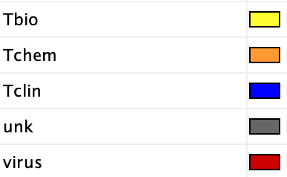

Network Visualization
Custom Cytoscape style created (analysis/network/covid19_styles.xml)
Nodes:
  NodeType
  TDL categories:
Edges
P-HIPSTER
STRINGApp
Preprint
Tudor’s AIML
04/09/20 revision

Slide 32
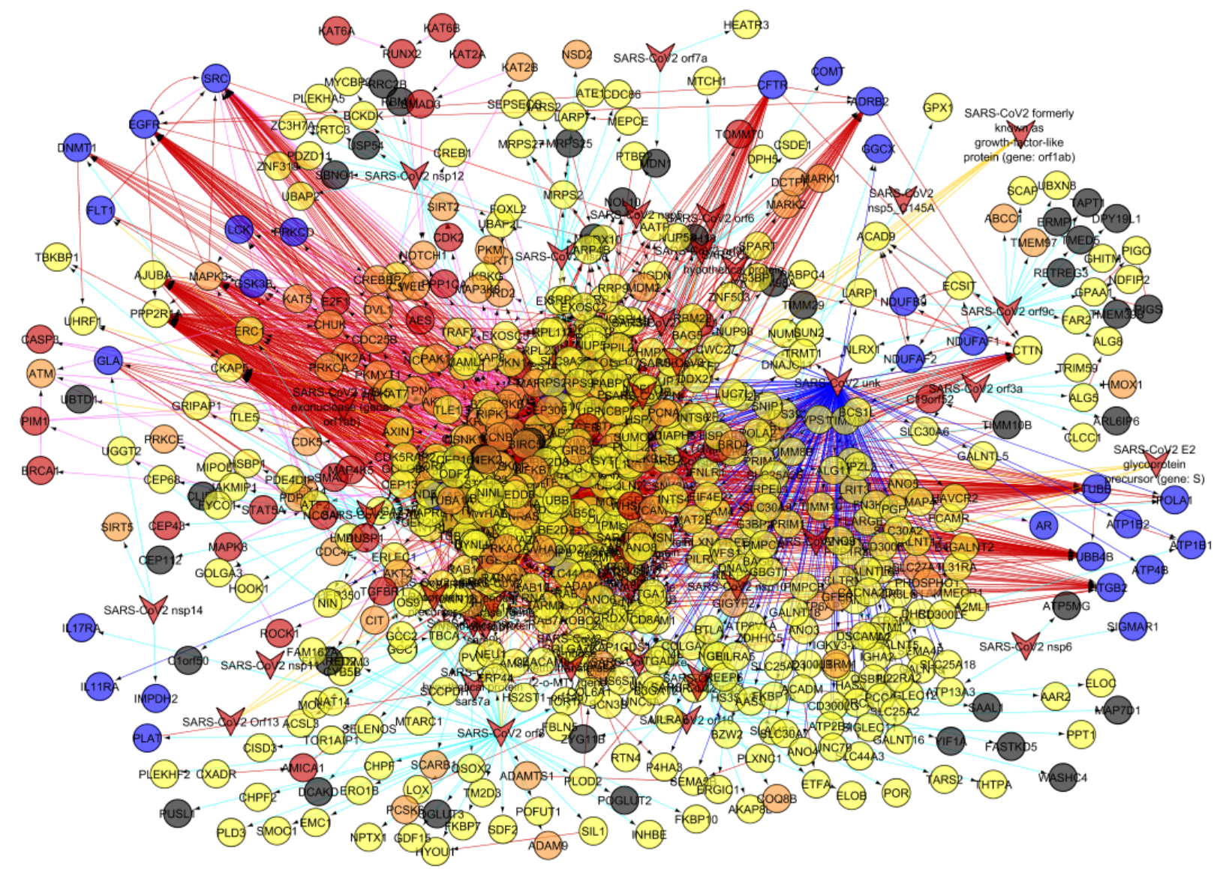
SARS-CoV-2 Human Protein Interactome
SARS-CoV-2 proteins interact with multiple Tclin targets (blue).
Less priority given to ATP- and tubulin- type related targets.
Exploration in progress…
04/09/20 revision

Slide 33
Early Results
HDAC2
Interacts with SARS-CoV2 nsp5 and with SARS-CoV2-Spike.
HDAC inhibitors: "HDIs have a long history of use in psychiatry and neurology as mood stabilizers and anti-epileptics. More recently they are being investigated as possible treatments for cancers, parasitic and inflammatory diseases."
HDACs or HDAC inhibitors can be used to treat viral infections including coronavirus infections:
https://www.ncbi.nlm.nih.gov/pubmed/?term=28780424
https://www.ncbi.nlm.nih.gov/pubmed/?term=23807710
04/09/20 revision

Slide 34
Wake up Call on HDAC2
From: Willson, Tim [mailto:tim.willson@unc.edu]
Sent: Thursday, March 26, 2020 4:38 PM
Reference 1 says in its abstract “Surprisingly, the antiviral activity of U18666A was suppressed by the histone deacetylase inhibitor (HDACi), Vorinostat”
Reference 2 says in the abstract “Not surprisingly, viruses have evolved a wide array of mechanisms to subvert HDAC functions.”
I have not read the papers, but sounds like an HDAC inhibitor is likely to promote replication of the virus
Viruses appear to HDAC activity so they can initiate their own replication. So the association is real, it just favors viruses. Tim suggested the reverse effect by blocking HATs, histone acetyl transferases.
04/09/20 revision

Slide 35
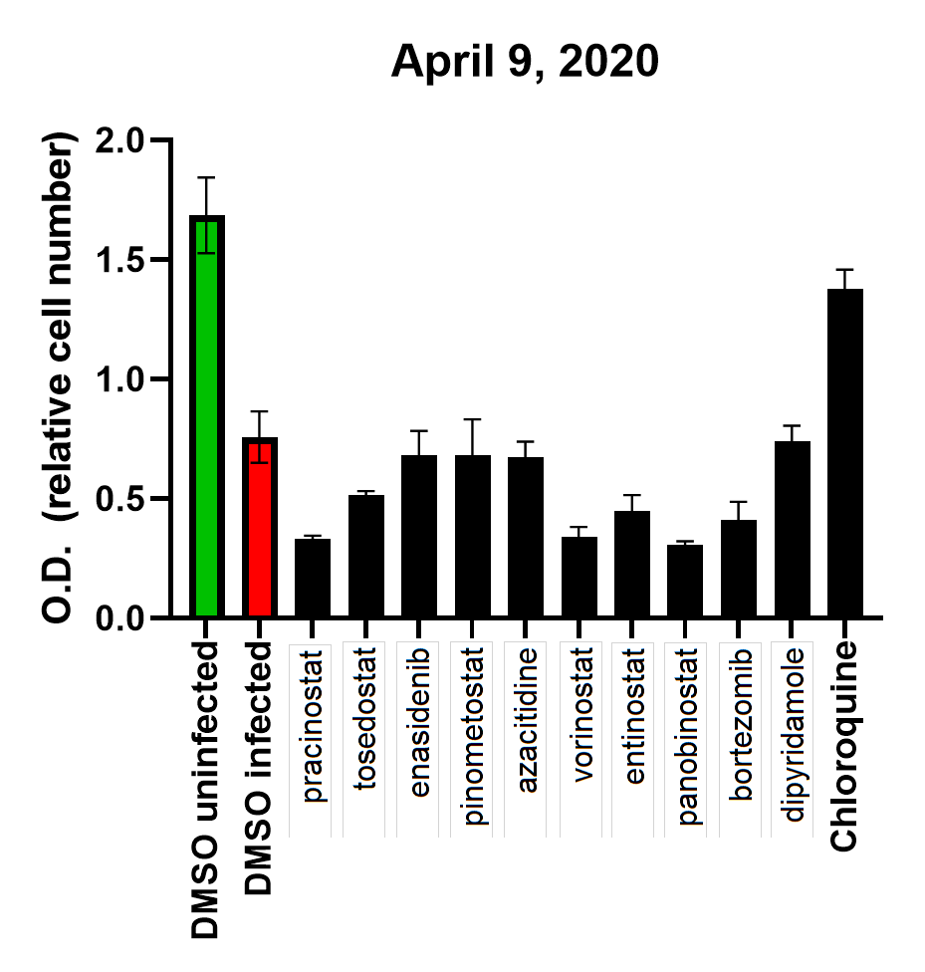
Indirect(?) Confirmation
Pracinostat, vorinostat and panobinostat appear to accelerate the virus-induced killing process
Alternatively, these drugs directly kill VEROE6 cells.
This preliminary finding encourages us to further pursue the histone deacetylase hypothesis
04/09/20 revision

Slide 36
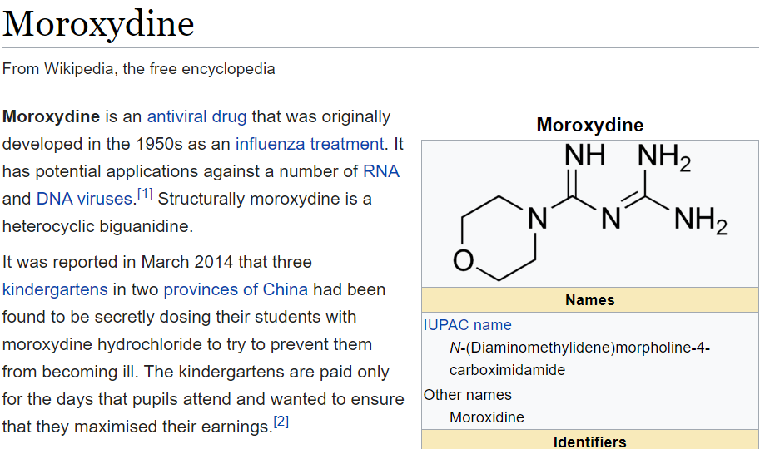
Tclin and Associated Drugs
PreyGene | Drug | Test
XPO1 | selinexor | ++++
IDH2 | enasidenib | +++
GLA | migalastat | ++
IMPDH2 | mycophenolate mofetil | +++
UMPS | oteracil | ++++
FDPS | zoledronic acid | ++++
PSMB2 | bortezomib | ++++
NDUFA10 | metformin | +++++
NDUFB10 | metformin
MT-ND1 | metformin
MT-ND3 | metformin
MT-ND5 | metformin
DNMT1 | azacitidine | +++++
ITGB1 | Natalizumab | ++++
SLC29A1 | Dipyridamole | +++
CRBN | lenalidomide | +++++
Metformin is remarkably similar to moroxydine.
From Krogan et al data, metformin targets ~20 proteins. Other potential mechanisms of action to be explored (based on the summary Table).
04/09/20 revision

Slide 37
SmartGraph Analysis of HATs and COVID-19 Implicated Proteins
SmartGraph available at: https://smartgraph.ncats.io/
Source
  HATs provided by Tudor
  Other proteins from the stringified PPI network.
  Parameters
    distance <= 3
    confidence >= 0.15
  Directionality
    HATs were used as start or end nodes (“forward”/“reverse” networks, respectively)
    “Bidirectional HATs PPI” by merging forward and end networks.
04/02/20 revision

Slide 38
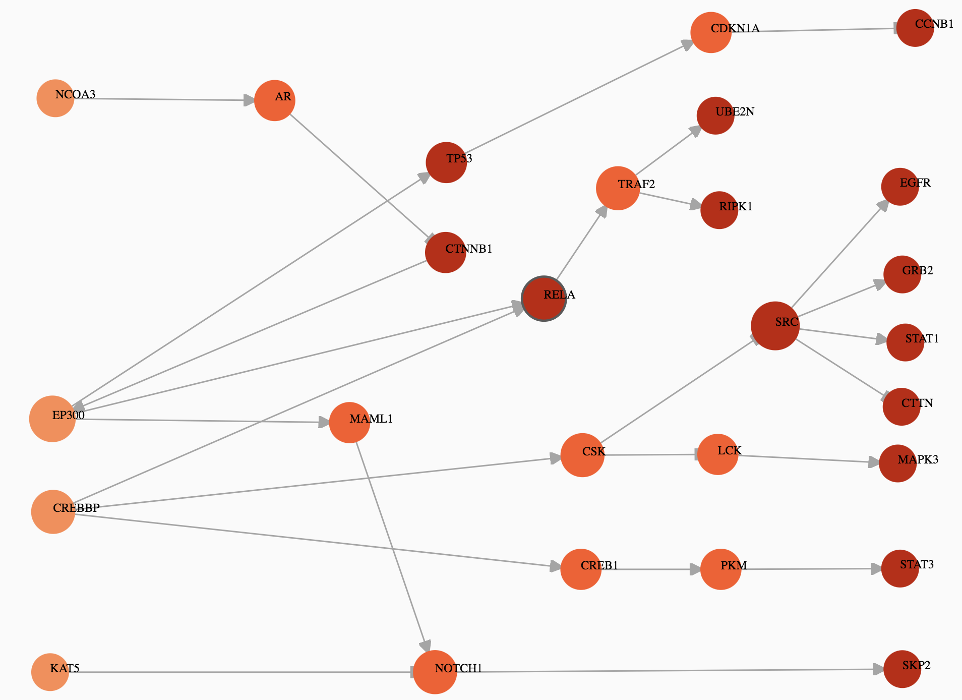
HATs
One of the HATs, RBBP7, is consistently overexpressed when interacting w/ SARS-CoV2. Two others, HAT1 and NAA40, are relatively under-expressed (data from Krogan et al)
No other HATs are on the list.
Graph below: “chemicalizing” the HATs network
EP300 Q09472 Tchem
HAT1 O14929 Tbio
KAT2A Q92830 Tbio
KAT2B Q92831 Tchem
KAT5 Q92993 Tchem
KAT6A Q92794 Tbio
KAT6B Q8WYB5 Tbio
KAT7 O95251 Tbio
KAT8 Q9H7Z6 Tchem
NAA60 Q9H7X0 Tbio
RBBP7 Q16576 Tbio
CREBBP Q92793 Tchem
ATF2 P15336 Tbio
TAF1 P21675 Tchem
NAA40 Q86UY6 Tbio
NCOA1 Q15788 Tchem
NCOA3 Q9Y6Q9 Tbio
04/02/20 revision

Slide 39
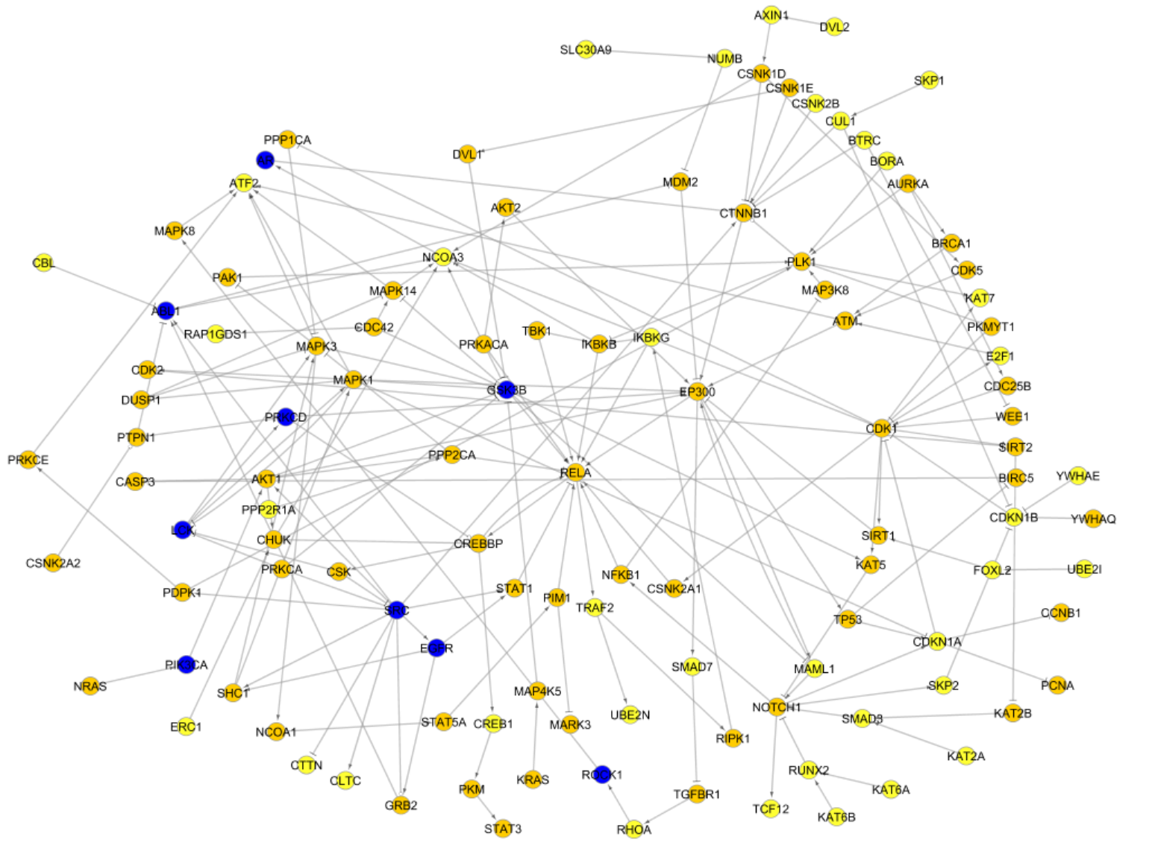
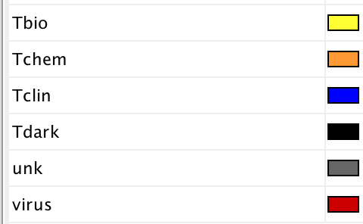
Bidirectional Network centered on HATs
Merging the “forward” and “reverse” networks illustrates how Tclin end-nodes could be used to modulate HAT function
Exploration in progress…
04/02/20 revision

Slide 40
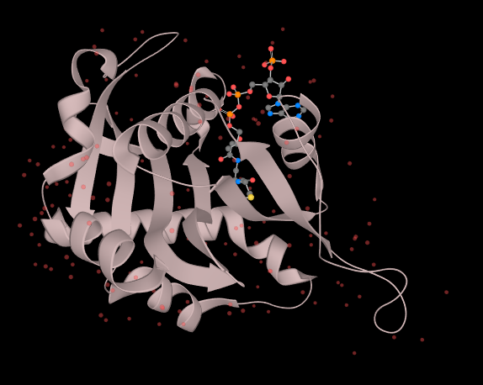
NAA40
4U9V, shown here liganded to acetyl CoA, is very likely to be ligandable with an inhibitor. Starting with similarity to the SGRG tetrapeptide could serve as basis for virtual screening.
N-alpha-acetyltransferase 40 specifically mediates the acetylation of the N-terminal residues of histones H4 and H2A (PubMed:21935442, PubMed:25619998).
In contrast to other N-alpha-acetyltransferase, has a very specific selectivity for histones H4 and H2A N-terminus and specifically recognizes the 'Ser-Gly-Arg-Gly sequence' (PubMed:21935442, PubMed:25619998).
This enzyme is consistently under-expressed when exposed to SARS-CoV-2, suggesting that its inhibition.
Note: Cristian Bologa is running virtual screening for NAA40 & HAT1 (drug repositioning)
04/02/20 revision

Slide 41
Virus-Human Bipartite PPI Network
Rationale: Are there human proteins acting as hubs for virus proteins?
Derived from merged network
  Preprint PPIs, Tudor’s AIML, P-HIPSTER, STRING, HATs SmartGraph
  All human PPIs removed, but virus-human PPIs retained
  (“SARS-CoV2 unk” artificial node also removed)
“High-degree” (>=3) human proteins in the resultant bipartite network hypothesized to be hubs, thus of potential importance.
“Virus hubs”: ISG15, UBC, UBB, EZR, NEDD8, UBA52, UBD, MSN, RAD23B
Network: analysis/network/Bipartite_COVID-19_PPI.cys
“CytoHubba” plugin utilized for analysis
04/02/20 revision

Slide 42
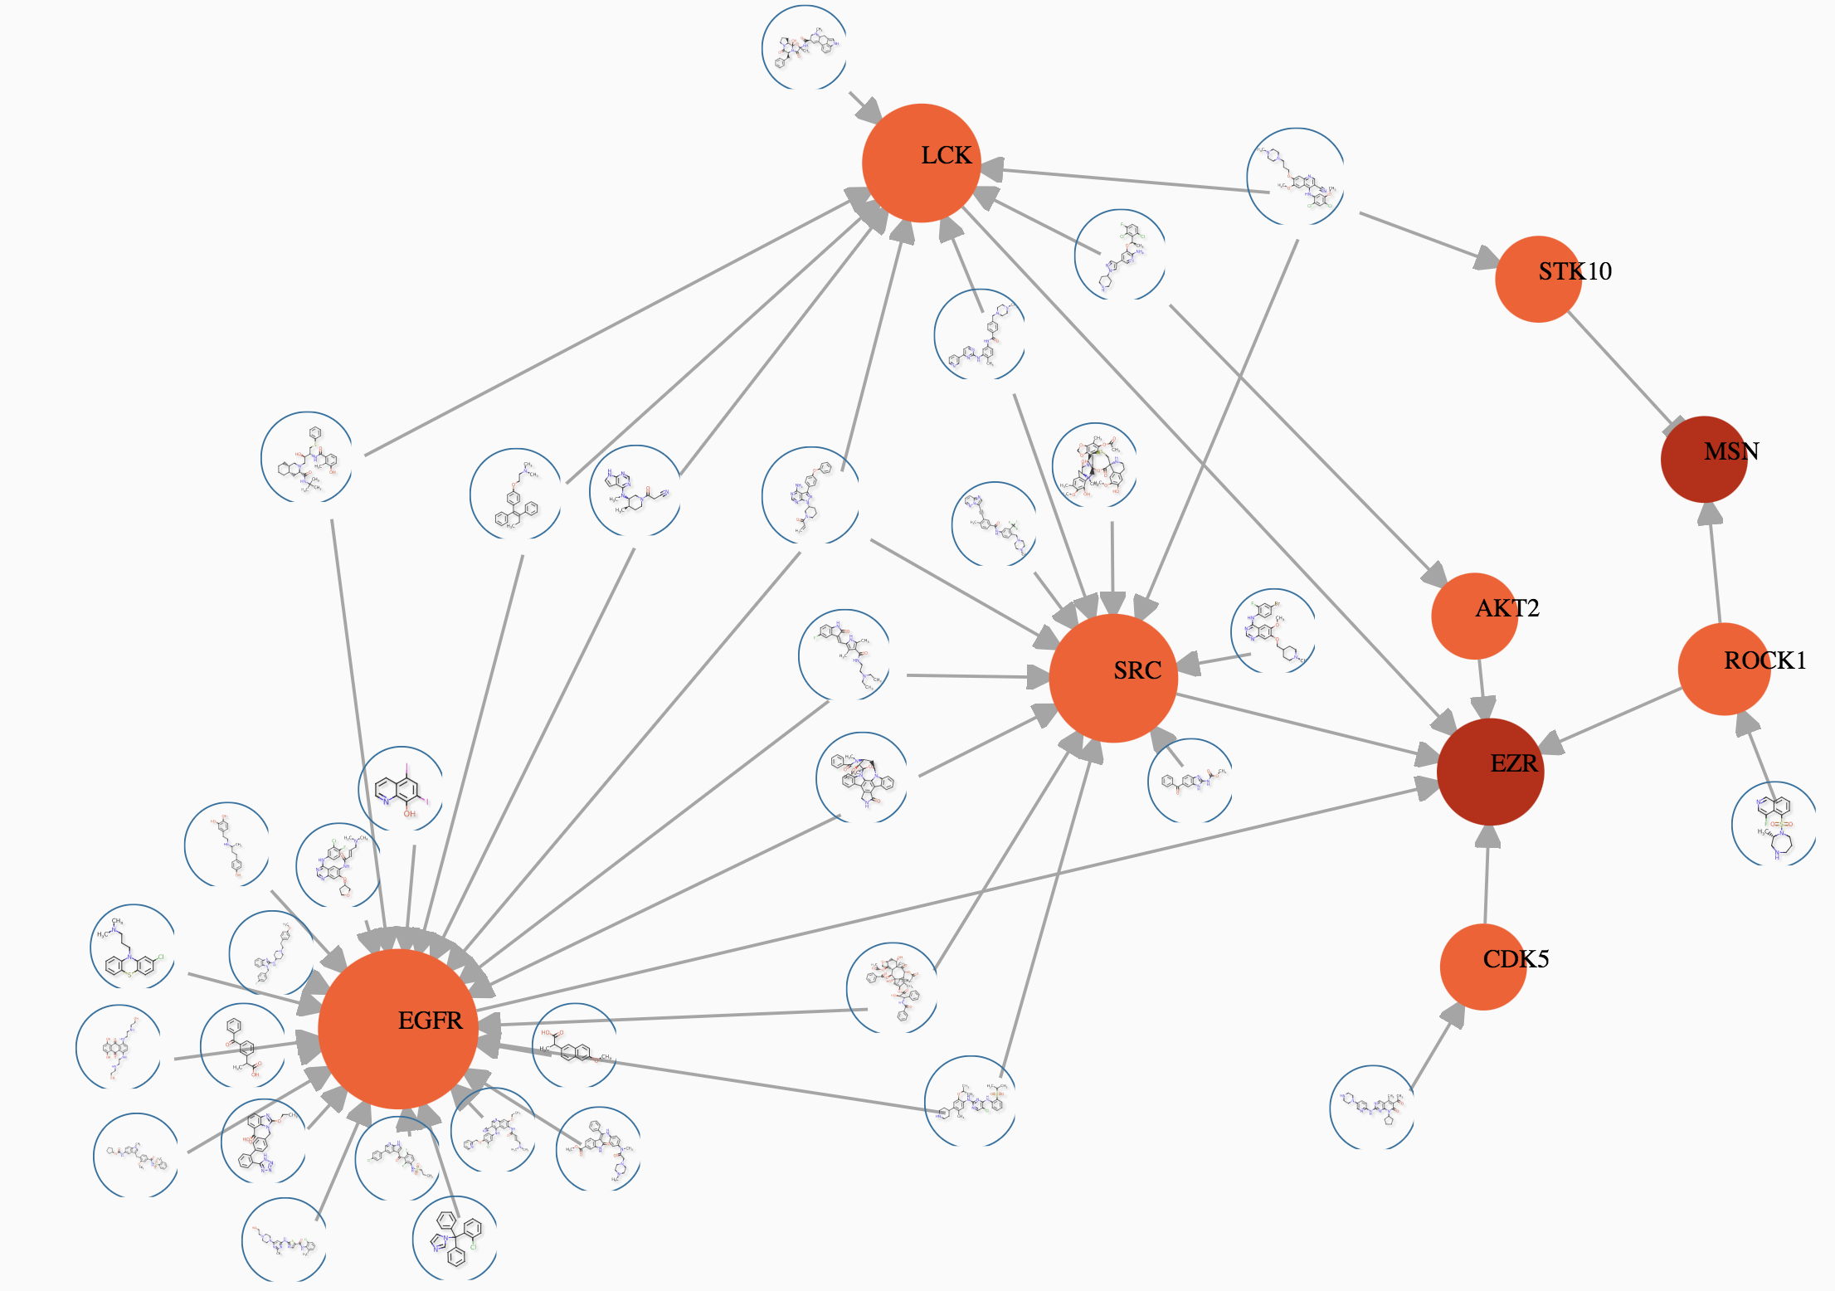
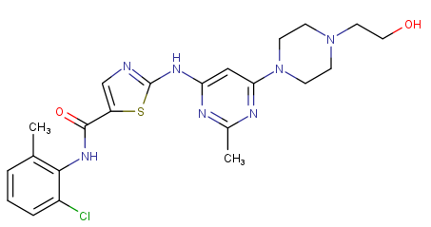
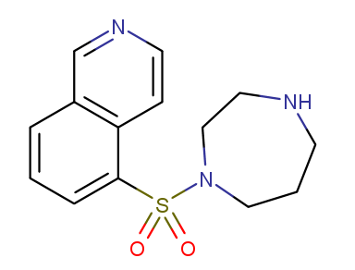
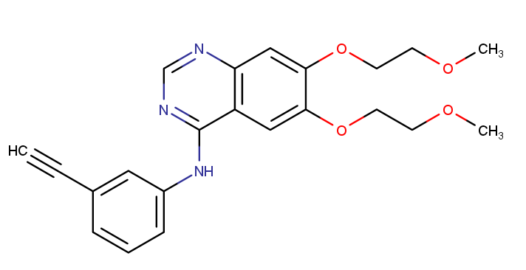
DTIs and PPIs Implicated by Virus Hubs
Virus hubs
dasatinib
erlotinib
fasudil
Target | Drug | Test
EGFR | erlotinib | ++++
ROCK1 | fasudil | +++
SRC | dasatinib | ++++
04/09/20 revision

Slide 43
SARS-CoV-2 Interactome: Tclin/Tchem
Tclin
There are 169 significant (Fold change above 10) between 23 viral and 56 human proteins. Some occur multiple times, and are likely to be crucial in the way the virus subverts intracellular machinery.
These are currently evaluated for potential repurposing.
Tchem
The Spike protein only had one significant (Fold change above 10) Tclin target, so we added 8 Tchem proteins for Spike and 6 for E-protein.
Looking for drugs hitting these targets as well.
Note: Giovanni Bocci is virtual screening viral targets for drug repositioning
04/09/20 revision

Slide 44
Virtual screening against SARS-CoV-2 viral targets
Drug | CMax (uM) | PDB Template
tegaserod | 0.01 | 5E6J
triamterene | 0.33 | 6NUR
meloxicam | 5.41 | 5E6J|6NUR
ibuprofen | 295.71 | 5E6J|6NUR
naproxen | 408.24 | 5E6J|6NUR
hydrochlorothiazide | 0.25 | 6NUR
baclofen | 0.75 | 5E6J
trimethoprim | 4.13 | 5E6J|6NUR
ethambutol | 17.13 | 5E6J|6NUR
cidofovir | 70.20 | 5E6J|6NUR
ixazomib | 0.17 | 5E6J
safinamide | 3.31 | 5E6J|6NUR
avibactam | 55.04 | 6NUR
Start: 3,981 small molecules drugs from DrugCentral. Enumerated tautomeric and protomeric forms available at pH 7.4 with minimum abundance of 25% (total, 6057 structures). These were docked into the main SARS-CoV targets:
5E6J: SARS Coronavirus Papain-like Protease
6NUR: SARS-CoV nsp12 polymerase
Note: BDDCS Class 2 and 3 (matching antivirals) present in screening libraries in-house, with half-life of 2 hours or more, and with known CMax, were selected and shown in this Table (the last 3 lack BDDCS category).
04/13/20 revision

Slide 45
Take Home Message drug repositioning for COVID-19 is an iterative exercise
Experiments need to inform future experiments
4/14/20 revision

Slide 46
What can we improve?

Slide 47
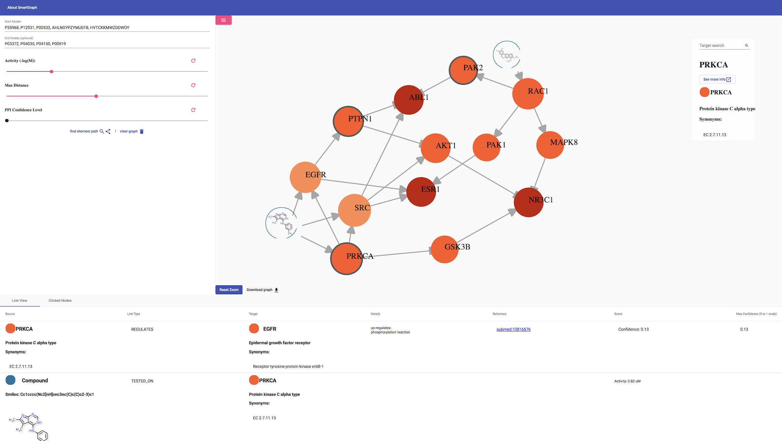
Data Integration via Graph Database (Neo4j)
SmartGraph has a Neo4j backend with a simple yet powerful data structure.
Focused on COVID-19: ‘Holistic network’ as core.
Needs a more comprehensive PPI data.
Needs additional layer of biomedical data:
  Metabolome
  IDG/Pharos: TDLs, tissue expression data, etc.
  OMICs
  Pharmacological action (NCATS - Inxight Drugs, UNM TID - DrugCentral)
https://smartgraph.ncats.io/
Zahoranszky-Kohalmi et al., J Cheminform 12, 5 (2020)

Slide 48
Note on Screening Drugs for Repositioning
A Prestwick library screen (pre-print) suggests metformin (VeroE6 cells, SARS-CoV-2 strain BavPat1, 10 μM drug concentration) is inactive.
Metformin maximum recommended therapeutic dose in man is 2500 mg/day
https://www.mayoclinic.org/drugs-supplements/metformin-oral-route/proper-use/drg-20067074
MW 165.62 for metformin HCl formulation
Average 70 L human body and 1250 mg dose ➔ test metformin at 100 μM
Screening concentration of approved drugs needs to take into account MRTD & Cmax where available
Of 845 drugs, 101 drugs >= 20 μM, and 169 drugs <= 0.1 μM.

