Slide 1
Use of electronic health records to evaluate treatment pathways – a Common Data Model approach
Desmond Teo
Data Analyst
Vigilance and Compliance Branch
Health Sciences Authority, Singapore
12 May 2020
Notes:
.

Slide 2
Outline
Drug safety surveillance system in Singapore
  Spontaneous reporting system
  Using Electronic Medical Records (EMR)
Study: “Use of electronic health records to evaluate treatment pathways – a Common Data Model approach”

Slide 3

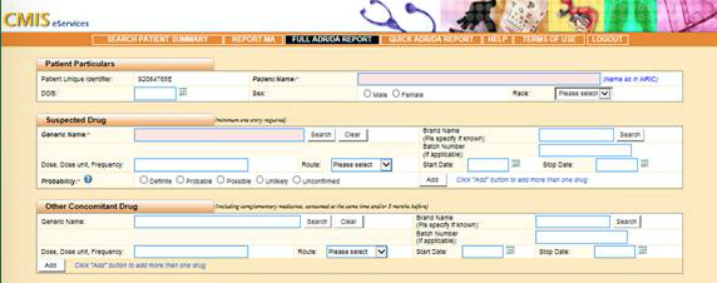
Traditional Drug Safety Surveillance
Spontaneous, voluntary reports to drug regulatory authority
2006: Critical Medical Information Store (CMIS)
  Real time drug safety reports from public hospitals and polyclinics
20,000 reports annually
Notes:
Here at the Health Products Regulation Group, our traditional surveillance drug safety surveillance program consists of a network of local healthcare professionals, who voluntarily report adverse events to us. Submission of reports can be done with fax, phone, and email, through HSA’s web-based reporting portal or through a module embedded in the clinical management system of public sector hospitals and polyclinics. This module, known as the Critical Medical Information Store, or CMIS was initiated in 2006. After the launch of CMIS, the number of ADR reports received increased by about 20-fold and about 20,000 are now received annually.

Slide 4
Limitations of Spontaneous Reporting Systems
Under-reporting, stimulated reporting
Captures only basic information
  Often missing data on drug dosages, concomitant medications
  Missing information on patient history, co-morbidities etc.
Lack of data on drug usage – unable to calculate incidence
Notes:
However, there are limitations to spontaneous adverse event reports. Firstly, a large proportion of cases go unreported, or only contain basic information about the ADR. For example, reports may have missing data on dosage and concomitant medications, patient history, co-morbidities and drug usage. This makes it difficult for regulators to have full oversight of the adverse drug reactions occurring, and evaluate how serious they really are.

Slide 5
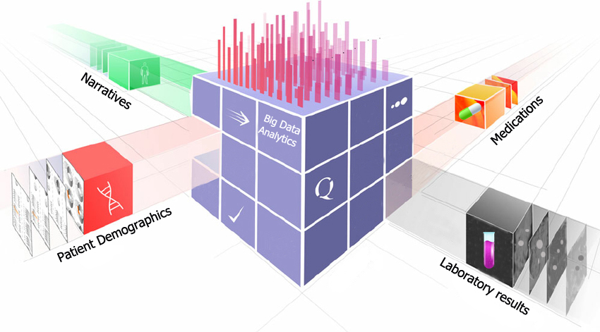
Enhancement with Electronic Medical Records
Passive ADR reporting program
Active Surveillance System
Notes:
Due to the limitations of spontaneous reporting systems, we recognize the need to use other data sources to fill the information gaps for post market pharmacovigilance activities, and move from a passive to active surveillance model.
One way to enhance the information collected is through the hospital electronic medical records. These records contain a large volume of patients’ data from real-world clinical practice and we could leverage on them to supplement traditional information sources.

Slide 6


Use of electronic health records to evaluate treatment pathways – a Common Data Model approach
Tan Hui Xing¹, Cynthia Sung^{1,2}, Chahed Haroun¹, Teo Chun Hwee Desmond¹, Ang Pei San¹, Tan Su Yin Doreen³, Dorajoo Sreemanee Raaj¹
¹ Vigilance & Compliance Branch, Health Products Regulation Group, Health Sciences Authority, Singapore
² Health Services and Systems Research, Duke-NUS Medical School, Singapore
³ Department of Pharmacy, Khoo Teck Puat Hospital, Singapore

Slide 7
Objectives
Demonstrate the use of a common data model (CDM) to harmonize electronic medical records (EMR)
  To transform data from an acute care hospital in Singapore to the CDM developed by the Observational Medical Outcomes Partnership (OMOP)
  To apply analytical tools on the data to uncover treatment patterns of patients newly diagnosed with diabetes mellitus, hypertension or depression.

Slide 8
Methodology
Conversion of source data files to the OMOP CDM
Federated query on the transformed data

Slide 9
Conversion of source data files to OMOP CDM
Data source:
  Approximately 250,000 patients
  Tertiary care hospital in Singapore
    795-bed general and acute care, with A&E services
    Serves a wide range of medical specialties from cardiology to general surgery to renal medicine, across multiple age groups and demographics of patients
    Get referral from primary care providers e.g. general practitioners, government clinics for management of diabetes, hypertension
  Data from January 2013 to December 2016 comprising the following:
    1.1 million rows of diagnoses
    5.2 million rows of ordered medications
    15.5 million lab records

Slide 10
Conversion of source data files to OMOP CDM
Data vocabularies employed:
  Systematic Nomenclature of Medicine Clinical Terms (SNOMED CT) for diagnosis codes,
  RxNorm Extension for drugs, and
  Logical Observation Identifiers Names and Codes (LOINC) for laboratory tests and vitals measurements
Extract, Transform, Load (ETL) process
Mapped to OMOP table based on “Concept Name”
Mapped to standardized vocabulary
ICD-10 J18.9 “Pneumonia, unspecified”
SNOMED CT 233604007 Pneumonia
OMOP concept_id
255848
Yes
Is it in the OMOP Vocabulary?
No
AMOXICILLIN- CLAVULANIC ACID
AMOX 500 MG, CLAV 125 MG TAB
RxNorm 617296 “Amoxicillin 500 MG/ Clavulanate 125 MG Oral Tablet”
Trace back to original prescription order (drug)
Manually mapped to standardized vocabulary
OMOP concept_id
1713694

Slide 11
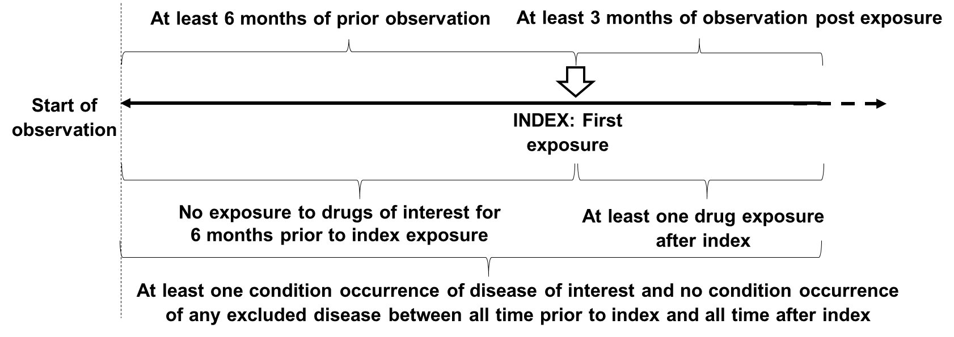
Federated query on the transformed data
Selection criteria of diabetes, hypertension and depression cohorts

Slide 12
Federated query on the transformed data
Diseases of interest, excluded diseases and drugs used in each cohort
Cohort | Disease of interest | Excluded disease | Drug classes included
Diabetes | Diabetes mellitus | Findings related to pregnancy | Insulins, biguanides, sulfonylureas, DPP4 inhibitors*, alpha-glucosidase inhibitors, SGLT2 inhibitors^
Hypertension | Hypertensive disorder | Findings related to pregnancy | Antihypertensives, diuretics, peripheral vasodilators, beta blockers, calcium channel blockers, agents acting on the renin-angiotensin-aldosterone system
Depression | Depressive disorder | Findings related to pregnancy, bipolar I disorder, schizophrenia | Antidepressants
*dipeptidyl peptidase 4 inhibitors
^sodium-glucose transport protein 2 inhibitors

Slide 13
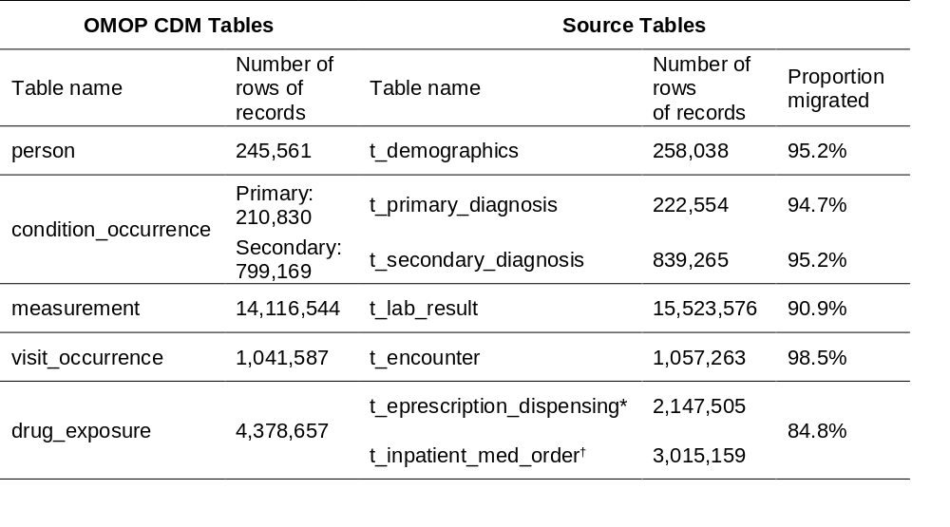
Results and Discussion
Percentage of records converted:
*Refers to outpatient pharmacy orders and inpatient discharge prescriptions
†Refers to medications used during inpatient ward stay
Notes:
First cut mapping of all records
During checking phase, prioritise top 90% of records
Remaining 10% not checked
Some non-drug items e.g. food, retail

Slide 14
Results and Discussion
Number of patients identified per cohort
  Diabetes mellitus (n = 1,006)
  Hypertension (n = 3,175)
  Depression (n = 251)
  Sequence of drug exposures in these patients were tracked, and plotted on sunburst diagrams

Slide 15
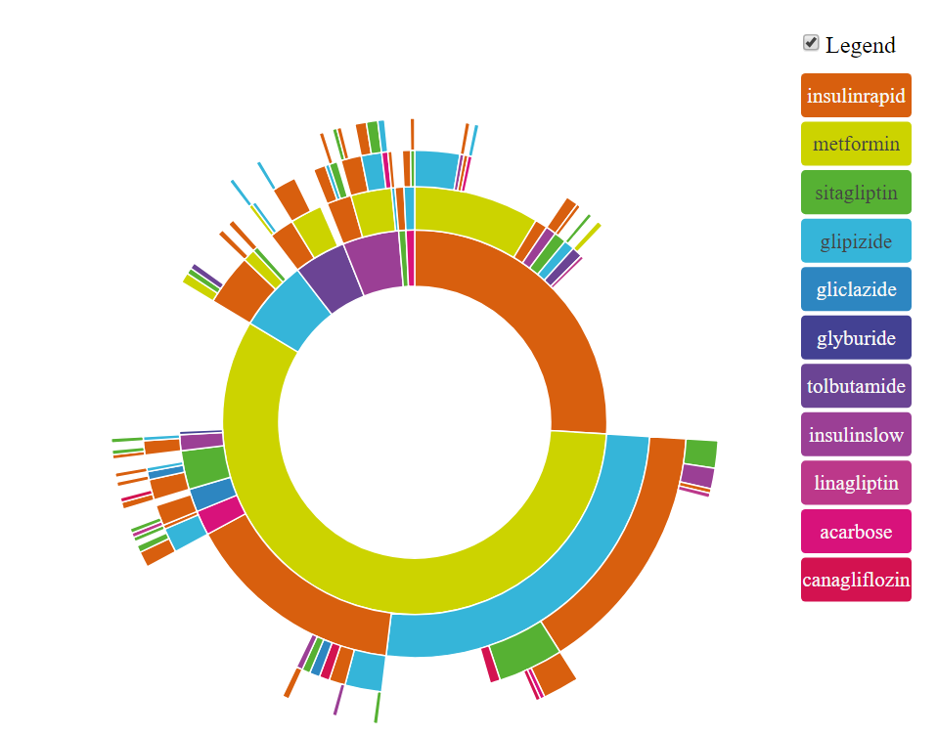
Results and Discussion
Diabetes Mellitus (n=1,006)
Metformin most often prescribed as the first medication (53.5%). Sulfonylureas (SU) were the most common second line agent used in diabetes. Among SU, glipizide was the most common (43.3%), followed by tolbutamide (7.1%). Newer generation alternatives such as gliclazide and glimepiride were used less frequently, at 5.5 and 0.6%, respectively.
Diabetes Mellitus
Period of Data: Jan 2013 to Dec 2016

Slide 16
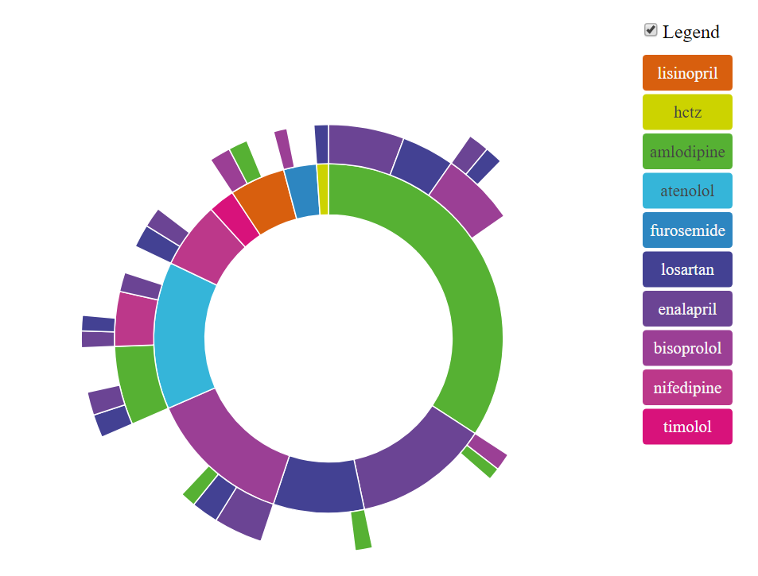
Results and Discussion
Hypertension (n=3,175)
Amlodipine (22.1%) was the most commonly used first line medication for hypertension. Considerable heterogeneity for first-line treatment for hypertension. However, for second-line options, most common drugs used were enalapril, losartan, nifedipine and amlodipine.
Hypertension
Period of Data: Jan 2013 to Dec 2016

Slide 17
Observations
PNAS treatment pathways study (published 2016): most prevalent drugs were hydrochlorothiazide, lisinopril, amlodipine
Our study: most prevalent were amlodipine, losartan, enalapril (very few diuretics)
  Data were from Jan 2013 to Dec 2016
  Clinicians likely adopted a newer version of the treatment guidelines i.e. JNC-8

Slide 18
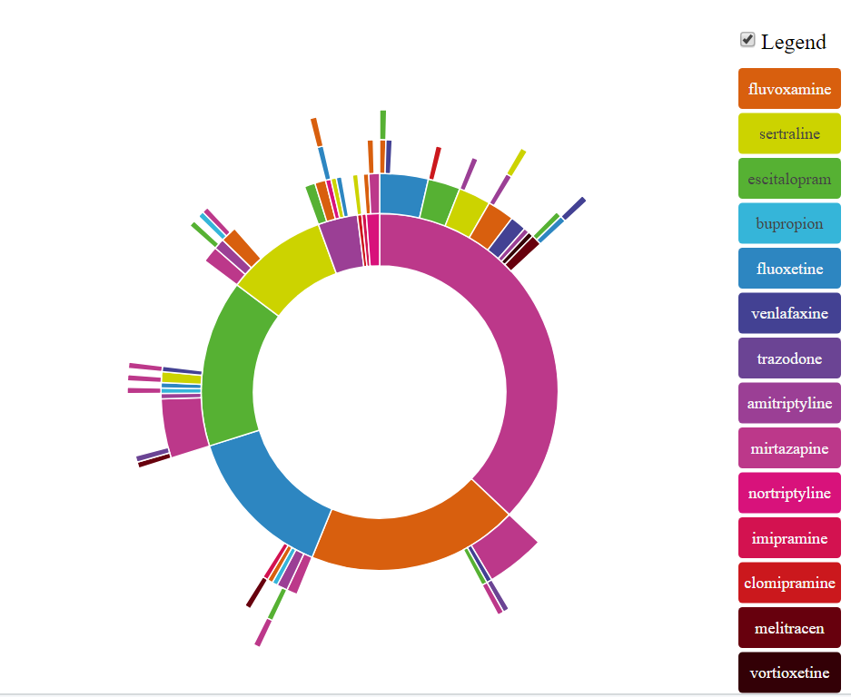
Results and Discussion
Depression (n=251)
Mirtazapine (37.1%) and fluvoxamine (19.1%) were the most commonly used first line medications for depression. Overall, a large variety of drug choices across all levels of treatment. Little consensus on prescribing patterns.
Depression
Period of Data: Jan 2013 to Dec 2016

Slide 19
Limitations with Sunburst Diagrams
Dosages and dosing frequency of different treatments not compared
Unable to identify whether treatment was stopped or switched

Slide 20
Conclusion
Considerable heterogeneity in treatment patterns for hypertension and depression, whereas for diabetes, metformin was the most common first-line agent (53.5%)
Use of CDM and federated query¹ were feasible for the data source
These models provide drug regulators valuable insights on real world drug utilization patterns and adherence to recommended treatment guidelines
1. Hripcsak, G., et al. Observational Health Data Sciences and Informatics (OHDSI): Characterising treatment pathways at scale using the OHDSI network. Proc Natl Acad Sci U.S.A, 2016. 113(27):7329-36.

Slide 21

Any Questions?

