Slide 1
Cohort Diagnostics
Gowtham Rao
06/16/2020

Slide 2
Overview
Motivation
Uses cases → software functionality

Slide 3
Motivation: Natural history of an observation study.
Research question
Write protocol
Implement study
Register protocol & study package
Protocol: Full (human-readable)
Study package: Full (machine-readable)
Execute study
WRONG
Results
Changing after results

Slide 4
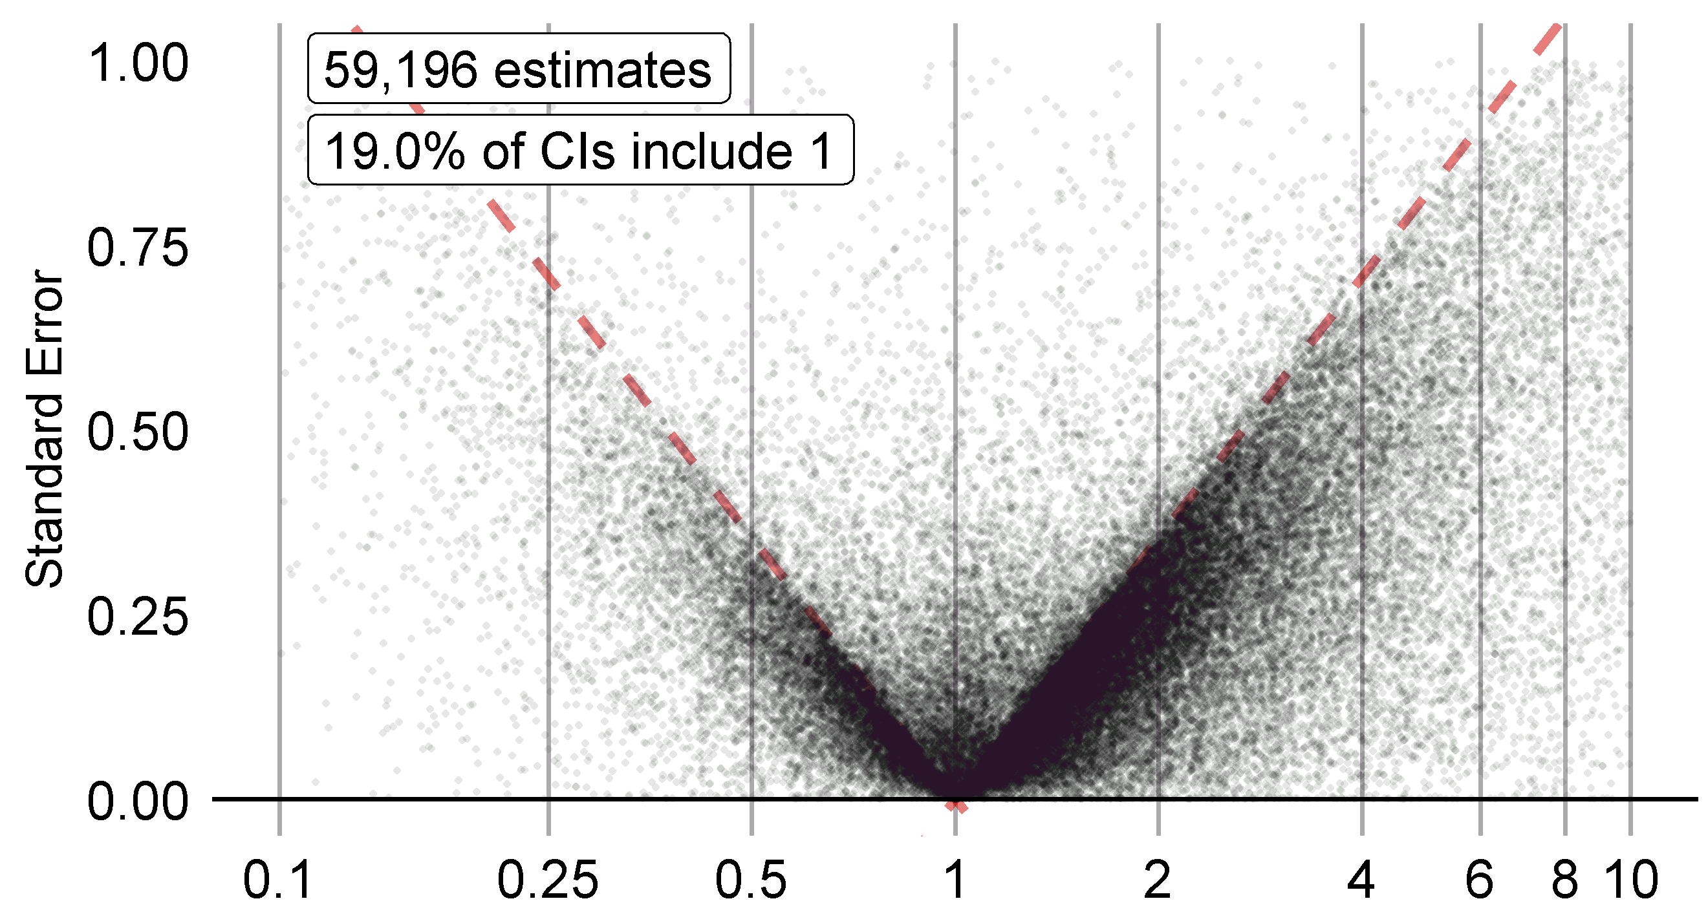
Motivation: Reduce bias/Improve confidence
p hacking
To make sure our study will provide a reliable answer
(before looking at the answer)
Effect size
Effect size estimates in published observational studies
Changing the question/study design/dissemination based on the results leads to unreliable evidence
Notes:
To make sure our study will provide a reliable answer
(before looking at the answer)

Slide 5
Diagnostics as a best practice
Research question
CORRECT
Write protocol
Implement study
Register protocol & study package
Protocol: Full (human-readable) description
Study package: Full (machine-readable) implementation
Execute study
Full diagnostics
Execute diagnostics
Results
Without looking at the outcome of interest!

Slide 6





Diagnostics in OHDSI
Phenotype Diagnostics
Clinical practice experience
Data domain expertise
Coding experience
Estimation Diagnostics
Expected statistical power
BIAS - Covariate balance with high dimensional propensity scores
Propensity score overlap
BIAS - Calibration with negative control
Something was missing
Earlier in the process (phenotyping)
  Before phevaluator, negative control, PS
Focussed specifically on building cohorts
  Feedback on impact of specification choices
  Clinical description → literature review → buiding cohorts
Enable conversation between investigators
  Compare the impact of specification choices across data sources.
PheValuator
Data Quality
Clinical Validity
Software Validity
Method Validity

Slide 7
Overview
Motivation
Uses cases → software functionality

Slide 8
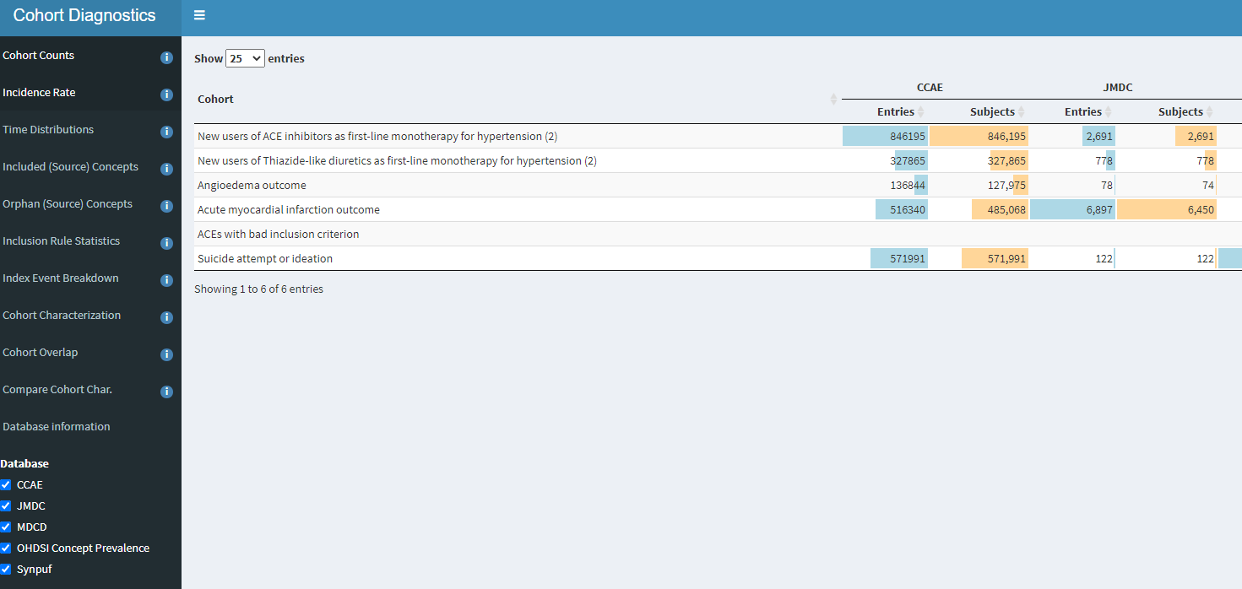
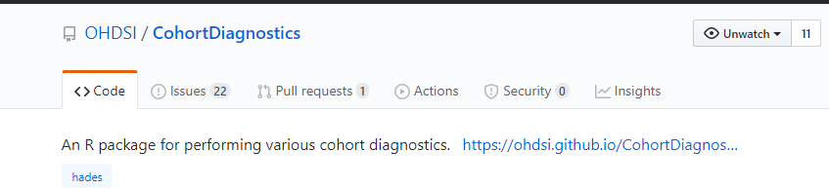
New R-package - Overview

Slide 9
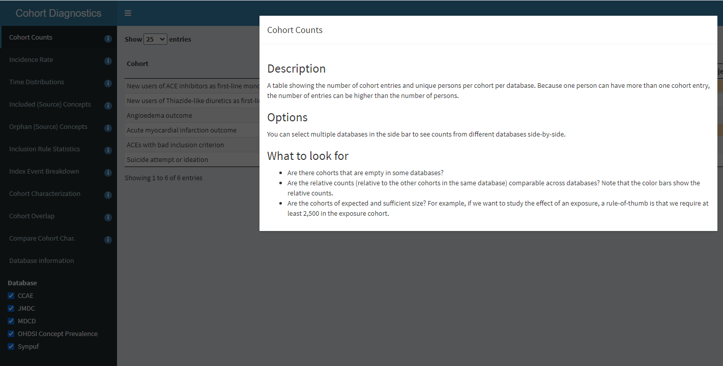
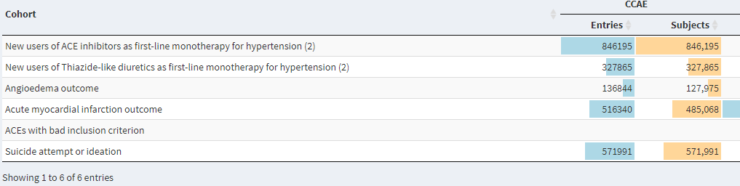
Functionality – Cohort Counts

Slide 10
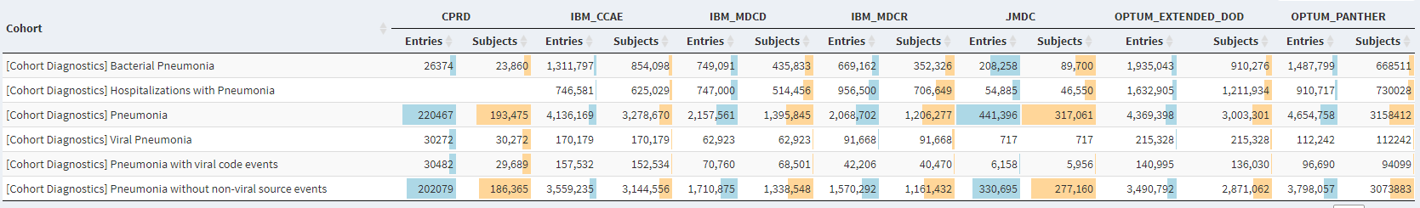
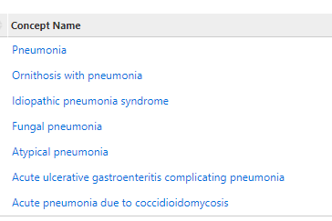
Functionality – Cohort Counts

Slide 11
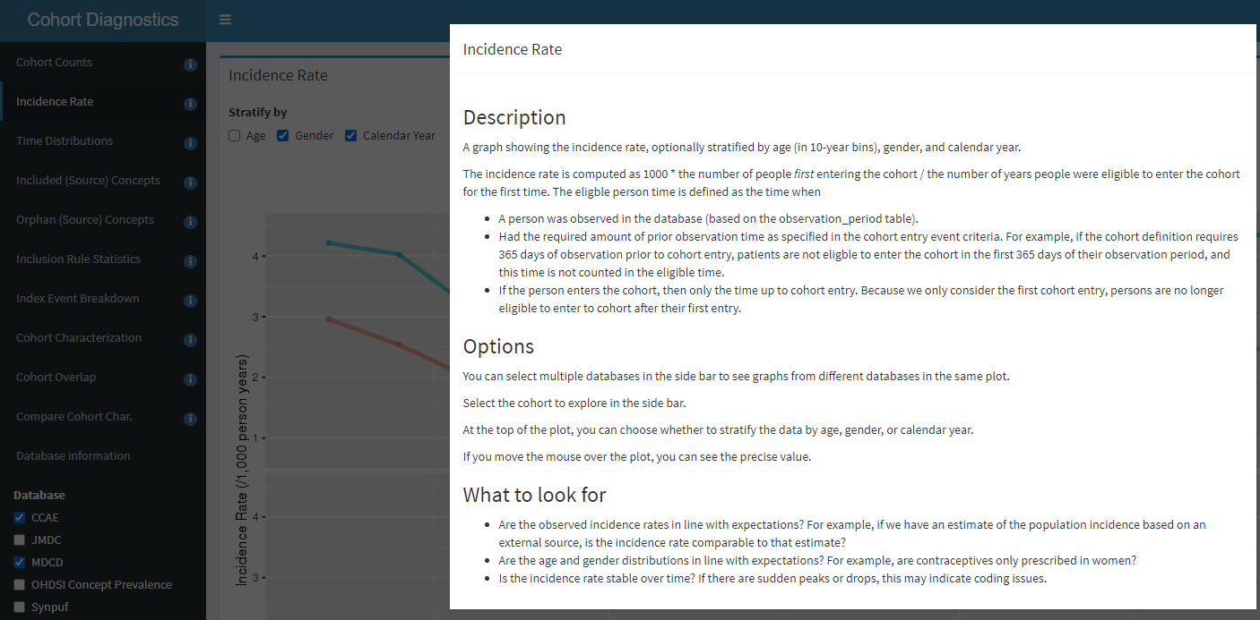
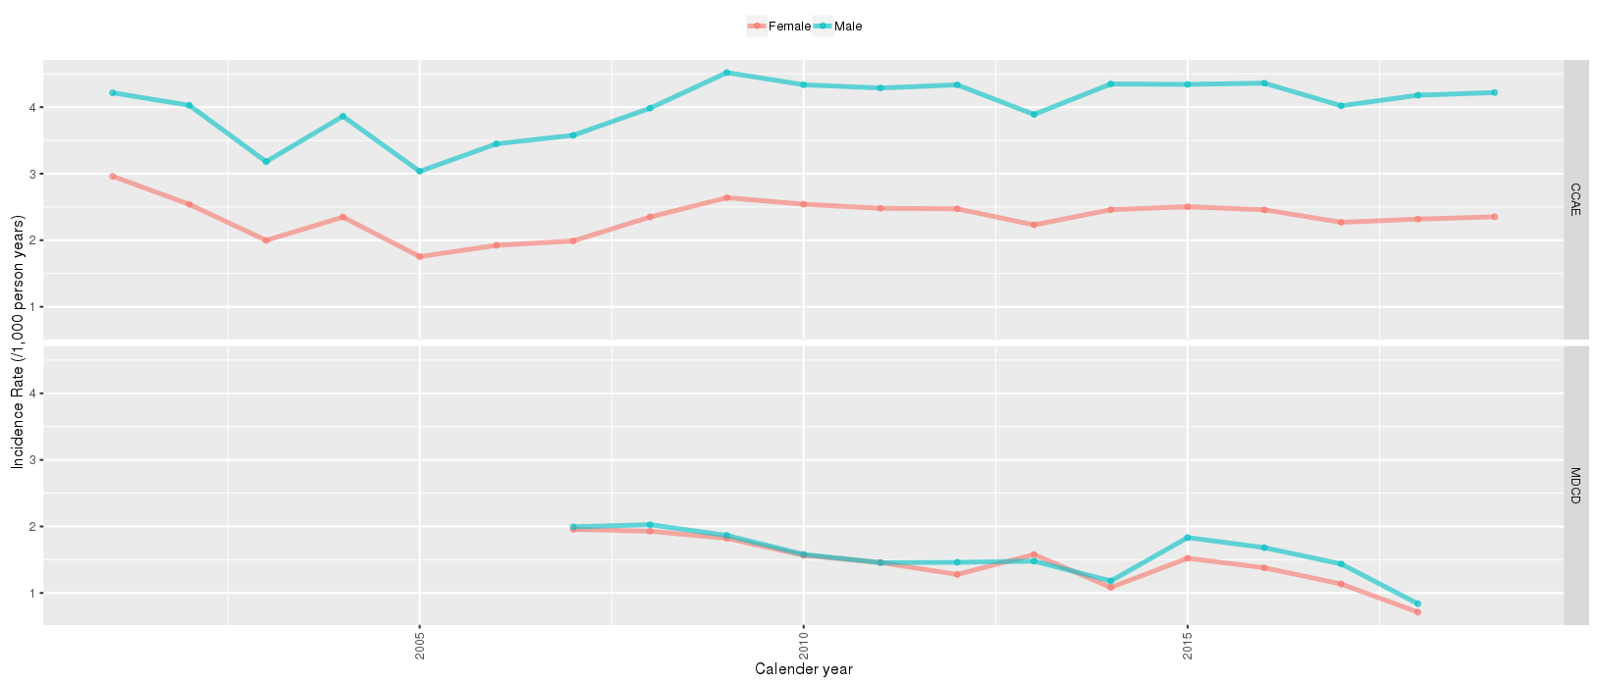
Functionality – Incidence Rate

Slide 12
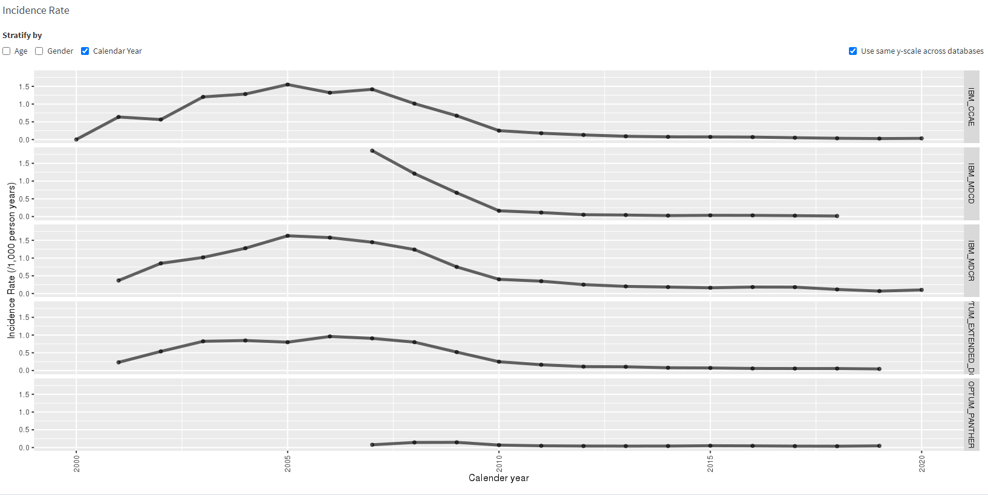
Functionality – Incidence Rate
Dramatic drop around 2008
Notes:
Cefaclor

Slide 13
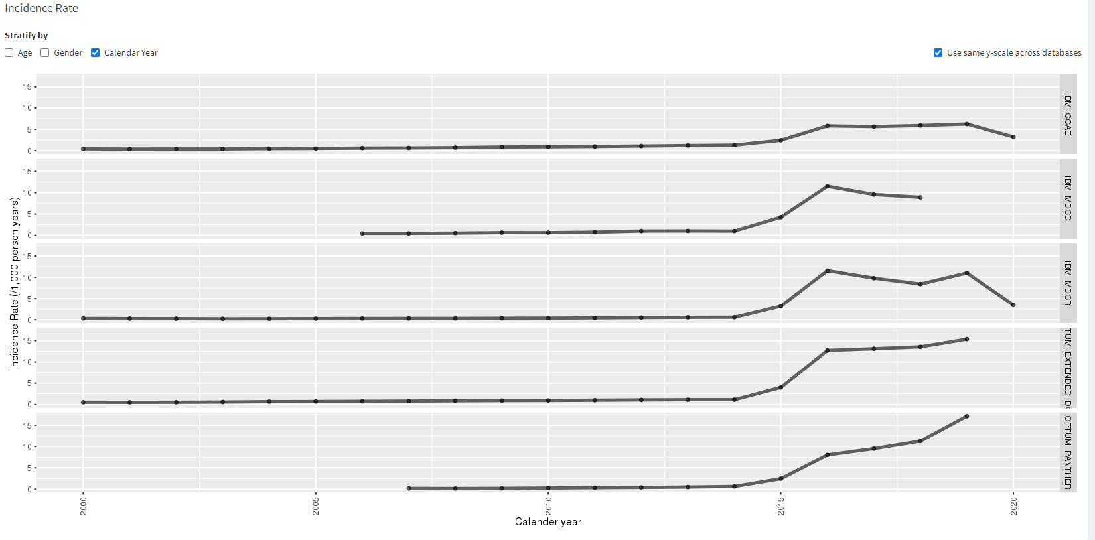
Functionality – Incidence Rate
Increase around 2015
Notes:
Allergic reactions

Slide 14
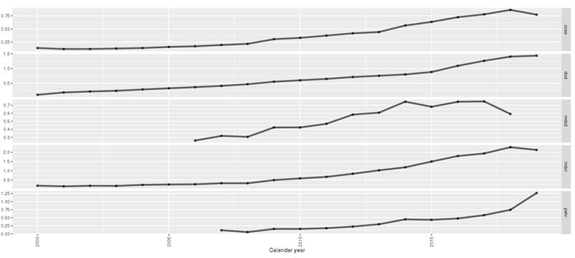
Functionality – Incidence Rate
Progressive increase over time
Notes:
Skin manifestations

Slide 15
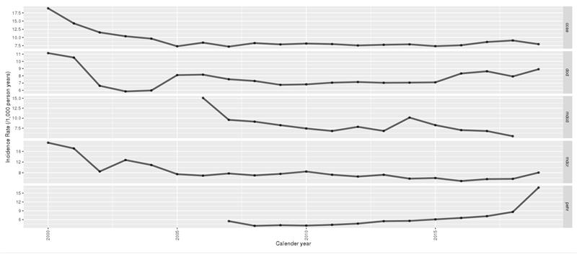
Functionality – Incidence Rate
Progressive decrease over time
Notes:
Fluoxetine

Slide 16
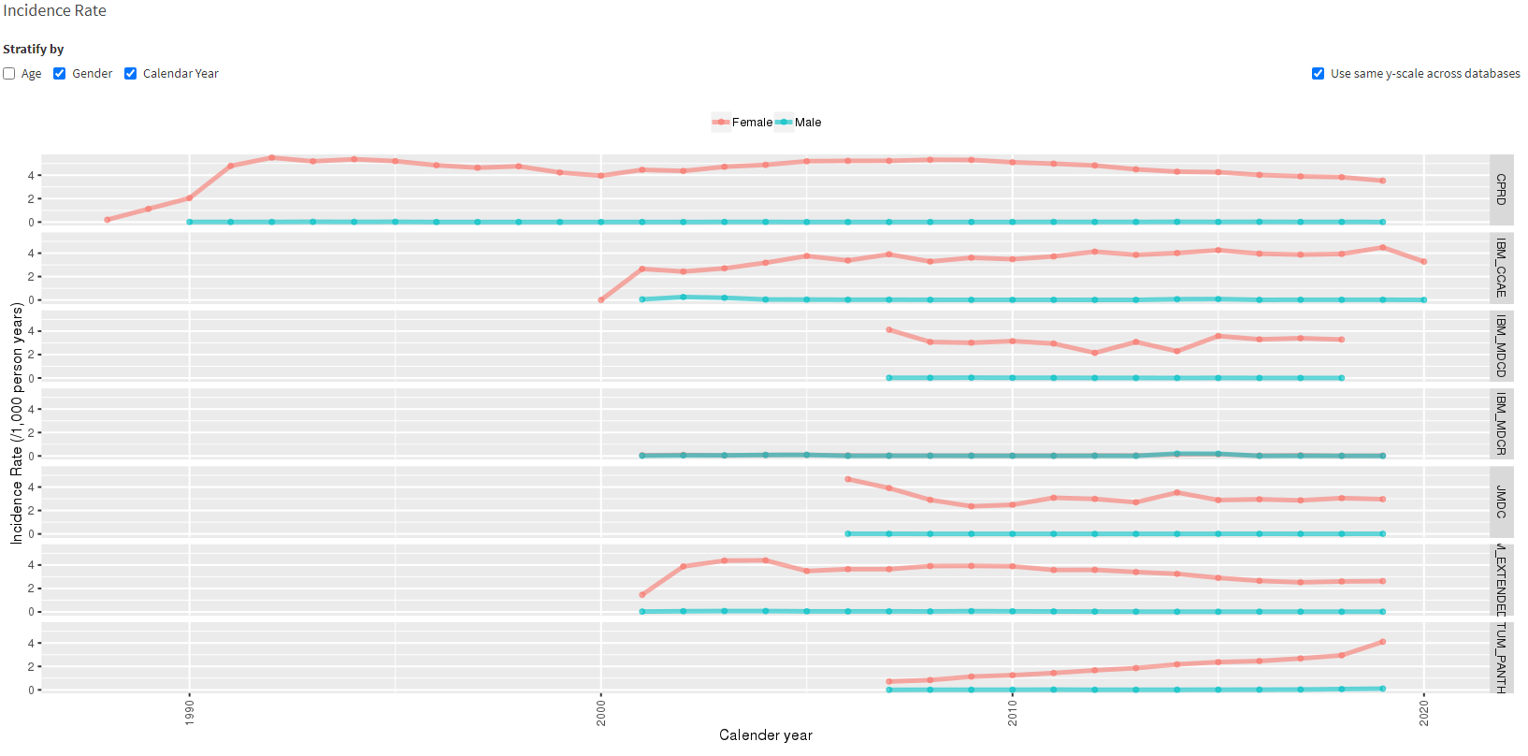
Functionality – Incidence Rate
Abortion among Male

Slide 17
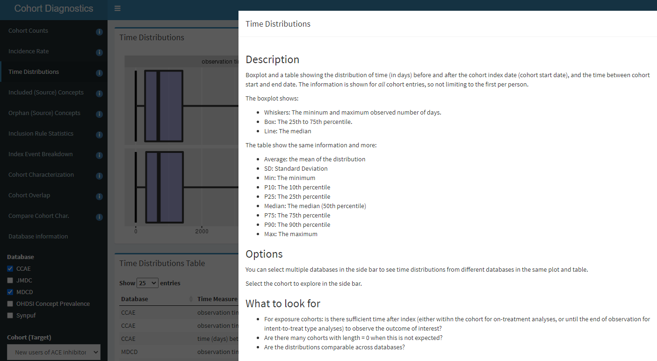
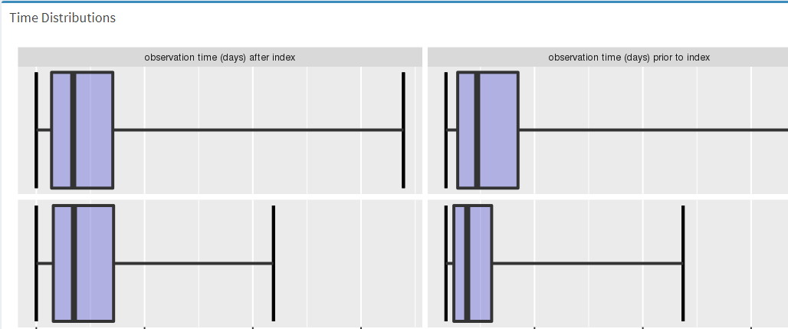
Functionality – Time distributions

Slide 18
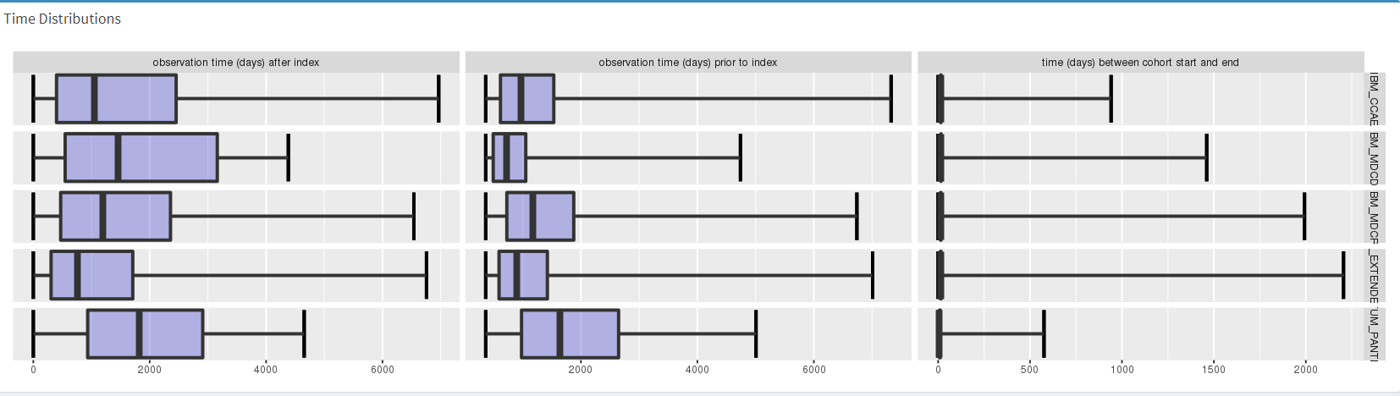
Functionality – Time distributions
Notes:
Azithromycin

Slide 19
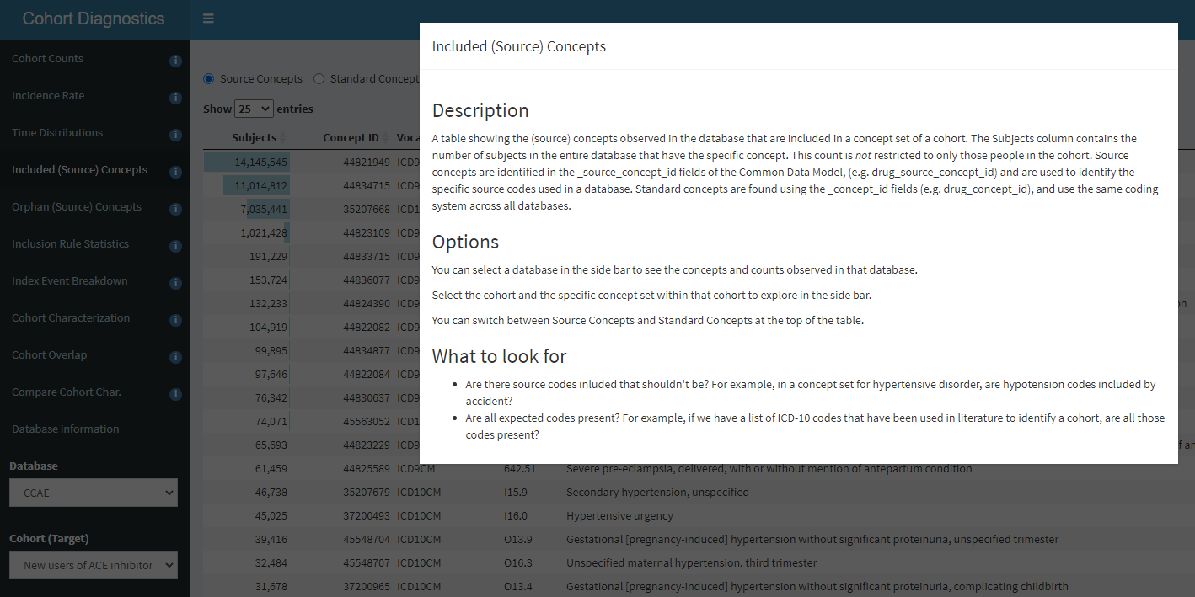
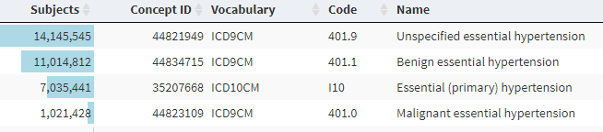
Functionality – Included concepts
Notes:
Included concepts – is not a cohort level diagnostics
-- database level diagnostic
-- this functionality is not new – it exists in Atlas

Slide 20
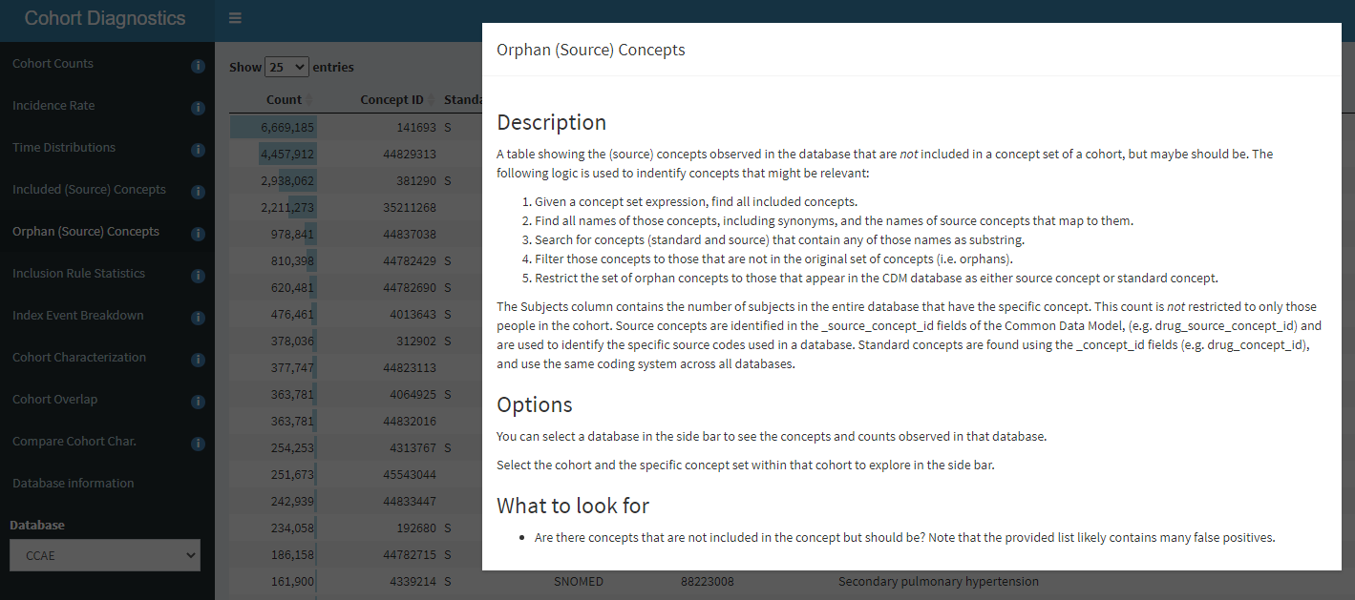
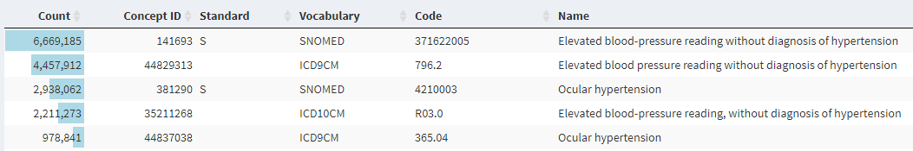
Functionality – Orphan concepts
Notes:
This is new functionality
Also database level functionality

Slide 21
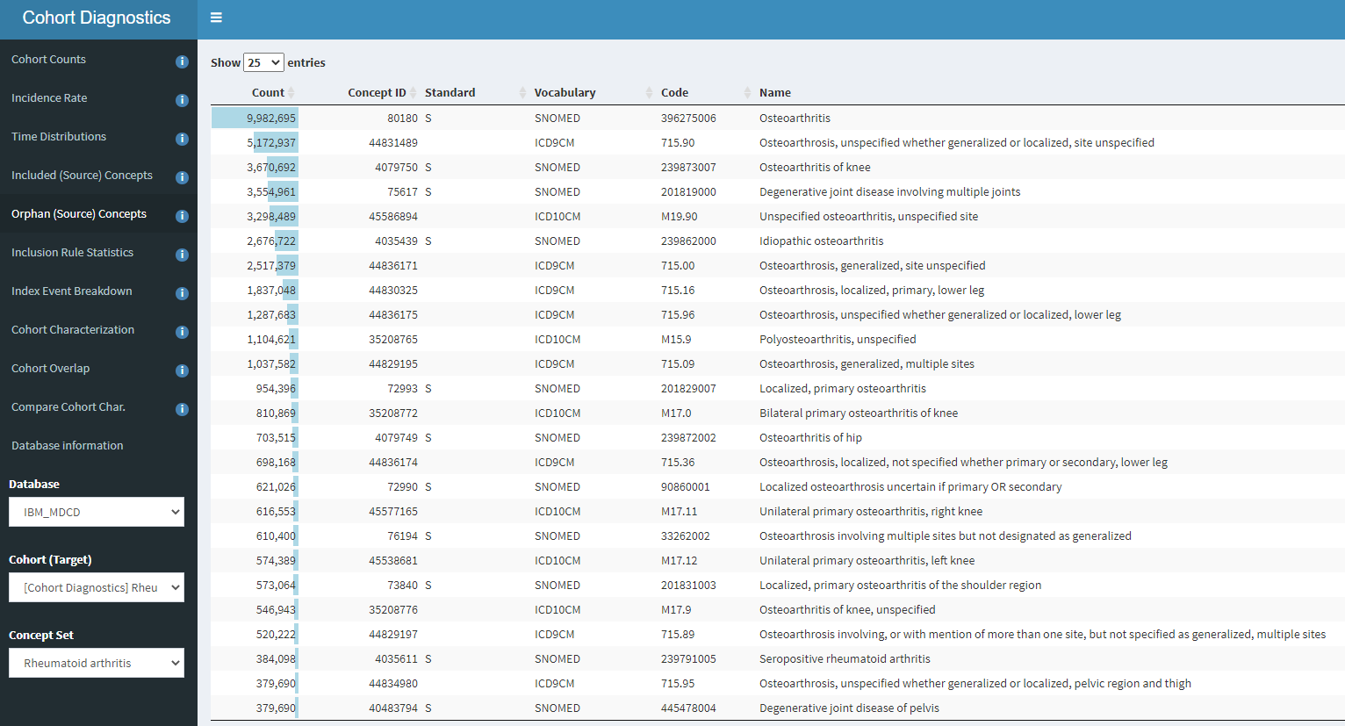
Functionality – Orphan concepts
Notes:
Sero positive and sero negative rheumatoid arthritis

Slide 22
Orphan codes
Concept set
Search terms
Suicide attempt
Descendants
Synonyms of descendants
Source concepts mapping to included concepts
Suicide attempt
Concept Name | Descendants
Suicide attempt | Y
Intentional harming self | Y
Suicidal poisoning
Intentional self-harm
Self-harm
Self-inflicted injury
Orphans: matches not included in concept set
Search matches
Substring search
Suicide attempt
Electrocution, intent to self-farm
Electrocution, intent to self-farm
Concepts to search
Cough
Suicide attempt
Data in Common Data Model
All standard concepts
All source concepts
Acetaminophen
Electrocution, intent to self-farm

Slide 23
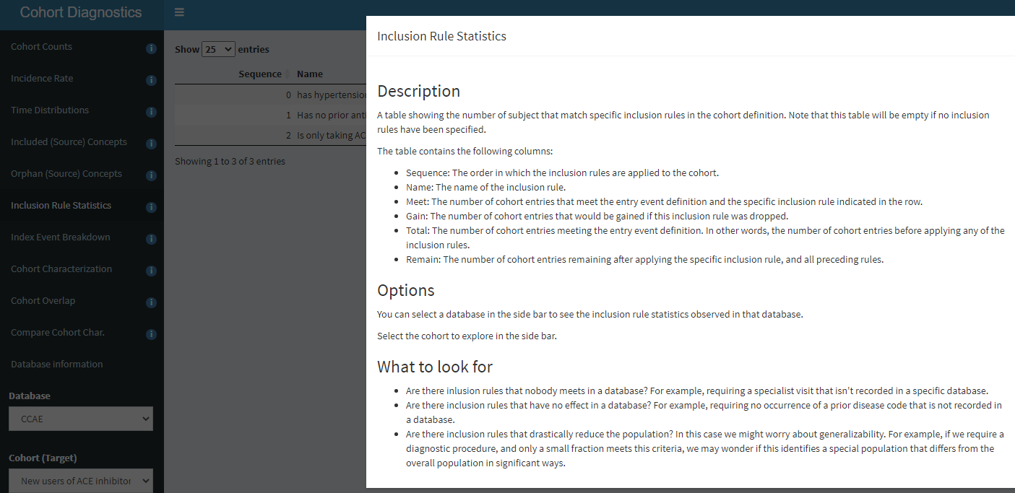
Functionality – Inclusion Rule Statistics
Notes:
This is cohor specific functionality
Exists in Atlas- not a new functionality

Slide 24
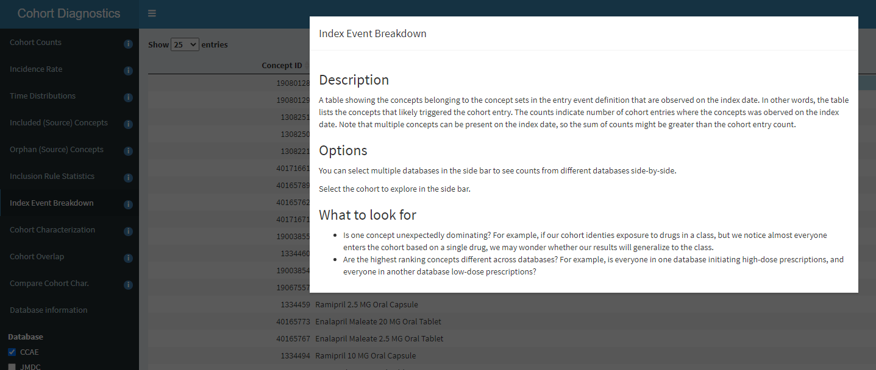
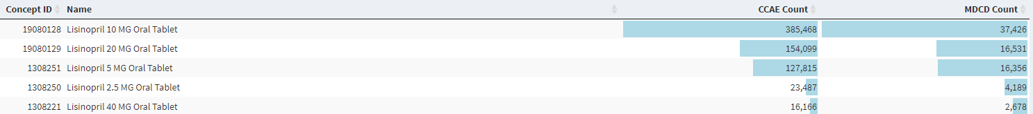
Functionality – Index Event Breakdown

Slide 25
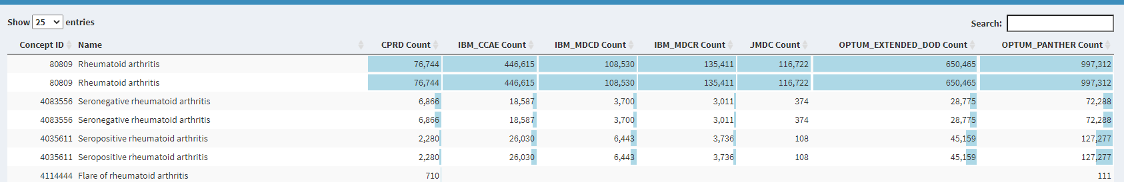
Functionality – Index Event Breakdown

Slide 26
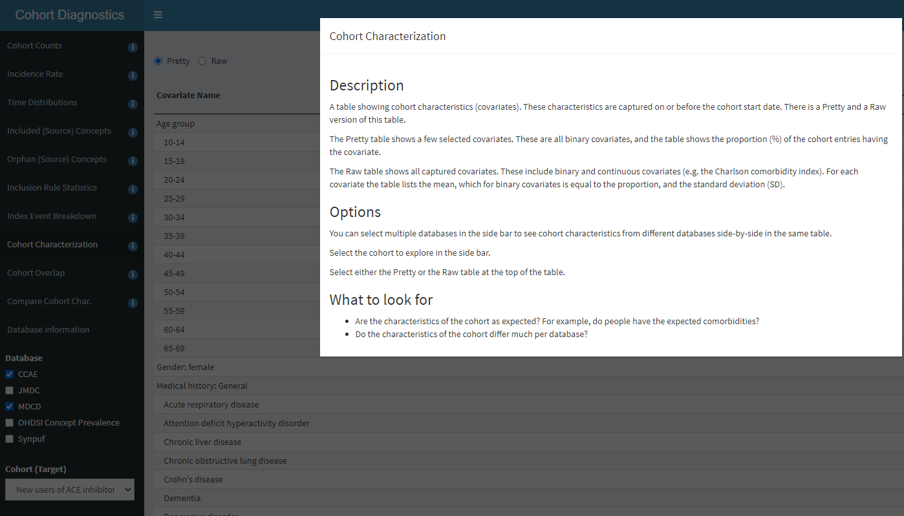
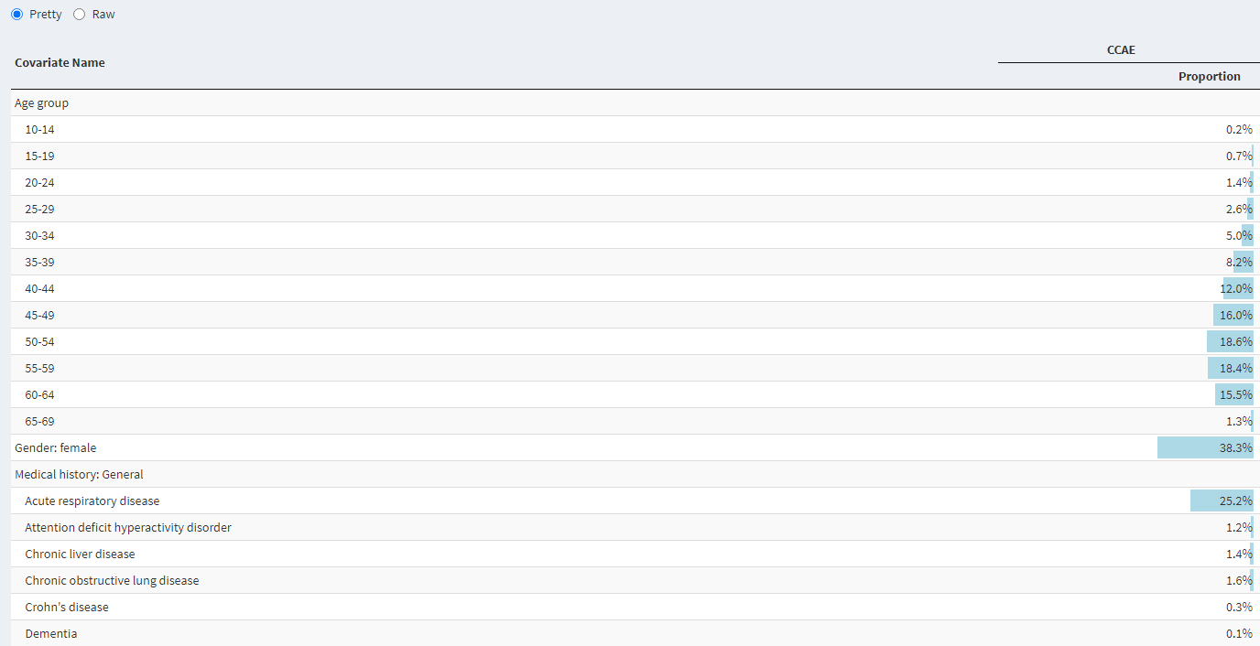
Functionality – Cohort Characterization

Slide 27
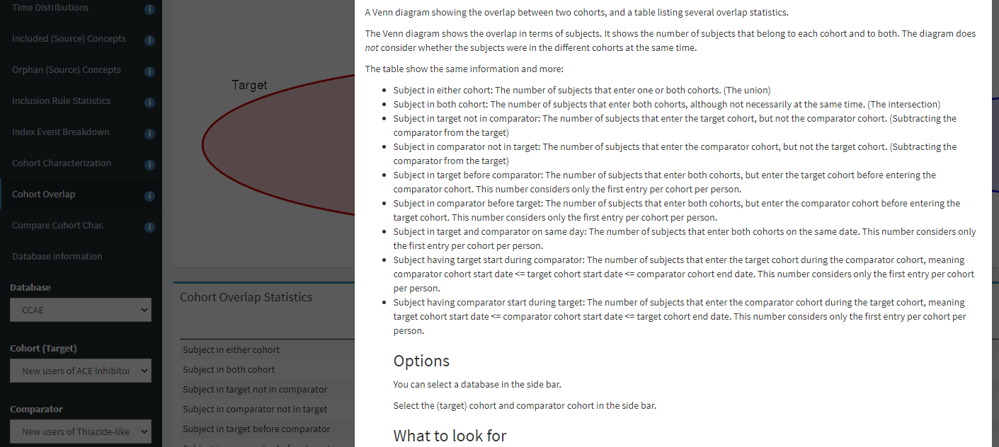
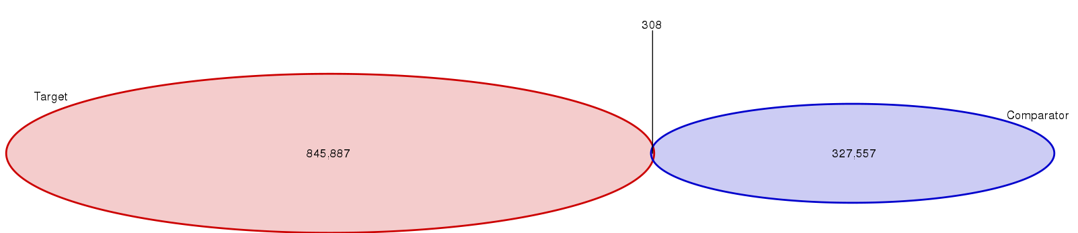
Functionality - Cohort Overlap (Subjects)

Slide 28
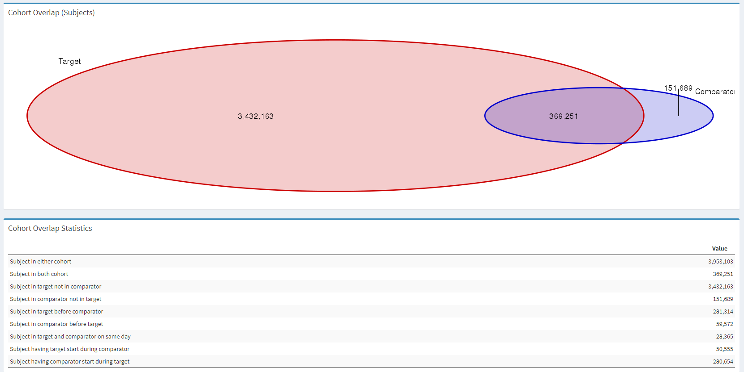
Functionality - Cohort Overlap (Subjects)
Depression
Fluoxetine

Slide 29
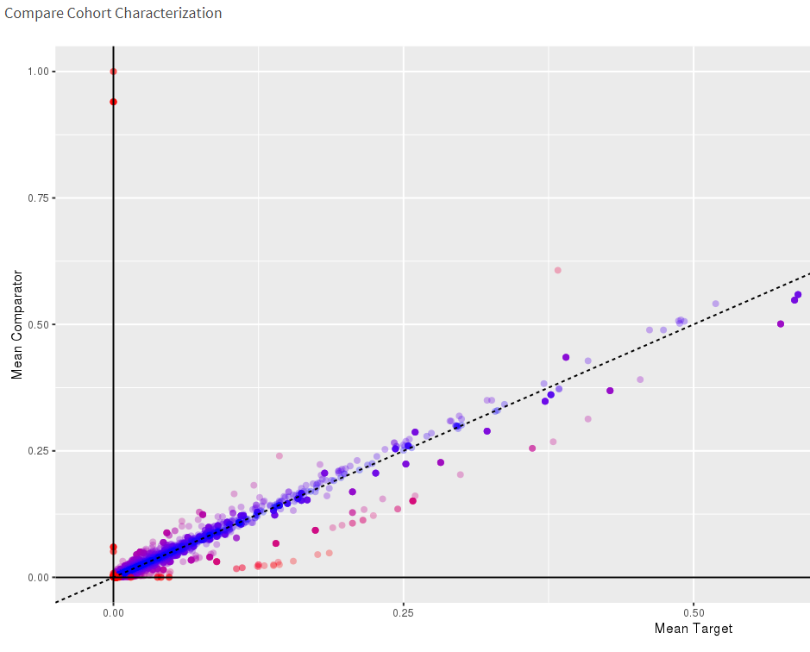
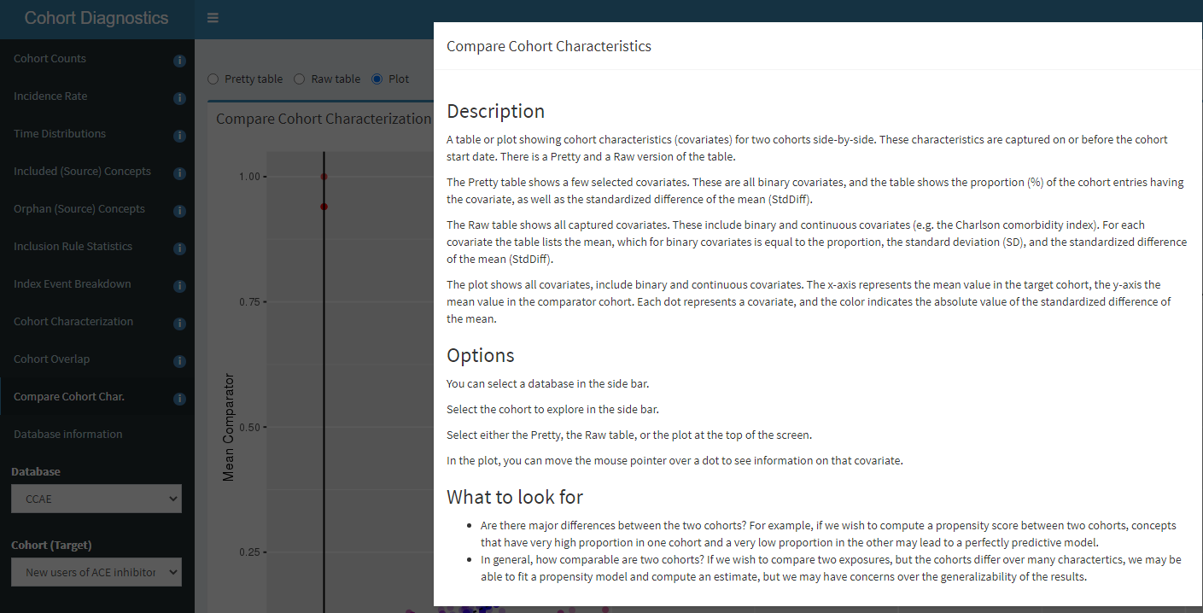
Functionality – Compare Cohort Characteristics

Slide 30
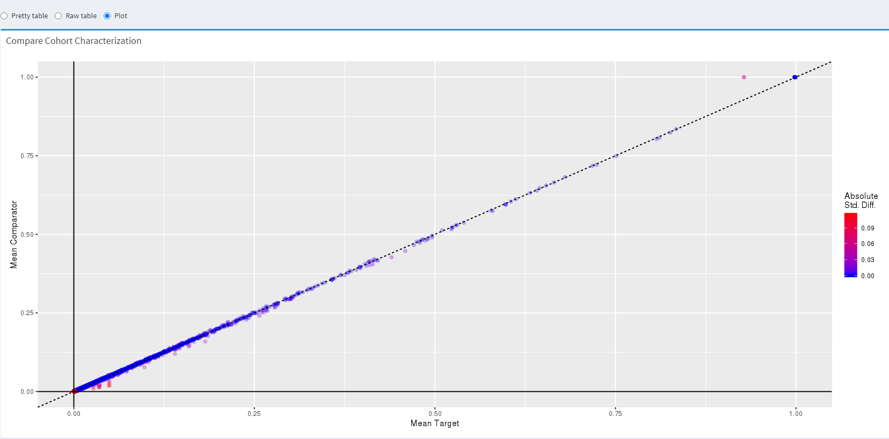
Functionality – Compare Cohort Characteristics
Notes:
Perfectly similar – why: Rheumatoid Arthritis with and without sero positive/negative code
Increased sensitivity – without changing the baseline chracteristics! So must be the same type of people

Slide 31
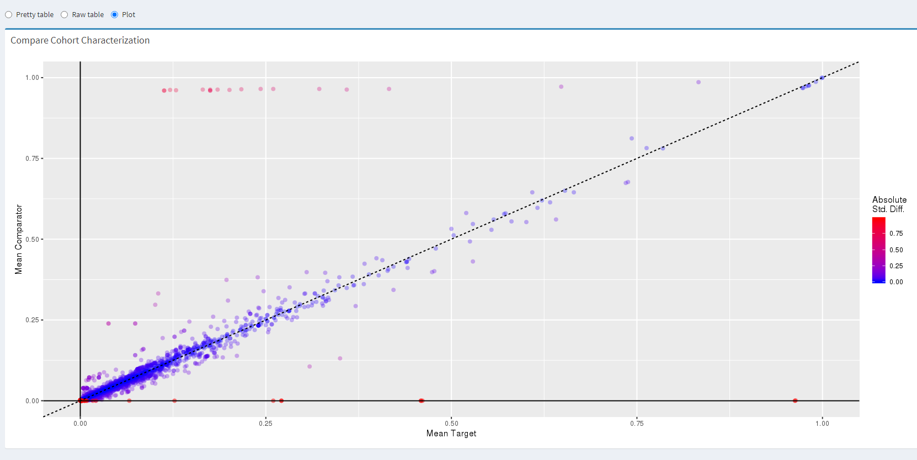
Functionality – Compare Cohort Characteristics
Ulcerative colitis
Crohns

Slide 32
Benefits of Cohort Diagnostics
CohortDiagnostics has already proven instrumental in improving cohort definitions (how did we do without?)
Provides insight into behavior of cohort definitions across research networks
How to record and communicate the higher standard we’re now using?

Slide 33
CohortDiagnostics in a distributed setting
Firewall
Study coordinating site
Database 1
Diagnostics
Firewall
Database 2
Diagnostics
Zipped set of CSV files
Enforcing a minimum cell count
(Fully human-reviewable, privacy preserving)

Slide 34
Cohort Diagnostics
https://data.ohdsi.org/Covid19CohortEvaluationSafetyOutcomes/

Slide 35
Overview
Motivation
Uses cases → software functionality

Slide 36
Walk thru Use case
Backup

Slide 37
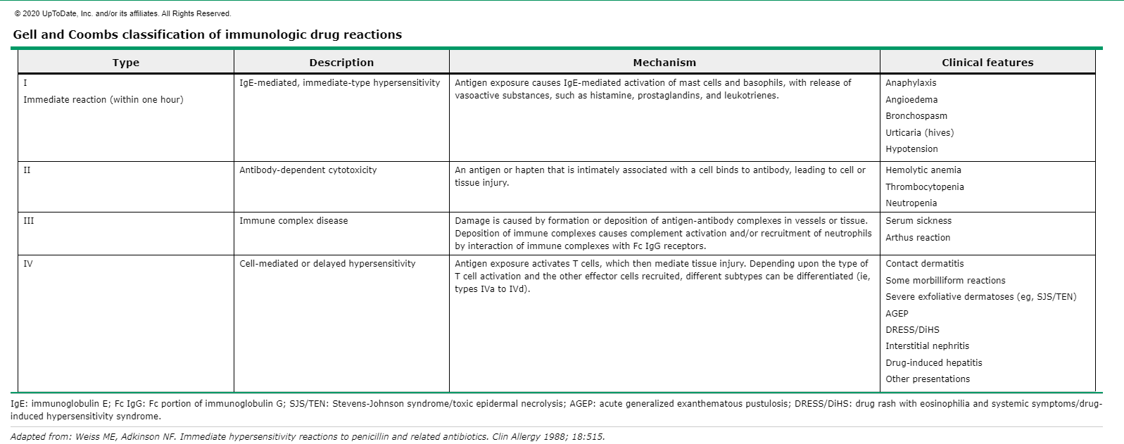
Clinical review
Complex syndrome – mostly clinical diagnosis (no testing)
Skin manifestations
Joint manifestations
Fever

Slide 38
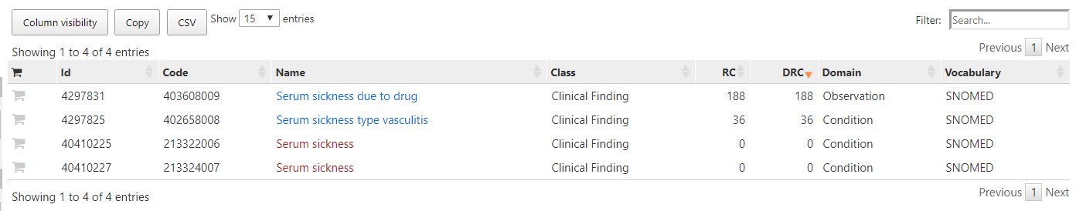
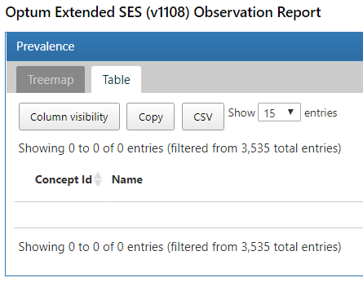
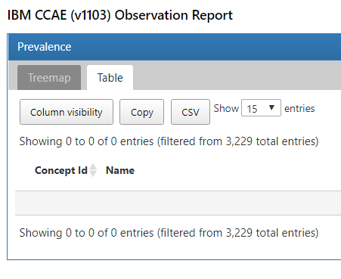
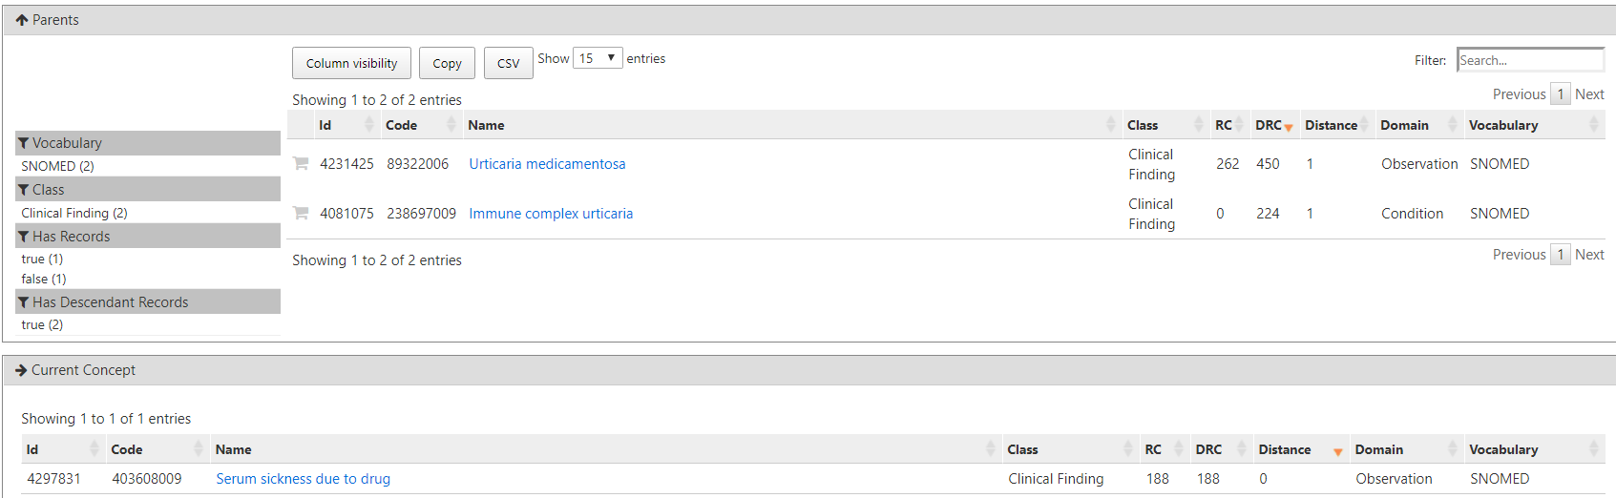
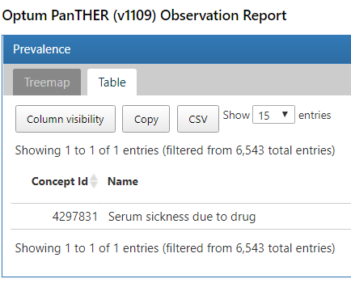
Data review
Not coded in data!!
Hierarchy

Slide 39
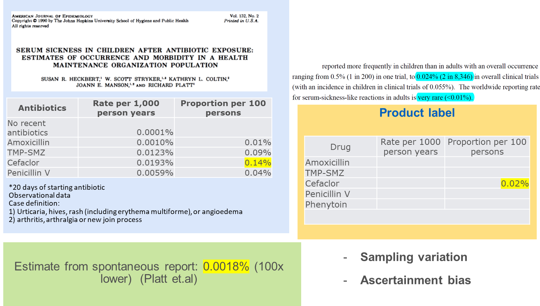
Literature review
In 1990!
Very rare phenotype!

Slide 40
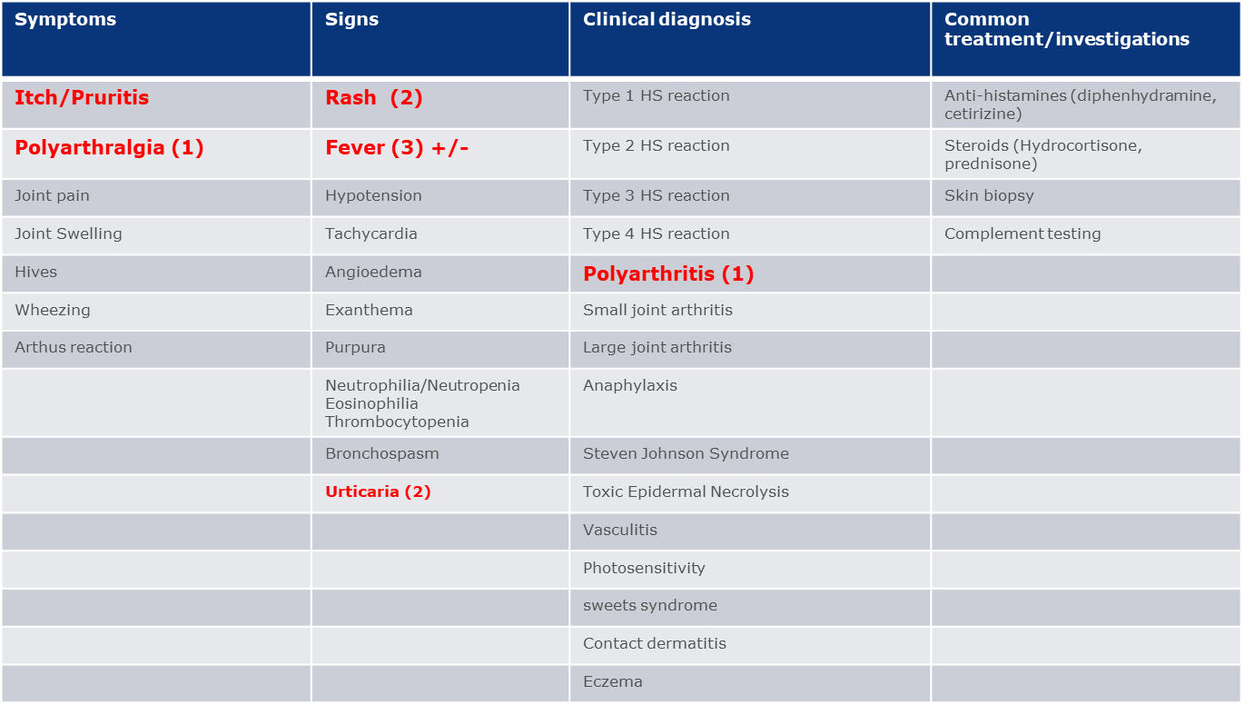
Lets start building phenotypes
Broad definition vs Narrow definition
  What is broad? What is narrow?
  How about ‘Very broad’? Or even ‘Very very broad’
  How about ‘very narrow’? Or ‘very very narrow’!
Since this is a syndrome – lets break it down into
‘Components’
Syndrome – ‘combination of components temporally related’

Slide 41
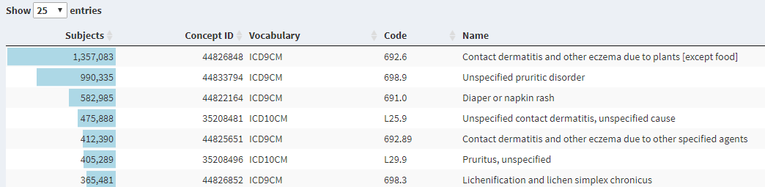
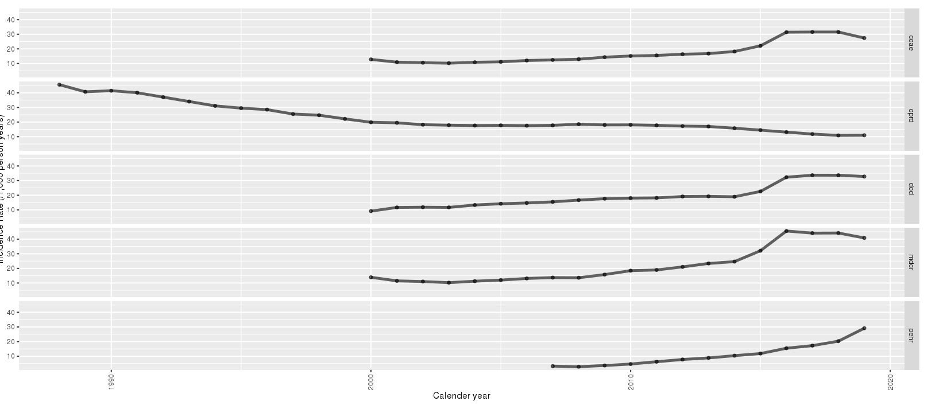
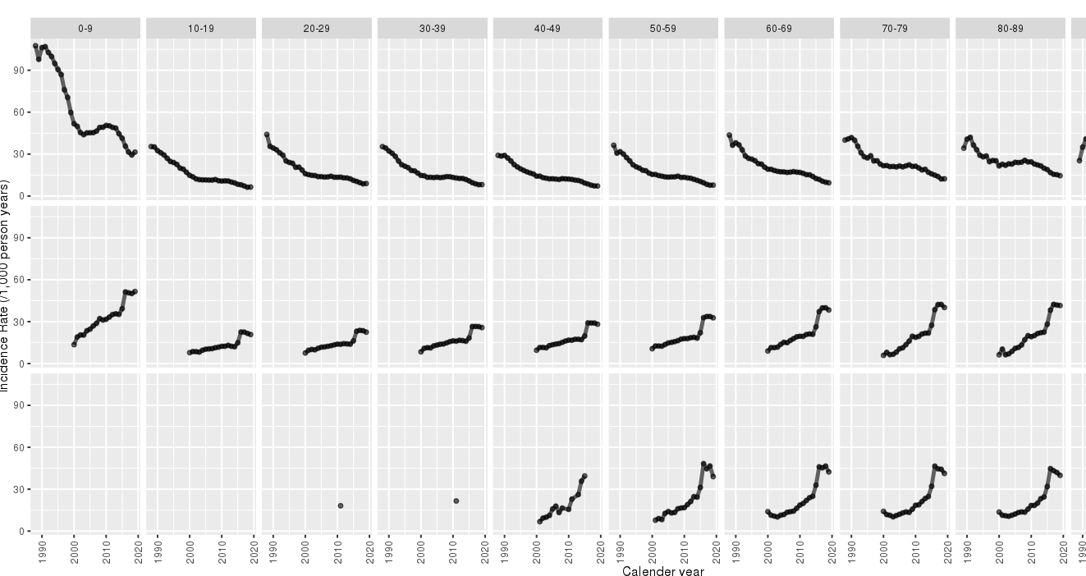
Component - Itch

Slide 42
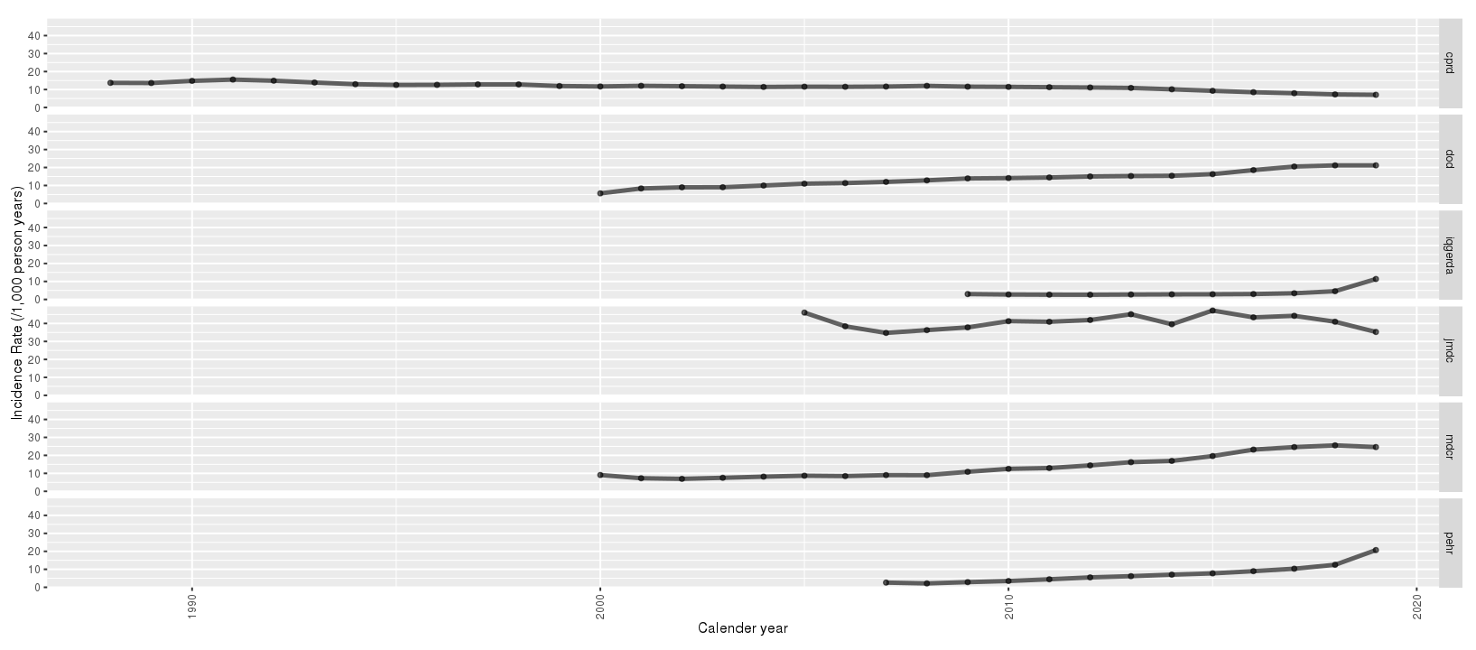
Itch or pruritis and-or urticaria (exclude diaper rash, contact dermatitis)
Flat – uniform
Passes my qualitative review!!

Slide 43
Rinse and repeat for each component

Slide 44
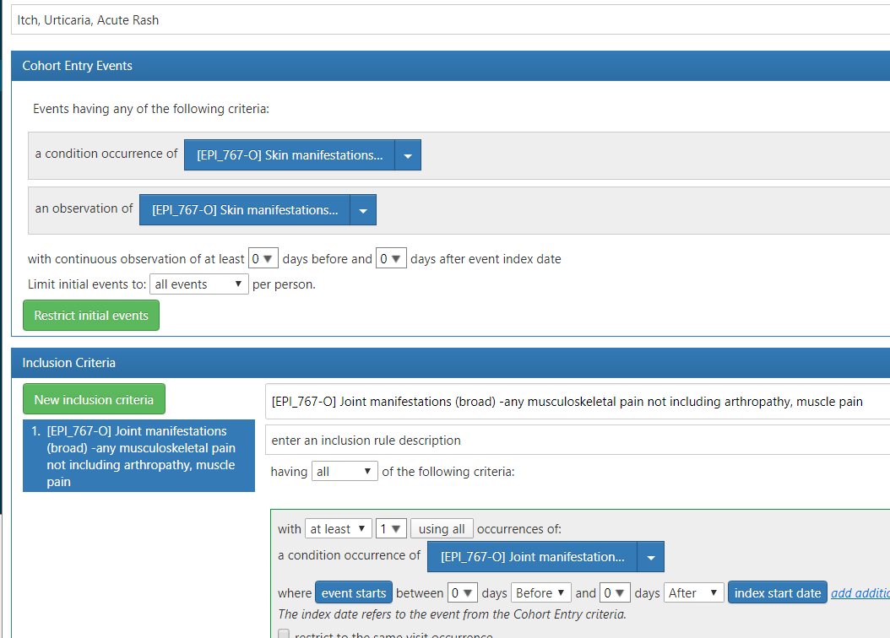
Composite outcome definition

Slide 45
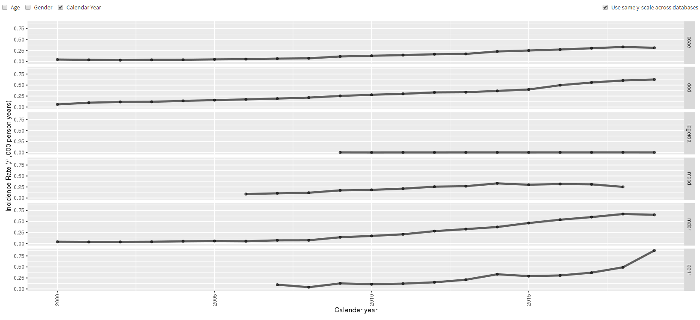
Composite definition

