Slide 1

Empowerment of German university hospitals to utilize OHDSI OMOP

Slide 2


Prologue
Medical Informatics Funding Scheme
MIRACUM - Medical Informatics in Research and Care in University Medicine
Data integration centres → collection and exchange of data (within the consortia)
Interoperable data formats + development of common tools and services
Enhance collaborative research and clinical care
We like open source

Slide 3
Introduction
Use case:
multi-centred patient recruitment infrastructure
Goals:
easy deployment & fast distribution
high flexibility
standardized data load process (German claim data)

Slide 4


Analyze
  missing Vocabularies
  no DBMS with OMOP CDM
  lack of data load process
Examination of OHDSI Broadsea:
  WebAPI
  Atlas
  OHDSI R methods lib

Slide 5

Enhance - Vocabulary
approx. 100 Athena vocabularies
determine
needed ones
German claim data
(9 out of 100)
SynPUF
(24 out of 100)

Slide 6


Enhance - Database
DBMS
PostgreSQL
OMOP CDM
flexible scripted Docker Volume generation based on selected vocabulary subset

Slide 7
Enhance – Data Load
Standardized data load process for all:
  clinical case data
  observational data
  diagnoses
  procedures
completly integrated in the docker environment

Slide 8
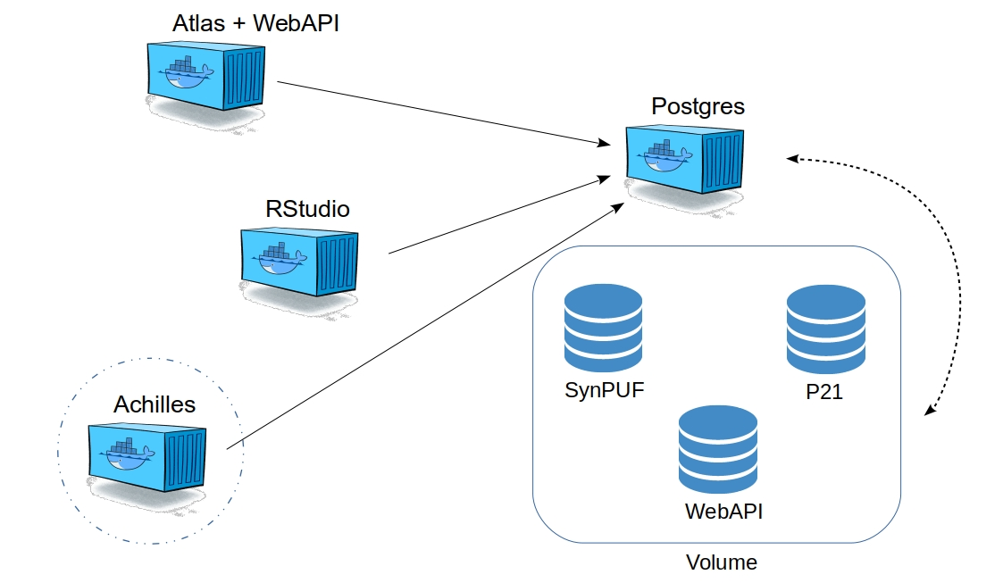

Results
download pre-configured docker environment
selectable docker databases volumes
deployment in a few minutes with a single command

Slide 9

Outlook
Federated showcase for patient recruitment in autumn 2020 in MIRACUM
ICD10GM in Athena
security aspects
revised database generation

Slide 10


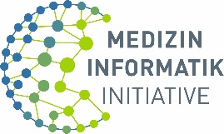
Many thanks!
Thanks for the attention :)
FKZ 01ZZ1801L

