Slide 1
Improvements for the
OHDSI Vocabularies
Support Process
Michael Kallfelz – Odysseus
Christian Reich – IQVIA

Slide 2
Vocabulary Management Process

Slide 3
OHDSI Vocabulary Management processes
New Vocab. Request
Prioritization & Funding
Development Process
Publish into ATHENA
Demand
refresh process
Obtain New Data Feed
Update Mappings
Perform Testing
Publish into ATHENA
Support & Maintenance
fixing a bug
Raise Issue in GitHub
Fix Mappings
Perform Testing
Publish into ATHENA
User / Requestor
OHDSI Vocabulary Team

Slide 4
Maintenance Process

Slide 5
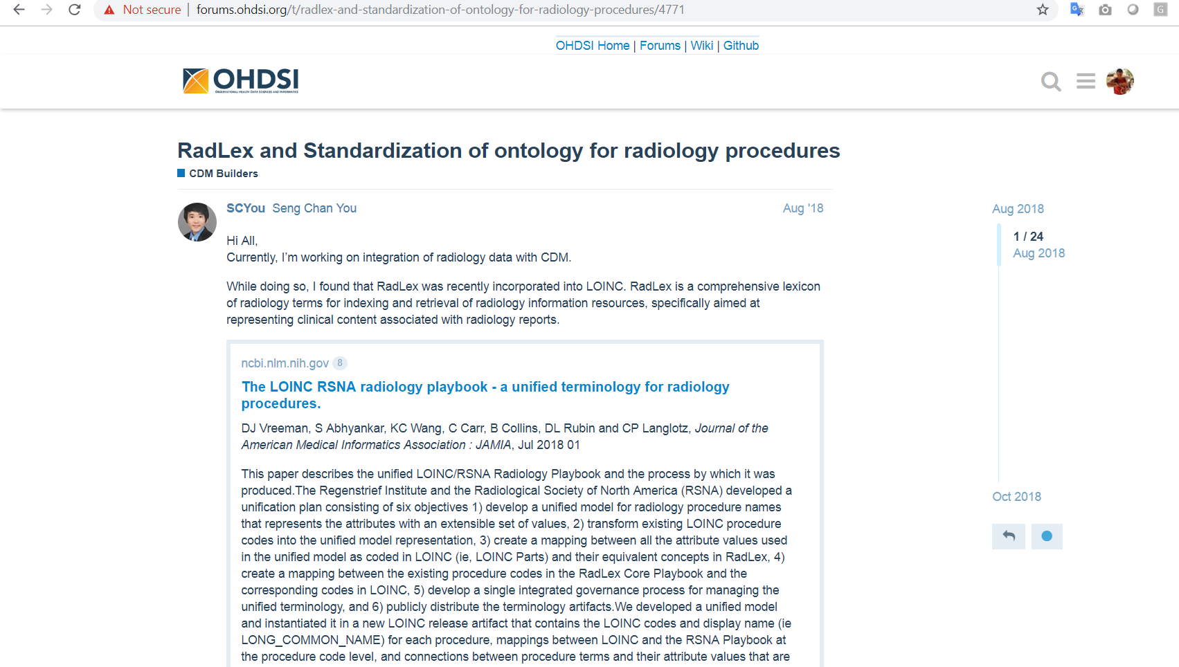
Raising New Vocab. Request (Step 1)
Describe the problem on forums, if discussion is needed (recommended), for example
http://forums.ohdsi.org/t/radlex-and-standardization-of-ontology-for-radiology-procedures/4771

Slide 6
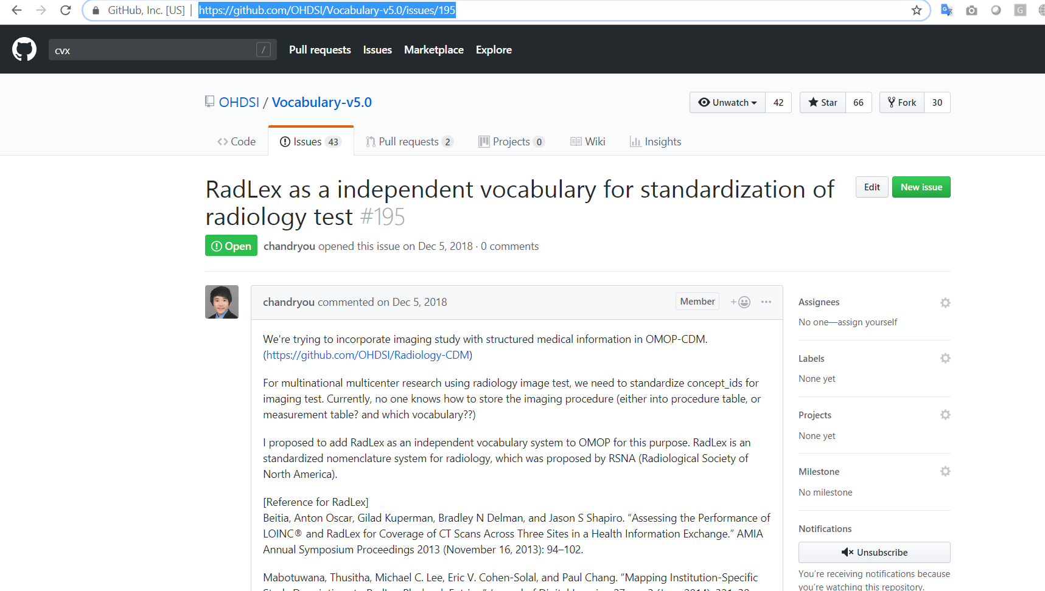
Raising New Vocab. Request (Step 2)
Step 2: Create a new issue on GitHub, for example:
https://github.com/OHDSI/Vocabulary-v5.0/issues/195

Slide 7
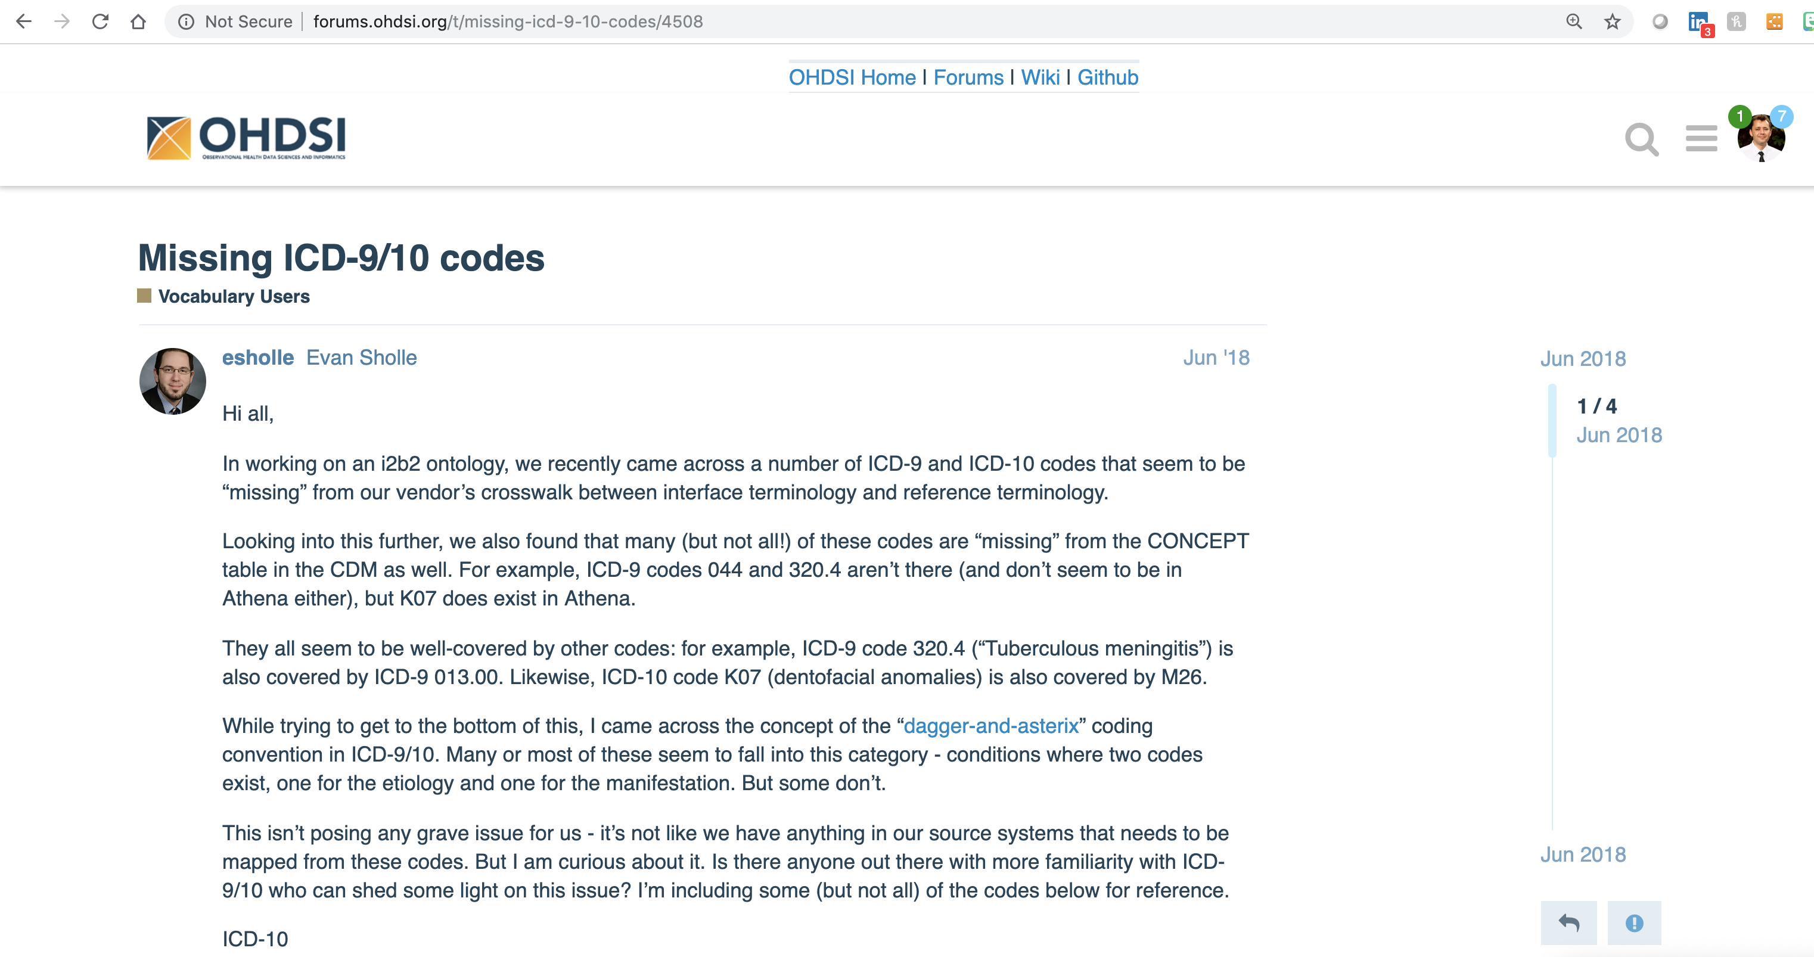
Raising a vocabulary bug (Step 1)
Describe the problem on forums, if discussion is needed (recommended), for example
http://forums.ohdsi.org/t/missing-icd-9-10-codes/4508

Slide 8
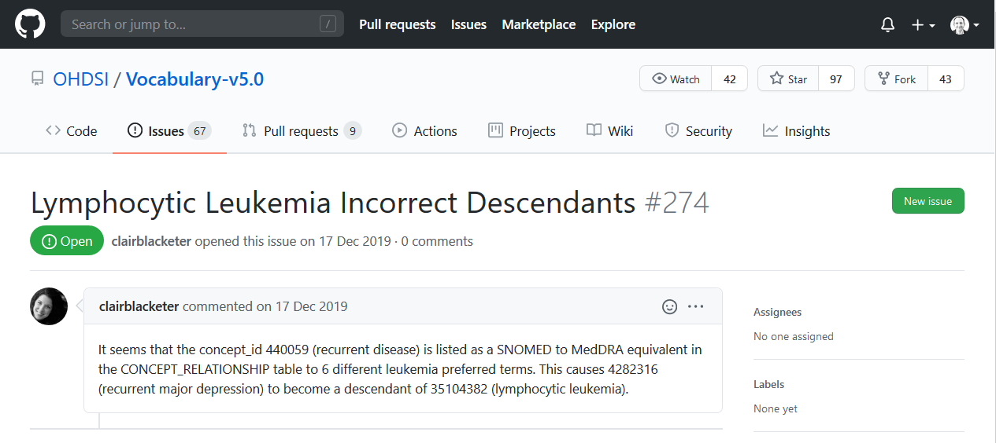
Raising a vocabulary bug (Step 2)
Step 2: Create a new issue on GitHub, for example:
https://github.com/OHDSI/Vocabulary-v5.0/issues/274

Slide 9
Possible improvements

Slide 10
Proposed Adjustments for Support
Provide dedicated forum category for defect handling and new requests?
Vocabulary team monitors and responds to as a priority
Try to avoid posting requests in various places
Vocabulary team monitors and responds to github issues
OHDSI forum
github
Issue management
New
requests
Defects

Slide 11
Enhanced Transparency
Improve github issue reflection into Forum post
Publish status for pending requests and refresh schedule for existing vocabularies
Future Improvement idea: Create extension to ATHENA to provide access to vocabulary metadata (readme, release notes)
Continuous improvement in consolidating documentation and related artifacts

Slide 12
Take home message
New vocabulary demand
  Find convincing arguments & get allies at the Forum
  Present the demand to OHDSI decision making
Suspected vocabulary defect
  Start a discussion at the Forum
  high probability of a defect > github issue

Slide 13
Decision for new demand
CDM Working Group reviews requests*
  Every 1st Tuesday of the month
  Meeting notes reflect decision steps
  * “OMOP CDM and Vocabulary Development” or “CDM and THEMIS”

