Slide 1
NCCD – RxNorm/Extension: Linking Chinese Clinical Drugs to International Drug Vocabulary
Yaoyun Zhang, Hua Xu, Jing Li, Mui Van Zandt
Melax Technologies, Inc, 7000 Fannin St Suite 1900, Houston, TX, USA;
Real World Solutions, IQVIA, Durham, NC, USA
Observational Health Data Science and Informatics (OHDSI), China Working Group

Slide 2
Outline
Introduction
  Background
  NCCD
  RxNorm
  RxNorm-Extension
Workflow of drug concept mapping
Results
  Coverage of NCCD in RxNorm/Extention
  Validation in frequent clinical drugs in China
Discussion & Conclusion

Slide 3
Background
Rapid development of Health Information systems in China
Increasing large archives of clinical data
Promoting interoperability locally and globally

Slide 4
NCCD: Normalized Chinese Clinical Drug knowledge base
Information sources
  China Food and Drug Administration
  China Health Insurance Systems
  Hospital Pharmacy Systems
  China Pharmacopoeia
Drugs
  Chemical drugs
  Chinese patent drugs
Wang, L., Zhang, Y., Jiang, M., Wang, J., Dong, J., Liu, Y., Tao, C., Jiang, G., Zhou, Y. and Xu, H., 2018. Toward a normalized clinical drug knowledge base in China—applying the RxNorm model to Chinese clinical drugs. Journal of the American Medical Informatics Association, 25(7), pp.809-818.

Slide 5
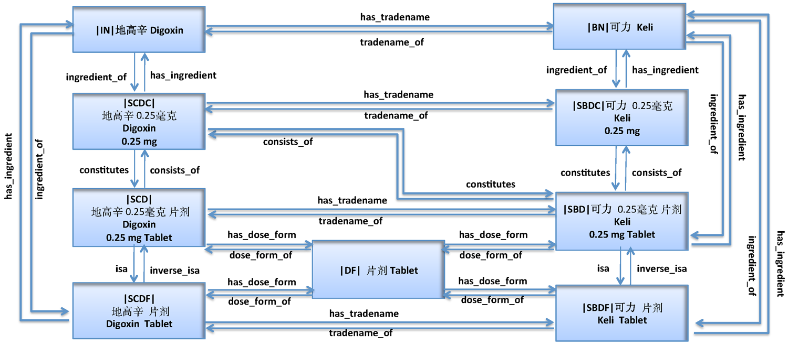
Semantic network of Chemical drugs in NCCD

Slide 6
RxNorm: A normalized naming system for generic and branded drugs in US
Liu, S., Ma, W., Moore, R., Ganesan, V. and Nelson, S., 2005. RxNorm: prescription for electronic drug information exchange. IT professional, 7(5), pp.17-23.
Notes:
the electronic exchange of clinical health information.The goal of RxNorm is to let various systems using different drug nomenclatures share and exchange data efficiently. It provides a way to link standard clinical drug names to many of the drug vocabularies commonly used in pharmacy management
Hospitals, pharmacies, and other organizations use computer systems to record and process drug information. Because these systems use many different sets of drug names, it can be difficult for one system to communicate with another. To address this challenge, RxNorm provides normalized names and unique identifiers for medicines and drugs. The goal of RxNorm is to allow computer systems to communicate drug-related information efficiently and unambiguously.

Slide 7
RxNorm-Extension: an OHDSI resource to represent international drugs
To support the expansion of the OHDSI research network beyond the US
Include active ingredients, dose forms, brand names, relations, ATC classification, additional attributes necessary for foreign drug markets
Specific international drug markets in Canada (DPD), UK (dm+d), France (BDPM), Germany (AMIS), Japan (JMDB), Australia (AMT), etc.
https://www.ohdsi.org/web/wiki/doku.php?id=documentation:international_drugs

Slide 8

NCCD
Data cleanup
Semantic similarity match
RxNorm/
Extension
Index
Workflow of
Drug Term Mapping
English translation
Manual check
no
no
unfound
Exact match
Semantically match
yes
yes
RxNorm
Extension
RxNorm/
Extension
Notes:
The workflow of mapping drug concepts in NCCD to RxNorm and RxNorm Extensions is illustrated in Figure 1: (1) Data cleanup: The NCCD was first cleaned up to remove concepts of Chinese Patent Drugs and noises of mislabels; (2) Concept translation: Terms (Synonyms) of drug concepts in NCCD were translated into English, by using known Chinese-English term pairs in existing resources,⁵ and manual check based on output from auto-translators. (3) Concept matching: To process English translations that cannot find exact string match in RxNorm terms, a search engine with indexed RxNorm terms was built. By querying the search engine, the semantic similarity will be calculated between the English translation and each RxNorm term of the same semantic type using the BM25 information retrieval model.⁶ The most semantically similar RxNorm terms will be returned for manual review. Semantic drugs that cannot find matches in RxNorm will further go through RxNorm-Extension to increase the coverage. (4) Enrich RxNorm-Extension: the rest concepts in NCCD that cannot find any match will be added into RxNorm-Extension.

Slide 9
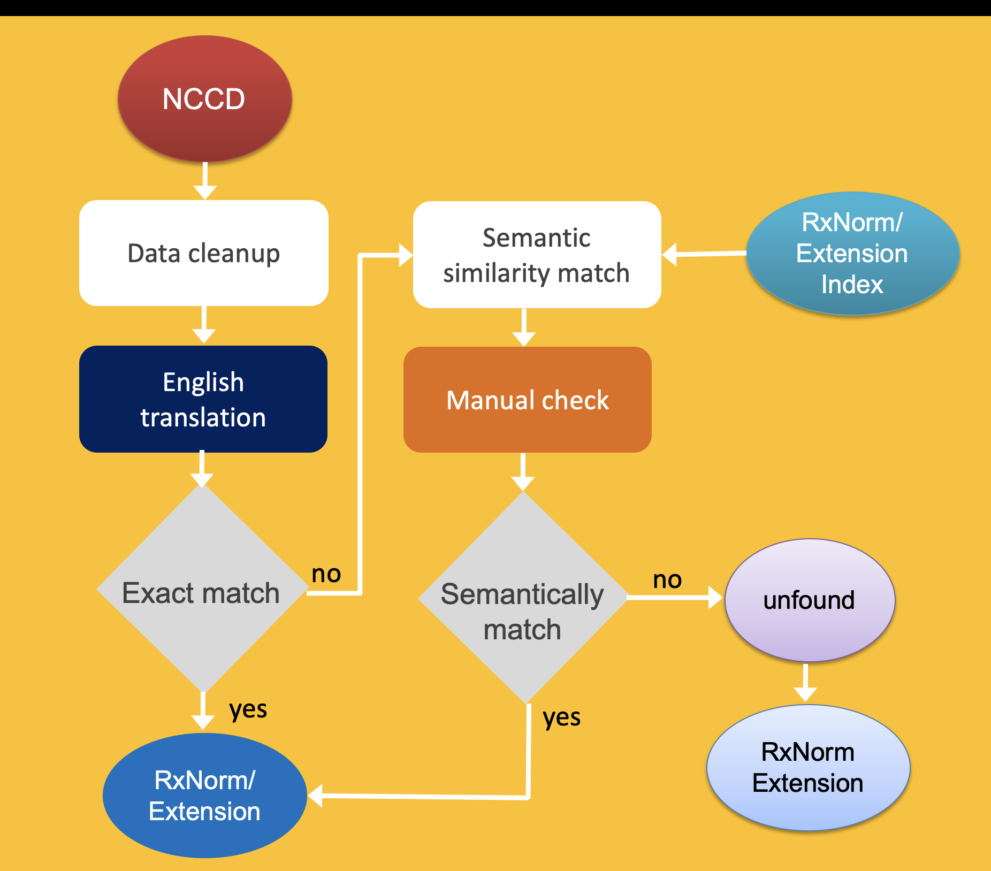
Workflow of
NCCD-RxNorm Mapping
Notes:
The workflow of mapping drug concepts in NCCD to RxNorm and RxNorm Extensions is illustrated in Figure 1: (1) Data cleanup: The NCCD was first cleaned up to remove concepts of Chinese Patent Drugs and noises of mislabels; (2) Concept translation: Terms (Synonyms) of drug concepts in NCCD were translated into English, by using known Chinese-English term pairs in existing resources,⁵ and manual check based on output from auto-translators. (3) Concept matching: To process English translations that cannot find exact string match in RxNorm terms, a search engine with indexed RxNorm terms was built. By querying the search engine, the semantic similarity will be calculated between the English translation and each RxNorm term of the same semantic type using the BM25 information retrieval model.⁶ The most semantically similar RxNorm terms will be returned for manual review. Semantic drugs that cannot find matches in RxNorm will further go through RxNorm-Extension to increase the coverage. (4) Enrich RxNorm-Extension: the rest concepts in NCCD that cannot find any match will be added into RxNorm-Extension.

Slide 10
Results
NCCD Chemical Drug | RxNorm | Coverage
Ingredient (IN) | Ingredient | 2 159 / 64.83%
 | Precise ingredient | 538 / 16.16%
 | Unmatched | 633 / 19.00%
Dose form (DF) | Dose form | 931 / 90.92%
Brand name (BN) | Brand name | 88 / 1.80%
 | RxNorm and RxNorm Extension
Semantic clinical drug form | Semantic clinical drug form | 3 075 / 37.63% 788 / 9.64%
Semantic clinical drug component | Semantic clinical drug component | 2 226 / 33.06% 578 / 8.58%
Semantic clinical drug | Semantic clinical drug | 2 370 / 22.70% 588 / 5.63%

Slide 11
Ingredient mapping
Matched : 2 159
Unmatched : 633
NCCD_NAME | NCCD_CODE | TRANSLATION | RXN_NAME | RXN_CODE | RXN_TYPE
克林霉素磷酸酯 | 100378 | clindamycin | clindamycin | 2582 | IN
硝苯地平 | 183394 | nifedipine | nifedipine | 7417 | IN
阿莫西林 | 76759 | amoxicillin | amoxicillin | 723 | IN
别嘌醇 | 76964 | allopurinol | allopurinol | 519 | IN
NCCD_NAME | NCCD_CODE | TRANSLATION
复方维生素U | 87252 | vitamin u
氨苯伪麻 | 134746 | amphibian
乙氧苯柳胺 | 115142 | etofesalamide
复方甲麻 | 190447 | Methylene
帕司烟肼 | 190444 | pasiniazide
重组人干扰素α1b | 190672 | recombinant human interferon α1b

Slide 12
Ingredient mapping
IN to RxN PIN (Precise Ingredient)
Total Unique: 538
NCCD_NAME | NCCD_CODE | TRANSLATION | RXN_NAME | RXN_CODE | RXN_TYPE
利福霉素钠 | 87592 | rifamycin sodium | rifamycin sodium | 236475 | PIN
硫酸阿米卡星 | 75472 | amikacin sulfate | amikacin sulfate | 643 | PIN
氨苄西林钠 | 176941 | ampicillin sodium | ampicillin sodium | 81953 | PIN
盐酸阿扑吗啡 | 89143 | apomorphine hydrochloride | apomorphine hydrochloride | 71225 | PIN
萘普生钠 | 93469 | naproxen sodium | naproxen sodium | 142442 | PIN
盐酸赖氨酸 | 76234 | lysine hydrochloride | lysine hydrochloride | 6538 | PIN
无水硫酸钠 | 117336 | sodium sulfate anhydrous | sodium sulfate anhydrous | 1299926 | PIN
醋酸可的松 | 77672 | cortisone acetate | cortisone acetate | 21655 | PIN
头孢唑肟钠 | 94793 | ceftizoxime sodium | ceftizoxime sodium | 82126 | PIN

Slide 13
Brand name mapping
Exact match: 88/4 875 (1.8%)
Potential problem: Chinese Brands are not covered in RxNorm
NCCD_NAME | NCCD_CODE | TRANSLATION | RXN_NAME | RXN_CODE | RXN_TYPE
美卓乐 | 174622 | medrol | medrol | 202702 | BN
保达琳 | 174196 | fortolin | fortolin | 1540829 | BN
卢美根 | 174268 | lumigan | lumigan | 284771 | BN
普米克令舒 | 174402 | pulmicort respules | pulmicort respules | 284850 | BN
思真 | 173197 | saizen | saizen | 202830 | BN
耐信 | 104516 | nexium | nexium | 284799 | BN
择泰 | 174858 | zometa | zometa | 285143 | BN
美卓乐 | 174622 | medrol | medrol | 202702 | BN
保达琳 | 174196 | fortolin | fortolin | 1540829 | BN

Slide 14
Dose form mapping
Matched dose forms: 931 out of 1 024 (90.92%)
Problem: granularity, definition
Solution: exact match or match to the upper level
NCCD_NAME | NCCD_CODE | TRANSLATION | RXN_NAME | RXN_CODE | RXN_TYPE
片剂（素片） | 43734 | Tablet (Plain) | tablet | 10311 | DF
软胶囊剂 | 176021 | soft capsule | Capsule | 1995 | DF
片剂 | 59625 | tablet | tablet | 10311 | DF
咀嚼片 | 98275 | chewable tablet | chewable tablet | 91058 | DF
片剂(包衣片) | 53501 | Tablet (coated) | tablet | 10311 | DF
糖衣片 | 40890 | sugar coated tablet | Tablet | 10311 | DF
Notes:
Plain tablets refer to the tablets that are formed by pressing machine but not coated

Slide 15
Mapping of Semantic Clinical Drug Form
SCDF: Semantic Clinical Drug Form
Total RxNorm Match: 3 075/8 171 (37.63%)
Total RxNorm_Extension Match: 788/8 171 (9.64%)
NCCD_NAME | NCCD_CODE | TRANS | DF | RXN_NAME | RXN_CODE | RXN_TYPE
克林霉素磷酸酯 胶囊剂 | 106451 | clindamycin | capsule | clindamycin oral capsule | 371555 | SCDF
克林霉素磷酸酯 凝胶剂 | 106457 | clindamycin | gelatin | None
硝苯地平控释 片剂（控释） | 106505 | nifedipine | tablet | nifedipine oral tablet | 373069 | TMSY
硝苯地平 软胶囊剂 | 106509 | nifedipine | capsule | nifedipine oral capsule | 373067 | TMSY
硝苯地平 缓释片 | 106517 | nifedipine | tablet | nifedipine oral tablet | 373069 | TMSY
硝苯地平 注射剂 | 106535 | nifedipine | injection | None
硝苯地平 胶囊剂(软胶囊) | 106536 | nifedipine | capsule | nifedipine oral capsule | 373067 | TMSY
硝苯地平 片剂 | 106542 | nifedipine | tablet | nifedipine oral tablet | 373069 | TMSY
硝苯地平 原料药 | 106549 | nifedipine | bulk drug | None
金刚烷胺 胶囊 | 106777 | amantadine | capsule | amantadine oral capsule | 370558 | SCDF

Slide 16
Mapping of Semantic Clinical Drug Component
SCDC: Semantic Clinical Drug Component
Total RxNorm Match: 2 226/6 733 (33.06%)
Total RxNorm_Extension Match: 578/6 733 (8.58%)
NCCD_NAME | NCCD_CODE | TRANS | DF | RXN_NAME | RXN_CODE | RXN_TYPE
克林霉素磷酸酯 250 毫克 | 106430 | clindamycin | ['250 mg'] | None
克林霉素磷酸酯 6 毫克/毫升 | 106432 | clindamycin | ['6 mg/ml'] | clindamycin 6 mg/ml | 328335 | SCDC
克林霉素磷酸酯 90 毫克/毫升 | 106434 | clindamycin | ['90 mg/ml'] | None
克林霉素磷酸酯 100毫克 | 106441 | clindamycin | ['100 mg'] | clindamycin 100 mg | 332440 | SCDC
阿莫西林 500 毫克 | 106634 | amoxicillin | ['500 mg'] | amoxicillin 500 mg | 317616 | SCDC
阿莫西林 500 毫克 | 106659 | amoxicillin | ['500 mg'] | amoxicillin 500 mg | 317616 | SCDC
阿莫西林 125000 毫克 | 106670 | amoxicillin | ['125000 mg'] | None
青蒿琥酯 50毫克 | 107239 | artesunate | ['50 mg'] | artesunate 50 mg | 437646 | SCDC
青蒿琥酯 100毫克 | 107245 | artesunate | ['100 mg'] | None

Slide 17
Mapping of Semantic Clinical Drug
SCD: Semantic Clinical Drug
Total RxNorm Match: 2 370/10 441 (22.70%)
Total RxNorm_Extension Match: 588/10 441 (5.63%)
NCCD_NAME | NCCD_CODE | IN | DF | RX_NAME | RX_CODE
克林霉素磷酸酯 150 毫克/毫升 注射剂 | 106424 | clindamycin | ['150 mg/ml']|injection | clindamycin 150 mg/ml injection | 1737246
克林霉素磷酸酯 150毫克 片剂 | 106466 | clindamycin | ['150 mg']|tablet | clindamycin 150 mg oral tablet | 433773
克林霉素磷酸酯 1200 毫克 注射剂 | 106421 | clindamycin | ['1200 mg']|injection | None
克林霉素磷酸酯 75 毫克/毫升 注射剂 | 106473 | clindamycin | ['75 mg/ml']|injection | None

Slide 18
Mapping of Semantic Branded Drug
SBD: Semantic Branded Drug
Total RxNorm Match: 22/ 7 257 (0.30%)
Total RxNorm_Extension Match: 7/7 257 (0.09%)
NCCD_NAME | NCCD_CODE | IN | DF | RXN_NAME | RXN_CODE
乳果糖 667毫克/毫升 口服溶液剂 [杜密克] | 110965 | lactulose | ['667 mg/ml']|oral solution | lactulose 667 mg/ml oral solution [duphalac] | 755469
依非韦伦 600毫克 片剂 [施多宁] | 122759 | efavirenz | ['600 mg']|tablet | efavirenz 600 mg oral tablet [sustiva] | 352143
对乙酰氨基酚 0.5克 片剂 [保达琳] | 141509 | acetaminophen | ['500 mg']|tablet | acetaminophen 500 mg oral tablet [fortolin] | 1540834
佐米曲普坦 2.5毫克 片剂 [佐米格] | 144797 | zolmitriptan | ['2.5 mg']|tablet | zolmitriptan 2.5 mg oral tablet [zomig] | 153353
尼古丁 2毫克 咀嚼胶 [力克雷] | 147598 | nicotine | ['2 mg']|chewing gum | nicotine 2 mg chewing gum [nicorette] | 209326
伏立康唑 50毫克 片剂 [威凡] | 151281 | voriconazole | ['50 mg']|tablet | voriconazole 50 mg oral tablet [vfend] | 352218

Slide 19
Coverage of common medications
1, 000 most frequent medications in hospital
Coverage
  673 drugs mapped to RxNorm at the Ingredient level – 67.3% RxNorm Ingredient Mapping
  Out of these 673 drugs, 358 mapped to RxNorm semantic drugs, and 52 mapped to RxNorm Extension semantic drugs – 41.0% RxNorm/RxNorm Extension Semantic Drugs Mapping

Slide 20
Discussion&Conclusion
Promising results of NCCD-RxNorm/Extension mapping
Incomplete drug attribute information, especially in hospital data
Future work
  Enrich RxNorm-Extension
  Validation in clinical research use cases

Slide 21
COVID-19 SignSym: A fast adaptation of general clinical NLP tools to identify and normalize COVID-19 signs and symptoms to OMOP common data model
Online Demo: https://clamp.uth.edu/covid/nlp.php
Paper: https://arxiv.org/abs/2007.10286

Slide 22
Thank you
Q&A yaoyun.zhang@melaxtech.com

