Slide 1
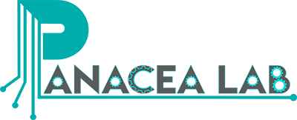
Leveraging the OHDSI vocabulary to characterize the COVID-19 epidemic using Twitter data and NLP
7/21/2020
Juan M. Banda
www.panacealab.org
jbanda@gsu.edu
@drjmbanda

Slide 2
Preface: Twitter is gaining attention for health-related research since 2009
Results of PubMed Query for Twitter and Health

Slide 3




My path to working on COVID-19 research
Ph.D in CS – Data Mining (Image data)
Postdoc and Research Scientist at Stanford University – Shah Lab on Biomedical Informatics (Medical text data – structured and unstructured)
OHDSI collaborator on probabilistic phenotyping using weak supervision and NLP Workgroup member standardizing resources to OHDSI vocabulary
Assistant Professor at Georgia State University – PI of Panacea lab
  Working with epidemiologists on identifying mobility patterns during natural disasters using social media data
  Extracting drug use from social media data

Slide 4
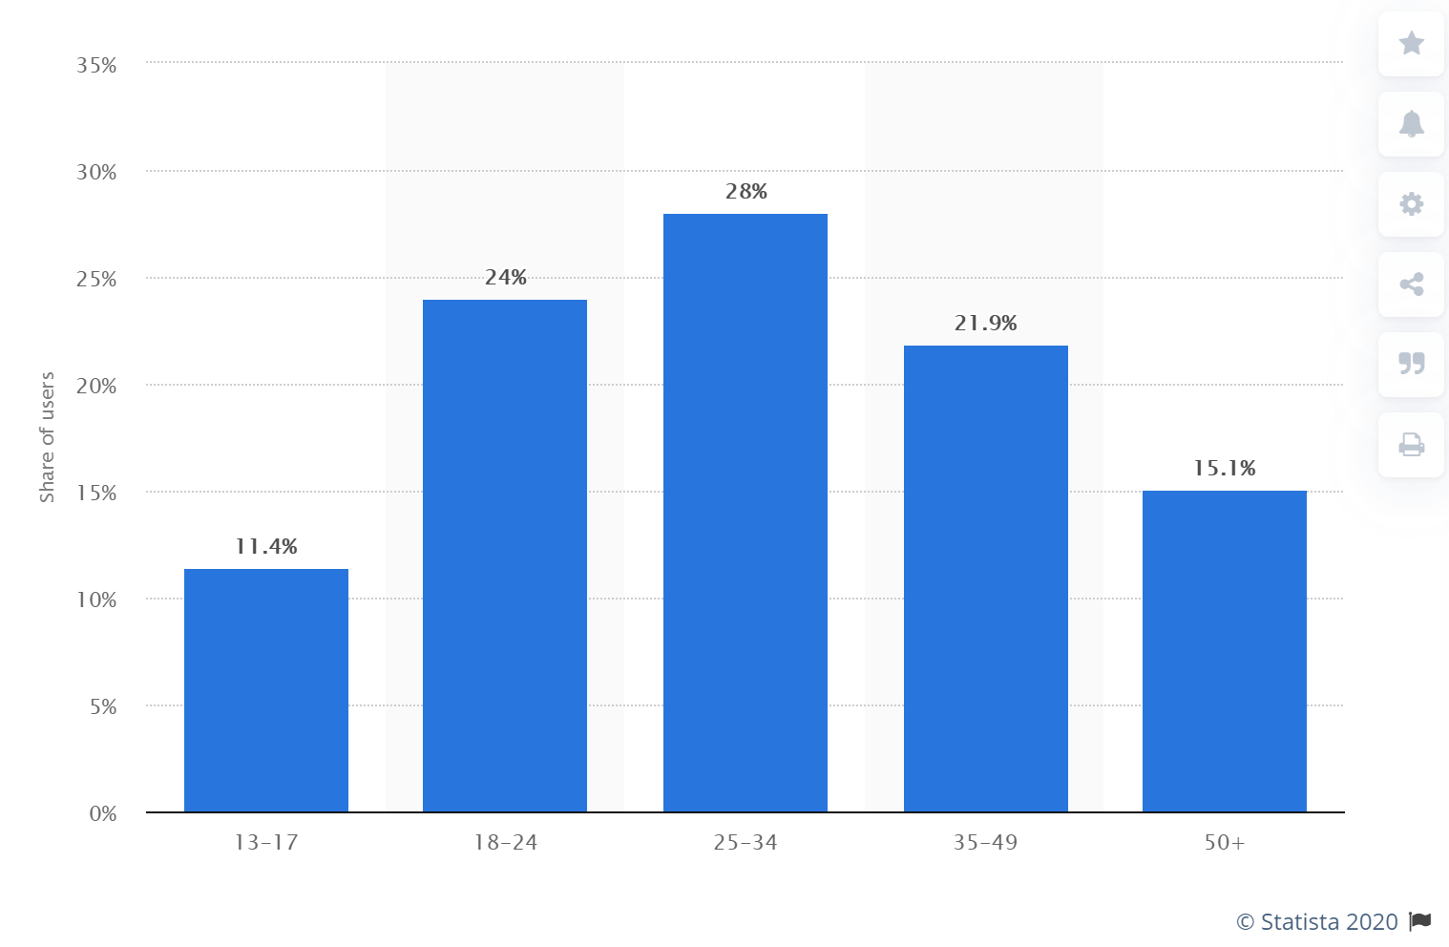
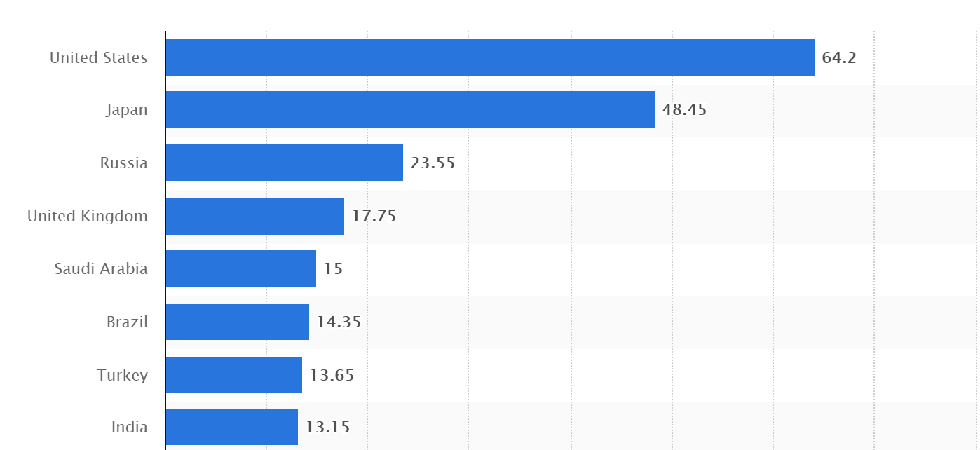
Benefits of using Twitter:
https://www.statista.com/statistics/242606/number-of-active-twitter-users-in-selected-countries/
Distribution of global users over
age groups
Good population representation
Everybody can post and have an account
Anonymity = unfiltered opinions
Data is freely available*
Tons of data generated each day (hundreds of millions of tweets get posted every day)
Easy filtering (hashtag usage, people mentions)
Number of users per country (millions)

Slide 5

Traditional disadvantages of using Twitter:
Messy data (plenty of misspellings, shorthand, emojis, etc.)
  There are at least 25 different ways people misspell hydroxychloroquine
Attribution is an issue – are people just mentioning something or did it happen to them?
Freely available data is only a 1% sample of whole set
Collection is hard and needs to be ongoing for days/weeks before getting considerable mass
Very unique challenges
  Short form text (up to 280 chars in Twitter)
  More colloquial, ambiguous, and expressive in different ways ( )

Slide 6
Collecting the data
Thanks to our work with Dr. Chowell (GSU – Public Health) we started collecting COVID-19 data early!
We also received contributed data for January and February from (new) collaborators – after we first shared our dataset publicly
……… wait, the data was released before any publications/work has been completed on it???

Slide 7
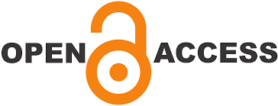
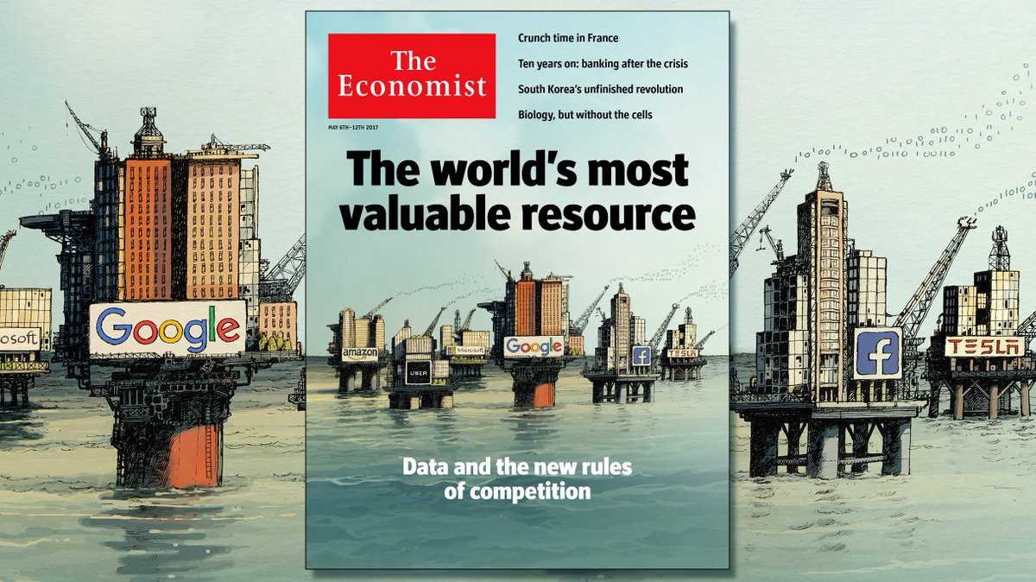

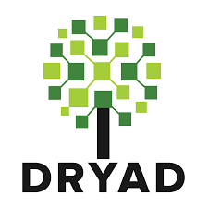


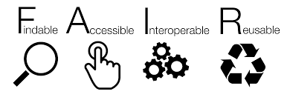
Short answer……Yes!
But it needs to be done right!
and for the benefit of everybody
….. within all legal and ethical responsibilities of the data being shared

Slide 8
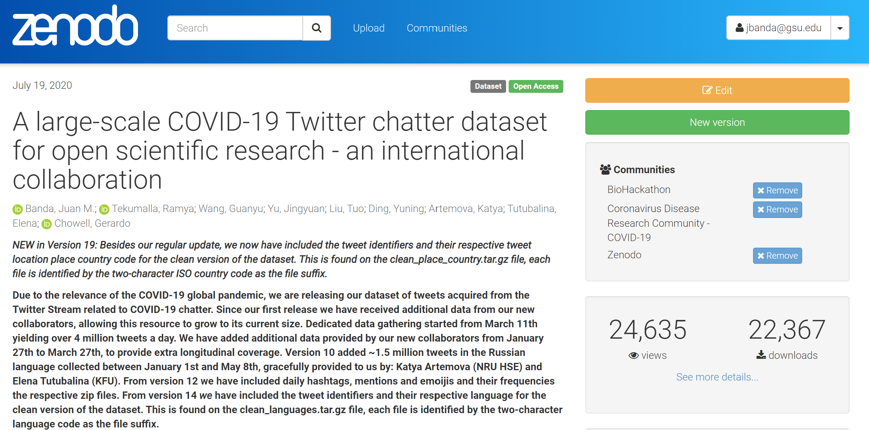
The dataset:
513+ Million Tweets
ONLY COVID related
chatter is included
Longitudinal – January 27th to today… and growing
Dataset: https://doi.org/10.5281/zenodo.3723939
Pre-print: https://arxiv.org/abs/2004.03688
Recent additions: https://github.com/thepanacealab/covid19_twitter

Slide 9
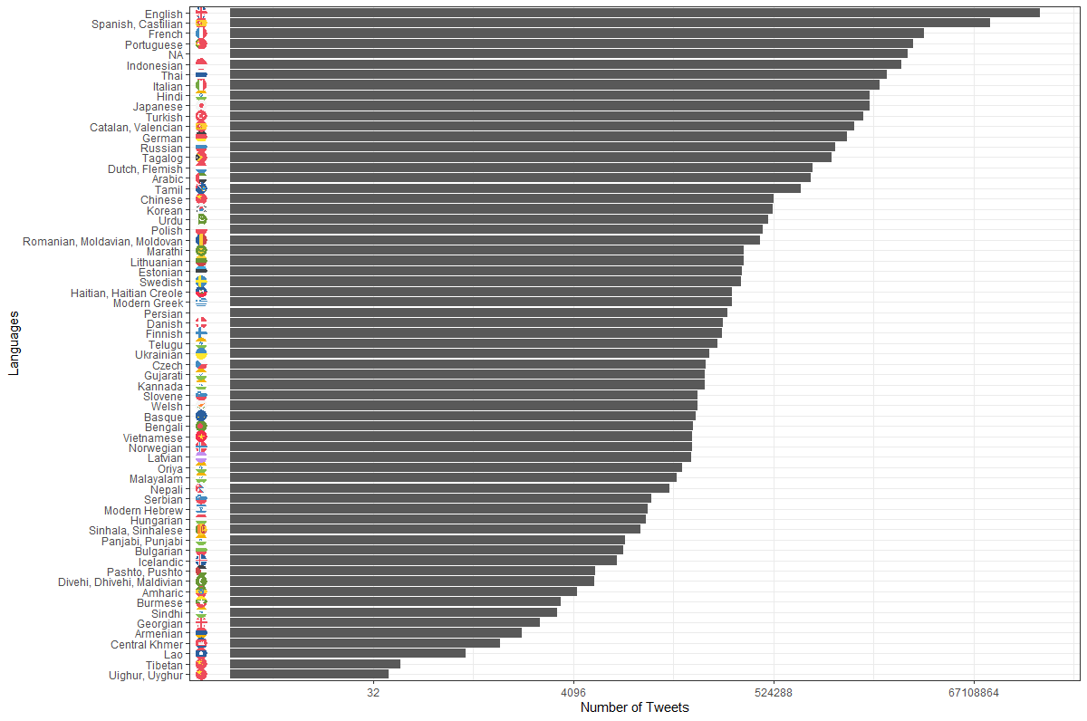
Languages available:
69 in total

Slide 10
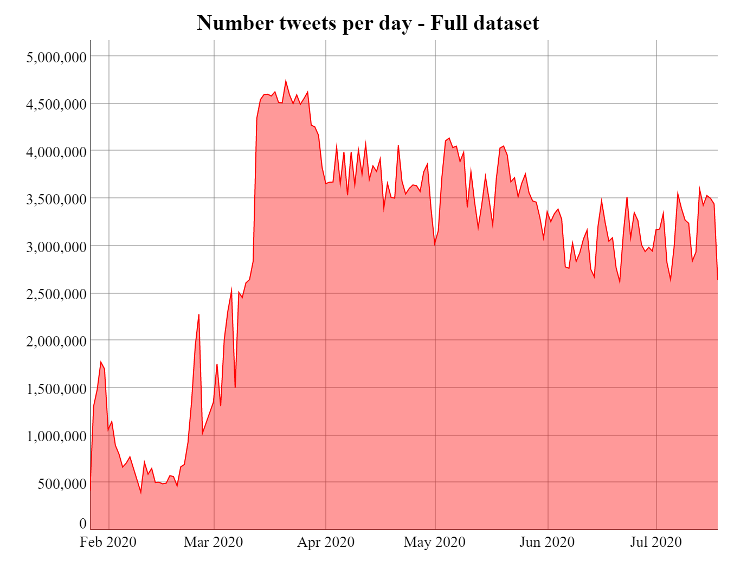
Tweets per day (all):
http://www.panacealab.org/covid19/

Slide 11
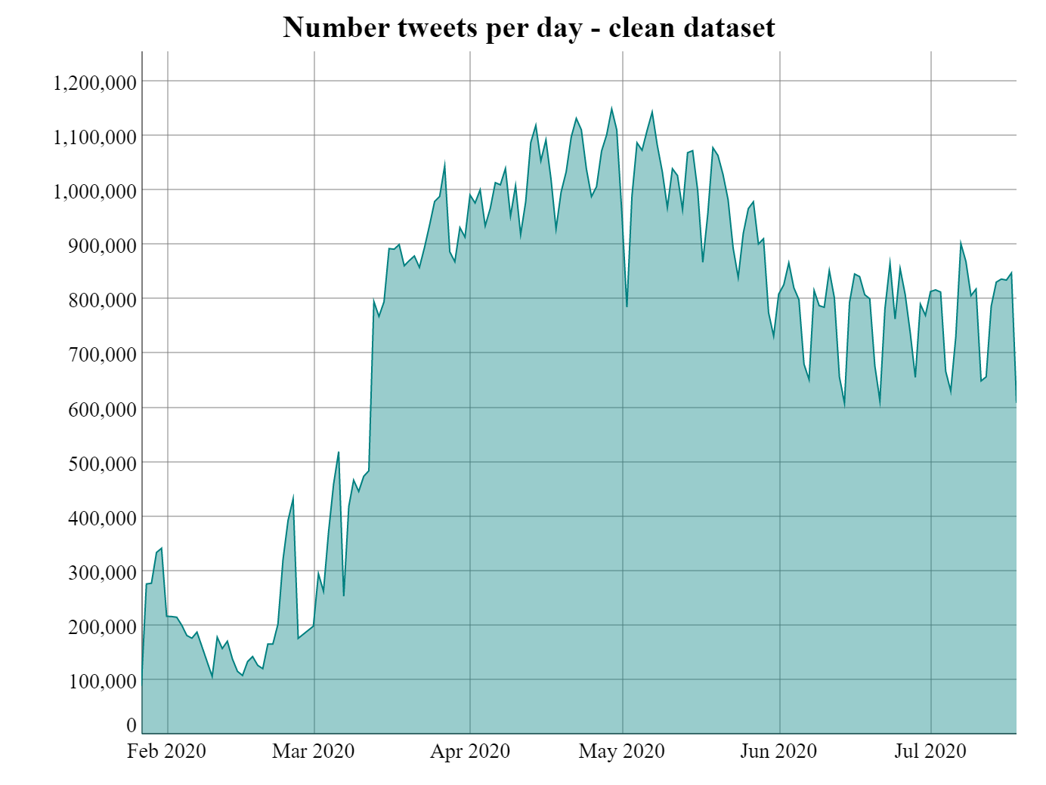
Tweets per day (clean):
http://www.panacealab.org/covid19/

Slide 12
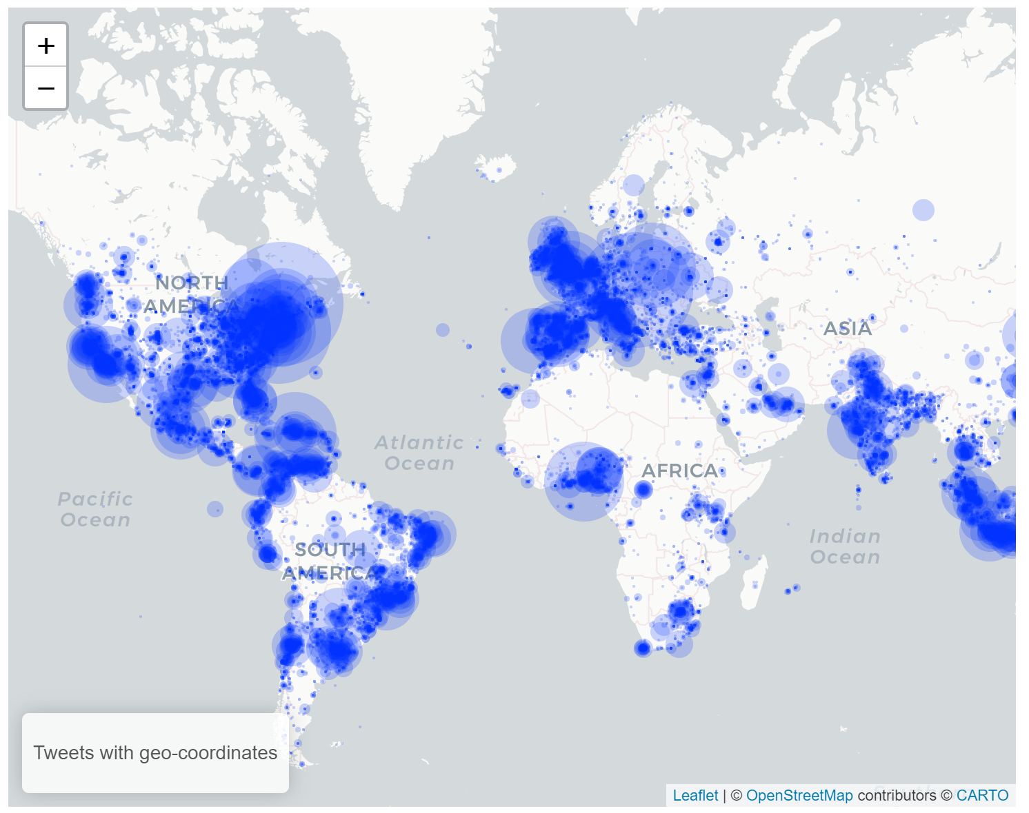
Geolocations?
… on some less than 1%

Slide 13
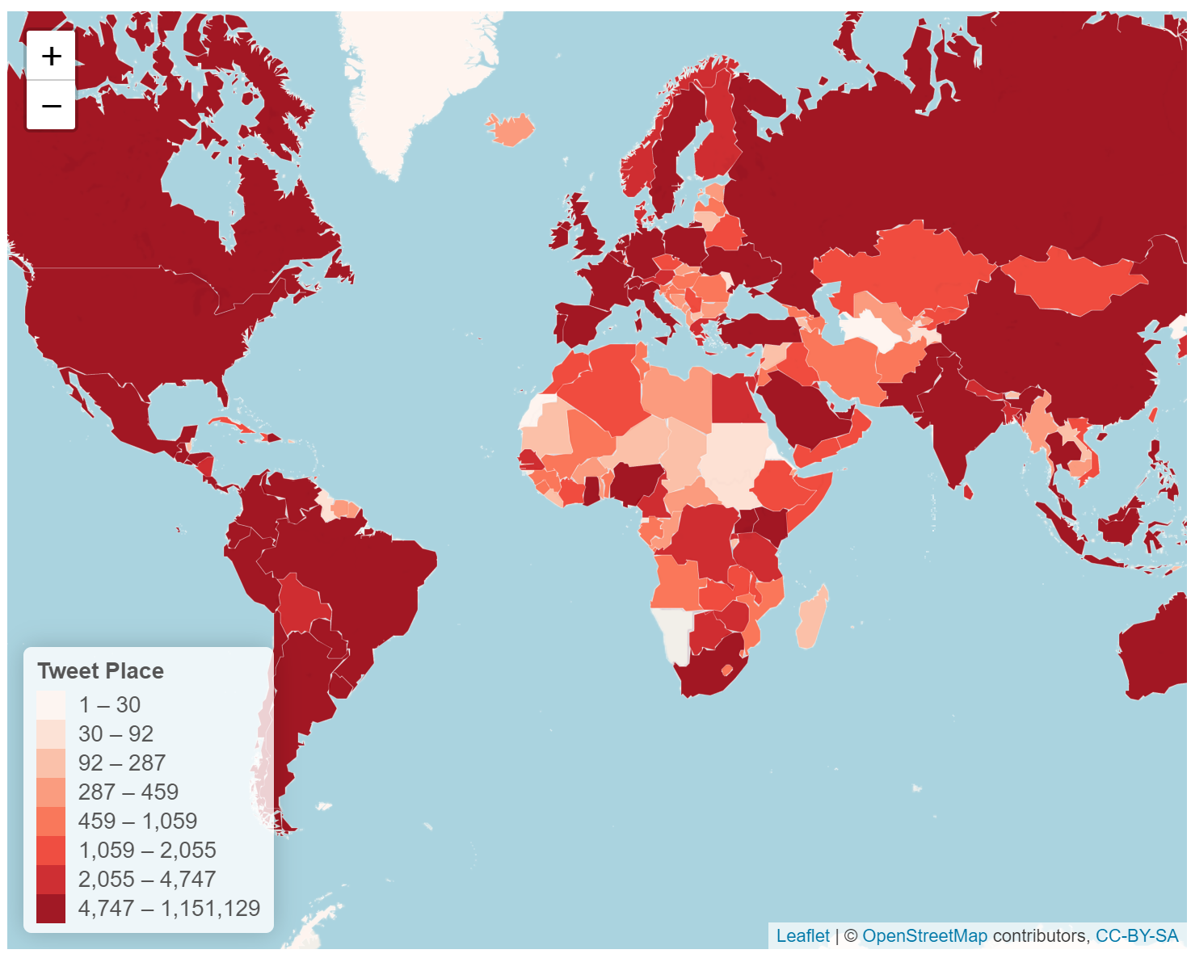
Tweets with place location enabled?
… some less than 2%

Slide 14
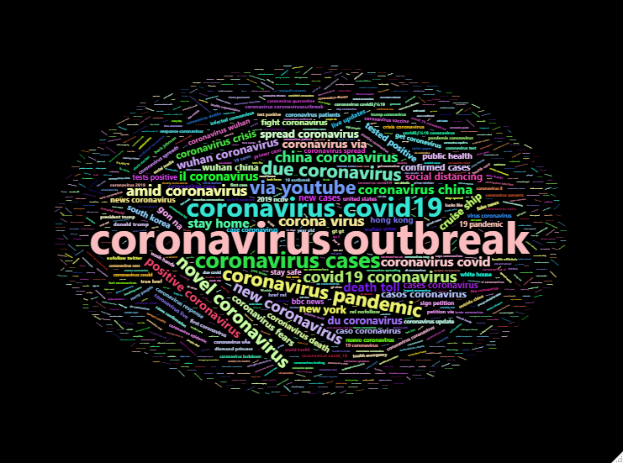
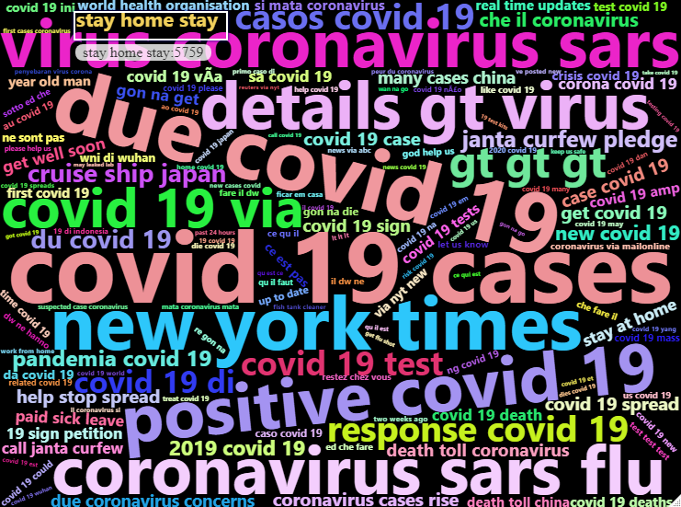
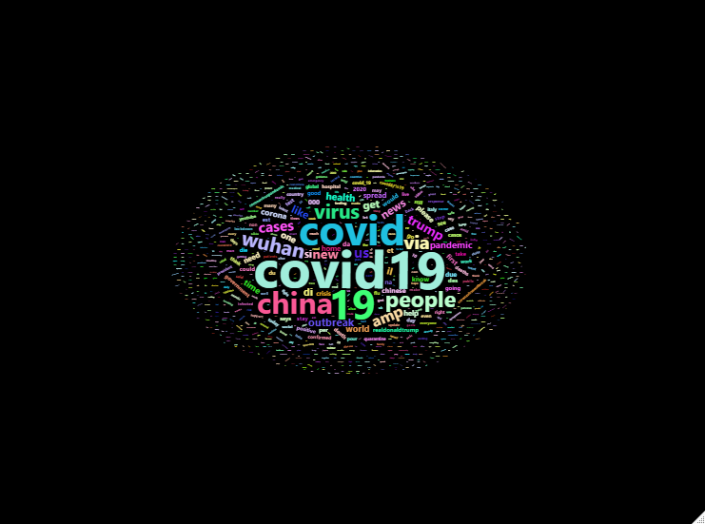
For instant NLP uses
We include:
  Top 1000 frequent terms
  Top 1000 frequent bigrams
  Top 1000 frequent trigrams

Slide 15
Is the dataset being used?
22K downloads since we started
Over 15 pre-prints cite us….. 3 datasets ‘aggregated’ us without attribution or even asking
Has been used on multiple hackathons: MIT-COVID19 challenge, Lumiata COVID hackathon,
COVID-19 biohacktahon
We have been invited to participate on:
- Bay Area Summer Institutes in Computational Social Science
- Harvard The Coronavirus Visualization Team – Xenophobia Project
Started new collaborations with over six academic institutions

Slide 16

So what can we do with this type of data?
https://images.app.goo.gl/YAVtt66nNxeZxQzKA

Slide 17
Perception towards the ethnic minorities and elderly populations
Being a fellow at Stanford SAGE Research Center one of our first questions was to identify the perception of the Twitter users to ethnic minorities and elderly populations
Turns out we can!
Turns out is not as expected!

Slide 18
Perception towards the elderly and ethnic minorities (1)
What we did:
  Curated terms to identify tweets for elderly populations and for ethnic minorities
  Identify Tweets with mentions. Build machine learning models to disambiguate ambiguous terms after manual curation.
  Sentiment Analysis using VADER (Valence Aware Dictionary and sEntiment Reasoner)
  Manual Evaluation of identified Tweets for correctness of polarity
  Comparison of Baseline tweets (2019) with epidemic related tweets (March)

Slide 19
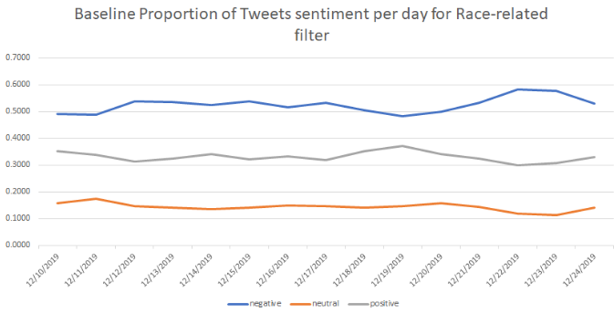
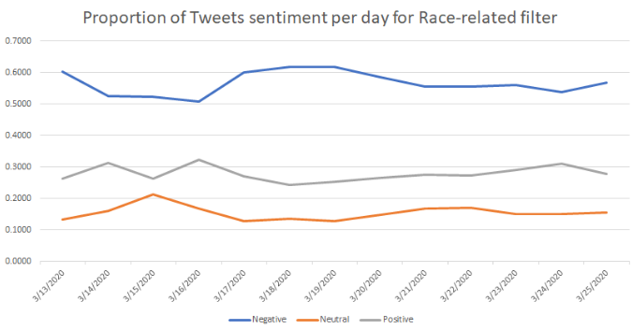
Perception towards the elderly and ethnic minorities (2)
For ethnic minorities:

Slide 20
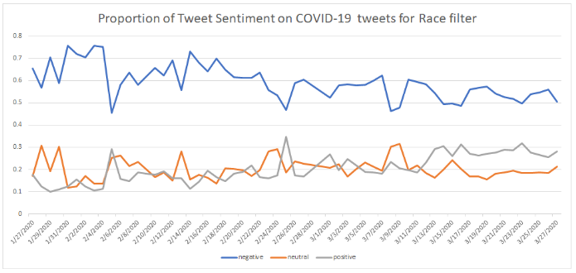
Perception towards the elderly and ethnic minorities (3)
The calculated proportion of negative versus positive tweets has increased to 28% more negative sentiment on racial minorities. This leads to an almost 10% increase in negative sentiments in the time periods we analyze.

Slide 21
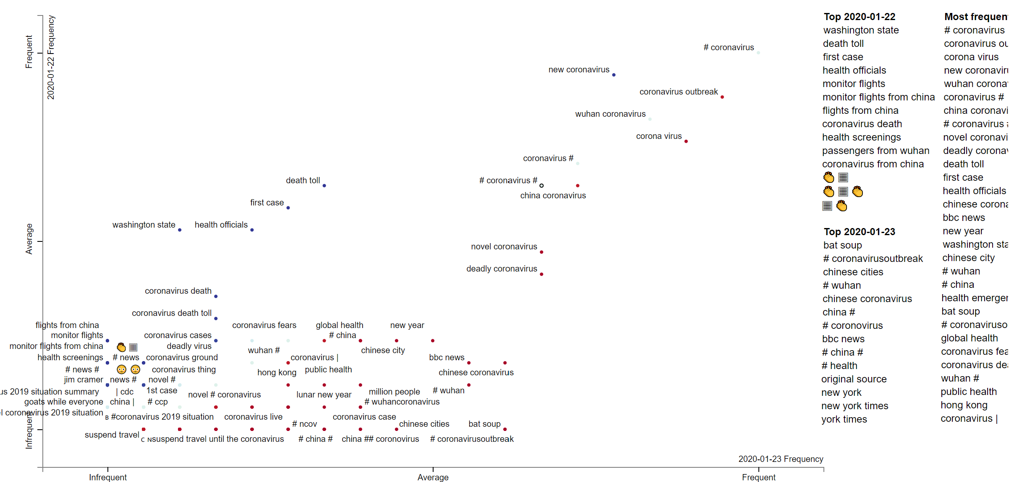
Hashtag Evolution over time

Slide 22
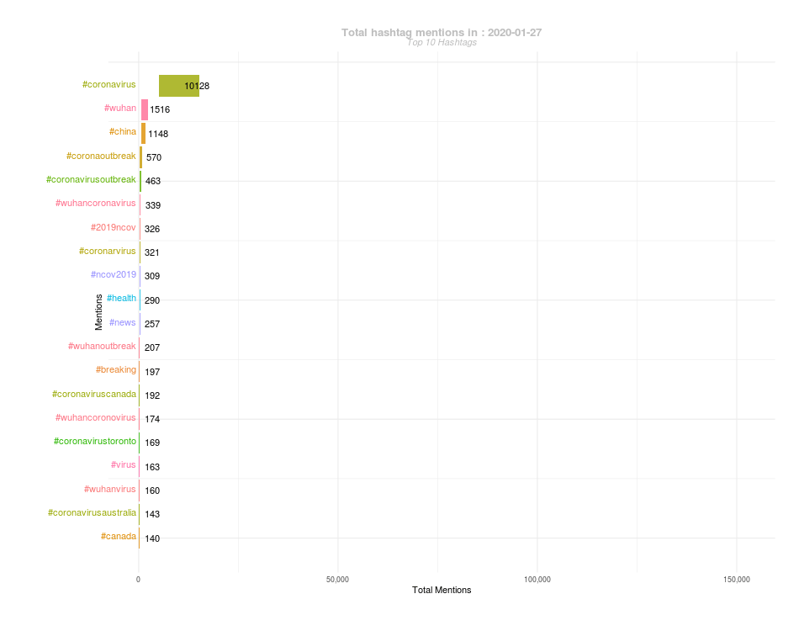

Slide 23
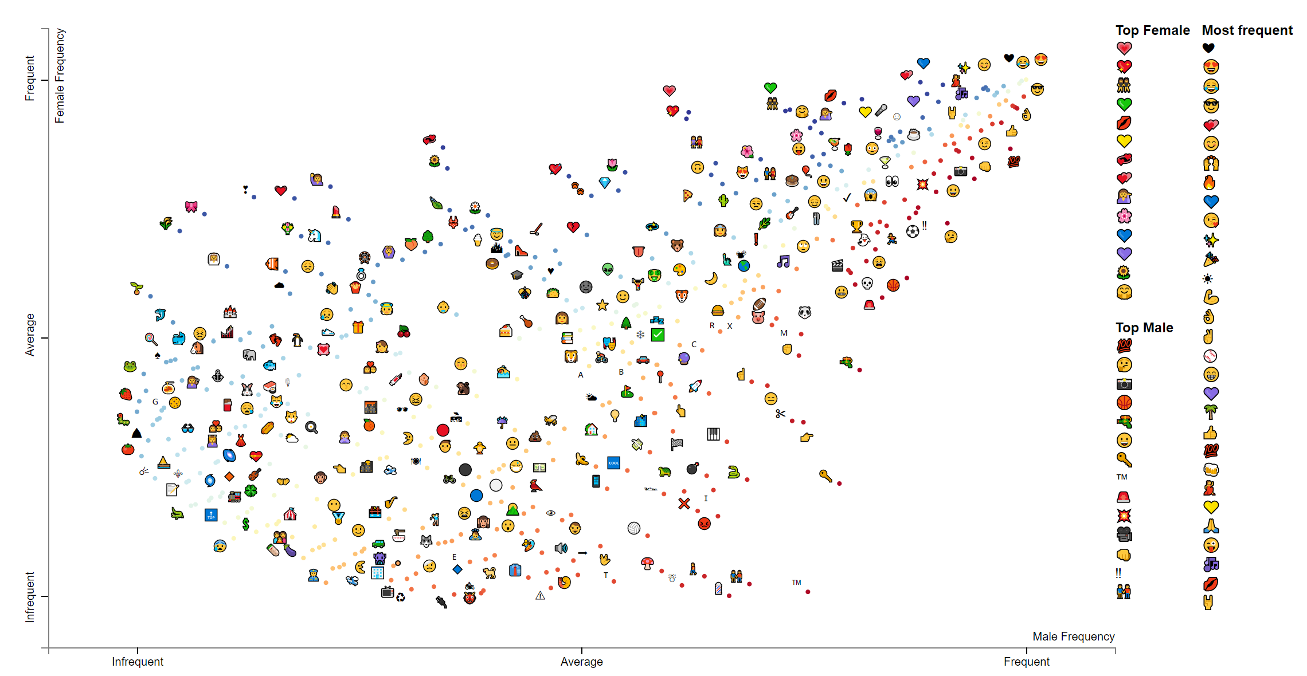
Emoji distribution by gender

Slide 24
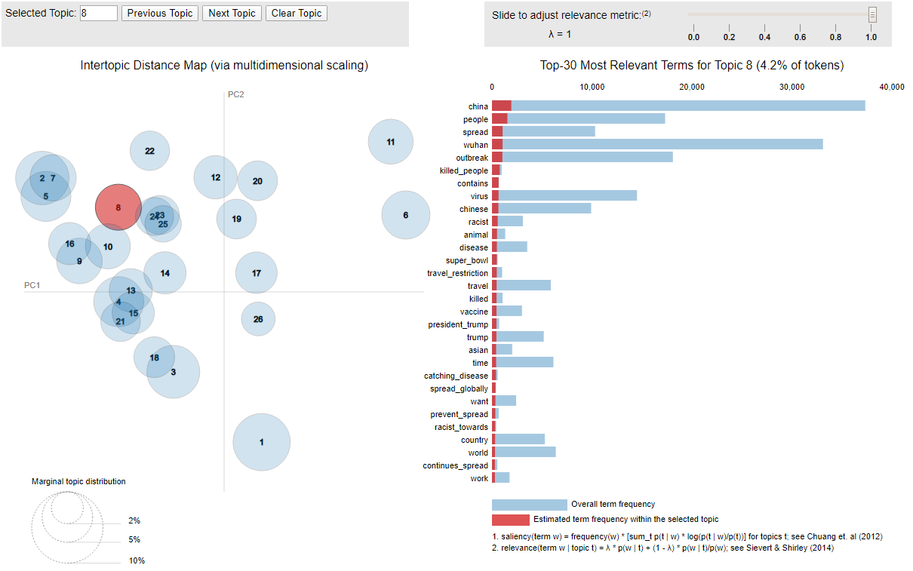
Topic modeling?
Quite tricky with Twitter data!
Too many topics, not enough clarity on our initial analyses with LDA and Dynamic LDA

Slide 25
Wait….. Isn’t this the OHDSI call?
Yes! And the previous and the following work was 100 times easier by leveraging the OHDSI vocabulary!
  …. How?

Slide 26
OHDSI Dictionary for NLP
A terms dictionary was created from the OHDSI vocabulary by selecting the uniquely distinct terms (by concept_name) with the following adjustments:
  a) Since Twitter has a limit of 280 characters per tweet, we removed any term string longer than 100 characters
  b) all the terms less than 3 characters are also removed due to their ambiguous nature
  c) stop words were removed, and
  d) all the terms were lower cased.
The final dictionary consists of 2,938,998 unique terms.

Slide 27
Annotation process
The tweet data pre-processing and automatic annotation was performed by using the Social Media Mining Toolkit (SMMT)*, and Spacy
NOTE: When collapsing the vocabulary by unique terms, we lose the domain, concept class, and vocabulary identifiers of repeated strings, however, this is recovered after annotation by joining the annotations back with the original vocabulary.
* https://genominfo.org/journal/view.php?number=605

Slide 28
What we got:
concept_name | frequency | concept_class_id | vocabulary_id
Coronavirus | 25,766,403 | LOINC Component | LOINC
People | 5,304,705 | Social Context | SNOMED
China | 2,407,265 | 2nd level | OSM
Virus | 2,323,879 | LOINC Component | LOINC
Time | 2,078,697 | LOINC Component | LOINC
Home | 1,532,694 | Visit | CMS Place of Service
Is a | 1,521,450 | Relationship | Relationship
death | 1,467,443 | Table | CDM
Due to | 1,379,014 | Attribute | SNOMED
Spread | 1,335,751 | Attribute | SNOMED
Today | 1,318,637 | Brand Name | RxNorm
Crisis | 1,301,976 | Clinical Finding | SNOMED
State | 1,299,045 | Concept Class | Concept Class
Outbreak | 1,225,292 | Context-dependent | SNOMED
Country | 1,192,392 | LOINC Component | LOINC
Support | 1,013,937 | LOINC Component | LOINC
India | 897,104 | Answer | LOINC
concept_name | frequency
Coronavirus | 25,766,403
People | 5,304,705
China | 2,407,265
Virus | 2,323,879
Time | 2,078,697
Home | 1,532,694
Is a | 1,521,450
death | 1,467,443
Due to | 1,379,014
Spread | 1,335,751
Today | 1,318,637
Crisis | 1,301,976
State | 1,299,045
Outbreak | 1,225,292
Country | 1,192,392
Support | 1,013,937
India | 897,104
Vaccine | 846,643
We found a total of 1,147,782,412* terms on 115M tweets
Is this useful this way?

Slide 29
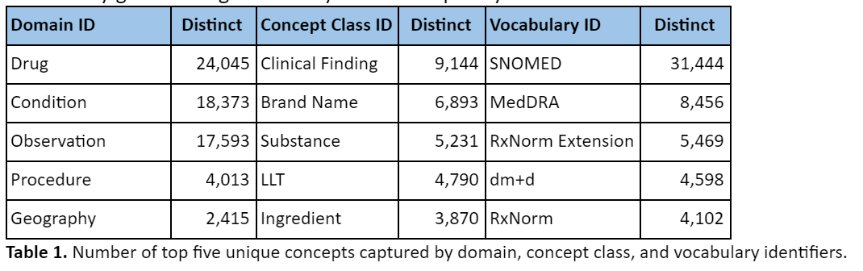
What the vocabulary gets us:

Slide 30
Cool story… show me some RWE

Slide 31
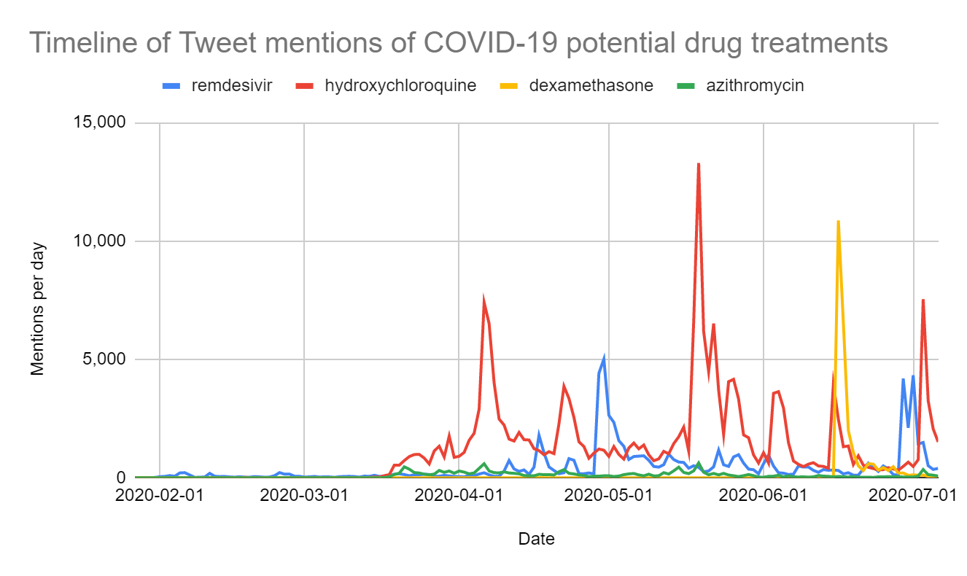
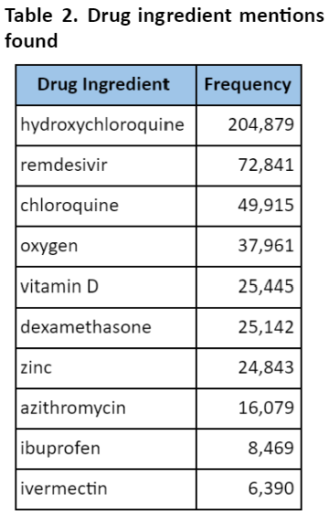
Can we characterize drug mentions?
Figure 1. Timeline of Tweets with potential drug treatment mentions.

Slide 32
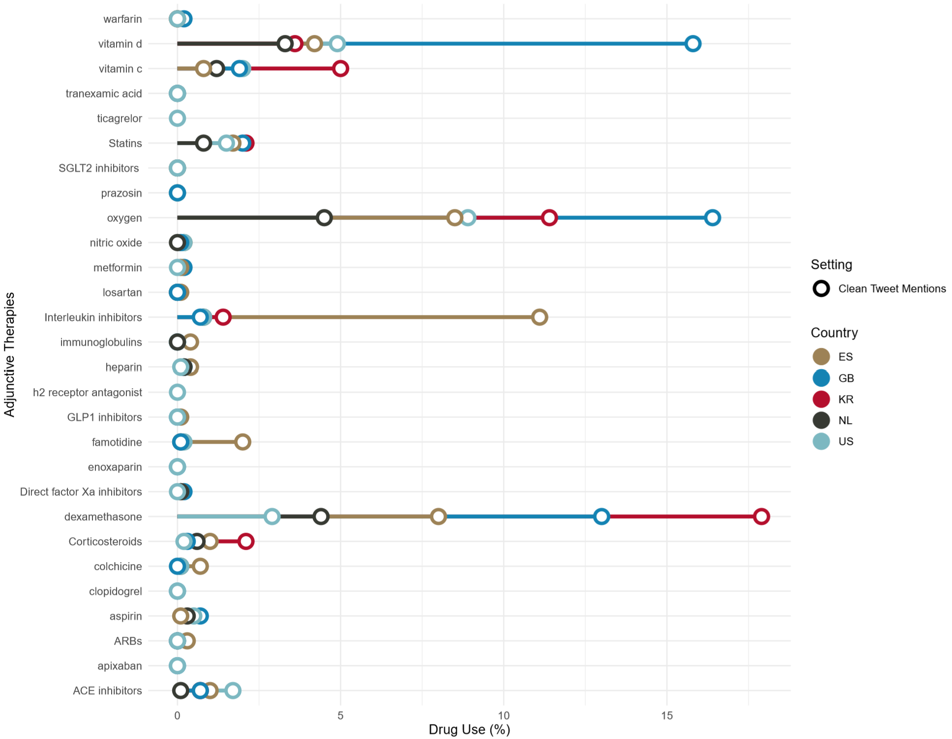
Charybdis style?
Charybdis-like characterization over countries (work with Dani Prieto-Alhambra – University of Oxford)

Slide 33
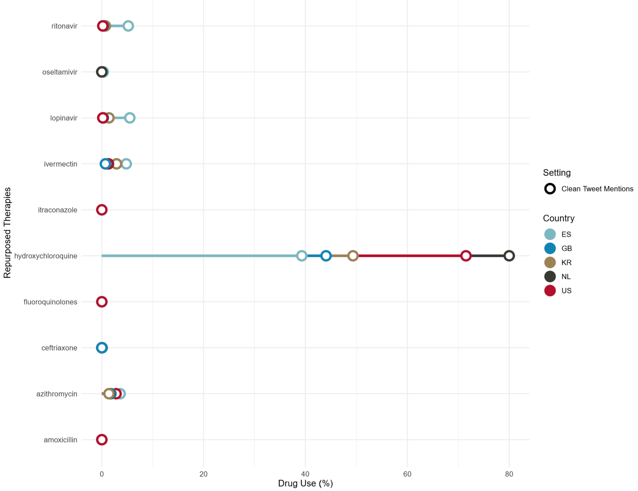
Charybdis style?
Charybdis-like characterization over countries (work with Dani Prieto-Alhambra – University of Oxford)

Slide 34
Charybdis style?
… over time?
Charybdis-like characterization over countries (work with Dani Prieto-Alhambra – University of Oxford)

Slide 35
Charybdis style?
… over time?
Very different pattern for retweets
Charybdis-like characterization over countries (work with Dani Prieto-Alhambra – University of Oxford)

Slide 36
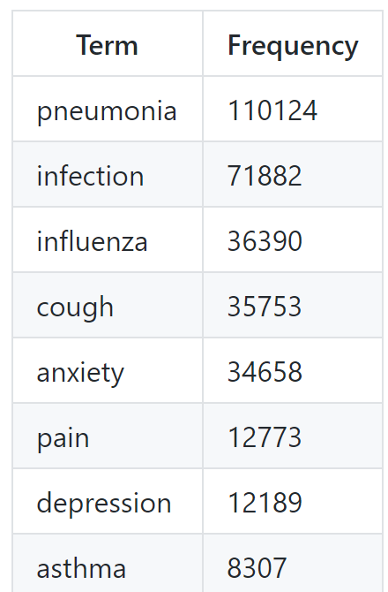
What about symptom/condition characterization?
Self-reported symptoms on Twitter vs EHR lists *
  Can we find related symptoms both found on EHR’s (Callahan, A., Steinberg, E., Fries, J.A. et al. Estimating the efficacy of symptom-based screening for COVID-19. npj Digit. Med. 3, 95 (2020). https://doi.org/10.1038/s41746-020-0300-0) but on Twitter?
* https://github.com/thepanacealab/covid19_biohackathon/tree/master/user_symptoms

Slide 37
Is this real RWE?..... Not quite…. Yet!
How do we get there?

Slide 38
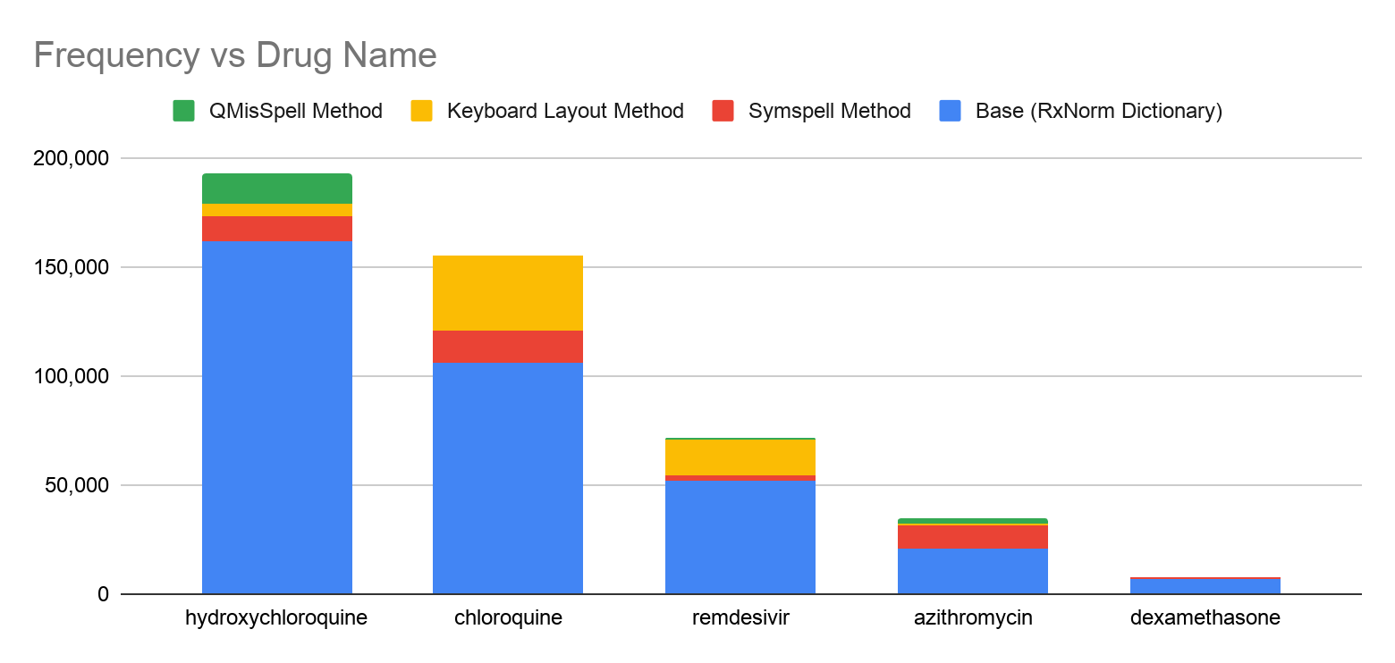
Data is very messy!
https://arxiv.org/abs/2007.10276
Misspellings are the norm –ignore them: lose 15% of data!

Slide 39
Attribution is critical
What about attributions?
  Others have done work on this:
    Klein, Ari, Arjun Magge, Karen O’Connor, Haitao Cai, Davy Weissenbacher, and Graciela Gonzalez-Hernandez. 2020. “A Chronological and Geographical Analysis of Personal Reports of COVID-19 on Twitter.” Health Informatics. medRxiv. https://doi.org/10.1101/2020.04.19.20069948
    Sarker, Abeed, Sahithi Lakamana, Whitney Hogg, Angel Xie, Mohammed Ali Al-Garadi, and Yuan-Chi Yang. 2020. “Self-Reported COVID-19 Symptoms on Twitter: An Analysis and a Research Resource.” Health Informatics. medRxiv. https://doi.org/10.1101/2020.04.16.20067421
  However, needs tons and tons of manual review
Can this be done easier and maybe semi-supervised (like APHRODITE)?
  Yes! We have done this for drugs!

Slide 40
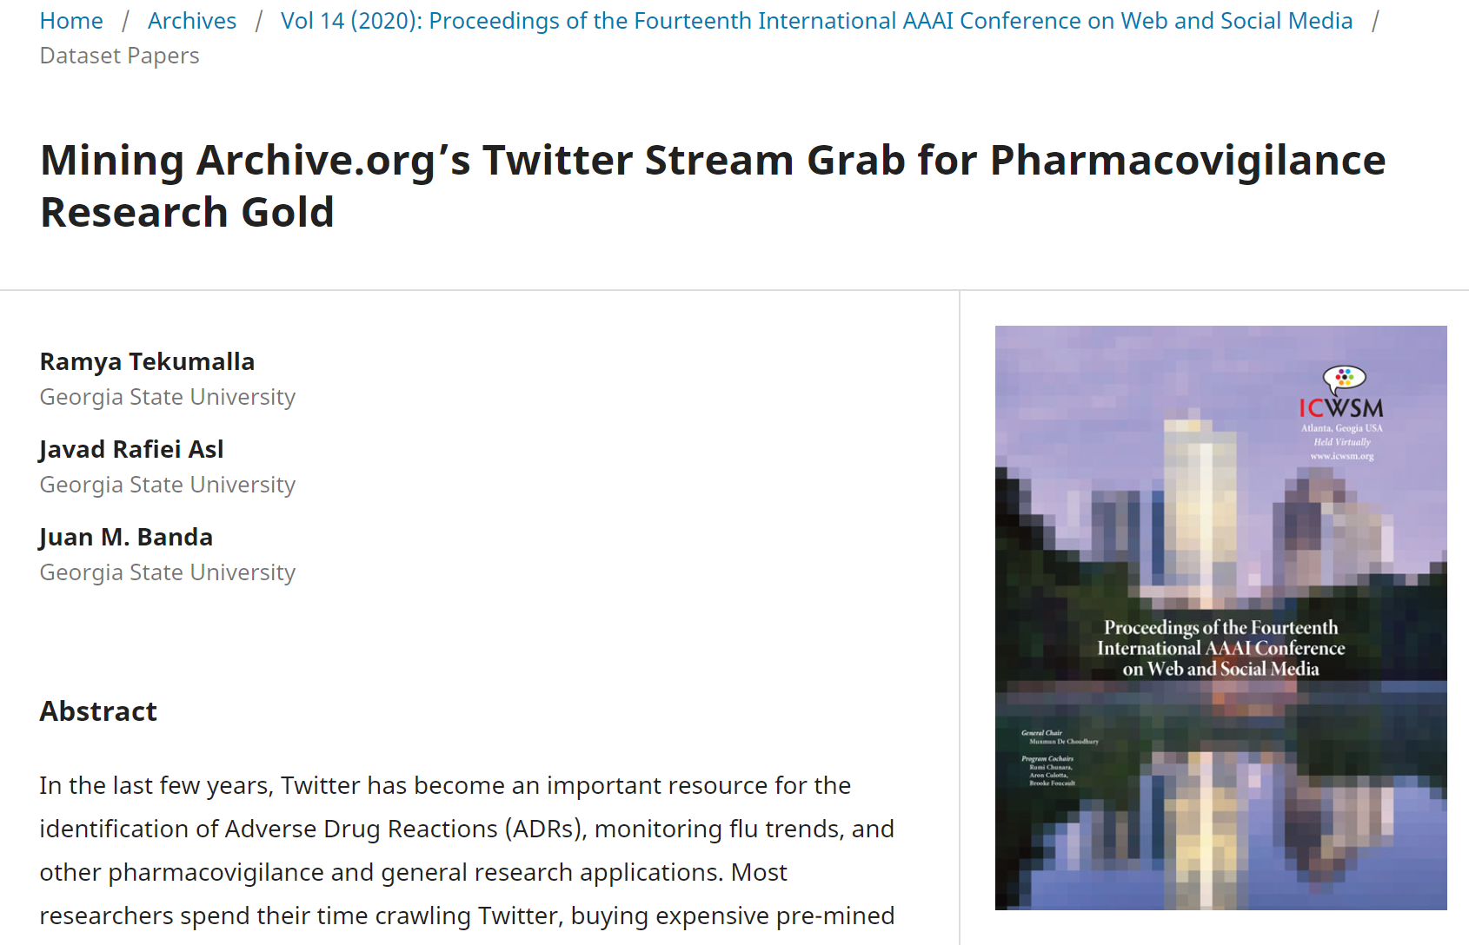
Mined 9 Billion tweets from public domain
Using heuristic we found ~6M tweets with drugs
Trained models on subsets of them
Used models to predict already existing labeled sets (~93% accuracy on them)
Subset of 3 million tweets gave us these results! No manual review on our side

Slide 41
So we have many pieces now: On going super exciting work

Slide 42
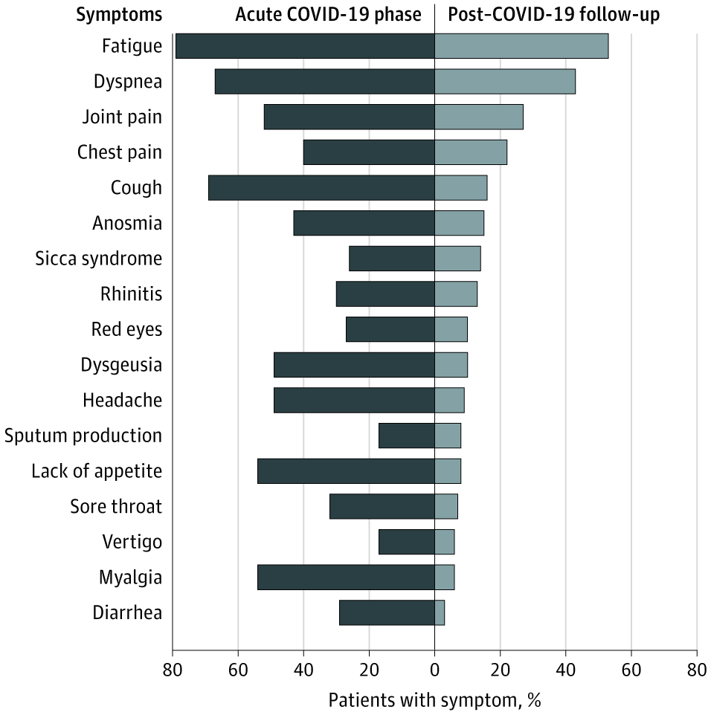
Tracking Self-Reported symptoms after infection recovery
Since we can find symptoms and drugs, we can also find people that had COVID and their symptoms after infection!
  On-going work with Dani Prieto-Alhambra and others
    Incorporates methods shown before + manual review by clinicians
JAMA doi:10.1001/jama.2020.12603
Some very preliminary findings:
fatigue | 789
shortness of breath=dyspnea | 701
chest pain | 687
palpitations | 674
anxiety | 212
post-exertional malaise | 36
Tired = fatigue | 36
muscle pain = myalgia | 35
UNDER REVIEW!!!

Slide 43
Identification of drug-safety signals for COVID19 drug treatments
We have found the drug mentions
We have found the adverse side effects
In process: generating PRR and OR from them
Next up: Proper attribution of signals

Slide 44
The future
We have users
We have user timelines
We have self-reported conditions
We have self-reported drug usage
We have self-reported lab tests (and with results sometimes!)
We have (some) methods to attribute these things
We have ‘patient’ timelines that can go into CDM
We have hundreds/thousands of them

Slide 45
The obstacles
Getting funding for Twitter research (in the Health sciences space) is super hard!
There is considerable noise on this data
  Cleaning/extracting stuff from clinical notes is a cake walk in comparison
Attribution is very hard

Slide 46
The gory details:
Technical stuff:
  “Building tools and frameworks for large-scale social media mining: Creating data infrastructure for COVID-19 research” dair.ai meetup 7/22: https://www.meetup.com/dair-ai/events/271690722/

Slide 47
Acknowledgments
All this work would not be possible without the help of my Ph.D student: Ramya Tekumalla
Collaborations with: Dani Prieto-Alhambra, Gurdas Viguruji Singh, Osaid H. Alser
Additional GSU collaborators: Dr. Gerardo Chowell
Extra data provided by: Guanyu Wang², Jingyuan Yu³, Tuo Liu⁴, Yuning Ding⁵.
Dr. VJ Periyakoil at Stanford University
Funding by: National Institute of Aging through Stanford University’s Stanford Aging & Ethnogeriatrics Transdisciplinary Collaborative Center (SAGE) center (award 3P30AG059307-02S1)
2. Missouri school of journalism, University of Missouri, Columbia, MO
3. Department of social psychology, Universitat Autònoma de Barcelona, Barcelona, Spain
4. Department of psychology, Carl von Ossietzky Universität Oldenburg, Oldenburg, Germany
5. Language technology lab, Universität Duisburg-Essen, Duisburg, Germany

Slide 48
Want to get involved?
Do you have interesting questions?
Do you have funding? ☺
Feel free to get in touch: jbanda@gsu.edu or @drjmbanda
Access the data and related items: http://www.panacealab.org/covid19/

