Slide 1
ETL in the Time of Data Privacy
Kristin Kostka, MPH
Talita Duarte-Salles, PhD

Slide 2
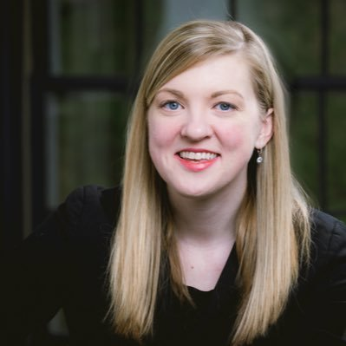
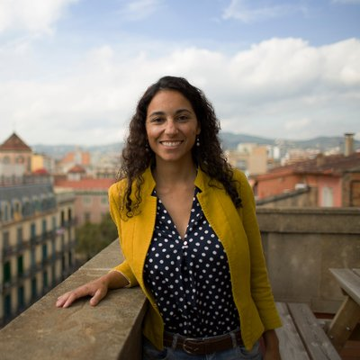
Who We Are
Kristin Kostka, MPH
IQVIA (United States)
Data steward: IQVIA data
Co-lead Project Charybdis
Talita Duarte-Salles, PhD
IDIAPJGol (Barcelona, Spain)
Data steward: SIDIAP, HM Hospitales
Co-lead Project Charybdis

Slide 3
I’ve been seeing all this cool COVID work that OHDSI’s doing…
how can I get my data into OMOP?

Slide 4
Process to become an OMOP site
Commit to OHDSI
Build ETL
Finish ETL / Release CDM
Run DQ Queries
Run Study Package
Send Results to OHDSI SFTP

Slide 5
Joining the OMOP Global Data Network
Becoming an OHDSI site involves a variety of decisions across the following dimensions (in no particular order):
  Who writes ETL scripts and executes the conversion?
  Who builds and maintains the infrastructure?
  Who leads OHDSI / OMOP training and support?
  Who installs the OHDSI Tools (e.g. ATLAS)?
  Who certifies the CDM data quality?
  How do receive, review and conduct network studies?

Slide 6
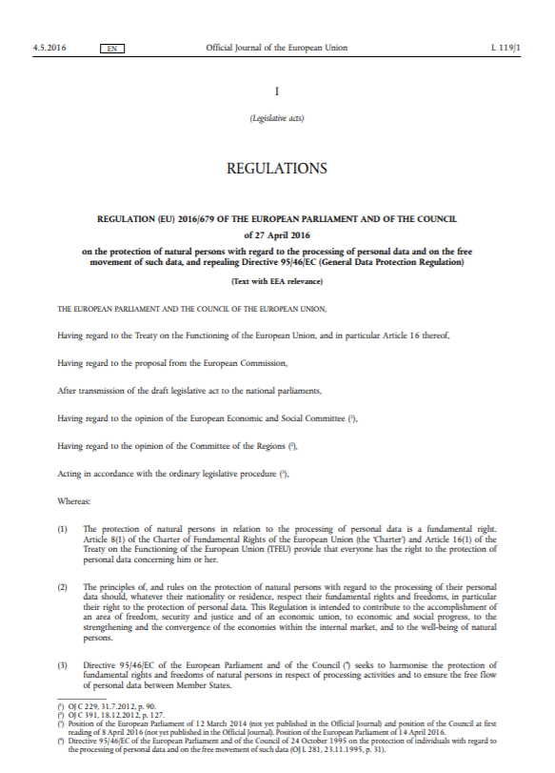

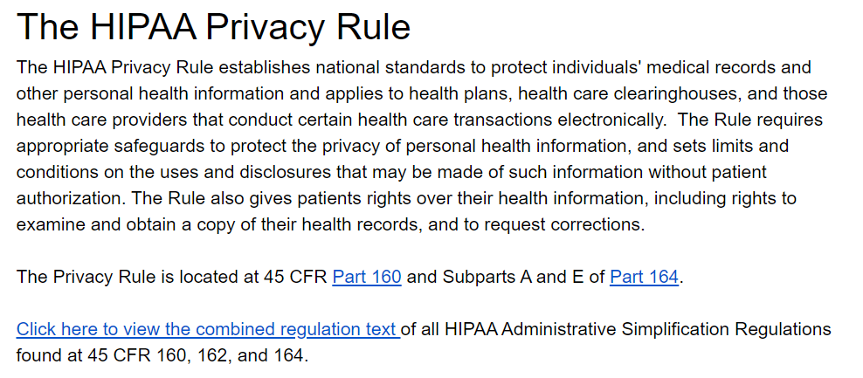
Sites have different rules about patient data.
In Europe:
General Data Protection Regulation (GDPR) is a regulation in EU law on data protection and privacy in the European Union (EU) and the European Economic Area (EEA)
  Implemented 25 May 2018
In the US:
The Health Insurance Portability and Accountability Act (HIPAA) of 1996 establishes national standards to protect individuals' medical records and other personal health information

Slide 7
What happens if you need help during developing site extract-transform-load processes but underlying data cannot be shared?

Slide 8
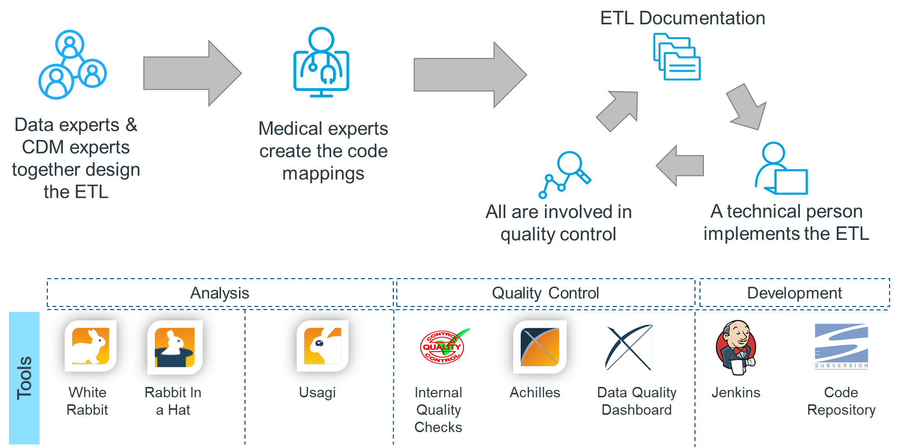
OMOP Conversion Process Flow

Slide 9
Take advantage of your OHDSI toolkit.

Slide 10
OMOP Conversion Process Flow

Slide 11
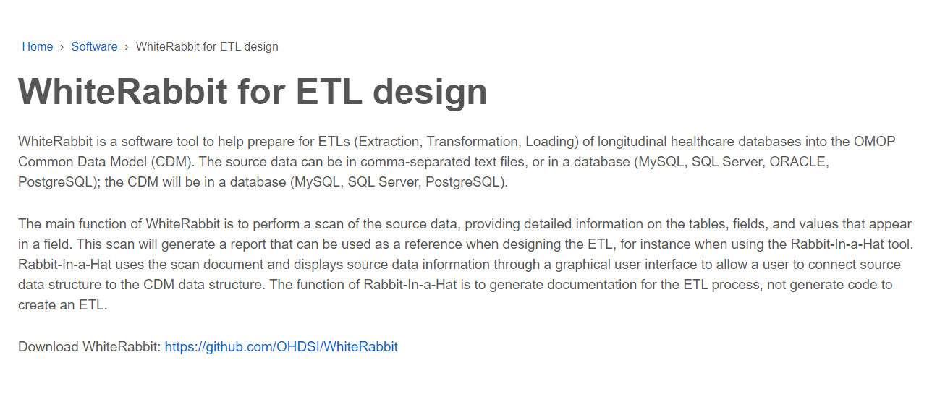
Leveraging the power of WhiteRabbit

Slide 12
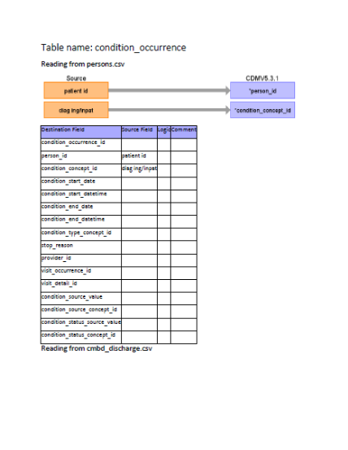
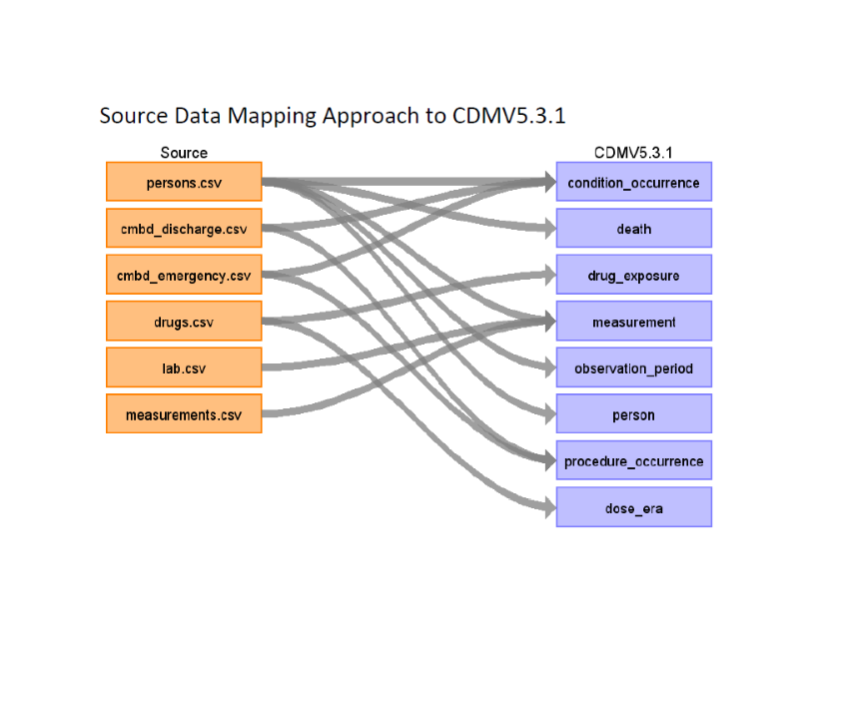
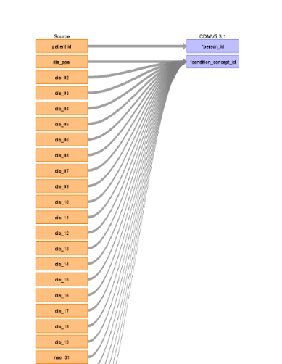
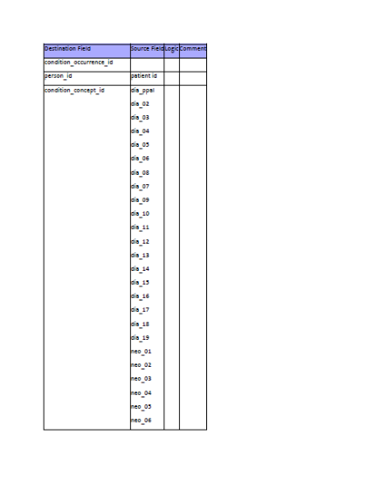
Leveraging the power of WhiteRabbit

Slide 13
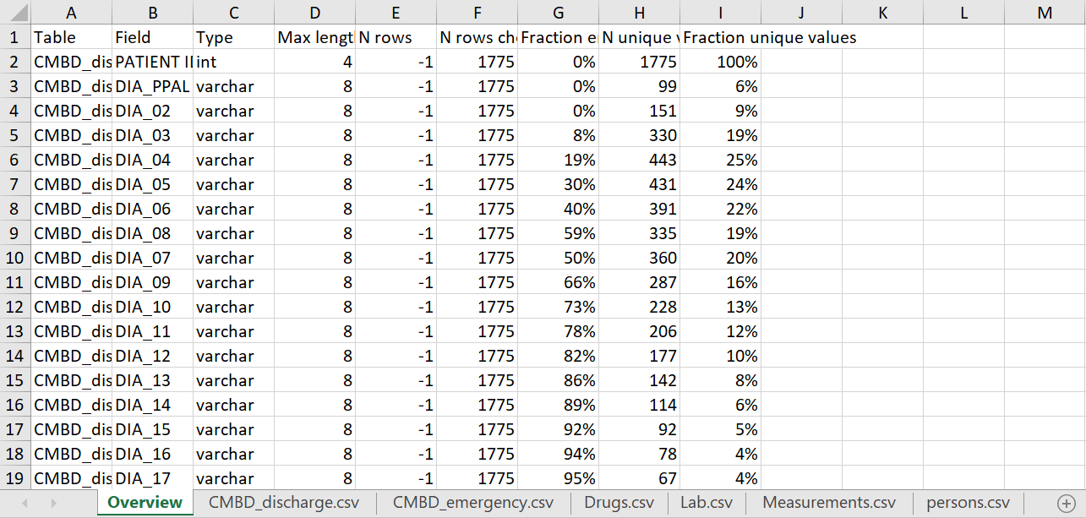
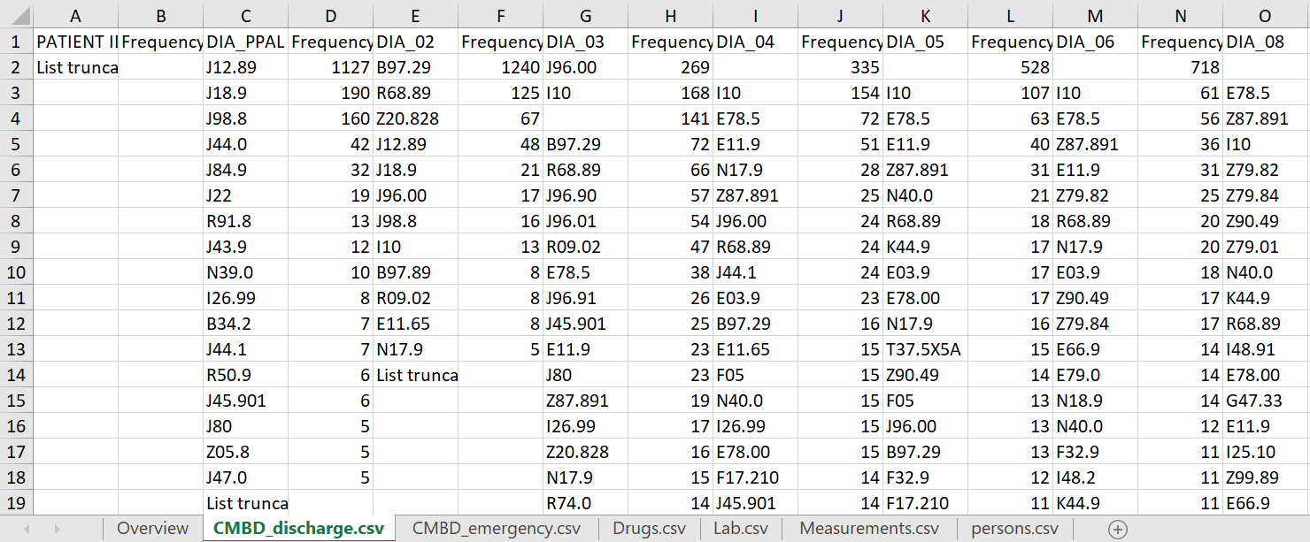
Scan reports are our friends

Slide 14
Don’t be afraid to ask for help!

Slide 15

The power of collaboration in action
Talita can do that! She translates the Scan Report into English and shares her artifacts to Patrick.
Patrick uses this to mock-up a DB and helps Talita write ETL for her database. He shares back the code she can deploy in her environment.
How does this work? This is aggregate results profiling the source data. No data moves.
Talita runs WhiteRabbit to generate the mapping document + ScanReport on her new Madrid data.
Along the way she realizes…
¡Necesito ayuda!
Patrick offers to help… except Patrick no habla español

Slide 16
More OHDSI Resources
on your ETL journey

Slide 17
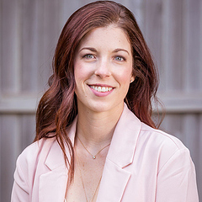
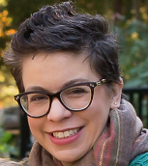
You can always phone a friend!
Clair Blacketer, MPH, PMP
https://www.ohdsi.org/who-we-are/collaborators/clair-blacketer/
Erica Voss, MPH
https://www.ohdsi.org/who-we-are/collaborators/erica-voss/

Slide 18
We can help you prioritize data elements!
Timeline | Elements
Health pre-COVID19 | Demographics
 | Conditions
 | Drugs
 | Health service utilization
COVID19 presentation | Recent health behaviour
 | Measurements/tests/lab
 | Conditions
 | Drugs
Test time | COVID19 test presence
 | COVID19 test type
 | COVID19 test results
Admission for COVID19 | Inpatient services
 | Complications (eg AKI, sepsis)
 | ICU
 | Procedures (eg tracheostomy)
 | Devices (eg ECMO)
ICU Admission detail | Date of ICU admission
 | CPAP
 | Intubation/mechanical vent
 | Procedures (eg tracheostomy)
 | Devices (eg ECMO)
Mortality | Date of death
 | Cause of death

Slide 19
Join the Journey
http://ohdsi.org

