Slide 1
New DQD Features!
Updates since the 2019 OHDSI Symposium

Slide 2
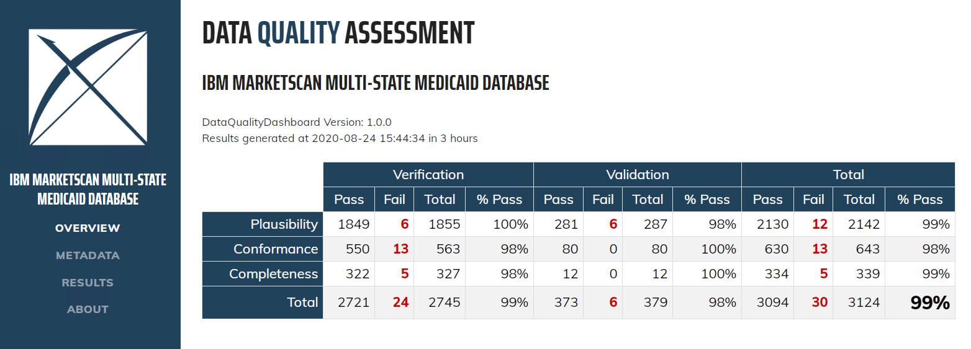

Data Quality Dashboard
Inputs
https://github.com/OHDSI/DataQualityDashboard/

Slide 3
Exciting New Additions
Metadata capture
DQD for Cohorts
Changes to the user interface
Lots of helpful guides

Slide 4
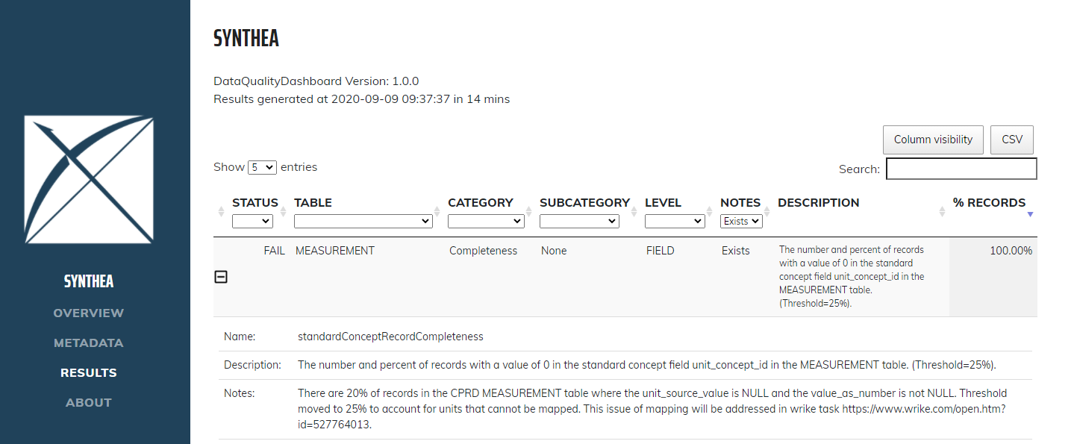
Metadata Capture

Slide 5
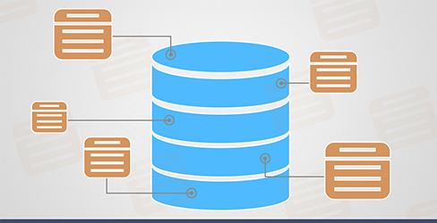
DQD for Cohorts
Requested by contributors with data from multiple sites in one DB
This can also be applied to clinical cohorts

Slide 6
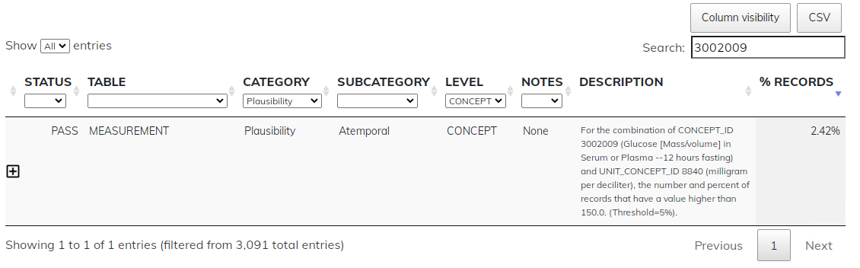
DQD for Cohorts
IBM CCAE

Slide 7
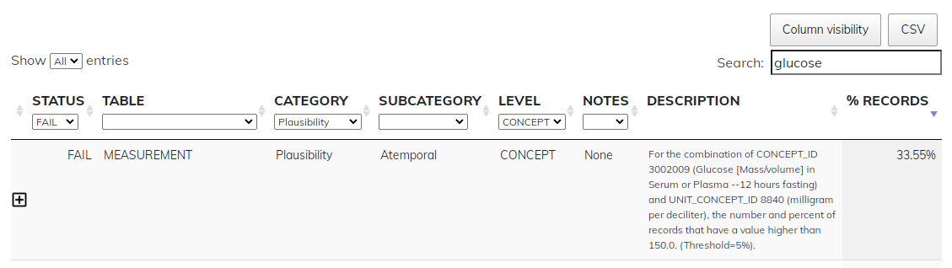
DQD for Cohorts
IBM CCAE Type 1 Diabetic cohort

Slide 8
DQD for Cohorts
This has opened up many questions and areas for research…
What are the use cases?
Is this covered by cohortDiagnostics or should it be added in some form?
Should the thresholds for the full database differ from the thresholds at the cohort level?
What is the correct interpretation of the DQD results at the cohort level?

Slide 9
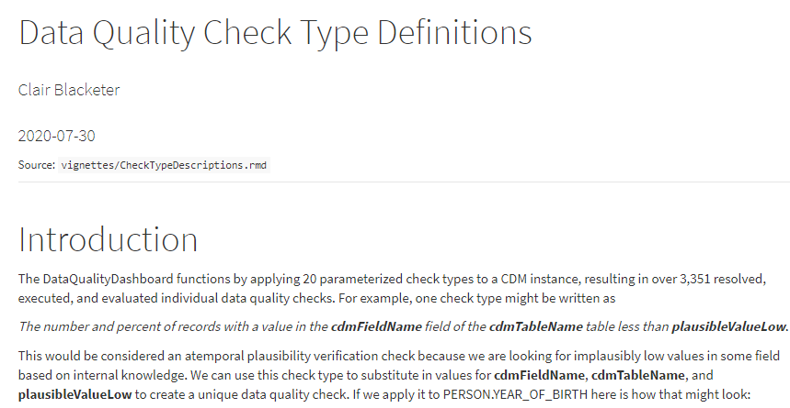
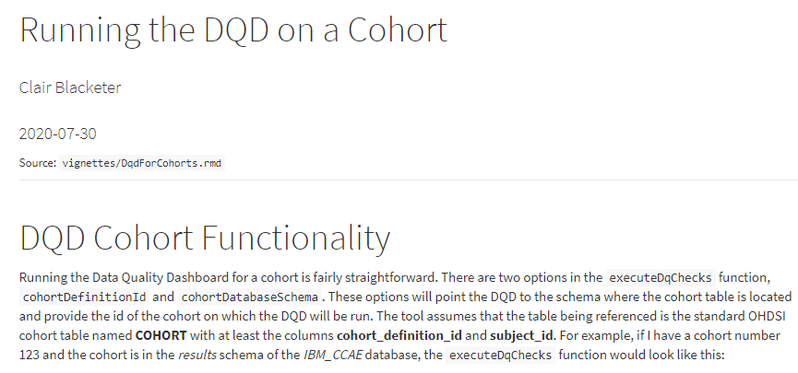
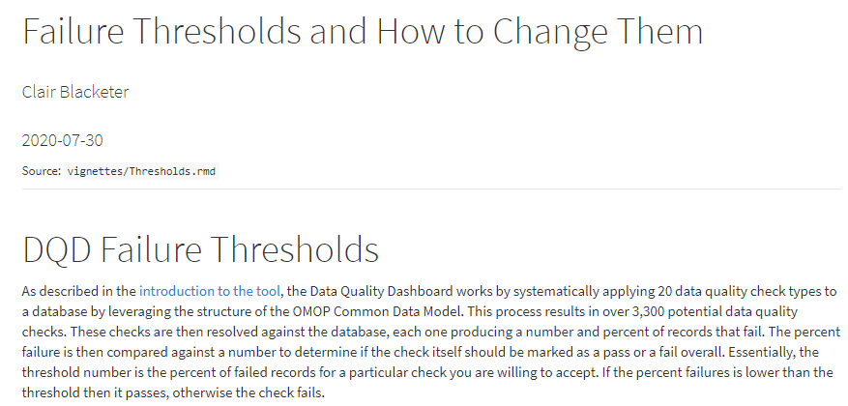
Lots of Helpful Guides
Ohdsi.github.io/DataQualityDashboard

Slide 10
Future Projects
Near term goals
Implementation of a unique check id
Configure the tool to only run checks with a non-zero denominator
Integrate CDM ETL standards with DQD checks
Long term goals
Create a fit-for-use roadmap
  Build out the DQD to assess fitness for use leveraging the phenotype library and characterization power of CHARYBDIS

