Slide 1
Lessons Learned Converting Patient Level Data to the OMOP Common Data Model to Support the COVID-19 Crisis
Erica A Voss, MPH ^{1,2,3}, Martijn J Schuemie, PhD ^{1,2},
Peter R Rijnbeek, PhD ^{2,3}
¹Janssen Research and Development, Titusville, NJ; ²OHDSI collaborators, Observational Health Data Sciences and Informatics (OHDSI), New York, NY; ³Department of Medical Informatics, Erasmus University Medical Center, Rotterdam, Netherlands
evoss3@its.jnj.com; mschuemi@its.jnj.com; p.rijnbeek@erasmusmc.nl
Notes:
ETL
COVID – opportunity
COVID - data

Slide 2
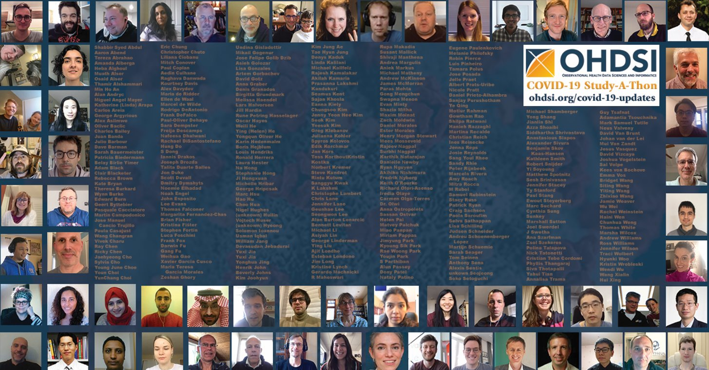
STUDY A THON FACES

Slide 3
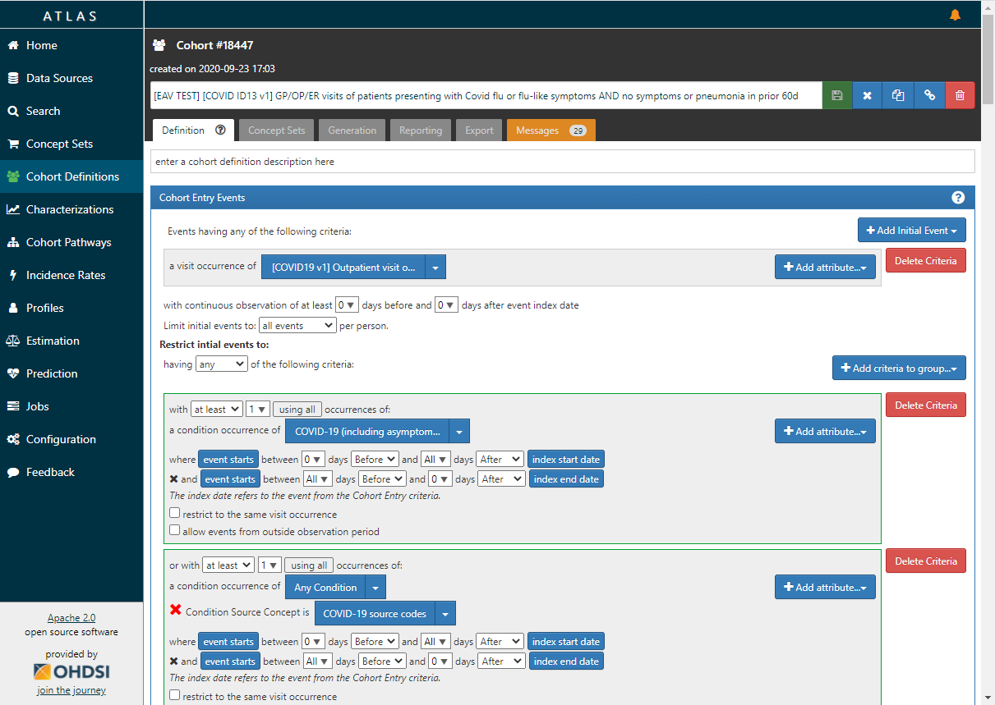


GP/OP/ER visits of patients presenting with COVID, flu, or flu-like symptoms AND no symptoms or pneumonia in prior 60d
  one of the following during visit:
    Disease cased by 2019-nCoV
    Suspected coronavirus infection
    Influenza
    COVID-19 testing
    Influenza Measurements
  OR all the following during the visit:
    Fever
    (Cough or Shortness of Breath or
    Myalgia or Malaise & Fatigue)
+18 Years Old
Outpatient or
Emergency Room Visit
Patient Timeline
AND no symptoms or pneumonia in last 60 days
AND no influenza in the last 60 days
AND no COVID diagnosis or test in last 60 days
AND >= 365 days of prior observation
https://atlas.ohdsi.org/#/cohortdefinition/135

Slide 4
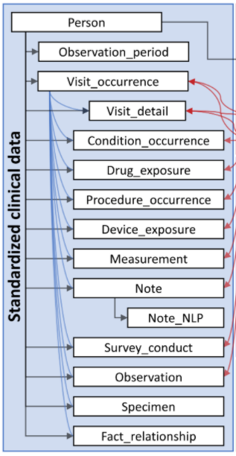
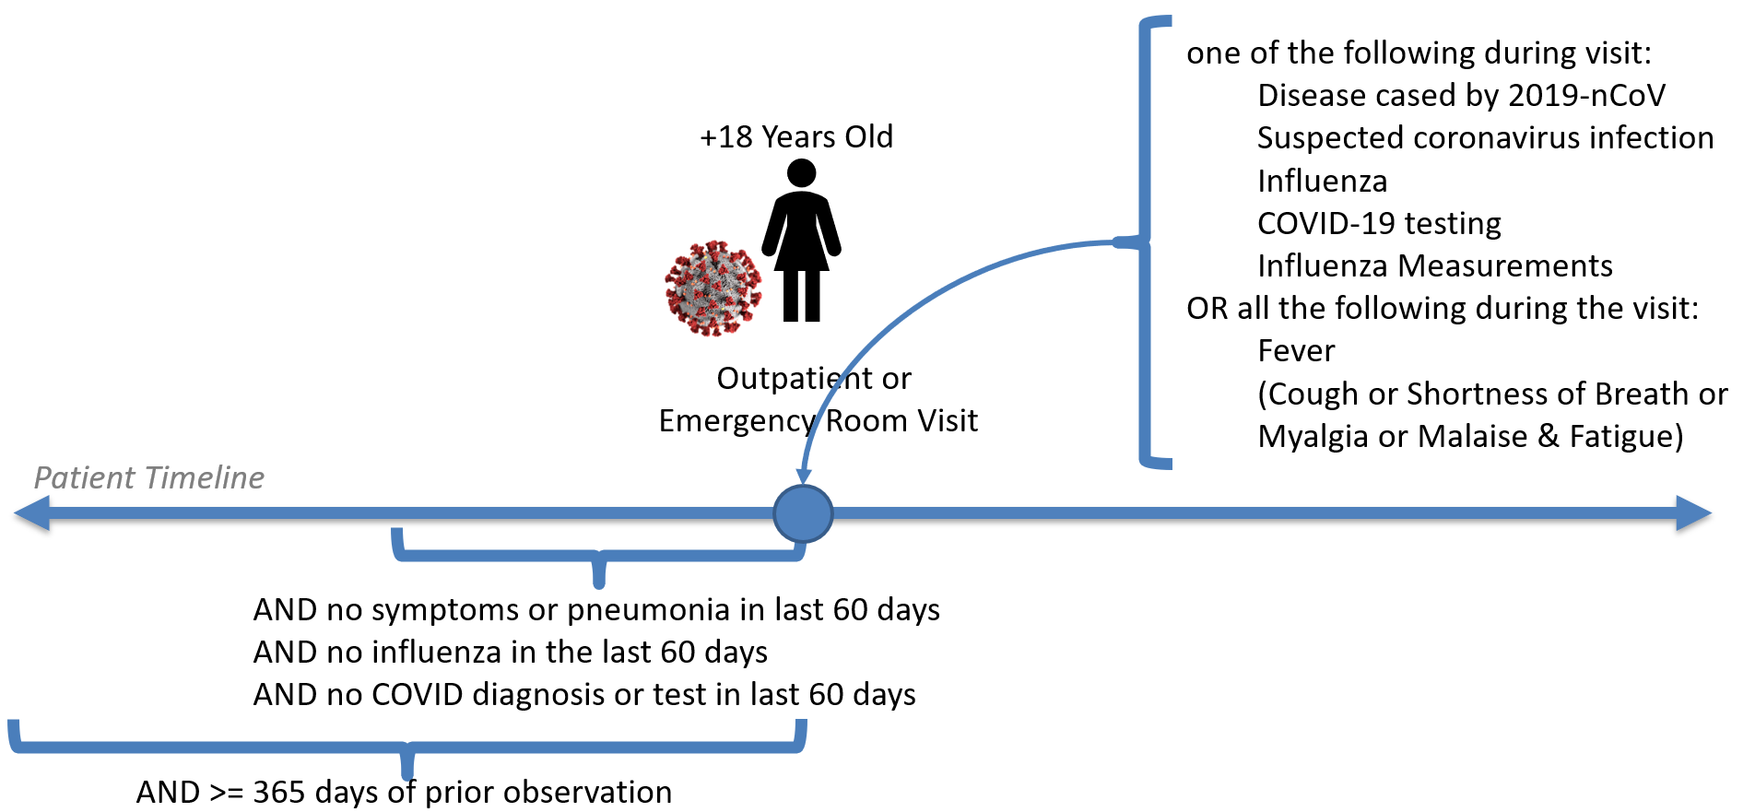
GP/OP/ER visits of patients presenting with COVID flu or flu-like symptoms AND no symptoms or pneumonia in prior 60d

Slide 5

GP/OP/ER visits of patients presenting with COVID flu or flu-like symptoms AND no symptoms or pneumonia in prior 60d

Slide 6
GP/OP/ER visits of patients presenting with COVID flu or flu-like symptoms AND no symptoms or pneumonia in prior 60d

Slide 7
GP/OP/ER visits of patients presenting with COVID flu or flu-like symptoms AND no symptoms or pneumonia in prior 60d

Slide 8
GP/OP/ER visits of patients presenting with COVID flu or flu-like symptoms AND no symptoms or pneumonia in prior 60d

Slide 9
GP/OP/ER visits of patients presenting with COVID flu or flu-like symptoms AND no symptoms or pneumonia in prior 60d

Slide 10
GP/OP/ER visits of patients presenting with COVID flu or flu-like symptoms AND no symptoms or pneumonia in prior 60d

Slide 11
GP/OP/ER visits of patients presenting with COVID flu or flu-like symptoms AND no symptoms or pneumonia in prior 60d

Slide 12
GP/OP/ER visits of patients presenting with COVID flu or flu-like symptoms AND no symptoms or pneumonia in prior 60d

Slide 13

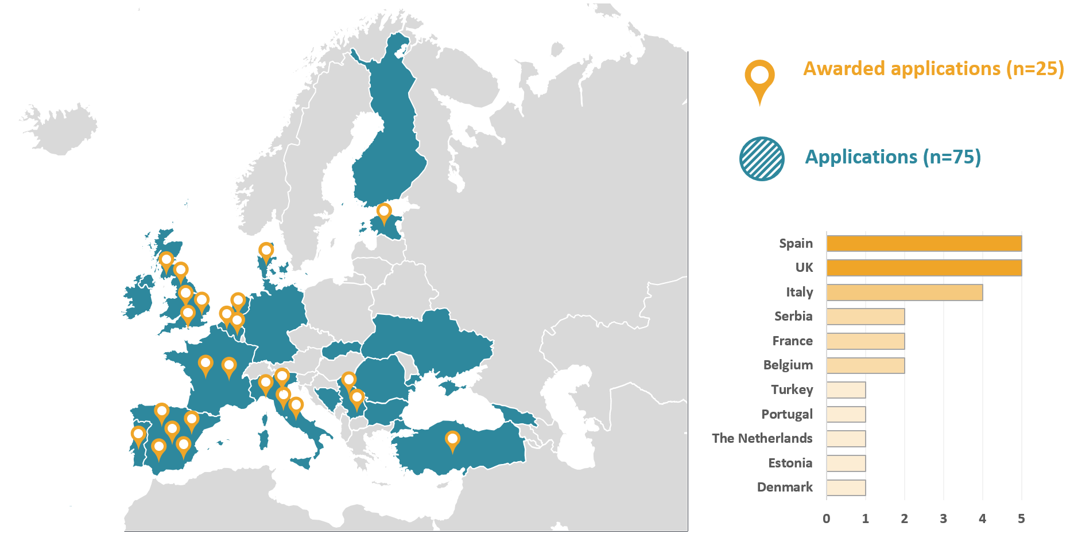
COVID19 Rapid Collaboration Call
75 applications
25 data partners selected
11 countries
Over 115M
patient records
www.ehden.eu
Notes:
In parallel with the study-a-thon . . .
European Health Data & Evidence Network (EHDEN) held a COVID-19 Rapid Collaboration Call
institutions with COVID-19 data could apply for financial and technical support to convert their data to the OMOP CDM.
The goal was to produced high quality CDMs needed to run important drug safety research in the upcoming months, in particular to support COVID-19 research.

Slide 14
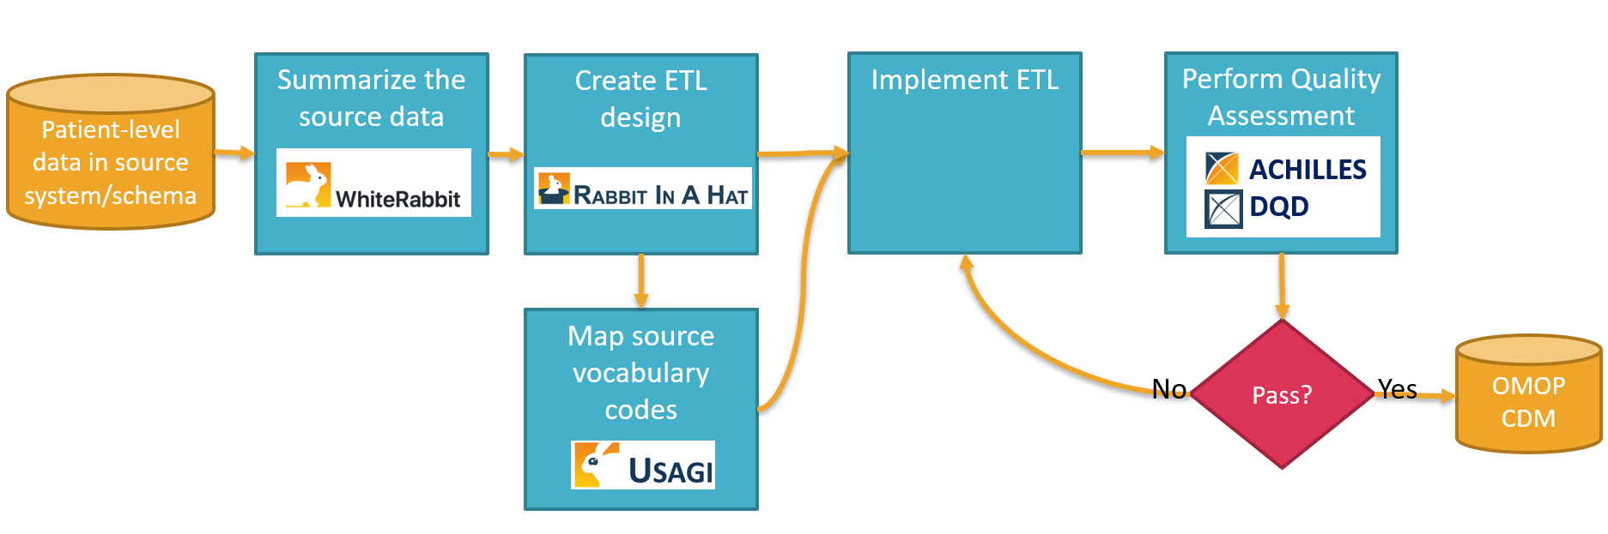







Extract, Transform, & Load (ETL)
Medical Knowledge | Data Expertise | Technical ETL Expertise | CDM Experience
Notes:
Normally have a 2 day working session
Health data comes in many forms . . . standardization allows for systematic analysis across disparate health data sources
Over the years of producing CDMs first as OMOP and now as OHDSI, we have produced what we think the optimum process for doing so.
However this as never been measured nor tested and we have not researched if there are ways to improve upon it.

Slide 15
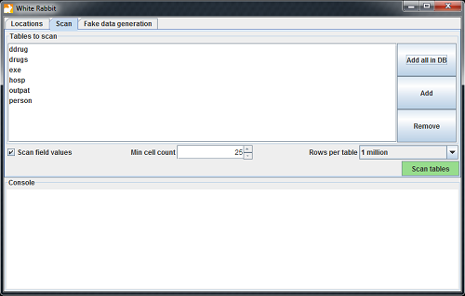
Extract, Transform, & Load (ETL)
Medical Knowledge | Data Expertise | Technical ETL Expertise | CDM Experience
Notes:
Normally have a 2 day working session
Health data comes in many forms . . . standardization allows for systematic analysis across disparate health data sources
Over the years of producing CDMs first as OMOP and now as OHDSI, we have produced what we think the optimum process for doing so.
However this as never been measured nor tested and we have not researched if there are ways to improve upon it.

Slide 16
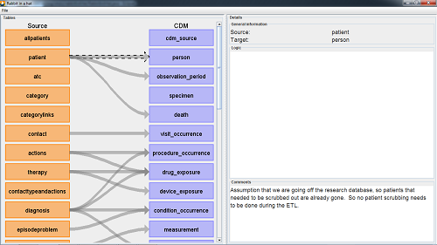
Extract, Transform, & Load (ETL)
Medical Knowledge | Data Expertise | Technical ETL Expertise | CDM Experience
Notes:
Normally have a 2 day working session
Health data comes in many forms . . . standardization allows for systematic analysis across disparate health data sources
Over the years of producing CDMs first as OMOP and now as OHDSI, we have produced what we think the optimum process for doing so.
However this as never been measured nor tested and we have not researched if there are ways to improve upon it.

Slide 17
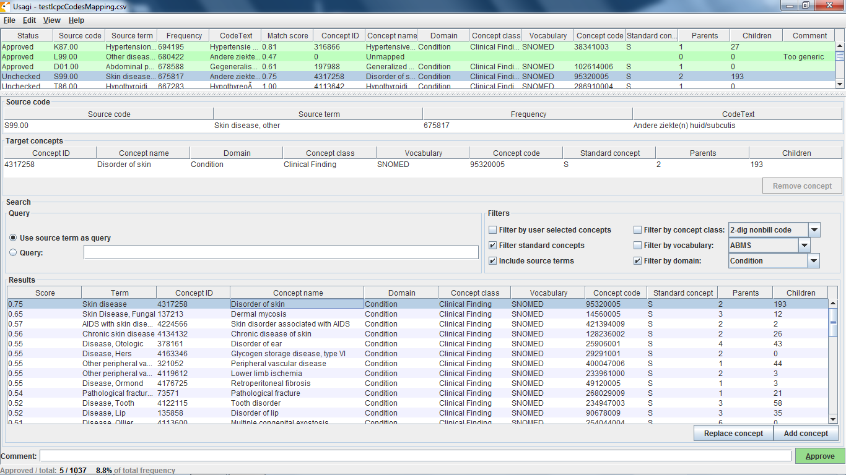
Extract, Transform, & Load (ETL)
Medical Knowledge | Data Expertise | Technical ETL Expertise | CDM Experience
Notes:
Normally have a 2 day working session
Health data comes in many forms . . . standardization allows for systematic analysis across disparate health data sources
Over the years of producing CDMs first as OMOP and now as OHDSI, we have produced what we think the optimum process for doing so.
However this as never been measured nor tested and we have not researched if there are ways to improve upon it.

Slide 18
Extract, Transform, & Load (ETL)
Medical Knowledge | Data Expertise | Technical ETL Expertise | CDM Experience
Notes:
Normally have a 2 day working session
Health data comes in many forms . . . standardization allows for systematic analysis across disparate health data sources
Over the years of producing CDMs first as OMOP and now as OHDSI, we have produced what we think the optimum process for doing so.
However this as never been measured nor tested and we have not researched if there are ways to improve upon it.

Slide 19
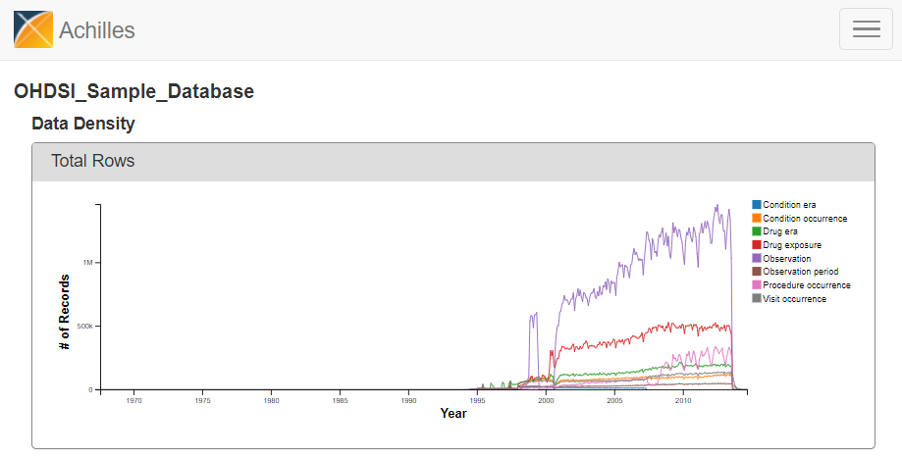
Extract, Transform, & Load (ETL)
Medical Knowledge | Data Expertise | Technical ETL Expertise | CDM Experience
Notes:
Normally have a 2 day working session
Health data comes in many forms . . . standardization allows for systematic analysis across disparate health data sources
Over the years of producing CDMs first as OMOP and now as OHDSI, we have produced what we think the optimum process for doing so.
However this as never been measured nor tested and we have not researched if there are ways to improve upon it.

Slide 20
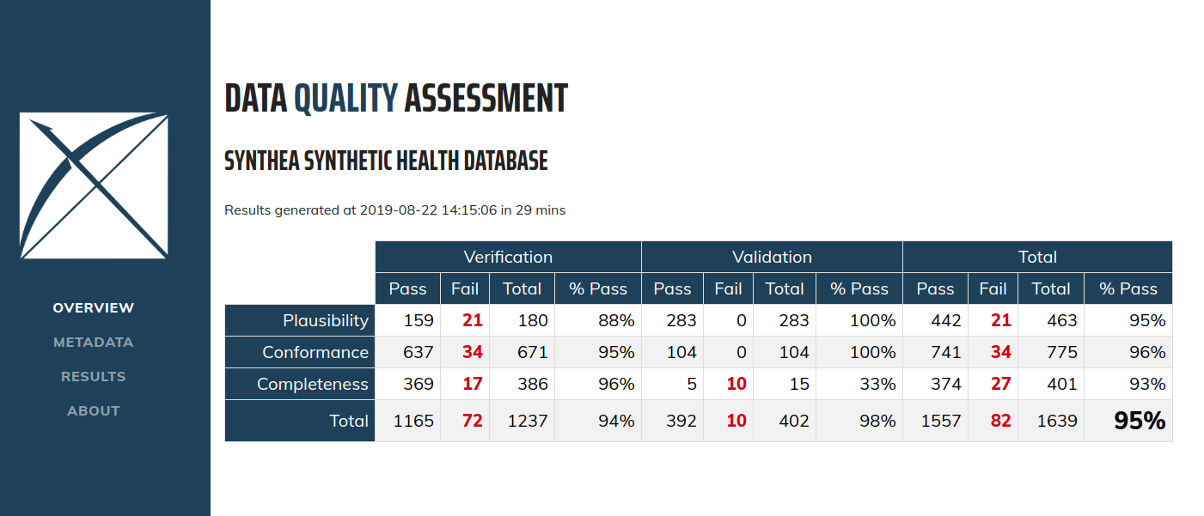
Extract, Transform, & Load (ETL)
Medical Knowledge | Data Expertise | Technical ETL Expertise | CDM Experience
Notes:
Normally have a 2 day working session
Health data comes in many forms . . . standardization allows for systematic analysis across disparate health data sources
Over the years of producing CDMs first as OMOP and now as OHDSI, we have produced what we think the optimum process for doing so.
However this as never been measured nor tested and we have not researched if there are ways to improve upon it.

Slide 21
Extract, Transform, & Load (ETL)
Medical Knowledge | Data Expertise | Technical ETL Expertise | CDM Experience
Notes:
Normally have a 2 day working session
Health data comes in many forms . . . standardization allows for systematic analysis across disparate health data sources
Over the years of producing CDMs first as OMOP and now as OHDSI, we have produced what we think the optimum process for doing so.
However this as never been measured nor tested and we have not researched if there are ways to improve upon it.

Slide 22
Extract, Transform, & Load (ETL)
Medical Knowledge | Data Expertise | Technical ETL Expertise | CDM Experience
Notes:
Normally have a 2 day working session
Health data comes in many forms . . . standardization allows for systematic analysis across disparate health data sources
Over the years of producing CDMs first as OMOP and now as OHDSI, we have produced what we think the optimum process for doing so.
However this as never been measured nor tested and we have not researched if there are ways to improve upon it.

Slide 23
Data Partner | Medical Knowledge | Data Expertise | Technical ETL Expertise | CDM Experience
1 | Lacked Clinical Role | Proficient | 5+ years experience | No Prior Experience
2 | Lacked Clinical Role | Competent | <1 years experience | No Prior Experience
3 | Has Clinical Role | Proficient | 5+ years experience | No Prior Experience
4 | Has Clinical Role | Expert Level | 5+ years experience | No Prior Experience
5 | Has Clinical Role | Proficient | 1-2 years experience | Prior CDM Experience
6 | Has Clinical Role | Expert Level | 5+ years experience | No Prior Experience
7 | Lacked Clinical Role | Expert Level | No experience | Prior CDM Experience
8 | Lacked Clinical Role | Proficient | No experience | No Prior Experience
9 | Has Clinical Role | Expert Level | 2-4 years experience | No Prior Experience
10 | Has Clinical Role | Expert Level | 5+ years experience | No Prior Experience
11 | Lacked Clinical Role | Expert Level | No experience | No Prior Experience
12 | Lacked Clinical Role | Competent | 5+ years experience | No Prior Experience
13 | Has Clinical Role | Competent | 1-2 years experience | Prior CDM Experience
14 | Lacked Clinical Role | Expert Level | 5+ years experience | No Prior Experience
15 | Lacked Clinical Role | Beginner | 5+ years experience | No Prior Experience
Less experience / Less Proficient
Experienced / Proficient
Notes:
KEY:
Medical Knowledge (Primary Role: clinical scientist, epidemiologist, or medicine, 1 = don’t have someone, 5 = have someone)
Data Expertise (highest level they have, 5=Expert, 4=Proficient, 3=Competent, 2=Beginner, 1=Novice)
Technical ETL Expertise (Primary Role: computer scientist, data manager, informatician, 1=don’t have someone, 2 = less than 1 year, 3 = 1-2, 4 = 2-4, 5=5+)
CDM Experience (5 = had started the process before, 1 = not started before)
Time Per Week (1=0-8,2=9-16,3=17-24,4=25-32,5=33-40)
We seem to have teams strongest in Data Expertise and Technical ETL Expertise, but definitely lacking in CDM Experience – but the Rapid Collaboration call addresses this by the EHDEN Task force.

Slide 24
Data Partner | Medical Knowledge | Data Expertise | Technical ETL Expertise | CDM Experience
1 | Lacked Clinical Role | Proficient | 5+ years experience | No Prior Experience
2 | Lacked Clinical Role | Competent | <1 years experience | No Prior Experience
3 | Has Clinical Role | Proficient | 5+ years experience | No Prior Experience
4 | Has Clinical Role | Expert Level | 5+ years experience | No Prior Experience
5 | Has Clinical Role | Proficient | 1-2 years experience | Prior CDM Experience
6 | Has Clinical Role | Expert Level | 5+ years experience | No Prior Experience
7 | Lacked Clinical Role | Expert Level | No experience | Prior CDM Experience
8 | Lacked Clinical Role | Proficient | No experience | No Prior Experience
9 | Has Clinical Role | Expert Level | 2-4 years experience | No Prior Experience
10 | Has Clinical Role | Expert Level | 5+ years experience | No Prior Experience
11 | Lacked Clinical Role | Expert Level | No experience | No Prior Experience
12 | Lacked Clinical Role | Competent | 5+ years experience | No Prior Experience
13 | Has Clinical Role | Competent | 1-2 years experience | Prior CDM Experience
14 | Lacked Clinical Role | Expert Level | 5+ years experience | No Prior Experience
15 | Lacked Clinical Role | Beginner | 5+ years experience | No Prior Experience
Less experience / Less Proficient
Experienced / Proficient

Slide 25
Data Partner | Medical Knowledge | Data Expertise | Technical ETL Expertise | CDM Experience
1 | Lacked Clinical Role | Proficient | 5+ years experience | No Prior Experience
2 | Lacked Clinical Role | Competent | <1 years experience | No Prior Experience
3 | Has Clinical Role | Proficient | 5+ years experience | No Prior Experience
4 | Has Clinical Role | Expert Level | 5+ years experience | No Prior Experience
5 | Has Clinical Role | Proficient | 1-2 years experience | Prior CDM Experience
6 | Has Clinical Role | Expert Level | 5+ years experience | No Prior Experience
7 | Lacked Clinical Role | Expert Level | No experience | Prior CDM Experience
8 | Lacked Clinical Role | Proficient | No experience | No Prior Experience
9 | Has Clinical Role | Expert Level | 2-4 years experience | No Prior Experience
10 | Has Clinical Role | Expert Level | 5+ years experience | No Prior Experience
11 | Lacked Clinical Role | Expert Level | No experience | No Prior Experience
12 | Lacked Clinical Role | Competent | 5+ years experience | No Prior Experience
13 | Has Clinical Role | Competent | 1-2 years experience | Prior CDM Experience
14 | Lacked Clinical Role | Expert Level | 5+ years experience | No Prior Experience
15 | Lacked Clinical Role | Beginner | 5+ years experience | No Prior Experience
Less experience / Less Proficient
Experienced / Proficient

Slide 26
Data Partner | Medical Knowledge | Data Expertise | Technical ETL Expertise | CDM Experience
1 | Lacked Clinical Role | Proficient | 5+ years experience | No Prior Experience
2 | Lacked Clinical Role | Competent | <1 years experience | No Prior Experience
3 | Has Clinical Role | Proficient | 5+ years experience | No Prior Experience
4 | Has Clinical Role | Expert Level | 5+ years experience | No Prior Experience
5 | Has Clinical Role | Proficient | 1-2 years experience | Prior CDM Experience
6 | Has Clinical Role | Expert Level | 5+ years experience | No Prior Experience
7 | Lacked Clinical Role | Expert Level | No experience | Prior CDM Experience
8 | Lacked Clinical Role | Proficient | No experience | No Prior Experience
9 | Has Clinical Role | Expert Level | 2-4 years experience | No Prior Experience
10 | Has Clinical Role | Expert Level | 5+ years experience | No Prior Experience
11 | Lacked Clinical Role | Expert Level | No experience | No Prior Experience
12 | Lacked Clinical Role | Competent | 5+ years experience | No Prior Experience
13 | Has Clinical Role | Competent | 1-2 years experience | Prior CDM Experience
14 | Lacked Clinical Role | Expert Level | 5+ years experience | No Prior Experience
15 | Lacked Clinical Role | Beginner | 5+ years experience | No Prior Experience
Less experience / Less Proficient
Experienced / Proficient

Slide 27
Data Partner | Medical Knowledge | Data Expertise | Technical ETL Expertise | CDM Experience
1 | Lacked Clinical Role | Proficient | 5+ years experience | No Prior Experience
2 | Lacked Clinical Role | Competent | <1 years experience | No Prior Experience
3 | Has Clinical Role | Proficient | 5+ years experience | No Prior Experience
4 | Has Clinical Role | Expert Level | 5+ years experience | No Prior Experience
5 | Has Clinical Role | Proficient | 1-2 years experience | Prior CDM Experience
6 | Has Clinical Role | Expert Level | 5+ years experience | No Prior Experience
7 | Lacked Clinical Role | Expert Level | No experience | Prior CDM Experience
8 | Lacked Clinical Role | Proficient | No experience | No Prior Experience
9 | Has Clinical Role | Expert Level | 2-4 years experience | No Prior Experience
10 | Has Clinical Role | Expert Level | 5+ years experience | No Prior Experience
11 | Lacked Clinical Role | Expert Level | No experience | No Prior Experience
12 | Lacked Clinical Role | Competent | 5+ years experience | No Prior Experience
13 | Has Clinical Role | Competent | 1-2 years experience | Prior CDM Experience
14 | Lacked Clinical Role | Expert Level | 5+ years experience | No Prior Experience
15 | Lacked Clinical Role | Beginner | 5+ years experience | No Prior Experience
Less experience / Less Proficient
Experienced / Proficient

Slide 28
Lessons Learned
High Interest:
The interest in the COVID19 Rapid Collaboration Call highlights the recognized need for improved interoperability of health data in Europe.
Health Data Research Maturity:
We experienced that organizations are at different levels of maturity with respect to research readiness with their data which considerably impacts timelines.
Building a Research Network:
The data partners are seeing the value gained by the standardization to the OMOP CDM that enables use of OHDSI’s analytical tools for network research.

