Slide 1
CDM Working Group
Updates and 2021 Plan
Meetings: 1st Tuesday of the month @1pm est
Location: OHDSI Teams environment
Team: Workgroup – Common Data Model

Slide 2
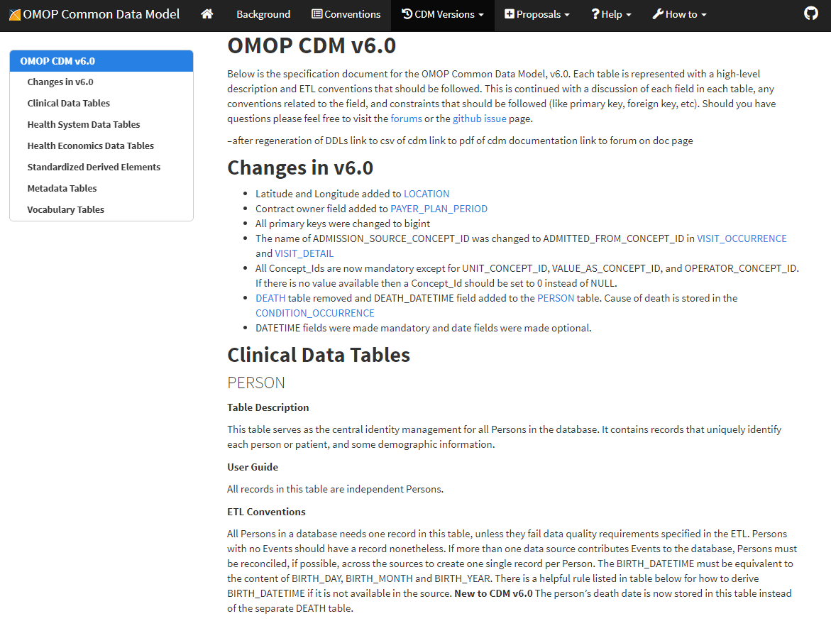
2020 Accomplishments
https://Ohdsi.github.io/CommonDataModel

Slide 3

2021 Plan
Pre-release of Oncology Tables
What’s the deal with CDM v6?
Resuming regularly scheduled programming

